Slide 1
Exploring Techniques for Spatio-Temporal Analysis in Genealogy
A Case Study of the Hawley Record
Bennett Hawley
GEOG 596A

Slide 2
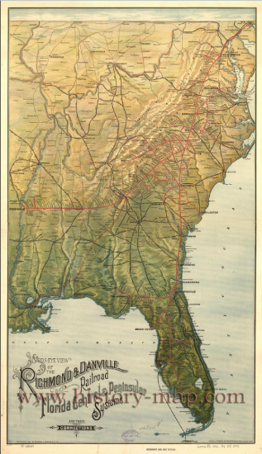
Introduction
Purpose of this project
  Examine Spatio-Temporal analysis in genealogy
This Presentation
  Brief overview of genealogy
  Sources of data
  Representation techniques
  Highlight example questions
http://www.history-map.com/picture/004/pictures/Richmond-Danville-Railroad.jpg

Slide 3
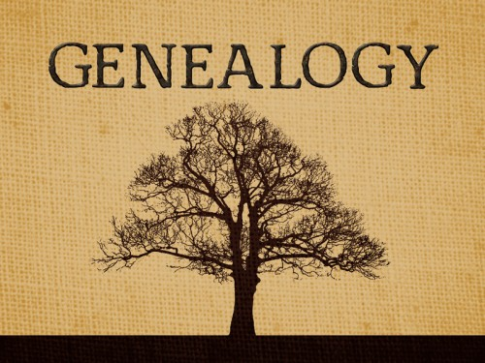
What is Genealogy?
  “An account of the descent of a person, family, or group from an ancestor or from older forms”
  -http://www.merriam-webster.com/dictionary/genealogy
  Source Examples:
    Interviews (first-hand sources)
    Historical Records
      Census
      Obituaries
      Birth records
http://www.norwoodnylibrary.org/genealogy
Notes:
Discuss a quick overview of what is meant by genealogy for this project
Relate the listed sources to this project by naming examples

Slide 4
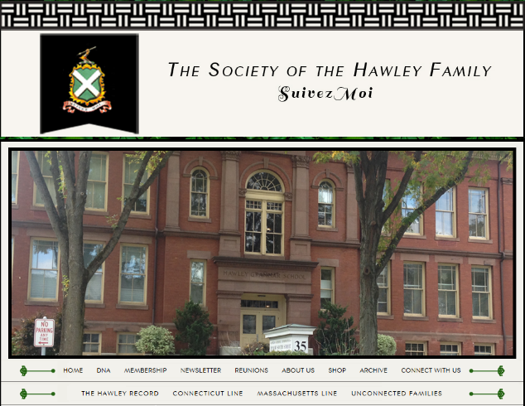
Sources of Base Data
The Hawley Society
  Genealogy research into the Hawley Surname
  Online searchable database
http://www.hawleysociety.org/
Notes:
Series of slide to show some of the specific sources used during this project.
Discuss the role of the Hawley society and contacts made
Discuss membership

Slide 5
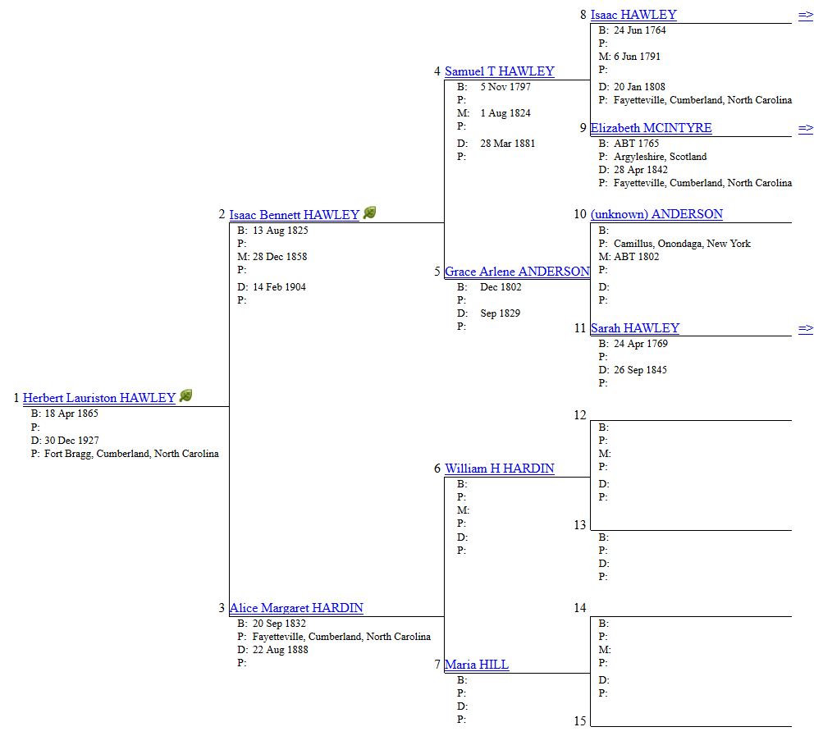
Notes:
Discuss how this information is navigated and what is commonly found

Slide 6
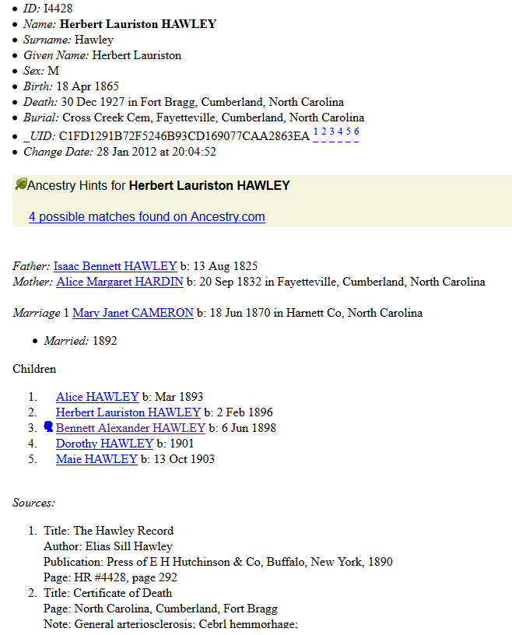
Notes:
Discuss how this information is navigated and what is commonly found

Slide 7
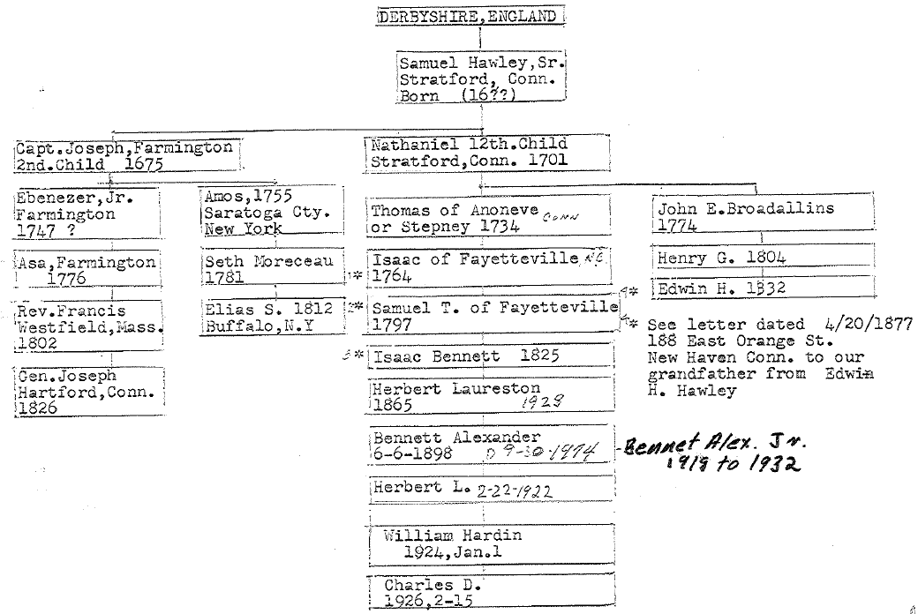
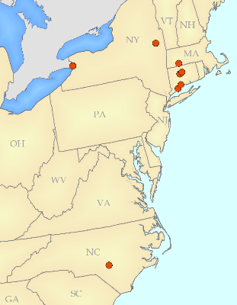
Sources of Base Data
Personal documentation
  Obituaries
  Family documents
Family document created by Charles D. Hawley
Notes:
Bottom of image source as family record
Talk about spatiality of tree
Could red highlight box to point out place names
Could point out spread of different trees
Could place map in lower left of places in this graphic

Slide 8
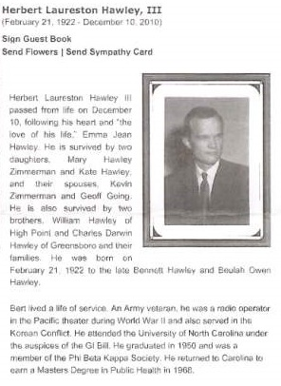
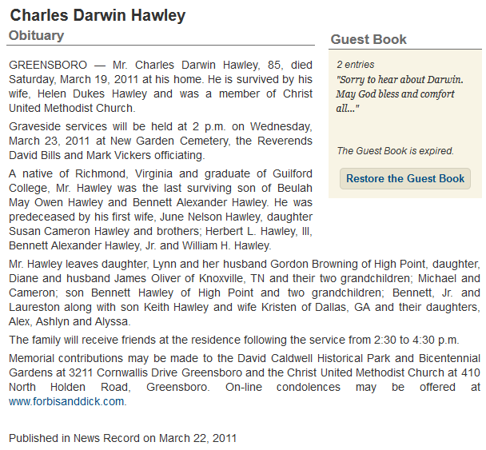
Notes:
Point out key information that can be gathered from these sources
Highlight in blue spatial information to point out spatial element

Slide 9
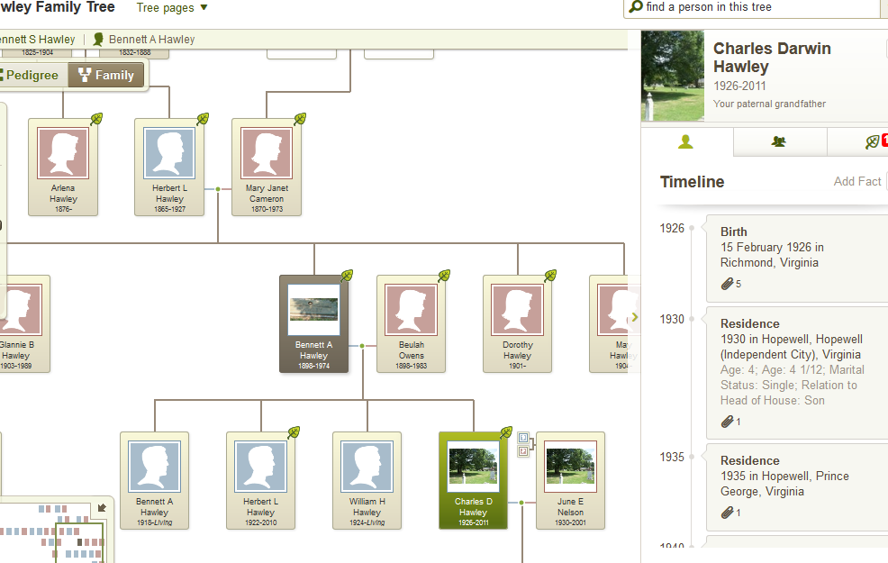
Sources of Base Data
Ancestry.com
  Census data
  Birth/Death records
  Event records
Notes:
Highlight spatial element in timeline with temporal
Point out not mapped

Slide 10
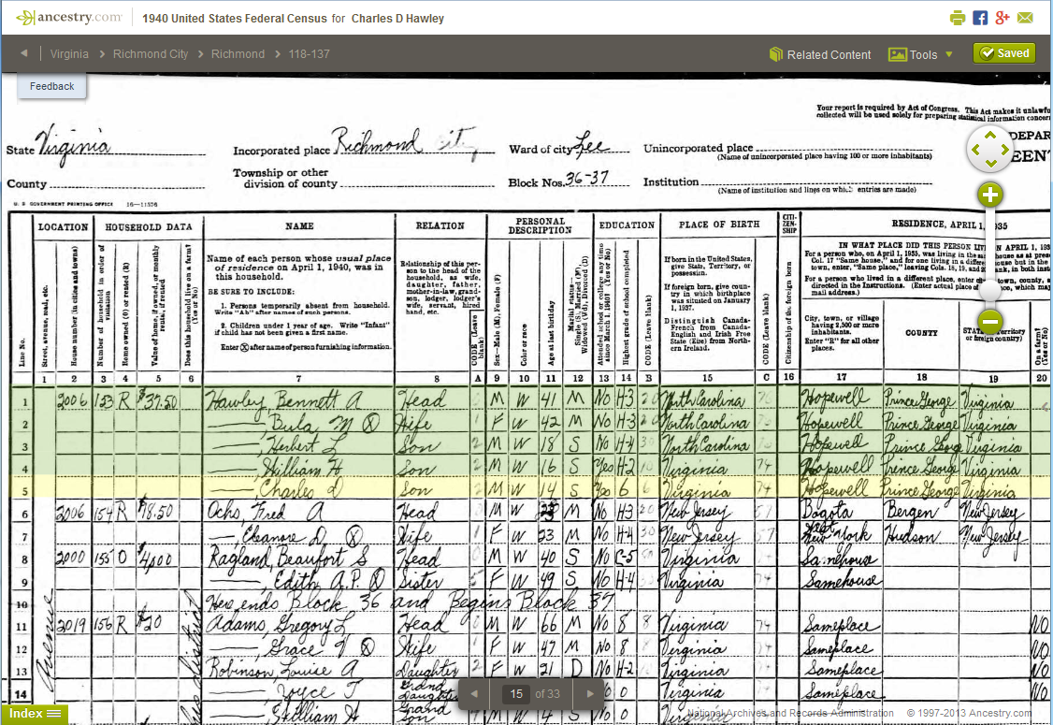
Notes:
Example 1940 census of Charles Darwin

Slide 11
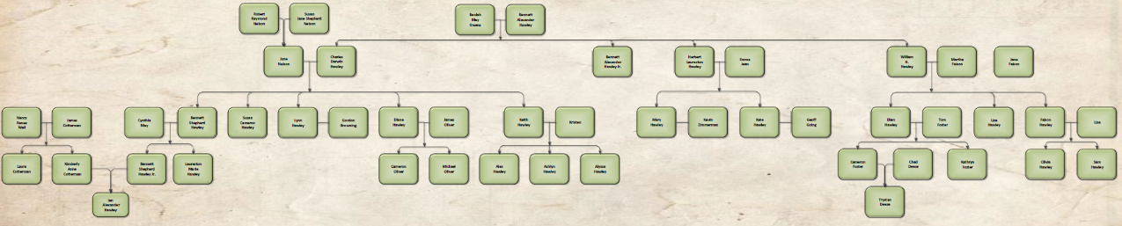
Immediate Hawley Family Tree
Notes:
Show image of coat hanger style graphic with highlighted direct line
Explain benefits of looking at this segment
Can examine further time slice of family
Can test methods on segment and build out
Remove brothers and sisters not enough room

Slide 12
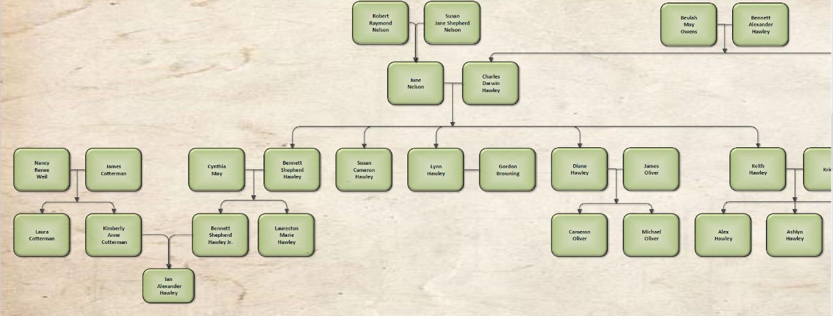
Immediate Hawley Family Tree

Slide 13
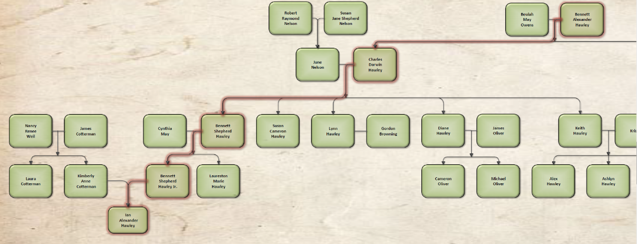
Immediate Hawley Family Tree

Slide 14
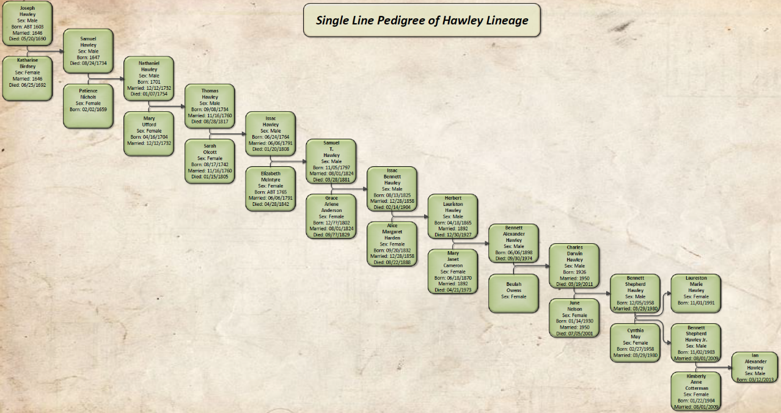
Notes:
Discuss benefit of looking at a single line for concept presentation
13 generations

Slide 15
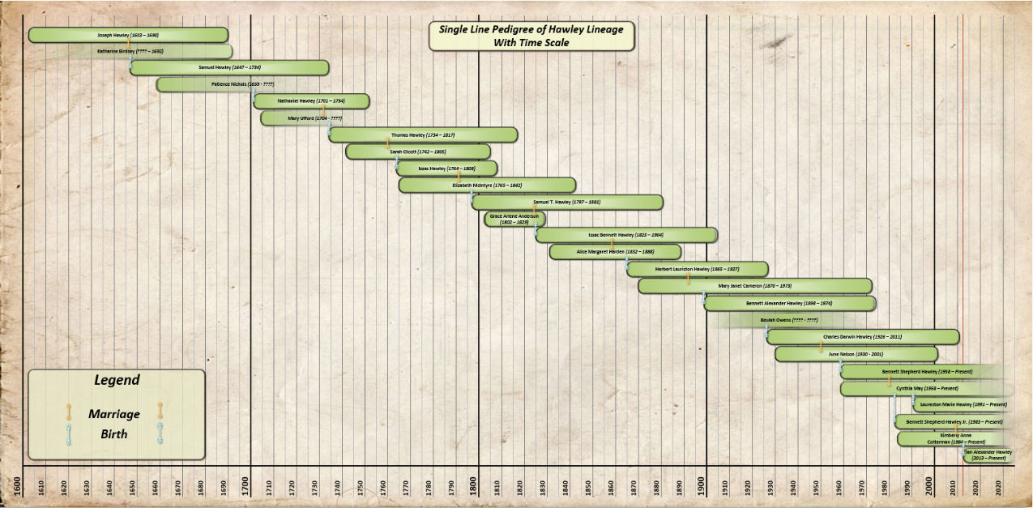
Notes:
Show a possible way to highlight time
Show graphic of overlapping family members through time
Highlight time scale
Highlight life events
Explain how these life events have locations

Slide 16
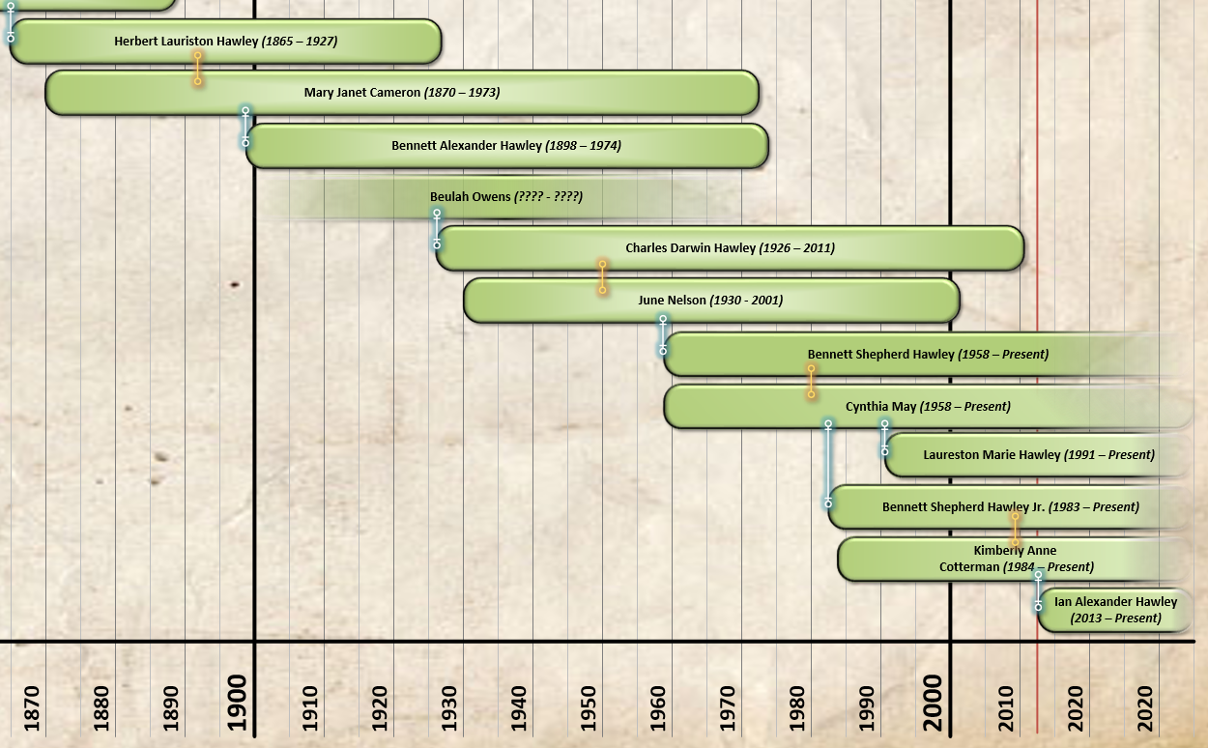
Notes:
Show a possible way to highlight time
Show graphic of overlapping family members through time
Highlight time scale
Highlight life events
Explain how these life events have locations

Slide 17
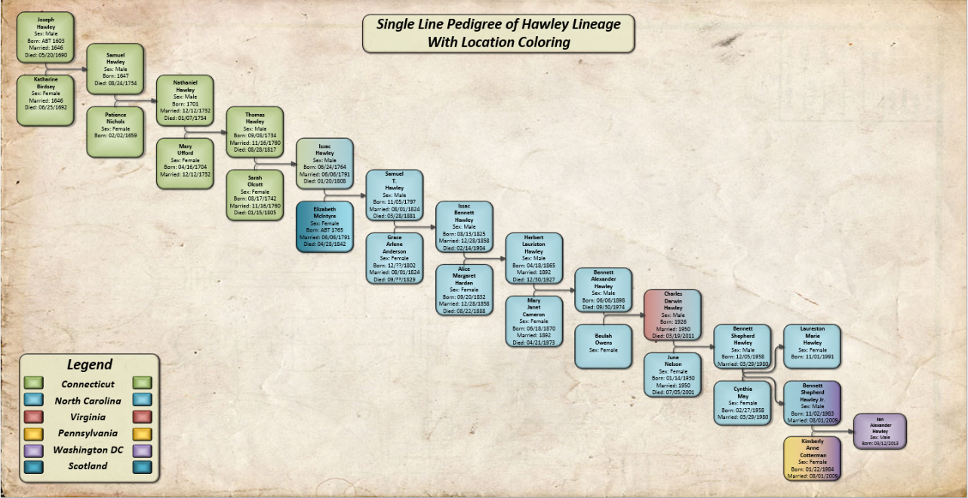
Notes:
This is the place to start relating the temporal element to the spatial element
Add in Virginia (red for Virginia)
Prespeterian blue for Scotland

Slide 18
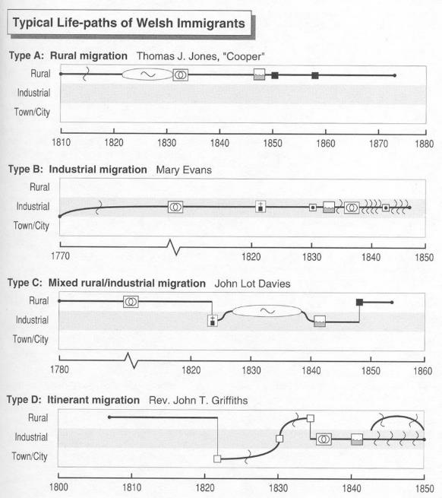
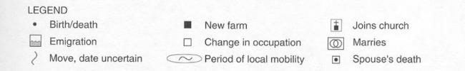
Knowles, A.K. 1995. Immigrant trajectories through the rural-industrial transition in Wales and the United States, 1795-1850. Annals, Association of American Geographers, 85, 2:246-266.
Notes:
Discussion of other methods to represent spatio-temporal data analysis
Life-path graphic showing significant events along a line of time

Slide 19
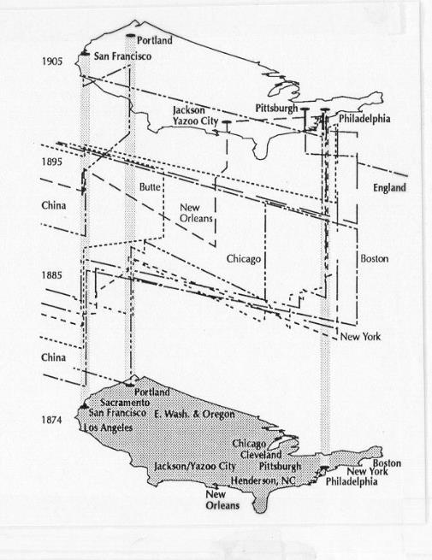
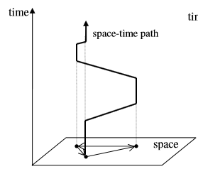
http://www2.geog.okstate.edu/users/HongboYu/NSF-Project-Website/publications/Yu_Shaw_2005.pdf
McGlinn, L. 1995. Power networks and early Chinese immigrants in Pennsylvania. Journal of Historical Geography, 21, 4:430-445.
Notes:
Discussion of other methods to represent spatio-temporal data analysis
Time-space path and prism showing known locations along a 3D line, with height representing time scale

Slide 20
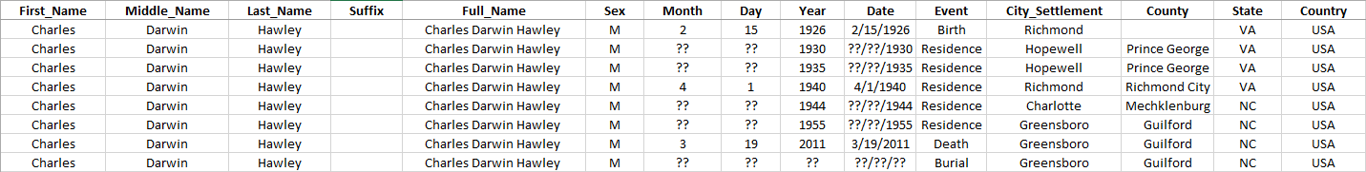
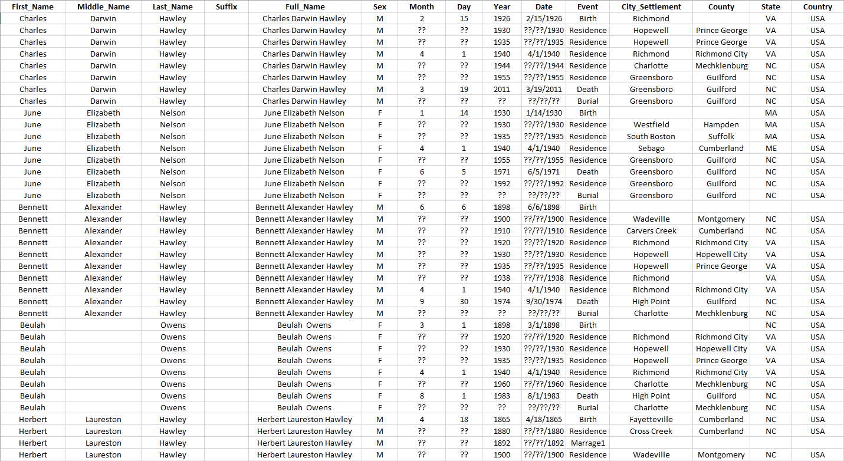
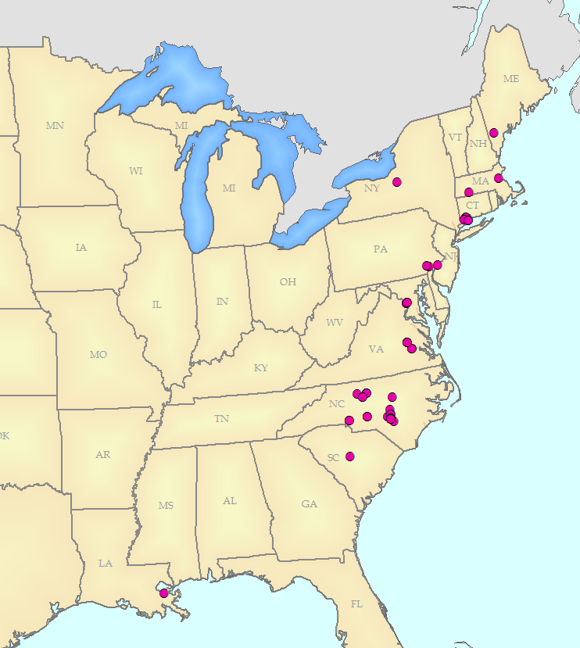
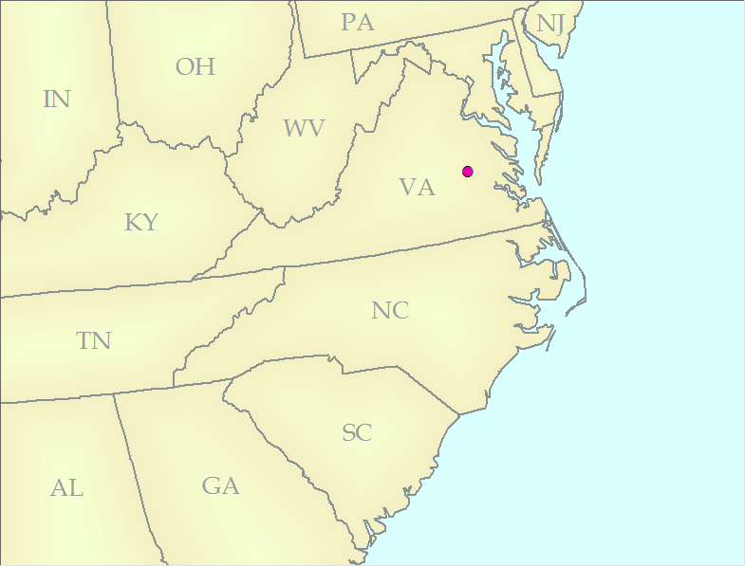
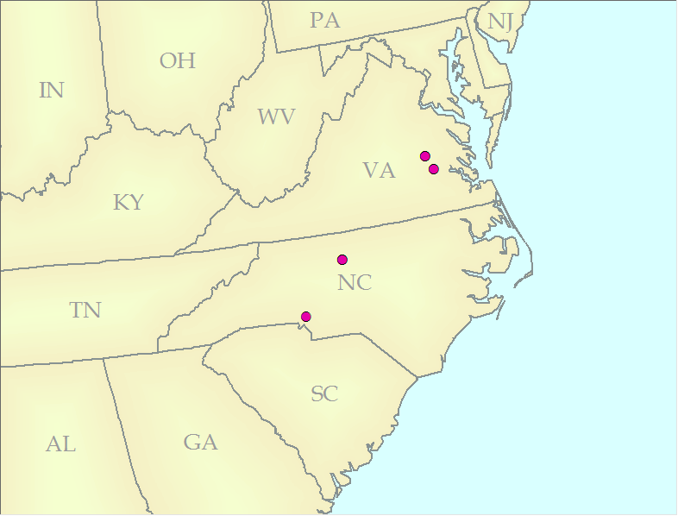

Slide 21
Why Explore the Spatial Element?
Demonstrate spatial element usefulness by answering specific questions
  What do the lifepaths of the Hawleys look like through time?
  How does the average birth distance from person to person change over time?
  How do the life paths of the Hawleys change with the introduction of
    Roads/Cars?
    Rail?

Slide 22
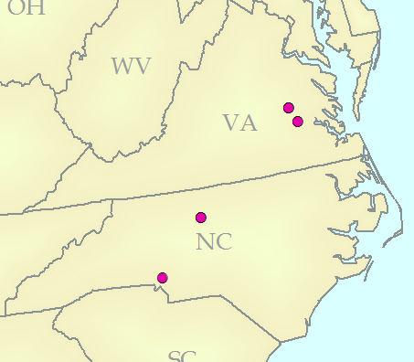
Lifepaths of the Hawleys Through Time
Observe the lifepath of the paternal straight-line descendants
  Link together each known location using lines
  Link in the order of time
  Calculate the total straight-line distance for each person

Slide 23
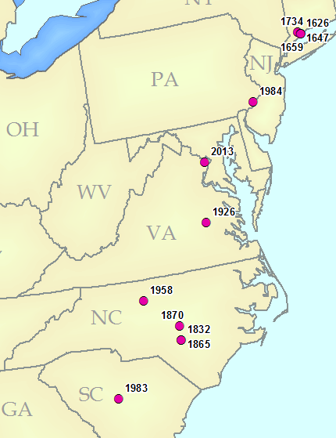
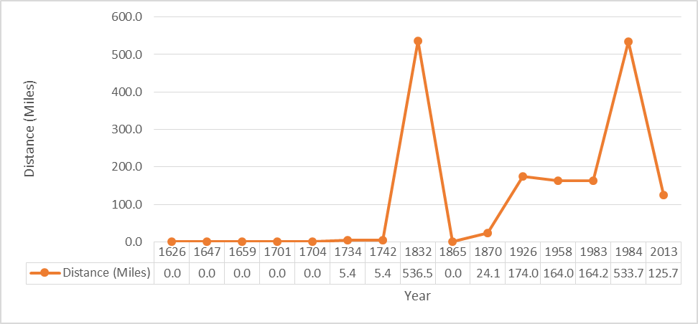
Average Birth Distance Change Over Time
Observe the birth to birth distance of the family over time
  Link together each known Birth location to the next descendant's birth location
  Observe the change over time

Slide 24
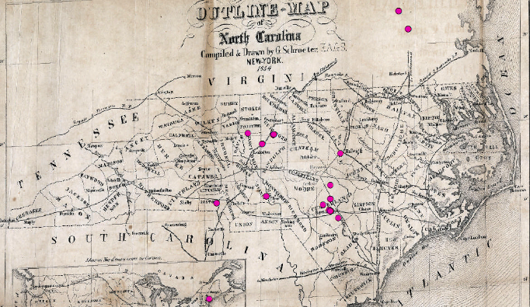
Lifepaths During Introduction of Transportation Methods
Observe the lifepath of the Hawleys after the introduction of certain modes of transportation
  Connect all known residencies for each Hawley member
  Observe the distances between each movement when modes of transport are introduced
http://www.learnnc.org/lp/media/collections/nc/maps/1854/nc-railroads-1854.jpg
Notes:
Explain transportation study as a continuing look instead of definite time slices

Slide 25



Platforms to Analyze Hawley Spatial Data
Several methods to explore
  ArcMap
    http://www.esri.com/
  Open source GIS packages
    http://www.qgis.org/en/site/
  Google fusion tables
    http://www.google.com/drive/apps.html#fusiontables
  Possible others?

Slide 26
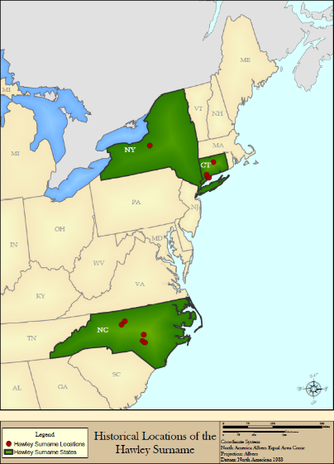
Arcmap
Benefits
  Familiar platform to many GIS analysts and students
  Wide acceptability in field
  Diverse functionality
  Large body of knowledge and help online

Slide 27
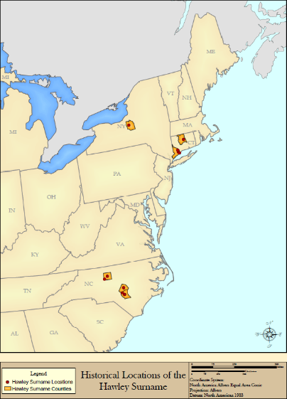
Arcmap
Challenges
  Expensive license cost
  Learning curve
  Proprietary formats

Slide 28
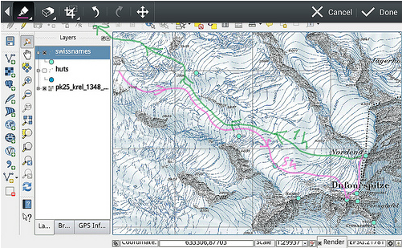

Open Source GIS Packages
Benefits
  Most are freely available
  Large variety of packages
  Constant development to improve
http://qgis.org/en/site/about/screenshots.html
Notes:
Discuss what open source packages are
Discuss how these are different from commercial packages (like Arc)
Name a few packages (show image of some)

Slide 29
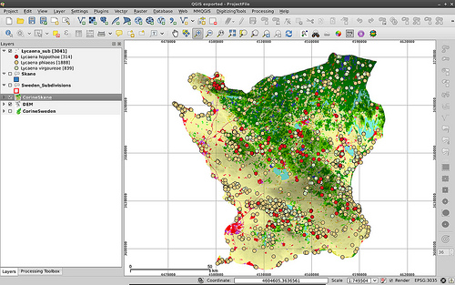
Open Source GIS Packages
Challenges
  No “ownership” of program base
  Not as much support as a large commercial platform
  Variable development to address concerns
http://qgis.org/en/site/about/screenshots.html

Slide 30
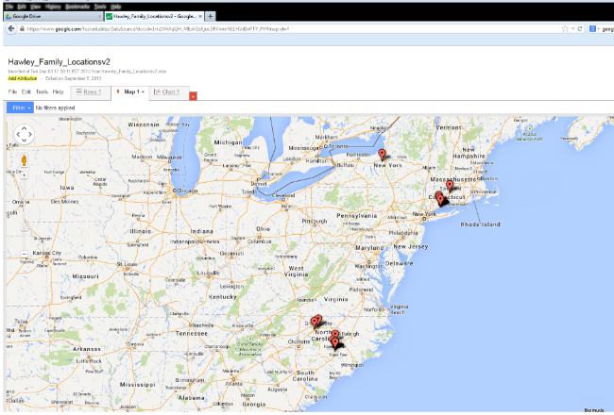
Google Fusion Tables
Benefits
  Online platform, no software
  Built to share results
  Very easy to import data and start analyzing
https://www.google.com/fusiontables

Slide 31
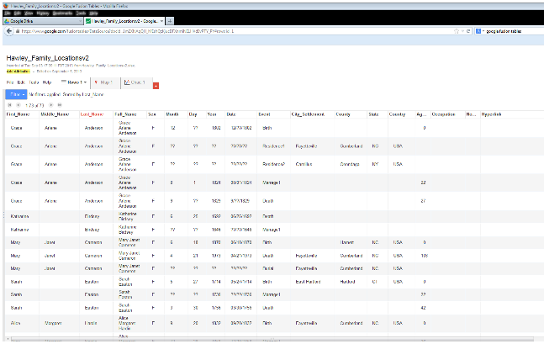
Google Fusion Tables
Challenges
  Importing data into Google-owned server base
  Limited flexibility with functions without programming
https://www.google.com/fusiontables

Slide 32
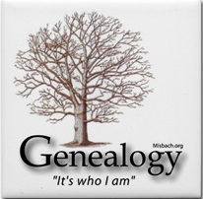
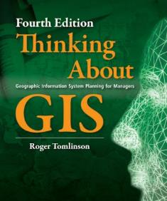
Review/Conclusion
Spatial element an important descriptive resource
  Helps describe more information than traditionally available with family trees
  Able to answer more location- based questions with data
  Several methods to perform analysis
http://www.klahorst.com/Genealogy/
http://downloads2.esri.com/ESRIpress/images/197/TAGIS_Lrg.jpg

Slide 33
Bibliography
The Hawley Society
  http://www.hawleysociety.org/
Ancestery.com
  http://www.ancestry.com/
Life-path line diagrams
  Knowles, A.K. 1995. Immigrant trajectories through the rural-industrial transition in Wales and the United States, 1795-1850. Annals, Association of American Geographers, 85, 2:246-266.
Time-space prisms
  http://www2.geog.okstate.edu/users/HongboYu/NSF-Project-Website/publications/Yu_Shaw_2005.pdf
  McGlinn, L. 1995. Power networks and early Chinese immigrants in Pennsylvania. Journal of Historical Geography, 21, 4:430-445.
  http://meipokwan.org/
Historic transportation maps
  http://www.learnnc.org/lp/media/collections/nc/maps/1854/nc-railroads-1854.jpg
  http://www.history-map.com/picture/004/pictures/Richmond-Danville-Railroad.jpg
Environmental Science Research Institute (ESRI)
  http://www.esri.com/
QGIS open source GIS package
  http://www.qgis.org/en/site/
Google fusion tables
  http://www.google.com/drive/apps.html#fusiontables

