Slide 1
A GIS Analysis of Surface Disturbance and Invasive Species Associated with Hydraulic Fracturing Operations in the Marcellus Shale
Ashley Hayes
MGIS Program advisor: Patrick Drohan, ESM
Penn State University
GEOG 596A, Fall 2012
Notes:
Hello, my name is Ashley Hayes and tonight I would like to introduce you to my MGIS Capstone: “A GIS Analysis of Surface Disturbance and Invasive Species Associated with Hydraulic Fracturing Operations in the Marcellus Shale”.

Slide 2
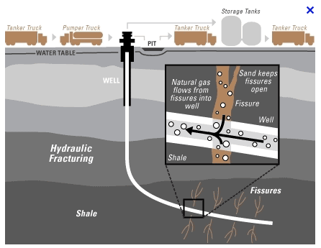
Hydraulic Fracturing
www.h2odistributors.com
Notes:
I am sure many of you have heard of the term “hydraulic fracturing” before … this relatively new natural gas extraction process is also known as “hydrofracking” or simply “fracking” … this process has received a lot of publicity over the past few years … some positive, some negative … but before we get into that … let me explain this method. In brief, hydraulic fracturing generally involves the injection of more than a million gallons of water, sand, and chemicals at high pressure down and across horizontally drilled wells that reach as far as 10,000’ below the surface. The pressurized mixture causes the natural gas containing rock layer, the Marcellus Shale in the case of my study sites, to crack. These cracks in the Shale are held open by the sand particles allowing the gas to escape and travel up the well for collection.

Slide 3
Marcellus Shale
Notes:
Though the process of hydraulic fracturing for natural gas extraction is used throughout the world, one of the larger areas of development, and the focus area of my study, is, as I mentioned previously, the Marcellus Shale. The Marcellus Shale covers a wide area in the northern Appalachian Basin, this area includes significant portions of Ohio, West Virginia, New York, and Pennsylvania.

Slide 4
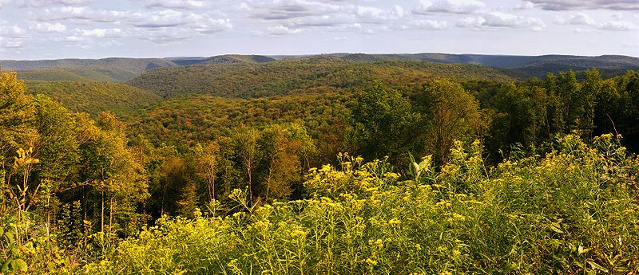
Important and abundant domestic source of energy … but how to minimize the
impact of this resource extraction
on the environment?
Notes:
Okay, so now that we all have some understanding of the process of hydraulic fracturing, let’s get back to some of those “positive and negative” aspects of the method that I alluded to earlier. What are some positives? Until renewable energy sources are fully developed, we are all going to need some energy from fossil fuels … and the Marcellus Shale is a tremendously large domestic source of it. How large? Well estimates vary, but with current technology there is likely enough to satisfy two years of total U.S. consumption with a value of 200 billion dollars. These numbers could greatly increase as technology and extraction techniques improve further. In addition, Penn State economists have estimated that, in Pennsylvania alone, hydraulic fracturing creates over 1 billion dollars in state tax revenue each year and has resulted in over 200,000 new jobs.
But, with these benefits, comes associated costs … if not managed properly, hydraulic fracturing has the potential to have a significantly negative impact on the environment. This is where my study comes in … I will utilize GIS in attempt to better understand the ecological impact of hydraulic fracturing with the hope that this information will, in part, eventually guide science-based best management practices for responsible gas extraction and environmental restoration procedures.

Slide 5
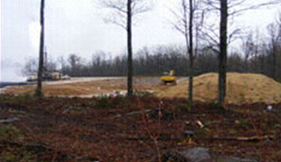
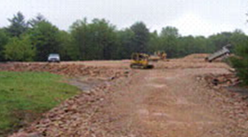
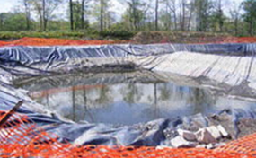
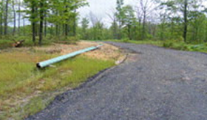
Landscape Disturbance
Well pads, ponds, staging areas, roads, etc.
~12 ha/pad
Notes:
Though there are a number of environmental issues associated with hydraulic fracturing, my study is designed to focus on surface disturbances. The development of each gas well, such as the one shown on the left of this slide, involves, in many cases, the creation of the well pad, water storage ponds, and equipment staging areas, and the modification and extension of roads. As you see in the pictures to the right, this is a significant undertaking and it has been estimated that an average of ~12 hectares of the surface is disturbed for each well pad that is built.

Slide 6
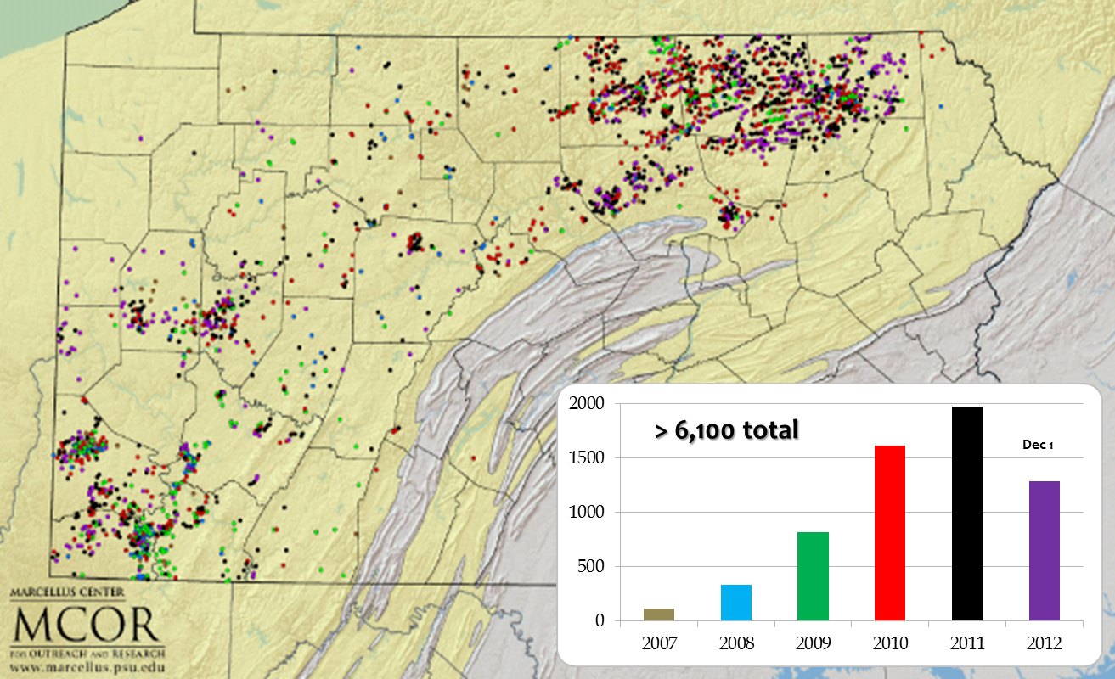
Wells Drilled Since 2007
Notes:
This map and associated graph shows the distribution and quantity of wells drilled in the Marcellus since 2007 which was, essentially, the first year with a substantial number of wells drilled …
Given that >75% of well pads contain only 1-2 wells and there have been over 6,100 wells drilled in PA alone … you can begin to get a feel for the large extent of disturbance … to put those numbers in perspective … assuming 2 wells per pad … that is equivalent to 73,200 football fields of disturbance or > 11% of the area of Rhode Island … now lets talk about some of the problems that this large amount of disturbance may cause if not properly managed.

Slide 7
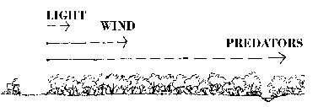
Forest Fragmentation & Edge Effects
Disturbance
Scarlet Tanager
Light
Wind
Invasive Species
Notes:
It has been estimated that 38-54% of well pad development is occurring on forested land. Ecologists use several different terms when describing the spatial components of a forest … the term “core” refers to forest that is greater than 100 meters from any non-forest habitat and “edge forest” refers to forest that is <100m from any non-forest habitat. You can see in the diagram at the top left that core forest is represented in darker green and edge forest in lighter green and when forest is disturbed, as on the right, the amount of core significantly decreases and the amount of edge significantly increases
Core forest is unique and has many characteristics that make it environmentally important. Among other contributions, such as the protection of headwater streams, core forest supports species that are edge-intolerant and thus the presence of core forest often leads to greater overall biodiversity. An example of an edge-intolerant species that relies on core forest is the scarlet tanager … ~19% of this songbird’s global population is found in PA core forests. The reason that some species are edge-intolerant is that edge forest has a different microclimate and different biotic interactions than core forest … the diagram at the bottom of this slide illustrates that, for example, greater amounts of light, wind, and invasive species (including predators) may all be present in edge forest.

Slide 8
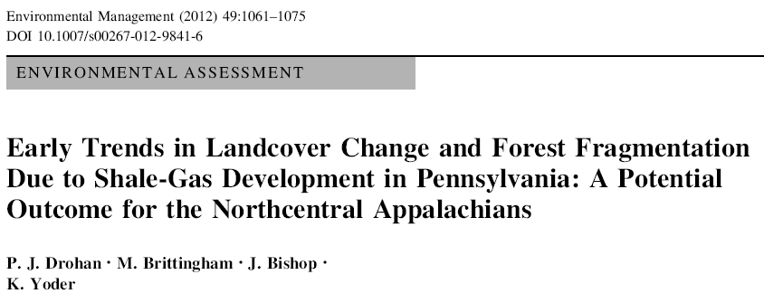
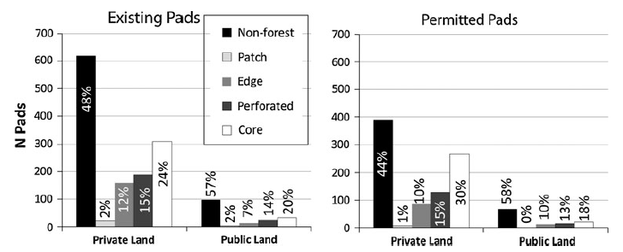
Notes:
Previous studies, including work by my advisor Patrick Drohan and others from Penn State, have used GIS to classify forest habitat near hydraulic fracturing well pads and quantify the conversion of previously core forest to edge forest due to well-pad-related surface disturbances. Some of their GIS methods include a state-wide assessment of 993 well sites that was based, in part, on a 30m resolution, unsupervised classification of land cover into forest, agriculture, and disturbed. The forested area was then sub-classified into: core, edge, and a couple of other forest types that I will discuss later … called patch, and perforated. They found that almost 700 hectares of core forest has been developed as of 2011. They also looked at permitted sites in an attempt to evaluate future trends and, as the graph at the bottom of the slide indicates, permitted sites (where future drilling will likely occur) are located in core forests at a higher proportion, overall, than currently drilled sites. On private land, where most drilling occurs, the percentage increases from 24 to 30%.
In addition, unpaved and paved road layers were acquired from the PA Spatial Data Access public data clearinghouse and the minimum distance to each road type from each drilling site was calculated. They found that permitted sites are farther from existing roads, and thus future drilling will likely require greater amounts of road to be built.

Slide 9
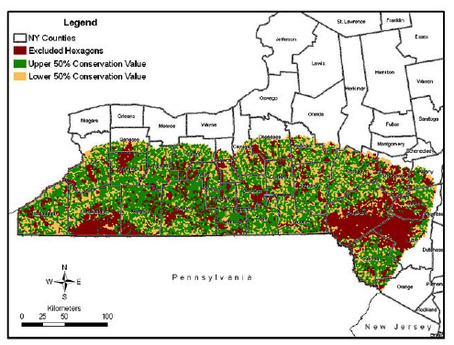
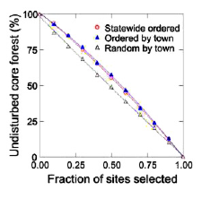
Notes:
A GIS study of shale-gas surface disturbance in New York state was conducted by Davis and Robinson. They covered the entire portion of the state containing Marcellus Shale in 2.57km-squared hexagons and evaluated the ecological characteristics of each hexagon to determine an estimated Conservation Value (see map) that included, among other measures, the proportion of core forest within each hexagon.
They then assigned the hexagons to one of 478 towns, based on proximity, and used three different selection methods to determine what hexagons would be chosen for drilling … two methods were ordered and one method was random. The ordered methods chose hexagons either statewide or for each town based on conservation value … with the least valuable being selected first. And the random method chose hexagons randomly for each town without regard for conservation value. The result, as shown in the graph, was that the ordered selection methods would likely lead to 6% less degradation of core forest habitat than the random selection method.

Slide 10
My Study
Hypothesis: Hydraulic fracturing well pad locations that are near a previously disturbed landscape may be more likely to currently contain invasive species now, and be more susceptible to future invasions
Importance: Understanding spatial patterns associated with species invasion may lead to the development of more effective predictive detection models and facilitate management planning and responses
Notes:
My study adds another piece to the knowledge gained from these previous studies. Patrick’s paper indicated that disturbance is likely to increase in core forest areas as currently permitted sites are drilled; my study is going to examine a specific ecological implication of this new disturbance … the potential for an increased spread and abundance of invasive species. My research will attempt to quantify the pre-drilling level of disturbance within 200 meters of current gas wells and this analysis will then be combined with a study of invasive species dispersal … conducted by a weed ecology group at Penn State … to determine if pre-drilling disturbance at well pad locations are correlated with the current presence or absence of invasive species at well pad locations.
My hypothesis is that hydraulic fracturing well pad locations that are near a previously disturbed landscape may be more likely to currently contain invasive species now, and be more susceptible to future invasions.
The Davis and Robinson paper was one example of how management decisions may lead to less degradation to ecologically vulnerable habitat. I hope that my study will result in a better understanding of the spatial patterns associated with species invasion and lead to the development of more effective predictive invasive species detection models that facilitate management planning and responses.

Slide 11
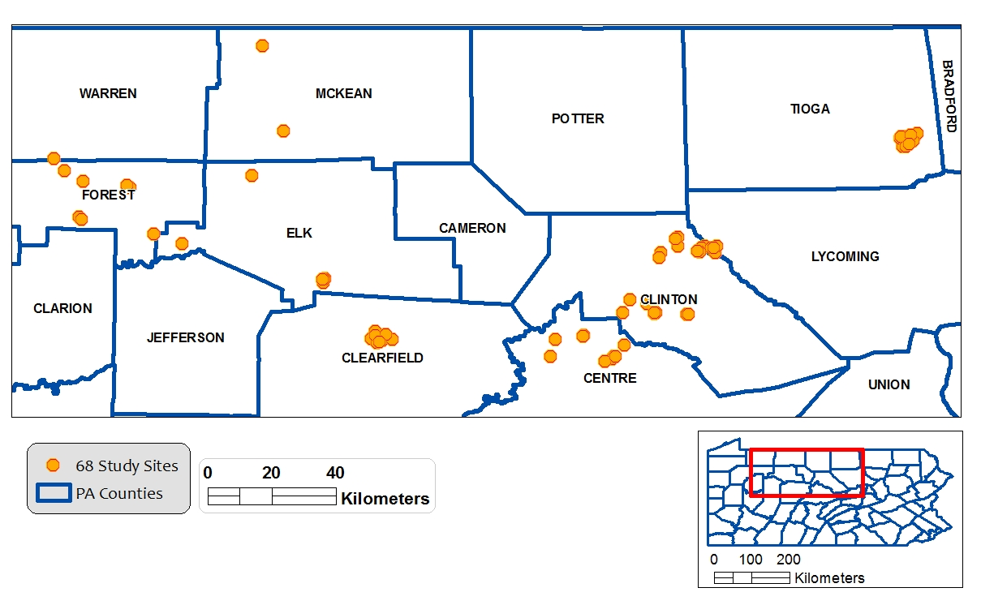
Study Sites
Notes:
My 68 shale-gas well pad study sites are located in 7 different counties within northcentral Pennsylvania. These particular sites were chosen because they are found in the region of Pennsylvania where development in core forest areas is most concentrated (per Patrick’s previous studies) and because they are on public land where field investigations are more accessible and resource management decisions are likely to be more standardized.

Slide 12
Supervised Classification
2005 NAIP to classify disturbances prior to shale-gas drilling
ArcGIS Bing Maps Aerial base map to classify current disturbances
Disturbances categories: shale-gas well pads, roads, conventional gas wells, water storage ponds, staging areas, barren ground, utility corridors, residential, and regrowth
Disturbances Unclassified
Disturbances Classified
Notes:
Using supervised classification, I will digitize each of the disturbances within 200 meters of my study sites. 2005 NAIP imagery will be used to classify disturbances prior to shale-gas drilling and the Bing Maps Aerial basemap, available within ArcGIS, will be used to classify current disturbances … Bing Maps imagery will be used because the latest NAIP for Pennsylvania, 2010, is not recent enough to include many of the well pads at my study sites. Disturbances include the shale-gas well pads, roads (classified as paved or unpaved and dead-end or not), former conventional gas wells, water storage ponds, staging areas, barren ground, utility corridors, residential, and areas that were previously disturbed but the vegetation is now partially regrown.
The example pair of images at the bottom show two of my well pad study sites that happen to be nearby each other … on the left is an unclassified image and on the right you can see that I digitized the disturbances that I located within 200m … in this case, there were a couple of former conventional gas wells, which are gas wells that did not use hydraulic fracturing, there were about 5 different road segments, and the two shale-gas well pads.

Slide 13
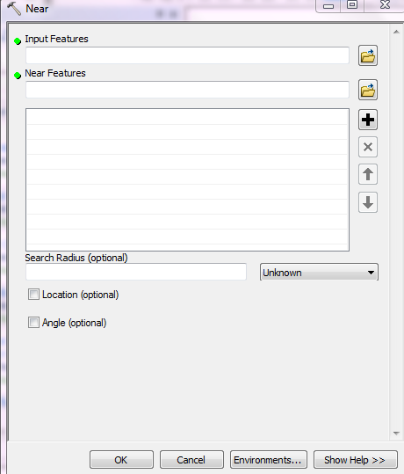
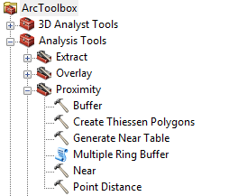
Distance to Disturbances
ArcGIS Near tool:
Distance to nearest non-road disturbances
Distance to paved and unpaved roads
Notes:
Once all disturbances have been classified, I will then use this data to calculate selected metrics that describe the distance to the disturbances, the configuration of the disturbances, and classify the forest types based on disturbance.
Distance from each of my 68 study sites to nearby disturbances will be obtained using the ArcGIS “Near” tool (shown at the bottom of my slide). By loading the study sites as the “Input Features” layer and the disturbances as the “Near Features” layer this relatively simple to use tool will determine the nearest disturbance to each study site and record its description and distance in the appropriate row of the study site’s attribute table. I will determine the distance from each site to the nearest non-road disturbance and determine the distance to nearest paved and unpaved roads.

Slide 14
Configuration of Disturbances
FRAGSTATS:
Contagion Index
0.0
0.5
1.0
www.k-state.edu
Notes:
The configuration of the disturbances surrounding my study sites will be described using a metric called “contagion”. Contagion is, essentially, a measure of how clumped patches are within a landscape, so, in my case, how clumped are the areas of disturbance surrounding my study sites. The diagram at the bottom of this slide illustrates an example range of contagion values … lower contagion values result from smaller, more dispersed patches and higher contagion values result from larger, more clumped patches. I will calculate contagion values for my study sites using a stand-alone landscape analysis program called FRAGSTATS that accepts ESRI files as inputs.

Slide 15
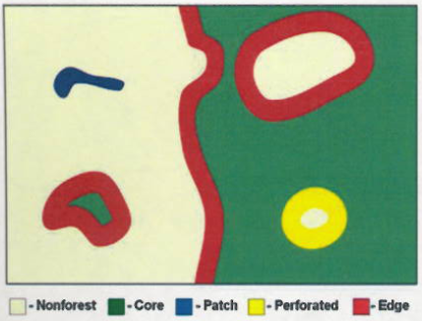
Forest Classification
ArcGIS Landscape Fragmentation Tool
Core: > 100m from non-forest disturbances
Edge: < 100m from non-forest disturbances and adjacent to core forest
Patch: <100m from non-forest disturbances and not adjacent to core forest
Perforated: <100m from small non-forest disturbances within core forest
Notes:
Though Patrick has provided me with the forest type classifications for each of these sites from his previous studies, if you remember, these forest types were calculated based on an unsupervised classification of 30m resolution land cover data. I will re-evaluate each of my 68 sites based on my supervised classification of 2m resolution NAIP imagery using the Landscape Fragmentation Tool for ArcGIS. Forest will be classified into core (> 100 m from non-forest disturbances … green in the example diagram below); edge (<100m from non-forest disturbances and adjacent to core forest); Patch (<100m from non-forest disturbances and not adjacent to core forest); and Perforated (<100m from small non-forest disturbances within core forest)

Slide 16
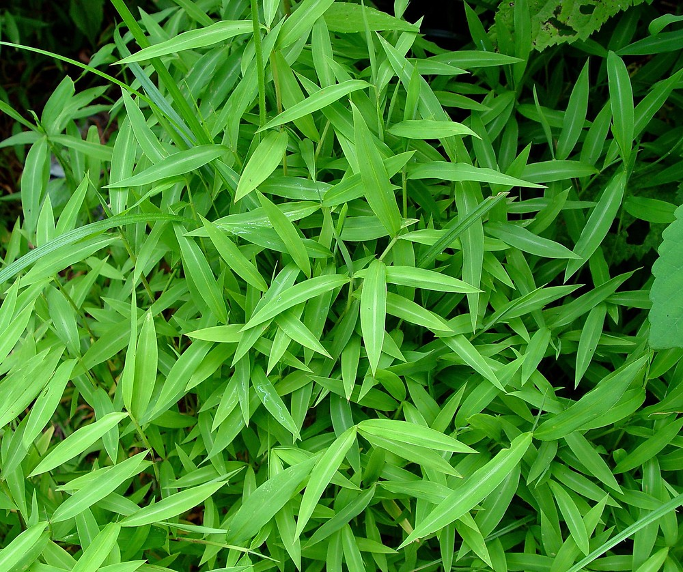
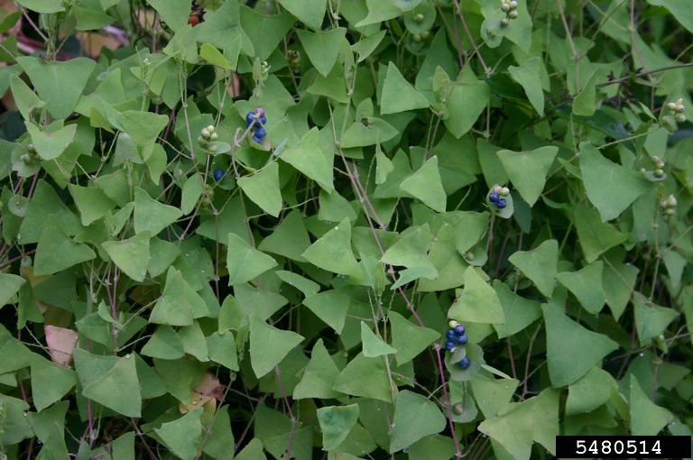
Invasive Plant Species
Japanese Stiltgrass (Microstegium vimineum)
Mile-a-Minute (Persicaria perfoliata)
http://gobotany.newenglandwild.org/
http://www.forestryimages.org
Notes:
Once I obtain my disturbance metrics, I will determine if they help explain my invasive species data.
Two of the species of primary concern at my sites are Japanese Stiltgrass and Mile-a-Minute. Japanese Stiltgrass was likely introduced to the United States around 1920 via its use as packing material for porcelain arriving from Asia. This bamboo-like grass species grows to a height of 2-3’ , spreads easily to disturbed areas, and negatively impacts native plants via shading and the alteration of soil chemistry.
Mile-a-Minute was introduced to the United States in the 1930s, likely via imported holly plants that were contaminated. As the name implies, Mile – a –Minute grows quickly … about 6” day … and can rapidly colonize disturbed areas. This viney plant is also native to Asia and it grows on and over native plants blocking their light, thus eventually causing their death.
The Penn State ecologists that I am collaborating with for this project walked the perimeter of each of my 68 study sites and noted the presence/absence of each invasive species along with a rough estimate of their abundance.

Slide 17
Statistical Analysis
Test for significant differences in disturbances between sites with and without invasive species
Distance to nearest non-road disturbances and distance to nearest paved and unpaved roads
Contagion Index
Forest types
Notes:
Once I have digitized and categorized all disturbances, determined distances to these disturbances, calculated contagion, and classified the forest types, I will summarize my findings and use statistical analysis to evaluate significant differences between sites that contain each invasive species and sites that do not contain each invasive species.

Slide 18
Project Timeline:
January/February | February | February/March
Complete supervised classification, distance measurements, and forest classification | Complete statistical analysis, evaluate results and their importance, and consider additional measurements and analysis | Finish all analysis and prepare final paper and presentation
Notes:
My goal is to complete all data acquisition, supervised classification, measurements, and forest classification by the end of January or beginning of February. I will then summarize all findings, complete statistical analysis, evaluate results and their broader meaning and importance, and consider if any additional measurements or tests would be useful. Then, by the end of February, I will be in the process of finishing all analysis and will be completing my final paper and my presentation for delivery at a conference. At the moment, I have not settled a conference to present my findings, but I hope to have that decided relatively soon.

Slide 19
Anticipated Results:
An understanding of the relationship between the presence or absence of invasive species at current well pad sites and previous disturbance
Information that can be used to help predict where invasive species may be most likely to appear in the future and assist with management planning and enable responsible gas extraction
Notes:
I anticipate that by the conclusion of my project, I will have a much better understanding of the relationship between the presence or absence of invasive species at current well pad sites and previous disturbance at these sites.
This quantified information will hopefully be useful for helping predict where invasive species may be most likely to appear in the future and assist with management planning that enables responsible gas extraction.

Slide 20
Acknowledgements
Patrick Drohan
Katy Barlow
Penn State MGIS Faculty & Classmates
Notes:
I would to now take a bit of time to thank my faculty advisor, Patrick Drohan, for all of his great feedback and ideas for this project. I also want to thank Katy Barlow, an ecologist at Penn State, for generously allowing me to use the invasive species data that she collected at all of my study sites. And, lastly, I would like to thank all of the Penn State MGIS faculty and classmates that have influenced and assisted me over the past 2.5 years.

Slide 21
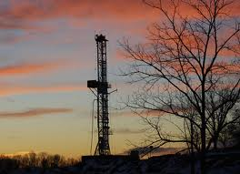
Questions? Comments? Suggestions?
Notes:
Thank you very much for your time and attention. Please let me know if you have any questions, comments, or suggestions for me. Thanks again.

