Slide 1
Using GIS in international relations
Mackenzie Higgins | Advisor: Dr. Gregory Thomas | Penn State MGIS Program

Slide 2
Agenda
Background
Objectives
Methodology
Data
Anticipated Results
Project Timeline
Project Venue
Notes:
Insert a picture of one of the points of interest for your country.

Slide 3
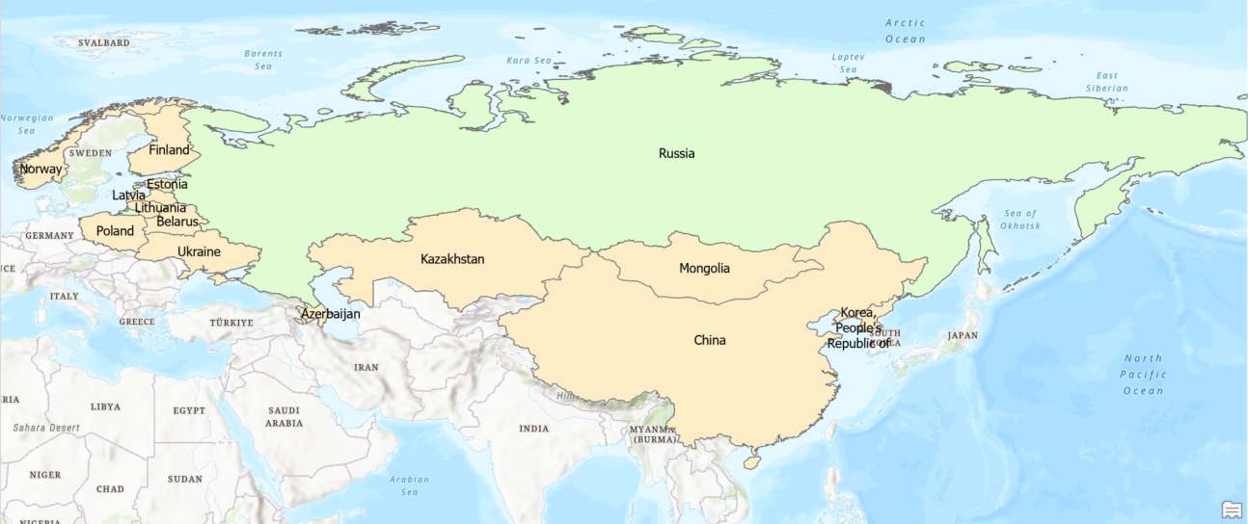
Background
Russia’s 14 bordering countries
  Azerbaijan
  Belarus
  China
  Estonia
  Finland
  Georgia
  Kazakhstan
  North Korea
  Latvia
  Lithuania
  Mongolia
  Norway
  Poland
  Ukraine
Notes:
Insert a picture of one of the points of interest for your country.

Slide 4





Objective
Diplomatic Ranking Variables
  Overall Trade
  Military Comparisons
  NATO/CSTO/Neither
  Conflict Disputes
Border Variables
  Ethnicities
  Economics
  History
  Population
  Terrain
  Length
Border characteristics and relations through willingness and opportunity
Starr, H. (2013). On geopolitics: Space, place, and international relations. Paradigm.
Notes:
Insert a picture of one of the points of interest for your country.

Slide 5

Methodology
Diplomatic ranking
Trade – overall trade balance between Russia and bordering countries
Military – size and location of military
Collective Security Treaty Organization (CSTO) (Weitz 2018)
North Atlantic Treaty Organization (NATO) (NATO 2020)
Conflict – Indicator of current relationships between Russia and bordering countries
Notes:
Insert a picture of one of the points of interest for your country.

Slide 6
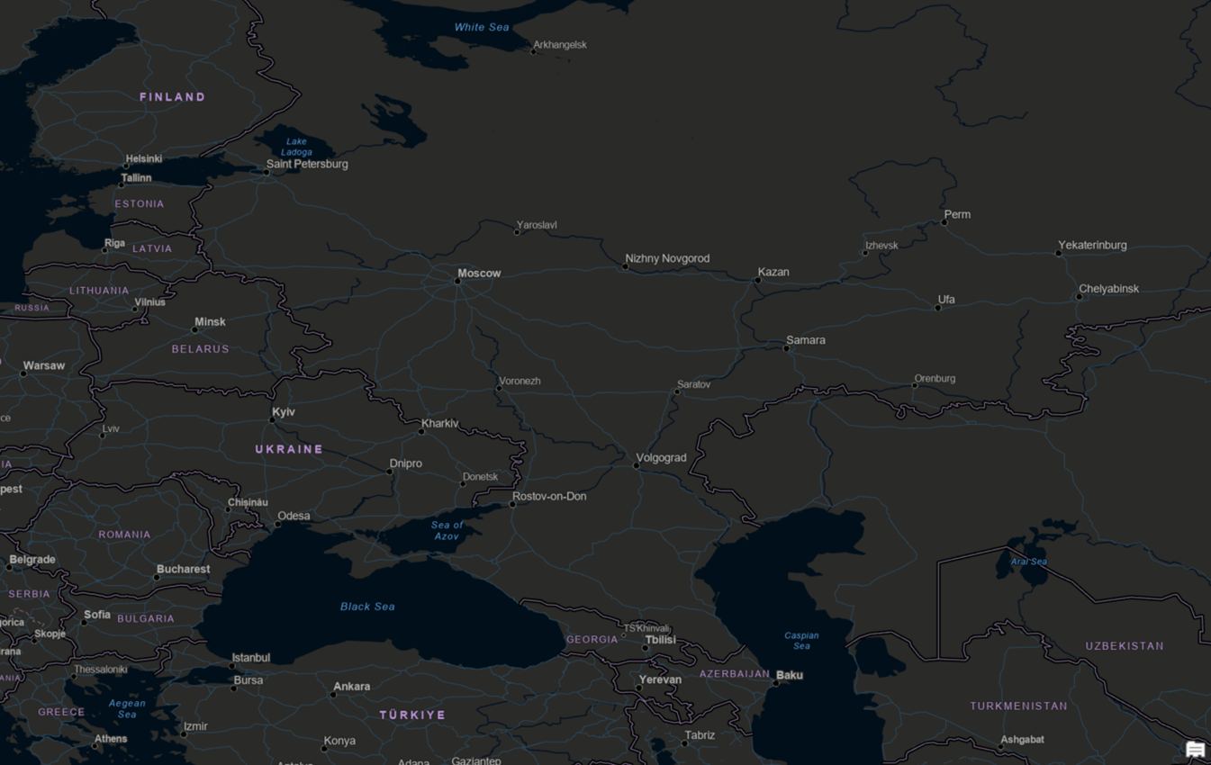
Methodology
Border Variables (Gleditsch & Weidmann, 2012)
Political
  Length of border
  History shown through spatial and temporal changes of border
Demographic
  Population along borders
  Ethnicity groups along borders (Khan, Hamza, Burke, and Nawaz-ul-Huda, 2020)
Socioeconomic
  Economic standing between Russia and bordering countries
Environmental
  Terrain along borders such as elevation
Notes:
Insert a picture of one of the points of interest for your country.

Slide 7
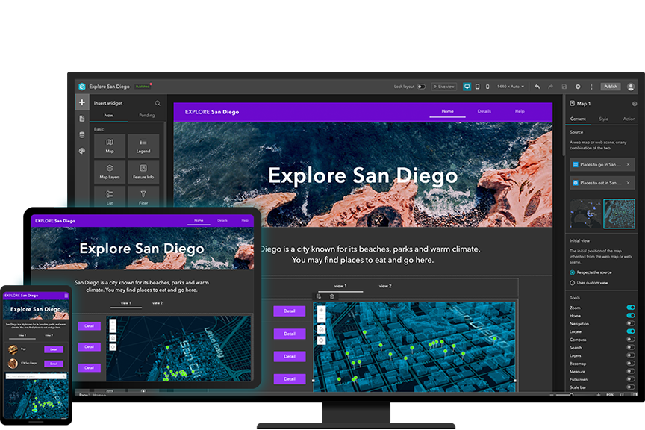
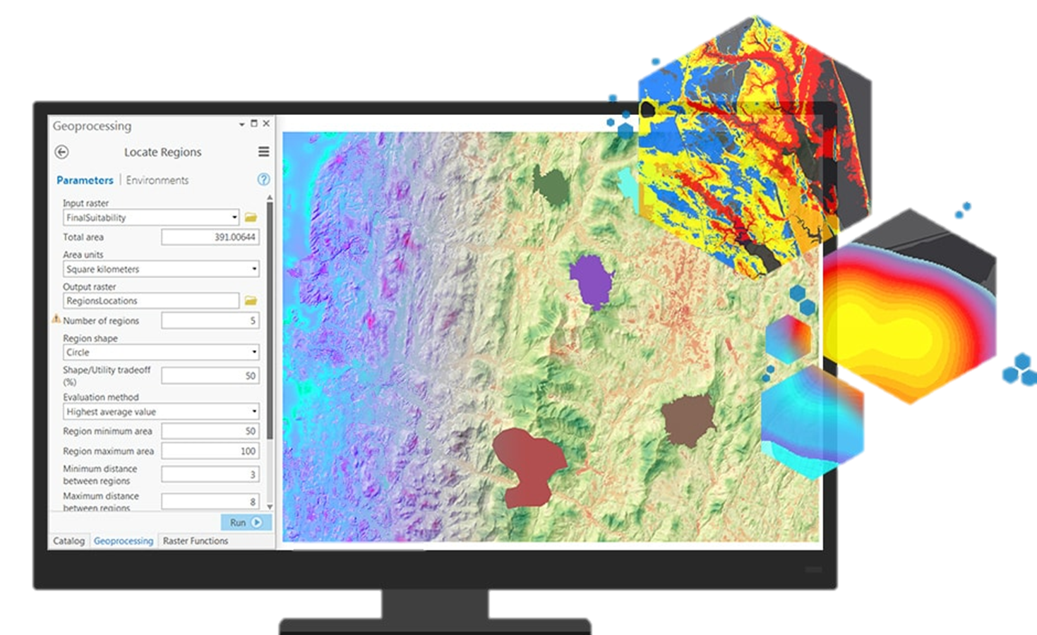
Methodology
Mix of qualitative and quantitative
Clean, manage, analyze, and visualize data
ArcGIS Pro for spatial analysis
ArcGIS Experience Builder to present and communicate data
https://www.esri.com/en-us/arcgis/products/arcgis-spatial-analyst/overview
https://www.esri.com/en-us/arcgis/products/arcgis-experience-builder/overview
Notes:
Insert a picture of one of the points of interest for your country.

Slide 8
Data
Categories | Dataset | Type | Coord System | Year Span | Last Updated | Data Types
Political
History/Length | Cshapes | Vector | WGS84 | 1889-2021 | 2021 | CSV
Demographic
Ethnicities | GeoEPR | Vector | WGS84 | 1880-2021 | 2021 | Shapefile
Population | GPW Gridded Population of the World | Raster | WGS84 |  | Dec-18 | GeoTIFF
Socioeconomic
Economic | G-Econ Geographically Based Economic Data | Tabular | N/A | 1990-2005 | May-11 | CSV
Environmental
Elevation | GTOPO30 | Raster | WGS84 |  | 1996 | GeoTIFF
Trade
 | World Integrated Trade Solution | Tabular | N/A |  | 2020 | CSV
Military
 | World Population Review | Tabular | N/A |  | 2022 | CSV
 | Russian Military Forces | Tabular | N/A
 | How Many Military Bases Does Russia Have Overseas | Tabular | N/A
Conflict
 | Correlate of War Datasets | Tabular | N/A | ~1800-2014 | 2014 | CSV
 | Armed Conflict Location & Event Data (ACLED) | Tabular w/ coordinates | N/A | ~1997-2022 | 2022 | CSV
Notes:
Insert a picture of one of the points of interest for your country.

Slide 9
Anticipated Results
Hypothesis 1: A country’s diplomatic relationship will not have a strong correlation to its ethnic makeup
Hypothesis 2: If Russia’s neighboring country has a history of changing its border demarcations, then the diplomatic relations will be lower.
Hypothesis 3: If the terrain between Russia and the bordering country is unencumbered by natural barriers then relations will be lower between the two countries.
Notes:
Insert a picture of one of the points of interest for your country.

Slide 10
Project timeline and Venue
Aug-Oct 2022
Jan 2023
Feb 2023
Mar 2023
Research into the topic
Data collection and organization
Data analysis
Communicate results through Experience Builder and final paper
Presentation Preparation
USGIF GEOINT Symposium
ESRI Federal GIS Conference
St. Louis| 21-24 May 2023
D.C.| 7-8 Feb 2023
Notes:
Insert a picture of one of the points of interest for your country.

Slide 11
references
Notes:
Insert a picture of one of the points of interest for your country.

