Slide 1
CR-Site: An Infrastructure Siting Tool for Crisis Response
Ehren Hill
Advisor: Frank Hardisty

Slide 2
Agenda for tonight’s presentation
Background
Development Process
Use Case
Future Work
Outreach
Conclusions
Questions

Slide 3
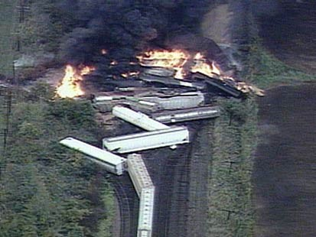
Background
My background
What is CR-Site?
Why was this topic selected?

Slide 4
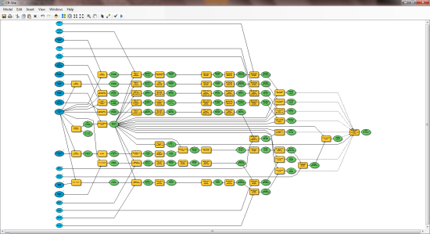
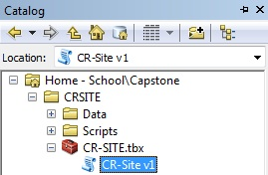
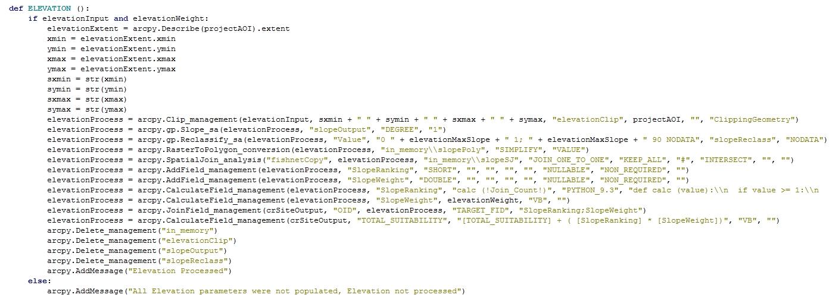
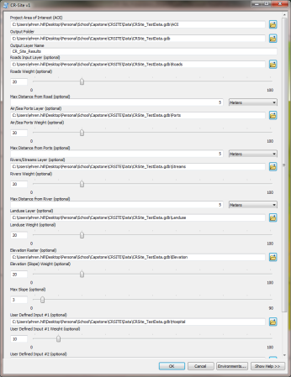
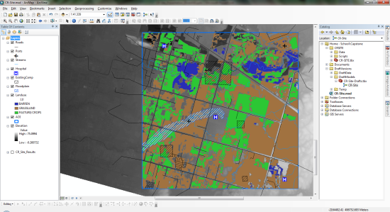
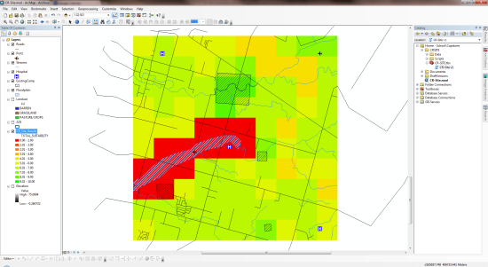
Background: How CR-Site Works
Designed in ModelBuilder and Python
Run through the ArcGIS environment
CR-Site uses multiple user parameters, most are optional

Slide 5
Development Process: ModelBuilder

Slide 6
Development Process: Python

Slide 7
Development Process: Criteria & Rankings
Input Layer | Parameter | Ranking Value
Elevation | Slope | Cells that meet user specified slope receive ranking of 10 All other cells receive ranking of 1
Roads | Distance | Cells with 2 or more roads within user specified distance receive ranking of 10 Cells with 1 road within user specified distance receive ranking of 5 All other cells receive ranking of 1
Ports (Sea & Air) | Distance | Cells with 2 or more ports within specified distance receive ranking of 10 Cells with 1 port within specified distance receive ranking of 5 All other cells receive ranking of 1
Streams | Distance | Cells with 2 or more streams within specified distance receive ranking of 10 Cells with 1 stream within specified distance receive ranking of 5 All other cells receive ranking of 1
Land Use (Land Cover) | Type | Cells that intersect land use layer receive ranking of 10 All other cells receive ranking of 1
User Defined Input #1 | Type | Cells that intersect user defined layer receive ranking of 10 All other cells receive ranking of 1
User Defined Input #2 | Type | Cells that intersect user defined layer receive ranking of 10 All other cells receive ranking of 1
Exclusion Layer | N/A | All cells that intersect the exclusion layer will be set to 0

Slide 8
Development Process: Creating a Geoprocessing Tool

Slide 9
Use Case: Data
CR-Site will be delivered with usable data
Data will be broken into regions
Default data can always be replaced

Slide 10
Use Case: Input Layers
Notes:
Input Layers
AOI is broken down into a grid of cells

Slide 11
Use Case: Parameters

Slide 12
Use Case: Output

Slide 13
Use Case: Output

Slide 14
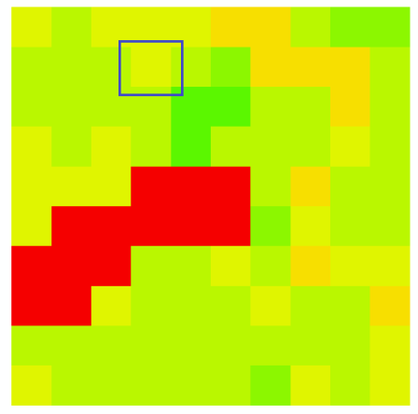
Use Case: Example Calculation
Input Layers | Ranking Value | User Defined Weight | Normalized Weight | Suitability Value
Elevation | 10 | 1 | 0.1 | 1
Roads | 1 | 1 | 0.1 | 0.1
Ports (Sea & Air) | 10 | 1 | 0.1 | 1
Streams | 10 | 1 | 0.1 | 1
Land Use (Land Cover) | 10 | 2 | 0.2 | 2
Undefined Input #1 (Hospital) | 1 | 3 | 0.3 | 0.3
Undefined Input #2 (Existing Camp) | 1 | 1 | 0.1 | 0.1
TOTALS |  | 10 | 1.0 | Total Suitability Value: 5.5

Slide 15
Live Demo

Slide 16
Use Case: Performance
Use case contained 100 output cells
Around 5 minutes for 10,000
Around 30 minutes for 62,500 Cells
50 Sq. KM area
Use of in_memory processing

Slide 17
Future Work

Slide 18
Future Work: Enhancements
Primarily based on feedback from ISCRAM conference
Change to web based tool
Compare to previous crisis response efforts
Create a CR-Site Basic and CR-Site Advanced
New enhancement options in ArcGIS 10.1

Slide 19
Outreach
ISCRAM 2012 in Vancouver, British Columbia
Poster Session
Live Demo Session
CR-Site will be released as open source project on Google Code

Slide 20
Conclusion
Still a prototype tool
Available for users of all levels
Feedback from conference
Continued development
Freely available
Thanks to Dr. Frank Hardisty

Slide 21
Questions?

