Slide 1
Critiquing tax-based land use models in small cities: a GIS-based inquiry in Eagan, MN
Presented by: Kendell Hillis
Adviser: Stephen Mainzer
October 20, 2020
Image source: buzzbuzzhome

Slide 2
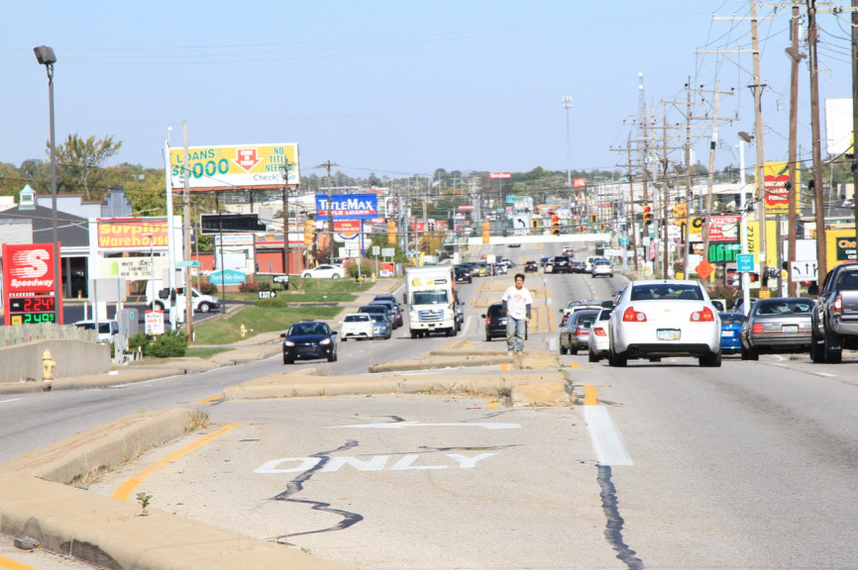
Why I chose this project
Image source (L): Redlands Community News
Image source (R): Strong Towns

Slide 3
Problem Statement
The suburban development pattern has contributed to communities being financially unproductive, fragile, homogenous, and inefficient. Low-density development has shown to limit choices for residents, landowners, business owners, and workers. The goal of this study is to use economic data to visualize the effect of policy on community design in Eagan, Minnesota. A model will be created that spatially compares taxation methods and the financial outcomes of land use decisions. The analysis will assist in executing the goals of the City’s 2040 Comprehensive Plan.

Slide 4
Presentation Overview
Background
History of suburbs
Characteristics of suburbs
Economic outcomes of suburban development
Eagan community profile
How property is taxed
Visualizing financial productivity
Goals and Objectives
Methodology
Challenges/Considerations
Anticipated Results
Project Timeline
Presentation Venue

Slide 5
What is a suburb?
Broadly defined as lower-density areas outside the city core
Additional criteria include:
predominance of single-family housing
dependence on automobiles (particularly for non-work trips)
age of housing stock
distance from central core

Slide 6
The history of suburbs in the United States
After Industrial Revolution, most Americans moved from farms to rural areas
Movement to surrounding areas was facilitated by railroads and automobiles
Cars would become affordable and massive roadbuilding was necessary
Land values around new or improved roads increased

Slide 7
(continued)
Suburbs experienced rapid growth after WWII
To meet demand of returnees from war, developers began to build quickly and cheaply
Private homeownership was pitched as essential in maintaining individualistic identity
Developments often consisted of single-purpose zoning that prohibited mixed-use, common in urban areas
This model was repeated throughout the country

Slide 8
Federal Government’s role in suburbs
1933 – Home Owners’ Loan Corporation (HOLC)
Mortgage terms extended to 20 years
1934 – Federal Housing Administration
Made homeownership attainable for more Americans
Standardized home building
1956 – National Interstate and Defense Highways Act
Construction of Interstate Highway System

Slide 9
Traditional development pattern
Pattern of growth humans used for thousands of years
Time-tested
Trial-and-error approach
Incremental
Low-risk
Iterative
Built to human scale
Revolved around pedestrian activity
No long-term financing mechanisms
Heterogeneous, mix of uses
Less restrictive zoning ordinances
Bottom-up approach

Slide 10
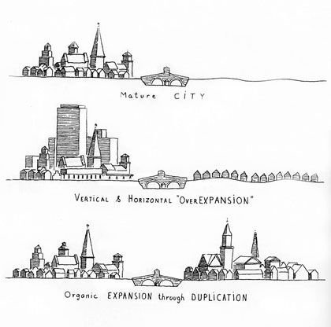
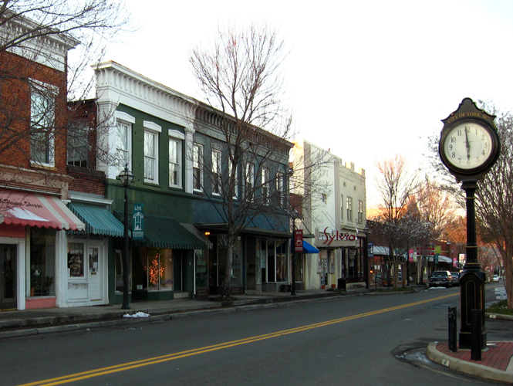
(continued)
Architecture and design were direct reflections of the needs of the community
Image source (L) : Strong Towns, Leon Krier
Image source (R): Furniture Academy

Slide 11
The “Suburban Experiment”
Suburban development pattern after World War II is a massive experiment
It has not been tried in history
Strong Towns refers to this development as the “Suburban Experiment”
New way of building and financing cities
Sacrificed resiliency for growth
American cities have spread out beyond their abilities to financially sustain themselves
Requires continuous growth to sustain

Slide 12
How the Suburban Experiment is supported
Strong Towns describes low-density suburban development as an “Illusion of Wealth”
Each round of continued unsustainable development generates short-term revenue for cities, but long-term liabilities such as infrastructure maintenance are not considered
Communities do not have adequate property tax bases to pay bills long-term
Cities are forced to continue to grow to create revenue to pay for previous projects – like a Ponzi scheme

Slide 13
Case Studies
Strong Towns founder, Charles Marohn provided evidence of the imbalance
He quotes the cost to resurface a suburban road at $354,000. Based on the property taxes being paid by the property owners along the road, it would take 79 years to recoup that cost. For the city to recoup the costs immediately, the city would have to increase the property taxes of those property owners by 46%.
City officials would like to service a low-density industrial park with municipal sewer and water utilities. It would require $316,000 of private development to pay for this infrastructure – double the current rate of investment in the park.
Marohn suggests that solving this problem involves a more productive pattern of development that creates more return on investment at the local level. Local governments often face low initial costs of entry for development but kick the can down the road on paying for maintenance costs to support it

Slide 14
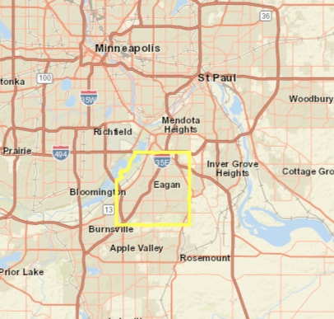
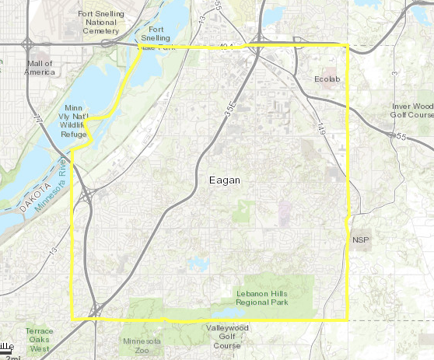
Eagan, MN Community Profile
Suburb in the Minneapolis-St. Paul Metropolitan Area
Population of 64,206 (2010 census)
34 sq. miles or 21,000 acres
Image source: ArcGIS Online

Slide 15
2040 Eagan Comprehensive Plan
Document serves as a guide for Eagan’s future growth, development, and redevelopment. The plan influences the form, pace, and location of new development
Key takeaways:
98% of the land has been developed
28.5% of land is dedicated to low-density and large lot residential land use
Less than 5% of vacant land is available for development
52% of housing stock is single-family detached, 22% is attached townhomes, 26% is multifamily
More townhome, apartment, and senior living units were built than single-family detached homes in 2014
Only 2% of residential land in Eagan is identified to have potential for infill residential development

Slide 16
Goals of the Land Use Plan
As part of the Comprehensive Plan, the Land Use Plan provides the framework for how every parcel will be used in the future
Some goals of the Land Use Plan include:
Maintain a land use pattern that reflects a variety of land uses including residential neighborhoods of varying densities and housing types; retail commercial and office areas; and industrial and service employment areas
Encourage a mix of land uses that help to maintain a strong tax base in the community
Create housing near shopping areas, recreational opportunities, and support services
Designate sufficient land for higher density housing
Increase connectivity between neighborhoods and destinations
Encourage mixed uses to support walkability and non-automobile transportation
Redevelop underutilized properties
Support compact development patterns that can provide a mix of jobs and housing
Notes:
Stuff from comprehensive plan
Talk about land use, housing stock, redevelopment strategy

Slide 17
Measuring productivity
“Land is the base resource from which community prosperity is built and sustained. It must not be squandered.” – Strong Towns
“Do the math”
Property should create enough wealth to support infrastructure and services needed for the place to exist and thrive

Slide 18
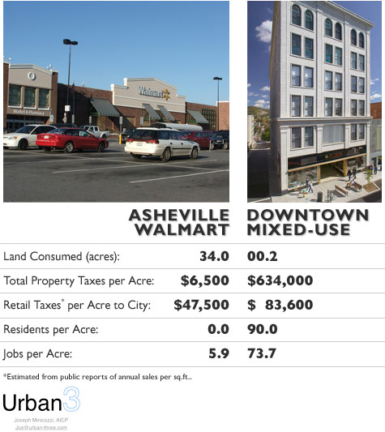
Image source: Urban3

Slide 19
How property is taxed
Value of land and structures (improvements) are assessed
Current traditional property tax system taxes the total value of properties
Current property tax more heavily taxes the building value
Land value tax taxes only the land
Incentivizes in-fill and redevelopment of underutilized land
Creates built-in pressure to develop and reduce the amount of space dedicated to parking
Improvement to Land (I/L) Ratio

Slide 20
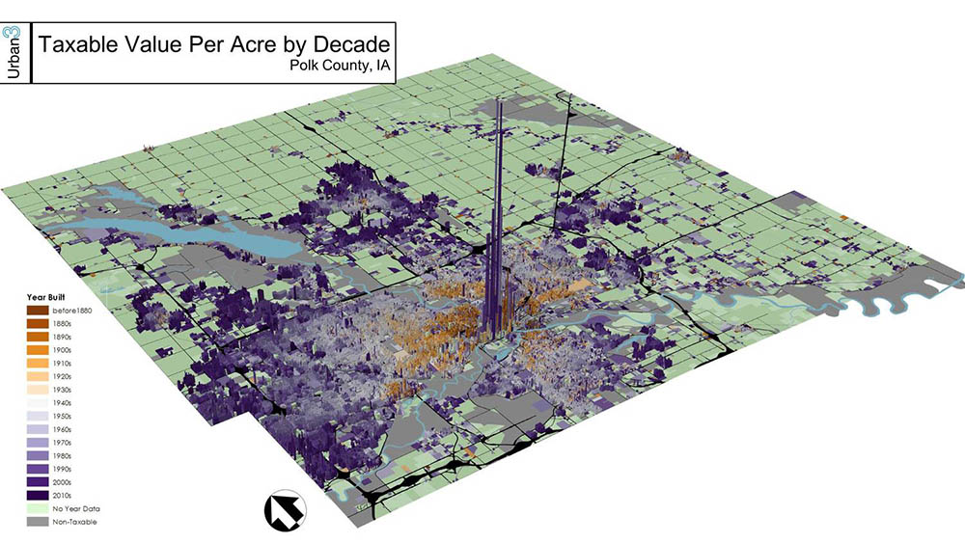
Visualizing Financial Productivity
Image source: Urban3

Slide 21
Goals and Objectives
The goal of this study is to use GIS to visualize financial productivity of parcels in Eagan, MN. By analyzing the spatial distribution of tax revenue and exploring alternative taxation approaches, city officials can more precisely plan for development that achieves the policies and goals of the 2040 Comprehensive Plan. Mapping the productivity of the city will allow users to identify opportunities for infill or redevelopment.

Slide 22
Proposed Methodology
Data
Dakota County Assessor’s parcel GIS data
Locations of city points of interest
Technology
ArcGIS Online, ArcGIS Pro
Deliverables
3D visualization, interactive web application showing value per acre for properties
Map showing Improvement to Land (L/I) Ratio of properties
Map identifying vacant or underutilized properties
Model comparing traditional property tax to land value tax
Model that compares low-density development to more intense uses such as the addition of accessory dwelling units or duplexes
Identify areas for potential connectivity between commercial and residential areas

Slide 23
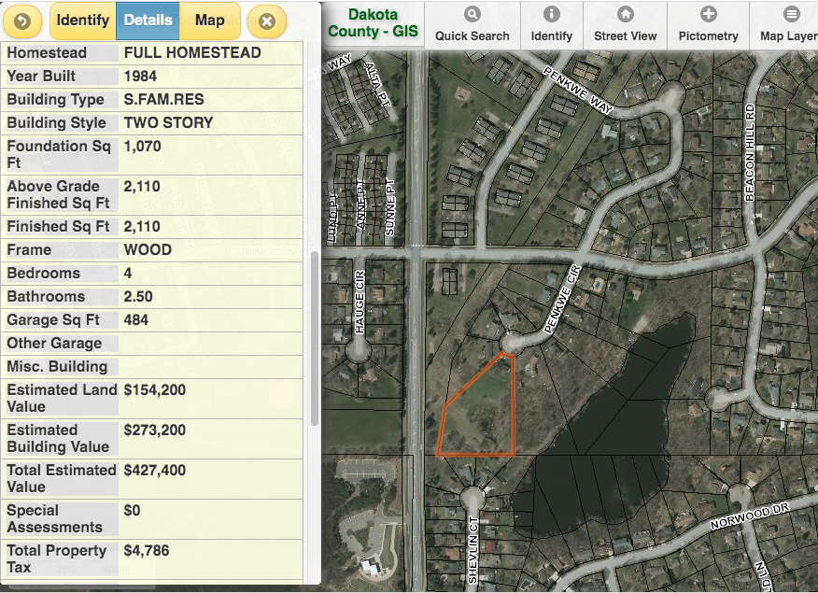

Slide 24
Continued Research
Are there cultural or social preferences that prevent more intense land uses?
Is land value tax appropriate at large scale or just specific neighborhoods?
What are the factors that affect land value in Eagan, specifically?

Slide 25
Anticipated Results
Dense areas of city will show most value per acre
Areas of city with older housing stock will show low Improvement to Land (I/L) Ratio
A land value tax system would most impact properties with low floor area ratio (FAR)
Opportunities for connectivity to commercial and mixed use areas will likely include higher-density housing rather than single-family detached homes

Slide 26
Project Timeline
November 2020
Assess feedback from peers, adviser
Data will be acquired and assessed
Submit abstract to Wisconsin Land Information Association (WLIA) for annual conference
November – December 2020
Analysis and visualization of data
January – February 2021
Final project and presentation to be completed
February 17-21, 2021
Present final project at WLIA Annual Conference

Slide 27
Presentation Venue
Wisconsin Land Information Association (WLIA) Annual Conference
February 17-19
Wisconsin Dells, WI
Anticipated to be held virtually or in hybrid format
WLIA is an organization representing professionals working to develop, maintain, and apply a network of statewide land information systems

Slide 28
References
Berger, A., & Kotkin, J. (Eds.). (2018). Infinite suburbia. Chronicle Books.
Burns, A., & Nymoen, R. (2020, February 10). Land Value Tax: A promising land-use tool proposed for our communities. MinnPost. https://www.minnpost.com/community-voices/2020/02/land-value-tax-a-
City of Eagan. (2020). 2040 Comprehensive Plan. https://www.cityofeagan.com/2040plan
Dakota County. (2020, October 15). Tax Parcels - Points and Polygons, Dakota County, Minnesota [Dataset]. Minnesota Spatial Geocommons. https://gisdata.mn.gov/dataset/us-mn-co-dakota-plan-parcels
Herriges, D. (2020a, July 29). The Road to Insolvency is Long. Strong Towns. https://www.strongtowns.org/journal/2020/7/26/the-road-to-insolvency-is-long
Marohn, C. (2019). Strong Towns: A Bottom-Up Revolution to Rebuild American Prosperity (1st ed.). Wiley.
Marohn, C. (2017, June 15). Three neighborhoods in arrested development. Strong Towns. https://www.strongtowns.org/journal/2017/6/15/three-neighborhoods-in-arrested-development
Marohn, C. (2013). Suburban Ponzi Scheme. Leadership and Management in Engineering, 13(3), 181–189. https://doi.org/10.1061/(asce)lm.1943-5630.0000234
Minicozzi, J. (2012, January 23). The Smart Math of Mixed-Use Development. Planetizen. https://www.planetizen.com/node/53922

Slide 29
(continued)
Narayanan, S. (2020, August 28). Why Minnesota Needs a Land Value Tax. Streets MN. https://streets.mn/2020/08/28/why-minneapolis-needs-a-land-value-tax/
Nielsen, C. (2018a, July 2). How Property Taxes Shape Our Cities. Strong Towns. https://www.strongtowns.org/journal/2018/6/28/how-property-taxes-shape-our-cities
Nielsen, C. (2018b, July 12). Breaking Down Atlanta’s Suburban Experiment. Strong Towns. https://www.strongtowns.org/journal/2018/7/11/breaking-down-atlantas-suburban-experiment
Stein, J. (2020, May 2). The Weeds: the land value tax, explained (out loud). Vox. https://www.vox.com/2016/5/2/11533936/the-weeds-land-value-tax-explained
The Congress for the New Urbanism, Sprawl Retrofit Initiative. (2011, November). The unbearable costs of sprawl. https://www.cnu.org/sites/default/files/SPRAWL-RETROFIT-UNB_1.pdf
Wright, R. O. (2007). Chronology of Housing in the United States. McFarland.
Zhang, A. (2019, April 30). My City Has Massive Infrastructure Liabilities. So Do 99% of the Cities in America. Strong Towns. https://www.strongtowns.org/journal/2019/4/30/my-city-has-massive-infrastructure-liabilities-so-do-99-of-the-cities-in-america
Zuegel, D. (2017, October 20). How We Subsidize Suburbia. The American Conservative. https://www.theamericanconservative.com/urbs/we-have-always-subsidized-suburbia/

