Slide 1
Open Source Mapping for Earthquake Risk Assessment and Risk Reduction
Richard Hinton, MGIS Candidate
Dr. Anthony Robinson, Adviser
Notes:
Opening remarks…

Slide 2
Outline
Introduction
Emergency Response Cycle
Current Geospatial Frameworks
Purposed Methodology
Data Considerations
Open Source in Disaster Management
The Road Ahead
Closing thoughts

Slide 3
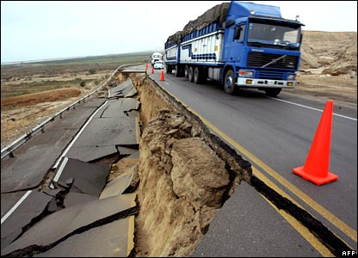
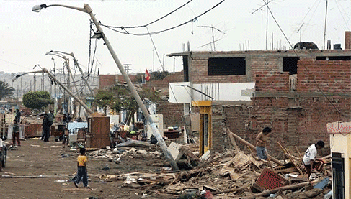
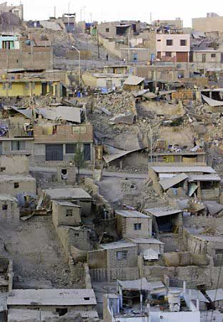
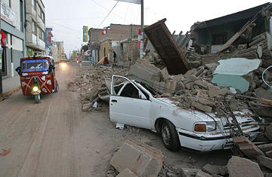
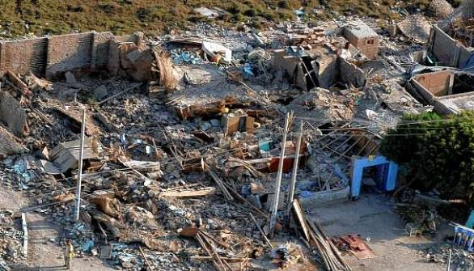
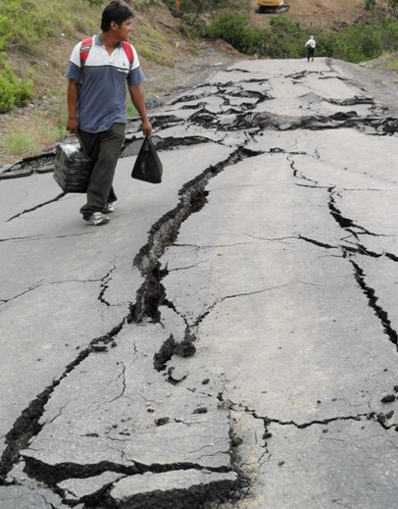
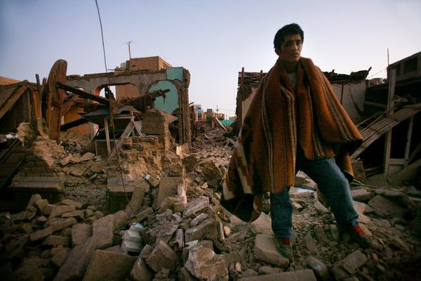
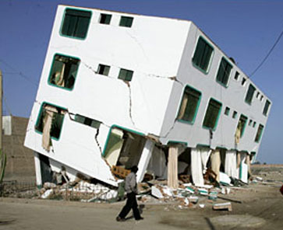
Notes:
Intro remarks…
the last 30 years has seen a steady and significant increase in the number and severity of disasters around the globe.
Natural disasters and their broadly-felt effects are spatial by nature.
Developing countries frequently lack the infrastructure or resources to assess their vulnerability to a natural disaster and develop a preparedness plan.
Through the use of free and open source technologies (FOSS), key capabilities for data collection, analysis and storage are readily available, often requiring fewer resources to be allocated for their procurement and implementation when compared to proprietary systems.

Slide 4
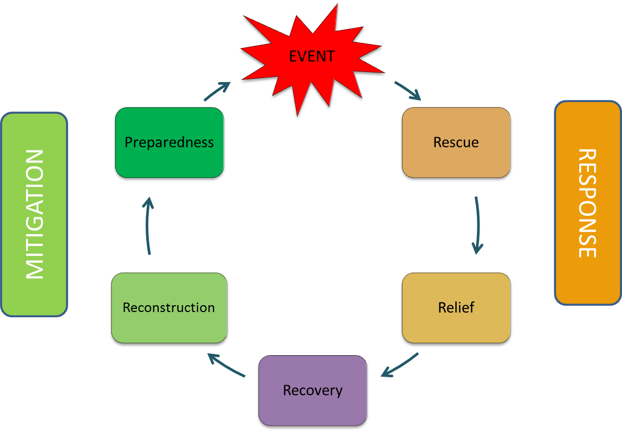
Emergency Response Cycle
Notes:
Emergency Response Cycle
the event occurs – such as an earthquake or flood - followed by response which includes rescue, relief and then recovery efforts. The next phase is mitigation encompassing the longer term processes of reconstruction and preparedness.
As you can see, it was only well after the event, that preparedness was made a priority.
Over the last several years however, more resources have been placed on pre-event preparedness.

Slide 5
Current Geospatial Frameworks/Initiatives
Developed countries often have preparedness plans available
www.ready.gov
www.ncdp.mailman.columbia.edu
Notes:
In developed countries like here in the United States, citizens have access to well established resources on how to prepare for a disaster. Sites such as FEMA’s ‘Ready’ website educate and help people to prepare for a disaster.

Slide 6
Current Geospatial Frameworks/Initiatives
www.dpri.kyoto-u.ac.jp
www.gazi.edu.tr
www.fema.gov/hazus
Notes:
GIS applications:
portal for data delivery
mobile damage assessment app
efficient issuance of damage claims

Slide 7
Motivation
Developing countries often lack the geospatial infrastructure
Use GIS to facilitate disaster reduction through vulnerability assessment
Use only Free and Open Source Software (FOSS) and data
Can help minimize procurement resources
Provides agility and flexibility (no vendor lock-in)
End result: most anyone, with some training, can identify areas and infrastructure vulnerable to earthquakes, using only freely available data and software
Notes:
Adopting the Free and Open Source Software (FOSS) business model allows for multiple users and developers to provide services and extensions without restriction concerning its distribution.
Here the focus is not on one specific software technology, but on any from the FOSS spectrum which can add flexibility and agility so as to better suit the dynamic needs of a disaster management context.

Slide 8
Proposed Methodology
5 stages:
Site location
Search for and procure data
Identify gaps and resolve if possible
Edit data to ensure compatibility
Perform analysis

Slide 9
Proposed Methodology cont…
Not used to predict casualty figures
To predict casualty figures…
HAZUS-MH- Hazard U.S. – Multi Hazard
www.fema.gov/hazus
CATS - Consequences Assessment Tool Set
www.saic.com/products/security/cats/

Slide 10
Proposed Methodology cont…
PAGER – Prompt Assessment of Global Earthquakes for Response
http://earthquake.usgs.gov/research/pager/
InaSAFE - Indonesia Scenario Assessment for Emergences
inasafe.readthedocs.org

Slide 11
Data Considerations
Data Sources:
Open Source Free Including Crowd-sourced
Primary Data Concerns:
Quality Usability Security
Crowd-sourced proven useable:
Geocoding data project - proved to be 85% accurate
www.usaid.gov
Ushahidi-Haiti Project
www.ushahidi.com
Notes:
Data sources include open source and free including crowd-sourced
Concerns, particularly with crowd sourced include quality, usability and security. Quality and usability go hand in hand – if of sufficient quality it should be useable for the study area.
Security – since all data is free and or open sourced, issues of privacy, ownership or sensitive information is minimized.
A couple of examples where crowd-sourced data work well is with USAID’s geocoding project. In 2010 USAID’s geocenter wished to geocode several thousand records in a database….
Ushahidi-Haiti Project. To give some background for those unfamiliar with Ushahidi…Ushahidi, means ‘testimony’ in Swahili, this platform was originally created following the 2007-2008 post-election violence in Kenya. The original website was used to map incidents of violence and peace efforts across the country based on reports submitted via the web and mobile phones by anyone who witnessed them. These reports are then logged and illustrated on a web-based, interactive map.
Since then this platform has been used by various organizations across the world. In the Haiti case, within the first few days of the 2010 earthquake, first responders were using the Ushahidi-Haiti maps and data. As reports came in they were reviewed, clarified and approved by over 100 volunteers. In this situation it was impossible to validate all incoming reports, but the project team took the approach that any time lost responding to inaccurate reports was outweighed by the overall net benefit of logging all of the reports and verifying what they could.

Slide 12
Data Considerations
Common datasets include:
Administrative boundaries and populated places
Hydrography
Topography
Land cover and land use
Utilities
Critical infrastructure
Demographic data
Disaster specific datasets for earthquakes:
Fault lines
Historical seismic activity
Soil classification
Notes:
There are several considerations when looking at the data needs for disaster preparedness. With disasters, the more and sooner data is available, the better.
There is no way to know all of the datasets that would be required for a particular event, as each community and location will have specific information regarding its particular situation. There are however several datasets that can be used for disaster preparedness, regardless of the disaster.
For earthquakes, data on seismic activity, fault lines and soils/surfical geology would be needed.
The more robust and attribute specific a dataset is the more robust the analysis and preparedness plan can be.

Slide 13
Data Considerations
Issues with data from various sources:
Access
Interoperability
Scale
Accuracy
Currency
Coordinate system
Redundancy
Issues with data from developing countries
Slow/intermittent Internet connection
Notes:
With many independent groups creating the data, issues with integrating these data together will inevitably crop up.
Concerns that arise from data collected from various sources include: access, interoperability, scale, accuracy, currency, coordinate system and redundancy.
All of these issues and concerns underscore the need for a preparedness plan and mitigation measures, before a disaster strikes.

Slide 14
DATASETS | FEATURE TYPE | POTENTIAL SOURCE(S)
Administrative Boundaries | Admin level 1 Admin level 2 Admin level 3 Populated place | OSM SEDAC GeoNetwork (FAO) GISTPortal
Transportation | Roads Airports Railroads Sea Ports Bridges | OSM GeoNetwork (FAO) GISTPortal
Hydrography | Rivers Coastline Reservoirs Floodplains Lakes Dams Canals | OSM SEDAC GeoNetwork (FAO) UNEP
Land Use | Forest Agriculture Urban/Rural | OSM SEDAC GeoNetwork (FAO)
Utilities | Water/sewer line Oil/gas line Electrical network Power plant location
Critical Infrastructure: building footprints where possible | Fire/Police/EMS stations Hospitals Military installation Government buildings Schools Community centres Elderly care facilities | OSM GISTPortal
Topography | Contour lines Spot elevation DEM | GeoNetwork (FAO) GLCF
Seismic | Historical seismic locations Fault lines | USGS GeoTECH
Demographic | Population distribution | SEDAC GeoNetwork (FAO)
Geological | Surfical geology/Soil | ISRIC GeoNetwork (FAO)
Data
Acquisition
Notes:
If these data have been captured in a useable geospatial format and is it available is the follow-up concern now that many of the datasets and their respective concerns have been identified.
Over the past several years many organizations have been creating data and making it available online for download. Many of these sites allow the user to download and use the data without restriction. It is from these sites that much of the needed data for this project can be acquired.
These sites include:
OpenStreenMap (OSM)
US Geological Survey (USGS)
Socioeconomic Data and Applications Center (SEDAC)
Food and Agriculture Organization GeoNetwork (FAO)
Geographic Information Support Team (GIST)
Natural Earth (NE)
ISRIC World Soil Information
United Nations Environmental Program

Slide 15
Open Source in Disaster Management
www.gfdrr.org/gfdrr/opendri
www.opengeospatial.org/
inasafe.readthedocs.org
Quantum GIS
www.qgis.org/
UNOSAT
www.unitar.org/unosat/
Notes:
Open source (OS) technologies and philosophy have been used with disaster management in many areas including academic research and international organizations.

Slide 16
The Road Ahead…
Notes:
Settle on location
Find data
Identify gaps and articulate new data if possible
Prep and import data into GIS
Complete analysis
Produce maps
Write up results and create the final presentation

Slide 17
Closing Thoughts
Open Source has been used with success
Community involvement
With little training, areas and infrastructure at risk can be identified
Every community has it’s own specific needs
Communities change over time

Slide 18
Thank you!

