Slide 1
GEOG 596A MGIS CAPSTONE Project PROPOSAL: COMPUTING SOLAR ENERGY POTENTIAL OF URBAN AREAS USING AIRBORNE LIDAR DATA Ryan Hippenstiel

Slide 2
Outline
Introduction/Background
LiDAR Data
Existing Tool - PV Analyst
Goals & Objectives
Proposed Methodology
Project Timeline
Anticipated/Desired Results

Slide 3
Introduction/Background
According to the U.S. Energy Information Agency, between 2004 and 2008, the United State’s energy consumption produced by solar energy nearly doubled. Unfortunately, it was still only 0.1% of overall consumption.
Current processes and technology limit the cost-effectiveness of solar energy use (single homes, buildings, etc.)
Many solar energy analysis systems cannot take into account geographically-affected data….
…and many current GIS systems for photovoltaic (PV) analysis are at the national or continental level limiting their use for smaller region areas.
PVGIS – European Commission Joint Research Centre
http://re.jrc.ec.europa.eu/pvgis/

Slide 4
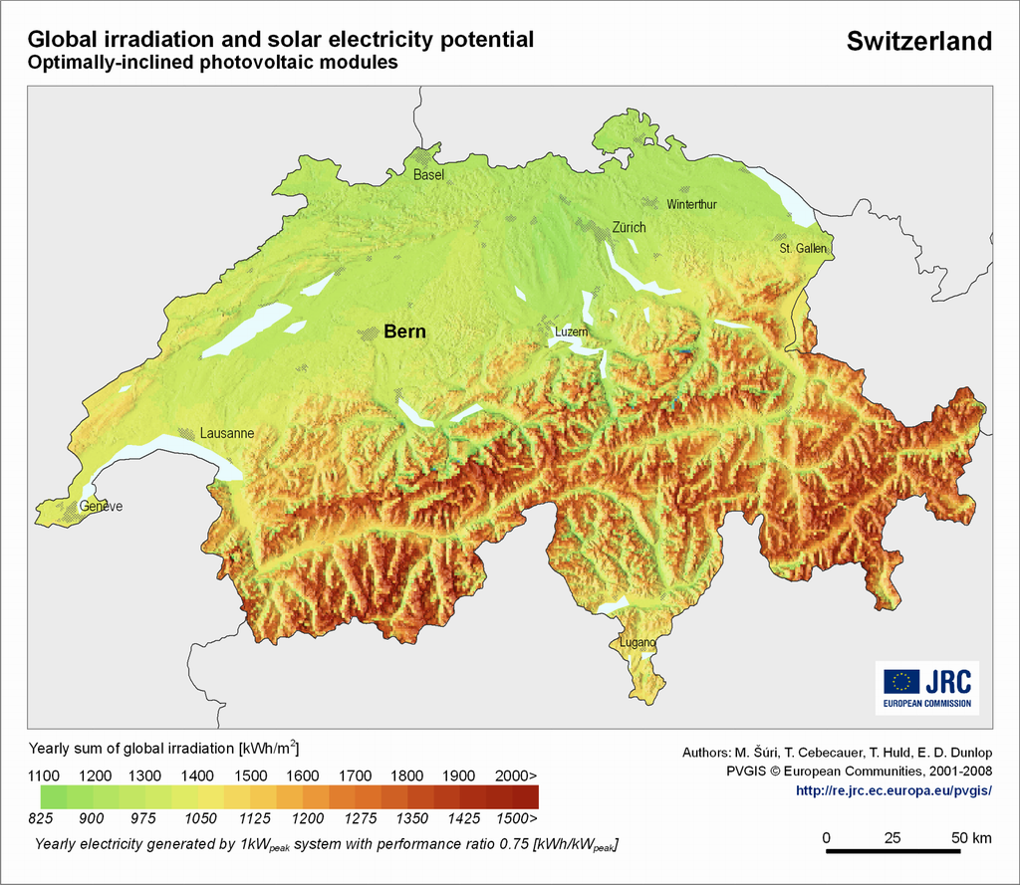
PVGIS Map Product

Slide 5
Introduction/Background
Need for a tool to easily analyze regional level (city, county, subdivisions) solar potential.
GIS systems provide an excellent opportunity to incorporate solar energy potential equations into geographic data available.
The hunt for usable data begins….

Slide 6
LiDAR (Light Detection and Ranging)
Airborne Laser Scanning measures returns of laser pulses to create a “point cloud” of features on the ground.
Growth of airborne LIDAR data provides a vast amount of information that can provide buildings and high vegetation.
PAMAP program in Pennsylvania
Orthophotography, Contours, LiDAR Files (.las)
Data returned can be viewed and interpreted by many characteristics.
Elevation
Intensity
Classification

Slide 7
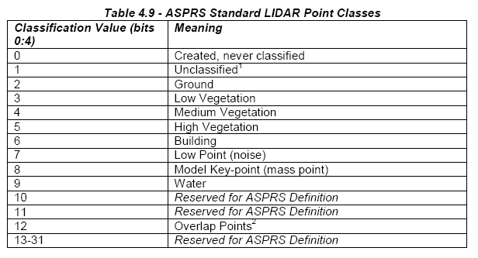
LiDAR (Light Detection and Ranging)
.las File Classification

Slide 8
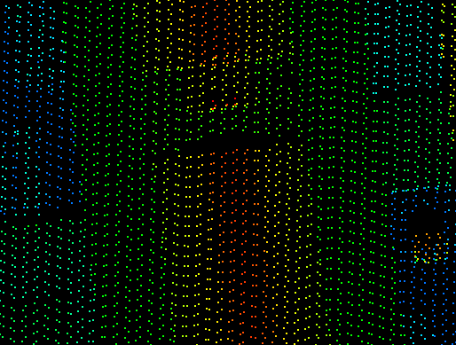
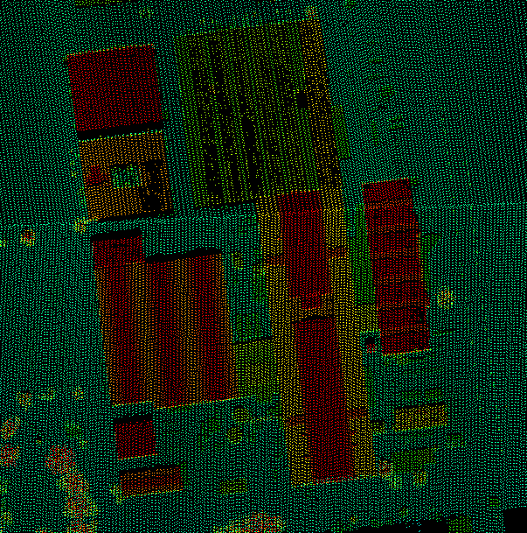
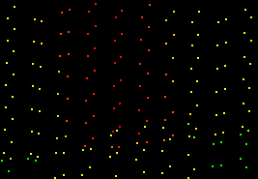
Sample LiDAR Data
PAMAP Data
Displayed by Elevation
Viewed in LP360

Slide 9
Existing Tool – PV Analyst
PV Analyst by Dr. Yosoon Choi while researching at Penn State
Developed as Extension of ArcMap
Uses grid-based DSM to identify usable rooftop areas w/ no shade by running simulations through TRaNsient SYstem Simulation (TRNSYS)
TRNSYS - energy simulation software developed by the University of Wisconsin
DSM was created manually through blueprints provided by Penn State
User Input
Selection of PV panels & mounting types
Creates TRNSYS file
Calls TRNSYS.exe
Saves results as layers for visualization in ArcGIS

Slide 10
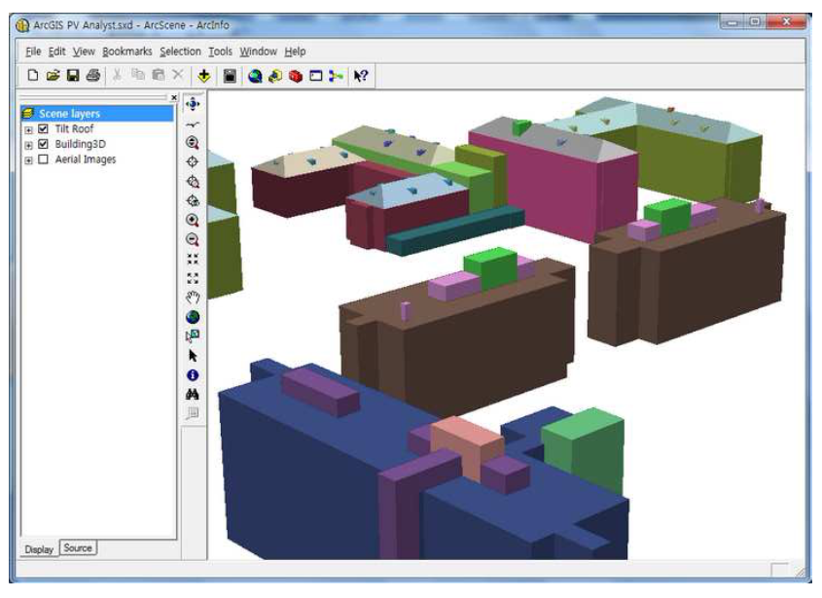
Existing Tool – PV Analyst
Photo of 3D Buildings as shown by Choi

Slide 11
Existing Tool – PV Analyst
User Input
Selection of PV panels & mounting types
Creates TRNSYS file
Calls TRNSYS.exe
Saves results as layers for visualization in ArcGIS

Slide 12
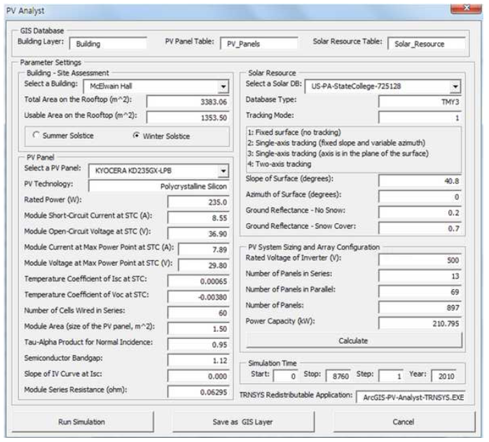
PV Analyst User Input

Slide 13
Goals & Objectives
Identify software & data available.
Determine a reliable workflow to extract pertinent building information from LiDAR data.
Build input data necessary for PV computations.
Models of buildings & high vegetation
Shading information
Tilt and orientation data
Potentially develop tool that allows user selection of geographic area and automatic export of PV potential.

Slide 14
Proposed Methodology
Critique existing third-party software to examine extraction abilities and data output.
Trial & error approach
LIDAR Analyst by Overwatch Systems, Ltd.
LP360 & Extractor by Qcoherent
MARS by Merrick
eCognition by Trimble
ENVI by ITT
Determine if data available is of a quality to obtain useable and repeatable results necessary for PV output computations.
Gather available data through online resources.
Look at accuracy reporting & map view

Slide 15
Proposed Methodology
Extract building and vegetation information from LIDAR data.
Should include area, aspect, slope, etc. for building rooftops and sides (if useable)
Create model of vegetation that would restrict useable area.
Compare results to those of Choi
Determine necessary input data of buildings.
Latitude, Orientation, Tilt, Area
Complete shading and time-lapse processing.

Slide 16
Proposed Methodology - Testing
Complete test extraction of the Pollock Commons on Penn State University Park campus
Compare results of extraction to the 3D models hand-built during the development of PV Analyst.
Using various inputs, see if results can be produced within an acceptable level of tolerance.

Slide 17
Proposed Methodology
Improve existing tool PV Analyst, developed through research at PSU
Ability to select geographic region to extract data
Use real-world georeferenced data rather than hand-built 3D building models
Through scripting or Model Builder, streamline process as a whole.
Complete documentation of final workflow using third-party software as a step if it’s independent OR…
…ideally use a software that runs as an extension as part of a larger model or script in ArcGIS.

Slide 18
Test Area – Philadelphia Navy Yard
Orthophotography from PAMAP Program

Slide 19
Philadelphia Navy Yard & On-going Efforts
Multiuse complex with historical, industrial, and commercial buildings along with laboratories and sports facilities.
http://navyyard.org/
Greater Philadelphia Innovation Cluster (GPIC)
Goals to reduce carbon emissions and increase efficiency of buildings within the City
http://gpichub.org/

Slide 20
Project Timeline
Examine existing software & gather data – Oct.
Test extraction parameters & compare results – Oct. –Nov.
Develop process to provide necessary parameters – Nov.-Dec.
Develop Model or Script to automatically push desired parameters to PV Analyst – Dec.
Continue development to include tool to fully encompass process………

Slide 21
Anticipated/Desired Results
Testing and integration of extraction software.
Successful extraction of buildings and high vegetation data.
3D Models of useable area within selected urban area.
Output of necessary data for PV computations.
Improved and streamlined workflow of the whole process.
Potential development of all-in-one or “close-to-all-in-one” tool for selection all the way to analysis.
Most likely realized as improvements to PV Analyst
Improve the analysis of PV potential in urban areas (in some small but effective way).

Slide 22
Future Application
“Home-by-home” energy cost savings analysis.
Geo-coding addresses to homes within geographical area being studied.
Using design parameters of PV system, analyze potential savings for single homes, buildings, etc. within the parameters of the geographical area selected.
Allow a closer view based on the greater design.

Slide 23
References
References:
Choi, Y., Rayl, J. Tammineedi, C., Brownson, J.R.S. PV Analyst: a new tool for coupling GIS with solar energy simulation models to assess distributed photovoltaic potential in urban areas. Solar Energy. 2011, accepted.
U.S. Energy Information Agency. U.S. Energy Consumption by Energy Source. 2010.
Overwatch Systems, Ltd. (2010). LIDAR Analyst 5.0 for ArcGIS REFERENCE MANUAL. Textron Systems Corporation. Missoula, MT.
Photovoltaic Geographical Information System (PVGIS). European Communities, 20 DEC 2008. Web. 27 Aug 2011. <http://re.jrc.ec.europa.eu/pvgis/>.
ASPRS. LAS Specification Version 1.3 – R11. October 24, 2010.
Resources:
ESRI ArcMap Version 9.3.1. ESRI, Inc. 2009.
LIDAR Analyst Version 5.0. Overwatch System, Ltd.
LP360 2.0.0.12. Qcoherent Software, LLC. 2010.
DCNR PAMAP (2009). PAMAP Lidar Data. Retrieved May 1, 2011.

Slide 24
Thank you.
Special Thanks to:
Dr. Jeffrey Brownson
Dr. Yosoon Choi
Dr. Frank Derby
MGIS Advisors

