Slide 1
Determining sanitary sewer gravity system storage: a standardized approach
Shonia Holloway
Geography 596A
May 11, 2015

Slide 2
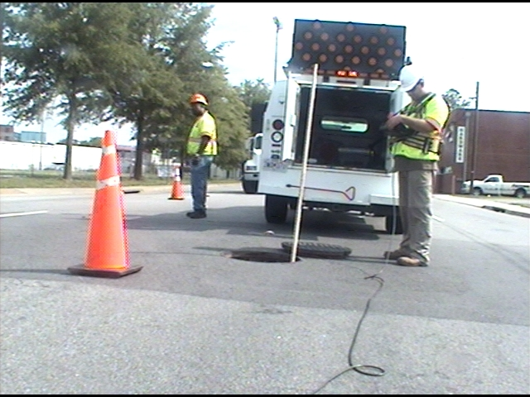
Agenda
Background
Goals and Objectives
Proposed Methodology
Project Timeline
Anticipated Results
Notes:
Discuss the basic agenda for the presentation and what will be get done!

Slide 3
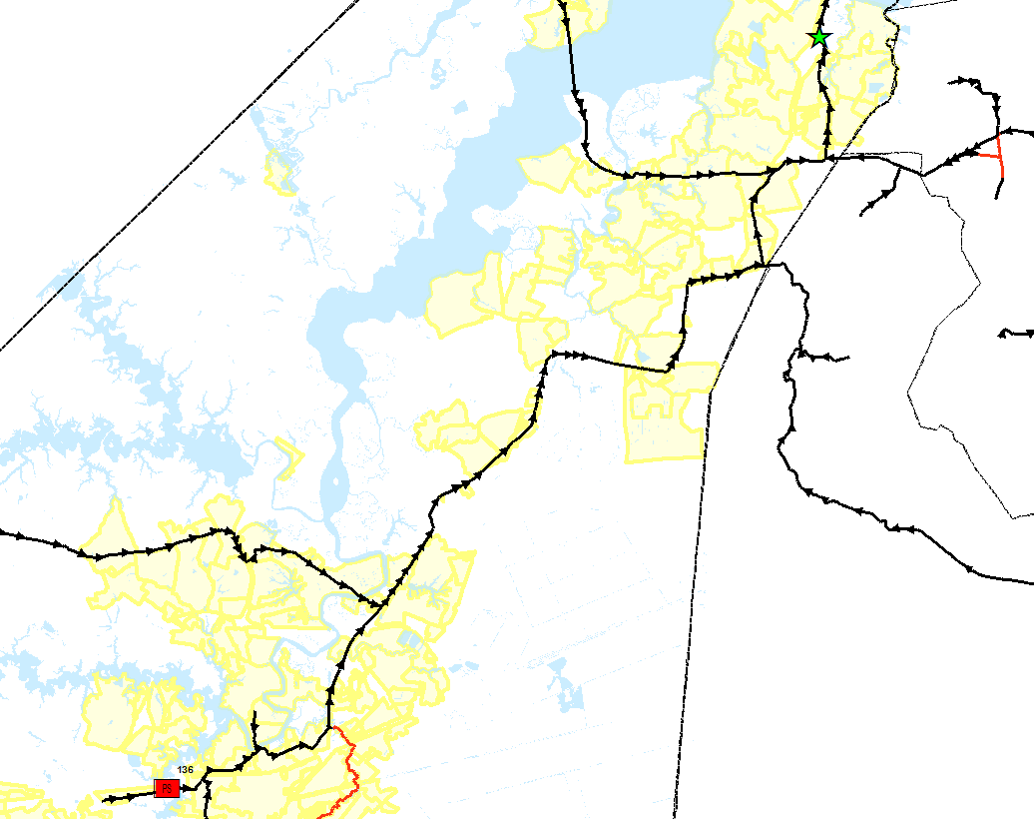
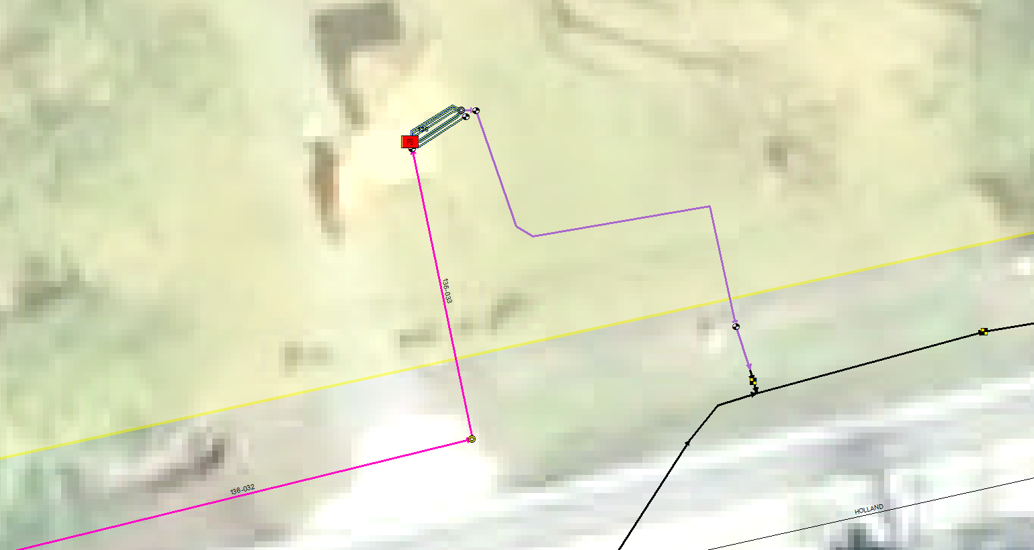
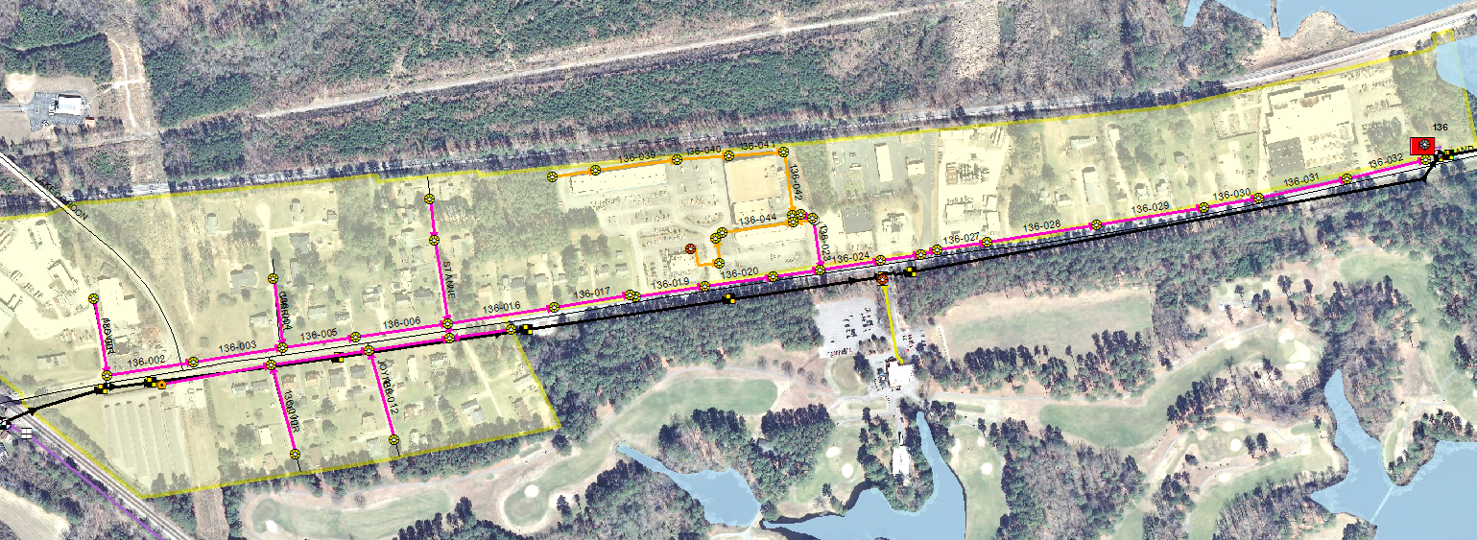
Background: How DOES a SEWER SYSTEM WORK?
WWTP
PS
Notes:
Provide background, including:
Describe the gravity components of a gravity collection system from the pipes to the wet well
First picture will show the entire gravity collection system for PS 136, discuss
How sewage enters the gravity system
How it travels (by gravity) to the pump station
Then the pump station is used to pump the sewage to a pressure system and ultimately the WWTP
I will show image #1 first of the entire service area, then show the zoomed in image to the pump station and then show the full zoomed out image of the WWTP

Slide 4
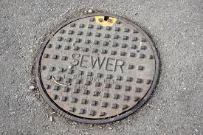
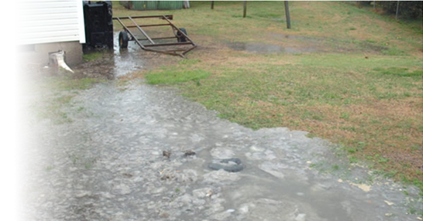
Background: What is CAPACITY?
You may be asking yourself…..Why do we care?
Sanitary Sewer Overflow
(SSO)
CLEAN WATER ACT
Adequate Capacity = Good
Lack of Capacity = Bad
Notes:
Capacity is important to know and understand with a system because when capacity is exceeded, the sewage will come out somewhere – typically at the lowest elevation in a system
Capacity can be exceeded when there is too much flow for the system to handle. Lack of capacity can happen when pipes are undersized OR when rain water gets into the system as well (like through pipe defects, uncapped cleanouts, etc...)
When sewage is released from a system, this is called a Sanitary Sewer Overflow (SSO)
Regulated by the Clean Water Act and Enforceable by State Environmental Agencies and EPA
They determine the size of pipes during design of a system and they can determine how much sewage the system can handle with modeling – this is called Capacity Analysis

Slide 5
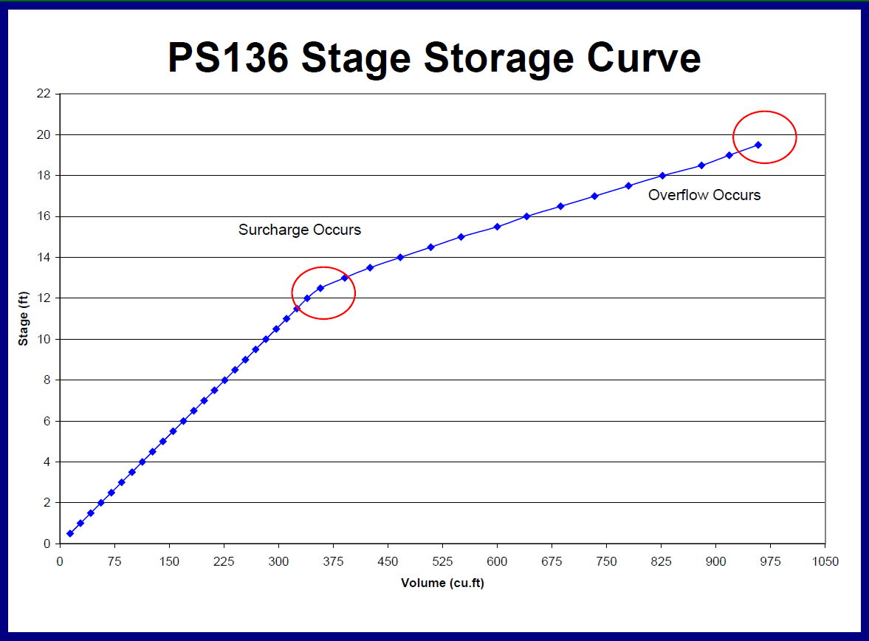
Background: HOW IS CAPACITY ANALYSIS CONDUCTED?
Sewage
Inflow and Infiltration
Total System Capacity Needs
Storage Capacity
During design and/or rehabilitation of the system – through modeling
Notes:
When determining capacity of the system, during design and/or modeling of the system you take into account:
Sewage Flow
Inflow and Infiltration that gets into the system from rainwater
Storage Capacity – which is storage at the pump station and pipes of the gravity system – this is what the stage storage curve gives you
If you don’t take into account the storage capacity of the system – you can incorrectly size the system and potentially miss overflows because you would underestimate your peak flow because sewage is stored in the system

Slide 6
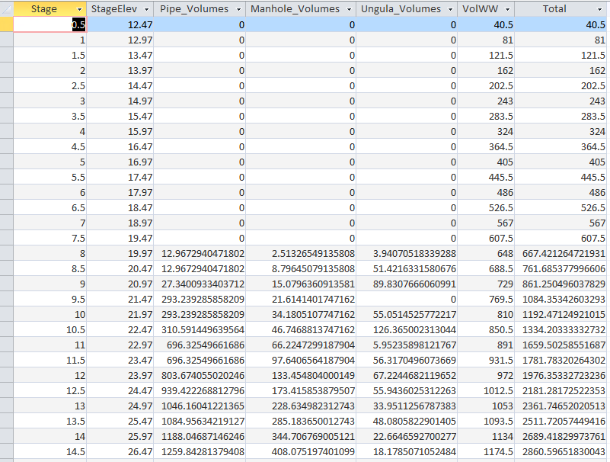
Background: What is gravity system storage?
How does gravity storage play a role in capacity?
Notes:
Continue discussion describing how stage storage plays a role in capacity analysis:
Remember, we have a gravity system that collects sewer (image 1)
It ends up at the sewer pump station (image 2)
Inside the sewer pump station is a wet well where all the sewer flows (image 3)
As that wet well’s water level rises, sewage can actually travel back up into the gravity system
Typically, at some point, the pumps will kick in and the water level will drop again – water levels in a wet well are constantly fluctuating
But, in some cases of very high flow events like wet weather, the water can continue to move up the system until a point of surcharge, or overflow (like we saw on the previous slide) – that is what capacity analysis and designs of systems are trying to avoid
BUT during that design (or modeling of system capacity) – the gravity system can actually serve as a storage mechanism that will prevent overflows during some peak flow events
So it’s important to know for each system what that storage volume is at various water levels (aka stages) in the wet well – this is the stage storage curve and this is the curve at the core of this project

Slide 7
Background: CASE STUDY: City of Suffolk
Suffolk,
VA
Notes:
This slide will describe the driver for this project, the City of Suffolk Case Study which will include:
Back in 2007 regional consent order to focus on the reduction of SSOs
Consent Order, back in 2007, as a regional initiative between HRSD, VA DEQ, and 13 area localities
Requires various activities, under regulatory compliance, that have to be conducted to determine the condition and capacity of their sanitary sewer systems
Main focus is to eliminate or greatly reduce the occurrence of sanitary sewer overflows (SSOs)
Requires capacity analysis
City of Suffolk our main client
had a need for a custom tool to develop stage storage volumes for each pump station service area – 130 SA’s, now have over 140

Slide 8
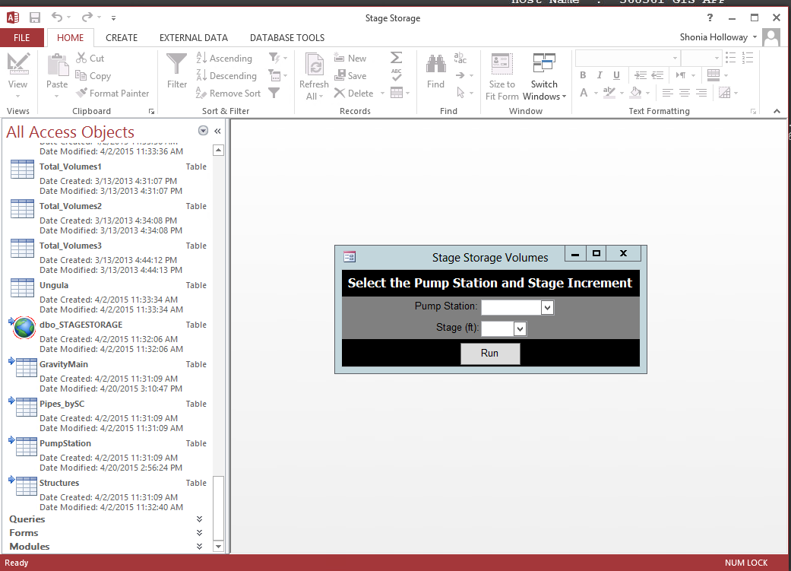
Background: CASE STUDY: City of Suffolk stage-storage
Results Tables
One simple user form
Linked tables to GIS export
Custom logic in
queries/modules
Notes:
So myself and an engineer worked to together to develop a tool – we started with a template in Excel for proof of concept and ended up with a custom database application in Microsoft Access that provides:
One simple user form that allows the user to select how fast the water rises, in 1/10 foot increments from 0.1 to 1.0 feet
Results tables
Linked tables to an export of the GIS data
Custom logic in VBA modules and supported by queries (lots and lots of queries…..)

Slide 9
Goals and Objectives: WHY a standardized approach?
So, what is good about the current tool?
Uses an export of the current GIS sewer assets – loosely integrated
To make accounting for the gravity storage volumes practical, an automated tool is required – spreadsheet/hand calculations are infeasible for larger systems
Result generation is fast and various datasets saved during the generation process can be easily used for QA/QC
Providing a ubiquitous platform allows for multiple users to have access to the tool
Notes:
Talk about what is good about what we created so far, including:
Is loosely integrated with GIS sewer assets, in that as part of the procedure you link to a fresh export of the data
Tested creating the calculations in Excel first and was very labor intensive and open to errors with data issues – like version control, etc…Became clear it would be infeasible to generate volumes using that method
Once it was built, curve generation is very fast and can be easily exported to create charts for QC. Also data of tables used to generate curves are accessible and easily used to find issues during QC (i.e. pipe inverts aren’t correct)
Using Access provided for a wide range of users to have access to the tool

Slide 10
Goals and Objectives: WHY a standardized approach?
So one might ask - What is wrong with that tool?
Stage 2: Sewage Depth in Wet Well: 12.5 feet
Overflow occurs here in system
Custom – no one else can use it
Not integrated with GIS data
No visual QC either through a graph or spatial interface built-in
Standardized database template and toolset
Integration with GIS for data review and QC
Automatic generation of results in map and graph format
Notes:
Now highlight the things we don’t like about the tool:
No one else can use it, custom for Suffolk
Not fully integrated with a GIS platform for additional spatial visualization QC
New tool will:
Development of a standardized toolset that can be used by a variety of organizations to develop stage-storage volumes
Toolset will be built to support ArcGIS 10.X technologies and is intended to be portable
Toolset will provide ability to:
Load sanitary sewer infrastructure into a standardized back-end database (researching ESRI Sewer data model for usage)
QC incoming data for validity for use with tool
Generate stage-storage curves as well as QC reports
Provide easy integration of outputs with ArcMap (maybe ArcScene) in order to provide additional QC and data analysis (show next image)
Be useable by many organizations, particularly in the areas with flatter gravity sewers where peak flow critical issue

Slide 11
Proposed methodology: How will the goals and objectives get accomplished?
Research Tool Applicability
Develop Design Prototype
Get Feedback from Colleagues
Develop/Test Final Toolset
Develop Requirements
Deploy and Document Final Toolset
Notes:
The methodology will be to use the software development lifecycle approach:
Develop the requirements (functionality and technology)
Design the product (how it will look and feel)
Build the tool/toolset prototype
Have reviews and iterative testing by outside entities (can use co-workers that will use the tool at CH and also one other person in the region that may want to use it)
Do final development after testing
Package the tool for deployment – at a minimum will be used on Suffolk but will also advertise for use regionally if desired
Document the tool and it’s usage

Slide 12
Project timeline: when will the approach be implemented?
Research Tool Applicability
Develop Design Prototype
Get Feedback from Colleagues
Develop/Test Final Toolset
Develop Requirements
Deploy and Document Final Toolset
March 2015 – May 2015
June 2015
July 2015 -
Sept 2015
Oct 2015
Notes:
Timeline:
Finish up research and final requirements by end of May 2015 (image 1)
Develop a prototype and get feed back in June 2015 (image 2)
July to September build and finalize in preparation for end of 596B (image 3)
Present have tool complete by October 2015 (image 4)

Slide 13
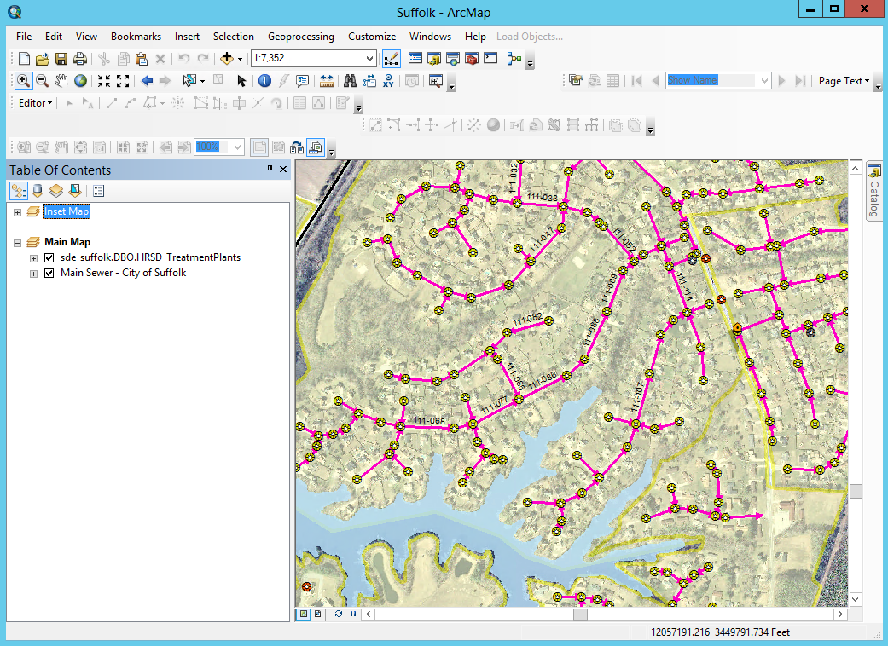
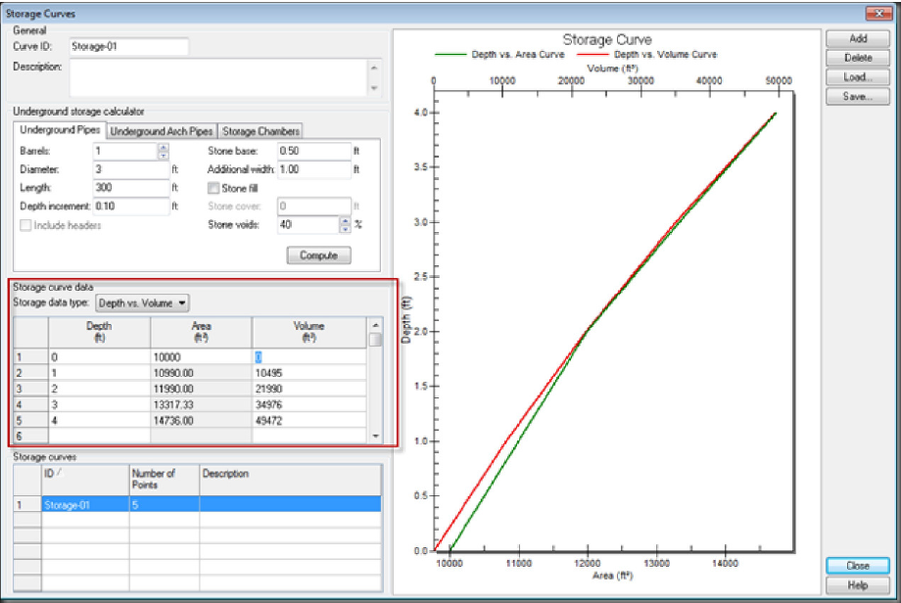
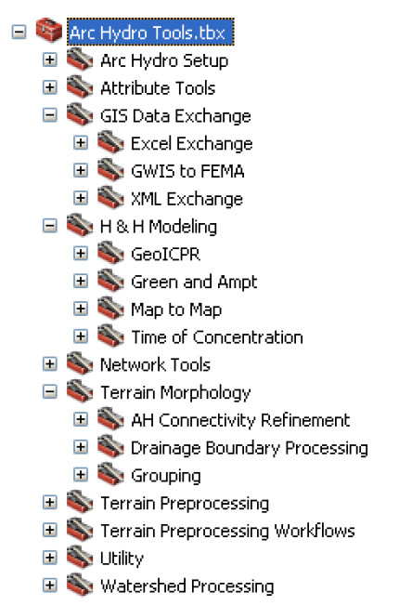
Anticipated results: what will be the outcome?
Map image credit: ESRI ArcGIS Online Resource Center: Delorme World Base Map
Notes:
Anticipated Results:
Take a customized tool with very limited GIS integration and create a GIS-centric toolset that can be used within ArcMap to:
Portable and standardized
Generate curves and map output
QA/QC data
View results
Ultimate goal is to make available to region or other organizations to use for stage-storage curve development (HR image)

Slide 14
QUESTIONS?
Notes:
Anticipated Results:
Development of a standardized toolset or package of tools that can be used by any utility organization to generate stage-storage volumes for their gravity systems
Make tool available for download or usage by utility organizations through ESRI or other means (local user group, etc…)
Documentation on the usage of the tool if provided for usage to other organizations

