Slide 1
Extensible and Usable Testing
for Geographic Information System Automation
GEOG 596A Capstone Proposal
Josie Holmes
Advisor: James O’Brien

Slide 2
Outline
Background
Goals and Objectives
Proposed Methodology
Project Timeline
Anticipated Results

Slide 3
Part I: Background

Slide 4
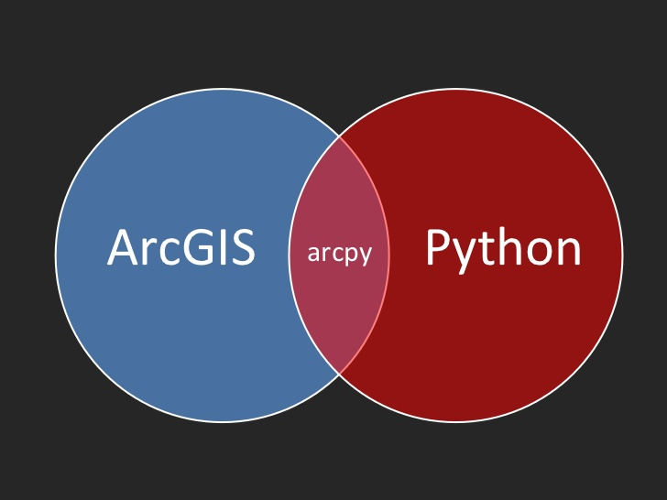
ArcPy
Released with ArcGIS 10
Allows scripting of ArcGIS functions in Python
Large, complex Python library
Over 50,000 lines of code in Python
Calls to the ArcGIS engine to perform tasks
Dozens of classes, hundreds of functions
ArcPy is latest in a long line of ways to script/automate ArcGIS

Slide 5
ArcPy
Simple example ArcPy code (from Esri)
Adds a field to streets feature class
Calculates the field
Loads into an enterprise geodatabase
import arcpy
arcpy.AddField_management("c:/data/Portland.gdb/streets", "LENGTH_MILES", "TEXT")
arcpy.CalculateField_management("c:/data/Portland.gdb/ streets", "LENGTH_MILES”,“shape.length@miles!", "PYTHON_9.3")
arcpy.FeatureClassToFeatureClass_conversion("c:/data/ Portland.gdb/streets", "Database Connections/MySDE.sde/ PortlandDataset", "streets”)
Notes:
Write Python code that causes the ArcGIS engine to perform some actions
Full-featured programming language (Python)
Can also add new tools inside the GUI

Slide 6
Part II: Goals and Objectives

Slide 7
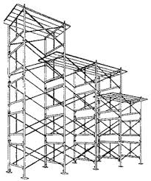
Goal: Automated Test Generation for ArcPy
Build a system to find faults in ArcPy
There are faults – we have all seen ArcGIS crash!
Usable testing: find ArcPy faults (and ArcGIS faults) without too much human effort or testing expertise
Extensible testing: build a system that is a starting framework for future efforts to better test ArcPy / ArcGIS
Notes:
Hard to debug ArcPy code when it just causes a crash
Want to make a system that is a starting place for making ArcPy, or libraries built on top of ArcPy, more reliable
Needs to be useable by GIS experts, not just experts in testing

Slide 8
Why Test ArcPy?
ArcPy/ArcGIS is too large to be bug-free
Systems of this size are never fault-free
Even Java libraries had many faults when tested
ArcPy limitations often not documented
Not a fault, exactly, but “you can’t do this!”
ArcPy is a way to make ArcGIS faults easy to find, reproduce, and report
Notes:
Systems of anywhere near this size testing in the research world found many faults, some critical
Some things are not faults, but are limits on what can be done in ArcPy that are not easy to discover
Can also make faults in ArcGIS engine easy to report, since they are just a sequence of ArcPy operations, no need to describe steps in using the GUI

Slide 9
Automated Test Generation
Doesn’t Esri test ArcPy/ArcGIS extensively?
So did developers of Java standard libraries
How to find faults that escape Esri’s testing?
Use cutting-edge research on software testing
Automated random generation of tests
Generate thousands (or millions) of lines of ArcPy code & run it, looking for failures
Method used to find flaws in Java libraries, NASA file systems, Linux, MacOS, and Windows, other critical software
Notes:
Esri already tests everything, we hope! but the systems (like Java) mentioned earlier were also very heavily tested and used
Research shows that traditional testing leaves lots of faults that can be detected by automatically, without human intervention, generating hundreds, thousands, or millions of tests
Calling random functions/using random inputs is now used at Google, Mozilla, Microsoft to find problems in very critical systems

Slide 10
Part III: Proposed Methodology

Slide 11
ArcPy
Generate random ArcPy code like:
﻿…
self.p_dist[0] = "2 Miles”
self.p_classorlayerlist[1] = []
self.p_fieldtype[1] ="SHORT”
arcpy.SelectLayerByLocation_management(self.p_newlayer[1], select_features=self.p_newlayer[0],overlap_type=
self.p_overlaptype[1],search_distance=self.p_dist[0],
selection_type=self.p_selectiontype[1])
arcpy.SelectLayerByLocation_management(self.p_newlayer[0],
select_features=self.p_newlayer[1],overlap_type=
self.p_overlaptype[0],search_distance=self.p_dist[0],
selection_type=self.p_selectiontype[1])
﻿arcpy.Statistics_analysis(self.p_featureclass[0],
self.p_stattable[0],self.p_statfields[1]); report()
self.p_shapefile[1] = arcpy.env.workspace + "\new3.shp”
…
Notes:
The testing tool this project is aiming to produce has as main goal the production of long sequences of ArcPy code, sequences that look like this
Tests in the real system are slightly cleaned up for readability
A test just assigns values to parameters used in calls, and makes calls to functions

Slide 12
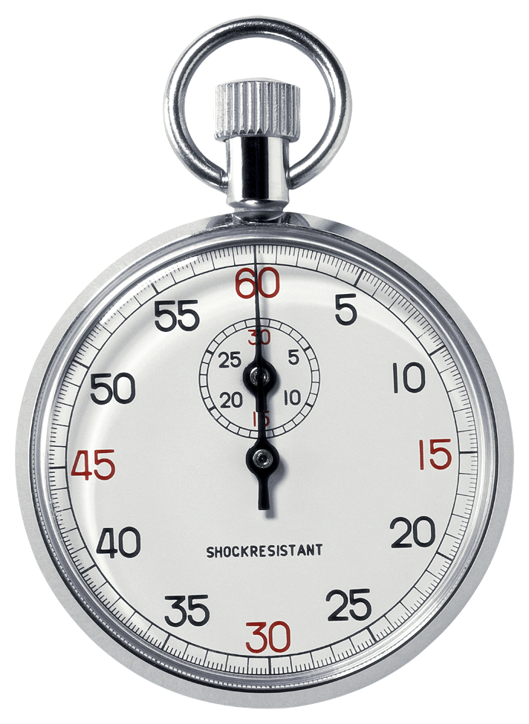
Generating Random ArcPy Programs
Could write a huge Python program just to generate random calls to ArcPy functions
Will take a very long time to do
Error-prone, hard to read
Hard for other people to build on
Makes it hard for anyone to change choices I make
Have to build many testing and debugging tools
Not usable, not extensible!
Notes:
Writing such a system by hand, without any tool to assist, would be very tedious
Changing it or adding to it would be a nightmare
Need some way to just say what we want to test, and then separate that from generating the tests, picking random values, and so forth

Slide 13
Generating Random ArcPy Programs
Solution:
Use an existing language for testing Python libraries, TSTL https://github.com/agroce/tstl
TSTL stands for Template Scripting Testing Language
TSTL defines what a valid test is
Then tools generate tests, provide debugging support, and so forth
Automatically shrinks tests to just relevant operations
Sophisticated control of random testing
Collaboration with Oregon State University testing research group
Notes:
There is a Python-based language that aims to do exactly that
Just define what can be in a test (what parameters are needed, what functions to call)
Let a generator tool produce the tests, make choices about how to choose random values, saving and replaying tests, getting rid of irrelevant parts of a test, etc.

Slide 14
Very Simple TSTL for ArcPy
﻿@import arcpy
@from arcpy import ExecuteError
pools:
<shapefile> 2
<out> 2
<amt> 2
<dist> 2
actions:
<shapefile> := arcpy.env.workspace + “\\file1.shp”
<shapefile> := arcpy.env.workspace + “\\file2.shp”
<out> := arcpy.env.workspace + “\\new1.shp”
<out> := arcpy.env.workspace + “\\new2.shp”
<amt> := <[1..50]>
<dist> := str(<amt>) + “ Feet”
<dist> := str(<amt>) + “ Meters”
{ExecuteError} arcpy.Buffer_analysis(<shapefile>,
<out>, <dist>)
Notes:
This is a very simple TSTL “harness” (what they call a definition of tests) for ArcPy
Only calls one function, producing a Buffer, and it is the simplest way to call Buffer, with no optional arguments
Pools are the values used in parameters. They can be re-used, to make tests easier to read and more likely to find problems
Buffer needs a feature class (here just a shapefile), a feature class to output to (here a shapefile again), and a distance for the buffer.
This lets the shapefiles be just fixed values, but allows the distance to be either in feet or meters, and between 1 and 50 in quantity
The curly braces on ExecuteError mean that if the buffer causes an error, that is allowed (for instance, if the file does not exist, or something)

Slide 15
How TSTL Works
TSTL code:
pools:
<int> 1
<list> 1
actions:
<int> := <[1..2]>
<list> := []
<list>.append(<int>)
properties:
len(<list>) <= 20
(,)
int0 = 1
int0 = 2
list0= []
(1,)
(2,)
(,[])
(,[])
int0 = 1
int0 = 2
(1,[])
(1,[])
(2,[])
list0.append(int0)
(1,[1])
Notes:
Using such a definition TSTL has tools to generate tests
It works by choosing randomly among actions that are currently allowed (need all the parameters to call a function), a kind of graph to explore
At the initial state, the pools don’t have any values, so any actions that need a value from a pool are not allowed (we can’t append, in the ArcPy example, we can’t do a Buffer yet)
Initially just set the int to either 1 or 2, or the list to an empty list
After setting the list to empty AND setting the int to some value, then it is possible to append
Changing the numbers after pools to higher than 1 means there can be more than 1 int or list TSTL “keeps track of” at one time

Slide 16
Building tstl.arcpy
Choose set of ArcPy functions
For each function, identify all the possible parameters (most of these include optional parameters)
Add the function call as an action
Add actions to build up all the input parameters needed to call it
Most parameters will need a pool
There will be multiple versions for some functions, due to different ways to call them
Notes:
Start by choosing what to test
Work backwards, to determine how to build up parameters needed to call that function

Slide 17
Building tstl.arcpy
First choose an ArcPy function to call, and determine parameters it needs:
For this example, will need pools for classorlayerlist, featureclass, joinattributes, and dist, which may also need other pools
For example:
{ExecuteError} arcpy.Intersect_analysis(<classorlayerlist>,
<featureclass>, join_attributes=<joinattributes>,
cluster_tolerance=<dist>);
<classorlayerlist> := []
<classorlayerlist>.append(<classorlayer>)
<classorlayer> := <featureclass>
<classorlayer> := <newlayer>
Notes:
If we pick intersect, we need several parameters to call it
Some of these are quite complex to make available!

Slide 18
Building tstl.arcpy
To choose a feature class, needs more work, just for shapefiles:
<featureclass> := <shapefile>
len(<gdbfeatureclasslist,1>) >= 1 -> <featureclass> :=
<gdbfeatureclasslist>[0]
<shapefilelist> := sorted(glob.glob(arcpy.env.workspace +
"\\*.shp"))
len(<shapefilelist,1>) >= 1 -> <shapefile> :=
<shapefilelist> [0]
<shapefilelist> = <shapefilelist> [1:]
<shapefile> := arcpy.env.workspace + "\\new1.shp"
<shapefile> := arcpy.env.workspace + "\\new2.shp"
<shapefile> := arcpy.env.workspace + "\\new3.shp"
Notes:
Let the system pick a shapefile from ones that are in a special working temporary directory for each test

Slide 19
Building tstl.arcpy
Some complex parameters are used in many different functions, for example SQL queries:
<whereclause> := '"' + <fieldname> + '" ' + <op> +
str(<val>)
<whereclause> := <whereclause> + ' AND ' + <whereclause>
<whereclause> := <whereclause> + ' OR ' + <whereclause>
<whereclause> := 'NOT' + <whereclause>
…
{IOError,exceptions.RuntimeError} <searchcursor> :=
arcpy.SearchCursor(<featureclass>,<whereclause>);
<hascursor>[<featureclass,1>] = True
…
{ExecuteError} arcpy.MakeFeatureLayer_management
(<featureclass>,<newlayer>,where_clause=<whereclause>);
report
Notes:
SQL queries have a recursive structure – in theory no limit to size of the query, but random ensures most are small

Slide 20
Approach
Don’t try to handle all of ArcPy at once!
Start with a few operations that are known to cause problems
Projections cause crashes in ArcMap sometimes (problem in some past classes at Penn State)
Advisor reported issues with using selections in code, I had noticed some odd behavior with it
Past experiences with problems using cursors in complex ways
Build from there, make sure to produce good parameters to test those functions well
Notes:
Pick a few functions, start small, with things I thought might cause some crashes in ArcPy

Slide 21
Challenges
TSTL had only been used for small libraries, simple examples
TSTL was built for computer scientists, not GIS developers
TSTL tools not built for programs that crash Python itself (ArcPy does this constantly)
Notes:
TSTL was not built for systems as big and complex as ArcPy
Only used on small examples, small parts of those examples, before
Only used by a few researchers in software testing
Not built to handle anything that actually causes Python itself to crash, did not even have a way to record how the crash was caused

Slide 22
Key Tasks
Make TSTL language more readable
Modify TSTL tools to handle crashing programs and work on Windows
Make debugging and understanding complicated test cases easier
Choose which functions and make definitions for testing many ArcPy functions
Notes:
I worked with OSU to fix all these defects in TSTL, in most cases coding the changes myself, in a few conveying the problem to the TSTL developers, and working with them
In the process, some new ideas in software testing research came about
And we were able to really test the new features of TSTL, since they were important for figuring out complex ArcPy crashes

Slide 23
Part IV: Timeline

Slide 24
Milestones/Schedule
Task | Date
Run ArcPy inside TSTL harness | September 4, 2015 (COMPLETE)
Check in initial arcpy.tstl version | September 8, 2015 (COMPLETE)
Working version of fresh object generalization | September 28, 2015 (COMPLETE)
Submit IEEE ICST paper “One Test Case to Rule them All” | October 24, 2015 (COMPLETE)
Check in stable arcpy.tstl, focus on language upgrades | October 26, 2015 (COMPLETE)
Submit Software Quality Journal paper “Extensible and Usable Testing for Geographic Information System Automation” | October 29, 2015 (COMPLETE)
Submit 596A writeup, schedule to adviser | December 12, 2015 (COMPLETE)
Presentation | December 22, 2015 (In Progress)
Implementation of known-fault avoidance | January 30, 2016
New arcpy.tstl with many more API calls | February 28, 2016
Major releases of arcpy.tstl, supporting tools | Monthly in 2016
Notes:
There is a release of the ArcPy code and the modified version of TSTL with support for all the features needed for this, now
Also submitted a conference paper based on ideas that came up during ArcPy testing, part of the technical work is part of my project, ArcPy is the major case study in the paper
And a journal paper to a special issue on test automation, that is just describing this work, and the idea of bringing automated testing to more users than just a few computer scientists
I plan to keep adding features, finding new problems, and releasing incremental versions in the new year and as 596B takes place
Probably support this beyond the end of 596B

Slide 25
Part IV: Anticipated (and Attained) Results

Slide 26
Current arcpy.tstl
Available with TSTL release on github
arcpy.tstl
Has 46 different types of pools to support parameters
Supports 37 different ArcPy function calls, many with complex parameters
Compiles to 59,599 lines of Python code
1,983 possible actions
1,378 ArcPy function calls in actions
Lets users choose data on which testing is based, tester automatically detects it and uses it
Handles locking problems, making a fresh workspace to guarantee independent tests
Notes:
As noted, TSTL and the arcpy testing tools are available on github
TSTL code is compact but very capable
The TSTL code, run through the compiler, turns into a huge Python file, that actually provides the testing
The system is set up so if you want to find ways ArcGIS can cause problems with custom data of your own, that is easy
I just used some simple basic Esri United States shapefiles, and census data, so far

Slide 27
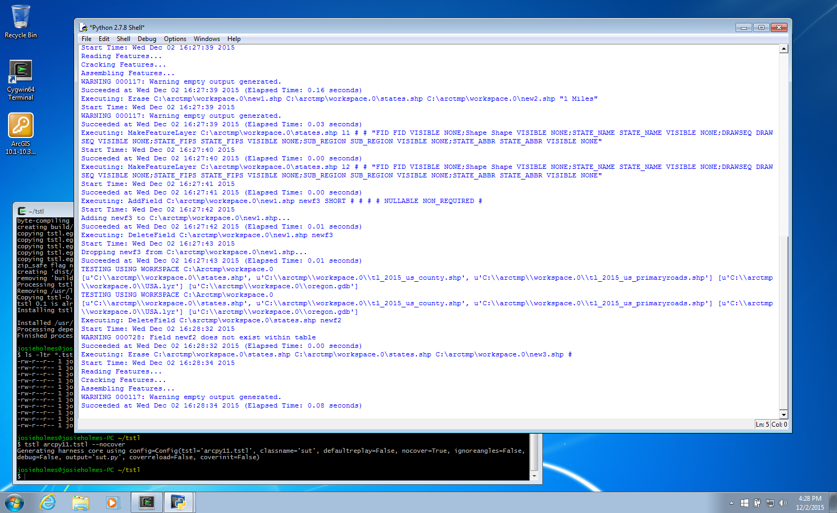
Notes:
Screen shot of TSTL in action. Not very exciting! Just compile it in a terminal window (I used cygwin to run Python at the command line)
Then load into IDLE Python that comes with ArcGIS and run the random test generator. It gives feedback on what it is doing, writes tests to the current directory

Slide 28
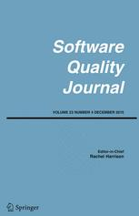
New TSTL Features
Ability to produce complete standalone test case that does not need TSTL
Just Python that shows how a fault is produced
Ability to handle crashing programs (run tests in a separate Python process)
Changes to the language (easier to read, better ways to group parts of file together)
Submitted paper to Software Quality Journal on these extensions, the whole testing effort

Slide 29
New TSTL Features
ArcPy used the main case study in an academic paper on normalizing and generalizing test cases
Even after getting rid of irrelevant parts, test cases still long and complex to read
Normalizing further simplifies, makes tests consistent
Generalizing explains what could be different while keeping test case failing
I invented and developed one of the generalization methods while testing ArcPy (substitute a new object)
Paper submitted to IEEE International Conference on Software Testing

Slide 30
Faults Discovered
First crashing fault:
Make a layer from a feature class
Delete the feature class
Use SelectLayer (on attributes or location)
ArcPy crashes
Not documented that layers are just views, and ArcPy/ArcGIS fails to invalidate them if feature class goes away
Notes:
I found several problems such that what seems to be reasonable ArcPy code causes the system to crash.
Some are probably more “undocumented restrictions” than faults, but all seem important to note, and show that the system can find obscure behavior of ArcPy well!

Slide 31
Faults Discovered
Three more distinct faults:
Computing statistics over a deleted field when using layer on feature class causes ArcPy to crash
Creating insert cursor before or after adding a field to the feature class, then adding second field, creating second insert cursor, causes crash
Advancing search cursor on a layer, adding field to the feature class twice, causes a crash

Slide 32
Faults Discovered
shapefilelist0 = sorted(glob.glob(arcpy.env.workspace + "\*.shp")) # step 0
shapefile0 = shapefilelist0 [0] # step 1
featureclass0 = shapefile0 # step 2
#[
classorlayer0 = featureclass0 # step 3
fieldtype0 = "DOUBLE” # step 4
# or fieldtype0 = "TEXT” or “FLOAT” or “SHORT” or “LONG” or “DATE”
^{# swaps with step 6}
fieldname0 = "newf1” # step 5
^{# or fieldname0 = "newf3"}
^{# swaps with steps 6 and 8}
#] (steps in [] can be in any order)
#[
insertcursor0 = arcpy.InsertCursor(classorlayer0) #step 6
^{# swaps with steps 4 and 5}
arcpy.AddField_management(featureclass0,fieldname0,fieldtype0); report() #step 7
#] (steps in [] can be in any order)
fieldname0 = "newf2” # step 8
^{# or fieldname0 = "newf3"}
^{# swaps with step 5}
arcpy.AddField_management(featureclass0,fieldname0,fieldtype0); report() # step 9
insertcursor0 = arcpy.InsertCursor(classorlayer0) # step 10
Before reduction and normalization, test had hundreds of steps!

Slide 33
Future Work
Find more faults
Add more ArcPy functionality to arcpy.tstl
Check for problems beyond crashes
Compare different versions, different file types
Implement method to avoid known faults
Right now, I modify arcpy.tstl to not perform the actions causing a crash
Makes it hard to maintain, confusing, not test things it should
Better to just avoid things already discovered, without removing them from testing
Further improve TSTL language, tools to make testing ArcPy easier

