Slide 1
Guiding Land Preservation Through Value Based Proximity Analysis
Ron L. Holmes, GISP
MGIS Graduate Student – Penn State Univ.
GIS Coordinator - County of New Castle DE

Slide 2
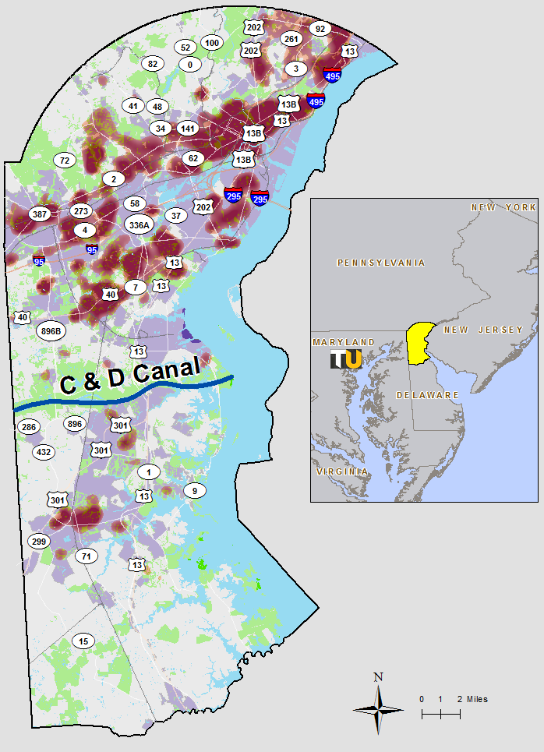
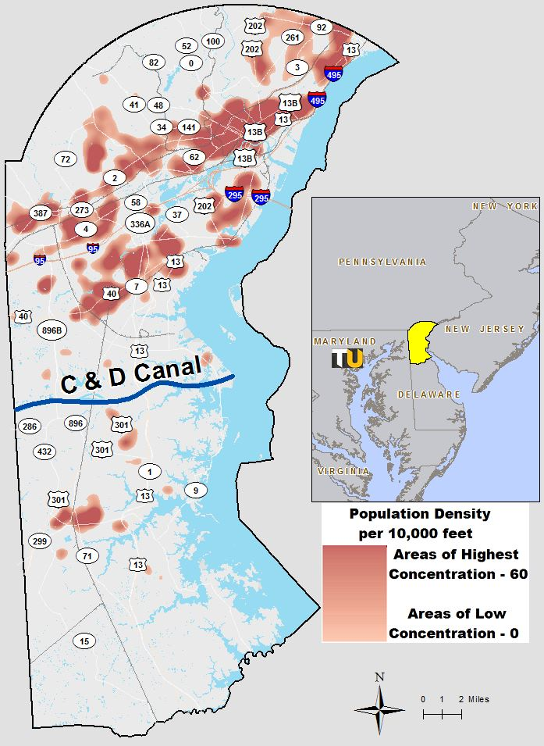
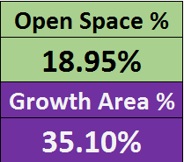
New Castle County initiatives
2020 State Strategies / NCC UDC update.
Growth Boundaries being explored
Encouraging citizen engagement through technology and education.
GreeNCC- Environmental impact
Educating the public on environmentally
Green practices
Population densities looking to regions south of Chesapeake & Delaware Canal.
New Castle County:
Addressing population
Density while preserving
Non-developed areas

Slide 3
Acknowledging population growth
Census trends:
no decrease in growth rate since 1810
2016 to 2017:
.35% growth
Estimated 2027
population 720,000
Growth Rate >
< Trendline
http://worldpopulationreview.com/us-counties/de/new-castle-county-population/

Slide 4
Background, concerns, & efforts
Population growth has raised awareness to concerns of our current process being reactionary versus proactive in planning.
GreeNCC Program (implemented 2019)
Sewer & Stormwater Management
Open Space Turnover
Land Preservation
Introduction of automation into the plan review process for developer feedback.
New Castle County:
Population density

Slide 5
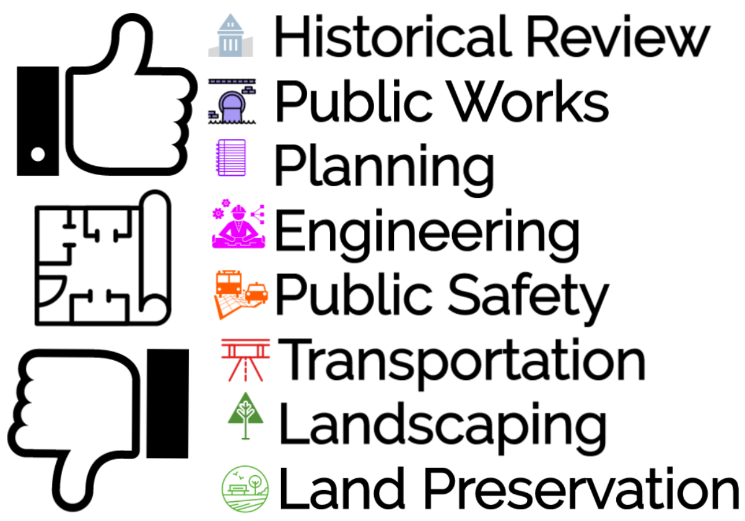
Modernizing the plan review process
Dept of Land Use staff
collaborate through
a web-based program
"ProjectDox" helping
communication with
developers and staff.
This new tool adds
GIS analysis into the
plan review process
for Land Preservation

Slide 6
Identifying capstone objectives
Introducing land preservation strategies with the intent to improve quality of life for residents in New Castle County.
Development pressure threatens land preservation, pocketed planning areas (near environmental areas) will be protected.
Slow the expansion of poorly planned residential neighborhoods.
GIS analysis-based evaluation process offers consistency, documentation, and reproducibility. If strategic, is tenable.

Slide 7
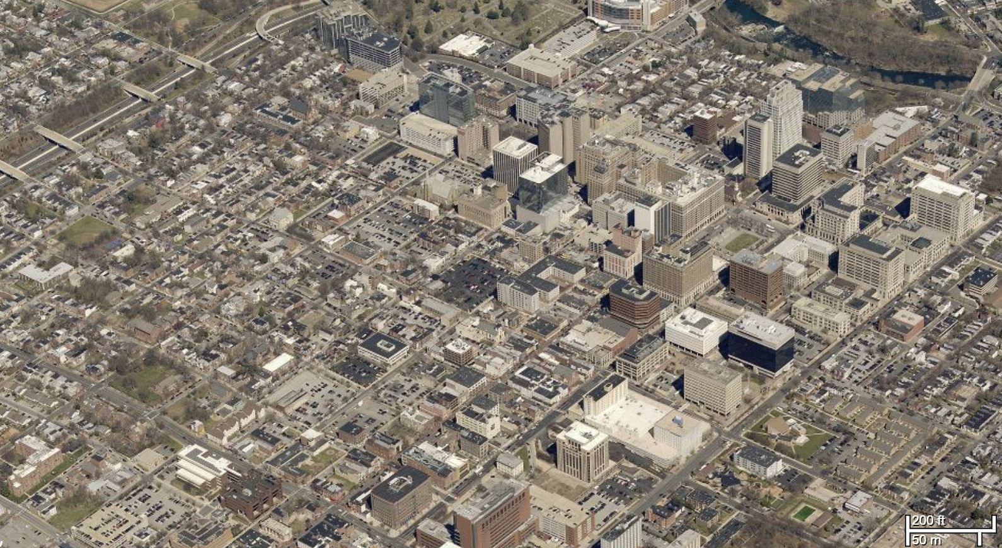
Land preservation approach
Prioritizing proper planning by developing a green map
Parks, Nature Areas, Sport Complexes, Plazas
Repurposing abandoned railbeds to bike trails creates neighborhood connectivity to retail and parks
Improves quality of life
Reduces stress from densification
Feeds the local economy
Skyward development - less sprawl

Slide 8
GIS analysis
Development plans to be assessed with respect to proximity to undeveloped land (farmland, forests, and open space) and statistics are tabulated respective to sewer access and property sale trends.
Proximity scores are translated into recordation fees
Assigns land valuations considered during the proposal approval stage.
Through the assessment of criteria and the determined valuation in the land review process, long-range planning, assessment, and the management of existing and proposed open space can develop. ^{[3]}

Slide 9
Geoprocessing concepts
Using buffered analysis determines proximity.
As each dataset is assessed for relationship to an associated buffer region, fields are added and populated with appropriate score.
As process is complete, scores are summed into final attribute column and can fluctuate based on buffer range and number of datasets assessed.
Entire manual process was recreated in Model Builder for review of “Land-Preservation” components during plan review.

Slide 10
Dataset attributes
New Castle County Datasets:
Parcel Features
ownership, parcel id, & property class
Sewer customers
database with parcel id & address
Agricultural Land
assessment records by parcel id
Parks & Open Space
name, acreage, & status

Slide 11
Data sources
New Castle County Department of Land Use- GIS Services.
Identifying PERTINENT data holistically includes environmental data types: agricultural lands, open space, parks, state lands.
Land based data includes parcels, centerlines, & sewer assets.
Property sale values recorded in the New Castle County computer assisted mass-appraisal system (CAMA) provide dollar amounts.

Slide 12
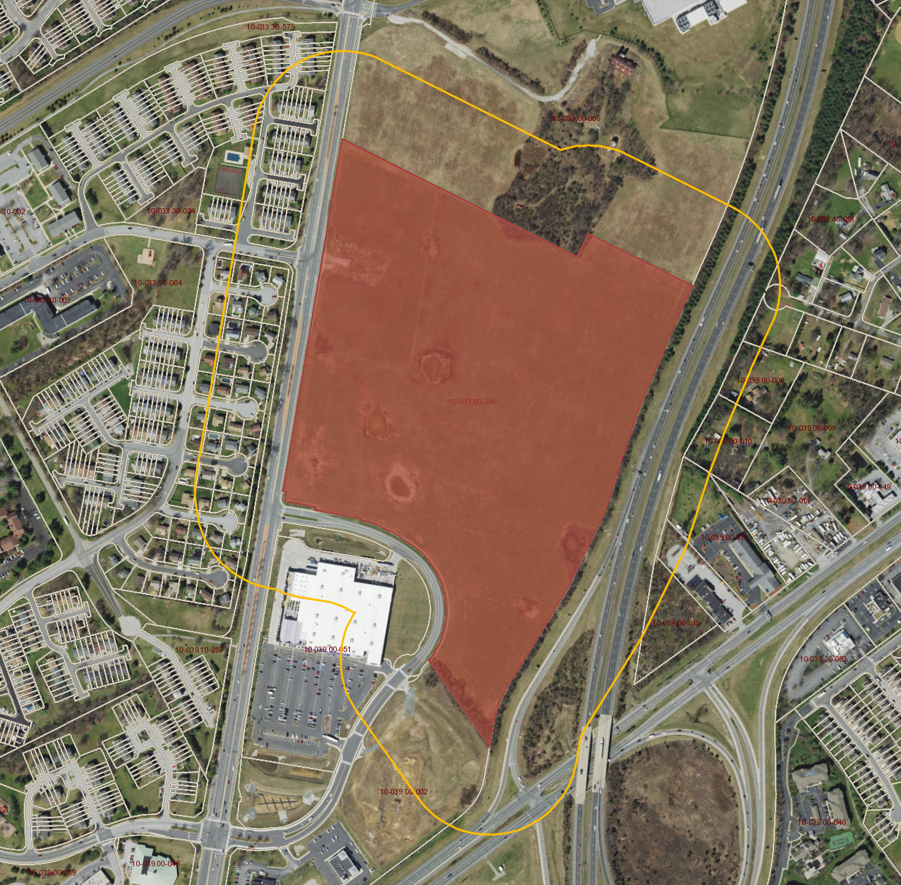
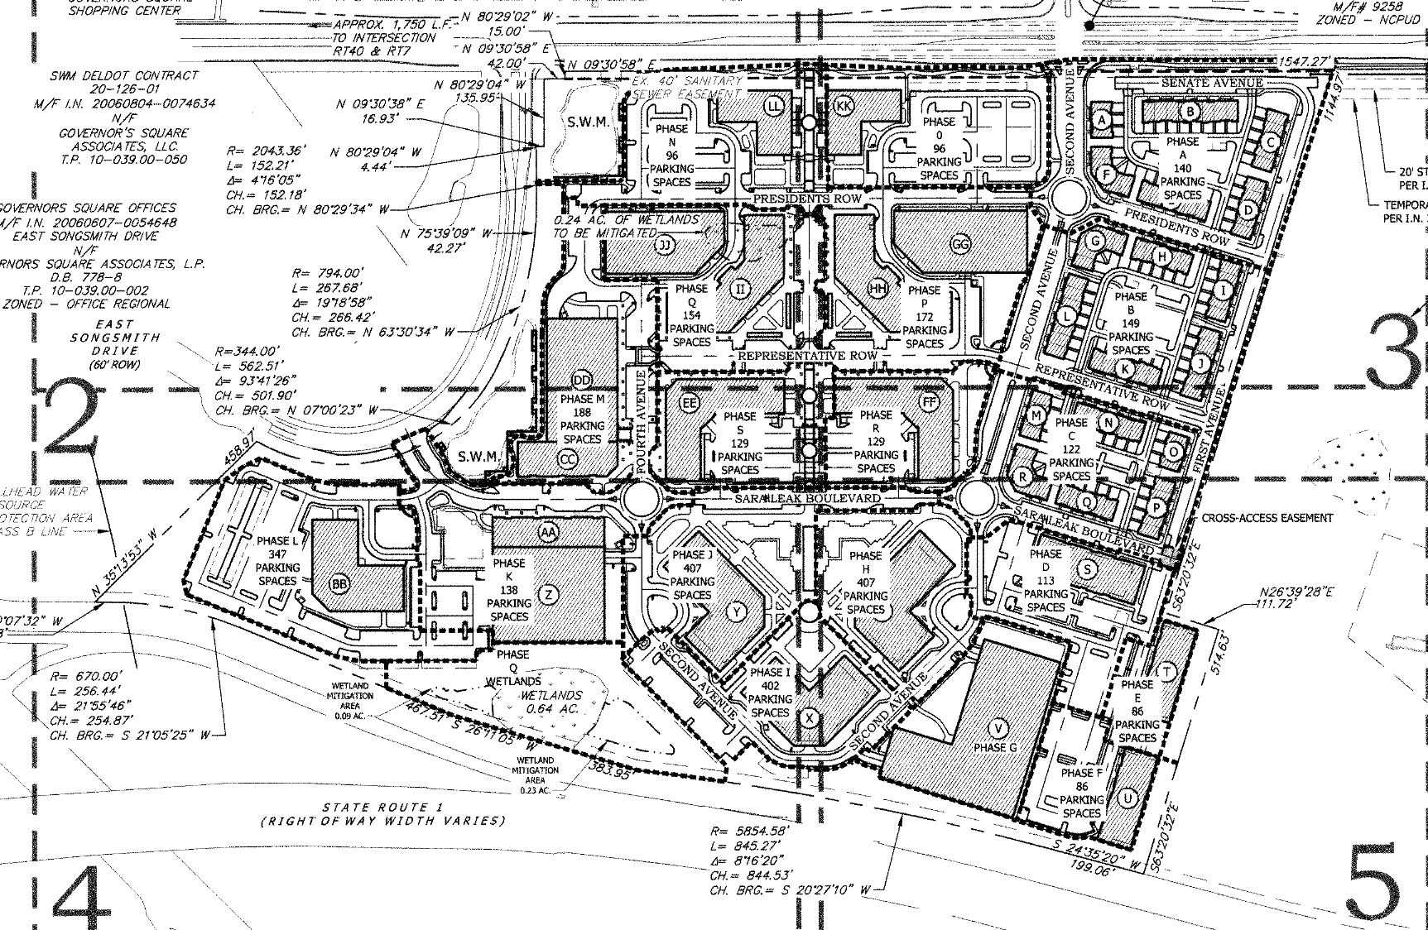
Georeferencing development plans
56 acre shopping center
Approved plan since 2013, no ground broken
Nearby cemetery

Slide 13
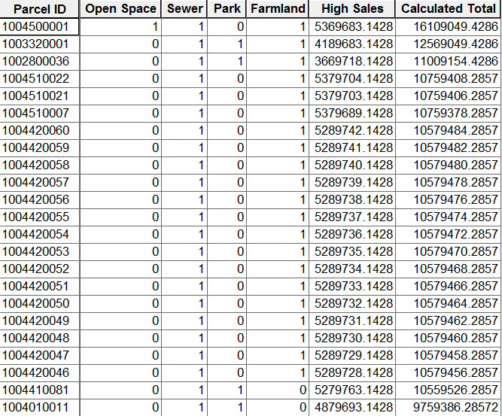
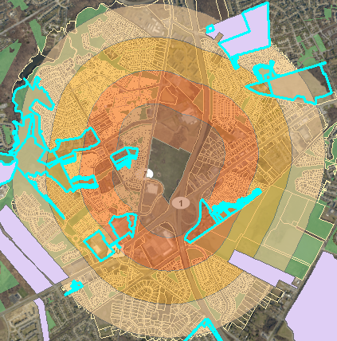
Concept: buffering statistics

Slide 14
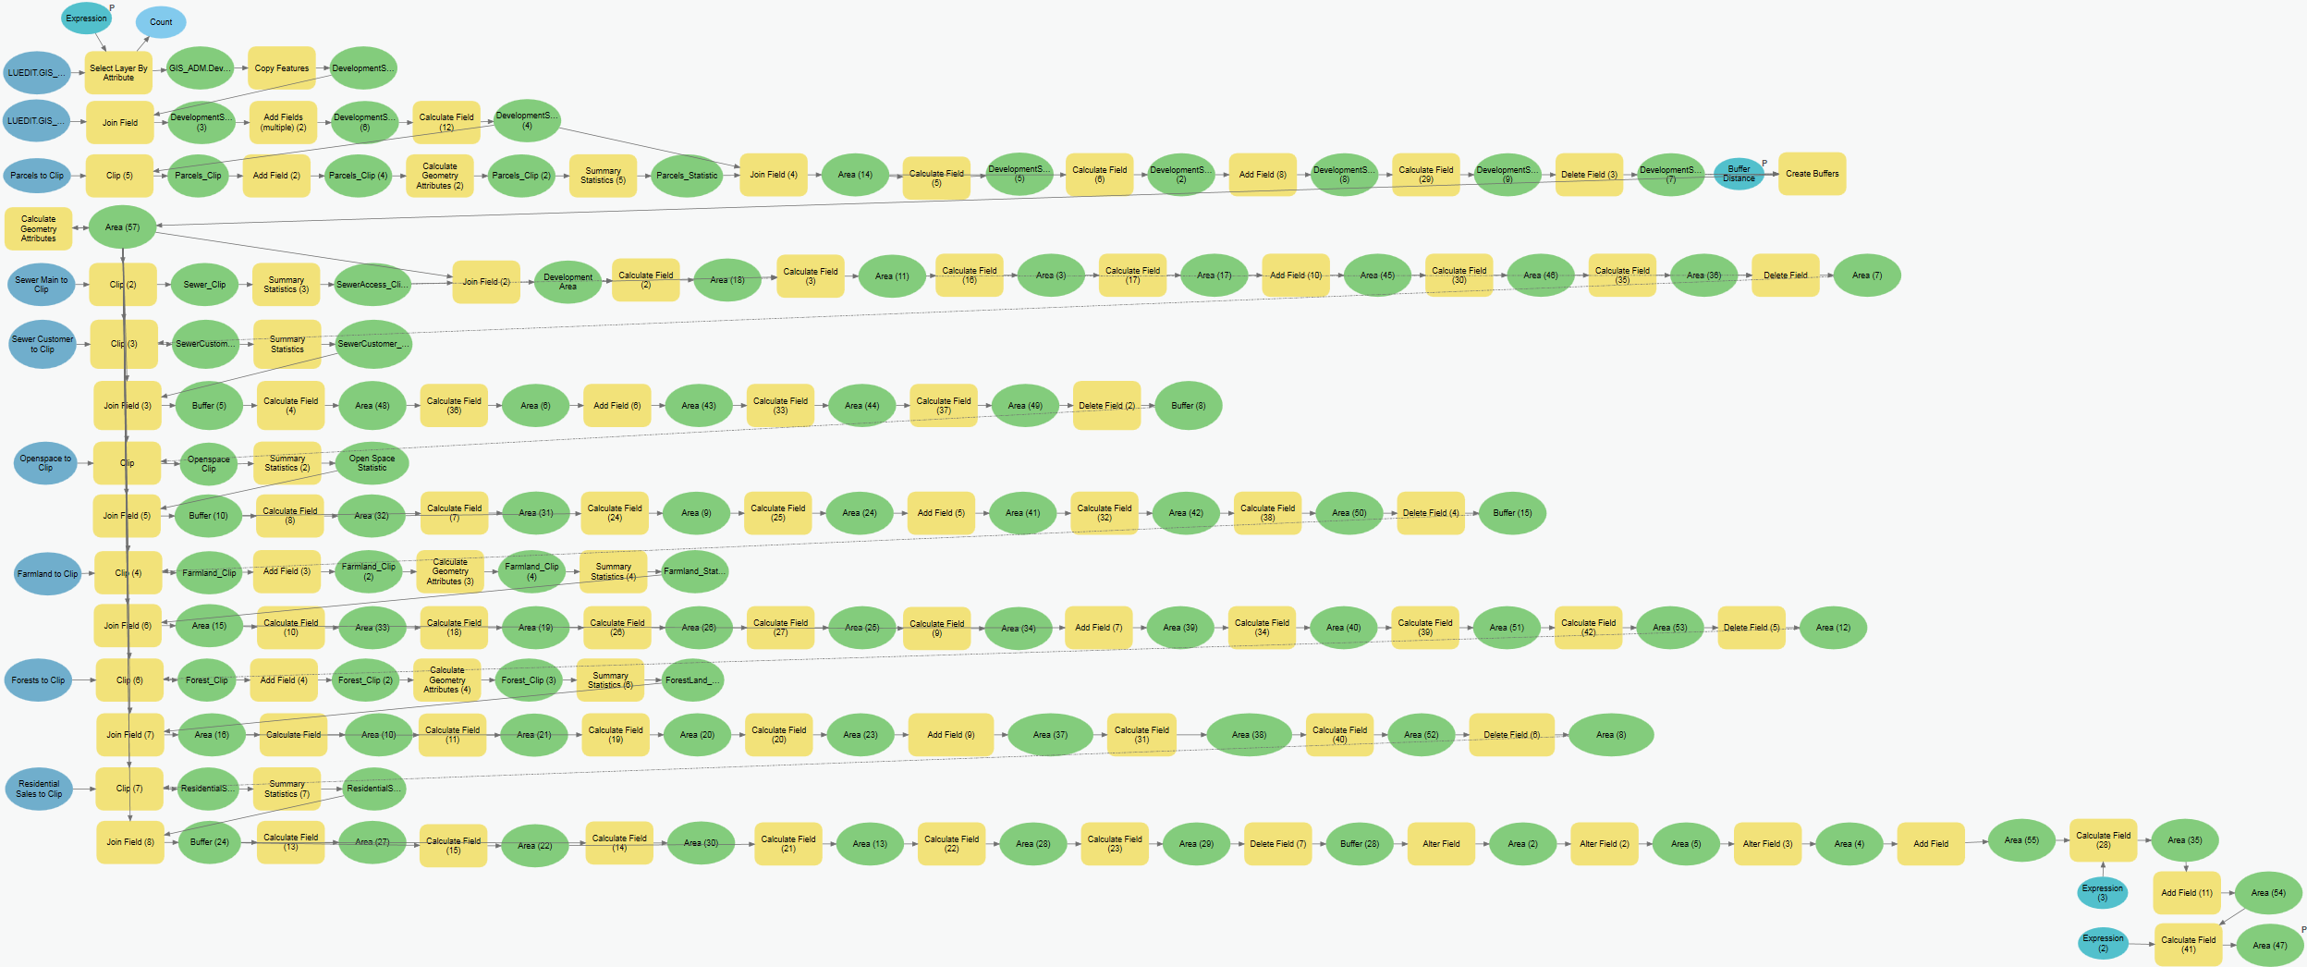
Developing the model for user input

Slide 15
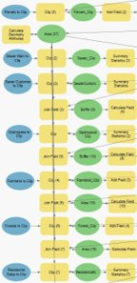
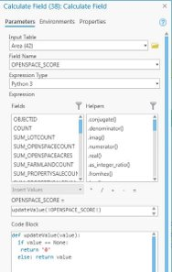
Model functionality
Stage 1 User input
Provide dev. app. Number as form of sql query, add necessary fields, then clip parcels
Stage 3 Summary statistics calculate acreage, frequency, maximum values on all inputs
Stage 5
Python expression uses arithmetic to calculate preserv. Score and value est.
Stage 2
clip input:
sewer lines
customers res. sales
& land types
Stage 4
null values calc’d to ∅ for score totals with if/then

Slide 16
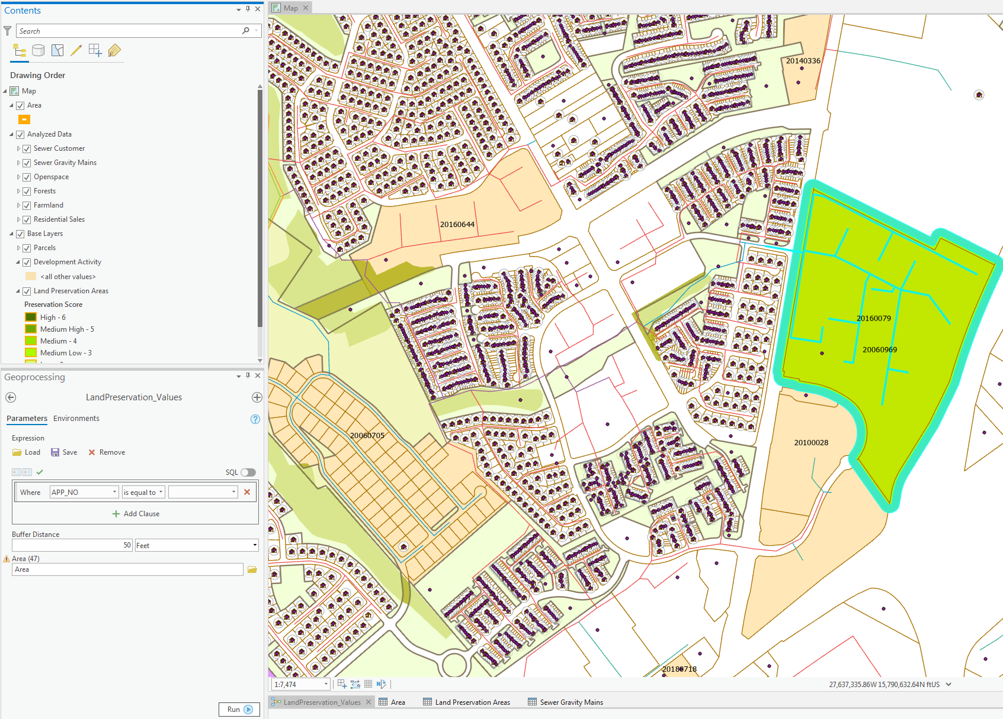
Working in ArcPro
Calculate Fields-
VB expressions not supported
Intermediate / Managed
data removed
No customization of tools appearance
Lists and series must be in the form of iterators

Slide 17
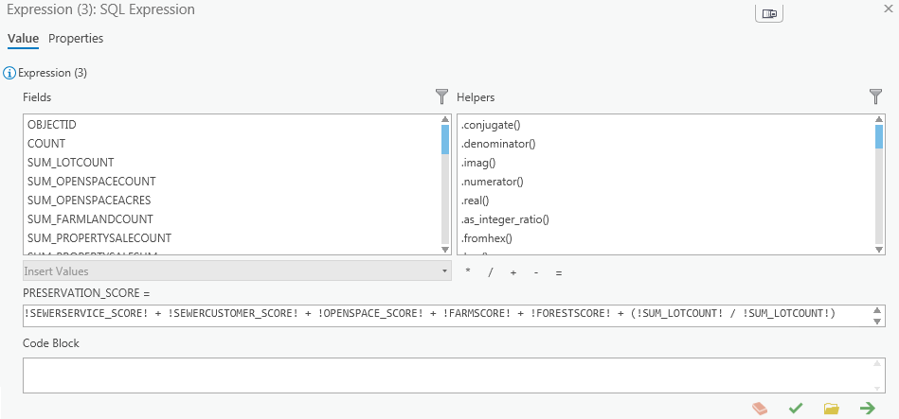
Scoring priority with technology
!SEWERSERVICE_SCORE! + !SEWERCUSTOMER_SCORE! + !OPENSPACE_SCORE! + !FARMSCORE! + !FORESTSCORE! + (!SUM_LOTCOUNT! / !SUM_LOTCOUNT!)

Slide 18
Calculating value from score
(30 + (!SUM_FARMLAND_ACRES! / !SUM_TOTALACRES!))
+
(20 + (!SUM_FORESTLOTACRES! / !SUM_TOTALACRES!))
+
(50 + (!SUM_OPENSPACEACRES! / !SUM_TOTALACRES!))
+
(!SUM_PROPERTYSALESUM! / !SUM_PROPERTYSALECOUNT!)
+
(!SUM_SEWERLENGTH! / !SUM_SEWERCUSTOMERCOUNT!)

Slide 19
Anticipated results
Agricultural land and open space calculated acreage will slow in pace of consumption.
Pocketed Planning will begin to develop- prioritizing an even distribution of land use, preservation of non-developed areas, & strengthens infrastructure.
Commercial development will congregate in centralized areas.
Sewer infrastructure planning will guide expansion below C&D Canal for growing housing demand.

Slide 20
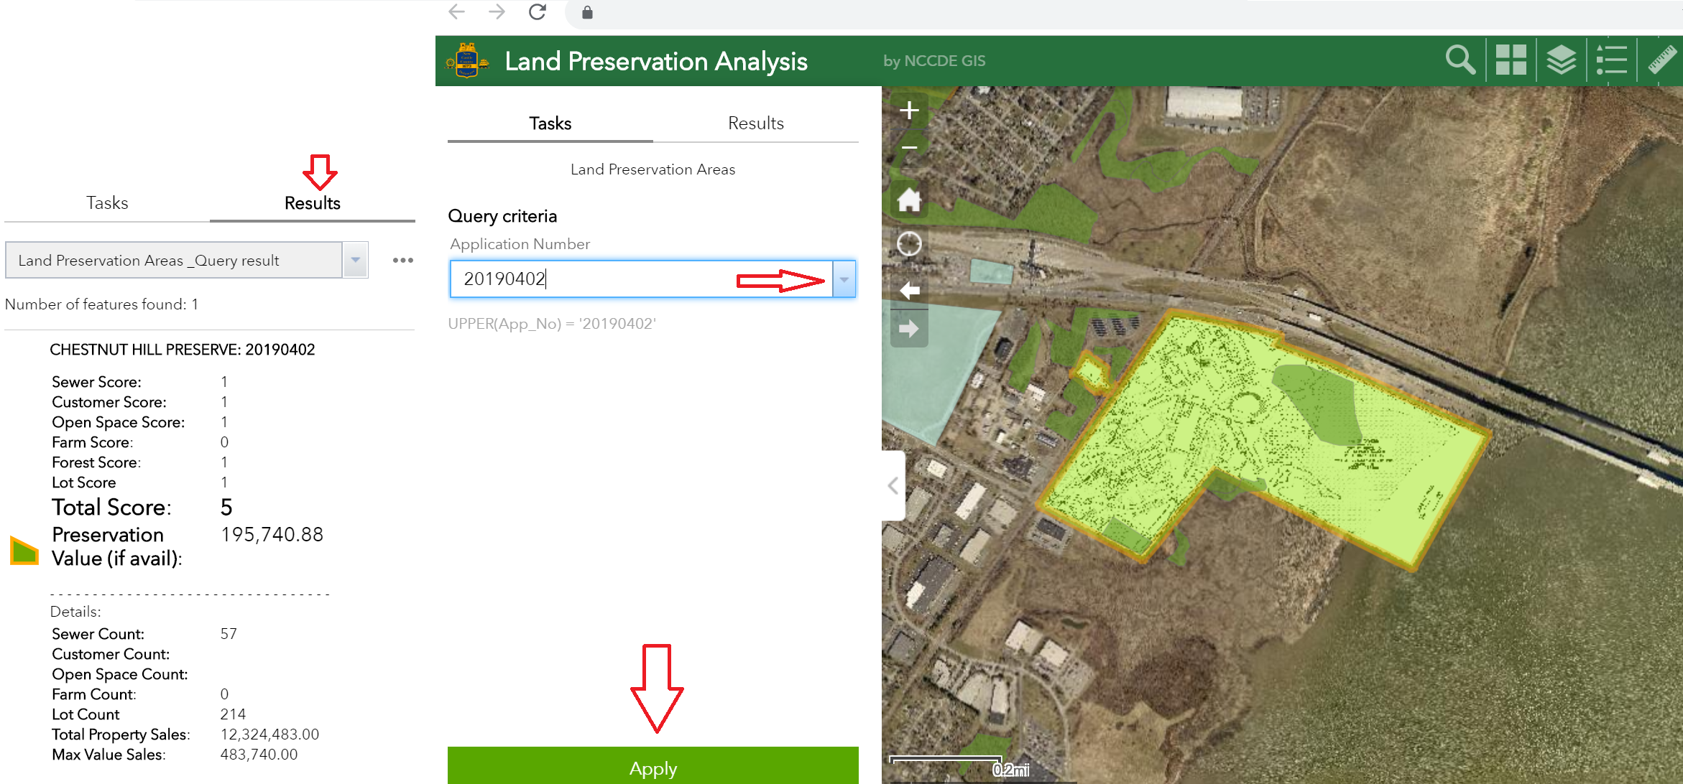
End product: Map application
3
1
2

Slide 21
Inspiration
Mincozzi, Joseph (2019) Mapping Dollar and Sense of Land Use. Location: Esri Geodesign Conference. Retrieved from: https://youtu.be/uQ25P8gB4d4
Ståhle, Alexander (2006) Sociotope mapping- exploring public open space and its multiple use values in urban and landscape planning practice. Location: Nordic Journal of Architectural Research Volume 19.
Vajjhala, Shalini P (2005) Integrating GIS and participatory mapping in community development planning. Paper for the Esri Int. Conf. Retrieved from: http://proceedings.esri.com/library/userconf/proc05/papers/pap1622.pdf
Willet, Kendis (2000) An interactive GIS approach in open space planning using a multiple criteria ranking system. Location: Winnona, Minnesota. Retrieved from: http://www.gis.smumn.edu/GradProjects/WilletK.pdf

Slide 22
Thank you – Any questions?

