Slide 1
An Analysis of Greenspace, Zoning, and Crime
Jacob Horwitz
Spring 2020
Advisor: Beth King

Slide 2
Outline
Introduction
Background
Problem Statement
Methodology
Analysis
Predicted Results
Timeline
References
Questions

Slide 3
Introduction
I wanted to do some research with crime data.
Interested in understanding how zoning and greenspace are related to crime.
Lack of systematic agreement on how greenspace influences crime.
Some articles found an increase while some found a decrease in crime within areas with greenspace.
I want to compare Houston and Chicago.
Chicago has zoning laws but Houston does not.

Slide 4
Background
Greenspaces are undeveloped and open to the public.
Research on greenspace and crime is limited.
A 2019 study revealed a lack of mutual agreement on a grounded theory (Shepley, 2019).
Within 10 studies focusing on greenspace parks and crime:
Three studies showed a decrease.
Two studies were inconclusive.
Three studies show a rise.

Slide 5
Background (cont’d)
Zoning laws are used to regulate and decide the development of property.
Zoning laws likely have an effect on crime.
Crime occurred in commercially zoned areas than residential zoned areas (Anderson, 2013).
Houston is the only major U. S. city without zoning laws.
Houston has three types of efforts for handling land use: large-scale initiatives, planning tools, and a development code.

Slide 6
Research Questions
What spatial patterns in greenspaces do zoning practices in Houston and Chicago create? Do crimes in Houston and Chicago cluster differently due to zoning differences? Does violent crime tend to cluster in and around greenspaces in Houston and Chicago?

Slide 7
Beneficial Outcomes
The World Health Organization (Urban green spaces, n.d.) lists benefits from greenspaces that include:
Safer walking and cycling routes.
Cooling cities.
Lowering the risk of poor physical and mental health.
Students and researchers can use the data to better analyze the benefits of greenspace to help reduce crime.
City planners can use this to establish more greenspace if it is determined there is a decrease in crime.

Slide 8
Methodology
Data and Technology
Data Manipulation
Data Analysis

Slide 9
Data and Technology
Data
Technology
Houston, Texas
Crime data
Neighborhood data
Census data
GIS data for greenspaces
Chicago, Illinois
Crime data
Neighborhood data
Census data
GIS data for greenspaces
Zones
ArcGIS Pro
Used to maintain data
Can be used to update or manipulate data
Can use geoprocessing tools to obtain results from the data

Slide 10
Variables
Crime
Murder/Homicide
Zone Characteristics
Residential
Commercial
Public
Industrial
Mixed
Assault
Robbery
Rape
Greenspace
Parks
Community Gardens
Vegetated Streets/Walkways
Trees and Ground Cover

Slide 11
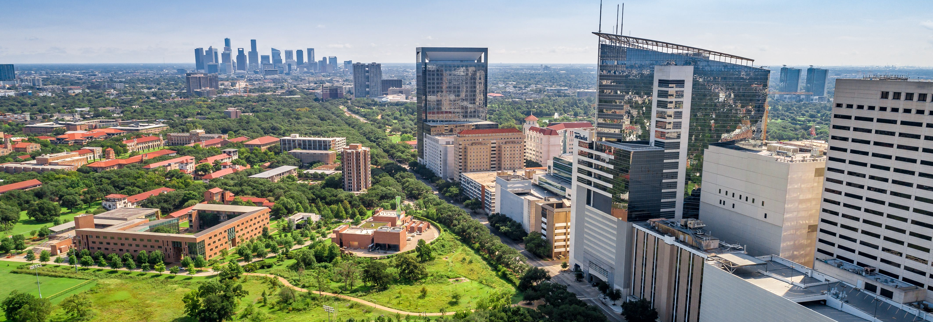
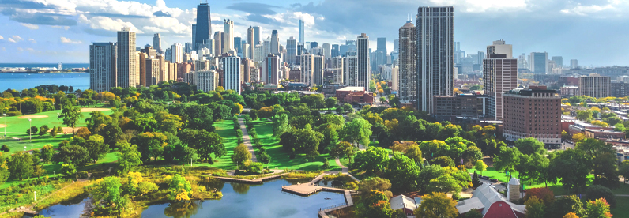
Location of Study: Chicago and Houston
Reason for Area of Study
Both cities have a population of over 2 million people.
Chicago has zoning laws.
Houston does not have zoning laws.
Houston uses a set of initiatives, planning tools, and development codes.
MGIS alumnus Larry Nierth works for the City of Houston.
Houston, Texas
Chicago, Illinois

Slide 12
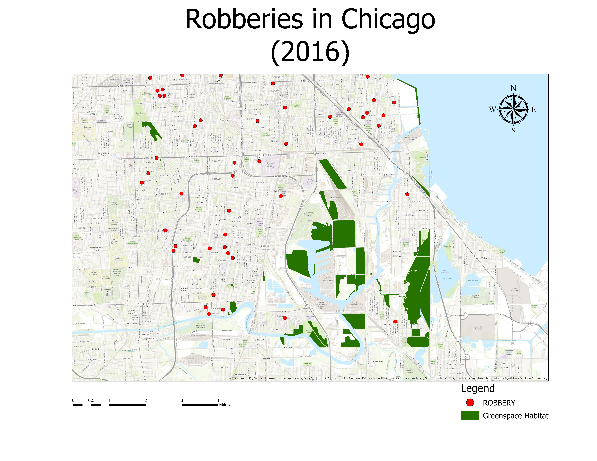
Data Manipulation
Update GIS data based on census, crime, and greenspace data.
Aggregate data by each area.
Calculate aggregated data.
Total area of greenspace.
Total area of designated zone.
Total amount of crime.
Produce descriptive statistics of greenspace by crime type.

Slide 13
Data Analysis
Create maps showing the greenspaces in each city.
Create maps showing the distribution of crimes overlain on top of the greenspaces.
Compute descriptive statistics (mean center, standard distance, etc.) of the crimes and overlay these on top of the greenspaces to see where the crimes are centered and distributed.
Create a density surface of the crimes (both overall crimes and by type) which will show where overall crimes and specific crime types are distributed according to the greenspaces. Overlay the density surfaces on top of the greenspaces maps for each city. This will help find zones containing significance between greenspace and crime.
Create the LISA cluster and significance maps for each city.
Create the LISA significance maps which will help to demonstrate the location of the clusters is statistically significant and not by chance.

Slide 14
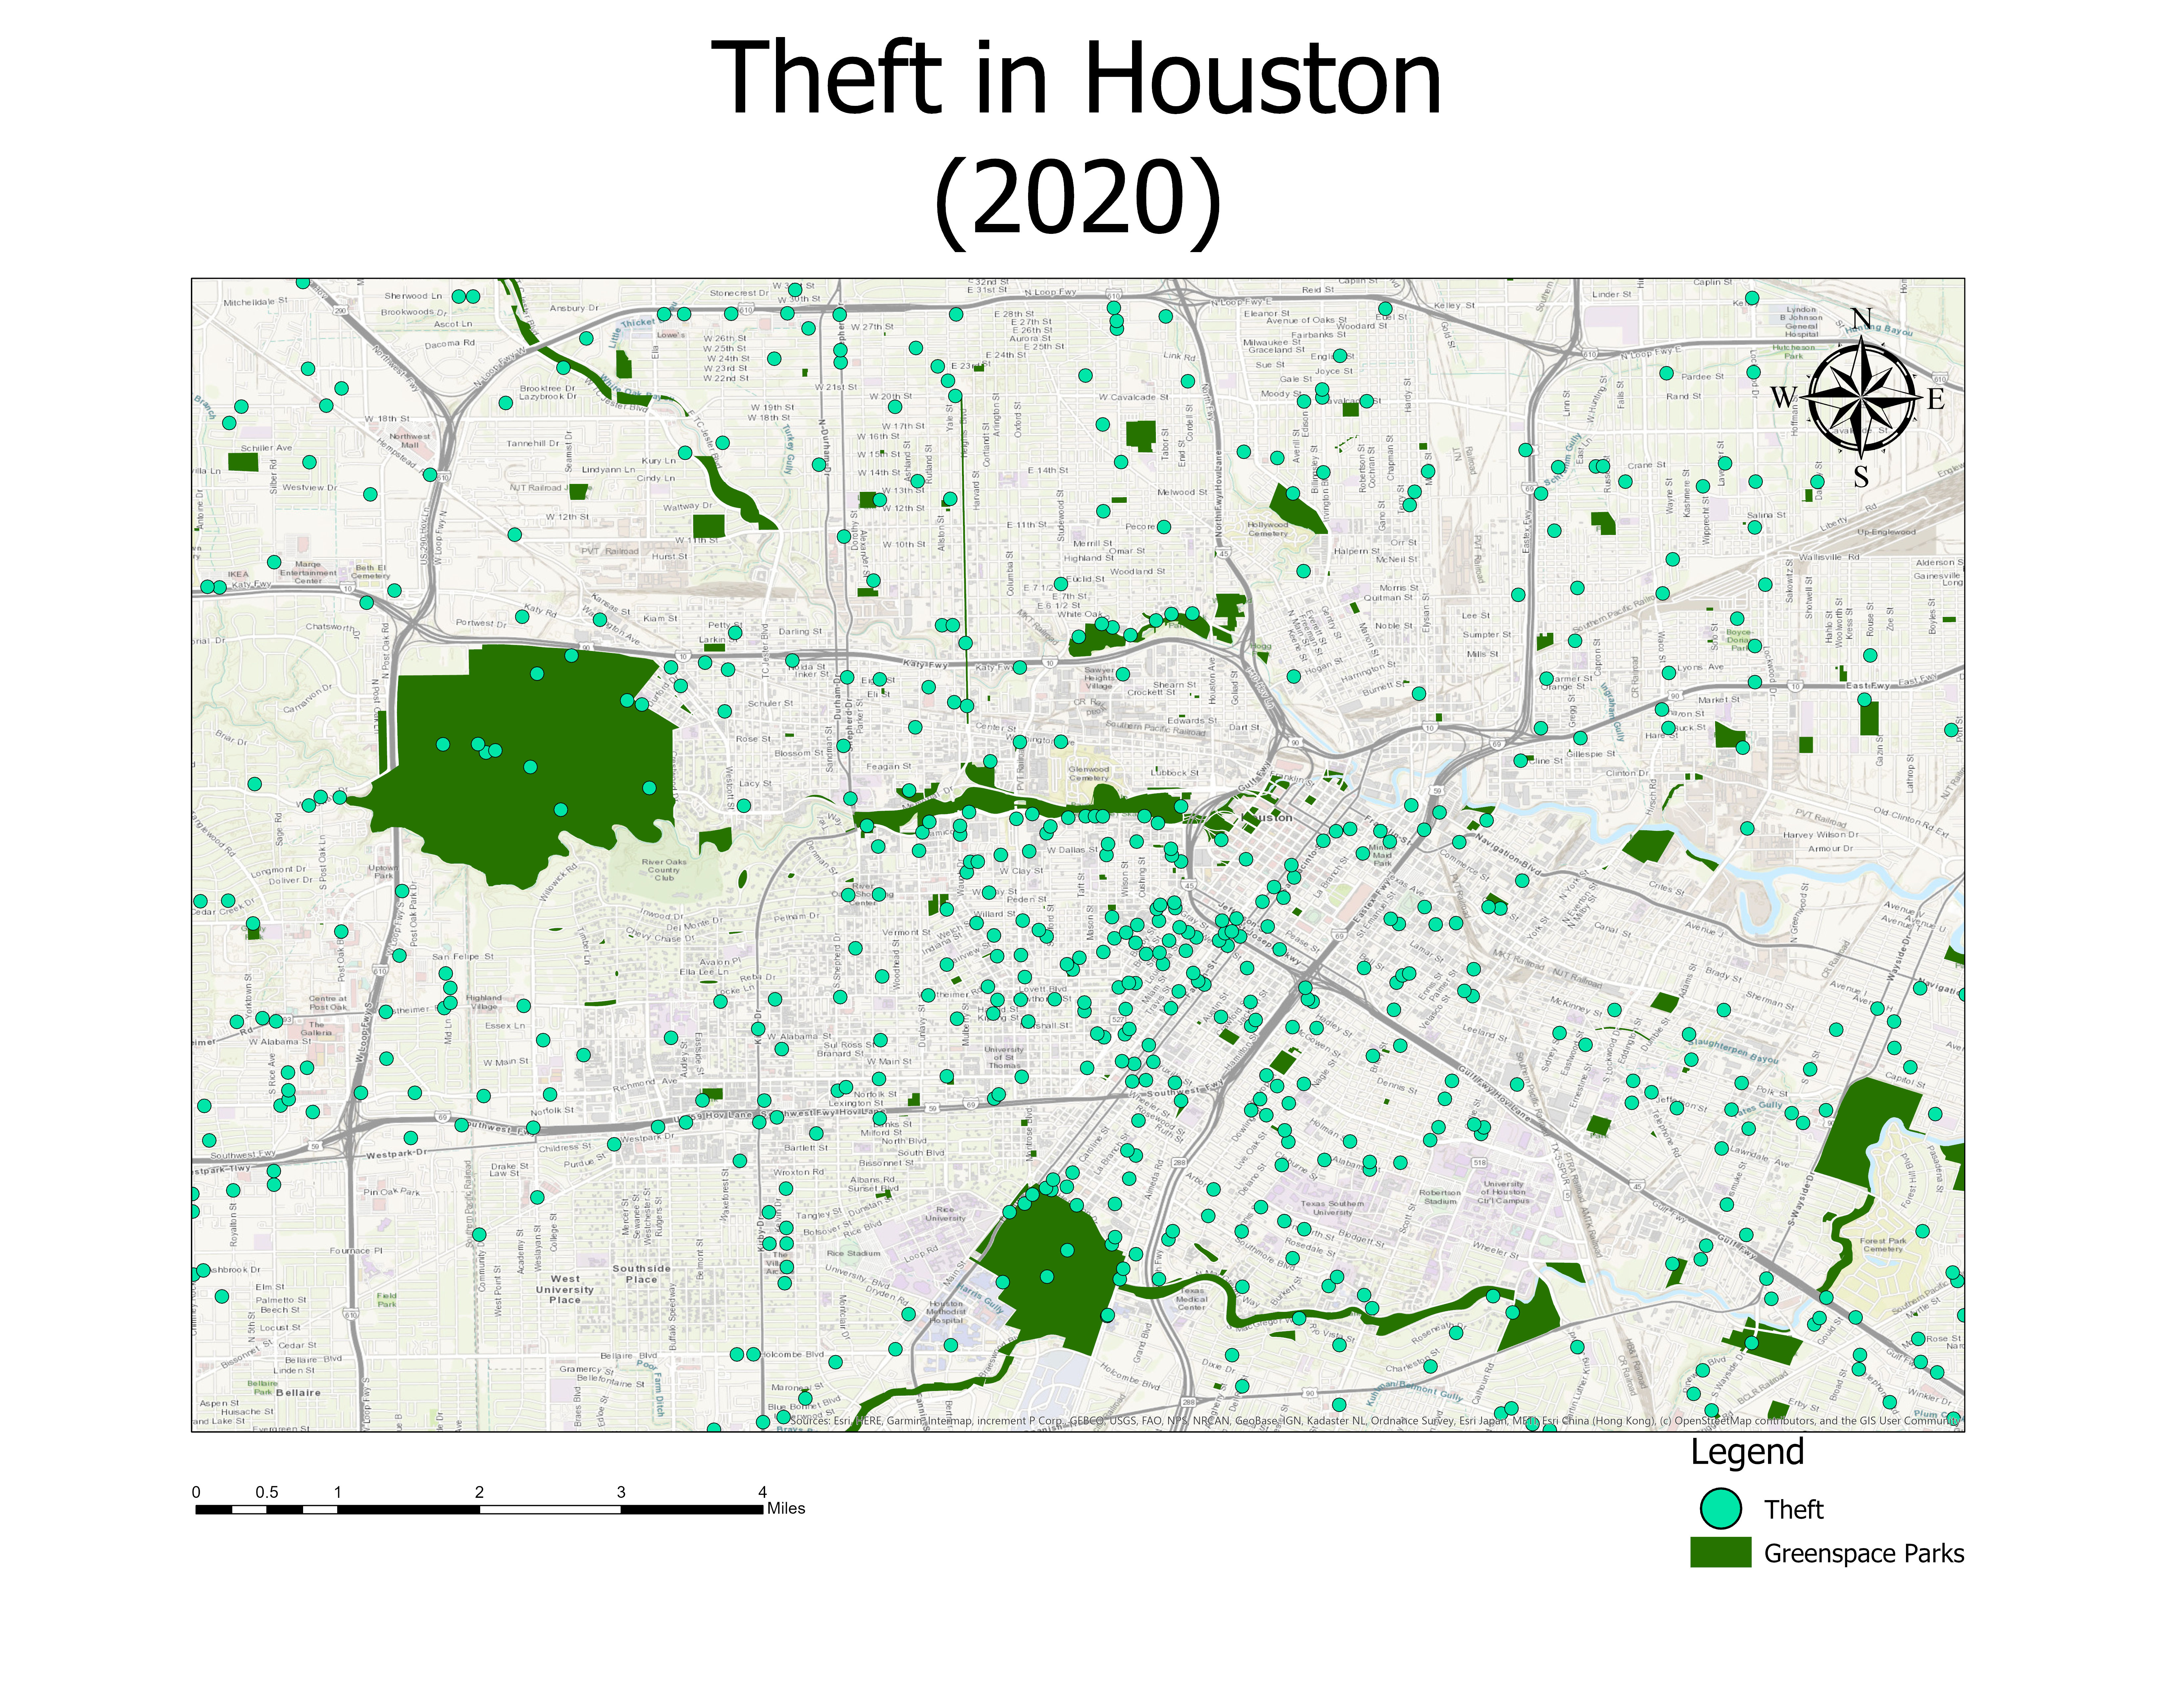
Hypothesis/Predicted Results
Zoning practices affect the spatial pattern of greenspaces.
Clusters of crimes in Houston and Chicago will differ due to how zoning is handled in each city.
There will be fewer clusters of violent crimes in and around greenspace zones.

Slide 15
Timeline
May - July 2020: Collect and compile data needed for the analysis.
August - September 2020: Perform analysis and record the results.
October 2020: Present findings to peers at a conference. One possibility is the 2020 South Florida GIS Expo. Another is a local GIS group meeting.
Graduate in December of 2020.

Slide 16
References
Anderson et al. (2013). Reducing crime by shaping the built environment with zoning: an empirical study of Los Angeles, University of Pennsylvania Law Review, Vol. 161 (3) Pg: 699-756.
What is Open Space/Green Space?. Retrieved April 29, 2020 from https://www3.epa.gov/region1/eco/uep/openspace.html
Urban green spaces. Retrieved April 29, 2020, from https://www.who.int/sustainable-development/cities/health-risks/urban-green-space/en/
Land Use and Zoning Basics. (2019, July 2). Retrieved April 29, 2020 from https://realestate.findlaw.com/land-use-laws/land-use-and-zoning-basics.html
Houston doesn't have zoning, but there are workarounds. (2020, January 12). Retrieved April 8, 2020, from https://kinder.rice.edu/urbanedge/2020/01/09/no-zoning-in-Houston-there-are-workarounds
Shepley et al., (2019). The Impact of Green Space on Violent Crime in Urban Environments: An Evidence Synthesis, International Journal of Environmental Research and Public Health, Vol. 16 Pg: 1-19.

Slide 17
Questions?

