Slide 1
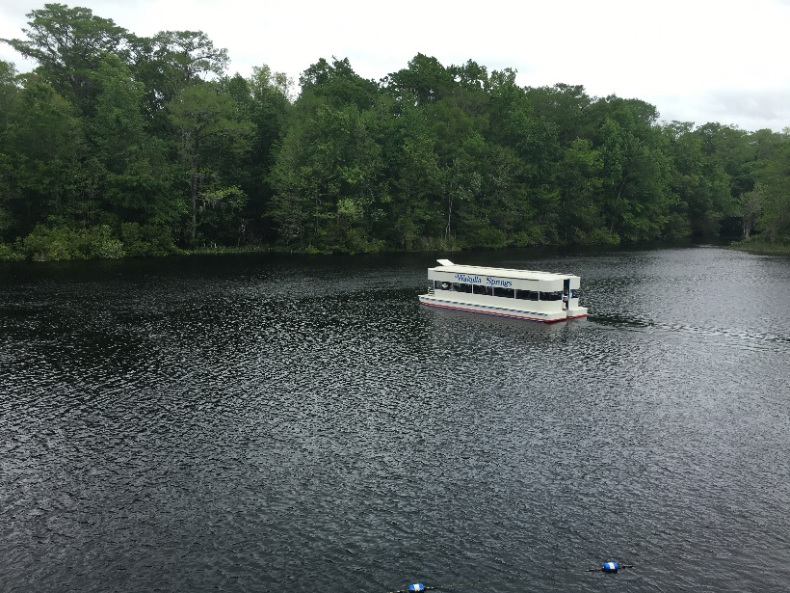
Septic Tank Conversion Prioritization using GIS in the Wakulla Springs Springshed
Jamie Hughes
Barry Evans, Advisor
GEOG 596A, Spring 2 2016
May 11, 2016

Slide 2
About Wakulla Springs
Edward Ball Wakulla Springs State Park in Wakulla County, Florida
Popular recreation spot
Swimming
Boat tours
Picnics
Hiking trails
Once was a popular filming location due to crystal clear water
Water became increasingly darker and regularly scheduled glass bottom boat tours were ended in the early 1990s
Nitrogen pollution is a major contributor to water quality issues
Service Layer Credits: Sources: Esri, HERE, DeLorme, TomTom, Intermap, increment P Corp., GEBCO, USGS, FAO, NPS, NRCAN, GeoBase, IGN, Kadaster NL, Ordnance Survey, Esri Japan, METI, Esri China (Hong Kong), swisstopo, MapmyIndia, © OpenStreetMap contributors, and the GIS User Community

Slide 3
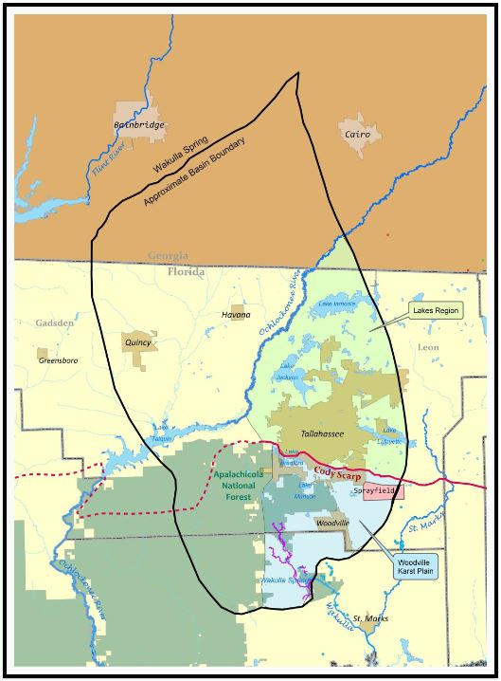
Physiography of the Springshed
Cody Scarp is the ancient shoreline
North of the scarp has sufficient clay soil layer to filter nitrates from surface water before reaching ground water table
South of the scarp is the Woodville Karst Plain, there is little to no clay and the ground water table is exposed in many places
Karst topography: Limestone that has been dissolved over time resulting in underground caves and sinkholes
Water travels from surface to spring in weeks
Springshed boundary to the south of Wakulla Springs shifts drastically depending on rainfall
Source: Wakulla Springs Alliance

Slide 4
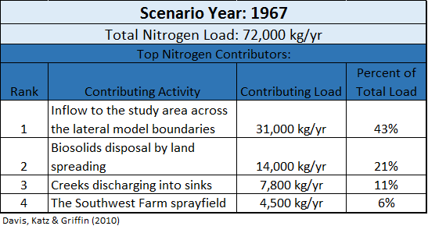
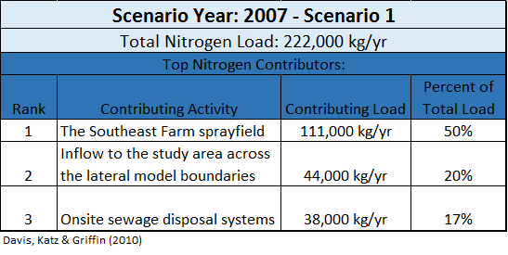
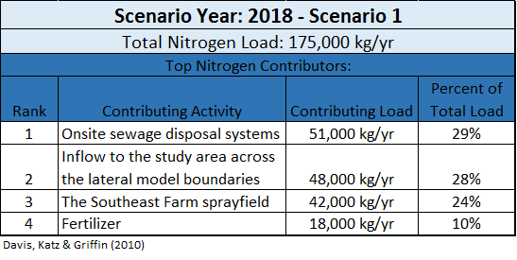
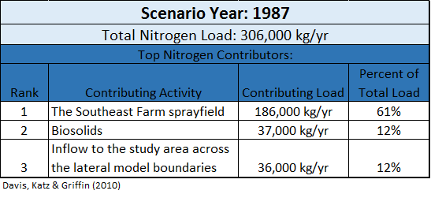
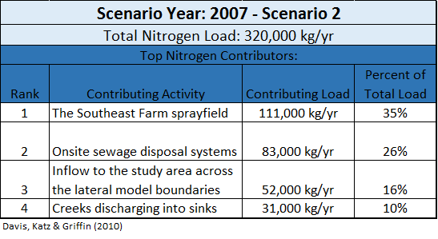
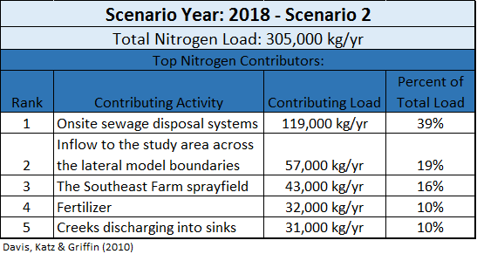
Nitrate Pollution Contributors
After years of argument over nitrate pollution sources, the USGS modeled nitrate loads to identify sources and level of contribution

Slide 5
Current Environmental Efforts
Federal, state and local governments along with special interest groups are coming together to find solutions to nitrogen pollution from septic systems within the Woodville Karst Plain
Basin Management Action Plan (BMAP) – Florida Environmental Protection Agency’s dedicated program
Northwest Florida Water Management District (NWFWMD) has shared stewardship over a state appointed annual budget to fund projects that improve Florida’s springs
Wakulla Springs Alliance advocates on behalf of Wakulla Springs’ environmental issues including septic tank conversion projects

Slide 6
My Capstone Project
Some analysis on groundwater pollution vulnerability and septic tank conversion types has been conducted in recent years but no multi-criteria analysis has been done to prioritize conversion projects
I will create a GIS tool that will prioritize septic tank conversions within the Woodville Karst Plain
This tool will provide focus to advocate funds being applied to projects that will provide the greatest benefit to groundwater quality improvement
I am working with the Wakulla Spring Alliance whose members provide a wide range of knowledge to help me create the best tool possible

Slide 7
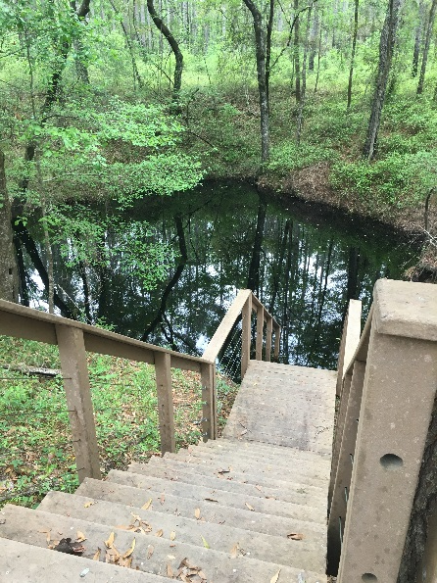
Prioritization Criteria
Groundwater pollution vulnerability
Recommended/ideal conversion type (central sewer, cluster system, septic upgrades, etc.)
a. Locational density
b. Age
c. Discharge load
d. Zoning
e. Realistic cost to install additional central system infrastructure
f. Eligible for inclusion of utility service area
Location within springshed (likelihood to drain to Wakulla Springs due to fluctuating springshed boundary)
Location north or south of Cody Scarp
Proximity to underground caves or karst features

Slide 8
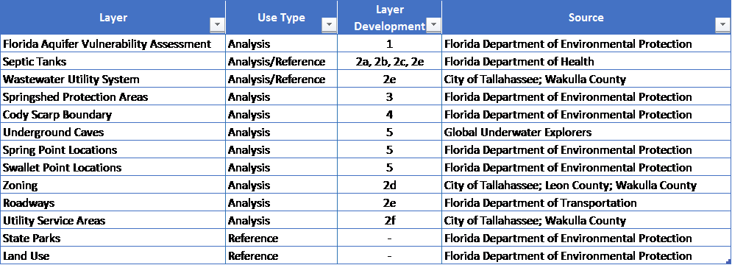
Data Sources & Acquisition
First project task is to collect data:

Slide 9
Project Plan
Define analysis parameters (spatial resolution, adding vs. multiplying cells, etc.)
Create each criteria layer one at a time
Compile acquired data
Think about an approach for layer development and possible ratings/weightings
Consult with someone or a group of people knowledgeable in the specific criterion
Define methodology and ratings/weightings for the individual layer creation
Manually create input layer based on mutually decided approach using ArcGIS tools
Carefully document all processes applied and tool settings and inputs used
When all layers are ready for analysis, manually run analysis to inspect the results of the methodology used. Input layers may be altered and the analysis re-run as many times as needed until the result satisfy the goal.

Slide 10
Project Plan
Create model flow chart using the final methodology documentation of each criteria layer and the final analysis.
Start constructing the basic analysis in ModelBuilder using the flow chart documentation in order to create an analysis tool.
If time and circumstances permit, identify improvements that could be made to the tool by advanced methods.
Export model to Python and make appropriate improvements.
Present tool and analysis results to the Wakulla Springs Alliance and Seven Hills Regional User Group (SHRUG) workshop in November/December.

Slide 11
Project Deliverables & Future
Project deliverables will be open source including tool and analysis results
Input data for the tool can be updated and/or improved and criteria rankings adjusted so the tool can be continually used
Stretch goal: Set up Wakulla Springs Alliance with an ArcGIS license through ESRI’s Non-profit program
Utilize ArcGIS Online to create online maps & share data and maps
Encourage continuing volunteer GIS efforts

Slide 12
References
Baker, A. E., Wood, A. R. & Cichon, J. R. (2007). The Leon County Aquifer Vulnerability Assessment. Retrieved from http://www.adgeo.net/content/lava/LAVA_Report_v1.1.pdf
Baker, A. E., Wood, A. R. & Cichon, J. R. (2009a). Florida Aquifer Vulnerability Assessment (FAVAII). Retrieved from http://www.adgeo.net/content/fava2/FAVAII_report.pdf
Baker, A. E., Wood, A. R. & Cichon, J. R. (2009b). The Wakulla County Aquifer Vulnerability Assessment. Retrieved from http://www.adgeo.net/content/fava2/WCAVA_Report.pdf
Davis, J. H., Katz, B. G. & Griffin, D. W. (2010). Nitrate-N Movement in Groundwater from the Land Application of Treated Municipal Wastewater and Other Sources in the Wakulla Springs Springshed, Leon and Wakulla Counties, Florida, 1966-2018. U.S. Geological Survey Report 2010-5099, 104 p.
Division of Environmental Assessment and Restoration (2015). Final Basin Management Action Plan for the Implementation of the Total Maximum Daily Load for Nutrient (Biology) by the Florida Department of Environmental Protection in the Upper Wakulla River and Wakulla Springs Basin. Retrieved from http://www.dep.state.fl.us/water/watersheds/docs/bmap/Wakulla-BMAP.pdf
Elder, J. F., Hunn, J. D. & Calhoun, C. W. (1985). Wastewater Application by Spray Irrigation on a Field Southeast of Tallahassee, Florida: Effects on Ground-Water Quality and Quantity, 1980-82. Retrieved from http://pubs.usgs.gov/wri/1985/4006/report.pdf
Lombardo Associates, Inc. (2011). Onsite Sewage Treatment and Disposal Management Options – Final Report for Wakulla Springs, Leon County, Wakulla County & City of Tallahassee, FL. Retrieved from https://www.talgov.com/Uploads/Public/Documents/planning/pdf/compln/onsite_sewage_mgt_rpt.pdf
Pruitt, J. B., Elder, J. F. & Johnson, I. K. (1988). Effects of Treated Municpal Effluent Irrigation on Ground Water beneath Sprayfields, Tallahassee, Florida. Retrieved from http://pubs.usgs.gov/wri/1988/4092/report.pdf

Slide 13
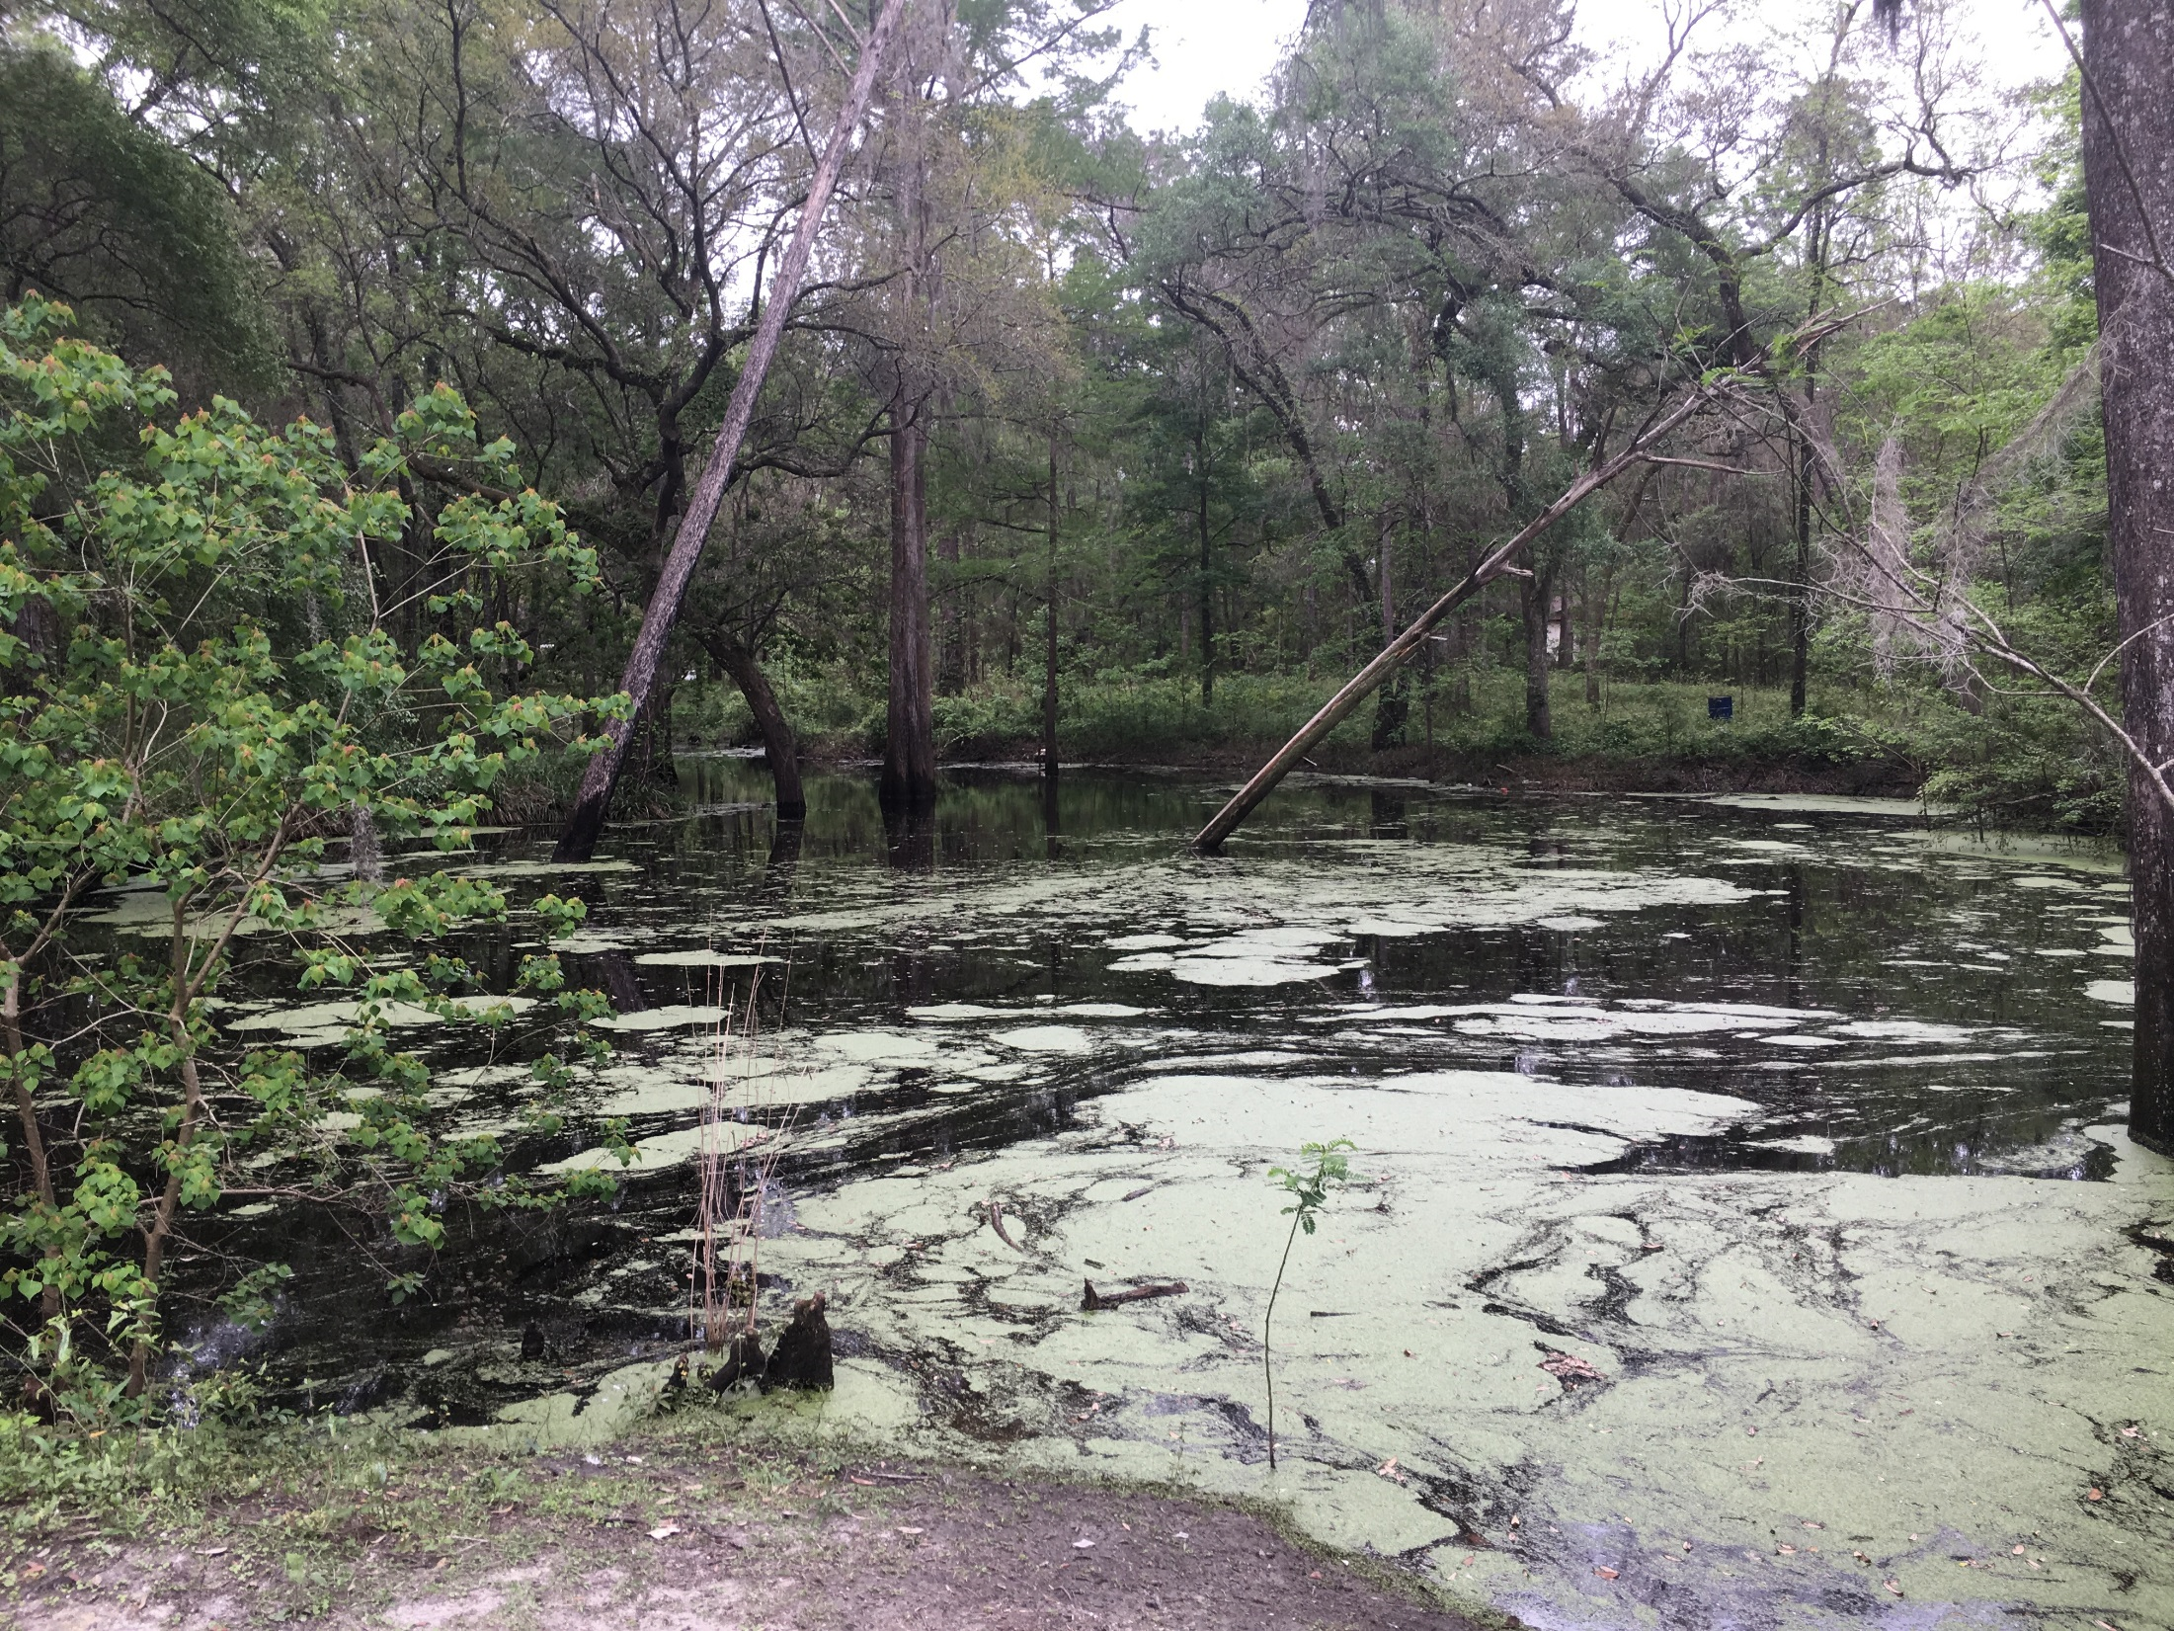
Questions… Thank you!
Jamie Hughes
jnh165@psu.edu

