Slide 1
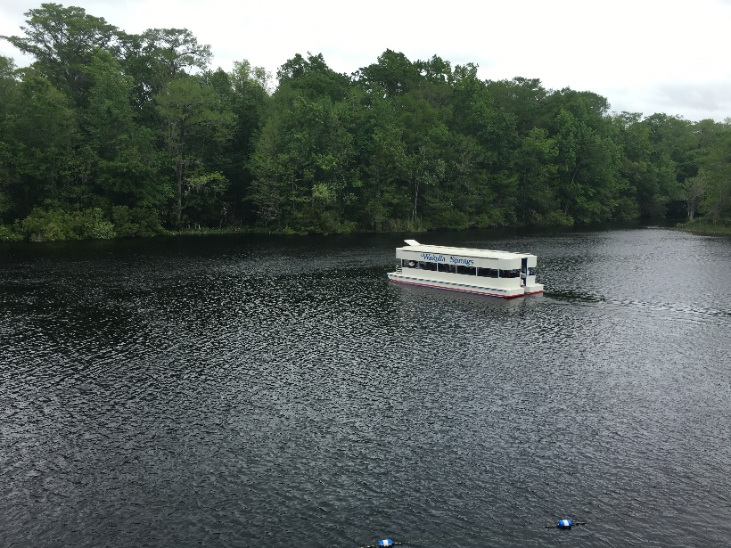
Septic Tank Conversion Prioritization using GIS in the Wakulla Springs Springshed
Jamie Hughes
Barry Evans, Advisor
SHRUG GIS 2016 Workshop
GEOG 596B, Spring 2 2016
November 16, 2016

Slide 2
About Wakulla Springs
Edward Ball Wakulla Springs State Park in Wakulla County, Florida
Popular recreation spot
Swimming
Boat tours
Picnics
Hiking trails
Once was a popular filming location due to crystal clear water
Water visibility drastically decreased and regularly scheduled glass bottom boat tours were ended in the early 1990s
Nitrogen pollution is a major contributor to water quality issues
Service Layer Credits: Sources: Esri, HERE, DeLorme, TomTom, Intermap, increment P Corp., GEBCO, USGS, FAO, NPS, NRCAN, GeoBase, IGN, Kadaster NL, Ordnance Survey, Esri Japan, METI, Esri China (Hong Kong), swisstopo, MapmyIndia, © OpenStreetMap contributors, and the GIS User Community

Slide 3
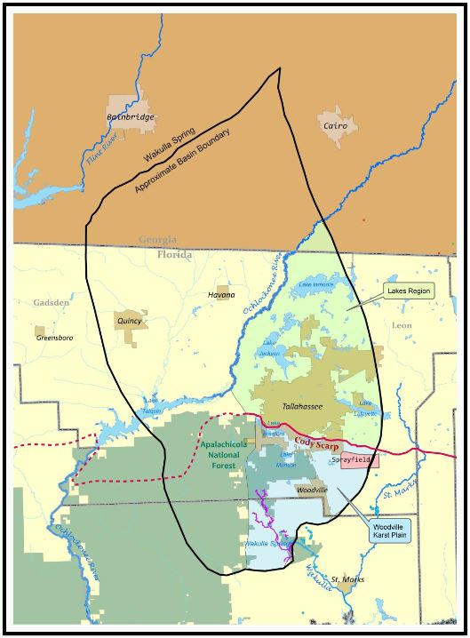
Physiography of the Springshed
Cody Scarp is the ancient shoreline
North of the scarp has sufficient clay soil layer to filter nitrates from surface water before reaching ground water table
South of the scarp is the Woodville Karst Plain, there is little to no clay and the ground water table is exposed in many places
Karst topography: Limestone that has been dissolved over time resulting in underground caves and sinkholes
Water travels from surface to spring in weeks
Springshed boundary to the south of Wakulla Springs shifts drastically depending on rainfall
Source: Wakulla Springs Alliance

Slide 4
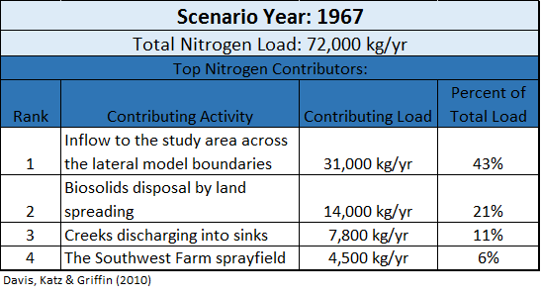
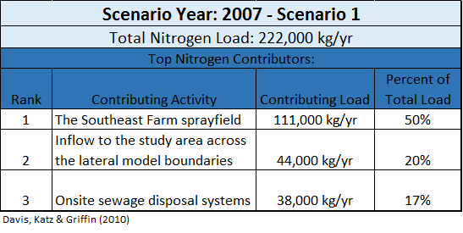
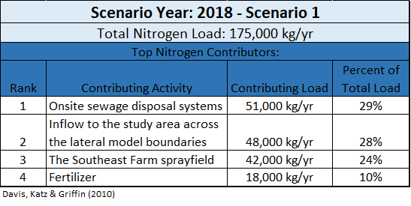
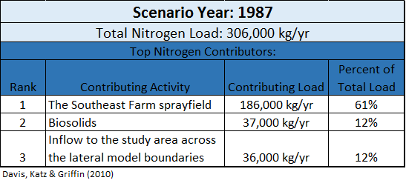
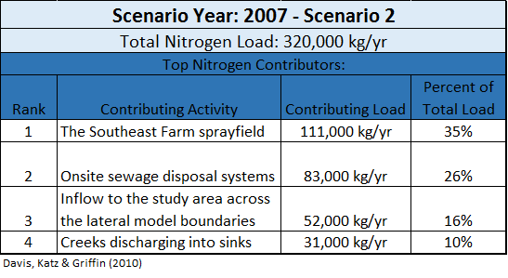
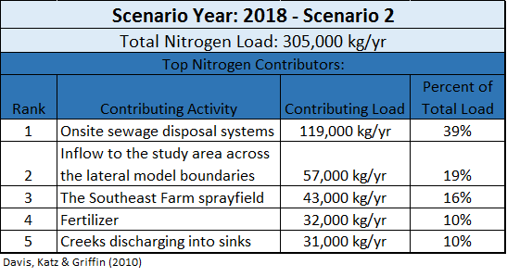
Nitrate Pollution Contributors
After years of argument over nitrate pollution sources, the USGS modeled nitrate loads to identify sources and level of contribution

Slide 5
Current Environmental Efforts
Federal, state and local governments along with special interest groups are coming together to find solutions to nitrogen pollution from septic systems within the Woodville Karst Plain
Basin Management Action Plan (BMAP) – Florida Environmental Protection Agency’s dedicated program
Northwest Florida Water Management District (NWFWMD) has shared stewardship over a state appointed annual budget to fund projects that improve Florida’s springs
Wakulla Springs Alliance advocates on behalf of Wakulla Springs’ environmental issues including septic tank conversion projects
Other special interest groups and concerned citizens provide support for issues regarding Wakulla Springs

Slide 6
My Capstone Project
Current situation:
State money is available to help fund expensive septic conversion projects within the Wakulla Springs springshed
Previous report (Lombardo, 2011) about onsite sewage treatment and disposal management options provides generalized recommendations on sewer conversion type for six areas of the springshed
No multi-criteria analysis had been done to prioritize the most critical conversion projects in the springshed
I created a GIS raster analysis that prioritizes septic tank conversions by septic parcel within the BMAP primary focus areas
This effort should provide focus in order to advocate for funds being applied to projects that will provide the greatest benefit to groundwater quality

Slide 7
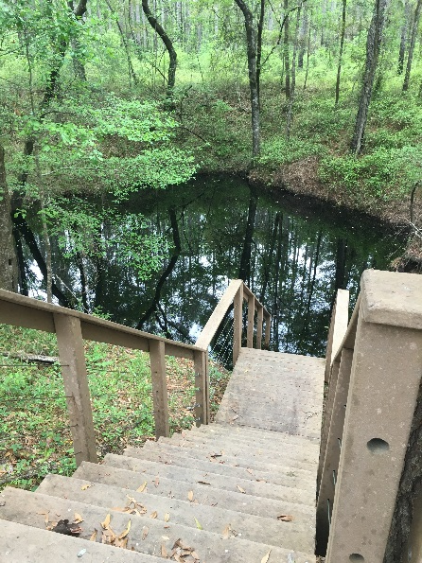
Prioritization Criteria
Layer 1: Groundwater pollution vulnerability
Layer 2: Locational density of septic systems
Layer 3: Distance to existing central wastewater system infrastructure
Layer 4: Location within springshed
Layer 5: Proximity to underground caves

Slide 8
Other Criteria Considerations
Septic tank age
Source data is incomplete
Possible future addition
Effluent nitrogen load per tank
No source information found
Difference in effluent between tanks is negligible
Abandoned tanks
No longer contributing effluent
Proximity to karst features
Sinkholes, swallets and Cody Scarp are incorporated in groundwater vulnerability analysis

Slide 9
Data Sources & Acquisition
First project task was to collect data:
Layer | Use Type | Layer Development | Source
DRASTIC Groundwater Vulnerability | Analysis | 1 | Florida Department of Environmental Protection
Septic Tanks/Sewered Parcels | Analysis | 2 | Florida Department of Health
Wastewater Utility System | Analysis | 3 | City of Tallahassee; Wakulla County
Roadways | Analysis | 3 | Florida Department of Transportation
Primary Focus Areas | Analysis | 4 | Florida Department of Environmental Protection (BMAP)
Underground Caves | Analysis | 5 | Woodville Karst Plain Project
Zoning | Reference | - | City of Tallahassee; Leon County; Wakulla County
Florida Managed Areas | Reference | - | Florida Natural Areas Inventory
Land Use/Land Cover | Reference | - | Florida Department of Environmental Protection

Slide 10
Other Source Data Considerations
Groundwater vulnerability
Florida Aquifer Vulnerability Assessment (FAVA)
Leon Aquifer Vulnerability Assessment (LAVA)
Wakulla County Aquifer Vulnerability Assessment (WCAVA)
Additional karst features
Cody Scarp boundary
Springs
Swallets

Slide 11
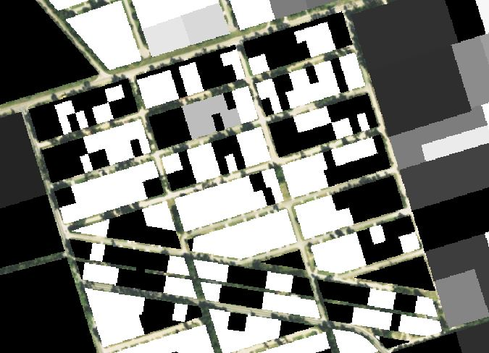
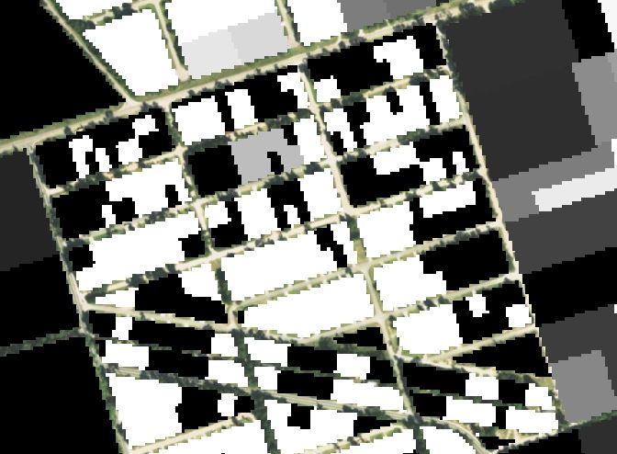
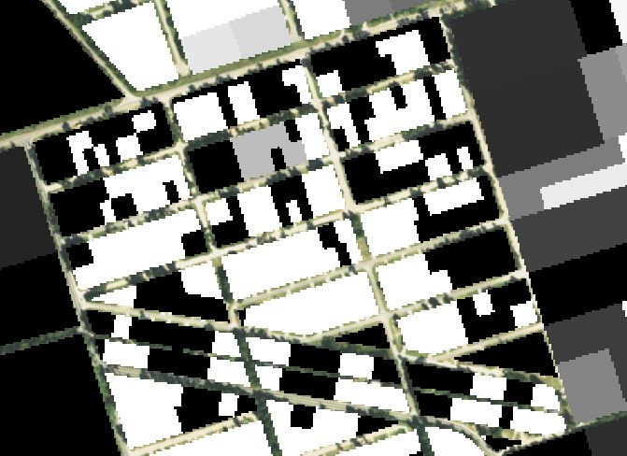
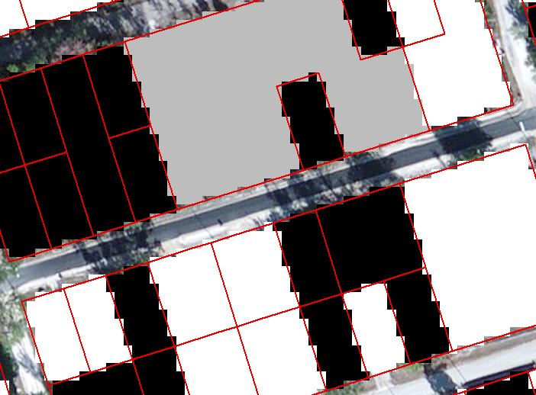
Cell Size Test
5 Ft
15 Ft
NAD_1983_HARN_StatePlane_Florida_North_FIPS_0903_Feet
Spatial resolution needs to represent smallest parcel as well as larger
5 Ft
10 Ft
15 Ft
10 Ft

Slide 12
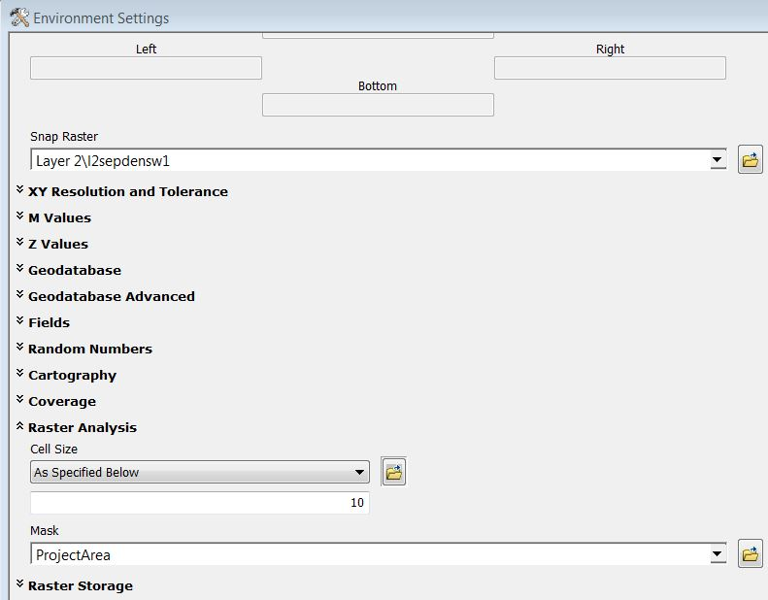
Analysis Parameters
Ratings:
1 – Low Priority
2
3 – Medium Priority
4
5 – High Priority
No applied weights
Cell Size: 10 Ft
Coordinate System: NAD_1983_HARN_StatePlane_Florida_North_FIPS_0903_Feet
All rasters are snapped to a single raster to ensure congruent cell configuration and clipped to project area

Slide 13
Overview of Input Data Layer Creation
Layer 1: Groundwater pollution vulnerability
DRASTIC (US EPA’s standardized analysis for groundwater vulnerability) – Use Index values to assign priority ratings
Layer 2: Locational density
DOH Florida Water Management Inventory (FLWMI) – Calculate density of septic systems by parcel and assign priority rating based on density values
Layer 3: Distance to existing central wastewater system infrastructure
Wastewater Infrastructure & Roads – Use the roads to create a cost raster then run cost distance and use the distance values to assign priority ratings
Layer 4: Location within springshed
BMAP Primary Focus Areas (PFA) – Assign the two zones appropriate priority ratings
Layer 5: Proximity to underground caves
WKPP cave lines – Run Euclidean distance to assign priority ratings according to distance from features

Slide 14
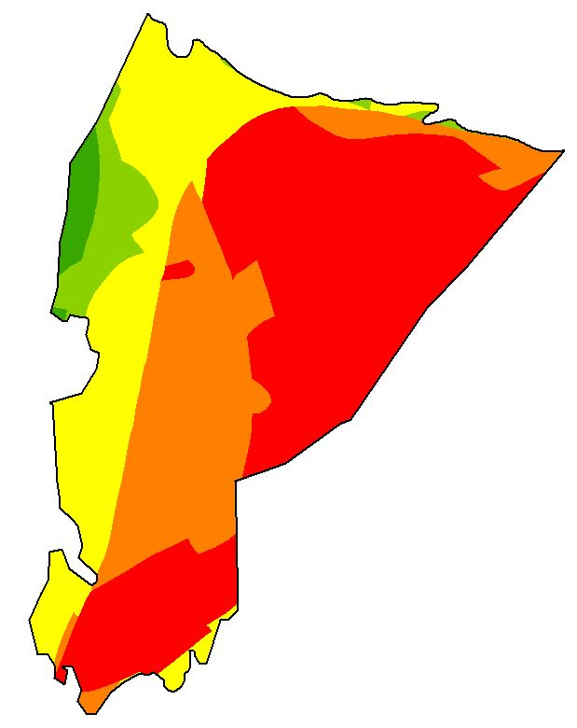
Layer 1 Creation
Convert polygon to raster using DRASTIC index as cell value
Rating value ranges
1: 0 – 90 (Low Priority)
2: > 90 – 120
3: > 120 – 150 (Medium Priority)
4: > 150 – 180
5: > 180 – 204 (High Priority)
Reclassify cell index values to analysis rating

Slide 15
Layer 2 Creation
Leon parcel inventory (DOH FLWMI) values for type of wastewater:
Estimated Septic; Septic = Yes (Will be considered for analysis)
Estimated Sewer; Sewer; N/A = No (Will not be considered for analysis)
Wakulla parcel inventory (DOH FLWMI) values for type of wastewater:
Known septic; Likely septic; SWL Septic = Yes (Will be considered for analysis)
Known sewer; Likely sewer; SWL Sewer; NA; UNDT; UNK = No (Will not be considered for analysis)
Calculating density assuming one septic system per parcel for each county:
Select by location the septic parcels within project area to apply calculations
Create and populate 2 new fields: Acre (calculated acreage) & OSTDSperAc (calculated 1/Acre)

Slide 16
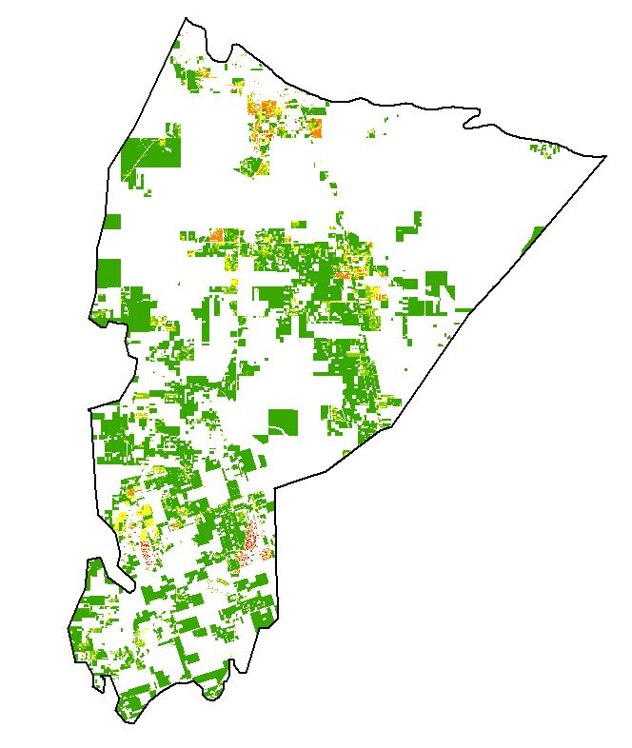
Layer 2 Creation (Cont.)
Rating value ranges
1: 0.000000 – 0.500000 tank/acre (> 2 Acres) (Low Priority)
2: 0.500001 – 1.000000 tank/acre (1 - 2 Acres)
3: 1.000001 – 2.000000 tank/acre (0.5 – 1 Acre) (Medium Priority)
4: 2.000001 – 5.000000 tank/acre (0.2 – 0.5 Acre)
5: 5.000001 – 23.000000 tank/acre (< 0.2 Acre) (High Priority)
Combine Leon and Wakulla analysis parcels into a single layer
Convert polygon to raster using density value as cell value
Reclassify cell density value to analysis rating

Slide 17
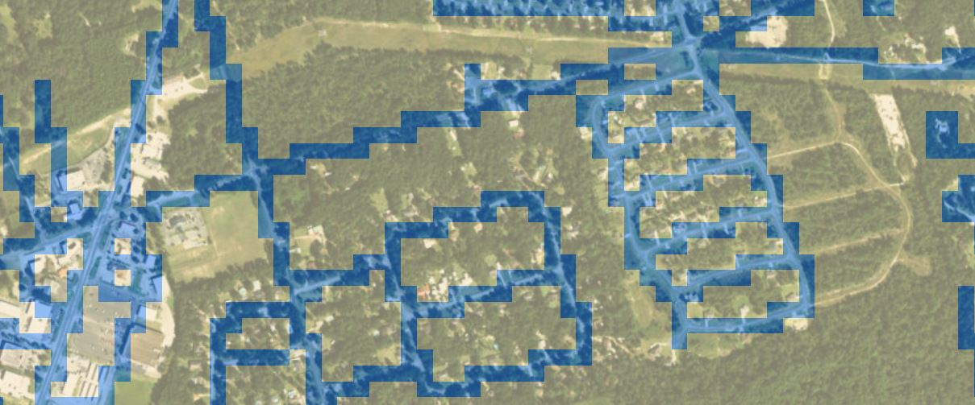
Layer 3 Creation
Cost raster development
Convert roads vector layer to raster with 100 ft cell size to act as roadway + buffer
Reclassify to create a cost raster making roadways cost 1 and other areas cost 5
Run Cost Distance tool with wastewater polylines as the input feature source data and roadway cost raster as the cost input

Slide 18
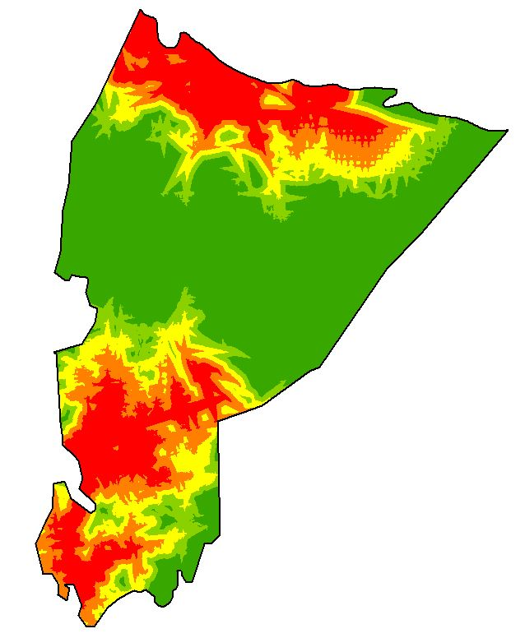
Layer 3 Creation (Cont.)
Rating value ranges
1: > 20,000 Ft (Low Priority)
2: > 15,000 – 20,000 Ft
3: > 10,000 – 15,000 Ft (Medium Priority)
4: > 5,000 – 10,000 Ft
5: 0 – 5,000 Ft (High Priority)
Reclassify cell distance value to analysis rating

Slide 19
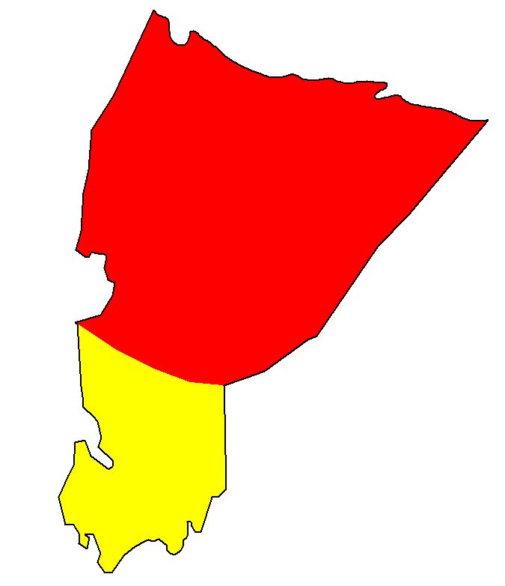
Layer 4 Creation
Convert polygon to raster using PFA names as cell value
Ratings
5: PFA1 (High priority area)
3: PFA2 (Medium priority area)
Reclassify cell PFA name to analysis rating

Slide 20
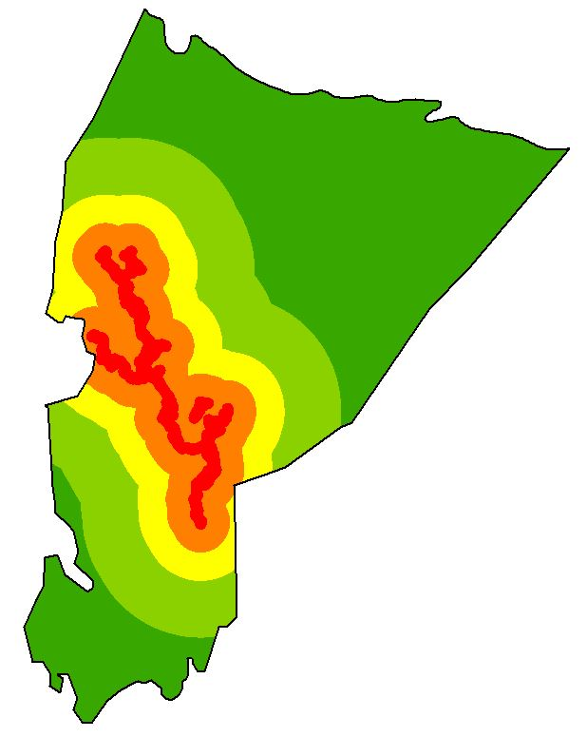
Layer 5 Creation
Run Euclidean Distance with caves lines as the input feature source data
Rating value ranges
1: > 20,000 Ft
2: > 10,000 – 20,000 Ft
3: > 5,000 – 10,000 Ft
4: > 1,000 – 5,000 Ft
5: 0 – 1,000 Ft
Reclassify cell distance value to analysis rating

Slide 21
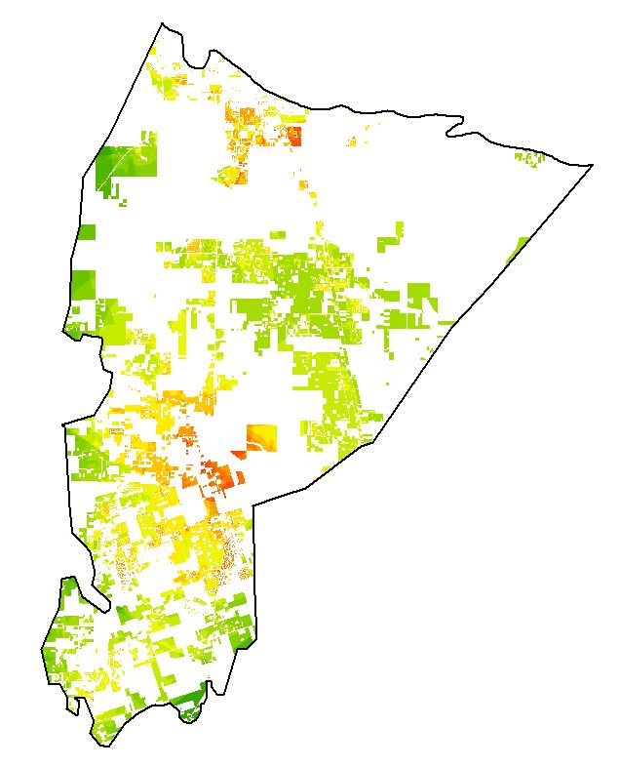
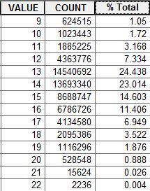
Raster Analysis
Add 5 input layers together with Raster Calculator
Output raster contains values ranging from 9-22
Value of 9 is the lowest priority
Value of 22 is the highest priority

Slide 22
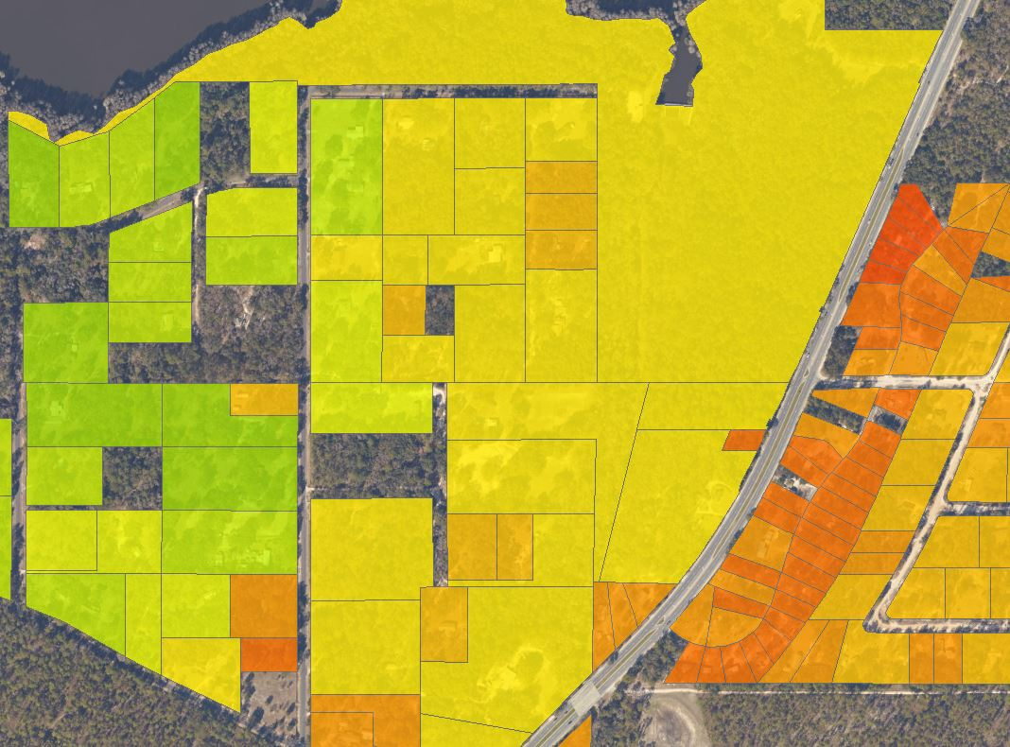
Zonal Statistics
Run Zonal Statistics as Table tool for each Leon and Wakulla counties using analysis parcel polygons as the input zone features
The tool creates a table with several calculated statistics including Min, Max, Mean & Median
Join zonal statistics to the parcel polygons and export all features

Slide 23
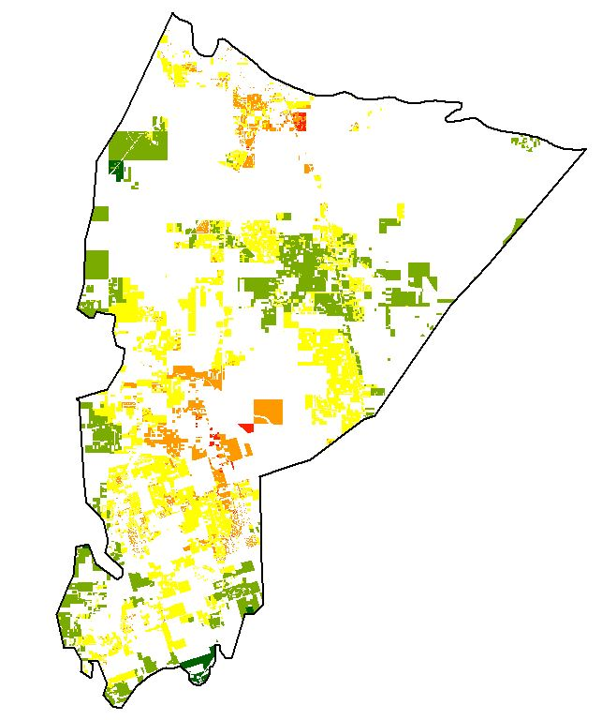
Results
This analysis output does not provide recommendation for type of septic tank conversion
This analysis output does provide insight into where conversion should have higher priority over other locations
Priority Value (Median) | Parcel Count | Percent Total
9 | 24 | 0.199%
10 | 49 | 0.406%
11 | 62 | 0.514%
12 | 223 | 1.848%
13 | 1126 | 9.329%
14 | 1873 | 15.518%
15 | 1930 | 15.990%
16 | 2015 | 16.694%
17 | 1616 | 13.389%
18 | 1851 | 15.336%
19 | 899 | 7.448%
20 | 374 | 3.099%
21 | 26 | 0.215%
22 | 2 | 0.017%

Slide 24
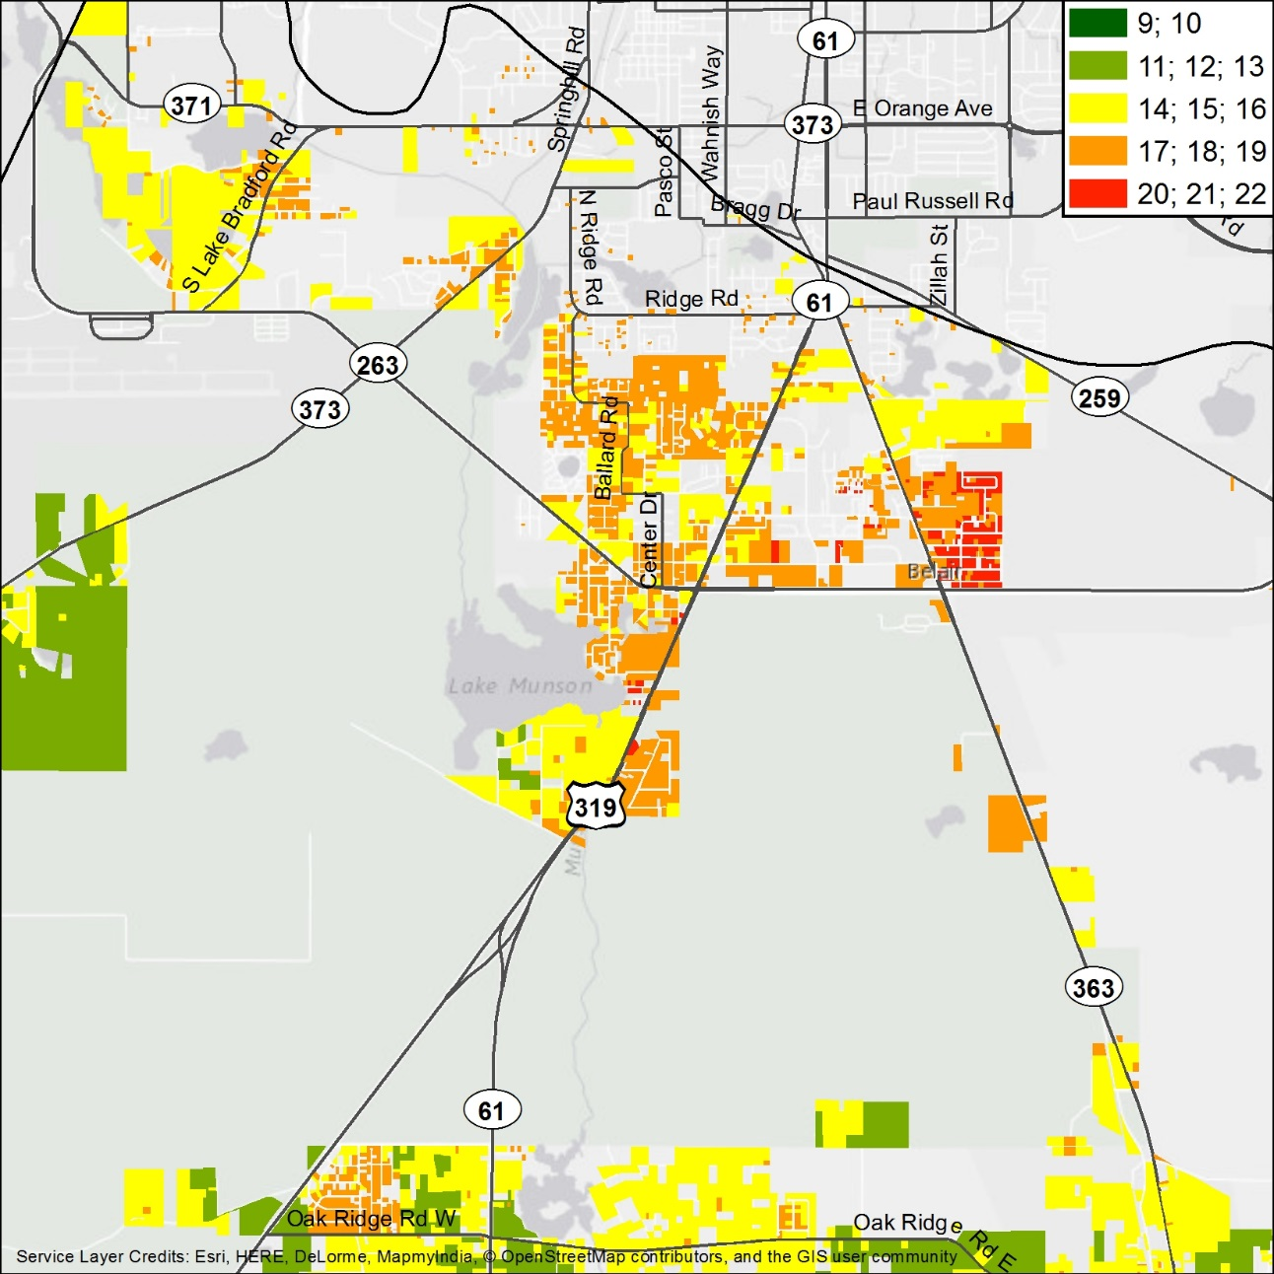
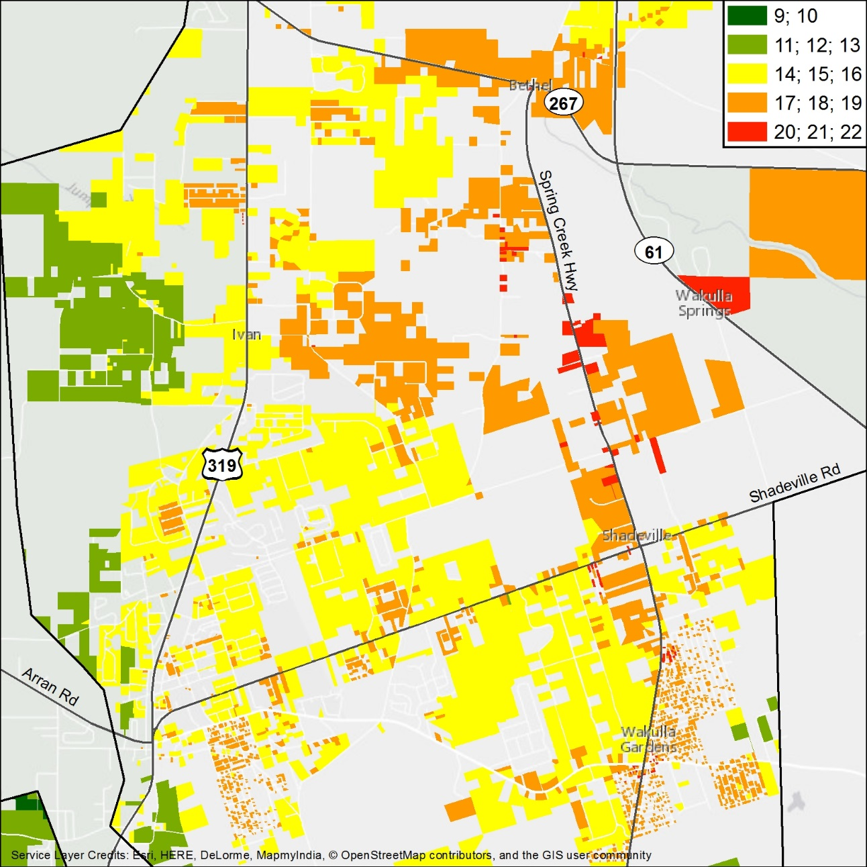

Slide 25
ArcGIS Online Webmap App
Converted all input and output raster to vector for map viewing
Accessed ArcGIS Online through National Audubon Society organizational account
Imported smaller layers directly into web map and asked the administrator to create feature service layers for large/detailed layers.
Created a web mapping application so it can be shared and utilized by non-GIS individuals in the Wakulla Springs alliance
http://audubon.maps.arcgis.com/apps/webappviewer/index.html?id=0bb623d5f8b94a2c9a114fda339c6858

Slide 26
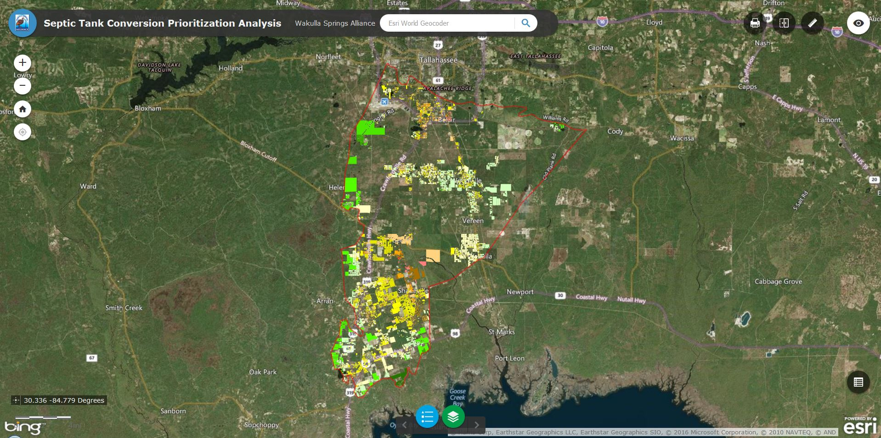

Slide 27
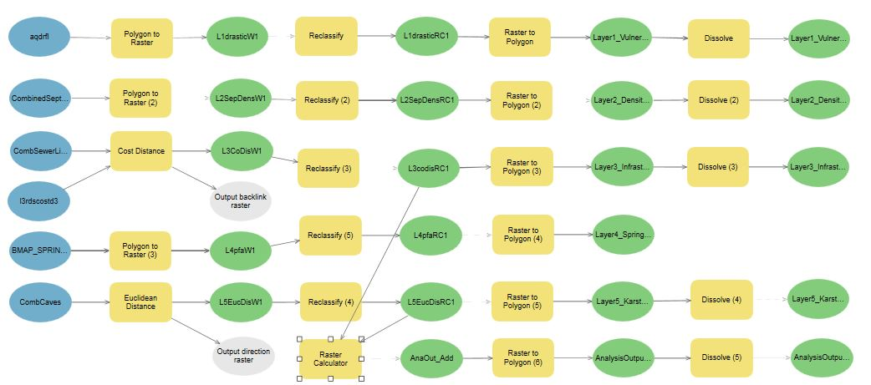
Model Builder
Built the analysis process from ready-to-use source data to input layer creation to analysis output to vector conversion

Slide 28
Future Considerations for Analysis
Additional input layers
i.e. septic tank age
Improved source data for input layer 1
Specially developed FAVA/LAVA/WCAVA
More complete wastewater source data for Wakulla county
Likely needs to be digitized from source information
More complete mapped cave source data
Future mapping efforts by Woodville Karst Plain Project (WKPP)
Improve applied ratings for input layers
Experienced professionals

Slide 29
References
Baker, A. E., Wood, A. R. & Cichon, J. R. (2007). The Leon County Aquifer Vulnerability Assessment. Retrieved from http://www.adgeo.net/content/lava/LAVA_Report_v1.1.pdf
Baker, A. E., Wood, A. R. & Cichon, J. R. (2009a). Florida Aquifer Vulnerability Assessment (FAVAII). Retrieved from http://www.adgeo.net/content/fava2/FAVAII_report.pdf
Baker, A. E., Wood, A. R. & Cichon, J. R. (2009b). The Wakulla County Aquifer Vulnerability Assessment. Retrieved from http://www.adgeo.net/content/fava2/WCAVA_Report.pdf
Davis, J. H., Katz, B. G. & Griffin, D. W. (2010). Nitrate-N Movement in Groundwater from the Land Application of Treated Municipal Wastewater and Other Sources in the Wakulla Springs Springshed, Leon and Wakulla Counties, Florida, 1966-2018. U.S. Geological Survey Report 2010-5099, 104 p.
Division of Environmental Assessment and Restoration (2015). Final Basin Management Action Plan for the Implementation of the Total Maximum Daily Load for Nutrient (Biology) by the Florida Department of Environmental Protection in the Upper Wakulla River and Wakulla Springs Basin. Retrieved from http://www.dep.state.fl.us/water/watersheds/docs/bmap/Wakulla-BMAP.pdf
Elder, J. F., Hunn, J. D. & Calhoun, C. W. (1985). Wastewater Application by Spray Irrigation on a Field Southeast of Tallahassee, Florida: Effects on Ground-Water Quality and Quantity, 1980-82. Retrieved from http://pubs.usgs.gov/wri/1985/4006/report.pdf
Lombardo Associates, Inc. (2011). Onsite Sewage Treatment and Disposal Management Options – Final Report for Wakulla Springs, Leon County, Wakulla County & City of Tallahassee, FL. Retrieved from https://www.talgov.com/Uploads/Public/Documents/planning/pdf/compln/onsite_sewage_mgt_rpt.pdf
Pruitt, J. B., Elder, J. F. & Johnson, I. K. (1988). Effects of Treated Municpal Effluent Irrigation on Ground Water beneath Sprayfields, Tallahassee, Florida. Retrieved from http://pubs.usgs.gov/wri/1988/4092/report.pdf

Slide 30
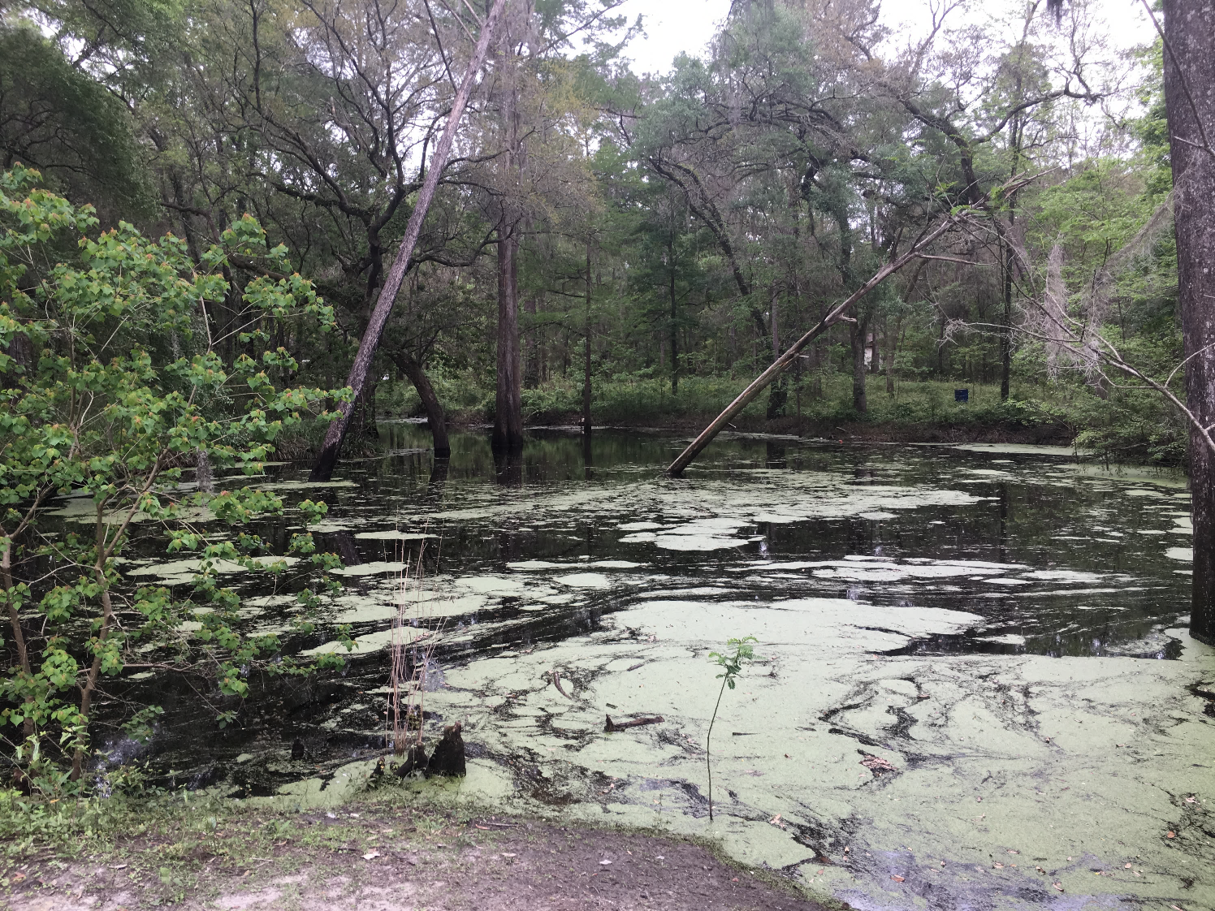
Special thanks to: Sean McGlynn Bob Deyle Pamela Hall Jim Stevenson Bill VanSickle Alan Baker Wakulla Springs Alliance Woodville Karst Plain Project
Questions… Thank you!
Jamie Hughes
jnh165@psu.edu

