Slide 1
Positional Accuracy Comparison of a DJI Phantom 4 and a Sensefly eBee
Daniel Hulsey
Advisor: Dr. Jan Van Sickle

Slide 2
Outline
My objective
Previous studies
Study area location
Drones
Control points/ Mission planning/ Processing
Accuracy assessment

Slide 3
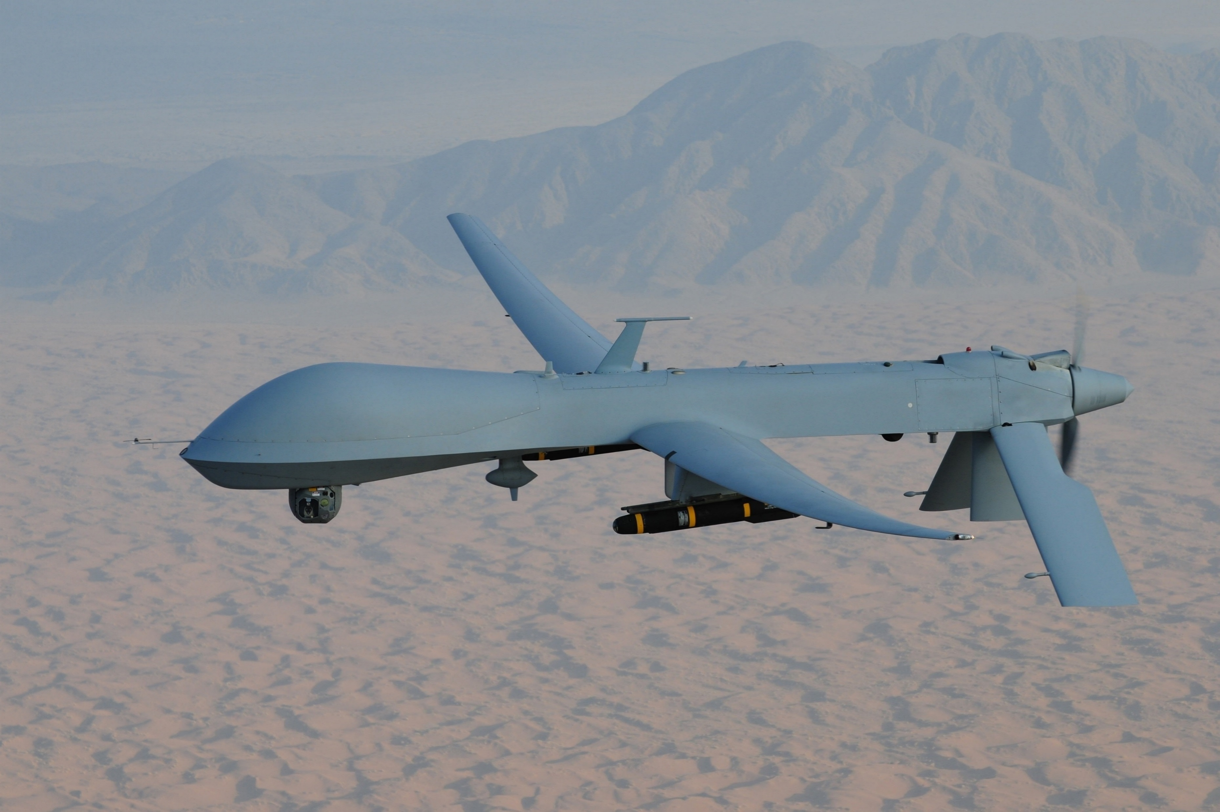
What is My Interest?
I got my start with drones in the Air Force where I was a
sensor operator for Predator UAVs. I’ve believed that drone technology could benefit society in many ways ever since.
I am starting a drone mapping program at the
engineering firm that I work at. I am currently using a Phantom 4 and am considering purchasing an eBee for the company.

Slide 4
Objective
To compare the horizontal and vertical positional accuracy of orthoimagery and digital surface models derived from a DJI Phantom 4 and a Sensefly eBee.
To make the comparison of the orthoimagery and digital surface models as accurate as possible; the two drones will need to be flown over the same study area, be flown at the same time of day, be flown so as to produce as similar of a product as possible, use the same control points and check points, and the imagery must be processed in the same way.

Slide 5
How Positional Accuracy is Defined
“The degree of compliance with which the coordinates of points determined from a map agree with the coordinates determined by survey or other independent means accepted as accurate”. (Congalton & Green, 2009)
It is important to consider the positional accuracy of mapping products generated from drone collected imagery because many practitioners of drone mapping are blindly claiming to have accuracies greater than they actually do because of statements in drone promotional literature.

Slide 6
Previous Studies
Paudie Barry and Ross Coakley, 2013 | Qasim Abdullah, 2017
C-Astral Bramor fixed wing drone | Kespry UAS
Camera – 24 megapixels | Camera – 24 megaipxels
Site size – 2 Ha (4.9 acres) | Site size – 31 acres (12.5 Ha)
9 ground control points and 45 check points used | 29 ground control points and 20 check points used
80% front and 80% side overlap | Front and side lap were not stated
Agisoft Photoscan used to process the imagery | Pix4D Mapper used to process the imagery
Resulting horizontal RMSE – 0.023 m (0.08 ft) | Resulting horizontal RMSE - .29 ft (0.09 m)
Resulting horizontal Accuracy 95% - 0.041 m (0.13 ft) | Resulting horizontal accuracy 95% - .49 ft (0.15 m)

Slide 7
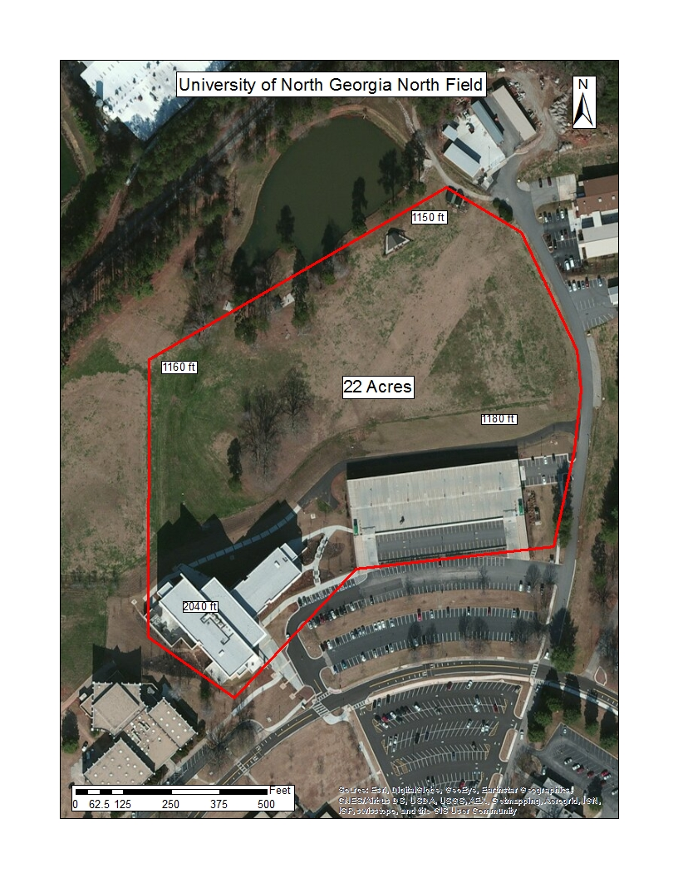
Study Area Location
I am working directly with
Dr. JB Sharma from the science
department.
I have been given permission
by campus security to fly here.
I have discussed my activities
with the local airport manager.
There are no dorms on this
campus.
22 acre study area
Consists of a field, a parking deck
and a multistory academic building.
The field slopes from the North to
the South by about 30 ft.
Site is relatively void of trees and
shrubbery which could add
complications to the study.
Site would not require flight over
any major roads to complete the study.

Slide 8
Project Methodology
I will use 10 ground control points and 20 check points evenly distributed over the study area. I will ensure that at least one check point is on top of the building in the study area to check how well each drone deals with elevation differences in the study area.
The missions for both drones will be planned so that they both produce orthoimagery of 1 inch resolution. The images collected from both drones will have 80% front lap and 80% side lap.
Image processing will be accomplished with the same software on the same machine.
Root mean squared error measurement will be used to assess the accuracy of the final products of both drones.

Slide 9
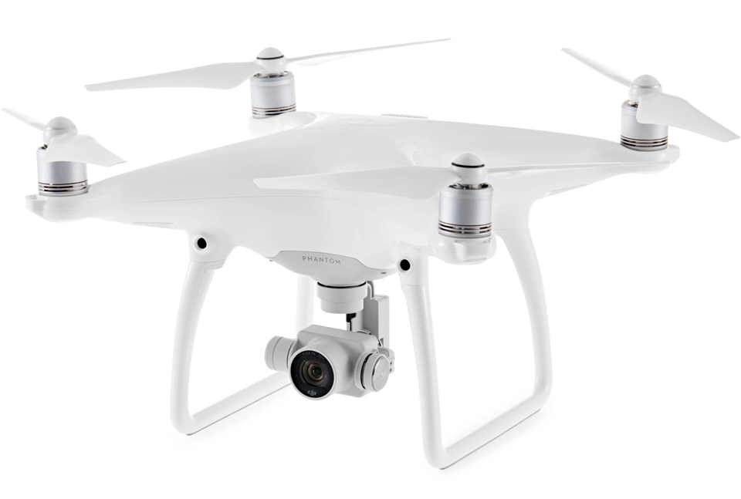
DJI Phantom 4 “Consumer Grade” Drone
Quad copter design
$1,200 Can be purchased at Best Buy
20 megapixel RGB camera
Dual compass and dual IMU.
Obstacle sensing and avoidance
Made in China
I currently use this drone in my mapping work for the engineering firm that I work for.
I have completed a full 3D model of a 360 acre dry lake bed in South Georgia for an ecological study.
90 acres of downtown Portland, Maine modeled for a visibility analysis.
3 acre environmental remediation site modeled for detailed contour analysis.
The Phantom 4 that I have access to belongs to the
engineering firm that I work for.

Slide 10
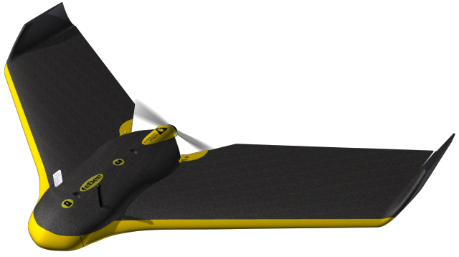
Sensefly eBee “Professional Grade” Drone
Costs around $12,500 and must be purchased by a reseller.
Fixed wing drone design.
18.2 megapixel RGB camera.
The eBee is a very safe drone.
Advertized to have a horizontal accuracy down to 3 cm and a vertical accuracy down to 5 cm.
Made in Switzerland
Used the eBee in undergraduate remote sensing projects at the University of North Georgia.
Created a full 3D model of the UNG Gainesville campus Science building.
Created a full 3D model of the UNG Oconee campus.
Helped implement the drone into GIS instruction at UNG.
The eBee that I have access to belongs to the University of North Georgia.

Slide 11
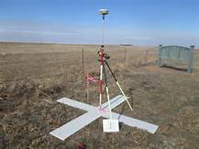
Control Point and Check Point Distribution
Control points will be used in the actual processing of the point cloud to ensure that it will be in the correct location.
Check points will be used after processing is complete to assess the accuracy of the final products.
The National Standard for Spatial Data Accuracy (1998) state that a minimum of 20 check points should be used to assess the positional accuracy of mapping products for a statistically valid estimate.
“Returns on investment quickly diminish after about 30.” (Congalton and Green, 2009) Because I have a small site at 22 acres, I will use the minimum of 20 check points.
I will use 10 ground control points for the processing of the imagery for this site.
My check points and control points will be marked with a white x and measured with a Trimble Geo7X. The points will then be post processed in Trimble’s differential correction service to be as accurate as possible.

Slide 12
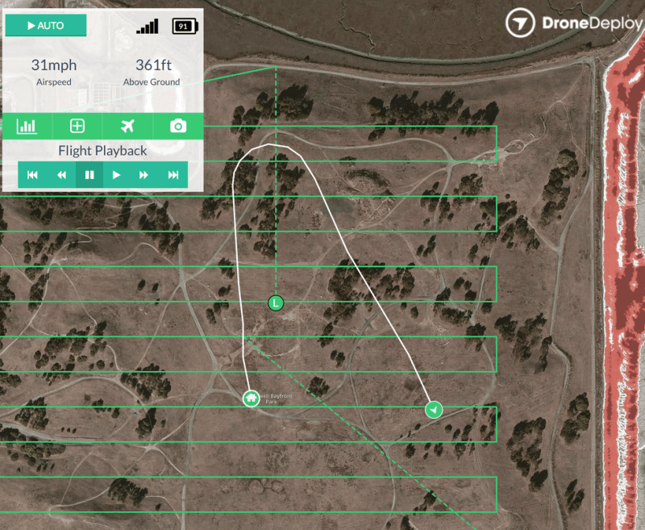
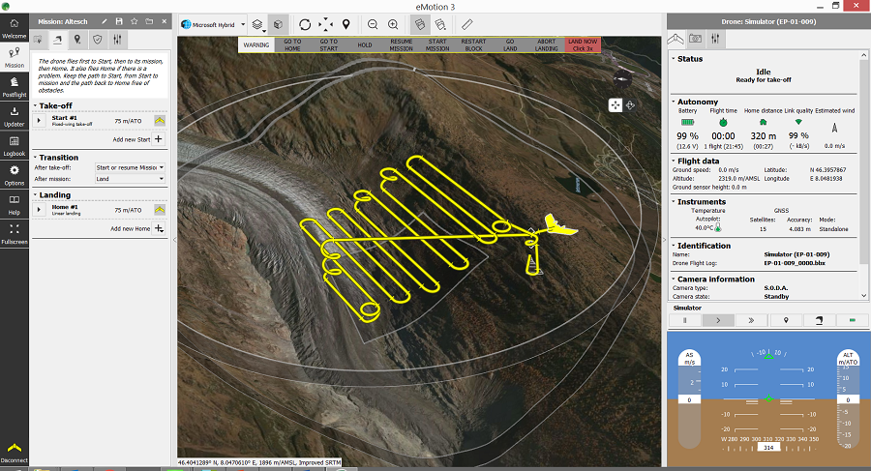
Mission Planning
I will not manually fly the drones over the study area and click pictures. The precision needed for correct photo locations is too high for me to achieve. Both drones will be controlled by mission planning software. The Phantom 4 uses Drone Deploy and the eBee uses eMotion.
Both software packages are very similar.
The user simply draws a polygon around the area that they wish to image.
Specify the desired image spatial resolution.
Specify the desired front and side lap of the image frames.
After mission planning, both pieces of software serve as mission monitoring software.

Slide 13
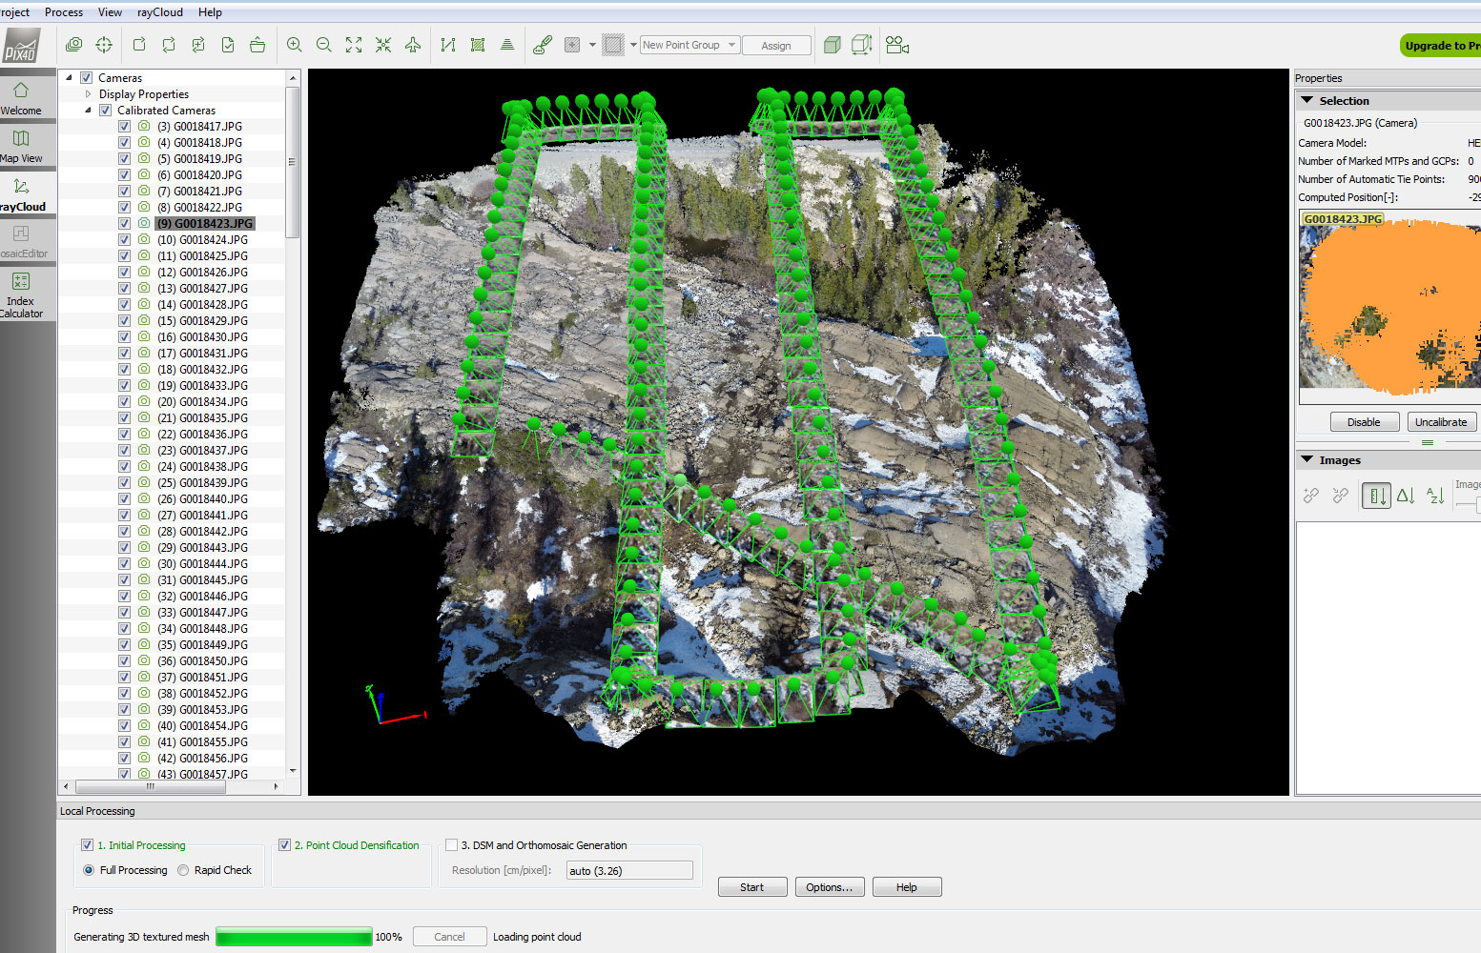
Image Processing
Pix4D Mapper Pro is a photogrammetric image processing software package.
The images collected by the drones of the study area as well as the GPS coordinates of each image location will be imported into Pix4D.
The 10 control points from around the study area will be put into Pix4D to tie the resulting orthoimagery and digital surface models to the datum.
Pix4D will first generate a 3D point cloud.
It will then use that point cloud to generate orthoimages and digital surface models.
For a study area of this size, each flight should take 3 to 4 hours to process.

Slide 14
Positional Accuracy Assessment
The orthoimagery and digital surface models will be imported into ArcMap along with the check point features.
The difference between the check point locations in the imagery and DSM and the check point features will be measured in x, y, and z directions.
After all residual measurements have been made, the root mean squares error (RMSE) will be calculated for each drone’s mapping products in each direction (x, y, and z)
These RMSE calculations will be compared to see if the much more expensive eBee is actually more positionally accurate than the Phantom 4.

Slide 15
Target End User
Practitioners of drone mapping for engineering/surveying purposes.
People trying to decide which drone to purchase to start a drone mapping program.
My company leadership to potentially determine if we should buy an eBee.

Slide 16
Timeline to Completion
The conference that I will present at is October 24th -26th.
I will take GEOG 596B in the Fall 2 Term. It goes from October 3rd to December 12.
Time between May 9th, 2017 and October 24th, 2017 = 5 months and 15 days.

Slide 17
Expected Outcomes
I expect that both drone’s mapping products will have very similar positional accuracies. I expect that both sets of accuracies will be in the 2 – 6 inch (1.66 – 0.6 foot) RMSE range.

Slide 18
Challenges & Limitations
FAA Certification
Flying within 5 miles of an airport
Access to the drones
Weather limitations

Slide 19
Presentation Venue
The Westgate Resort, Las Vegas, October 24-26, 2017
“Commercial UAV Expo is a conference and exhibition focused on commercial UAV integration for large asset owners in select market segments. The event focuses specifically on the needs of large enterprise in integration of UAV/UAS for industrial use.”

Slide 20
Summary
I propose to compare positional accuracy assessments of mapping products generated from a Phantom 4 and a Sensefly eBee.
My study area will be a field at the University of North Georgia Gainesville campus.
I will use 10 control points and 20 check points.
Accuracies will be computed in RMSE.
I will present this project at the Commercial UAV Expo.

Slide 21
Acknowledgements
Dr. Sharma at UNG
Terry Palmer at the Gainesville Airport
Jarrod Black at Rochester & Associates.
Dr. Jan Van Sickle

Slide 22
References
Abdullah, Qassim A. "Mapping Matters." Photogrammetric Engineering & Remote Sensing 82, no. 8 (August, 2016): 587-88. doi:10.14358/pers.82.8.587
Abdullah, Qassim A. "Mapping Matters." Photogrammetric Engineering & Remote Sensing 80, no. 1 (January, 2014): 19-21. doi:10.14358/pers.81.11.831.
ASPRS, 2014, ASPRS Positional Accuracy Standards for Digital Geospatial Data, Photogrammetric Engineering & Remote Sensing, Volume 81, No. 3, 53p., URL: http://www.asprs.org/Standards-Activities.html.
Barry, Paudie, and Ross Coakley. "Accuracy of UAV Photogrammetry Compared with Network RTK GPS." Engineers Journal. June 27, 2013. Accessed March 21, 2017. http://www.engineersjournal.ie/2013/06/27/accuracy-of-uav-photogrammetry-compared-with-network-rtk-gps/.
Campbell, J.B, and R.H Wynne. Introduction to Remote Sensing. Fifth ed. New York, NY: The Guilford Press, 2011.
Congalton, Russell G., and Kass Green. Assessing the Accuracy of Remotely Sensed Data: Principles and Practices. Boca Raton, FL: CRC Press/Taylor & Francis, 2009.
FDGC, "Geospatial Positioning Accuracy Standards Part 3: National Standard for Spatial Data Accuracy." 1998. Accessed March 21, 2017. https://www.fgdc.gov/standards/projects/FGDC-standards- projects/accuracy/part3/chapter3.
Maune, David F. Digital Elevation Model Technologies and Applications: The DEM Users Manual. Second ed. Bethesda, MD: American Society for Photogrammetry and Remote Sensing, 2007.
Tully, Mike. "Just How Accurate is Your Drone?" Aerial Services, Inc. January 20, 2016. Accessed March 21, 2017. https://aerialservicesinc.com/2016/01/just-how-accurate-is-your-drone/.
Van Sickle, Jan. GPS for Land Surveyors. Fourth ed. Boca Raton, FL: CRC Press Taylor & Francis group, 2015.
Wolf, Paul R., Bon A. Dewitt, and Benjamin E. Wilkinson. Elements of Photogrammetry with Applications in GIS. Fourth ed. New York, NY: McGraw-Hill, 2014.

Slide 23
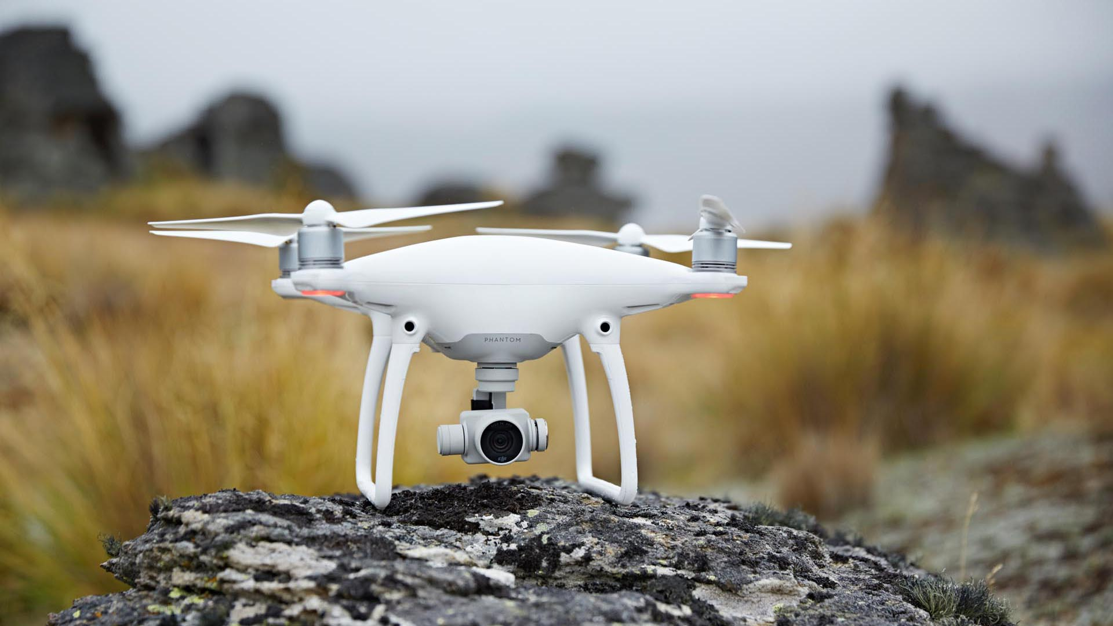
Questions? Comments
Associated Press

