Slide 1
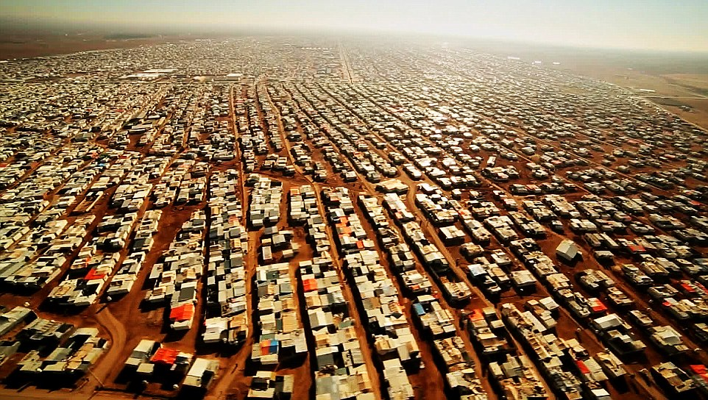
Where to place refugee camps? Suitable sites in Turkey for Syrian Refugees
By: Nouman Hussain
Geography 596A – Summer 2016
Advisor: Dr. Justine blanford

Slide 2

Table of Contents
Background
  Refugees: Why this is a problem
  Driving Factors
  Routes & Destinations
  Suitable Refugee Camp Locations
Objectives
Methodology
  Criteria and Requirements of Refugee Camps
  Suitability Analysis Past GIS studies for Camp Suitability Analysis
Timeframe for Completion
References

Slide 3


Background
Refugee Crises…Why this is important???
http://www.unhcr.org/en-us/news/latest/2016/6/5763b65a4/global-forced-displacement-hits-record-high.html

Slide 4
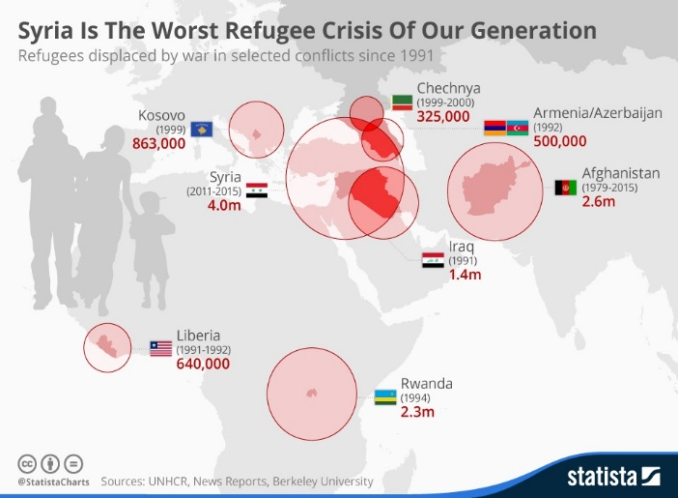
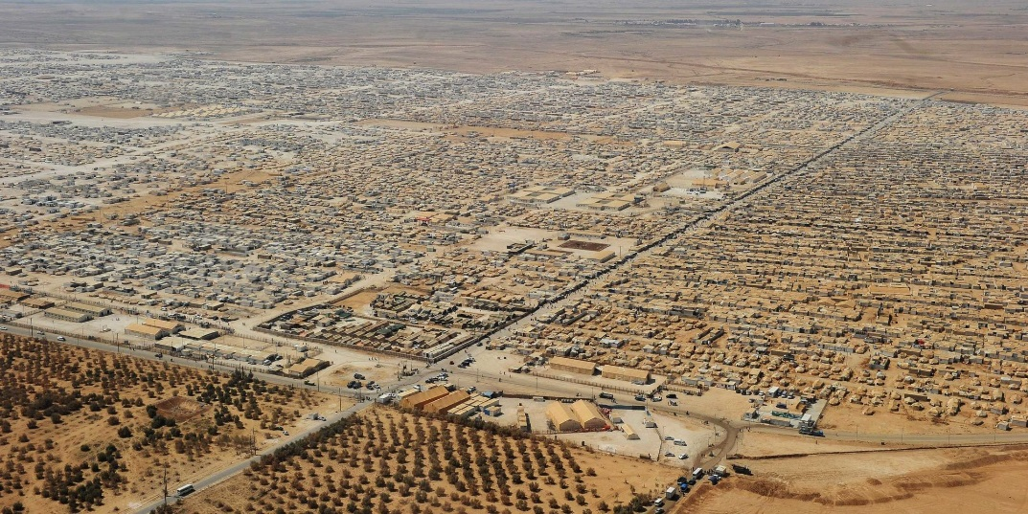
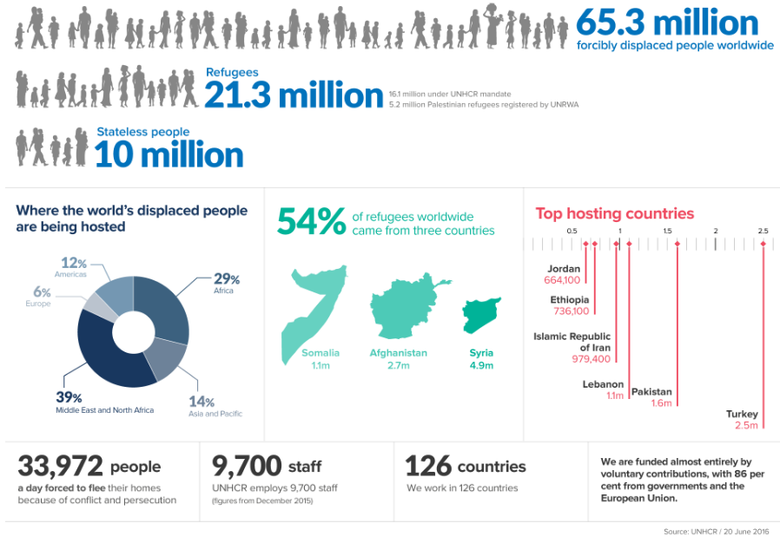
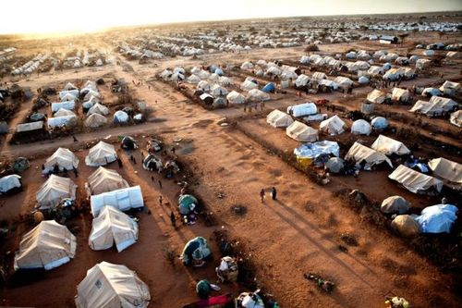
Background
Ariel View of Dadaab Refugee Camp in Kenya
Dadaab Refugee Camp in Kenya, Worlds Biggest Refugee Camp
http://www.unhcr.org/en-us/figures-at-a-glance.html
http://cctv-africa.com/2016/05/21/talk-africa-closing-dadaab-refugee-camp-in-northern-kenya/

Slide 5
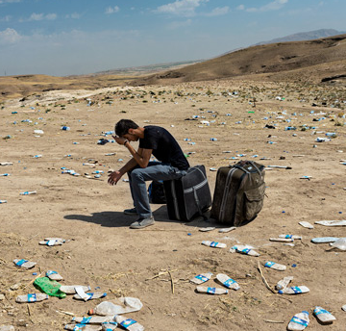
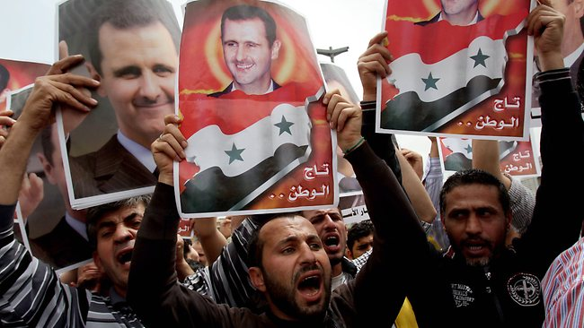

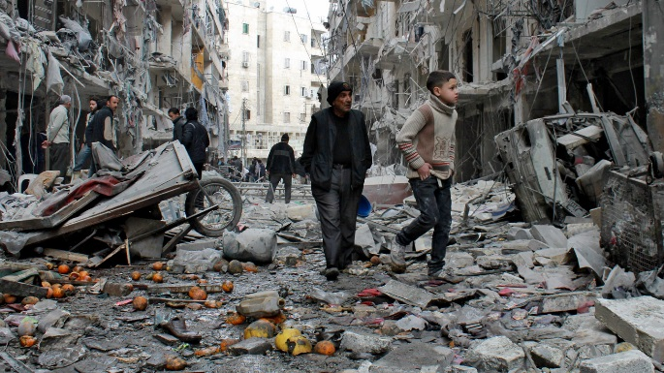
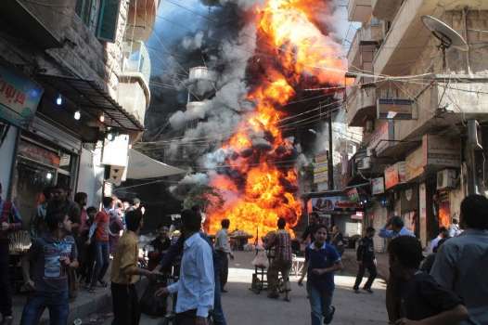
Driving Factors behind Refugee Movement
Political Unrest and War
Collapsed Infrastructure
Natural/Environmental Disasters and Catastrophes
Host Nations do very little to protect its citizens

Slide 6

Destination: Where are they going?
Refugee camps are temporary settlements built to receive refugees and people in refugee-like situations.
Usually they are built and run by a government, the United Nations, or international organizations or NGOs.
However
https://en.wikipedia.org/wiki/Refugee_camp

Slide 7
The role of Refugee Camps
“More and more refugees in the world are in camps that have been there for a really, really long time,….. That wasn’t the original model. Our model was that camps were there just to hold people temporarily until one of these ‘durable solutions’:
sending them back home,
allowing them to settle where they are — with legal rights —
or settle them in a third place.”
Almost all the post-World War II displaced-person, or D.P., camps were closed and their residents resettled by 1952.
But three years ago, the largest refugee camp in the world, Kenya’s Dadaab, turned 20. It was built for 90,000 refugees. It holds more than 420,000.”
http://www.nytimes.com/2014/02/16/magazine/how-to-build-a-perfect-refugee-camp.html

Slide 8
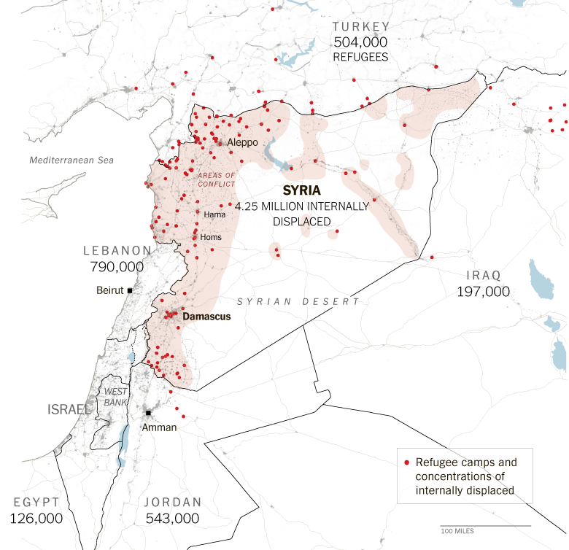
Destination: Where are they going?
Temporary
Close proximity to original home
  Within home country and in neighboring countries regardless of linguistic and cultural ties.
Source: Furst el al, 2013
http://www.nytimes.com/interactive/2013/10/16/world/middleeast/syrian-refugee-crisis-photos.html?_r=0

Slide 9
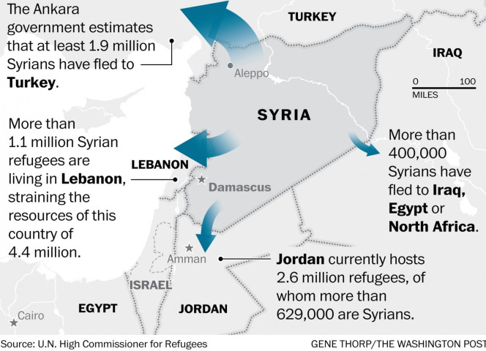
Regional Routes of Syrian Refugees into Neighboring Nations

Slide 10
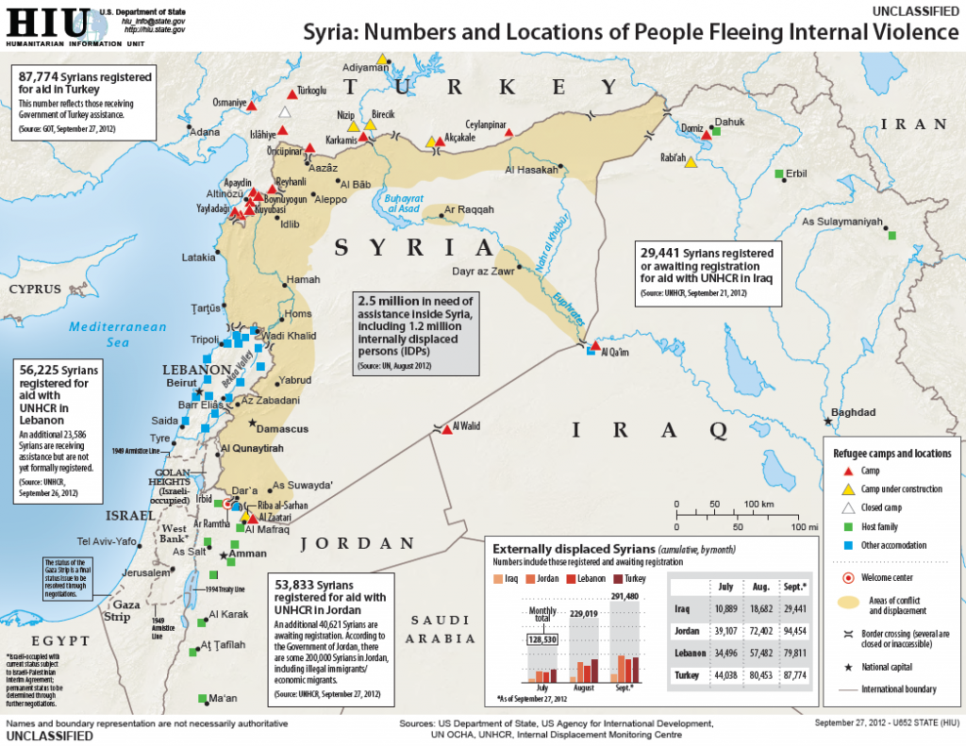

Slide 11
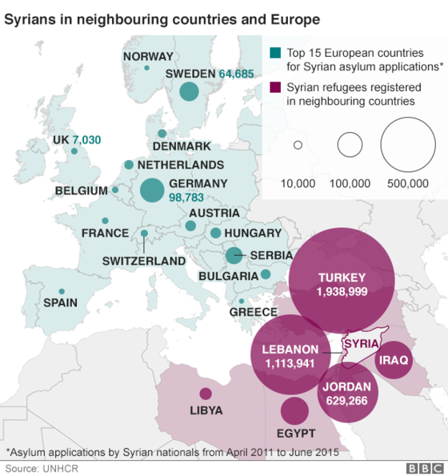
Destination: Where are they going?
Permanent
Permanent migration to destinations further away from place of origin.
Destinations may include: Europe or America
Rodgers et al, 2016
http://www.bbc.com/news/world-middle-east-26116868

Slide 12
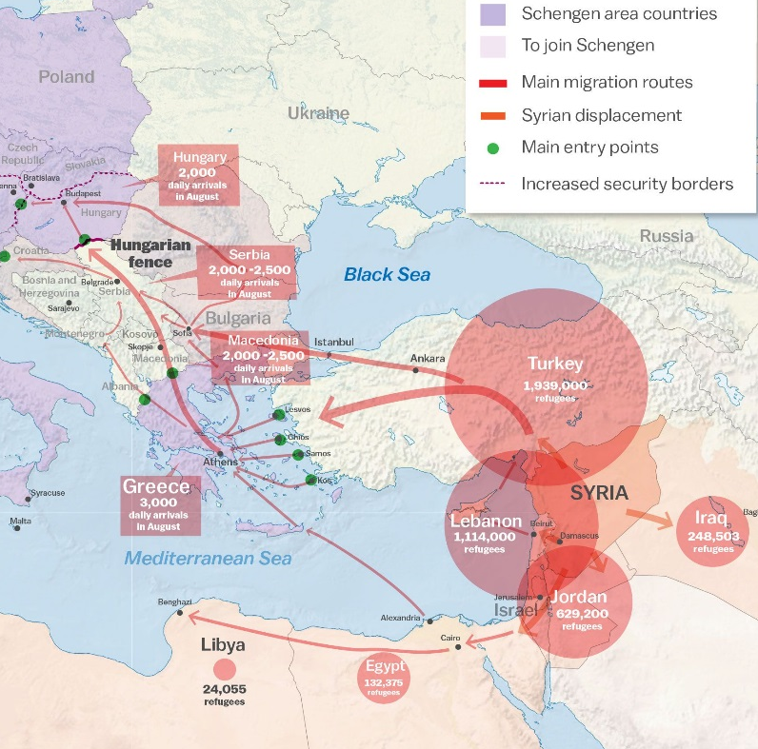
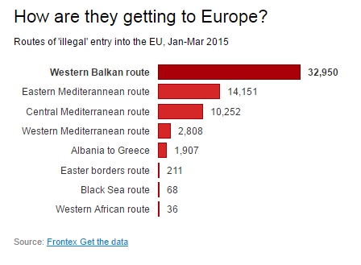
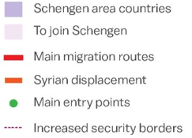
Intercontinental Routes of Syrian Refugees going into Europe
Transit routes, via land and sea, are dangerous and turbulent
http://www.independent.co.uk/news/world/europe/refugee-crisis-six-charts-that-show-where-refugees-are-coming-from-where-they-are-going-and-how-they-10482415.html

Slide 13
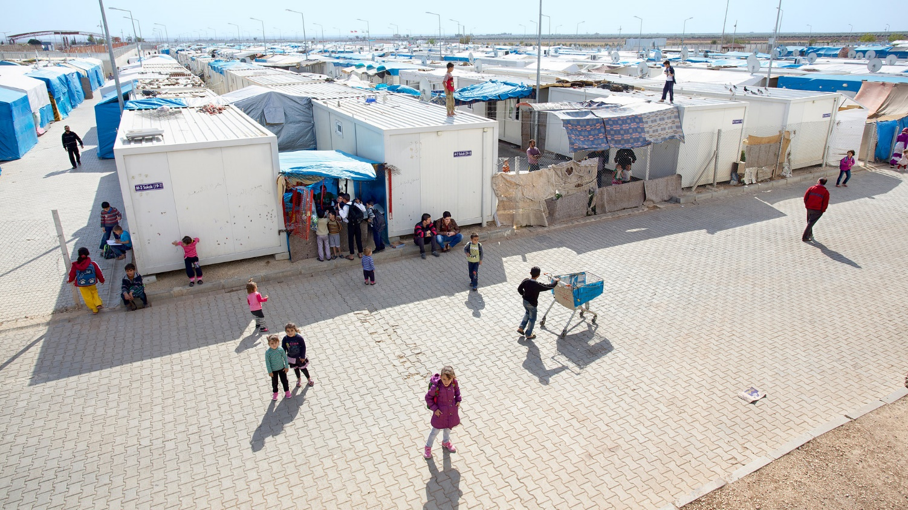
Refugee Camps
Tents
Containers
Kilis, a refugee camp in Turkey near the Syrian border.
Credit Tobias Hutzler for The New York Times
Notes:
http://www.nytimes.com/2014/02/16/magazine/how-to-build-a-perfect-refugee-camp.html

Slide 14
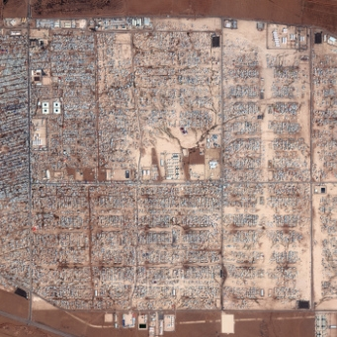
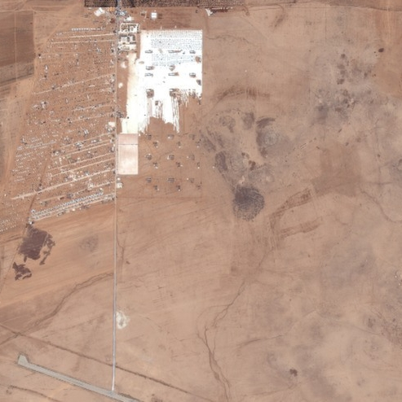
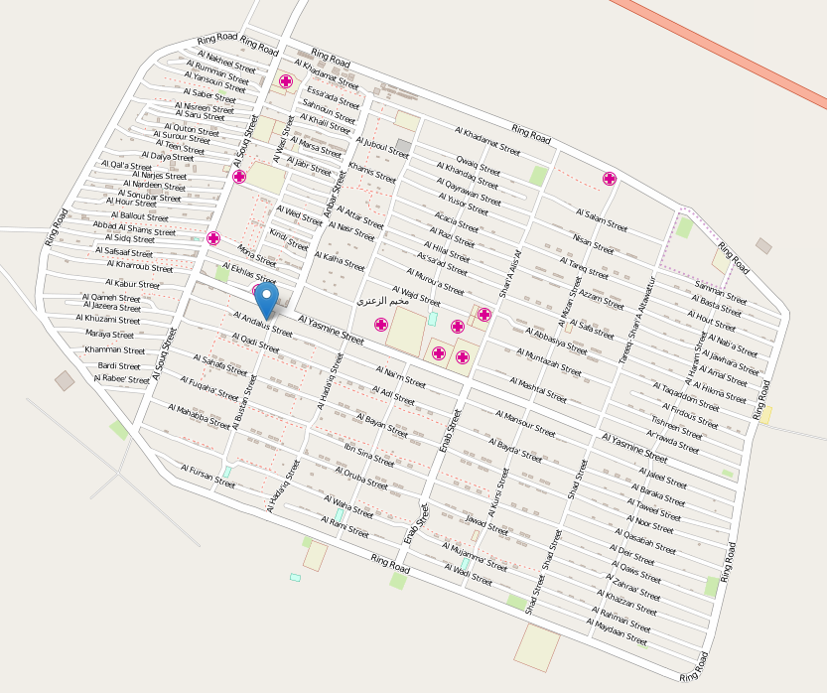
Refugee Camps
Zaatari camp for Syrian refugees in Jordan 2012
Zaatari camp for Syrian refugees in Jordan 2013
Zaatari camp for Syrian refugees in Jordan 2013
Made up of 30,000 shelters and administration buildings, 3 hospitals, and 3 schools.
The camp has expended rapidly to accommodate the influx of Syrian refugees.
Zaatari Camp is one of the first to be digitally mapped in detail via Open Street Maps.
http://www.livedprojects.org/zaatari-refugee-camp/

Slide 15
Requirements for Refugee Camps’ Interior
Shelter: tents, prefabricated huts, or dwellings constructed of locally available materials. (a minimum of 3.5 sqm of covered living area per person. There should be at least 2m between shelters). Gardens: attached to the family plot (plot size of 15 sqm per person).
Hygiene facilities: washing areas, latrines or toilets (One shower per 50 persons and one communal latrine per 20 persons). Distance for the latter should be no more than 50m from shelter and not closer than 6m. Showers should be separated by gender.
Water: Places for water collection (e.g. water tanks where water is off-loaded from trucks (filtered and treated with chlorine), or water tap). 20 litres of water per person and one tap stand per 80 persons that should be no farther than 200m away from households.
Rubbish Collection: One 100 litre rubbish container per 50 persons and one refuse pit per 500 persons.
Health Facilities (clinics, hospitals and immunization centres): one health centre per 20,000 persons and one hospital per 200,000 persons.
Food and therapeutic feeding centres: One food distribution centre per 5,000 persons and one feeding centre per 20,000 persons.
Communication: (e.g. radio, satellite etc)
Security: Protection from banditry (e.g. barriers and security checkpoints) and prevent armed violence.
Schools and training centers: One school per 5,000 persons.
Markets and shops: One market place per 20,000 persons.
Administrative headquarters: To coordinate services (this may be outside the actual camp).

Slide 16
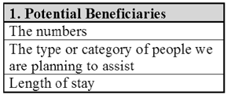
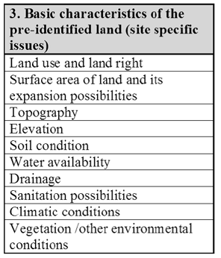
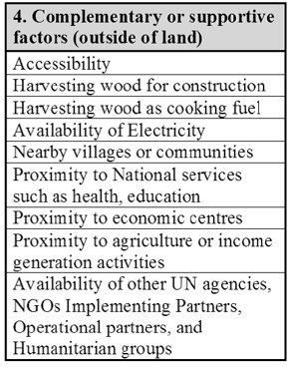
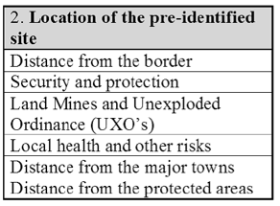
Finding Suitable Sites:
Factors of Importance
https://emergency.unhcr.org/entry/35944/site-planning-for-camps

Slide 17
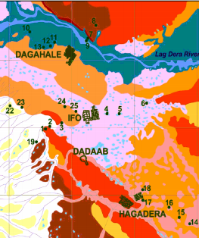
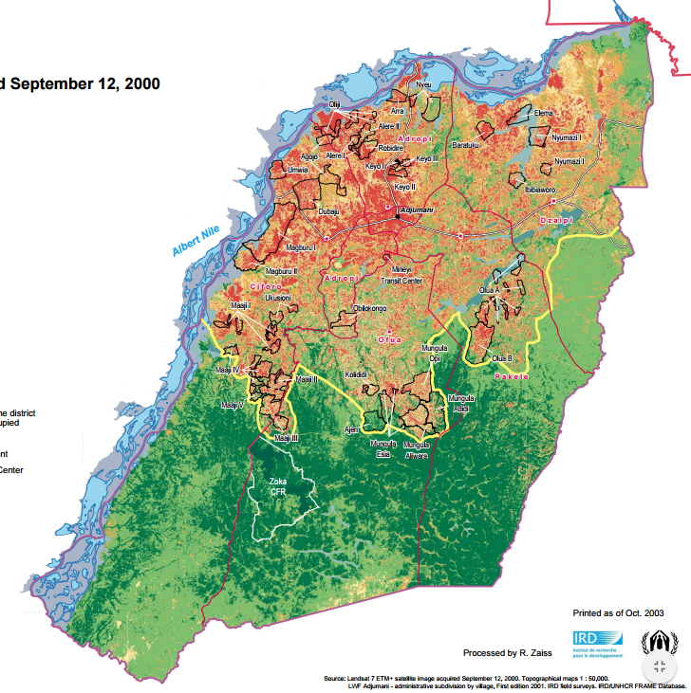
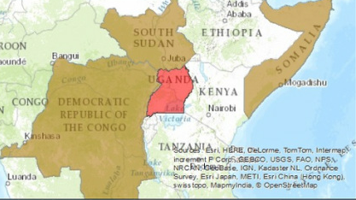
Past GIS Studies to Identify Refugee Camp Locations
Criteria for Site Selection of Temporary Shelters after Earthquake: A Delphi Panel
Site Selection for Refugee and IDP Camps to House Population Displaced from Nigeria
Geographical Information system, environment and camp planning in refugee hosting areas
Site Selection for Refugee Replacement in Uganda
Notes:
Need references and details about these studies

Slide 18
Past GIS Studies to Identify Refugee Camp Locations
Main Category | Criteria
Land suitability | Soil permeability
 | Land slope
 | Vegetation
 | Land ownership
 | Ecological considerations
 | Cultural heritage considerations
Socio-cultural considerations | Proximity to homes of affected people
 | Previous land use
 | Compatible neighboring land use
Service availability | Accessibility
 | Water supply
 | Medical services
 | Relief services
 | Security and protection
 | Electrical networks
 | Communication services
Disaster risk reduction | Geological hazards
 | Hydro- meteorological hazards
 | Environmental diseases
 | Secondary hazards
 | Polluting industries
Soltani et al (2015) identified 21 key criteria used to select sites for temporary shelters after earthquakes.
http://urpjournals.com/tocjnls/13_13v3i3_4.pdf
http://www.ncbi.nlm.nih.gov/pmc/articles/PMC4667771/

Slide 19
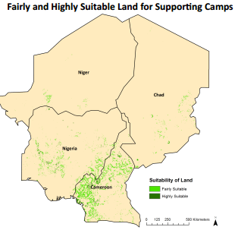
Past Studies: Using GIS for planning refugee camps
Spike (2015) used site suitability analysis for refugees and IDP camps to house population displaced from Nigeria.
Criteria used included:
  land-use, distance from roads, distance from surface water, slope, distance to highest areas of violence/unrest.
https://sites.tufts.edu/gis/files/.../Spink_Lauren_DHP207_2015.pdf

Slide 20
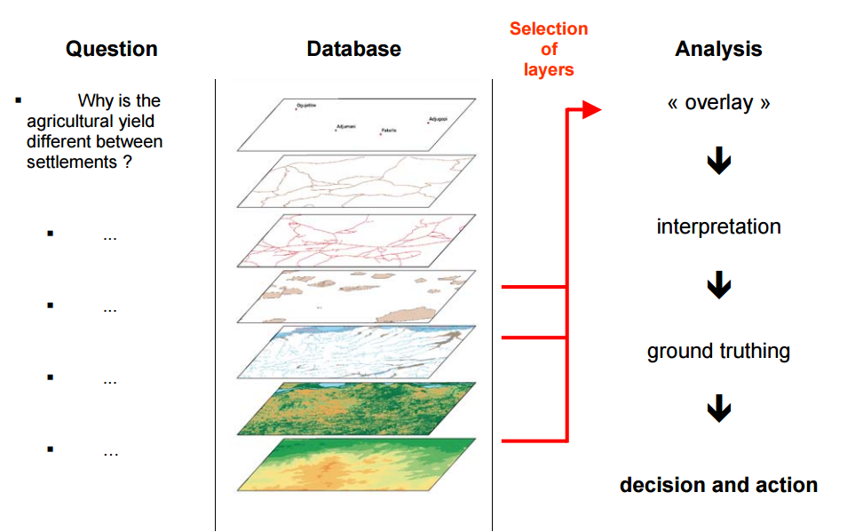
Past Studies: Using GIS for planning refugee camps
Beaudou et al (2003) used GIS planning refugee camps
Socio-economic and environmental data included were:
  population densities, the proximity of facilities;
  topographic relief, climate, hydrography, soils, and vegetation.
Beaudou A., Cambrézy L., Zaiss R., "Geographical Information system, environment and camp planning in refugee hosting areas: Approach, methods and application in Uganda," Institute for Research in Development (IRD); November 2003.
Notes:
http://www.cartographie.ird.fr/refugies/biblio-uganda.html

Slide 21
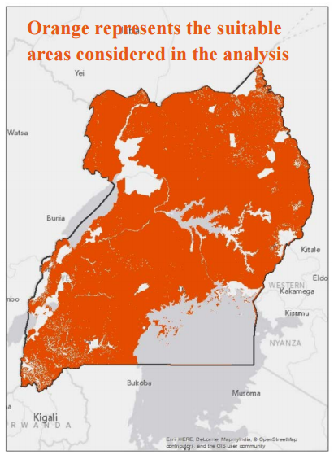
Past Studies: Using GIS for planning refugee camps
Mong et al (2014) used GIS to determine the best locations for refugee camps for IDPs entering Uganda.
Methodology used was surface overlay/ Multi-criteria decision analysis (MCDA)
Suitable sites were identified by combining 16 reclassified data layers using a weighted overlay.
http://gisforgood5.weebly.com/our-project.html
Notes:
http://gisforgood5.weebly.com/our-project.html

Slide 22
Essential Criteria for Suitable Refugee Sites
Based on the literature of previous GIS studies, there are a number common criteria to consider as follows:
Natural Environmental Criteria
Proximity to Water
Flood Risk
Drought Risk
Elevation
Terrain
Slope
Land Use
Soil Type
Social-Economical Criteria
Proximity to Roads
Proximity to Cities
Proximity to Health Centers
Proximity to Education Centers
Proximity to Electrical Networks
Proximity to violence / unrest

Slide 23
Research Questions
What are the factors affecting site suitability for refugees in Turkey?
  Essentially what are the minimum criteria needed to determine suitable refugee sites
Where should new sites be located, if needed?

Slide 24
Objectives of Study
Objective 1 – Develop a methodology to determine most suitable sites for refugee camps within Turkey based on environmental and social constraints.
Objective 2 – Determine best sites for future refugee camps in Turkey which will more than likely expand over the years.

Slide 25
Data Sources for Analysis
Subject | Description | Source | Format | Resolution | URL
Administrative areas (boundaries) | Country outlines and administrative subdivisions for all countries. | GADM, version 1.0 | Vector (area) | - | http://www.diva-gis.org/gdata
Inland water | Rivers, canals, and lakes. Seperate files for line and area features | Digital Chart of the World | Vector (line and area) | - | http://www.diva-gis.org/gdata
Roads | Roads | Digital Chart of the World | Vector (line) | - | http://www.diva-gis.org/gdata
Railroads | Railroads | Digital Chart of the World | Vector (line) | - | http://www.diva-gis.org/gdata
Elevation | SRTM30 dataset. CGIAR-SRTM data aggregated to 30 seconds | CGIAR SRTM (3 seconds resolution) | Raster | 30 seconds | http://www.diva-gis.org/gdata
Land cover | Land cover, original data resampled onto a 30 seconds grid | GLC2000 | Raster | 30 seconds | http://www.diva-gis.org/gdata
Population | Population density (old) | CIESIN, 2000. Global gridded population database | Raster | 30 seconds | http://www.diva-gis.org/gdata
Climate | Monthly climate data | WorldClim | Raster | 30 seconds | http://www.diva-gis.org/gdata
Gazetteer | A gazetteer is a list of place names and their coordinates. The files you can download here are for use in DIVA for automatic georeferencing (to assign coordinates to places). | U.S. National Imagery and Mapping Agency's (NIMA) database offoreign geographic feature names | DBF | - | http://www.diva-gis.org/gdata

Slide 26
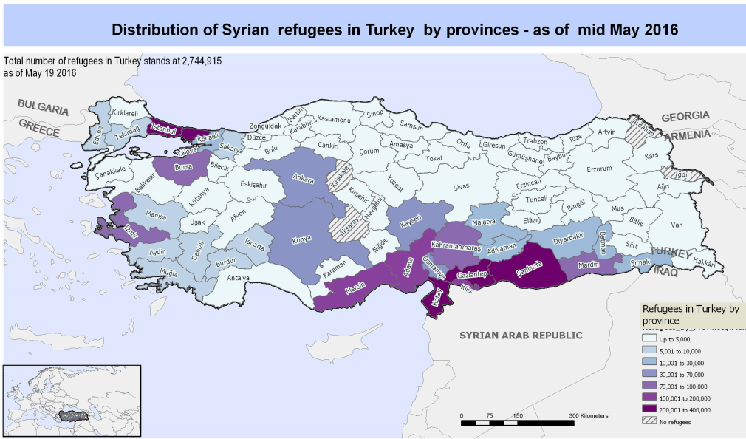
Study Location of Refugee Camps
Notes:
My study focus is on determining the best locations to build refugee camps in Turkey. As I mentioned in the background, the majority of refugees living in Turkey are Syrians.
There are over 2 million registered Syrian refugees living in Turkey, both inside and outside the government-run camps.
Sanliurfa Province, near the border with Syria, has camps housing 100,000 Syrians.
Living conditions are inadequate, however are the best when compared to standards of refugee camps.

Slide 27
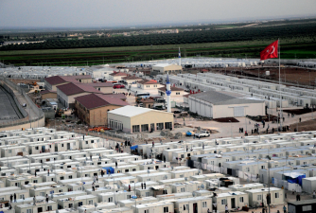
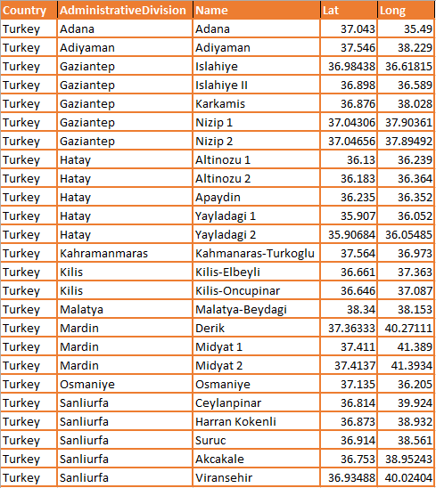
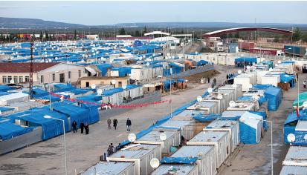
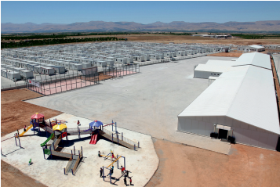
Refugee Camps Attribute List

Slide 28
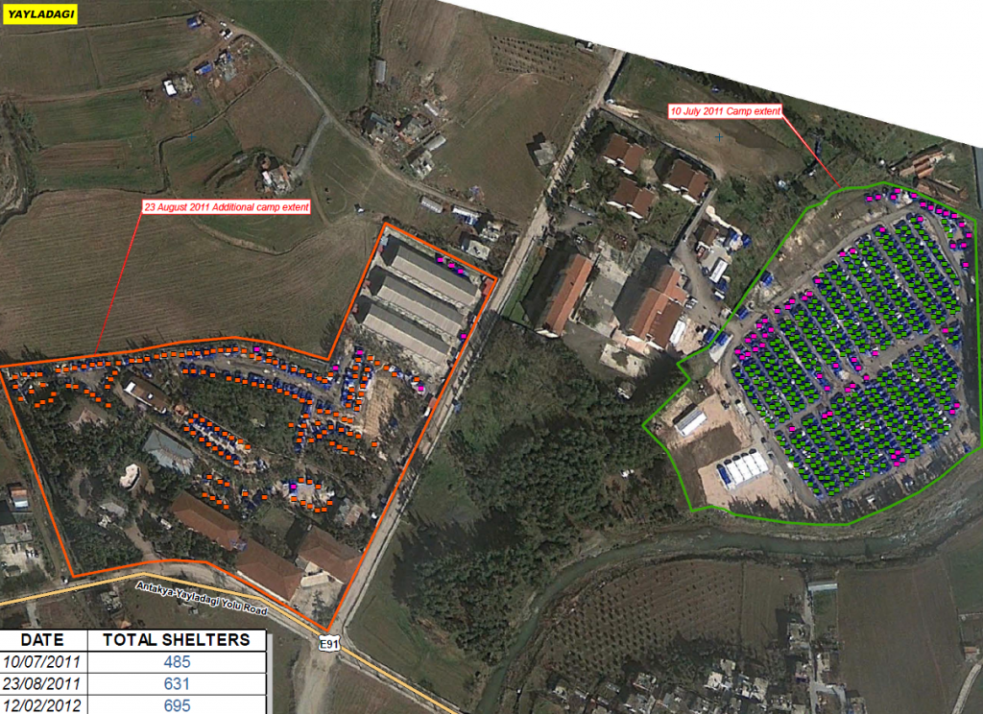
Turkey
Yayladagi Camps, Yayladagi District, Hatay Province, Turkey
Syria
https://publicintelligence.net/syrian-refugee-camps/

Slide 29
Methodology
Initial Input Layer | Geoprocessing Tool | Geoprocessing Tool | Intermediate tool | Geoprocessing Tool | Final Output Layer
Cities/Roads
Euclidean Distance
Reclassify
Reclassified Cities/Roads
Waterways
Euclidean Distance
Reclassify
Reclassified Waterways
Elevation
Slope
Reclassify
Reclassified Slope
Weighted Overlay
Suitable Future Camp Sites
Land-Use
Reclassify
Reclassified
Land-Use
Existing Camps
Euclidean Distance
Reclassify
Reclassified Existing Camps
Weighted Influence Index = (.15*Cities)+(.20*Waterways)+(.30*Elevation)+(.20*Land-Use)+(.15*Existing Camps)

Slide 30
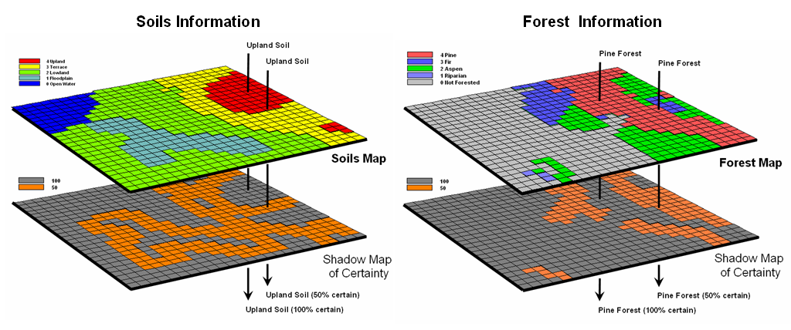
Rules to be applied to Data Source Layers
Population density: 10-30k inhabitance
Distance from cities: 1-5 km
Distance from water: 1-2 km
Distance from roads: 1-5 km
Flood risk: Ma 3 floods in area
Drought risk: Soil Moisture between 20-30 percentile
Elevation: 300-900 meters
Slope: >25%
Land use: Forest/Savanna, Open Grasslands with sparse shrubs
Distance from Borders: 20-30k
http://www.innovativegis.com/basis/mapanalysis/topic22/topic22.htm

Slide 31
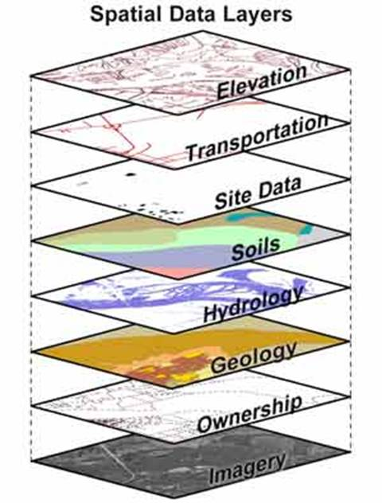
Expected Results
A model that can be used to identify suitable camp locations.
Map showing suitable locations to place a refugee camp.
Notes:
Where is this from? Need to include reference. Is this a report?

Slide 32
Timeline / Conference
Data retrieval / cleaning / parsing (01 Aug 2016 – 15 Aug 2016)
Data Analysis and Modeling for Data based on SME’s input for criteria for camps (15 Aug 2016 – 30 Sep 2016)
Compare results with existing camps (01 Oct 2016 – 15 Oct 2016)
Add future limitation for more robust Refugee Camp GIS Model (15 Oct 2016 – 30 Oct 2016)
I plan to present this methodology with final results at the ESRI Southeast Users’ Conference.

Slide 33
References
Adayley, Raad. "Inside the Largest Syrian Refugee Camp - Zaatari Camp Three Years on." The Telegraph. N.p., Apr. 2015. Web. <http://www.telegraph.co.uk/news/worldnews/middleeast/jordan/11782854/Inside-the-largest-Syrian-refugee-camp-Zaatari-camp-three-years-on.html?frame=3397373>.
Al-Issa, Khuder. "UNICEF Syria Crisis SitRep May 2016." (2016): n. pag. Syria Regional Refugee Response. Inter-agency Information Sharing Portal, 27 June 2016. Web. <www.data.unhcr.org/UNICEFSyriaCrisisSitRepMay2016.pdf>.
Balanche, Fabrice. "Why Now? The Syrian Refugee Flow to Europe." The Washington Institute for Near East Policy. N.p., 2 Nov. 2015. <http://www.washingtoninstitute.org/policy-analysis/view/why-now-the-syrian-refugee-flow-to-europe>.
Bigot, Antoine, Lucie Blok, Marleen Boelaert, Yves Chartier, Piet Corijn, Austen Davis, Murielle Deguerry, Tine Dusauchoit, Florence Fermon, Andre Griekspoor, Myriam Henkens, Jean-Pierre Huart, Francois Jean, Pim Scholte, Nathalie Sohier, Willem Van De Put, Saskia Van Der Kam, Stefaan Van Der Borght, Stefaan Van Praet, and Francoise Wuillaume. "Refugee Health - An Approach to Emergency Situations." Médecins Sans Frontières (1997): n. pag. Web. <http://refbooks.msf.org/msf_docs/en/refugee_health/rh.pdf>.
Doyle, Mark, and Helene Caux. "Nigerian Refugees Move from Volatile Border Zone in Cameroon." The UN Refugee Agency. N.p., 21 July 2015. <http://www.unhcr.org/en-us/news/latest/2015/7/55ae61746/nigerian-refugees-move-volatile-border-zone-cameroon.html>.
Edwards, Adrian. "New UNHCR Report Says Global Forced Displacement at 18-year High." The UN Refugee Agency. Ed. Jack Redden. N.p., 19 June 2013. <http://www.unhcr.org/en-us/news/latest/2013/6/51c071816/new-unhcr-report-says-global-forced-displacement-18-year-high.htmlChromeHTML.JYGIUBEXQQFVPYP7DGBE332UKI/Shell/Open/Command>.
Edwards, Adrian. "Seven Factors behind Movement of Syrian Refugees to Europe." UNHCR News. N.p., 25 Sept. 2015. <http://www.unhcr.org/en-us/news/briefing/2015/9/560523f26/seven-factors-behind-movement-syrian-refugees-europe.html>.
"Forced to Leave Home." Human Rights Now. N.p., 10 Nov. 2008. <http://blog.amnestyusa.org/refugees/forced-to-leave-home/>.
Hassune, Yahya. "Using GIS Technology to Map Shelter Allocation in Azraq Refugee Camp." UNHCR Innovation. N.p., 15 Jan. 2016. <http://innovation.unhcr.org/using-gis-technology-map-shelter-allocation-azraq-refugee-camp>.

Slide 34
References
Huber, Chris. "Google Map Perspective: A Refugee's Journey Walking from Syria to Serbia." World Vision. N.p., 18 Sept. 2015. <http://www.worldvision.org/news-stories-videos/google-map-refugees-walking-syria-serbia>.
Jonson, Brian. "Syria Refugee Crisis FAQ: How the War Is Affecting Children." World Vision. N.p., 8 June 2016. <https://www.worldvision.org/wv/news/Syria-war-refugee-crisis-FAQ>.
Kelley, Collin. "Climate Change in the Fertile Crescent and Implications of the Recent Syrian Drought." Proceedings of the National Academy of Sciences. N.p., 10 Jan. 2010. <http://www.pnas.org/content/112/11/3241.full>.
Mahamud, Abdirahman, Ann Burton, Mohamed Hassan, Jamal Ahmed, John Wagacha, Paul Spiegal, Chris Haskew, Rachel Eidex, Sharmila Shetty, Susan Cookson, Carlos Navarro-Colorado, and James Goodson. "Risk Factors for Measles Mortality Among Hospitalized Somali Refugees Displaced by Famine, Kenya." Oxford Journals. Clinical Infectious Diseases, 2 July 2012. <https://cid.oxfordjournals.org/content/early/2013/07/18/cid.cit442.full>.
Marchand, Katrin. Afghanistan Migration Report. Rep. N.p., 2014. <www.merit.unu.edu/publications/uploads/1442239958.pdf>.
Mockenhaupt, Frank P., Kira A. Barbre, Mogens Jensenius, and Carsten S. Larsen. "Profile of Illness in Syrian Refugees: A GeoSentinel Analysis, 2013 to 2015." Euro Surveill. Eurosurveillance 21.10 (2016): n. pag. Eurosurveillance. 10 Mar. 2016. <http://www.eurosurveillance.org/images/dynamic/EE/V21N10/art21407.pdf>.
Ozden, Senay. "Syrian Refugees in Turkey." MPC – MIGRATION POLICY CENTRE (n.d.): n. pag. Syrian Refugees A Snapshot of the Crisis – in the Middle East and Europe. May 2013. Web. <http://www.migrationpolicycentre.eu/docs/MPC-RR-2013-05.pdf>.
"Refugees." International Encyclopedia of the Social Sciences. 1968, David M. Reimers, "Refugees." Dictionary of American History. 2003, "Refugees." International Encyclopedia of the Social Sciences. 2008, "Refugees." West's Encyclopedia of American Law. 2005, "refugee." The Columbia Encyclopedia, 6th Ed. 2016, "refugee." The Oxford Pocket Dictionary of Current English. 2009, "refugee." World Encyclopedia. 2005, "Refugees." Encyclopedia of the Modern Middle East;North Africa. 2004, and "refugee." Oxford Dictionary of Rhymes. 2007. "Refugees." Encyclopedia.com. HighBeam Research, 01 Jan. 1968. "Refugees." International Encyclopedia of the Social Sciences. 1968. "Refugees." Encyclopedia.com. HighBeam Research, 01 Jan. 1968. Web. 14 June 2016. <http://www.encyclopedia.com/topic/refugee.aspx>.
Sirin, Selcuk, and Lauren Rogers-Sirin. "The Educational and Mental Health Needs of Syrian Refugee Children." National Center on Immigrant Integration Policy (2015): n. pag. Migration for Development. Oct. 2015. <http://www.migration4development.org/sites/default/files/fcd-sirin-rogers-final_0.pdf>.

Slide 35
Thank you
Questions?

