Slide 1
Crisis Mapping applications of google maps engine
Joel Irish | GEOG 596A Peer Review Presentation | May 5, 2014

Slide 2
Introduction
Why did I chose this capstone project?
Crisis Mapping is young
Google Maps Engine is even younger.
Research Gap
Personal
Academic
Professional
Notes:
Over the past few years, I’ve given a lot of thought to what I wanted to pursue as a Capstone topic. I had a lot of wild ideas, but the goal was always to do something at the nexus of my personal, professional, and academic lives. On a personal level, I have a lot of interest in crisis mapping, for a few different reasons but generally just because it feels good to do geography that impacts people’s lives in a positive way. Professionally, I work on the Ground Truth program at Google Maps, where among other things, I provide data level support for Google Maps Gallery, Geopolitical, and Crisis Response teams. Finally, I wanted to integrate my Penn State studies, particularly those related to cloud GIS, geospatial intelligence, data fusion, and cartography.
And the fact that web-based crisis mapping is very young as a discipline and Google Maps Engine is even young, I saw an opportunity to delve into a research gap that hadn’t yet been explored

Slide 3
Introduction
Refining the problem
Crisis Management
Crisis Mapping
Crisis Mapping with Google Maps Engine
Notes:
While my project is about GME crisis map applications, but I think it is important to start with the biggest problem, then peel back the onion, down to the smaller, more manageable problem. So I am structuring the first part of my presentation as a series of nested problems, one leading to the next.”

Slide 4
Top-level Problems
When crises occur, one of the most valued commodities among
stakeholders is geospatial information.
Acquiring and communicating actionable data is challenging.
Data should be:
Timely Accurate
Complete Contextual
Different stakeholders, different problems…
Notes:
At the highest level during crises, one of the most valued commodities among stakeholders is geospatial information. But it can be challenging to gather such information that meets these criteria. It can actually be hard to gather these even without a crisis happening.
“Timely” does not only mean current, but also invokes the necessity of temporal alignment. Imagine jurisdictions attempting to cooperate in an emergency mgt effort, but each agency is updating their data at different intervals.
“Accurate” and “Complete” data are important criteria for obvious reasons. “Contextual” data are also necessary, since we rarely make decisions based only on a single variable – we try to know all the relevant data and how they influence one another.
Different stakeholders, different problems
--so when I talk about “crisis management”, I am not only interested in how, say, the FEMA director or Police chief is operating, but in an all groups of people that are in some way managing their situation with respect to the disaster.

Slide 5
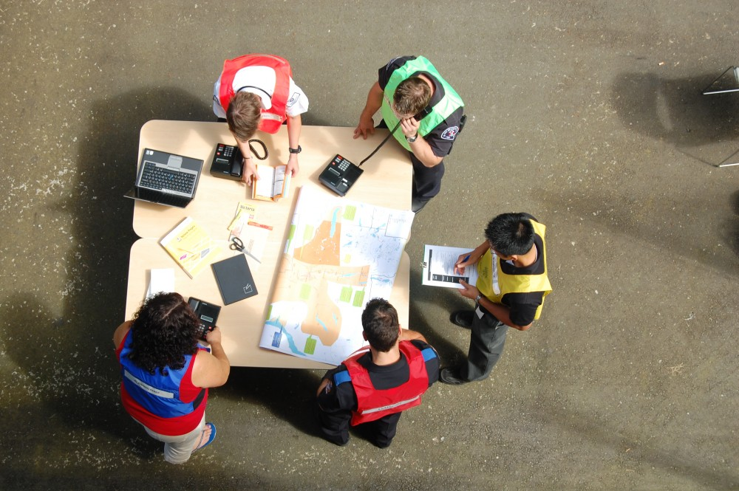
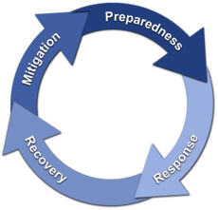
Top-level Problems
Emergency Management Problems
Damaged infrastructure
Multi-jurisdictional
data management
communication
Differing degrees of preparedness
Systems reliability
Phases of Emergency Mgt
Notes:
First, I will mention a few of the challenges that emergency managers may face in a crisis.
Infrastructure is very important in crisis management but can be compromised by the disaster itself.
Depending on the scope of the crisis, a manager may need to coordinate several jurisdictions and facilitate communication among them. Those jurisdictions may also have invested differently on disaster preparedness.
“Systems reliability” here refers to how well systems function during the event (regardless of physical damage). For exampleAre cell phone towers overloaded? Web sites crashing? Are there too few first-responders in a given section of a city?
Also, the management team may experience different problems during different phases of the crisis.

Slide 6
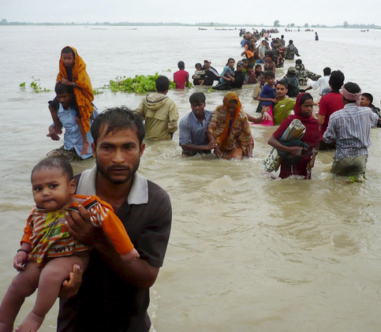
Top-level Problems
Victims within an impacted area
Family and friends of those victims
Damaged infrastructure
No information
Unreliable information
Evacuation routes
Shelter
Food and water
Notes:
The victims in a crisis are obviously dealing with the challenges caused by the crisis. And their friends and family may be desperate to understand the situation on the ground.
Again, damaged infrastructure – roads, telephone lines, radio – these are all going to impact the victims ability to react to the crisis.
“No information” - goes both ways. The victim might not be able to receive good info, but also may be unable to tell first-responders and relief workers about their condition.

Slide 7
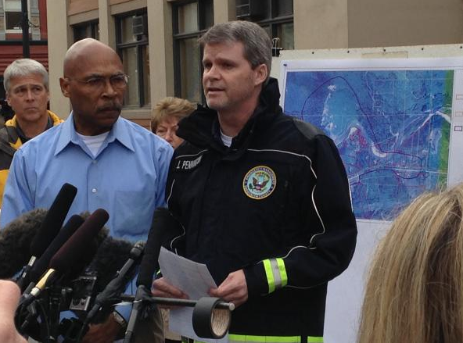
Top-level problems
In the heat of a crisis, complete, accurate,
contextual information may not reach the
broader community.
Media
NGOs, Non-Profit Orgs
Governments
Notes:
Finally, the rest of the world wants to know what is happening in a crisis. The broader community includes members of the media, NGO directors, and government officials who require high quality and complete data to make good decisions. These maps can also be useful tools to drum up support from orgs and individuals worldwide.

Slide 8
What is crisis mapping?
And how does it address these issues in crisis management?

Slide 9
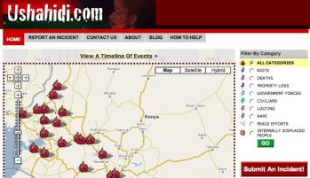
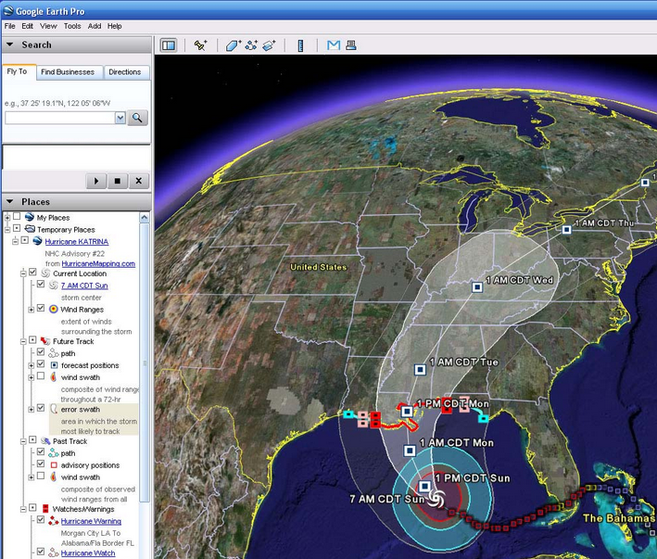
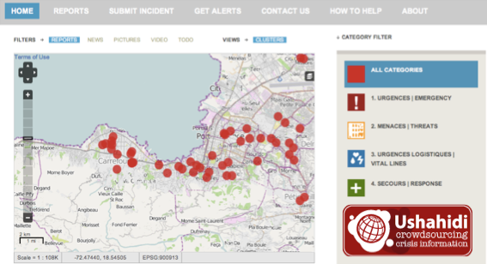
Literature review
Defining the “crisis map”:
Crisis maps draw on multiple disciplines to gather, analyze and communicate a variety of geospatial information in support of crisis management efforts.
Modern history of crisis maps
Google Hurricane Katrina 2005
Ushahidi Kenya Elections 2007
Ushahidi Haitian earthquake 2010
Notes:
This is my own definition – sort of a Frankenstein of other definitions found on the web.
These disciplines include: information communication technology (ICT), GIS, imagery analysis, social media, volunteered geographic information, software development, database management and journalism.
Some history…
During the devastation of Hurricane Katrina, a handful of Google developers used Google Earth to pull together geospatial information about the hurricane and with current satellite imagery of the area. It was quickly adopted in the relief effort.
The next milestone for crisis mapping is the platform built by Ushahidi. Ushahidi is a non-profit org that develop crisis mapping software. It was born from the need for technology that could support hundreds of crowd-source reports of violence during the 2007 contested elections in Kenya.
Then, in 2010, Ushahidi mapped out reports from Haiti after their earthquake hit. This map is widely believe to a literal life-saver in Haiti. And it was significant because it was the first time distant map volunteers organized to translate messages in Haitian Creole, geocode locations, and other processing on the data.
All three of these maps made it clear that crisis maps can have extraordinary benefits.

Slide 10
Literature review
Current expectations of crisis maps
Cloud architectures
Web cartography & geovisual analytics
Usability design
Interactive and distributable
Mobile support
Notes:
“Crisis maps rely on Cloud Architectures:
The cloud solves a handful of very important challenges within crisis management. First, reliability. Particularly, if local servers are offline as a direct result of the crisis, the maps and data will be more accessible if hosted at a distant data center. The use of the cloud-hosted crisis map will also scale better than one hosted on a small office server. A crisis map may work fine when only a few government employees are testing it out, but a cloud-base web map will remain stable even when it receives a tremendous spike in traffic.
With respect to a crisis map’s cartography, the symbology should make sense to a typical user and operate well at the appropriate scales.
Geovisual analytics is a field that aims to synthesize a variety of data in ways that are quickly meaningful to the reader. To meet such goals for a crisis map application, the platform needs to allow for extensive user interaction and reflect data changes in close to real time.
Usability design refers the process of testing the web map design iteratively with users. Such testing can help apply the right level of complexity within a map according to the motivation the user has in deciphering it.
Obviously, mobile plays a key role in crises. There is a good paper by the GeoCollaborative Crisis Management project at Penn State’s GEOVista program which argues necessity that software interfaces be supported by mobile devices, as well as desktop machines. The rapid adoption of smart, mobile devices worldwide makes it clear that this is becoming more and more relevant.

Slide 11
Literature review
Data Source Trade-offs
 | Authoritative | Crowd-Sourced
Advantages | More likely to have complete metadata More consistent data collection methods within a jurisdiction Validity, curated by GIS professionals | Large scale Capable of near real-time communication Transparency Crowd-feeding
Disadvantage | Slow release Data buried in sites or servers Licensing constraints “data hugging”, defensive government reluctance to give up control Inconsistent data storage, structures among jurisdictions | Spam Additional processing required Difficult pattern detection Digital Divide
Notes:
During my research, I read a lot about the certain aspects of crisis map data and how the source of such data can play a significant role. Typically, the discipline will classify data sources as “Authoritative” or “Crowd-sourced” (This is not to say that crowds cannot produce quality data, just that they differ from official agencies and organizations) While there is generally some consensus that crisis maps can produce meaningful results, many authors call attention to the drawbacks of each source of data, as well their advantages.
So let me briefly highlight some of these. Authoritative data benefits from having professionals, who have gathered data within a consistent criteria, and are more likely to include detailed metadata. On the other hand, authoritative data can move slower or be obscured in the nether regions of a sprawling website. Licensing is a major issue – outside of the scope of this project – but certainly warrants mentioning since that can be a major hurdle in sharing authoritative data. Data hugging is often described as a disorder in governments; when agencies cling to expensive or proprietary data.
There are significant benefits to crowdmapping as well – some crises have had enormous citizen engagement and that information, once processed, can be mapped very quickly. There is a sense of transparency working with crowdsourced data that might not be achieved by a governmetn agency or corporation. And crowdfeeding is a phenomenon in which victims use the platforms to communicate with one another.
The potential pitfalls of crowd-sourced data are of course Spam and the noise created by thousands of reports – running the range of usefulness. This can make pattern detection difficult for emergency managers. The digital divide may be shrinking but still has an impact on the who, what, and where about the data.

Slide 12
Second-level Problems
Crisis Map technology is evolving faster than our ability to completely understand its suitability, effectiveness and impact. [Shanley, 2013]
Acknowledging risks
Privacy
Security
Espionage
Additional Challenges
Costs
Reliability
Ubiquity
Distribution
Notes:
This gets us down to the second layer of the onion. Crisis map technology is evolving faster than our ability to completely understand its suitability, effectiveness and impact.
So certainly there are certain ethical risks, such as privacy, security, and espionage. Users on twitter or elsewhere may be unaware how their information is being used, or may be unaware entirely. Individuals may be captured in photos or videos uploaded to a crisis map, despite having given no consent.
Crisis mappers may also be subject to retaliation. Such was the case in 2012, when Mexican citizens who tracked and published the movement of drug cartels in Nuevo Laredo
Finally, it is also important to realize that crisis mapper are subject to the laws of the land which they are doing the mapping. For example, in China, some surveying and mapping by foreigners is considered “a threat to national defense and economic security”.
Of course, there are a number of other challenges to crisis mapping as we would expect. The costs or reliability of a crisis map may make it unfeasible. And we expect a crisis map to exist on a ubiquitous platform, one that is easily accessible and shareable to all.

Slide 13
Final Problem Statement: Research Gap
It is still unclear how well and in which ways Google Maps Engine has served and can serve as an effective crisis mapping platform.
Notes:
GME is another technological tool in the field of crisis mapping, yet it has not had any sort of academic critique.
So this project aims to discover how well and in which ways GME can serve as an effective crisis map platform.
It may be worth mentioning that my goal is not to try to show that GME is a better platform than other crisis maps. Rather, the goal is to determine whether GME, in its own right, is a feasible software for crisis management.

Slide 14
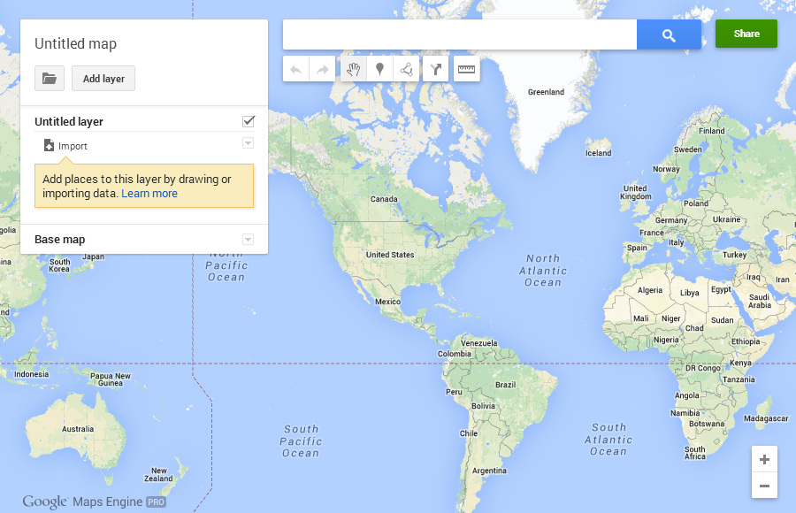
Google Maps Engine 101
Overview and history
Software as a Service
What it does, its purpose
Continuously developing and growing as a product
Notes:
Let me take a minute to give some background on GME as it is a very young product. It is something of a new incarnation of Google’s My Maps and Earth Builder. It allows users to digitize features or upload datasets on top of Google’s basemap, and hosts the information on Google’s cloud. In this way, it typically works as a Software as a Service, but developers can also use the GME API which gives them more control over the platform.
The product continues to get a lot of developer attention within Google and I expect its functions to continue growing over time.

Slide 15
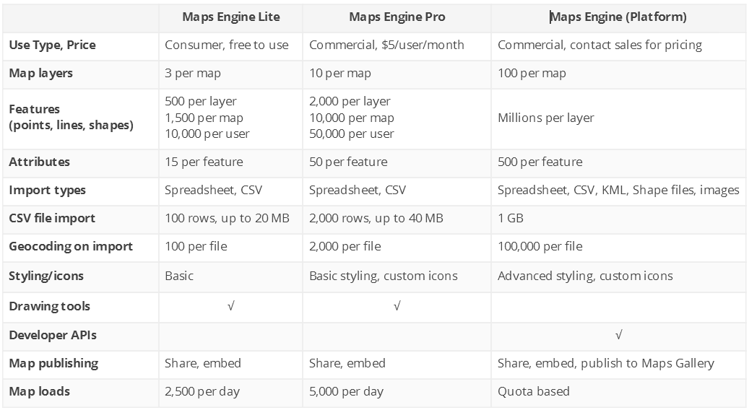
The GME “TriForce”
Cost
Function
Notes:
It’s important to recognize the Google Maps Engine currently embodies three different versions, with varying degrees of functionality and cost. For what it’s worth, many people on the Maps Engine team are well aware that the names are horribly confusing.
Google Maps Engine Lite is the entry level product – free and very easy to use. Gives novice mappers a platform to digitize features and share their maps online at no cost.
Google Maps Engine Pro is the next level up. In many ways, it is a similar product as Lite – simple graphical UI – but with fewer data upload limits, higher geocoding allowances, and more customizable.
The most capable product is known simply as Google Maps Engine. It has far fewer real data limitations, supports tabular data, shapefiles, kml, images, GeoTIFF and terrain. Additionally, it allows for some advanced styling and maps can be published to the Google Maps Gallery. However, with the exception of academia and non-profit orgs obtaining a grant license, the full platform version of GME can cost tens of thousands of dollars.
The chart on the right has more detail than I will go into now, but I want to impart on you that there are several differences among the three GME versions.

Slide 16
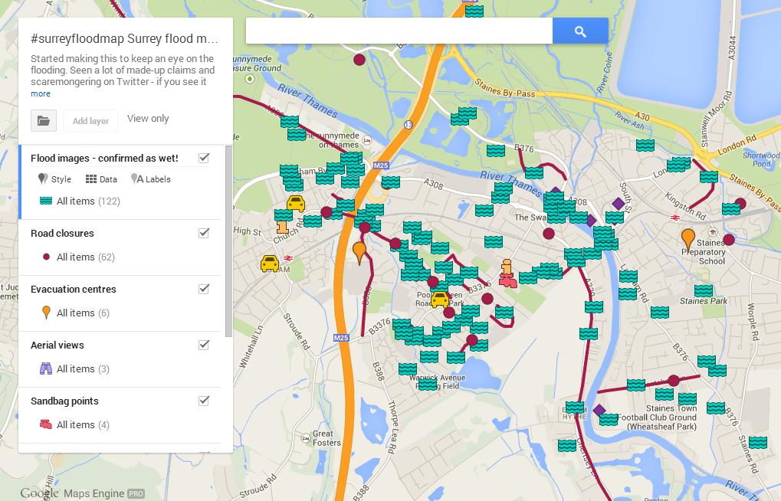
Examples of GME crisis maps
Producer: User
Notes:
This is a map that a user created with Google Maps Engine Pro. It shows locations in Surrey, UK pertinent to the major flooding that occurred there in February.

Slide 17
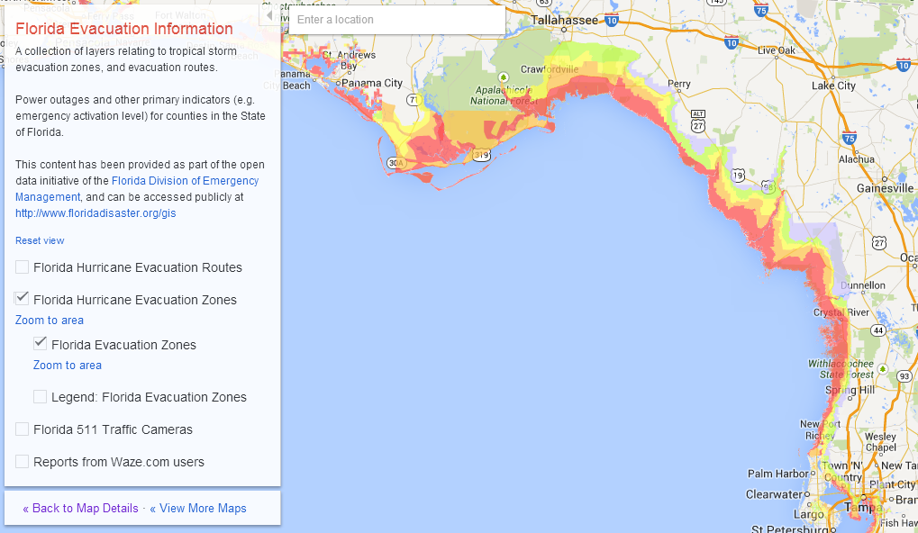
Examples of GME crisis maps
Producer: Government
Notes:
The Florida Division of Emergency Management published this map on the Google Maps Gallery. It shows areas for certain evacuations zones.

Slide 18
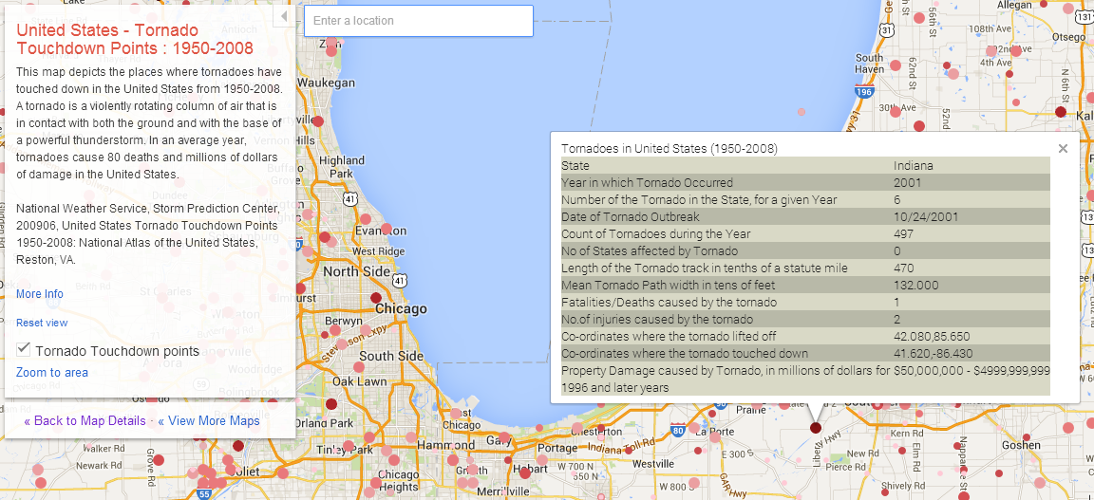
Examples of GME crisis maps
Producer: Google
Notes:
Finally, this is a map made by Google, using USGS data. It shows tornado sites nationwide over nearly 60 years. The screenshot also displays the info window containing a number of key statistics relating to the given tornado.

Slide 19
purpose
Determine how well and in which ways Google Maps Engine has served and can serve as an effective crisis mapping platform.

Slide 20
Methodology
Step 1: Quantitative analysis on the existing corpus of GME crisis maps
Step 2: Conduct verbal protocol analysis and cognitive Interviews with new GME users
Step 3: Investigate advantages of non-Google crisis maps
Step 4: Synthesize conclusions

Slide 21
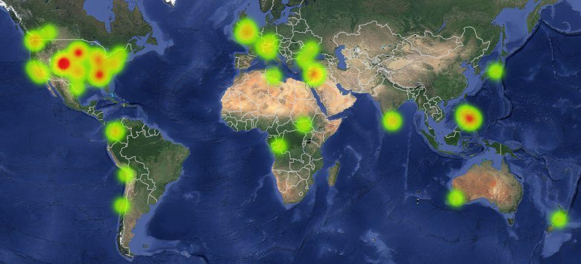
Methodology
Step 1: Quantitative analysis on the existing corpus of GME maps
Collect as many GME crisis maps as possible
Currently, 75 GME Crisis Maps collected and counting.
Early distribution of GME crisis maps
Hotspots
Boulder flooding
Typhoon Haiyan
Winter storms in Sioux Falls and Atlanta
Violence in Syria
Notes:
My first step involves grabbing as many GME crisis maps as I can find. So far, I have located 75 crisis maps through advanced searches on Twitter, Facebook, Google, Google+, and the Maps Gallery.
You can see that these maps are moderately distributed throughout the world. Mostly, I just wanted to be sure that the US wasn’t dominating GME usage.
Some of the recent hotspots for GME crisis mapping appear as a result of flooding in Colorado, the massive typhoon in the Philippines, some winter storms in the US, and the fighting in Syria.

Slide 22
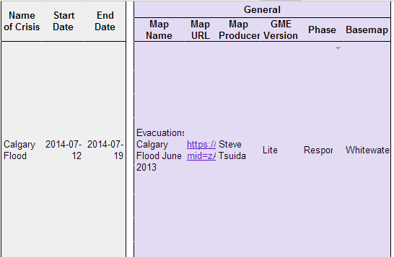
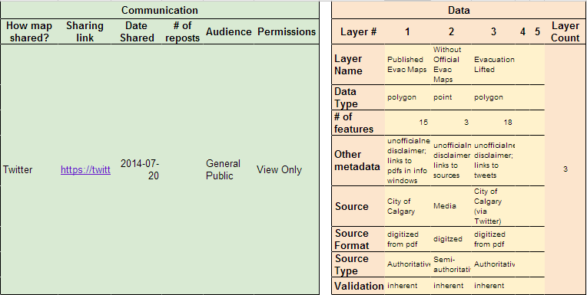
Methodology
(b) Run quantitative analysis on numerous map criteria
Notes:
As I collect the GME maps, I will evaluate them within this table. This will help answer several questions that relate to my original research question, such as
Who is the map author? And what version are they using?
What is the purpose of the map? This is indicated by the phase: preparedness, response, recovery, mitigation
How are they sharing the map? And especially, how quickly are they sharing it after/during the disaster?
Who are they sharing it with? Is there an intended audience?
What data is visualized on the map?
How much? And in what format?
What is the source of the data? Is it credible?

Slide 23
methodology
Step 2: Usability testing: protocol analysis and cognitive interviews
Perform small usability test
Authoring;
Interpreting;
Using verbal protocol assessment
to explore how new users behave
and succeed using GME maps.
Process design
1. Gather group of ~10 end users who have not used GME at all
2. Allow him/her to explore GME for 5 minutes
3. Once acclimated, ask them to complete a series of tasks and articulate what they are doing and thinking as they go.
4. Give a series of tasks, from very simple to very complex.
5. Ask follow up questions when the user get stuck, or when they do something in a strange way.
6. End with cognitive interview: let them discuss the experience
Notes:
asdfasdfasdfasdfff
submethodology

Slide 24
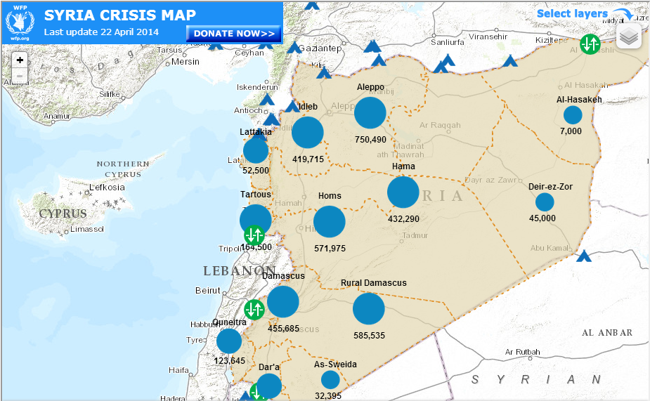
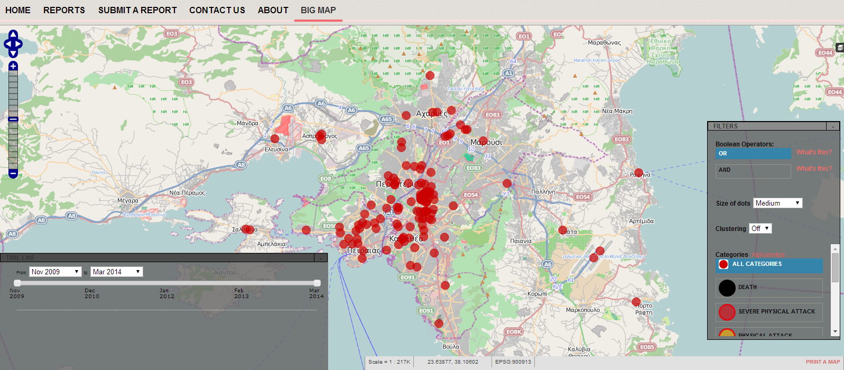
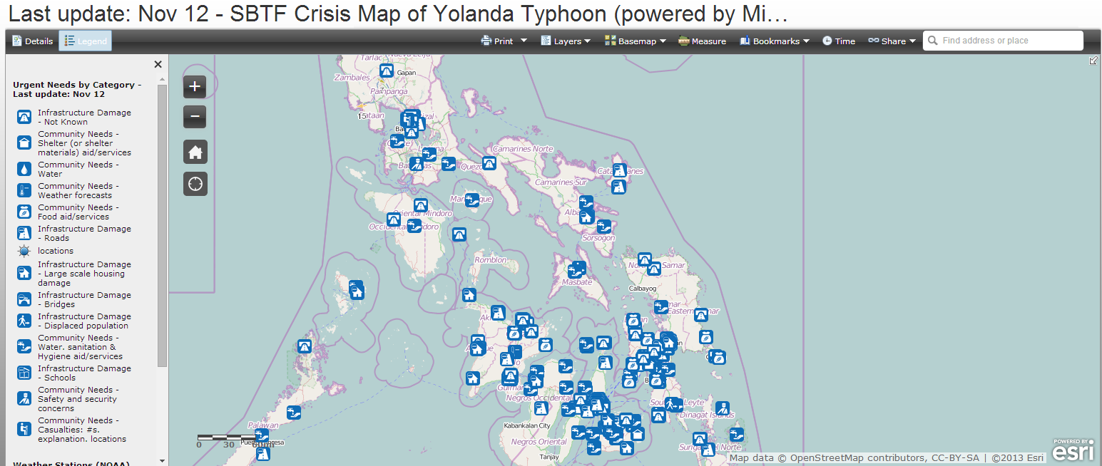
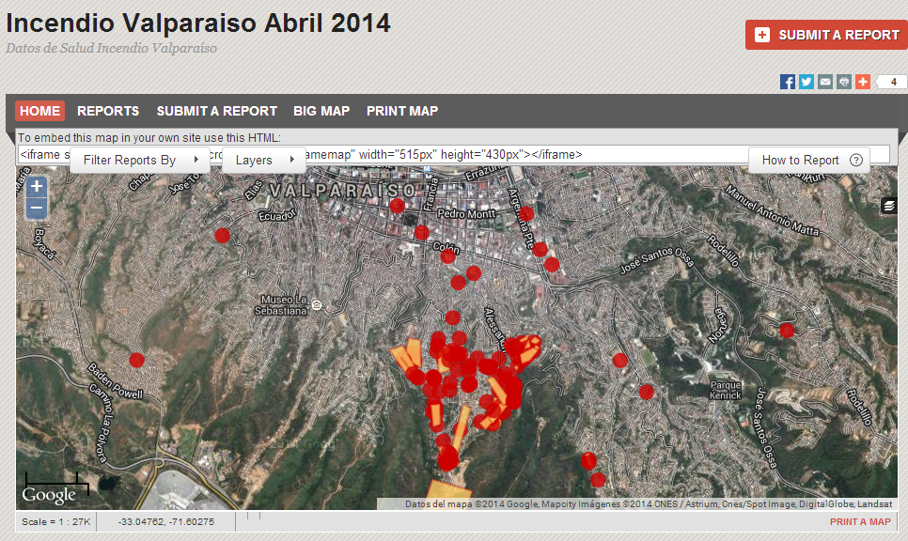
methodology
Step 3: Evaluate a sample of non-Google crisis maps
Producer, Contributors, Audience
Data sources and other metadata
Portability
Responsiveness
Data visualization
Interactivity
Complexity
Usability
Mobile support
Notes:
Who is the map author and who is the intended audience?
Where is the data from? Is it validated?
Can I add data to the map? Or can data be exported from the map?
How quickly was the map published after/during the crisis?
What cartographic choices were made?
Is it interactive and how easy or effective is the usability?
Is it too complex or over-simplified?
Does it have a mobile interface?

Slide 25
Methodology
Step 4: Synthesize conclusions
Determining whether the existing usage and functionality of
GME versions (because they could be different) are suitable for
crisis mapping.
Notes:
This is effectively the concluding synthesis of the results, based in the quantitative analysis, protocol analysis, cognitive interviews, and assessment of non-Google crisis maps.

Slide 26
Early Findings
Pros:
Highly reliable
Lite & Pro are low cost
Lite & Pro easy to use
Full Google Maps Engine is flexible
Cons:
Lite & Pro inadequate for most authoritative data
Full Google Maps Engine too complex for casual use
Full Google Maps Engine too costly for most users
Lack of versioning
Lack of temporal animation
Notes:
Pros:
Google Maps Engine has a service-level agreement which ensures maps will be up an running 99.9% of the time, but in fact has been at 100% since launching.
Lite and Pro are low cost – Lite being free, and Pro is $5/month
Lite and Pro easy to use – this is my assumption, but I want to verify with the usability testing component.
Full Maps Engine is flexible – can incorporate many different types of data
Cons:
Lite and Pro can only upload csv datasets and the full GME is probably too complex and too costly for any casual users.
Version is not currently supported. It would be useful in validating crowdsourced data - to differentiate dirty and blessed versions. It could also be useful to have versioning to show progress over time. Such snapshots could be used to produce insightful animations that expose trends.

Slide 27
timeline
Preparing research (February - April)
Conducting research, writing abstract (May - June)
Developing conclusions (July - August)
Presenting results (September - October)
Notes:
This slide outlines my timeline for the capstone. I have finished the research design and am now beginning to get a lot of the legwork done, so I can submit an early paper by June. Over the summer, I expect to finish the work and finalize conclusions, so I can present it in October.

Slide 28
Further work to be done
What are the most common avenues for GME crisis map sharing?
Are map authors validating crowdsourced maps? How?
How are Google, its partners and its competitors approaching legal and licensing obstacles before and during crises?
Notes:
These are some of the additional questions that I would like to answer but probably fall beyond the scope of the project.
How are users sharing GME maps? How extensively are they shared?
What, if any, validation measures are taken by the amateur GME crisis mapper?
And lastly, the question about licensing. I was doing an information interview with the product manager for Google.org Crisis Response team and he was really pushing me toward this topic of licensing in crisis maps, because it is such a real challenge. And if I were pursuing a law degree, I might have bitten.

Slide 29
Works cited
Baxter, Anthony. “Google Crisis Response | Hurricane Sandy”. October 2012. http://aemi.edu.au/EMC/assets/9-google-crisis-response---hurricane-sandy---anthony-baxter-.pdf
Cavelty, Myriam Dunn and Jennifer Giroux. “Crisis Mapping: A Phenomenon and Tool in Emergencies”. CSS Analysis in Security Policy. November 2011. http://isn.ethz.ch/Digital-Library/Publications/Detail/?lng=en&id=133958
Chamales, George. “Towards trustworthy social media and crowdsourcing”. Policy Memo Series, Vol 2. May 2013. http://www.wilsoncenter.org/sites/default/files/TowardsTrustworthySocialMedia_FINAL.pdf
Cisco. “Cisco Visual Networking Index: Global Mobile Data Traffic Forecast Update, 2013–2018” February 5, 2014 http://www.cisco.com/c/en/us/solutions/collateral/service-provider/visual-networking-index-vni/white_paper_c11-520862.html
Edwards, Jim. “Twitter’s ‘Dark Pool’: IPO Doesn’t Mention 651 Million Users Who Abandoned Twitter”. Business Insider. November 6, 2013. http://www.businessinsider.com/twitter-total-registered-users-v-monthly-active-users-2013-11
Elwood, Sara. “Critical issues in participatory GIS: Deconstructions, reconstructions, and new research directions”. 2006. Transactions in GIS, 10(5), 693–708.
Fung, Vincent. “Crisis Mapping and Disaster Risk Reduction.” December 16, 2011. http://www.unisdr.org/archive/24223
Gilbert-Knight, Ariel. “Social media, crisis mapping and the new frontier in disaster response”. The Guardian, Global Development Professionals Network. 8 October 2013. http://www.theguardian.com/global-development-professionals-network/2013/oct/08/social-media-microtasking-disaster-response.
Goodchild, Michael F., and J. Alan Glennon. “Crowdsourcing geographic information for disaster response: a research frontier”. International Journal of Digital Earth. April 15, 2010. http://www.tandfonline.com/doi/pdf/10.1080/17538941003759255
Greenberg, Brandon. “Why is Crisis Mapping So Popular?” Emergency Management, Disaster Preparedness & Recovery. October 23, 2013 http://www.emergencymgmt.com/disaster/Crisis-Mapping-Popular.html.
Liu, Sophia B. and Leysia Palen. “The New Cartographers: Crisis Map Mashups and the Emergence of Neogeographic Practice”. March 14, 2013.
https://www.cs.colorado.edu/~palen/Home/Articles_by_Year_files/TheNewCartographersLiuPalen.pdf
Mann-Jackson, Nancy. “Google Maps Engine Streamlines Emergency Management”. Acronym Online. September 24, 2012. http://acronymonline.org/google-maps-engine-streamlines-emergency-management/
Mayer, Robinson. “How Online Mapmakers Are Helping the Red Cross Save Lives in the Philippines”. The Atlantic. November 12, 2013. http://www.theatlantic.com/technology/archive/2013/11/how-online-mapmakers-are-helping-the-red-cross-save-lives-in-the-philippines/281366/
McDougall, Kevin. “An Assessment of the Contribution of Volunteered Geographic Information During Recent Natural Disasters”. August 31, 2012. http://www.gsdi.org/gsdiconf/gsdi13/papers/227.pdf.
Meier, Patrick. “How Crisis Mapping Saved Lives in Haiti”. National Geographic, Explorers Journal. July 2, 2012. http://newswatch.nationalgeographic.com/2012/07/02/crisis-mapping-haiti/
Meier, Patrick. “Crisis Maps: Harnessing the Power of Big Data to Deliver Humanitarian Assistance” Forbes. May 2, 2013. http://www.forbes.com/sites/skollworldforum/2013/05/02/crisis-maps-harnessing-the-power-of-big-data-to-deliver-humanitarian-assistance/
OCHA. “Big Data and Humanitarianism.: 5 things you need to know”. 27 June, 2013 http://www.unocha.org/top-stories/all-stories/five-things-big-data-and-humanitarianism
Poblet, Marta. “Visualizing the law: Crisis mapping as an open tool for legal practice”. Journal of Open Access to Law. Vol., No. 1 , 2013. http://ojs.law.cornell.edu/index.php/joal/article/download/12/13
Raymond, Nathaniel, Caitlin Howarth and Jonathan Hutson. “Crisis Mapping Needs an Ethical Compass”. Global Brief. February 6, 2012. http://globalbrief.ca/blog/2012/02/06/crisis-mapping-needs-an-ethical-compass/
Robinson, Anthony C, Robert E Roth, and Alan M. MacEachren. “Challenges for Map Symbol Standardization in Crisis Management” Proceedings of the 7th International ISCRAM Conference. Seattle. May 2010.
http://www.geovista.psu.edu/publications/2010/222-Robinson_etal.pdf
Shanley, Lea. “Tweeting up a Storm: the promise and perils of crisis mapping”. October 2013. http://www.wilsoncenter.org/publication/tweeting-storm-the-promise-and-perils-crisis-mapping
Thomas, J. J. and Cook, K. A. ”Illuminating the Path: The Research and Development Agenda for Visual Analytics” IEEE, Los Alametos, CA. 2005.

Slide 30
Works cited
Questions? Comments?

Slide 31
Appendix:
Example of the verbal protocol analysis

