Slide 1
Analyzing Tobler’s Hiking Function and Naismith’s Rule Using Crowd-Sourced GPS Data
Association of American Geographers Annual Meeting
April 9, 2014
Erik Irtenkauf, Master’s Candidate
The Pennsylvania State University

Slide 2
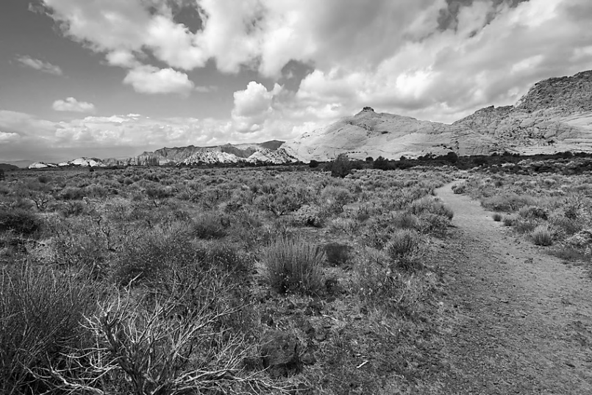
Background
Terrain has a big effect on human movement
Modeling movement is important
Helps explain how humans interact with our environment
Two common methods in Geography/GIS
Tobler’s Hiking Function
Naismith’s Rule

Slide 3
Tobler and Naismith
Both methods estimate walking speed/time based on slope
Dr. Waldo Tobler published his hiking function in 1993, based on empirical data from Imhof (1950)
Naismith’s Rule developed by mountaineer William Naismith in 1892, amended by Langmuir
Used for:
archaeology
recreation
resource management
public safety

Slide 4
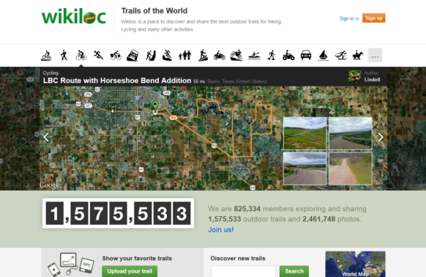
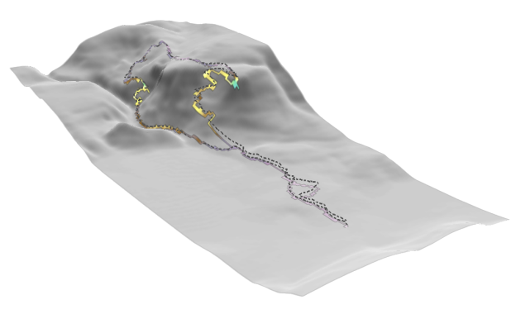
Methodology
Goal: Analyze both rules using hiking GPS tracks shared on the internet
Methodology:
Download a sample of 120 GPS tracks from www.wikiloc.com
Model Tobler and Naismith in a GIS to calculate predicted hiking times for each track
Analyze predicted vs. actual hiking times

Slide 5
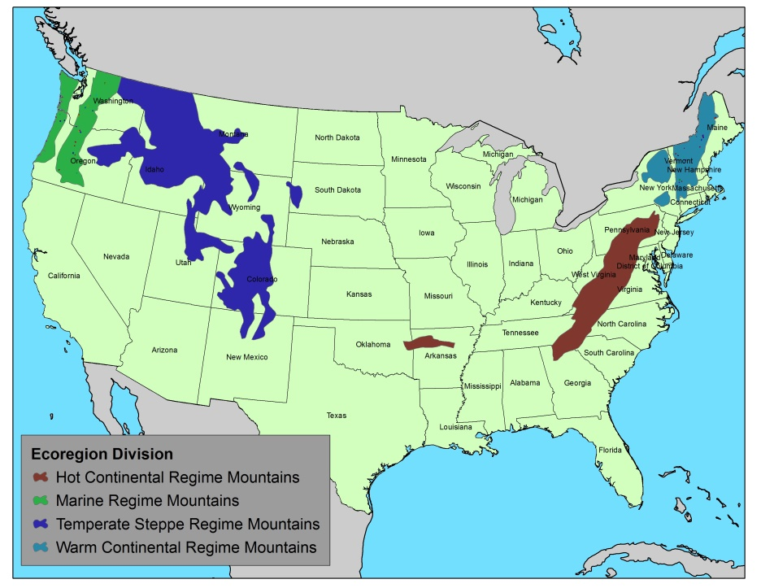
Crowd-Sourced GPS Data
Offers the chance to quickly gather data from a diverse range of environments and conditions :

Slide 6
Findings
Predicted times for each method are strongly correlated across ecoregion divisions:
Marine
Regime
Mountains
.98
Warm
Continental
Regime
Mountains
.98
.99
Temperate
Steppe
Regime
Mountains
Hot
Continental
Division
Mountains
.99
Correlation Between
Tobler and Naismith
Predicted Hiking Times

Slide 7
Findings
Accuracy ranges can be determined
Predicted times are generally accurate

Slide 8
Findings
Accuracy varies across ecoregion divisions
Available data does not fully explain these differences
28.34
23.52
Warm
Continental
Regime
Mountains
22.02
21.34
16.14
16.84
Marine
Regime
Mountains
Temperate
Steppe
Regime
Mountains
Hot
Continental
Division
Mountains
17.69
17.18
Tobler
Naismith
Average Difference (%)
Between Predicted
and Actual Times

Slide 9
Conclusions
Both models work well, with some caveats
Crowd-sourced GPS data is a rich data source
Lack of additional information limits usefulness
Questions remain about generalizing this sample to a larger population

Slide 10
Erik Irtenkauf, Master’s Candidate
The Pennsylvania State University
eji107@psu.edu
irtenkauf@gmail.com
Project Advisor: Dr. Doug Miller
Permission to use this project data
was obtained from www.wikiloc.com,
their contribution is gratefully acknowledged.

