Slide 1
Analyzing Tobler’s Hiking Function and Naismith’s Rule Using Crowd-Sourced GPS Data
Erik Irtenkauf
The Pennsylvania State University
October 2013
Capstone Advisor:
Dr. Doug Miller

Slide 2
Presentation Outline
Background
Data & Methods
Analysis
Expected Results
Timeline
Questions?
Notes:
This is an overview of what I’ll be discussing. I’ll start out explaining Tobler and Naismith’s methods for modeling walking times. Then I’ll discuss the data and methods I’ll be using to replicate both of these rules in a GIS and compare them to real world travel times. I’ll also discuss how I propose to analyze these results and what kind of outcomes I expect to discover.

Slide 3
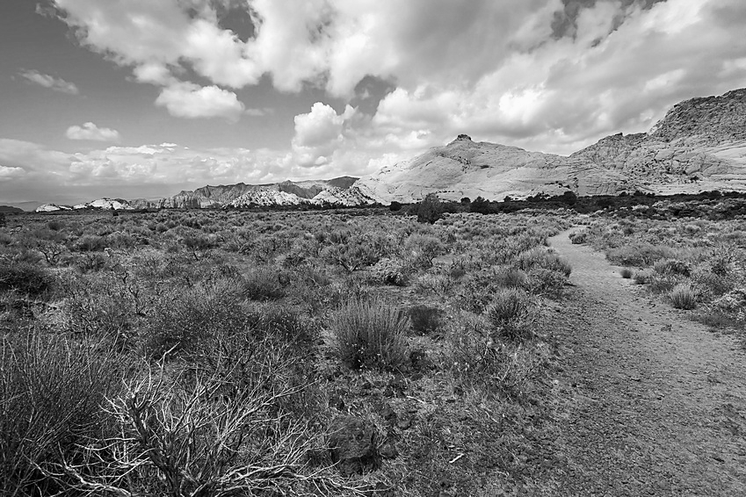
Background
Terrain has a big effect on human movement
Flat = EASY
Hills = HARD
Modeling movement is important
Helps explain how humans interact with our environment
Two common methods in Geography/GIS
Tobler’s Hiking Function
Naismith’s Rule

Slide 4
Example Uses
Common Uses | Application(s) | Authors:
Archaeology | Travel times / routes between archaeological sites, Catchment analysis | Gorenflo and Gale (1990); McCoy et al (2011); Kantner (2004); Kondo & Seino (2010); Herzog (2010)
Sports and Recreation | Calculate hiking and orienteering times, place observation and aid locations | Green (2006); Hayes and Norman (1984)
Land Use / Resource Planning | Monitor park trail conditions, define “wild” areas for conservation | Pettebone, Newman, & Theobald (2009); Fritz and Carver (1998)
Emergency Planning, Search and Rescue | Tsunami evacuation times, Search and rescue boundaries | Wood & Schmidtlein (2012, 2013); Magyari-Saska & Dombay (2012)
Placement of health facilities | Optimally position medical clinics in terms of population access and travel times | Matthews (2013); Noor et al (2006)

Slide 5
Tobler’s Hiking Function
Mathematical function published by Waldo Tobler in 1993
Predicts human walking speed based on slope
Based on empirical data from Eduard Imhof (1950)
Function expressed as:
W = 6 * exp {-3.5 * abs (S + 0.05)}
Where:
W = walking velocity (km / hr)
S = slope of the terrain (dh/dx)

Slide 6
Tobler’s Hiking Function - 2
Suggests that speed is fastest on gentle downslopes
Predicts maximum speed at -2.86° (-5%) slope
Offset from zero
Slope (degrees) | Speed (km/hr)
-70 | 0.00
-50 | 0.11
-30 | 0.95
-10 | 3.86
-2.8 | 6.00
0 | 5.04
2.8 | 4.23
10 | 2.72
30 | 0.67
50 | 0.08
70 | 0.00

Slide 7
Naismith’s Rule
Developed by Scottish mountaineer William Naismith in 1892
Uses horizontal and vertical distance to determine travel time:
But this doesn’t mention downhill travel!
Langmuir proposed an addition to the rule:
A person can walk 5 km / hr on flat ground, but add 30 minutes for every 300 meters of ascent
Subtract 10 minutes for every 300 meters of moderate descent (between -5° and -12° slope) and add 10 minutes for every 300 meters of descent on steep slopes (greater than -12°)

Slide 8
Naismith’s Rule - 2
The rule can also be expressed as an equation (GRASS, 2013):
T = [0.72 * (Delta S)] + [6 * (Delta H Uphill)] +
[1.9998 * (Delta H Moderate Downhill)] + [-1.9998* (Delta H Steep Downhill)]
Where:
T = travel time (in seconds)
Delta S = horizontal distance traveled
Delta H = vertical distance traveled
Moderate Downhill is between -5° and -12° slope
Steep Downhill is greater than -12 slope
Moderate Downhill
Steep Downhill
Flat
Uphill

Slide 9
Tobler and Naismith Compared

Slide 10
Validation
Various authors have attempted to validate Tobler and Naismith
Aldenderfer (1998) compared hiking times in the Peruvian Andes to Tobler
Kondo et al (2008) performed an experiment with seven subjects, compared results to GIS models
Kennedy (2007) compared his own walking times to Naismith’s rule
Magyari-Saska & Dombay (2012) compared Tobler and Naismith in a GIS
Most reviewed prior research uses a limited number of samples and/or focuses on a small study area

Slide 11
Project Proposal
Objective 1: Gather ~100 GPS tracks available online and compare actual travel times to those predicted by Tobler and Naismith
Objective 2: Determine for each track at which slope a maximum speed was attained and compare to those predicted by Tobler and Naismith.

Slide 12
Methodology
Download a sample of hiking GPS data tracks from the Internet
Prepare the data for analysis
Separate into discrete sub-tracks
Adjust overall travel times based on stopped movement
Download elevation data for each track
Model each GPS track in a GIS using Cost Distance analysis
Tobler: ArcGIS / Path Distance
Naismith-Langmuir: GRASS / r.walk
Analyze results
Compare predicted vs. actual travel times
Determine at which slope maximum travel speed is achieved

Slide 13
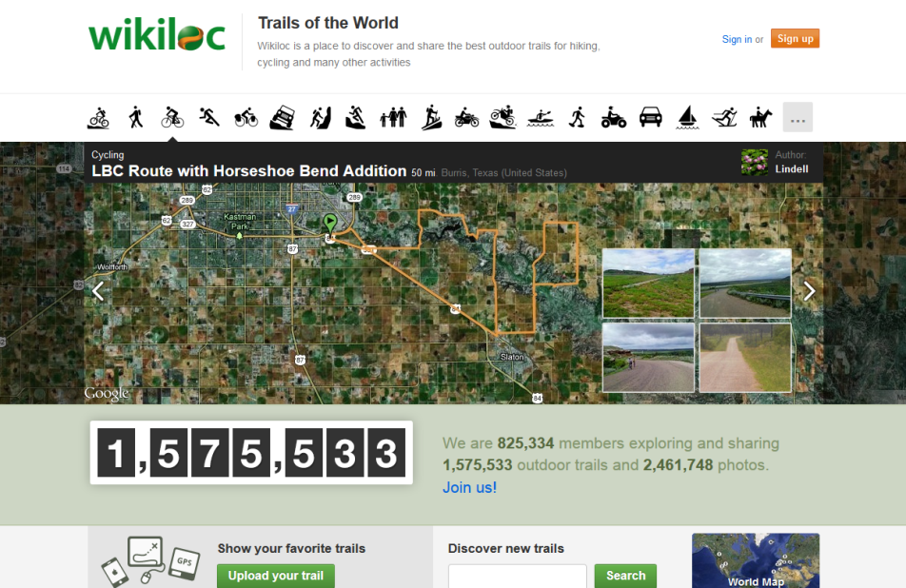
Crowd-Sourced GPS Data
This project will use GPS tracks uploaded to www.wikiloc.com
Over 1.5 million tracks available
All tracks in GPX format
Attributes include Date-Time, Lat/Lon and Altitude
Permission has been
obtained from Wikiloc
to use their data in this study.
Their participation is gratefully
acknowledged.

Slide 14
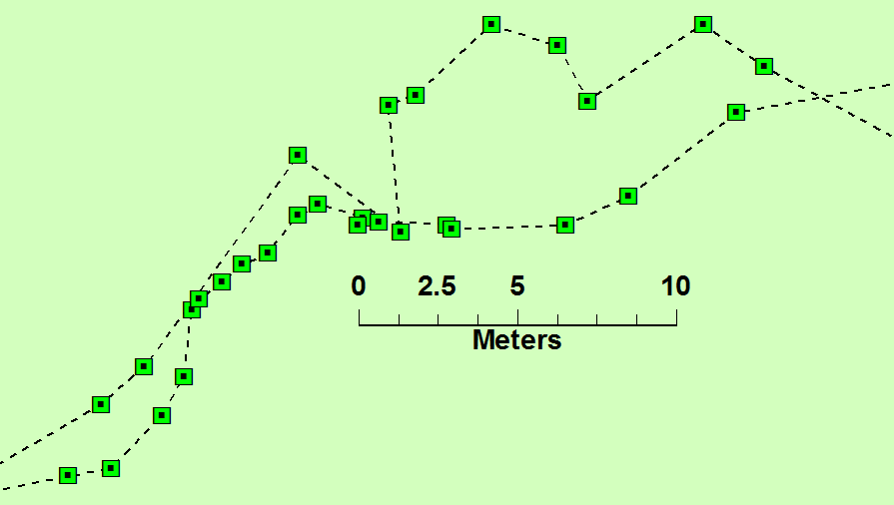
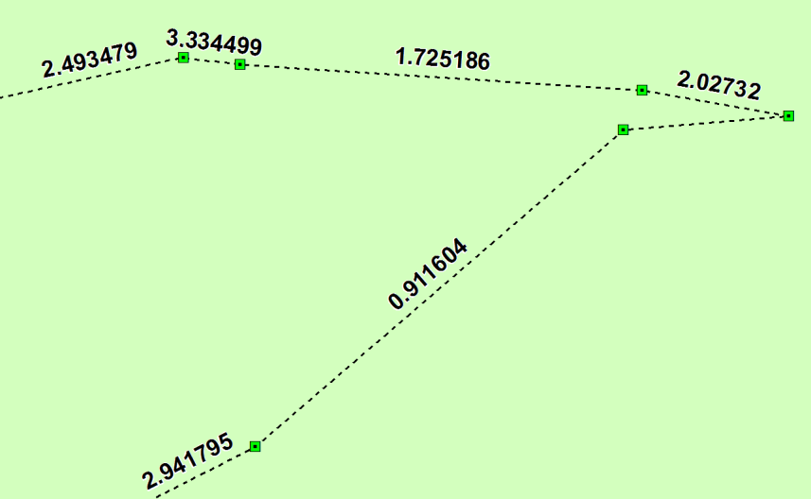
GPS Data Preparation
Split tracks into discrete sub-tracks
Remove areas of “stopped” travel
(breaks, lunch, picture taking, etc)
Calculate Travel Speed
Notes:
GPS data will be processed before analysis. Because of the way cost distance analysis works, tracks that “double back” to a starting position will be have to be broken into sub-tracks and analyzed separately. The tracks will also be cleaned up to remove areas where the person stopped. These areas will be removed from the tracks and the amount of “stopped” travel time will be subtracted from the overall total travel time. Finally, speeds will be calculated for each track segment using a script downloaded from the ArcGIS Resource Center.
Image Source: GPS data visualized in ArcGIS, by the author.

Slide 15
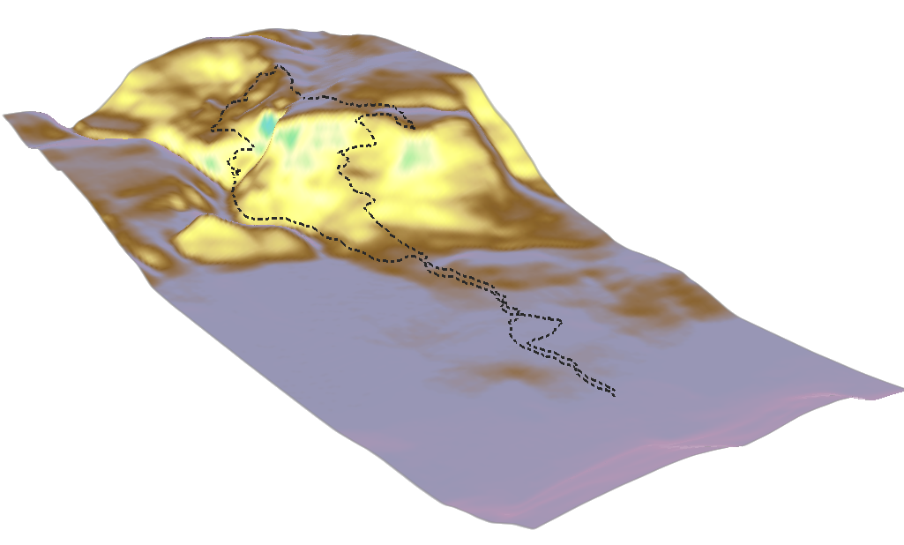
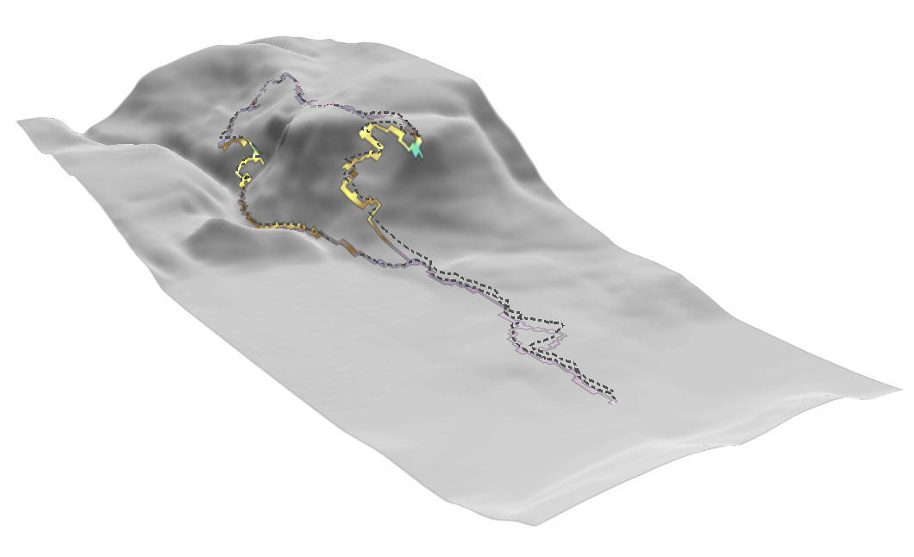
Elevation Data
Elevation and slope are essential inputs
Problem: Consumer GPS devices give unreliable altitude readings
Solution: Derive elevation values from a DEM
Elevation values will be extracted for each track:

Slide 16
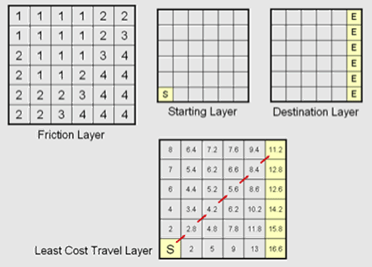
Cost Distance Analysis
Uses a raster cost/friction surface to determine the cost of movement
Each pixel has a cost value (time, money, etc.)
Costs accumulate with movement away from the starting location
Two approaches to measuring travel direction
Isotropic vs. Anisotropic
Image Source: GIS Commons (n.d.)
Licensed under CC Attribution-Share Alike License

Slide 17
Modeling Tobler’s Function
The ArcGIS Path Distance tool models cost, including the effects of terrain and travel direction
Requires:
Starting Point
Digital Elevation Model (DEM)
Vertical Relative Moving Angle (VRMA) table
Tripcevich (2009) gives a method for converting Tobler’s function to a VRMA table
Final output is a cumulative cost surface, where each pixel value is the travel time to that cell from the starting location.

Slide 18
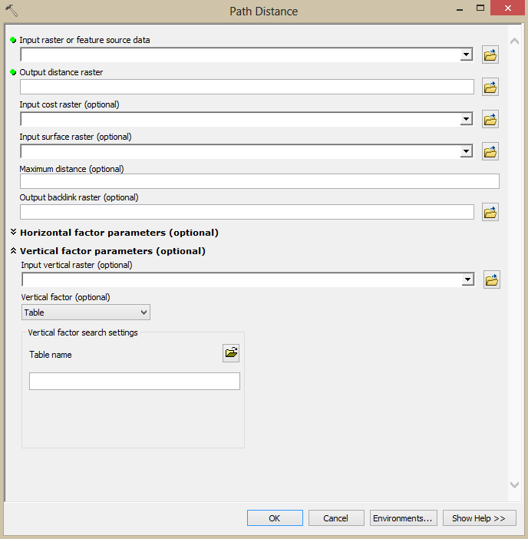
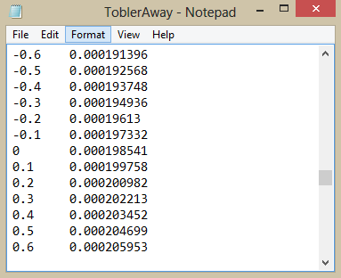
Modeling Tobler’s Function
GPS track
starting point
DEM file
VRMA table
Slope
(Degrees)
Hours Per KM

Slide 19
Modeling Naismith’s Rule
GRASS GIS natively implements Naismith-Langmuir using the r.walk tool
Requires:
Starting Point
Digital Elevation Model (DEM)
Final output is a cumulative cost surface, where each pixel value is the travel time to that cell from the starting location.

Slide 20
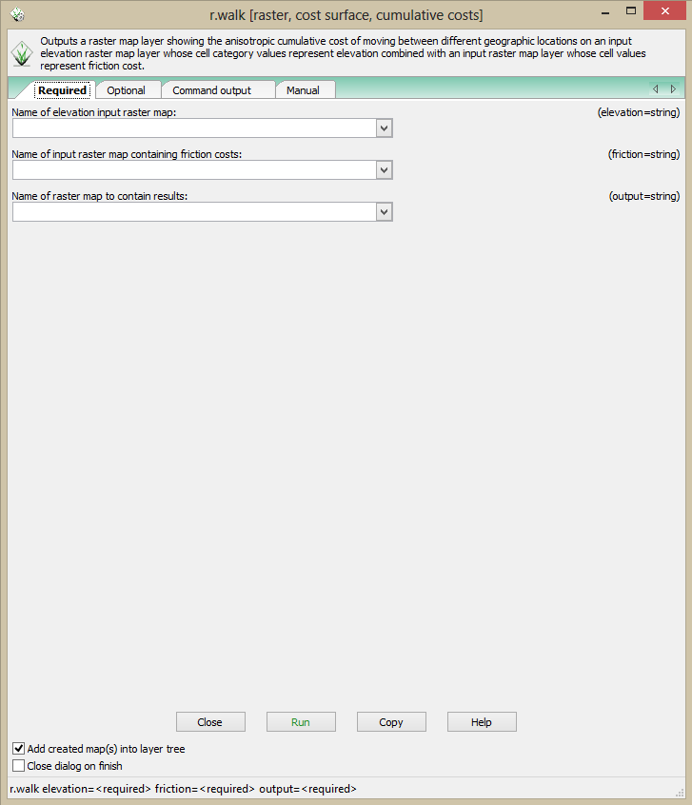
Modeling Naismith’s Rule
DEM file
Friction Raster
(required but not
necessary, see next
slide)

Slide 21
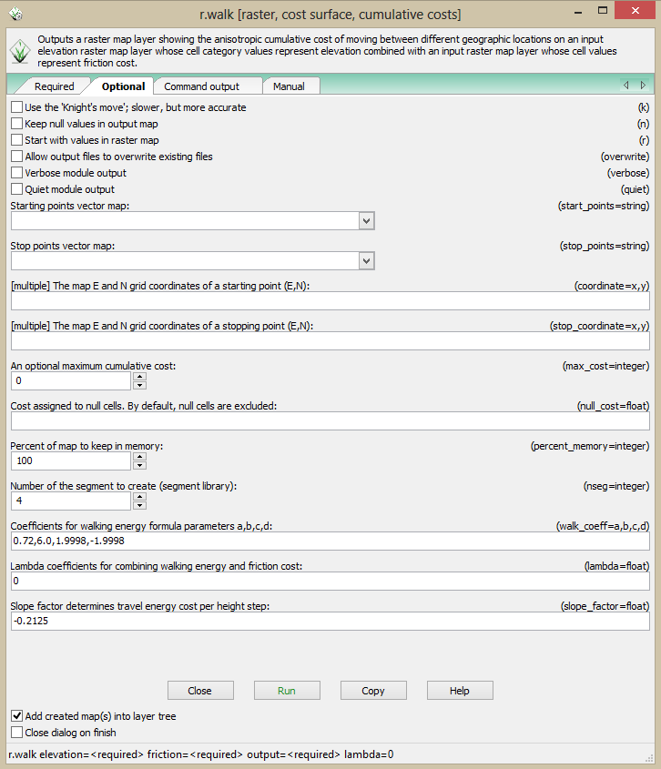
Modeling Naismith’s Rule
GPS track
starting point
Equation coefficients
Set Lambda = 0 to cancel
out the required, but
unnecessary, friction surface
Break point between
“gradual” and “steep” downhill
TAN(-12°) = -0.2125

Slide 22
Modeling Outputs
Analysis
Start Point
Pixel Value at
end of track
gives the total
predicted travel time
Raster
accumulated
cost surface
Actual Time:
37 minutes
Tobler
Naismith

Slide 23
Analysis
Compare predicted vs. actual travel times
Average / max / min differences
Does one method better fit the data?
Measure correlation between Tobler and Naismith predicted times
Look for geographic or seasonal patterns in data
???? – Other possibilities TBD
Calculate the slope along each track and record the slope where maximum speed was attained
How does this compare to predicted values?
Bottom Line: How does real world travel compare to GIS predicted travel?

Slide 24
Expected Results
Predicted Tobler travel times will be faster than Naismith times
Tobler and Naismith times will be highly correlated
Both methods will produce generally accurate travel times
Max Speed/Slope values will vary considerably from the predicted values
Abstract will be submitted for the 2014 Association of American Geographers annual meeting in Tampa, FL.
Timeline:
Literature Review / Proposal
Conduct Research
Analyze and Document Results
Present Results: AAG
AUG – OCT
2013
NOV - DEC
2013
JAN - MAR
2014
APR
2014

Slide 25
Questions?
Erik Irtenkauf
eji107@psu.edu

Slide 26
Partial Works Cited
Gorenflo, L. J., & Gale, N. (1990). Mapping regional settlement in information space. Journal of Anthropological Archaeology, 9(3), 240-274.
Hayes, M., & Norman, J. M. (1984). Dynamic programming in orienteering: Route choice and the siting of controls. Journal of the Operational Research Society, 35(9), pp. 791-796.
Imhof, E. (1950). Gelande und karte. Zurich: Eugen Rentsch Verlag.
Magyari-Saska, Z., & Dombay, S. (2012). Determining Minimum Hiking Time Using DEM. Geographia Napocensis, VI(2), 124-129.
Tobler, W. R. (1993). Three Presentations on Geographical Analysis and Modeling: Non-isotropic Geographic Modeling, Speculations on the Geometry of Geography And, Global Spatial Analysis. National Center for Geographic Information and Analysis. Retrieved from http://www.ncgia.ucsb.edu/Publications/Tech_Reports/93/93-1.PDF
Tripcevich, N. (2009). Workshop 2009, No. 1 – Viewshed and Cost Distance. Retrieved from http://mapaspects.org/courses/gis-and-anthropology/workshop-2009-viewshed-and-cost-distance
Wood, N. J., & Schmidtlein, M. C. (2012). Anisotropic path modeling to assess pedestrian-evacuation potential from Cascadia-related tsunamis in the US Pacific Northwest. Natural hazards, 62(2), 275-300.
Full citations available in the attached Project Proposal

