Slide 1

GIS Application in Firewall Security Log Visualization
Juliana Lo

Slide 2

Presentation Outline
What is a firewall
Problem definition
Project goal, objectives, constraints
Framework and system components
Solution
Conclusions

Slide 3



Firewall Definition
A firewall is a hardware or software designed to permit or deny network traffic based on a set of rules
Protect networks from unauthorized access.

Slide 4
Good and Bad Firewall Traffic
TCP sweep
Web traffic
Emails
Video conferencing
VPN
Teardrop
Web traffic
FTP
Emails
ICMP ping
TCP sweep
VOIP
Emails
Emails
Address sweep
ICMP fragment

Slide 5
Bad Firewall Traffic
ICMP fragment
ICMP ping
TCP sweep
Sync flood
Port scan
Address sweep
Log File
Jun 1 22:01:35 [xx] ns5gt: NetScreen device_id=ns5gt [Root]system-alert-00016: Port scan! From 1.2.3.4:54886 to 2.3.4.5:406, proto TCP (zone Untrust, int untrust). Occurred 1 times. (2004-06-01 22:09:03)
Jun 1 22:01:57 [xx] ns5gt: NetScreen device_id=ns5gt [Root]system-alert-00016: Port scan! From 1.2.3.4:55181 to 2.3.4.5:1358, proto TCP (zone Untrust, int untrust). Occurred 1 times. (2004-06-01 22:09:25)
Jun 1 22:02:10 [xx] ns5gt: NetScreen device_id=ns5gt [Root]system-alert-00016: Port scan! From 1.2.3.4:55339 to 2.3.4.5:1515, proto TCP (zone Untrust, int untrust). Occurred 1 times. (2004-06-01 22:09:38)
Jun 2 11:24:16 fire00 sav00: NetScreen device_id=sav00 [Root]system-critical-00436

Slide 6
Firewall Security Log File
Jun 1 22:01:35 [xx] ns5gt: NetScreen device_id=ns5gt [Root]system-alert-00016: Port scan! From 1.2.3.4:54886 to 2.3.4.5:406, proto TCP (zone Untrust, int untrust). Occurred 1 times. (2004-06-01 22:09:03)
Jun 1 22:01:57 [xx] ns5gt: NetScreen device_id=ns5gt [Root]system-alert-00016: Port scan! From 1.2.3.4:55181 to 2.3.4.5:1358, proto TCP (zone Untrust, int untrust). Occurred 1 times. (2004-06-01 22:09:25)
Jun 1 22:02:10 [xx] ns5gt: NetScreen device_id=ns5gt [Root]system-alert-00016: Port scan! From 1.2.3.4:55339 to 2.3.4.5:1515, proto TCP (zone Untrust, int untrust). Occurred 1 times. (2004-06-01 22:09:38)
Jun 2 11:24:16 fire00 sav00: NetScreen device_id=sav00 [Root]system-critical-00436
Important for
System monitoring, compliance, forensics
Challenges
Too much information to go through
Can’t relate IP address to origin of traffic

Slide 7
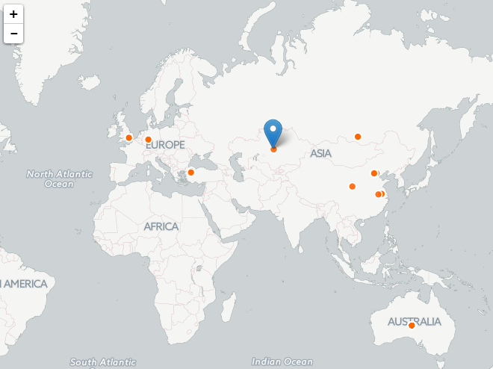
Log File Transformation
Jun 1 22:01:35 [xx] ns5gt: NetScreen device_id=ns5gt [Root]system-alert-00016: Port scan! From 1.2.3.4:54886 to 2.3.4.5:406, proto TCP (zone Untrust, int untrust). Occurred 1 times. (2004-06-01 22:09:03)
Jun 1 22:01:57 [xx] ns5gt: NetScreen device_id=ns5gt [Root]system-alert-00016: Port scan! From 1.2.3.4:55181 to 2.3.4.5:1358, proto TCP (zone Untrust, int untrust). Occurred 1 times. (2004-06-01 22:09:25)
Desired Outcome

Slide 8
Project Goal, Objectives, Constraints
Goal
Develop a geolocation map application to visualize firewall traffic in near-real time
Objectives
Geolocate IP address into locations
Near real-time events
Constraints
Project duration - weeks not months
Cost – low budget

Slide 9
Development Framework
Data Collection
Server to capture firewall traffic
Parsing Engine
Parser to extract IP addresses and other information
Geolocation Service
Convert IPv4 address into location
Database Service
Append features and search for records
Visualization
Application to visualize IP locations

Slide 10





System Components
Firewall
IDE
Database
Map application
Source of data Juniper Netscreen firewall
Windows 7 development server for data collection, parsing,
geolocation, and data updates
CartoDB’s PostgreSQL database
Javascript, HTML, CartoDB API, Leaflet, jQuery

Slide 11
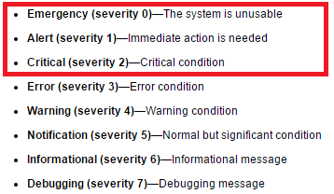
Solution - Data Automation
Step 1 - Firewall
Configure system logging messages
Enable external data monitor
Bad traffic
Syslog server

Slide 12
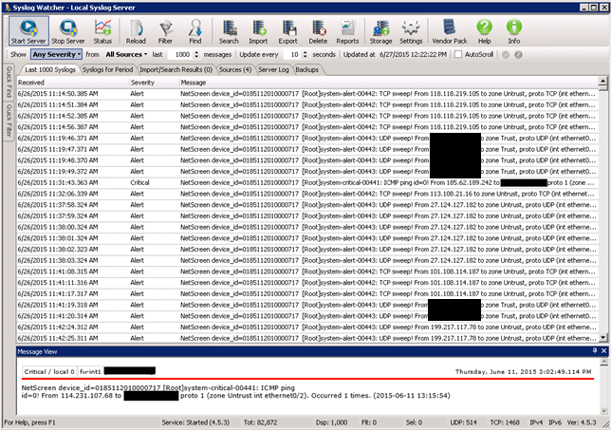
Solution - Data Automation
Step 2 – Data Collection
Install Syslog Watcher software on Windows machine to collect firewall traffic

Slide 13
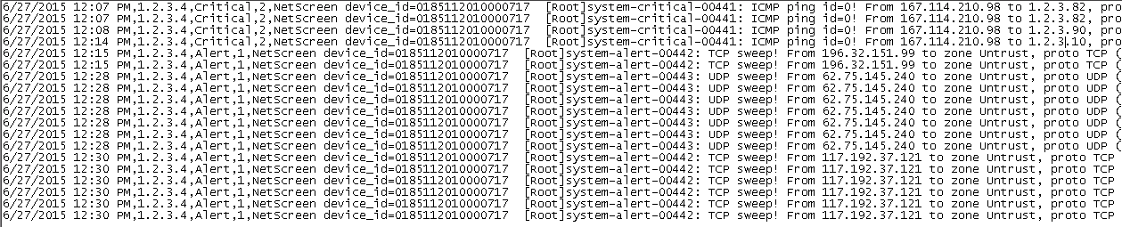
Solution - Data Automation
Step 3 – Parser Engine
Simple data extraction program
Python program extracts time stamp, firewall host, message level, error,
from host, and number of occurrences

Slide 14
Solution - Data Automation
Step 4 – Geolocation Service
Program to look up location from IP address
Uses MaxMind GeoLite City Database
Python API
import pygeoip
gi = pygeoip.GeoIP(‘C:\\geocode\\GeoLiteCity.dat‘, pygeoip.MEMORY_CACHE)
from_ip = ‘123.184.114.169’
rec = gi.record_by_addr(from_ip)
city =rec[‘city’]
country = rec[‘country_name’]
latitude = rec[‘latitude’]
longitude = rec[‘longitude’]
print city, country, latitude, longitude
>>> ‘Shenyang’,’China’,41.7922,123,4328

Slide 15
Solution - Data Automation
Step 5 – Database Update
Program to append new features to CartoDB’s PostGRES database
Python API
from cartodb import CartoDBAPIKey, CartoDBException
API_KEY =‘<api_key’'
DOMAIN = ‘<user_name>'
TABLE = ‘table_name’
COLUMNS = 'the_geom,alert,city,code,country,err,event_time,from_ip,latitude,longitude,
occur’
cl = CartoDBAPIKey(API_KEY, DOMAIN)
vals = “CDB_LatLng(%s,%s),'%s','%s',%s,'%s','%s','%s','%s','%s','%s','%s','%s',%s,%s
sql = 'INSERT into %s (%s) VALUES (%s);' % (TABLE,COLUMNS,vals)
cl.sql(sql)

Slide 16
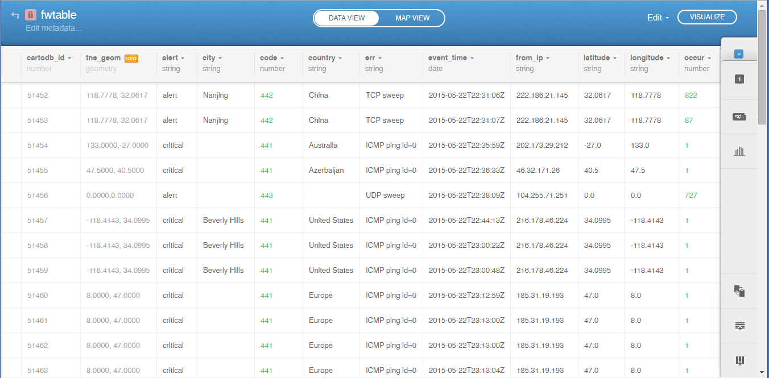
Solution - Data Automation
Step 5 – Database Table View

Slide 17
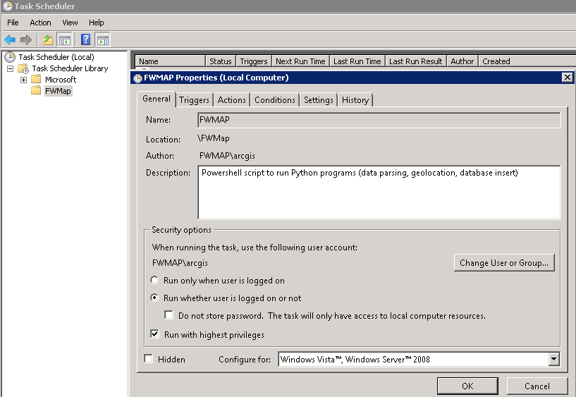
Solution - Data Automation
Step 6 – Automated Updates
Use Window’s Task Scheduler to automate the programs
Auto-start every 5 minutes

Slide 18
Solution - Application Development
Language: JavaScript
Libraries: CartoDB API, Leaflet, jQuery
Editor: NotePad+
Debugging tool: Google Chrome JavaScript Console

Slide 19
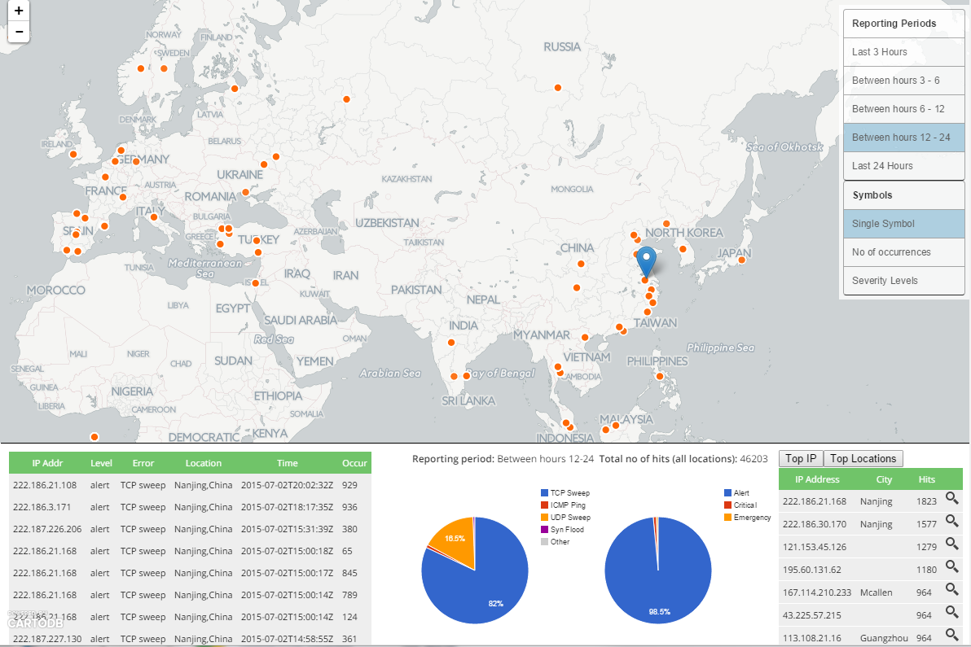
Results - Hits from Last 24 Hours
Layers/Symbols Selectors
Map Window
Dashboard

Slide 20
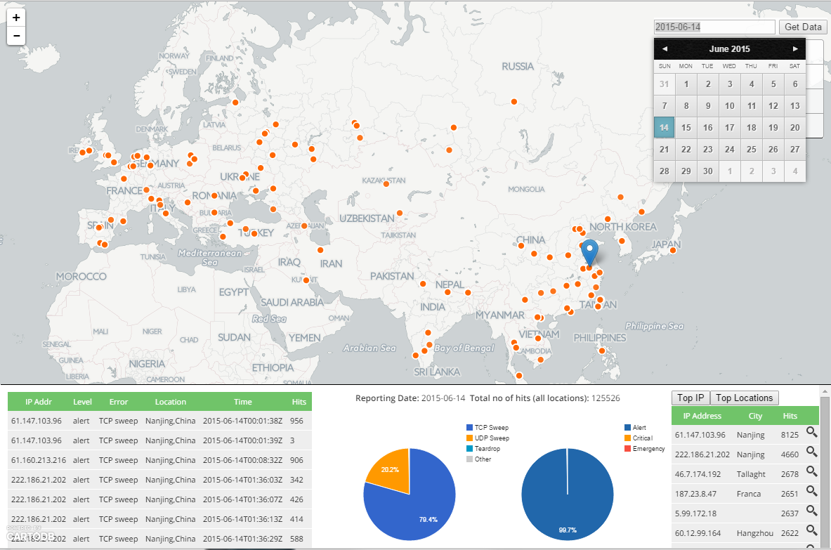
Results – Select a date

Slide 21
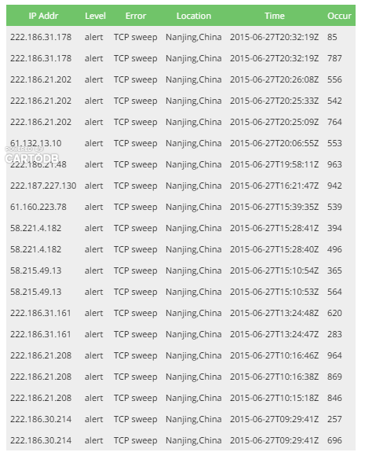
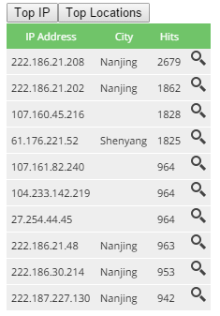
Results – Clickable Features
Click on a feature in the map to show details
Top hosts or locations

Slide 22
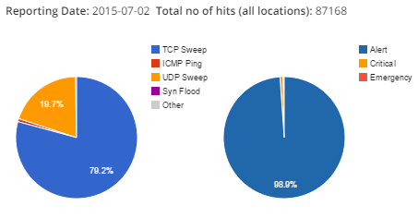
Results – Application Features
Pie charts show the distribution of hits by error types and by severity levels

Slide 23
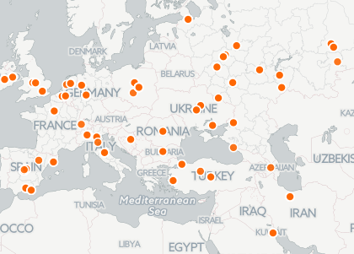
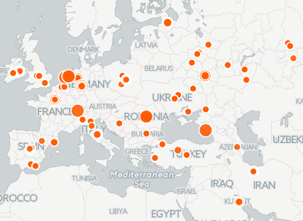
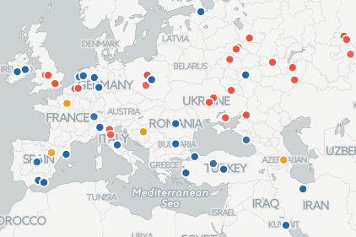
Results – Different Symbols
Single symbol
Number of occurrences
Severity Levels

Slide 24
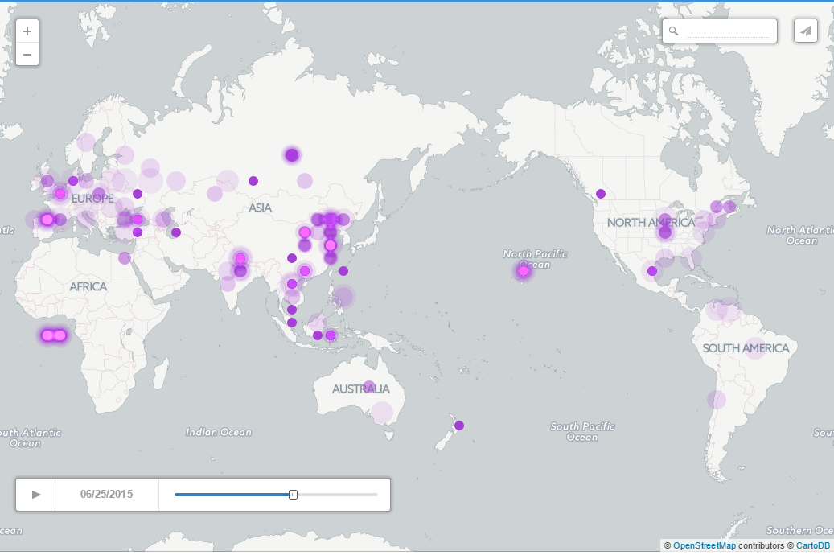
Results – Animated temporal map

Slide 25
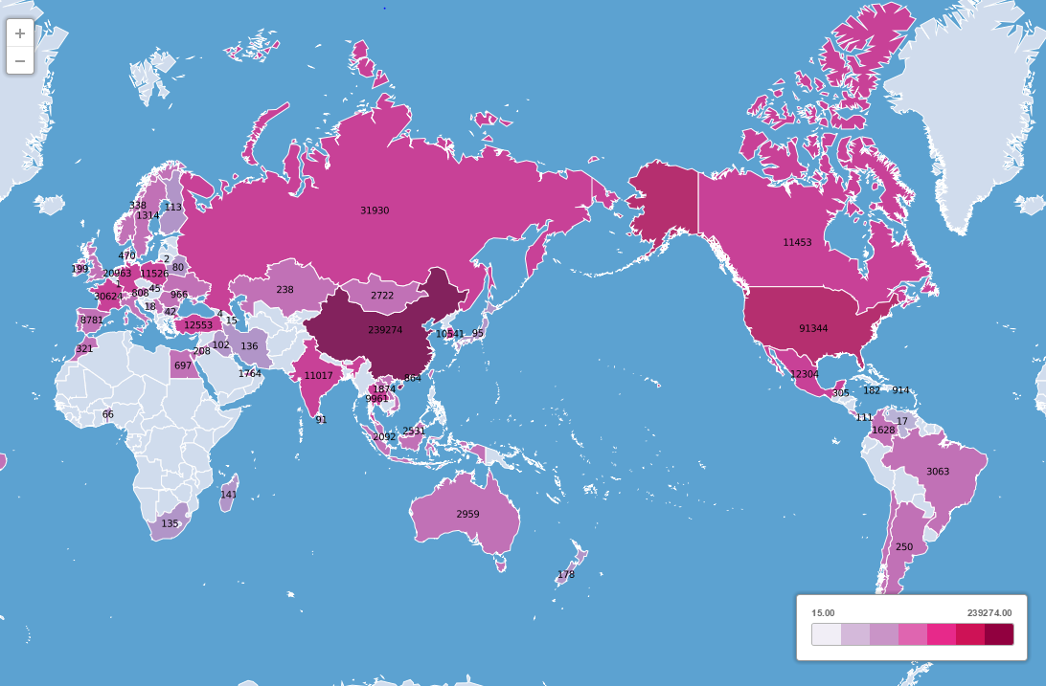
Results – Country breakdowns, last 7 days

Slide 26
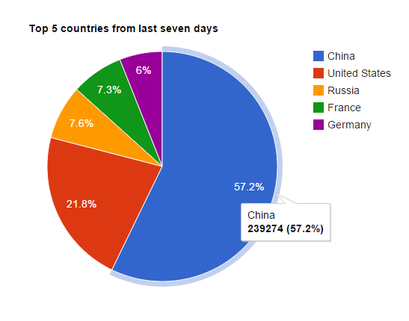
Results – Top 5 hits from last 7 days

Slide 27
Conclusions
Web-based GIS map application
Live dynamic data
Leverage cloud infrastructure
Low-cost solution

Slide 28
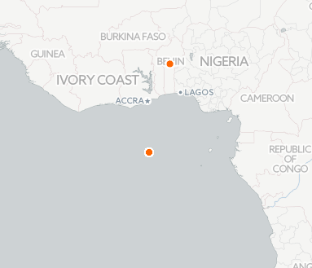
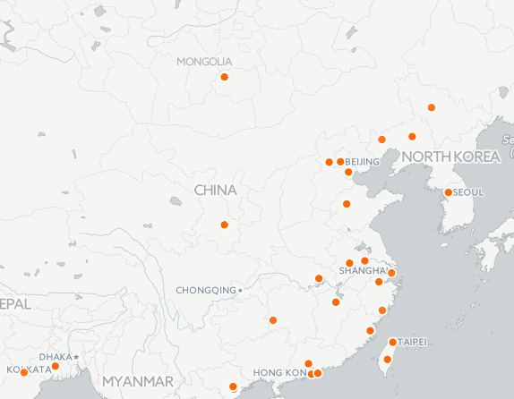
Issues and Improvements
Geolocation result accuracy
Zero accuracy
Country centroid

Slide 29
Issues and Improvements
IP Evasion Issue
Web proxies, anonymizer software such as Tor
Improvements
Add more filters
Handle multiple firewalls

Slide 30
Questions

Slide 31

Juliana Lo
Pacific Disaster Center
Email: jlo@pdc.org

