Slide 1
St. Louis: A Social, Economic and Infrastructure Trend Analysis, 1980-2010
MGIS Candidate: Sam Jehle
Advisor: Stephen Matthews

Slide 2
Outline
Background
Population and Racial Composition
Project Goal
Methodology
Anticipated Results
Timeline

Slide 3
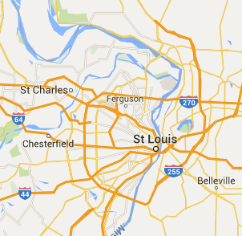
Background
1763: The location of St. Louis was founded
1803: The French and the United States came to terms on the Louisiana Purchase in the village of St. Louis
1822: St. Louis was incorporated as a city with a population of 5,000
1875: Home Rule adopted in Missouri
1876: St. Louis city seceded from St. Louis County
1900: Total population of St. Louis reached 575,238
1903: St. Louis selected to hold the World’s Fair
1917: Deadliest race riot in the St. Louis history
1919: Prohibition halts alcohol production at Anheuser Busch
“I have found a situation where I am going to form a settlement which might become, hereafter, one of the finest cities in America.”
- Pierre Laclede Liguest

Slide 4
Population and Racial Composition: 1930-2010
Year | St. Louis City | % Change | % White | % African-American | % Other | St. Louis County | % Change | % White | % African-American | % Other
1930 | 821,960 |  | 88.53% | 11.47% |  | 211,593 |  | 95.40% | 4.60%
1940 | 816,048 | -0.72% | 86.61% | 13.33% |  | 274,230 | 29.60% | 95.48% | 4.49%
1950 | 856,796 | 4.99% | 81.97% | 18.03% |  | 406,349 | 48.18% | 95.81% | 4.19%
1960 | 750,026 | -12.46% | 71.20% | 28.80% |  | 703,532 | 73.13% | 97.17% | 2.83%
1970 | 622,236 | -17.04% | 58.66% | 40.85% | 0.49% | 951,671 | 35.27% | 94.81% | 4.78% | 0.41%
1980 | 452,804 | -27.23% | 53.75% | 45.61% | 0.68% | 974,177 | 2.36% | 87.80% | 11.23% | 0.97%
1990 | 396,685 | -12.39% | 50.94% | 47.50% | 0.77% | 993,529 | 1.99% | 84.17% | 14.02% | 1.81%
2000 | 348,189 | -12.23% | 43.85% | 51.20% | 4.96% | 1,016,315 | 2.29% | 76.83% | 19.02% | 4.15%
2010 | 319,294 | -8.30% | 43.93% | 49.22% | 6.85% | 998,954 | -1.71% | 70.27% | 23.33% | 6.40%
Table 1: Total population and racial composition of St. Louis City and St. Louis County. The percent change is calculated by taking the difference from the previous census and dividing difference by the total population of the previous census. The total population was taken from the Missouri Census Data Center (http://mcdc.missouri.edu/trends/historical.shtml) and the 2010 populations were obtained through the United States Census Bureau website, http://quickfacts.census.gov/qfd/index.html. The racial percentage was calculated by dividing total race and then divided by the total population. The race data was downloaded from the National Historical Geographic Information System, https://nhgis.org/.

Slide 5
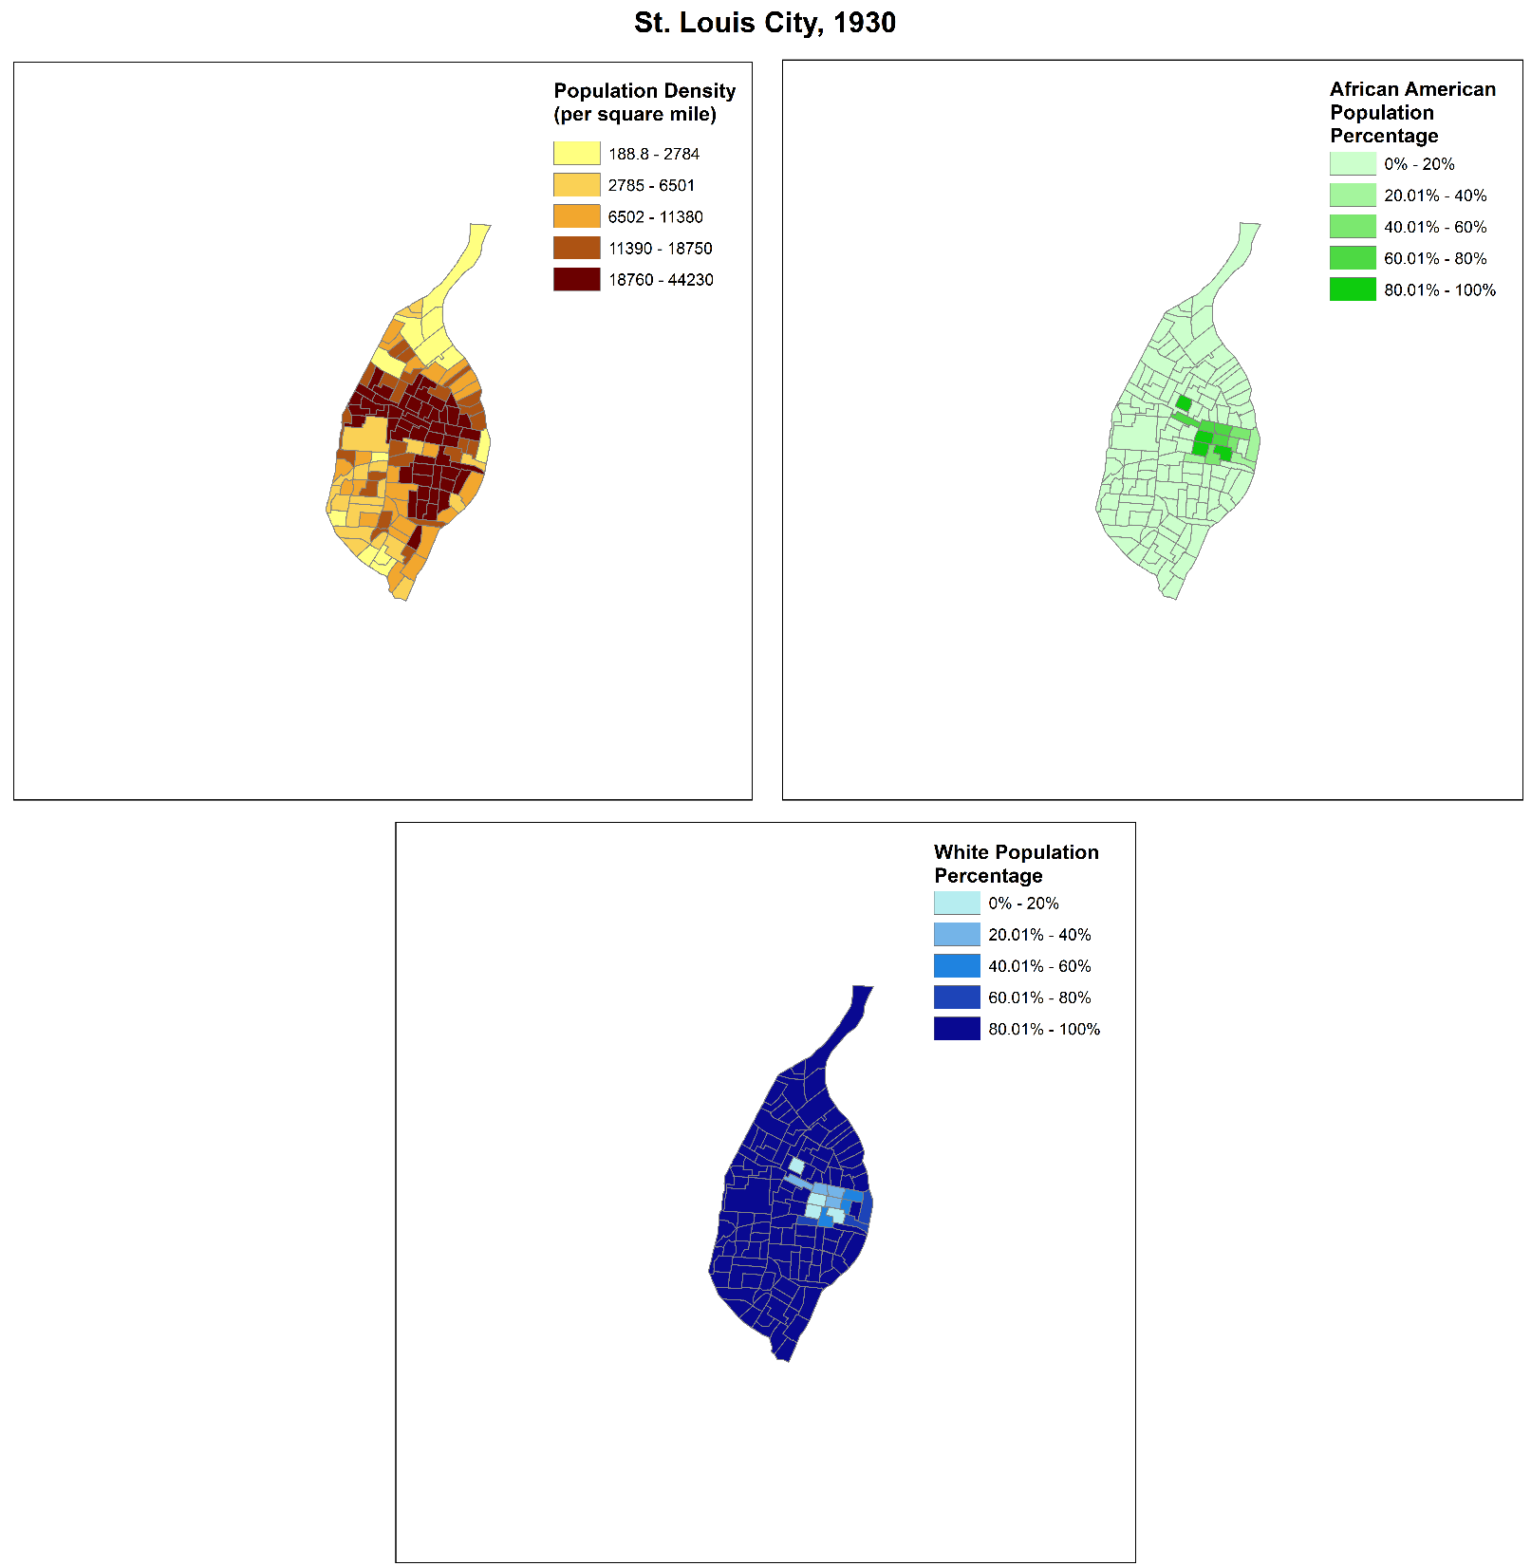

Slide 6
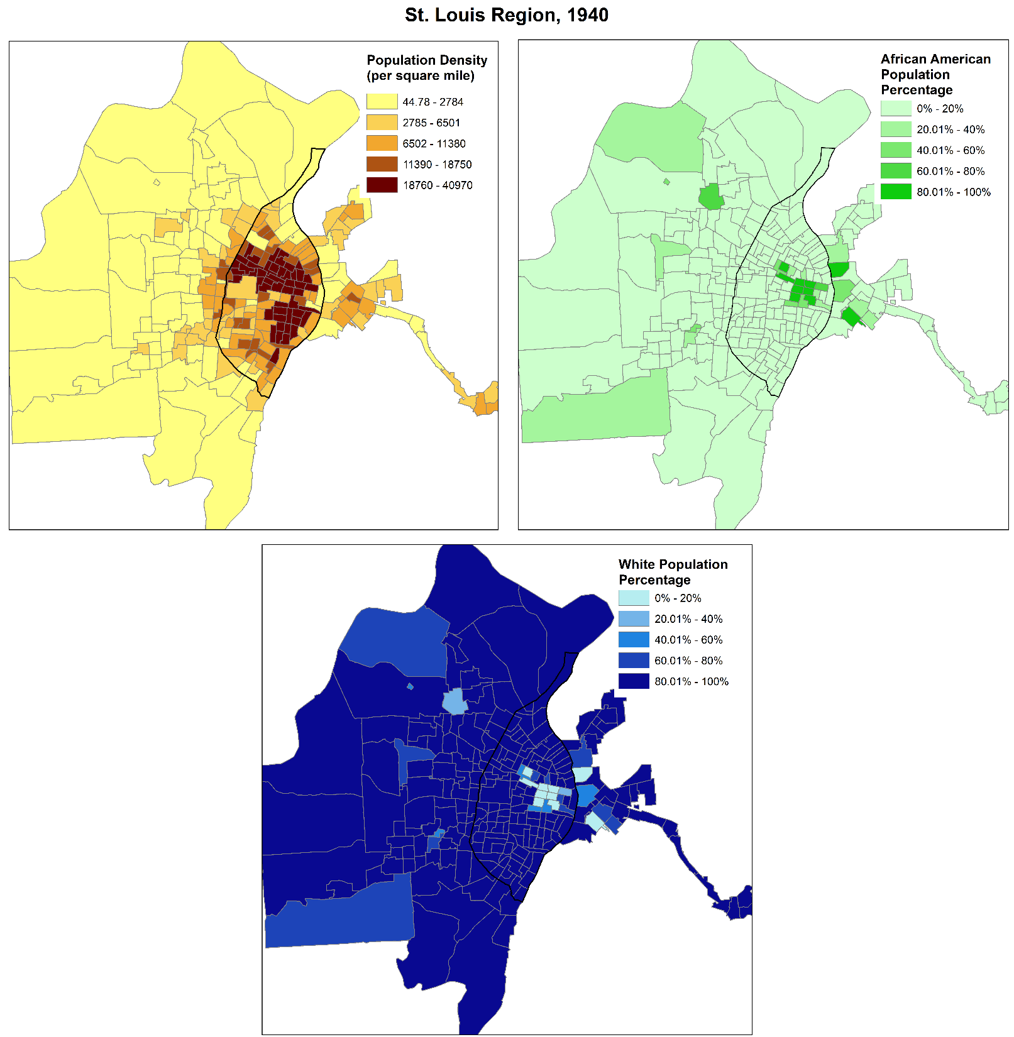

Slide 8
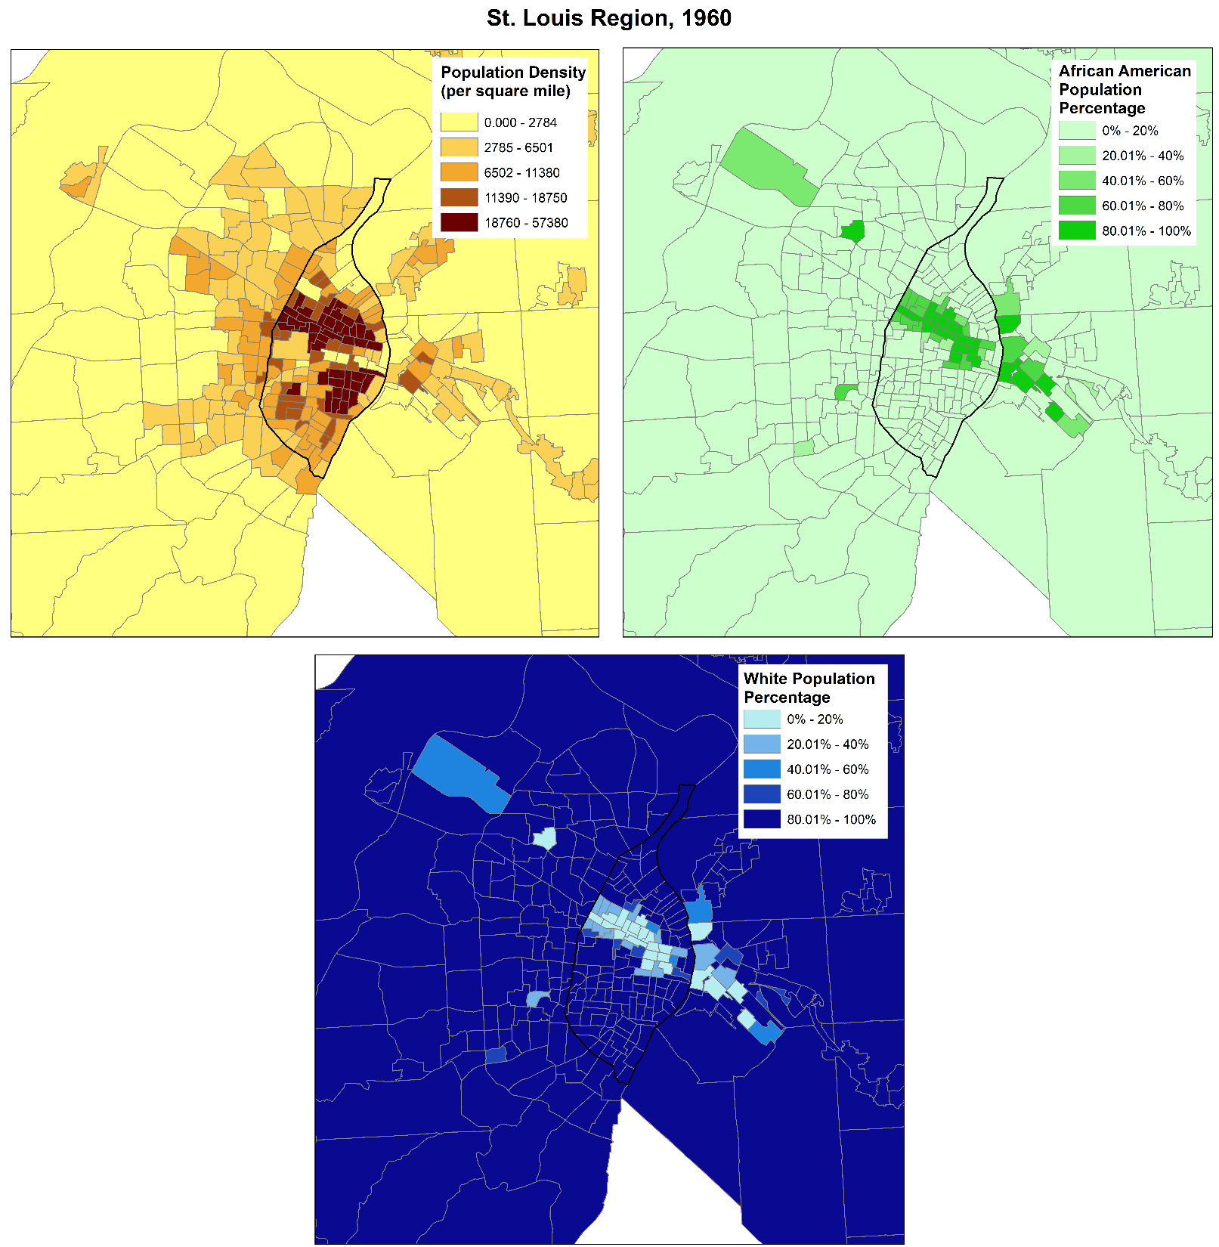

Slide 9
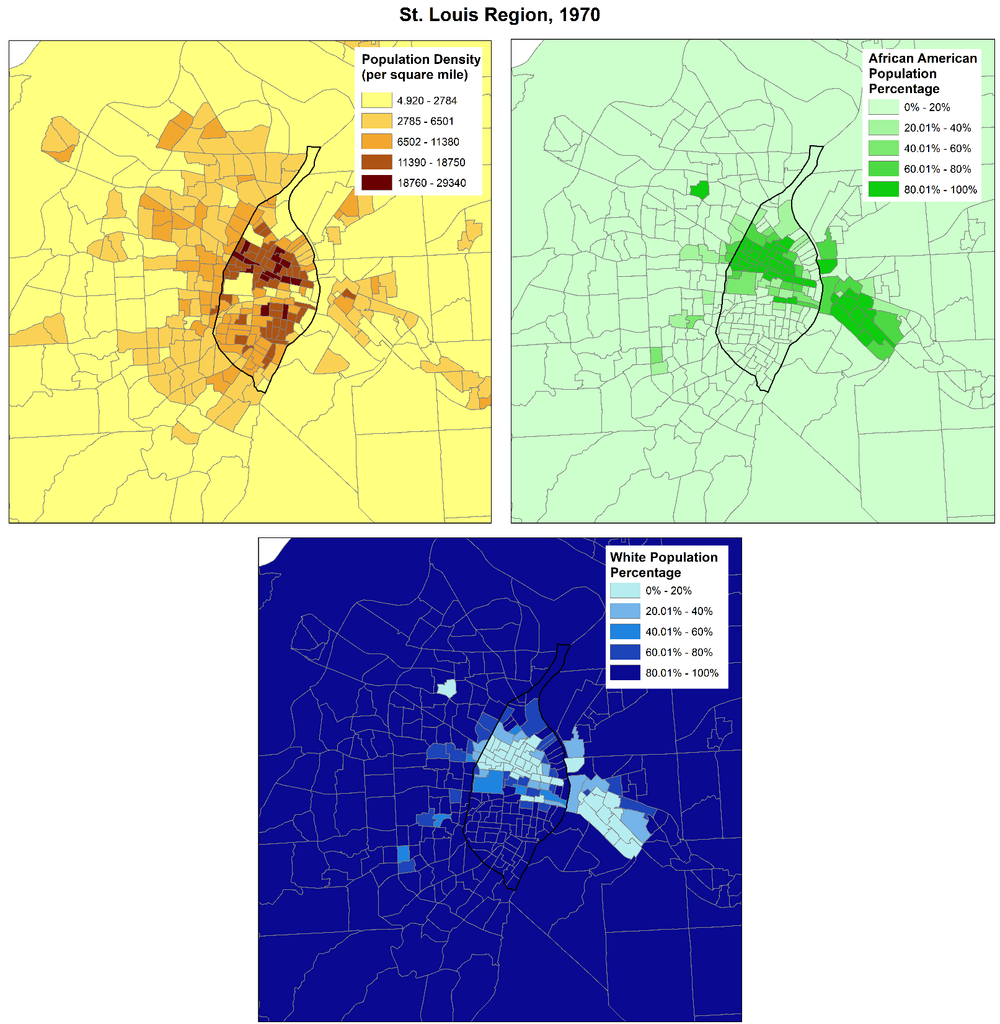

Slide 10
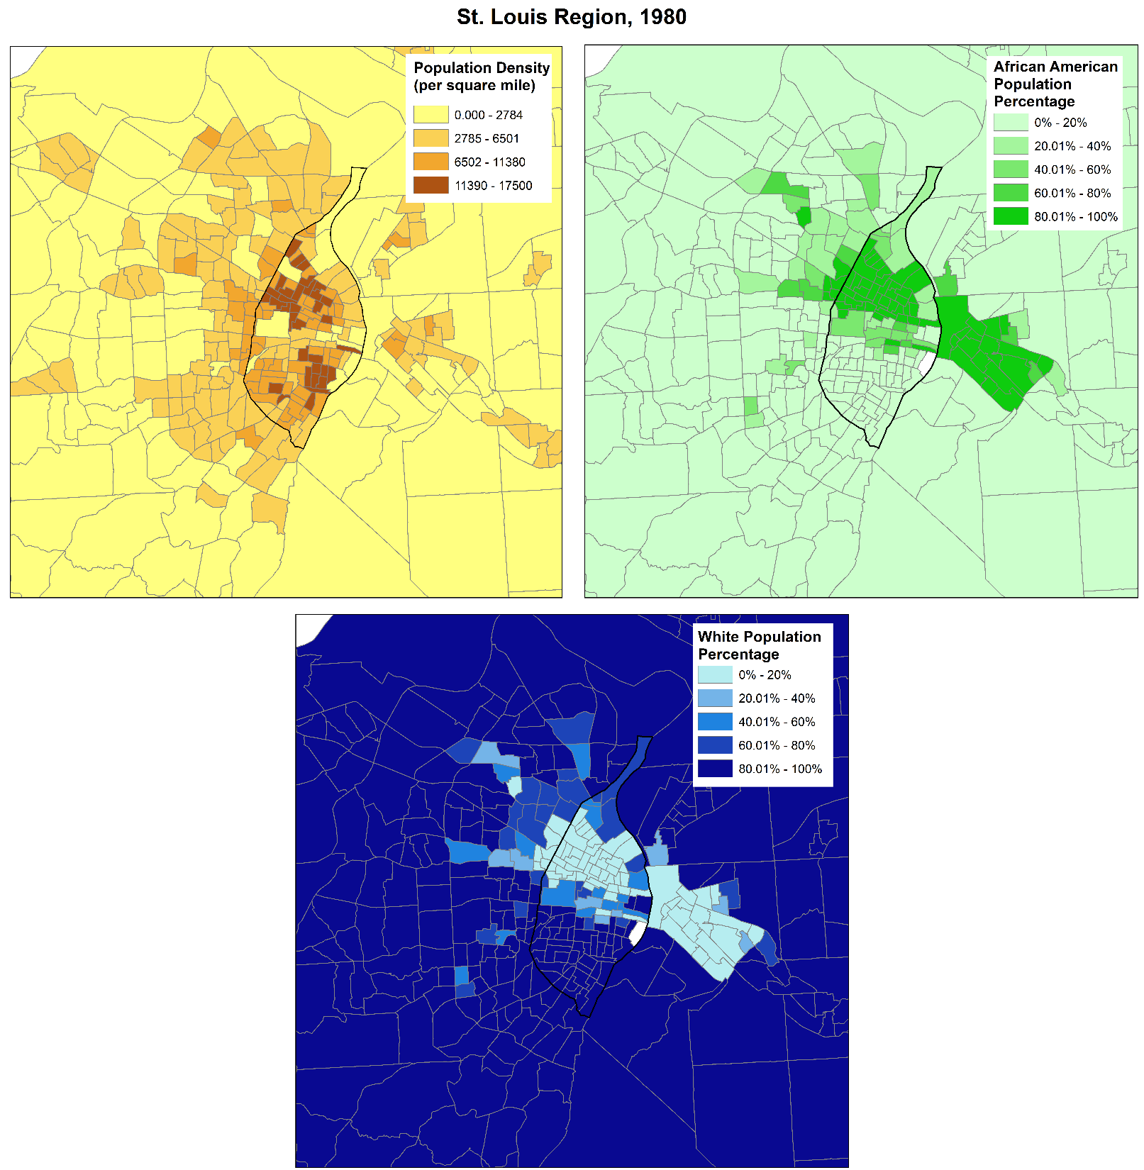

Slide 11
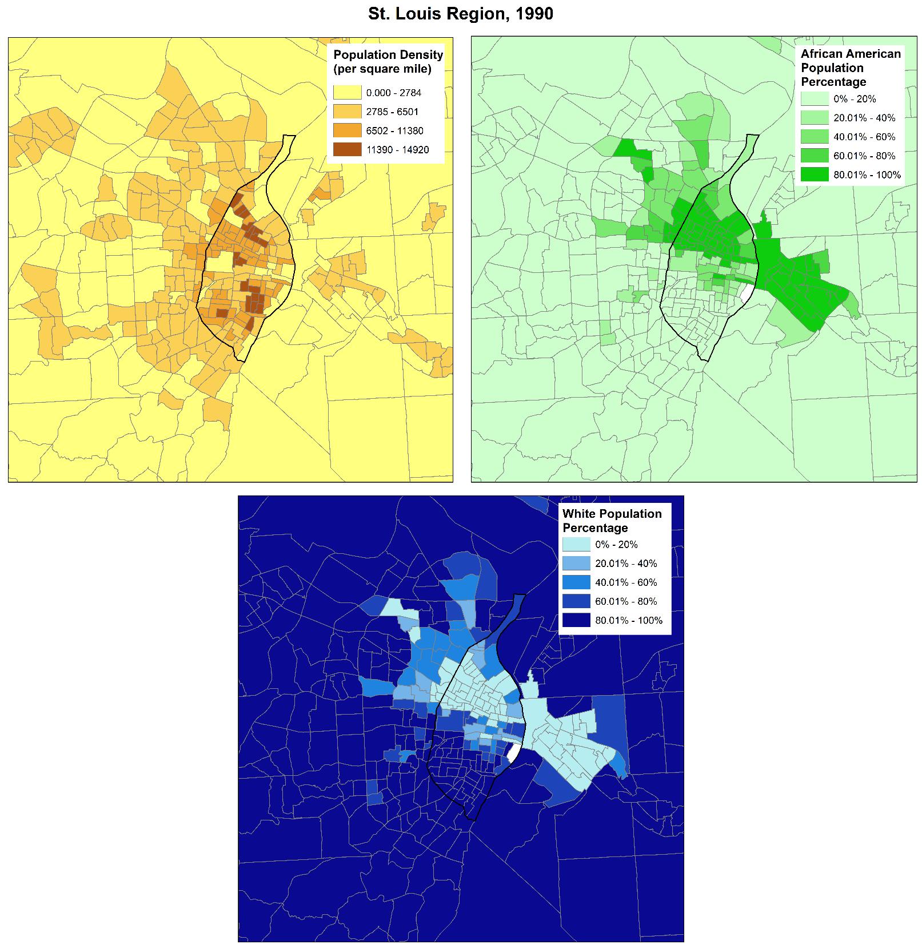

Slide 12
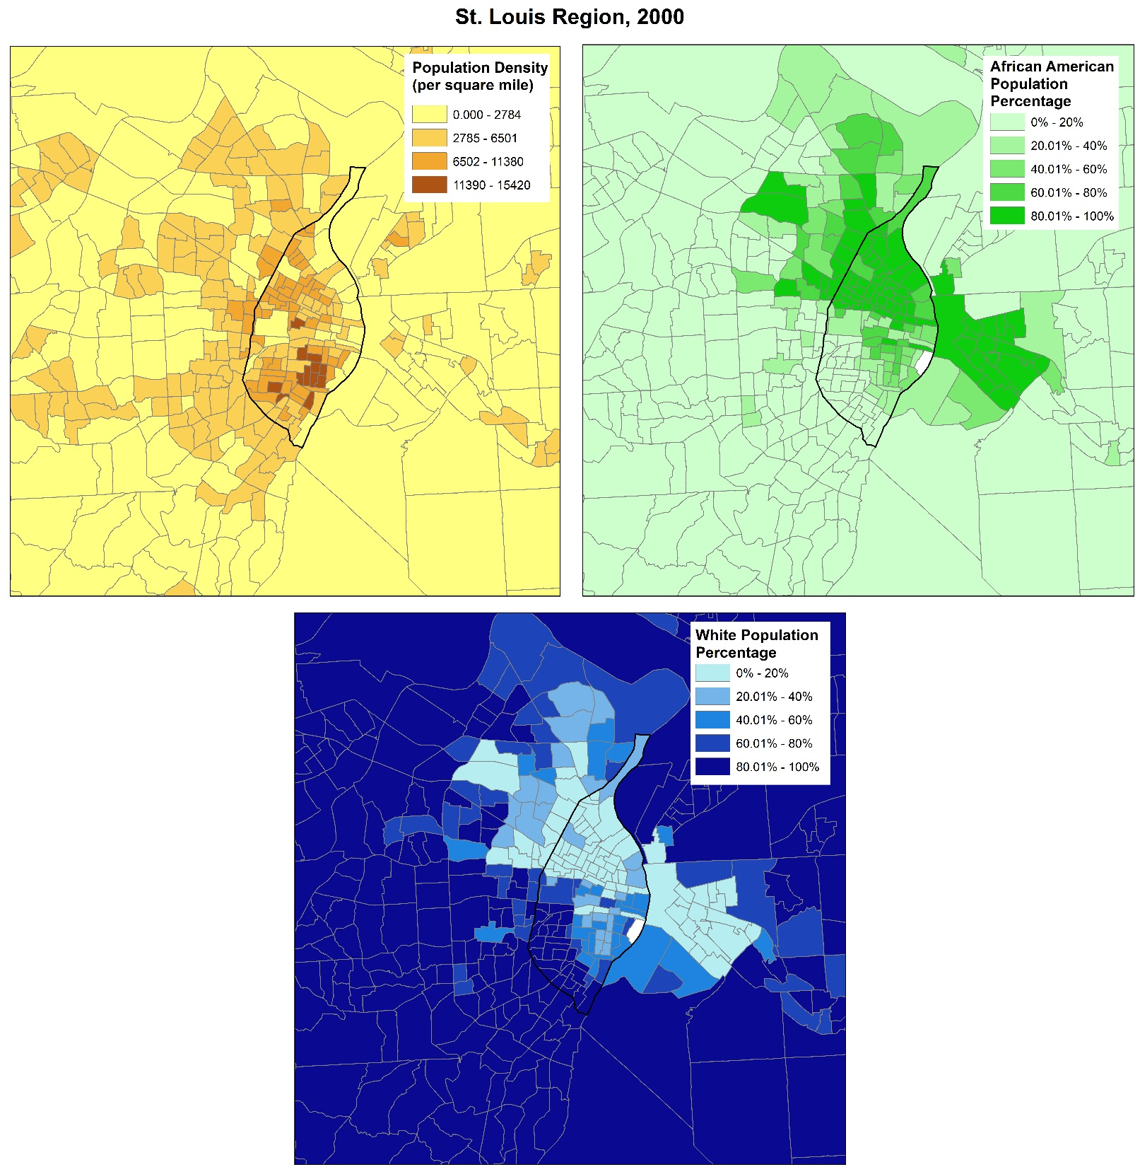

Slide 13
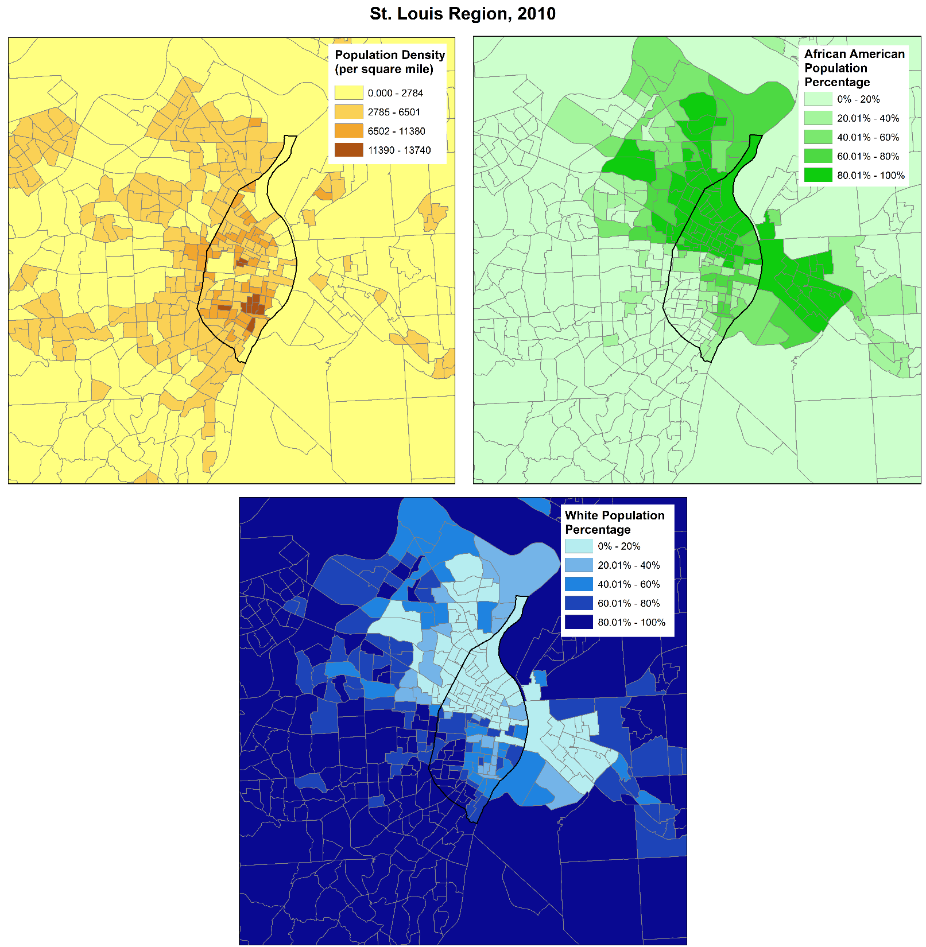

Slide 14
Goal
Analyze trends in St. Louis using economic, social and infrastructure dimensions from 1980 to 2010
Midwestern City Comparison
Tract Analysis

Slide 15
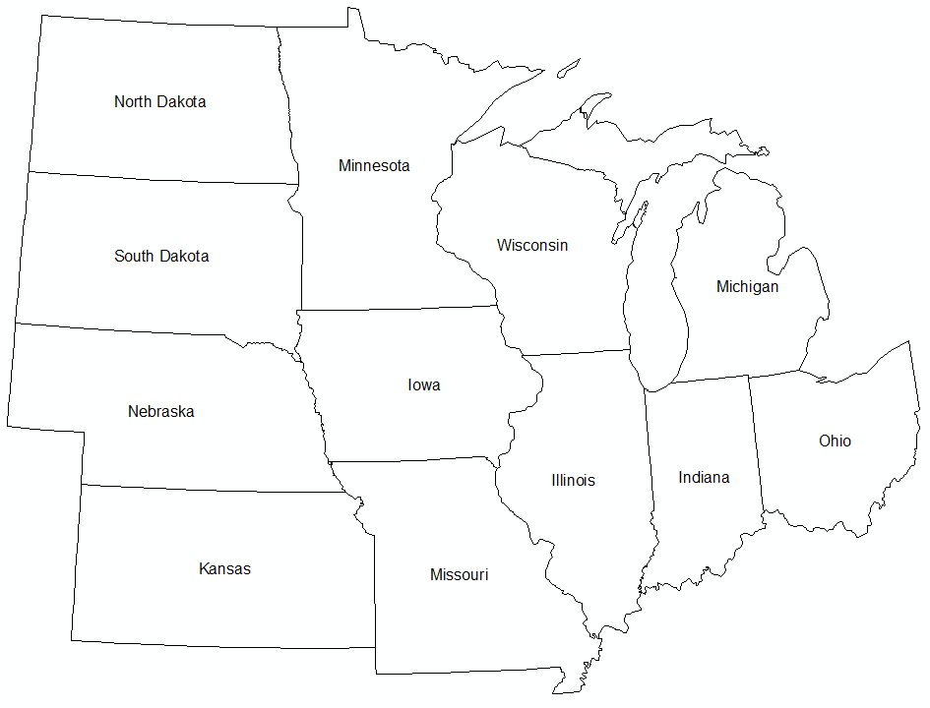
Methodology
MIDWESTERN CITY COMPARISON
Criteria:
The city must be located within a Midwestern state
City Population around 300,000 to 1,000,000 in the 2010 census
A metropolitan statistical area population around 1 million to 4 million in the 2010 census
Measures
Median Household Income
Population Change
Economic Inequality
Track the ranking of St. Louis per census
$$\left.Success Index=\left[\left(IncChange∗IncAbs\right.\right)+PopChange+(IneqChange∗0.50)\right]$$

Slide 16
Methodology
City | State | 2010 Census | 2010 MSA | 2014 land area (city)
Indianapolis | Indiana | 820,445 | 1,887,877 | 361.4 sq mi
Columbus | Ohio | 787,033 | 1,901,974 | 217.2 sq mi
Detroit | Michigan | 713,777 | 4,296,250 | 138.8 sq mi
St. Paul - Minneapolis | Minnesota | 667,646 | 3,348,859 | 193.8 sq mi
Milwaukee | Wisconsin | 594,833 | 1,555,908 | 96.1 sq mi
Kansas City | Missouri | 459,787 | 2,009,342 | 315.0 sq mi
Cleveland | Ohio | 396,815 | 2,077,240 | 77.7 sq mi
St. Louis | Missouri | 319,294 | 2,787,701 | 61.9 sq mi
Cincinnati | Ohio | 296,943 | 2,114,580 | 77.9 sq mi

Slide 17
Methodology
TRACT ANALYSIS
Rank census tracts using the following dimensions:
Concentrated Disadvantage
Population percentage of individuals below the poverty line
Population percentage of individuals on public assistance
Population percentage of female-headed households
Unemployed population percentage
Population percentage of people younger than 18
Dissimilarity Index
Measures the racial and ethnic evenness of a population
Calculated for: African American, Asian and Hispanic
Median Home Value (MHV)
Vacant Housing Units (VHU)
Identify the top and bottom 25% in 1980
Track the tract ranking through each census

Slide 18
Anticipated Results
Success Index: St. Louis falls within the bottom third of the cities
Tract Analysis: Tract dimension rankings remain the same

Slide 19
Timeline
Capstone Proposal DEC 17
Gather Census Data - End Date: JAN 30
GEOG 596B Starts FEB 24
Compile Data & Map Creation - End Date: MAR 2
Analyze & Document Results - End Date: APR 6
Report Findings (1st Draft) - End Date: APR 20
Revised Final Report - End Date: APR 30
Present Findings at Missouri History Museum MAY 2016

