Slide 1
St. Louis: A Social and Economic Trend Analysis, 1980-2010
MGIS Candidate: Sam Jehle
Advisor: Stephen Matthews

Slide 2
Introduction
Graduated from Western Illinois University in 2008 with bachelors in Meteorology and a minor in mathematics and GIS
Worked as a Geospatial Analyst at SAIC/Leidos from 2008-2016
Currently work for Ameren as an Applications Developer

Slide 3
Outline
Background
Project Goal
Methodology
Analysis and Results
Tract Summary
Future Work

Slide 4
Background: Population and Racial Composition, 1930-2010
Year | St. Louis City | % Change | % White | % African-American | % Other | St. Louis County | % Change | % White | % African-American | % Other
1930 | 821,960 |  | 88.53% | 11.47% |  | 211,593 |  | 95.40% | 4.60%
1940 | 816,048 | -0.72% | 86.61% | 13.33% |  | 274,230 | 29.60% | 95.48% | 4.49%
1950 | 856,796 | 4.99% | 81.97% | 18.03% |  | 406,349 | 48.18% | 95.81% | 4.19%
1960 | 750,026 | -12.46% | 71.20% | 28.80% |  | 703,532 | 73.13% | 97.17% | 2.83%
1970 | 622,236 | -17.04% | 58.66% | 40.85% | 0.49% | 951,671 | 35.27% | 94.81% | 4.78% | 0.41%
1980 | 452,804 | -27.23% | 53.75% | 45.61% | 0.68% | 974,177 | 2.36% | 87.80% | 11.23% | 0.97%
1990 | 396,685 | -12.39% | 50.94% | 47.50% | 0.77% | 993,529 | 1.99% | 84.17% | 14.02% | 1.81%
2000 | 348,189 | -12.23% | 43.85% | 51.20% | 4.96% | 1,016,315 | 2.29% | 76.83% | 19.02% | 4.15%
2010 | 319,294 | -8.30% | 43.93% | 49.22% | 6.85% | 998,954 | -1.71% | 70.27% | 23.33% | 6.40%
Table 1: Total population and racial composition of St. Louis City and St. Louis County. The percent change is calculated by taking the difference from the previous census and dividing difference by the total population of the previous census. The total population was taken from the Missouri Census Data Center (http://mcdc.missouri.edu/trends/historical.shtml) and the 2010 populations were obtained through the United States Census Bureau website, http://quickfacts.census.gov/qfd/index.html. The racial percentage was calculated by dividing total race and then divided by the total population. The race data was downloaded from the National Historical Geographic Information System, https://nhgis.org/.

Slide 5
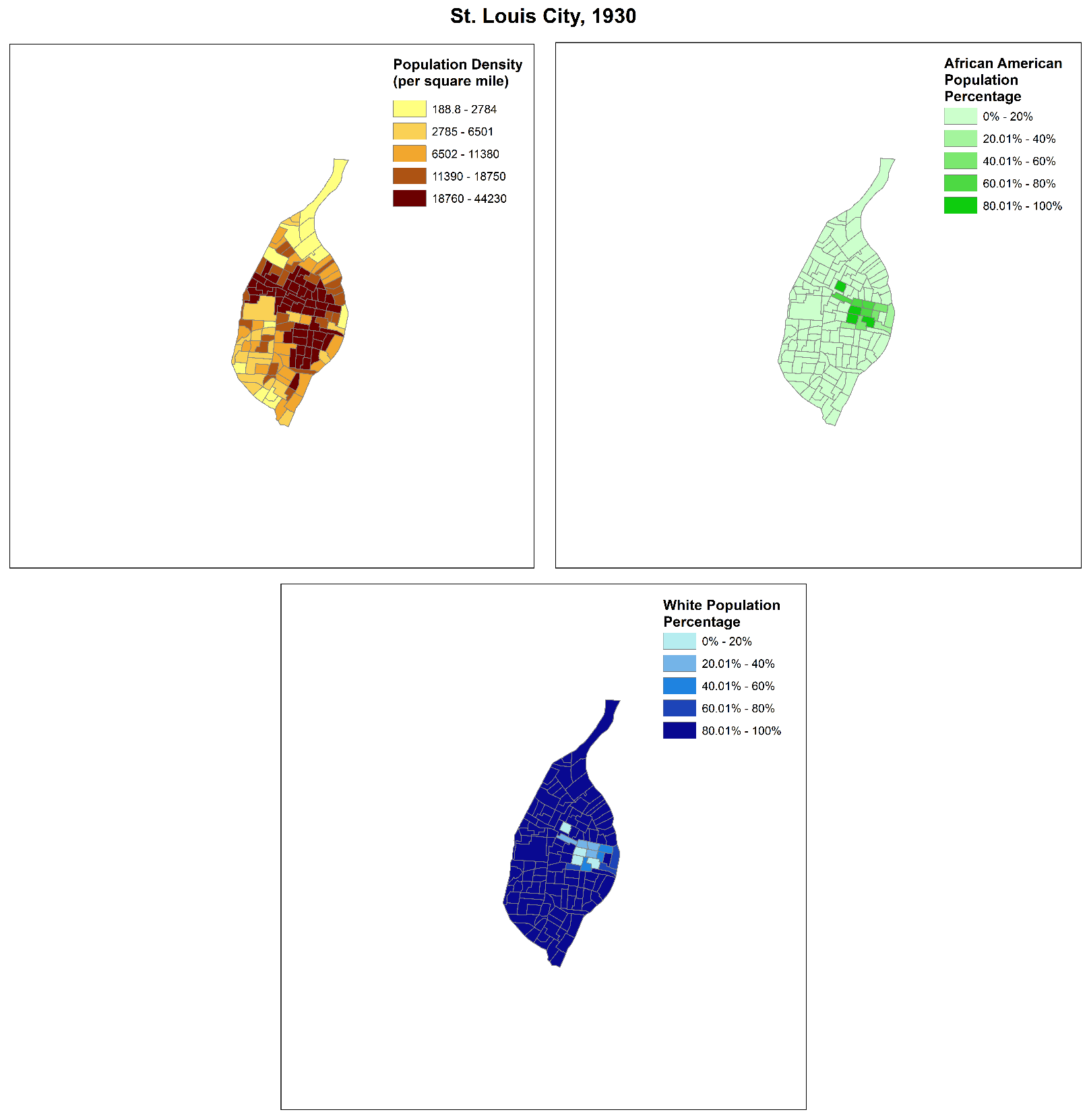

Slide 6
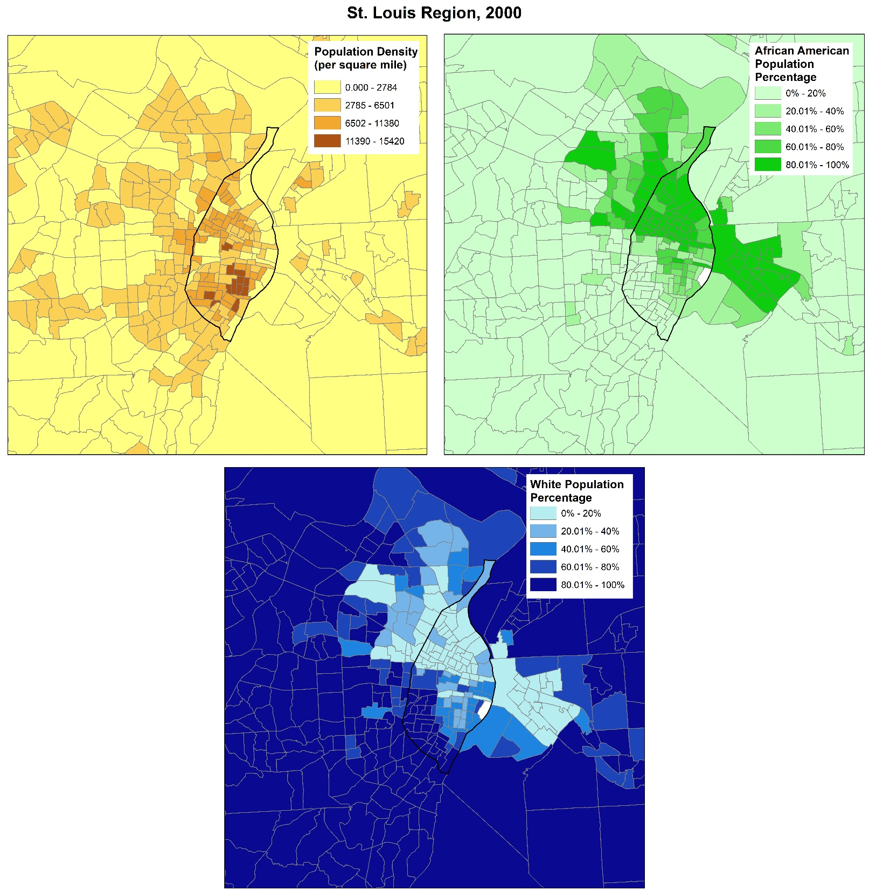
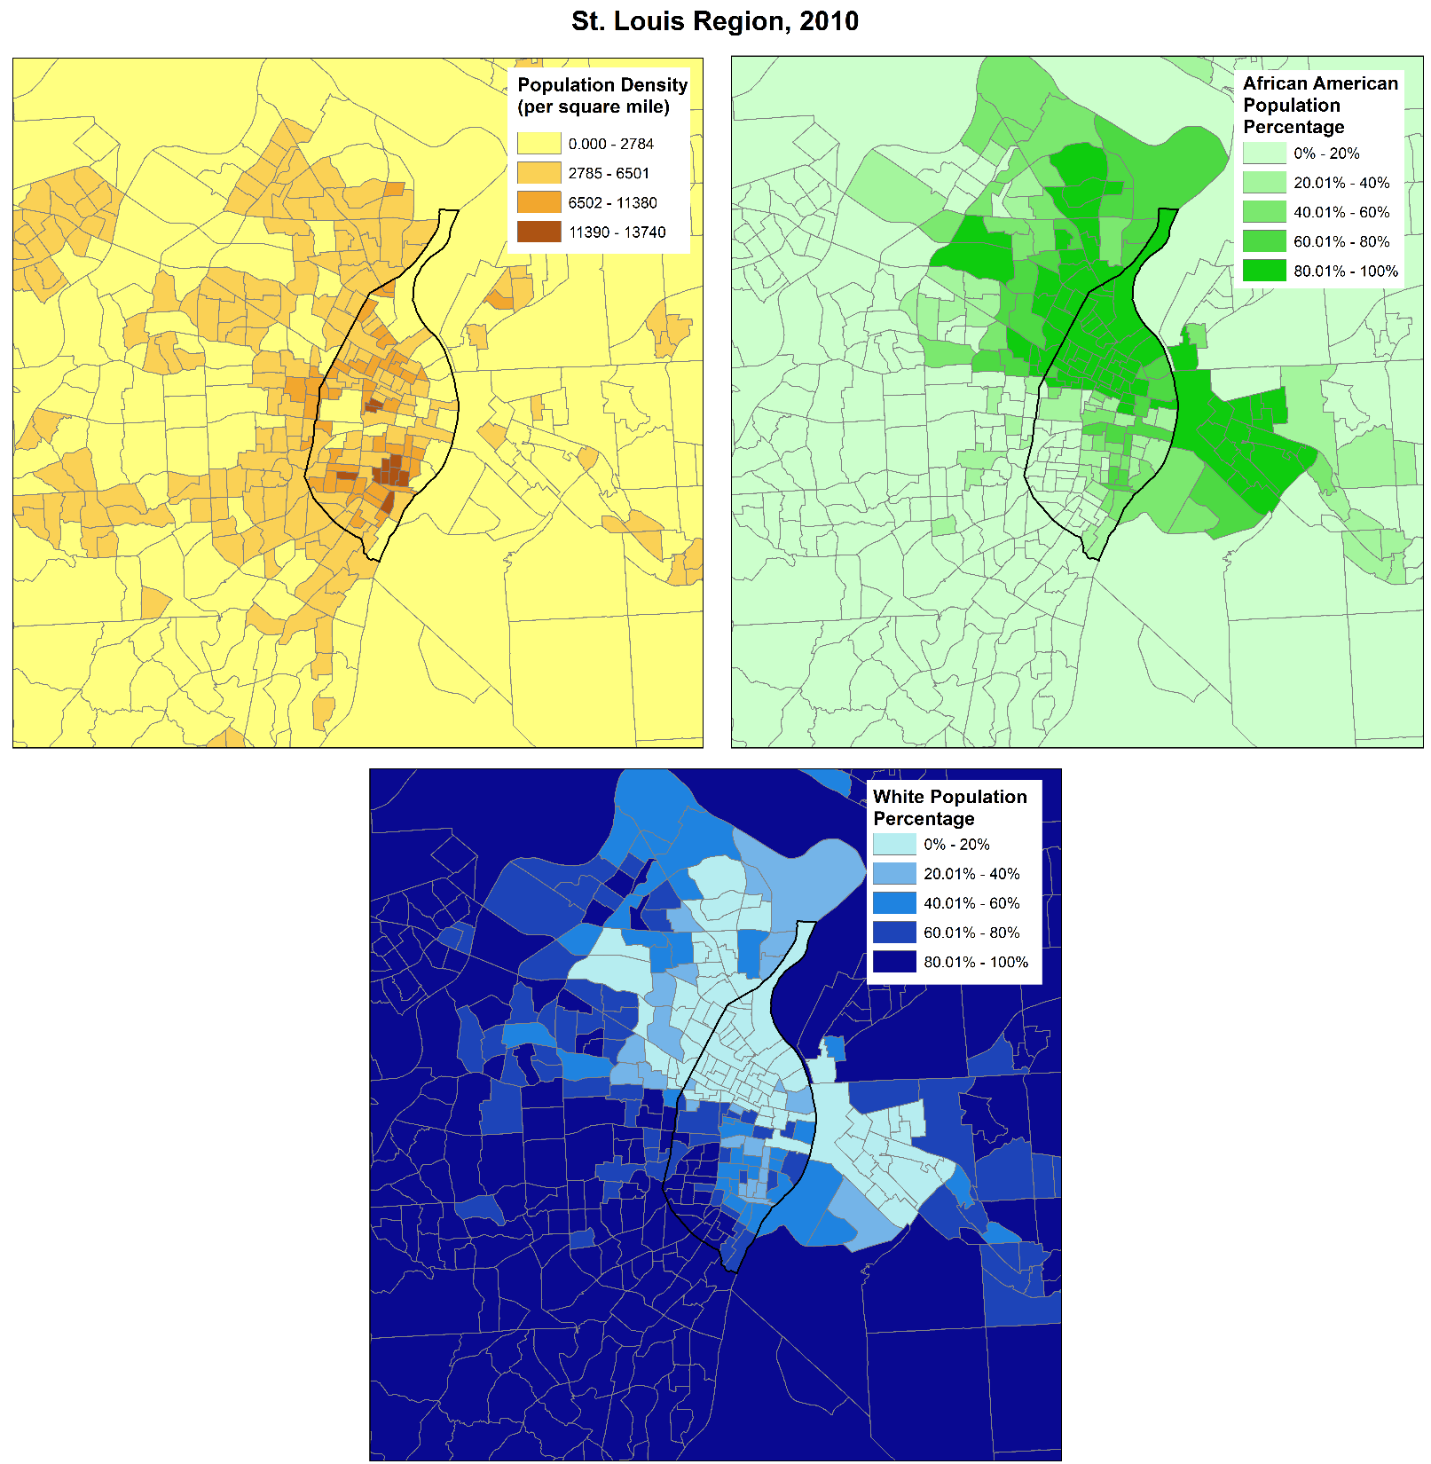
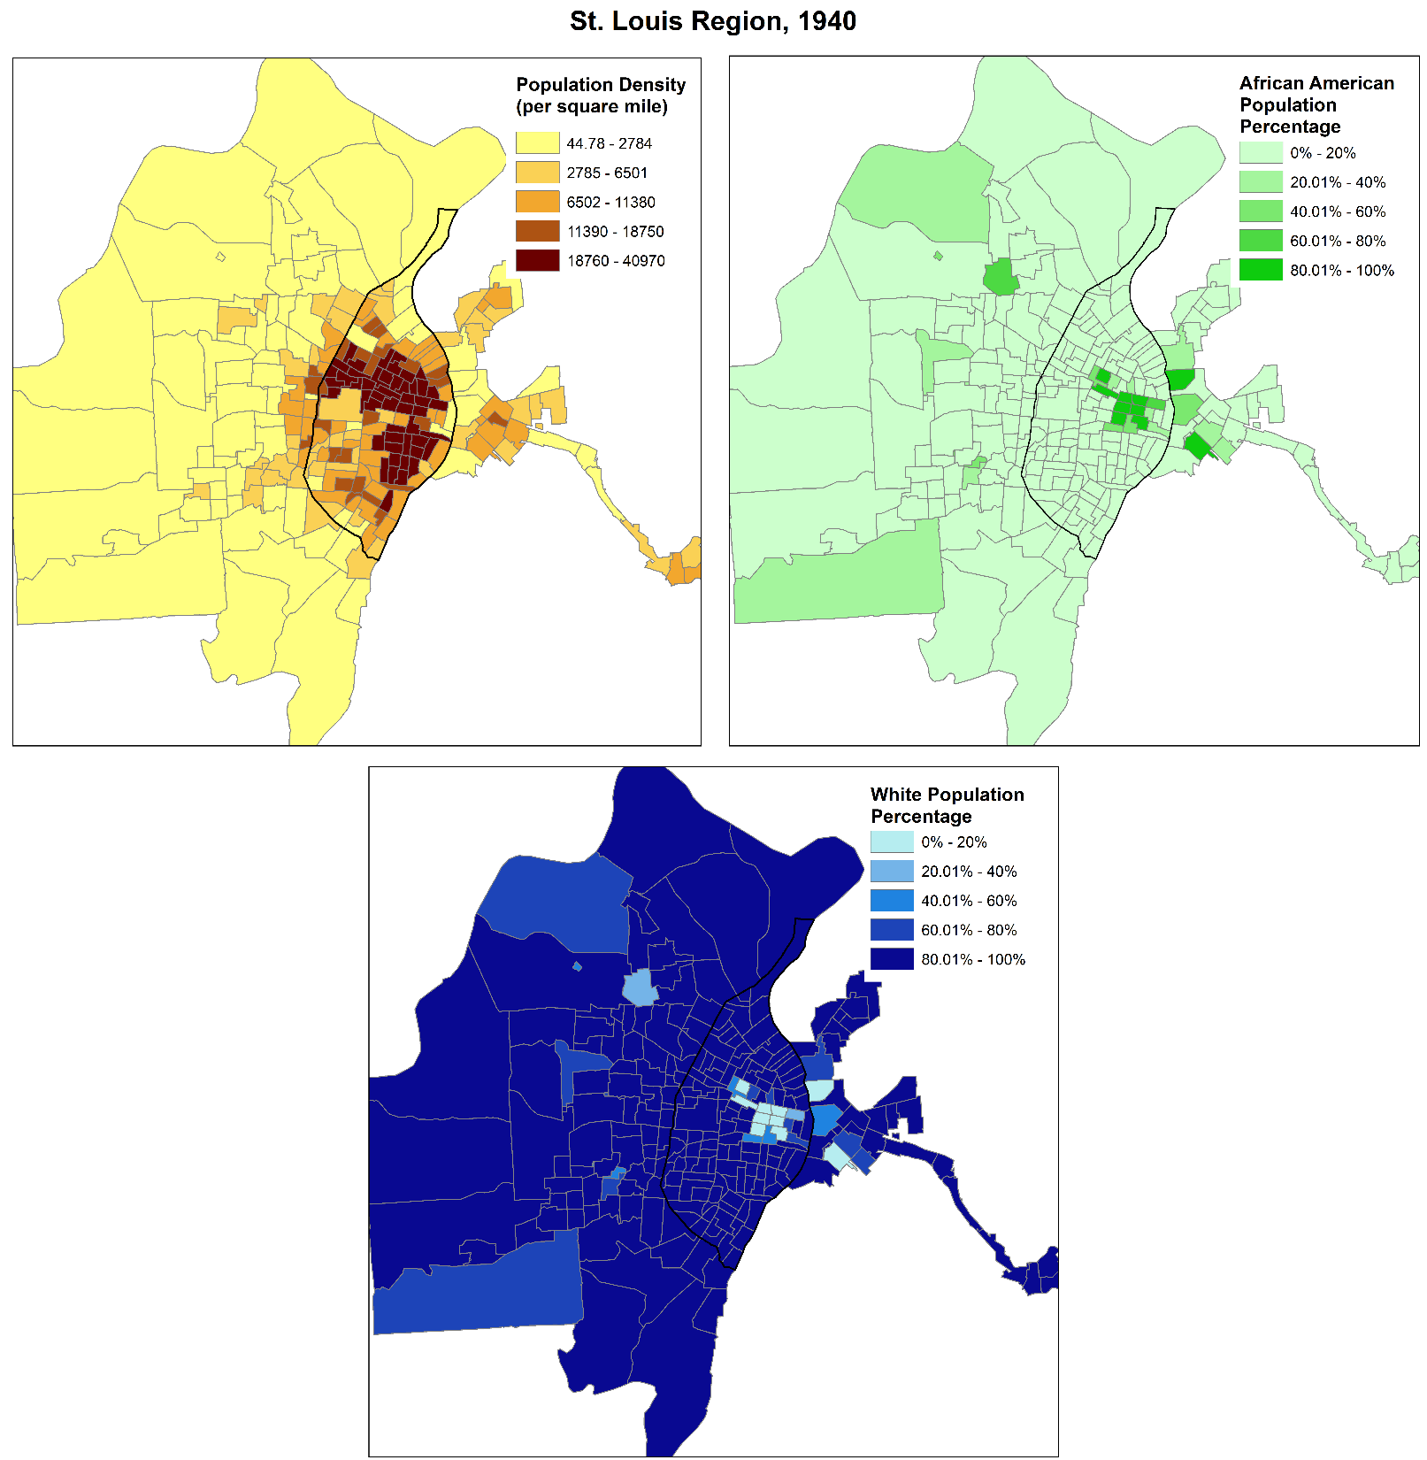
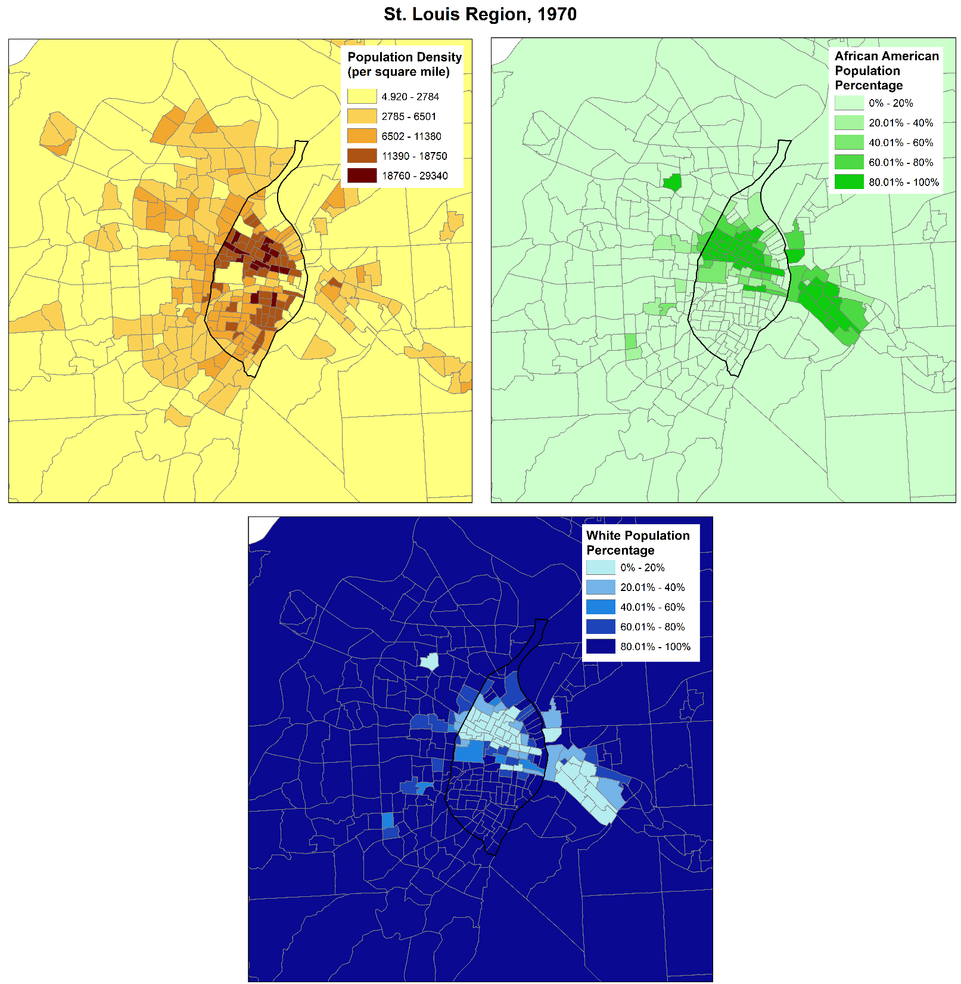
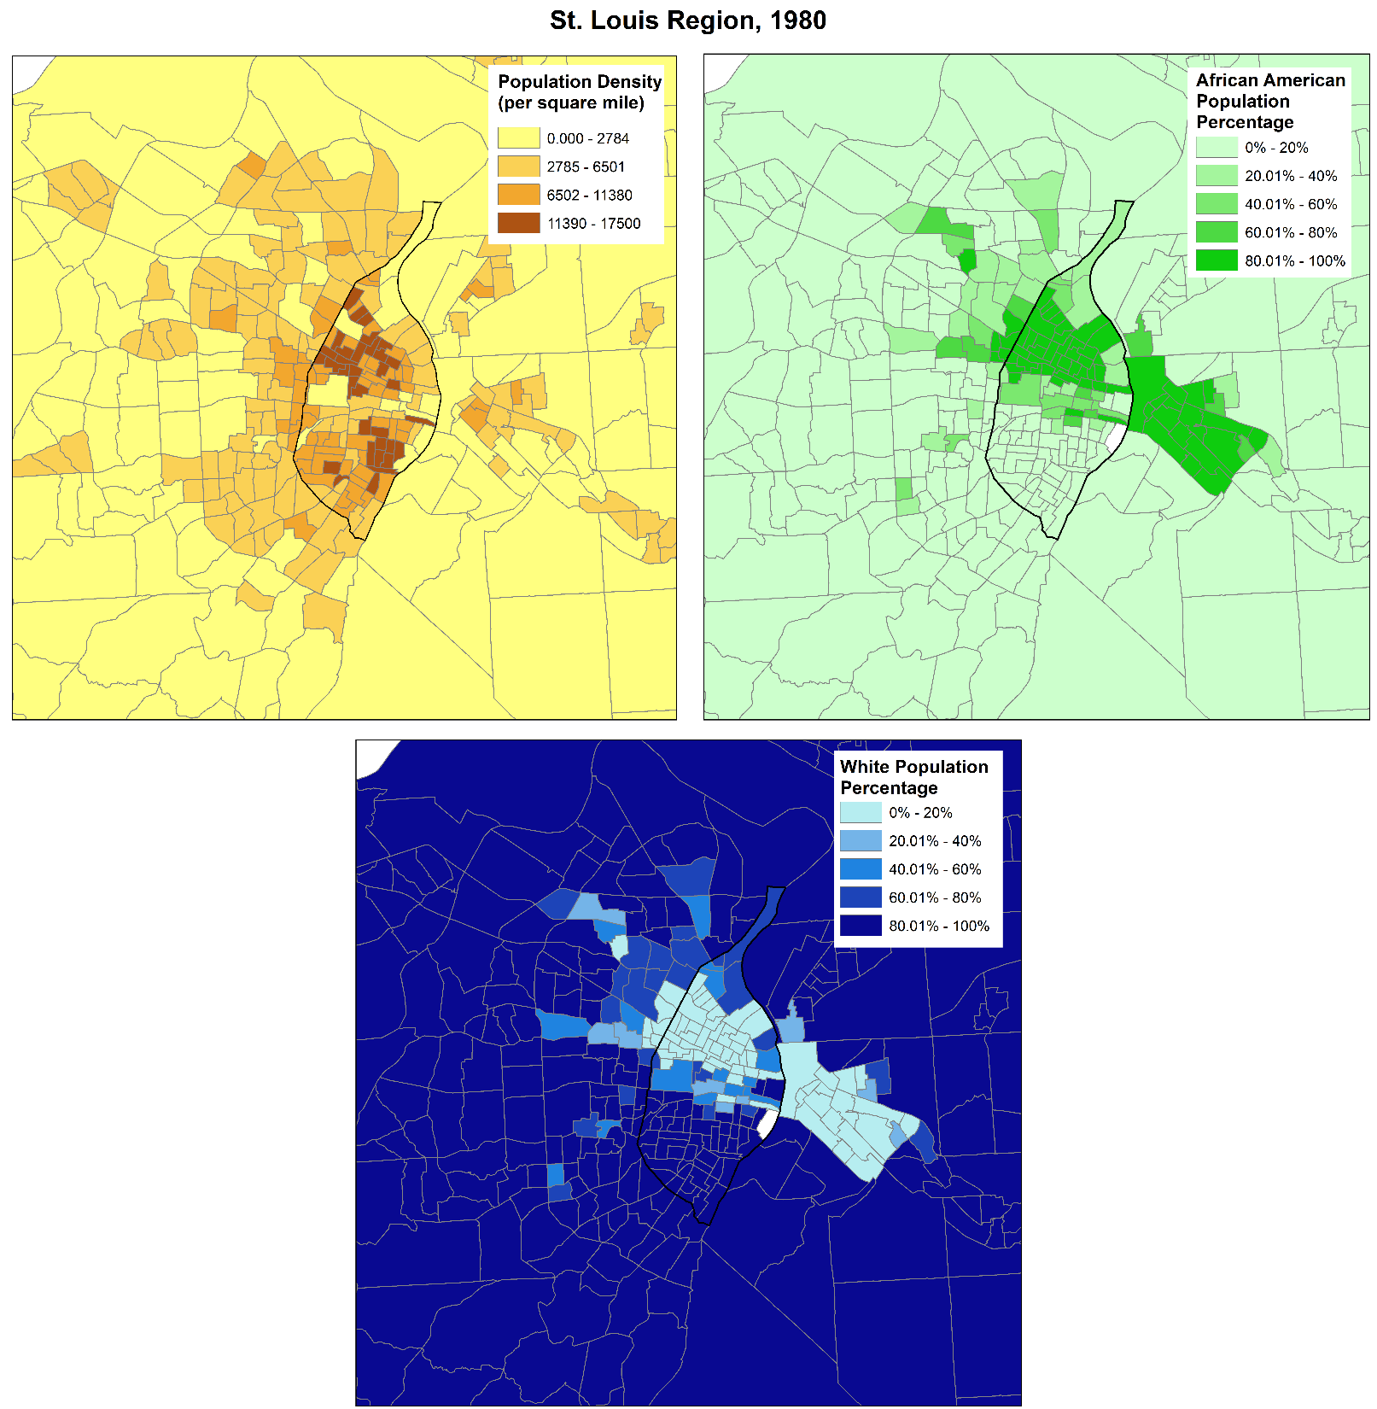
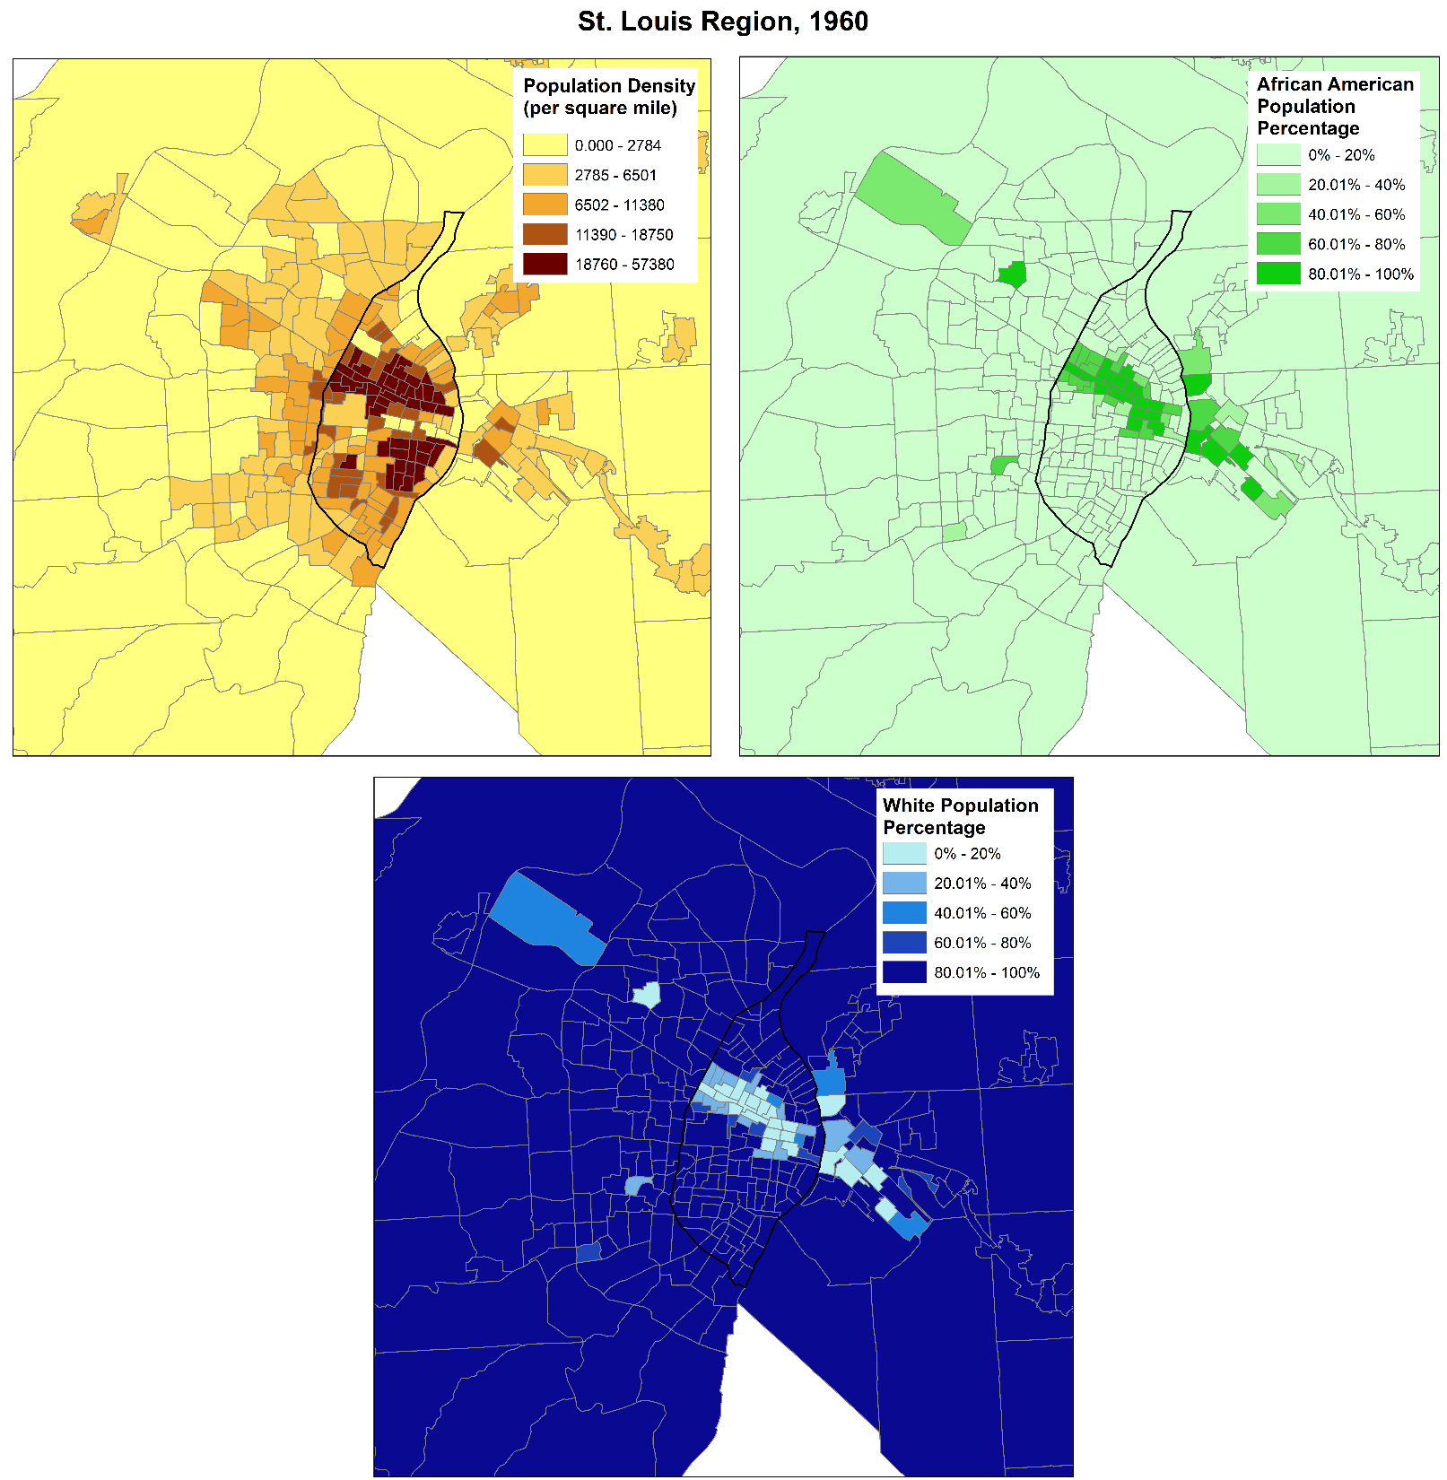
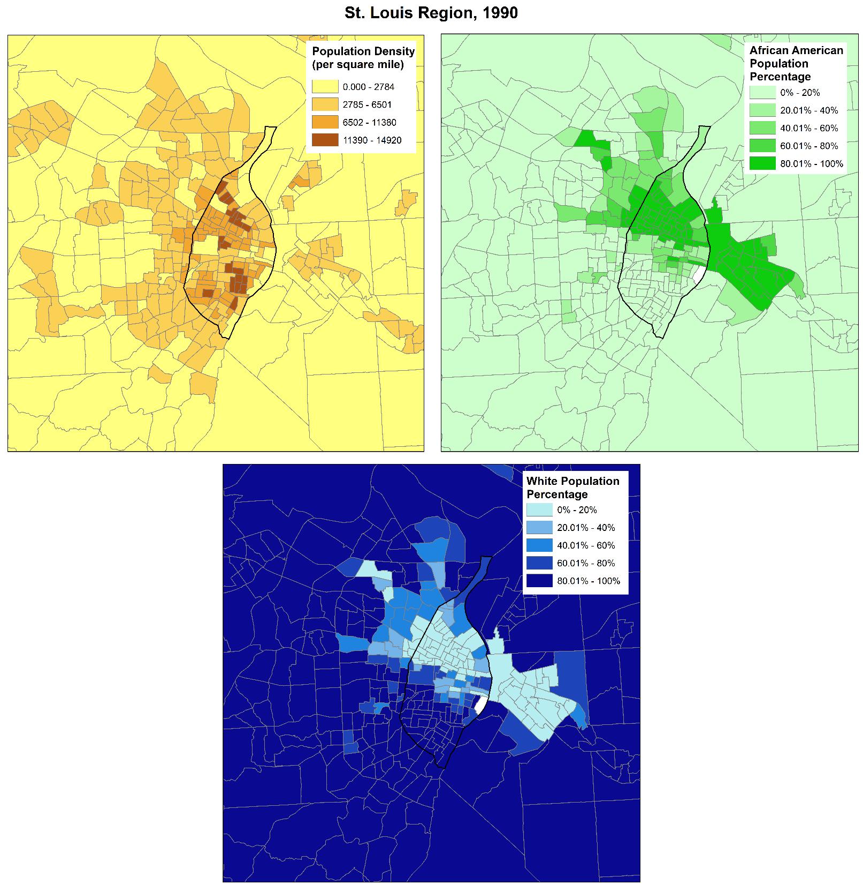

Slide 7
Goal
Analyze St. Louis from 1980 to 2010 using GIS and several different sociological and economical indices
Identify areas of poverty, demographic unevenness, home values and vacant housing at the tract level to identify trends. The focus for the tract analysis will be on the bottom and upper tertiles (33%).
St. Louis will be compared to other Midwestern cities in each decade using a success index developed by John Norman.

Slide 8
Tract Analysis
Measures
Concentrated Disadvantage
Dissimilarity Index
Median Home Value
Vacant Homes

Slide 9
Tract Analysis
Resulting values are ranked and broken up into tertiles: top, middle and bottom
Contingency tables were used to classify tracts
Stasis: a tract remaining in the same tertile
Fell: a tract whose rank dropped, placing it in a lower tertile
Rose: a tract whose rank increased, placing it in a higher tertile
Tracts that fall within a different tertile as time progresses are tracts that have changed
Each table uses 1980 as a reference point

Slide 10
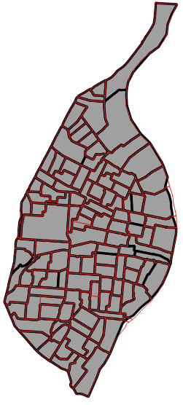
Tract Analysis
Requires time consistent spatial boundaries
St. Louis tracts were consistent from 1980 to 2000 with a total count of 113
In the 2010 census several tracts were split and merged, reducing the tract count to 106
A custom shapefile was created from the differing tract shapefiles resulting in 105 total tracts
Merged tracts received sum or weighted average of the individual tracts
TRACT VARIATIONS
1980-2000 | 2010
103900, 104100 | 126800
107100, 107700 | 126900
108400, 108500 | 127000
120100, 120300 | 127100
113100, 113400 | 127200
117300, 118500 | 127300
122100, 122200, 122400 | 127400
121300, 121400 | 127500
123400, 123500 | 127600
119100 | 119101, 119102
114100 | 114101, 114102
116300 | 116301, 116302

Slide 11
Concentrated Disadvantage
Combination of six interrelated census tract characteristics
Percentage of individuals below the poverty line
Percentage of households on public assistance
Percentage of female-headed households
Percentage of unemployed individuals
Percent of individuals less than age of 18
Racial composition (percentage African-American
Racial composition omitted from the measure
Z-scores were calculated, averaged and ranked to obtain an index

Slide 12
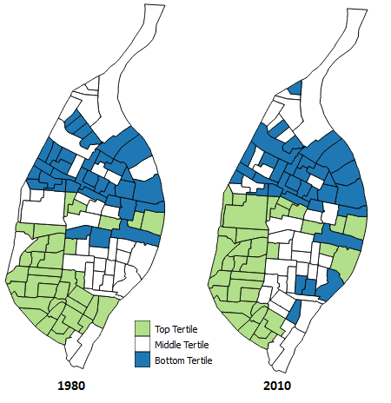
Concentrated Disadvantage
 |  | 1980
2010 |  | Bottom | Middle | Top
 | Bottom | 25 | 8 | 1
 | Middle | 9 | 19 | 7
 | Top | 0 | 8 | 26
Concentrated disadvantage contingency table
 | 1990 | 2000 | 2010
Stasis | 82.52% | 70.87% | 67.96%
Fell | 8.74% | 14.56% | 15.53%
Rose | 8.74% | 14.56% | 16.50%
Concentrated disadvantage contingency table ranking changes; the percentages are base off of the 1980 concentrated disadvantage rankings

Slide 13
Dissimilarity Index
Measures racial evenness based on racial majority population
Index ranges from 0 (complete integration) to 1 (complete segregation)
This means a total value for the entire city
Following sections use the resulting ratio difference for maps and contingency tables
Analysis done for the following race and ethnicities:
African American
Asian (combination of Asian, Pacific Islander and Native Hawaiian)
Hispanic

Slide 14
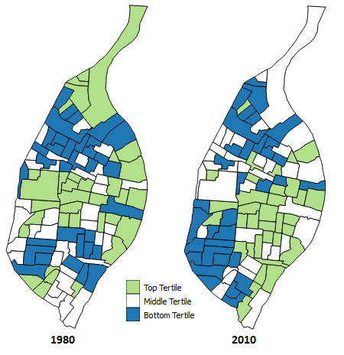
Dissimilarity Index: African American
African American Dissimilarity Index
1980 | 0.8350
1990 | 0.7803
2000 | 0.6869
2010 | 0.6511
 |  | 1980
2010 |  | Bottom | Middle | Top
 | Bottom | 16 | 13 | 5
 | Middle | 13 | 12 | 10
 | Top | 5 | 10 | 19
African American contingency table
 | 1990 | 2000 | 2010
Stasis | 79.61% | 53.40% | 45.63%
Fell | 10.68% | 24.27% | 27.18%
Rose | 9.71% | 22.33% | 27.18%
African American contingency table ranking percentage change; percentages based off of the 1980 dissimilarity values

Slide 15
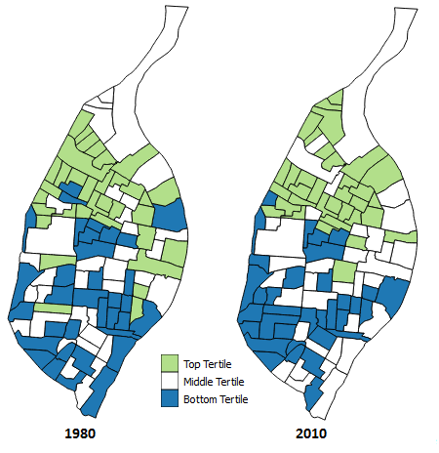
Dissimilarity Index: Asian
Asian Dissimilarity Index
1980 | 0.4188
1990 | 0.3710
2000 | 0.3652
2010 | 0.3619
 |  | 1980
2010 |  | Bottom | Middle | Top
 | Bottom | 19 | 11 | 4
 | Middle | 11 | 14 | 10
 | Top | 4 | 10 | 20
Asian contingency table
 | 1990 | 2000 | 2010
Stasis | 58.25% | 50.49% | 51.46%
Fell | 22.33% | 27.18% | 24.27%
Rose | 19.42% | 22.33% | 24.27%
Asian contingency table ranking percentage change; percentages based off of the 1980 dissimilarity values

Slide 16
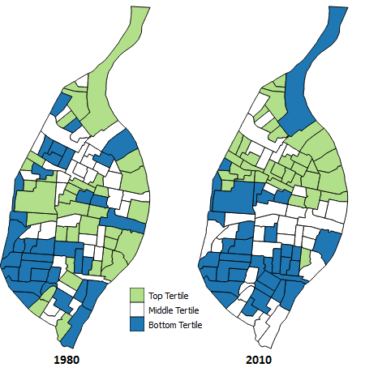
Dissimilarity Index: Hispanic
Hispanic Dissimilarity Index
1980 | 0.3230
1990 | 0.2579
2000 | 0.2941
2010 | 0.3434
 |  | 1980
2010 |  | Bottom | Middle | Top
 | Bottom | 16 | 8 | 5
 | Middle | 8 | 11 | 10
 | Top | 9 | 13 | 10
Hispanic contingency table
 | 1990 | 2000 | 2010
Stasis | 42.22% | 38.89% | 41.11%
Fell | 26.67% | 27.78% | 25.56%
Rose | 31.11% | 33.33% | 33.33%
Hispanic contingency table ranking percentage change; percentages based off of the 1980 dissimilarity values

Slide 17
Home Measures
Ranked the median home value and percentage of vacant homes
Used for residential stability and land use
Found a weak negative correlation, -0.14953, for the two variables in 1980
Concluded a moderate negative correlation, -0.41676, in 2010
Since a strong negative correlation was not observed (-0.70 to -0.90) the variable were analyzed independently

Slide 18
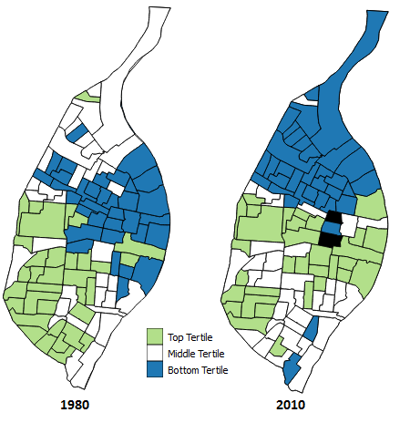
Median Home Values
 |  | 1980
2010 |  | Bottom | Middle | Top
 | Bottom | 18 | 16 | 0
 | Middle | 5 | 16 | 14
 | Top | 9 | 3 | 20
Median home value contingency table
 | 1990 | 2000 | 2010
Stasis | 76.70% | 66.99% | 53.47%
Fell | 14.56% | 19.42% | 29.70%
Rose | 8.74% | 13.59% | 16.83%
Median home value contingency table ranking changes; the percentages are base off of the 1980 median home value rankings
Median home value tertile rankings for St. Louis tracts in 1980 and 2010;
tracts with no available data are in black and were removed from the tract count

Slide 19
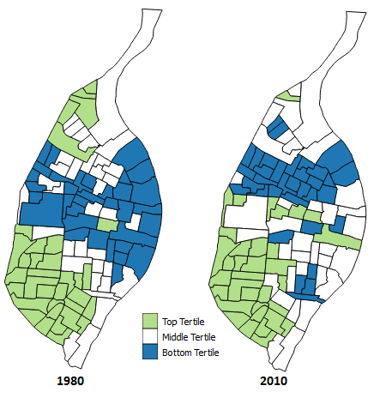
Vacant Homes
 | 1980
2010 |  | Bottom | Middle | Top
 | Bottom | 15 | 18 | 1
 | Middle | 15 | 12 | 8
 | Top | 4 | 5 | 25
Vacant home percentage contingency table
 | 1990 | 2000 | 2010
Stasis | 81.55% | 68.93% | 50.49%
Fell | 9.71% | 16.50% | 26.21%
Rose | 8.74% | 14.56% | 23.30%
Vacant home percentage contingency table ranking changes; the percentages are base off of the 1980 vacant home percentages

Slide 20
Correlation Coefficient: 1980
 | African America Dissimilarity Index | Asian Dissimilarity Index | Hispanic Dissimilarity Index | Concentrated Disadvantage | Median Home Value | Vacant Home Percentage
African America Dissimilarity Index | 1
Asian Dissimilarity Index | -0.038 | 1
Hispanic Dissimilarity Index | 0.409 | 0.163 | 1
Concentrated Disadvantage | 0.217 | -0.302 | -0.153 | 1
Median Home Value | -0.100 | 0.230 | 0.070 | -0.464 | 1
Vacant Home Percentage | -0.236 | -0.147 | -0.298 | 0.587 | -0.134 | 1

Slide 21
Correlation Coefficient: 2010
 | African America Dissimilarity Index | Asian Dissimilarity Index | Hispanic Dissimilarity Index | Concentrated Disadvantage | Median Home Value | Vacant Home Percentage
African America Dissimilarity Index | 1
Asian Dissimilarity Index | 0.205 | 1
Hispanic Dissimilarity Index | 0.160 | 0.756 | 1
Concentrated Disadvantage | -0.110 | -0.414 | -0.287 | 1
Median Home Value | -0.024 | 0.347 | 0.153 | -0.615 | 1
Vacant Home Percentage | -0.349 | -0.434 | -0.311 | 0.644 | -0.403 | 1

Slide 22
Summary
City of St. Louis experienced observable change for each measure
For most measures, an increasing number of tracts changed tertiles as time progressed
The Asian and Hispanic dissimilarity index were the exception

Slide 23
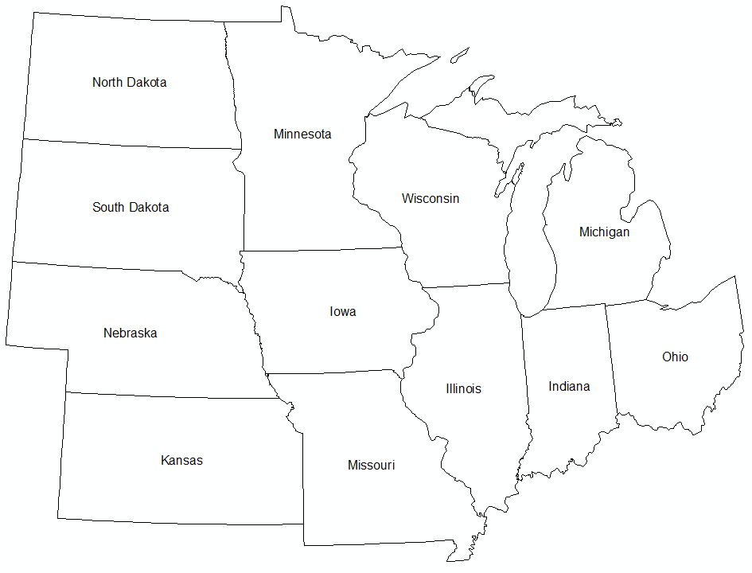
Midwestern City Comparison
Criteria:
The city must be located within a Midwestern state
City Population around 300,000 to 1,000,000 in the 2010 census
A metropolitan statistical area population around 1 million to 4 million in the 2010 census
City | State | 2010 Census | 2010 MSA | 2014 land area (city)
Indianapolis | Indiana | 820,445 | 1,887,877 | 361.4 sq mi
Columbus | Ohio | 787,033 | 1,901,974 | 217.2 sq mi
Detroit | Michigan | 713,777 | 4,296,250 | 138.8 sq mi
St. Paul - Minneapolis | Minnesota | 667,646 | 3,348,859 | 193.8 sq mi
Milwaukee | Wisconsin | 594,833 | 1,555,908 | 96.1 sq mi
Kansas City | Missouri, Kansas | 459,787 | 2,009,342 | 315.0 sq mi
Cleveland | Ohio | 396,815 | 2,077,240 | 77.7 sq mi
St. Louis | Missouri | 319,294 | 2,787,701 | 61.9 sq mi
Cincinnati | Ohio | 296,943 | 2,114,580 | 77.9 sq mi

Slide 24
Midwestern City Comparison
$$\left.Success Index=\left[\left(IncChange∗IncAbs\right.\right)+PopChange+(IneqChange∗0.50)\right]$$
Success index variables: median household income, population change and economic inequality for each decade (e.g. from 1990 to 2000)
$IncChange$ $−$percentage change in median household
$IncAbs$ $−$ absolute value of median household income
$PopChange$ $−$the percent change in population from the national mean population change
$IneqChange −$percentage change in the 90:10 index of inequality
SUCCESS INDEX RANKINGS
1990 | 2000 | 2010
1) Columbus | 1) Minneapolis/St. Paul | 1) Minneapolis/St. Paul
2) Indianapolis | 2) Columbus | 2) Columbus
3) Minneapolis/St. Paul | 3) Detroit | 3) Kansas City
4) Kansas City | 4) Indianapolis | 4) St. Louis
5) Milwaukee | 5) Kansas City | 5) Milwaukee
6) Cincinnati | 6) Cincinnati | 6) Indianapolis
7) St. Louis | 7) Cleveland | 7) Cincinnati
8) Cleveland | 8) Milwaukee | 8) Cleveland
9) Detroit | 9) St. Louis | 9) Detroit

Slide 25
Future Work
Determine if the same tracts change over time
Investigate tracts with greatest rank change
Compare tract trends with other Midwestern cities

Slide 26
Sources
Data
Minnesota Population Center. National Historical Geographic Information System: Version 2.0. Minneapolis, MN: University of Minnesota 2011.
Works Cited
https://www.stlouis-mo.gov/archive/history-physical-growth-stlouis/
http://www.stl250.org/crash-course-colonial-and-early.aspx
http://www.stl250.org/crash-course-fur-traders.aspx
http://www.census.gov/population/www/documentation/twps0027/tab06.txt
http://www.census.gov/population/www/documentation/twps0027/tab13.txt
http://scholarship.law.wm.edu/cgi/viewcontent.cgi?article=2835&context=wmlr
Colin Gordon. Mapping Decline: St. Louis and the Fate of the American City. 2008.
https://www.washingtonpost.com/news/the-watch/wp/2014/09/03/how-st-louis-county-missouri-profits-from-poverty/
http://www.stl250.org/crash-course-fourth-city.aspx
http://www.stl250.org/crash-course-dry-weary-years.aspx
https://www.census.gov/geo/reference/gtc/gtc_ct.html
Farley, John E. Past Trends and Future Directions. The St. Louis Region, 1950-2000: How We Have Changed.
Laslo, David. Past Trends and Future Directions. The Past, Present, and Future of the St. Louis Labor Force.

Slide 27
Sources
Works Cited cont.
Cummings, Scott. Past Trends and Future Directions. Racial Inequality and Developmental Disparities in the St. Louis Region.
Sampson, Robert; Raudenbush, Stephen; Earls, Felton. Neighborhoods and Violent Crime: A Multilevel Study of Collective Efficacy. 1997.
http://www.unc.edu/~pmeyer/carstat/tools.html. Massey, Douglas S.; Denton, Nancy A. The Dimensions of Residential Segregation. 1988.
Wesenberg, Richard. City Neighborhoods: Housing Stability, Quality, and Affordability.
Norman, Jon. Small Cities USA: Growth, Diversity, and Inequality.
Iceland, John and Weinberg, Daniel H. with Steinmetz, Erika. Racial and Ethnic Residential Segregation in the United States: 1980-2000. 2002.
Sampson, Robert J. Great American City: Chicago and the Enduring Neighborhood Effect. 2012. The University of Chicago.
Sampson, Robert J.; Sharkley, Patrick; Raudenbush, Stephen W. Durable Effects of Concentrated Disadvantage on Verbal Ability Among African-American Children. 2007. PNAS. January 22, 2008.
https://www2.census.gov/geo/pdfs/education/CensusTracts.pdf
Forest, Benjamin. Measures of Segregation and Isolation. 2005. http://www.dartmouth.edu/~segregation/IndicesofSegregation.pdf

