Slide 1
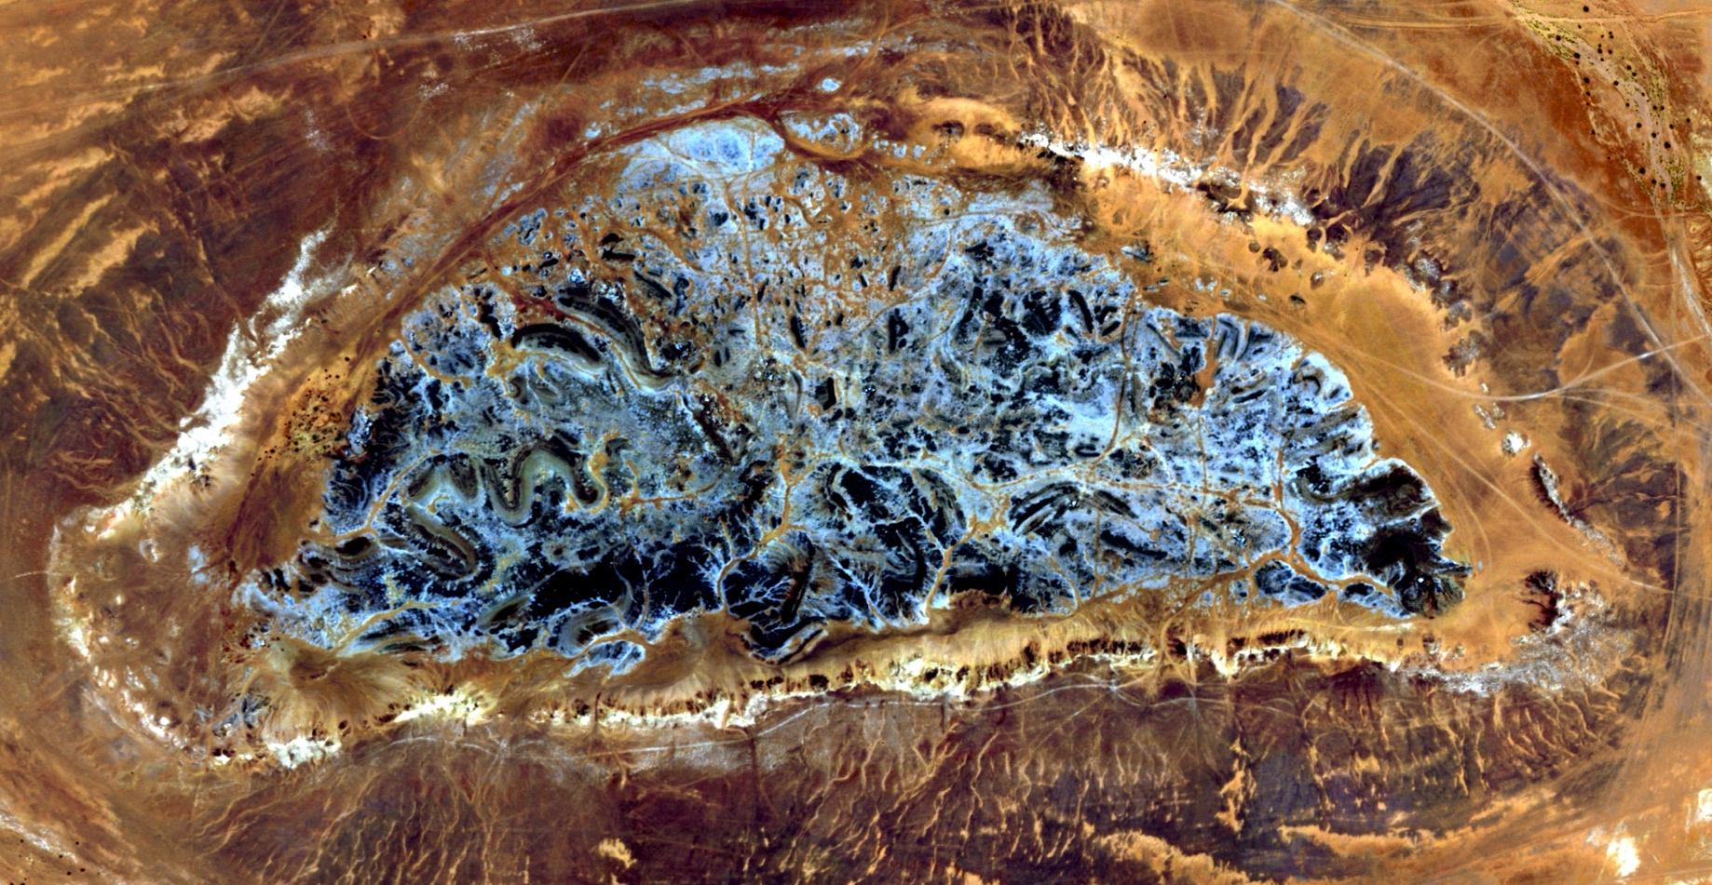
Remote Sensing & Lithological Mapping: The Milh Kharwah Salt Diapir
MGIS Candidate: Leslie Jessen
PSU Advisor: Patrick Kennelly
OMV Advisor: Gabor Tari
Course: Geog596A
Date: December 15, 2016
Credit: DigitalGlobe

Slide 2
Agenda
Capstone Overview
Geological Background
Project Setting
Working Methodology
Wrap-up

Slide 3
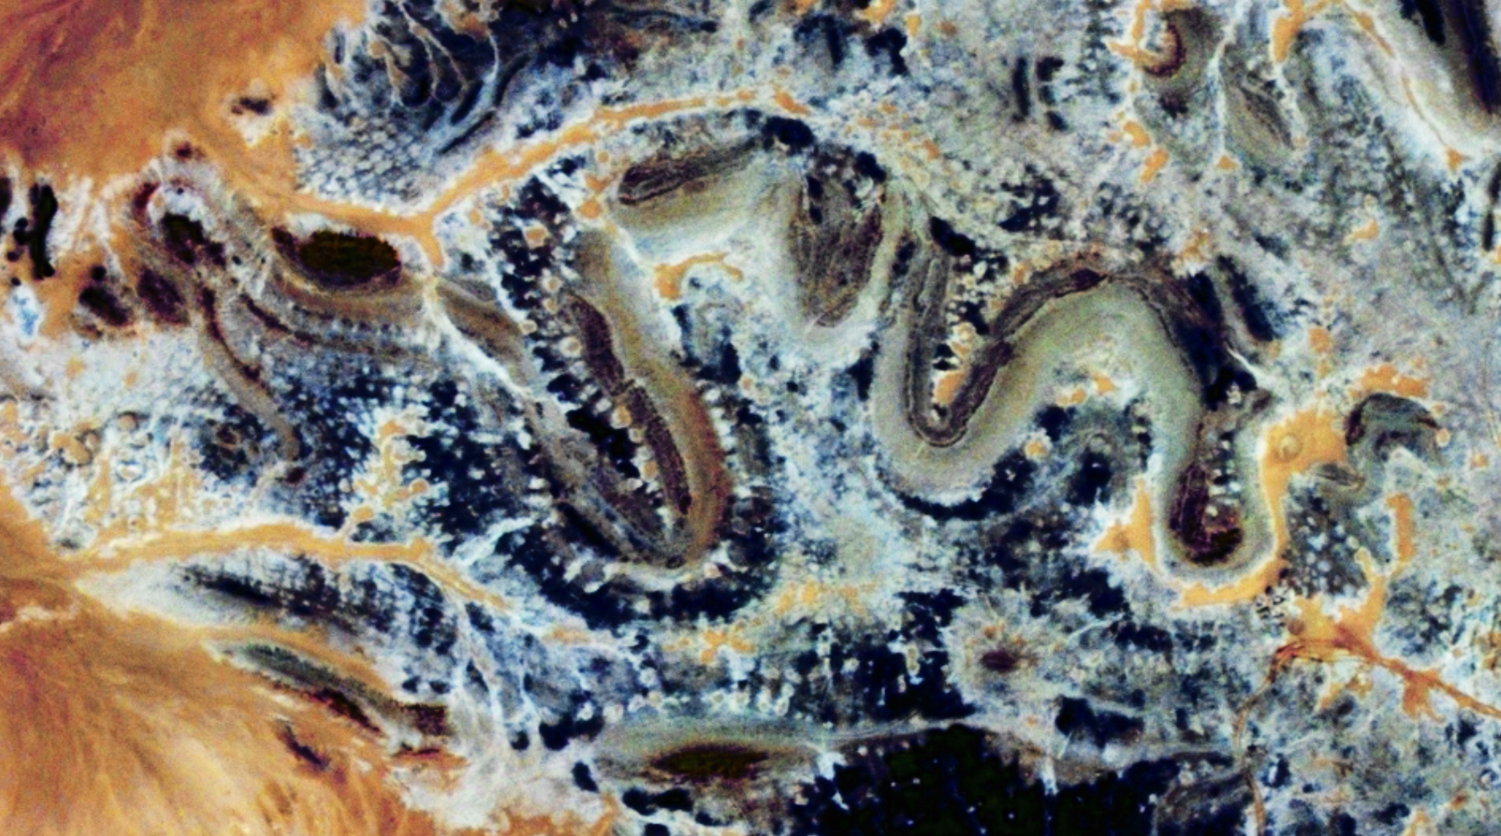
Capstone Overview
Credit: DigitalGlobe

Slide 4
Who?
Credit: Christian Streichsbier
Credit: Dr. Pat Kennelly
Credit: Dr. Gabor Tari

Slide 5
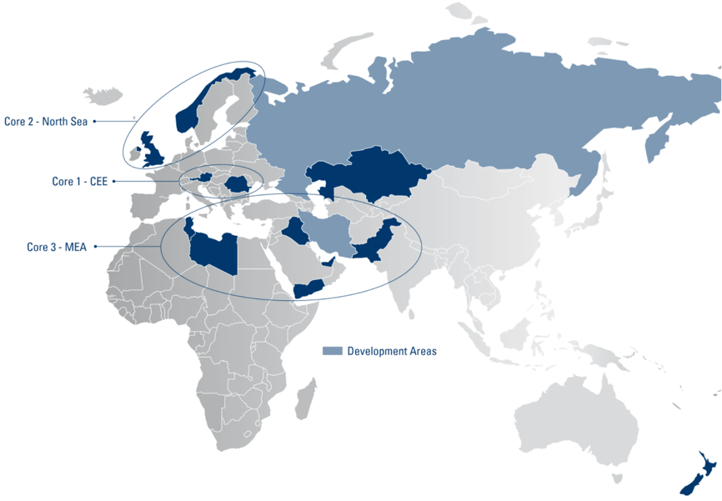
Where?
Credit: OMV 2016

Slide 6
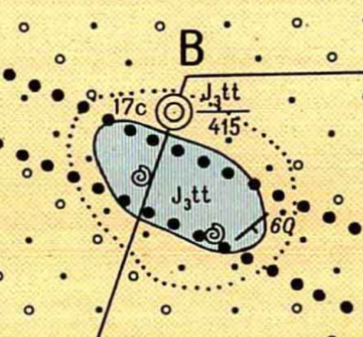
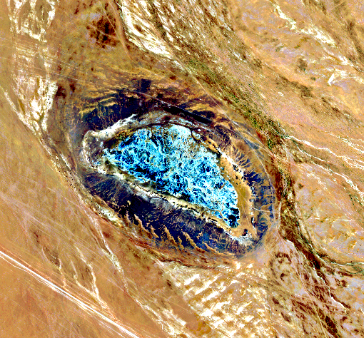
What?
Lithological Map of the Milh Kharwah Salt Diapir
Mapping
Salt
Stringers
Perimeter Outcrops
Alluvium
Regional Map of Salt Features (Central-Eastern Sab’atayn Basin)
Establish internal workflows for image analysis
Credit: People’s Democratic Republic of Yemen (L), DigitalGlobe (R)

Slide 7
Geological Background
Credit: DigitalGlobe

Slide 8
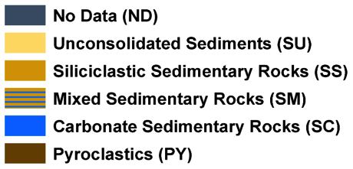
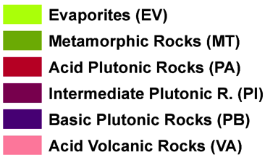
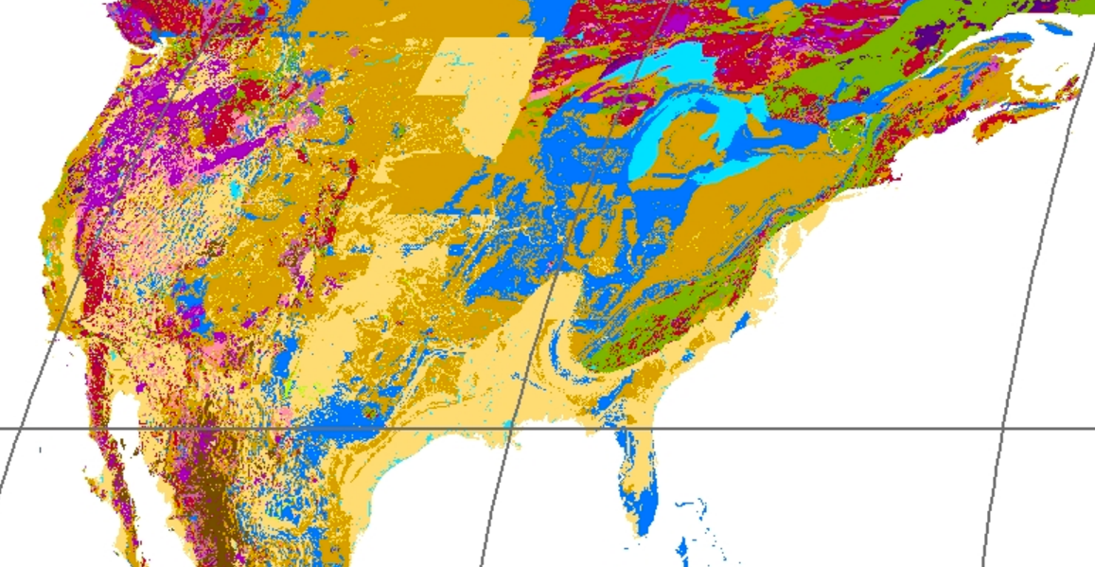
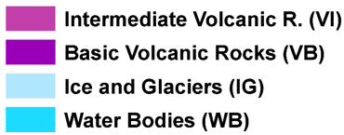
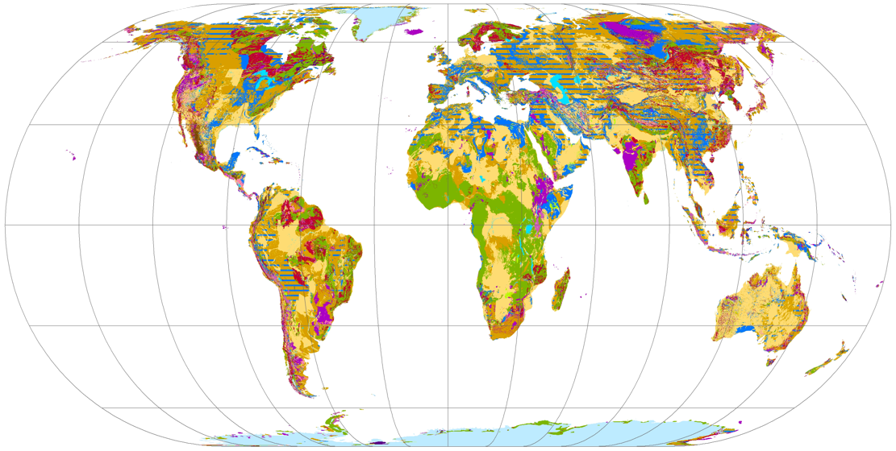
Lithological Maps
Credit: GLiM

Slide 9
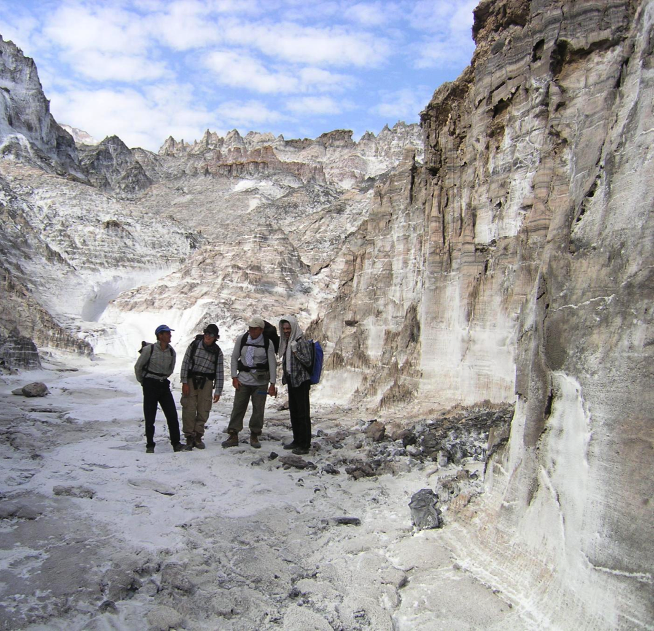
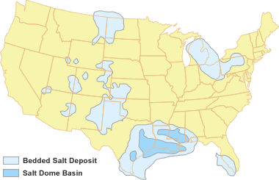
salt Domes, Diapirs
Credit: CAS 2016 (L), Geology.com 2016 (R)
Notes:
Highly complex
A diapir is any more mobile / buoyant material that has broken through more brittle layers usually above it.
Salts are typically low density, nearly impermeable, and flow easily when introduced to heat / pressure –
Although often displayed as salt, they actually contain a number of minerals, created primarily during periods of marine evaporation
(Salt domes are formed in three circumstances – active (shortening), passive (density & downbuilding), reactive (extension) or a mixture of events)
Cap rock forms when salt comes into contact with water, dissolving the pure salt and leaving less mobile, more resistant materials behind
Because they are nonpermeable they can create structural & stratigraphic traps for oil and gas (moving the layers also allows for migration from source to reservoir, etc…)

Slide 10
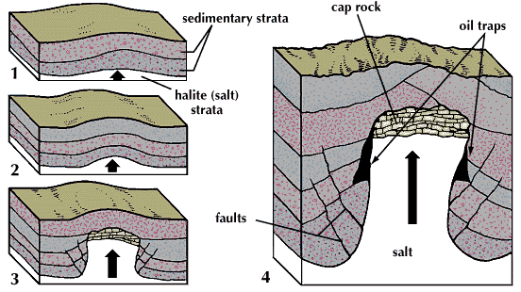
Salt Domes, Diapirs
Credit: Britannica
Notes:
Highly complex
A diapir is any more mobile / buoyant material that has broken through more brittle layers usually above it.
Salts are typically low density, nearly impermeable, and flow easily when introduced to heat / pressure –
Although often displayed as salt, they actually contain a number of minerals, created primarily during periods of marine evaporation
(Salt domes are formed in three circumstances – active (shortening), passive (density & downbuilding), reactive (extension) or a mixture of events)
Cap rock forms when salt comes into contact with water, dissolving the pure salt and leaving less mobile, more resistant materials behind
Because they are nonpermeable they can create structural & stratigraphic traps for oil and gas (moving the layers also allows for migration from source to reservoir, etc…)

Slide 11
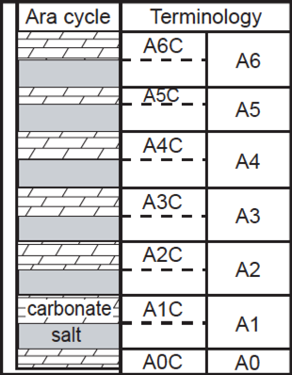
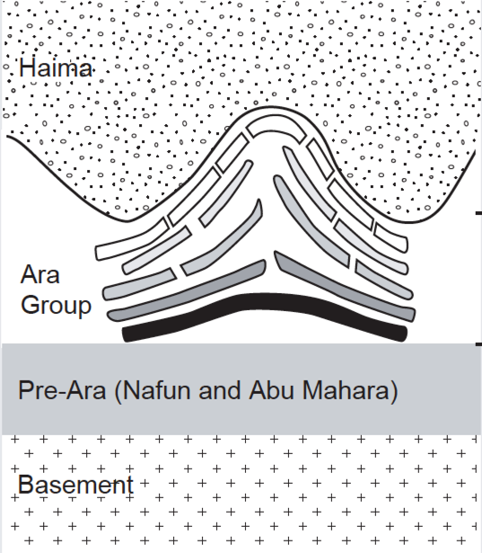
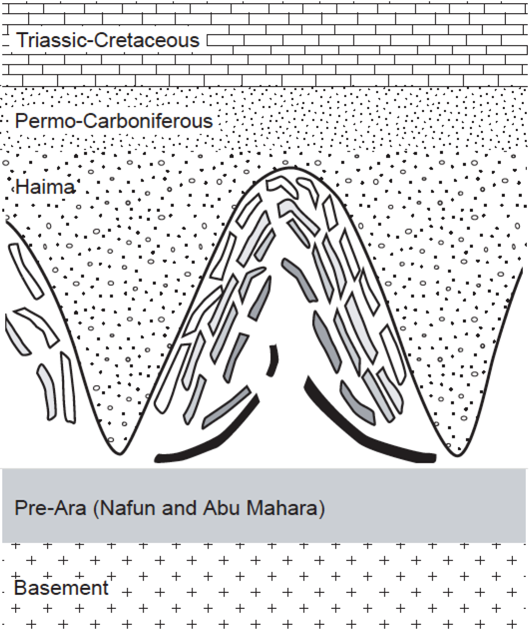
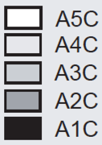
Stringers
4km
6km
Credit: Reuning, et. Al. 2007

Slide 12
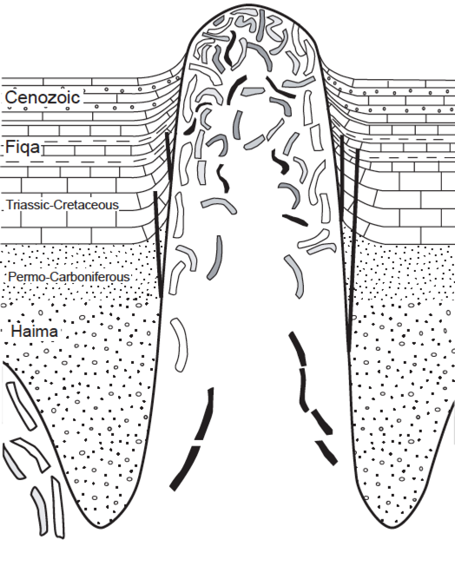
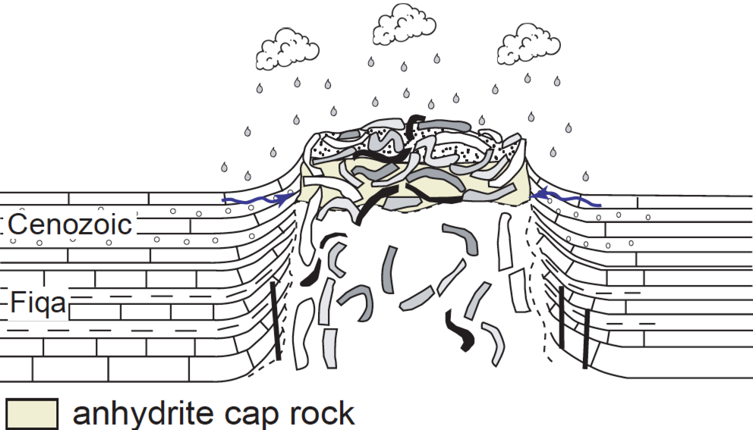
Stringers Cont.
Credit: Reuning, et. al. 2007
Notes:
Normally shown as continuous layers, but in reality sedimentation does not often occur this way
Carbonate rocks include limestone, which is made of calcite (CaCO₃), and dolostone , which is made of dolomite (CaMg(CO₃)₂). Dolomite often forms when limestone recrystallizes after burial. Many limestones are biochemical; some may be chemical (inorganically precipitated).
Evaporite rocks form when sea water or lake water dries up and precipitates gypsum (CaSO₄·2H₂O), halite (NaCl), or other minerals. Evaporites are chemical sedimentary rocks.
Interior Oman model
Six surface-piercing salt domes of interior north Oman provide
unique insights into the dynamics of the Late Neoproterozoic to
Early Cambrian Ghaba Salt Basin. The salt domes are
composed of numerous isolated carbonate blocks (so-called
'stringers') and associated evaporites. The salt domes possibly
are an important outcrop analogue for intra-salt hydrocarbon
plays in the deep subsurface (3-6 km) of the South Oman Salt
Basin, which is located around 500 km to the SW of the Ghaba
Salt Basin

Slide 13
Project Setting
Credit: DigitalGlobe

Slide 14
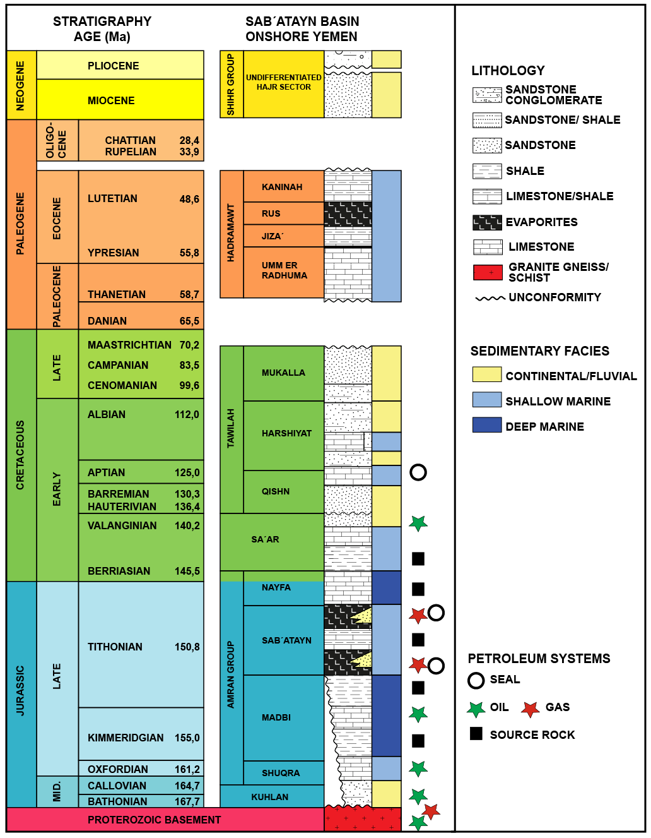
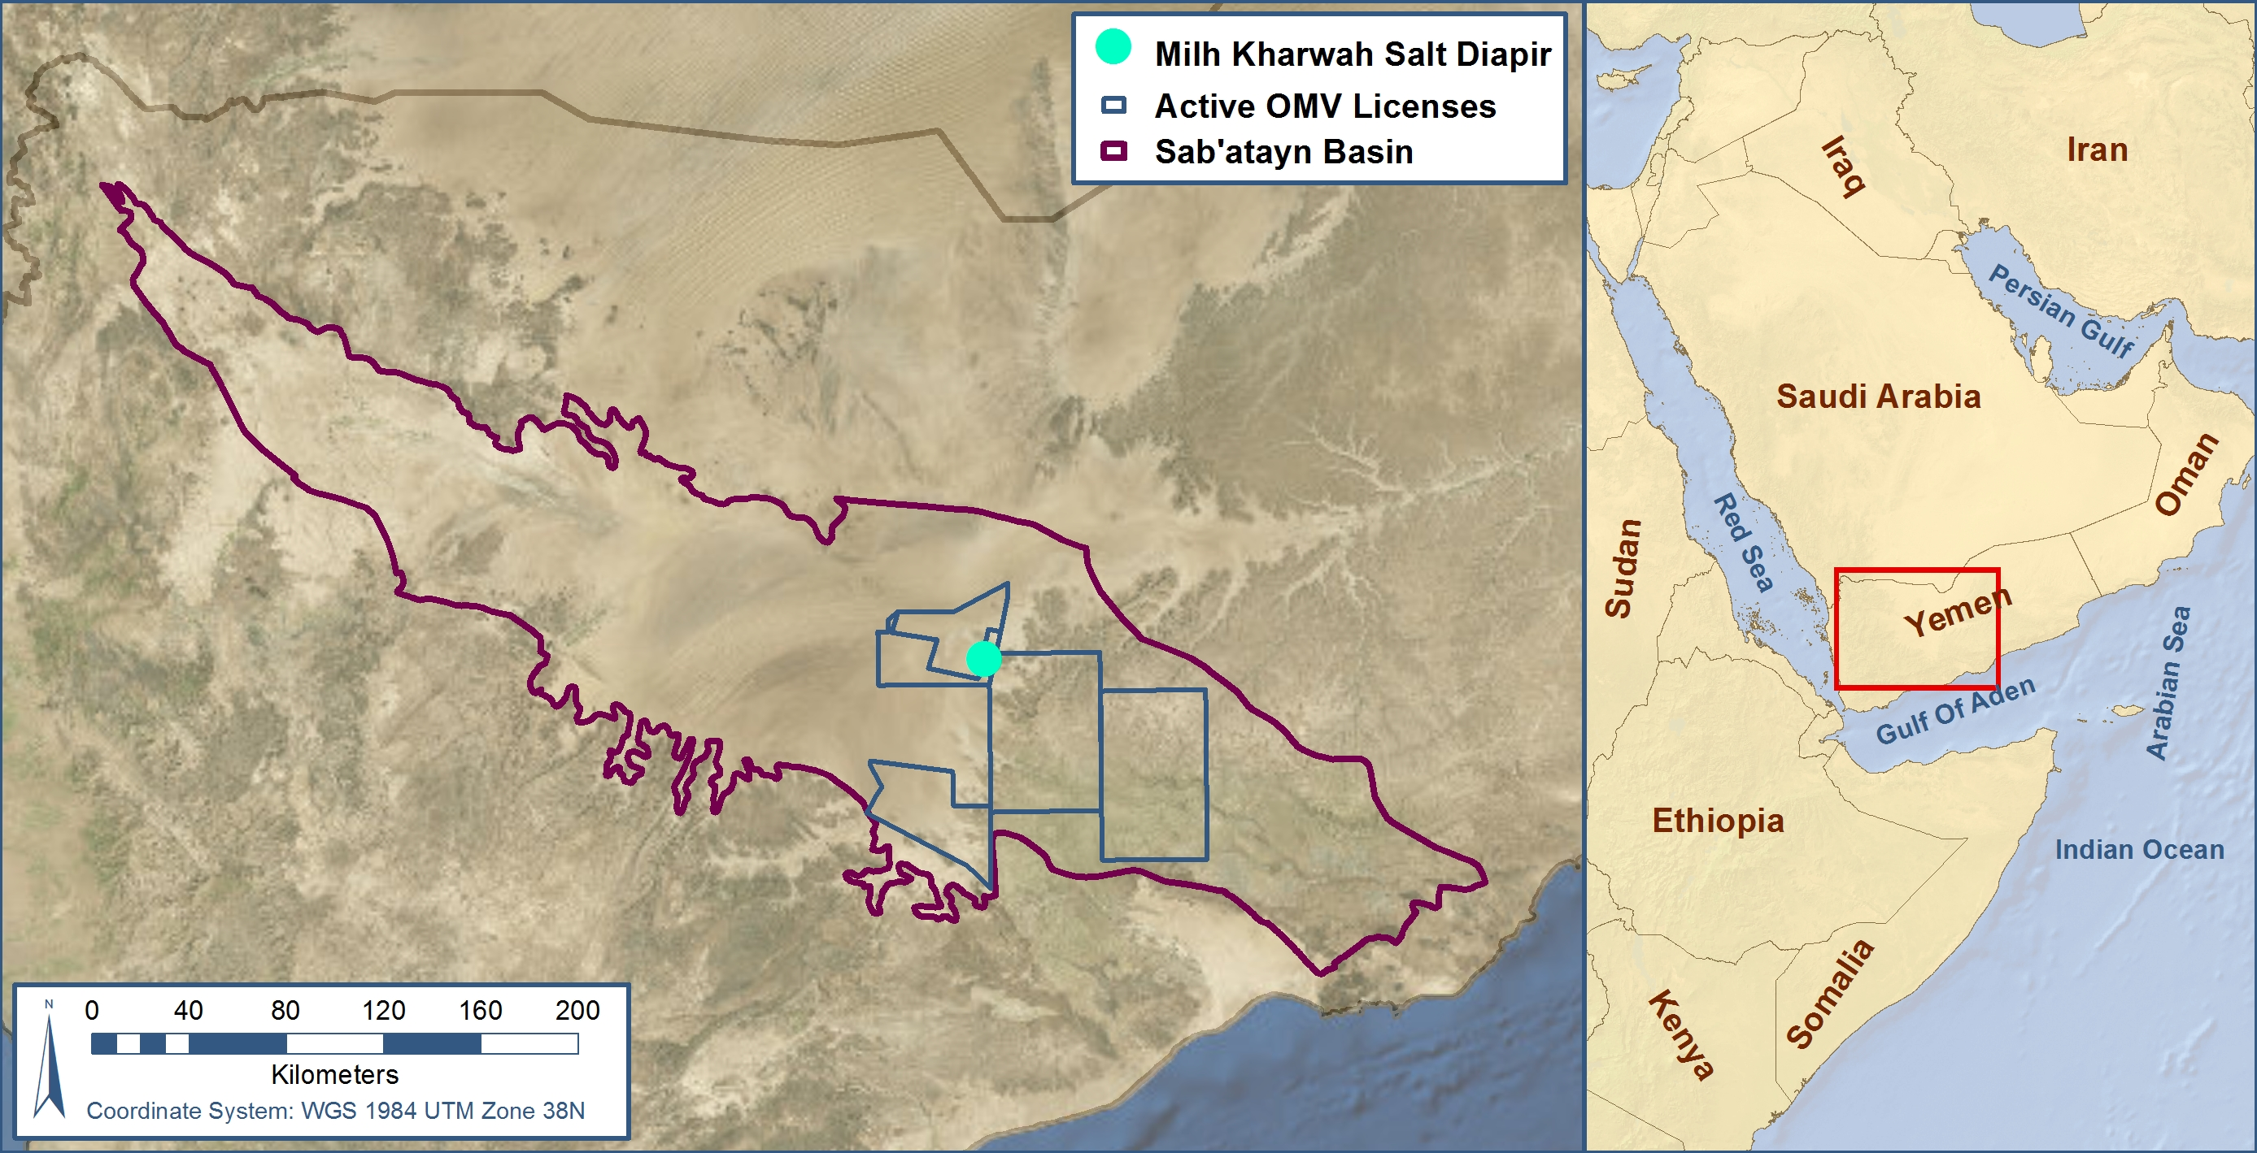
Overview
Credit: Esri Basemaps 2016, METI & NASA 2011

Slide 15
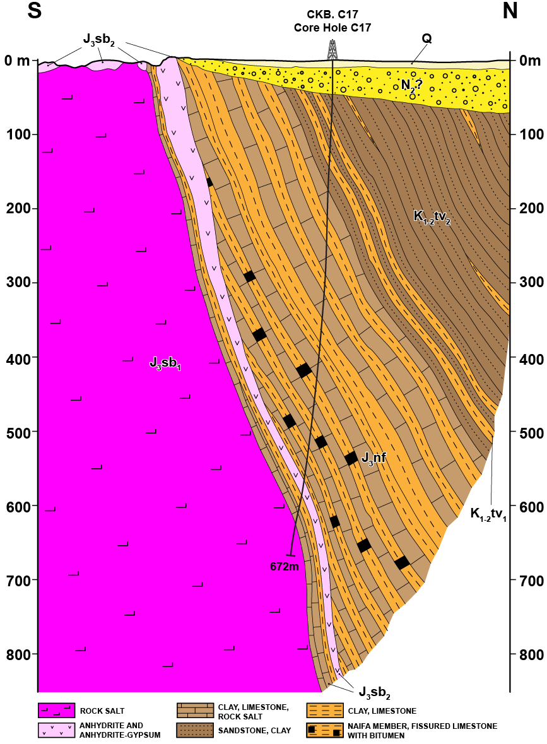
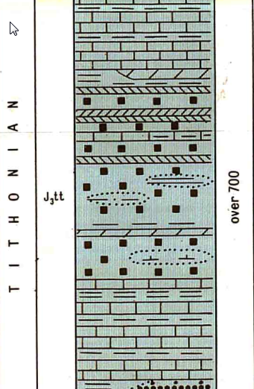
Mihl Kharwah Salt Diapir
Credit: People’s Democratic Republic of Yemen
Notes:
Tithonian Stage, Surrounding quartenary sediments: Upper Quartenary to Recent – Alluvial/proluvial gravel, sand, pebble gravel and conglomerate, Facies Boundary, Concealed faults (from geophysical data), Fossil Locality: invertabrate

Slide 16
Working Methodology
Credit: DigitalGlobe

Slide 17
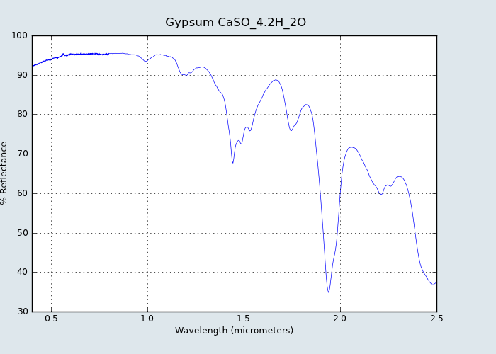
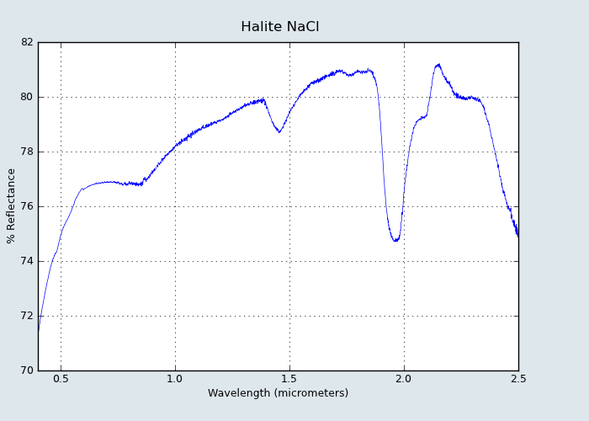
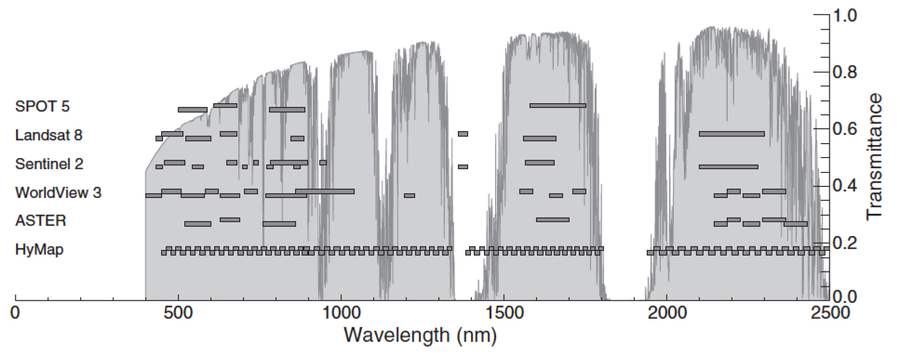
Research
Credit: Baldridge, Hook S, C.I., & Rivera 2009 & van der Meer 2014, p. 125
Spectral Properties
Mineral & Rock Indices
Lab Results

Slide 18
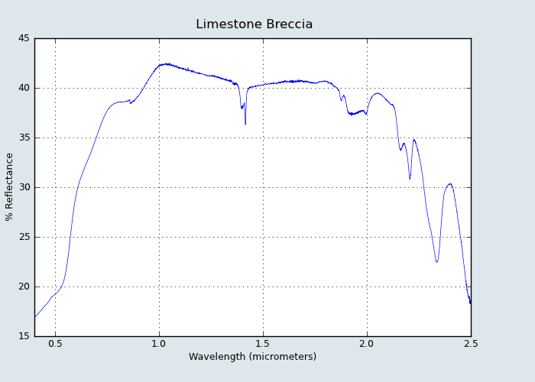
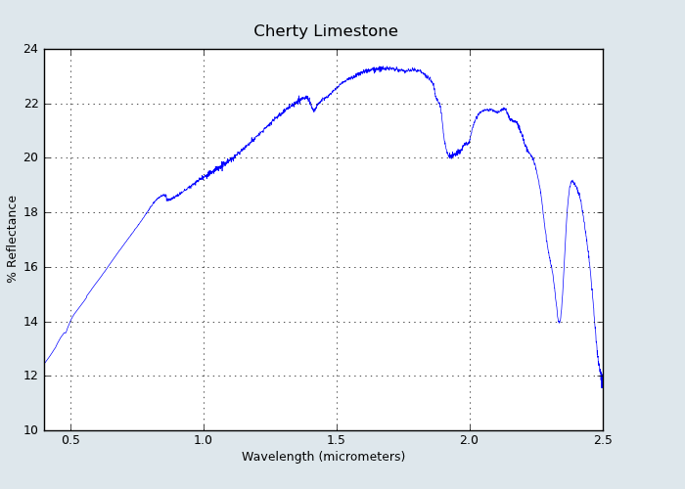
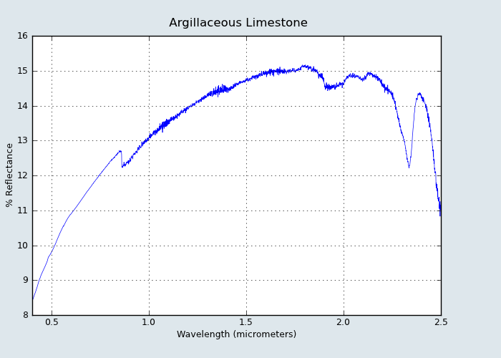
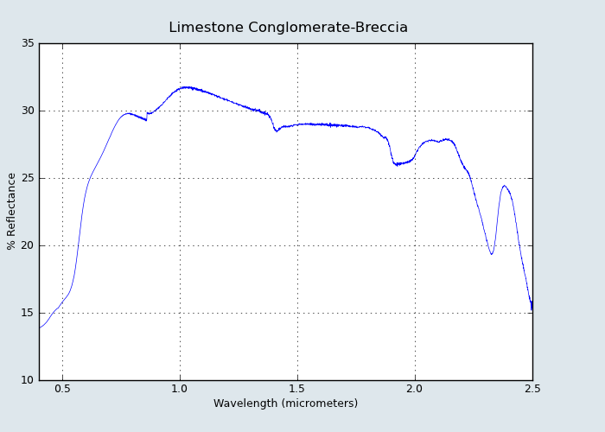
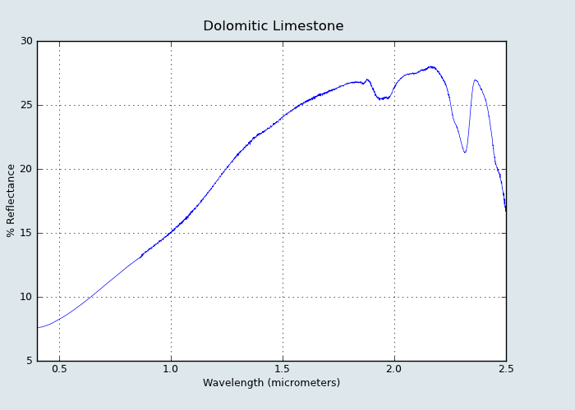
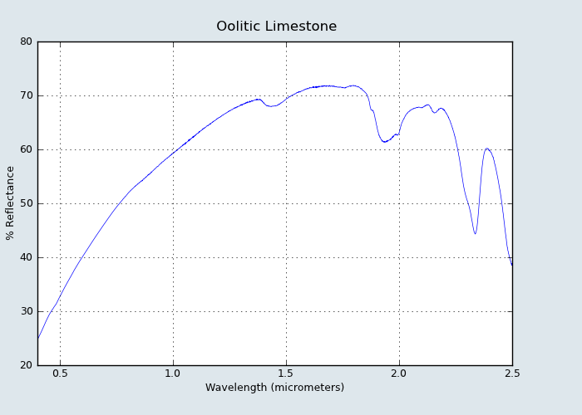
Spectral Signatures Continued
Credit: Baldridge, Hook S, C.I., & Rivera 2009

Slide 19
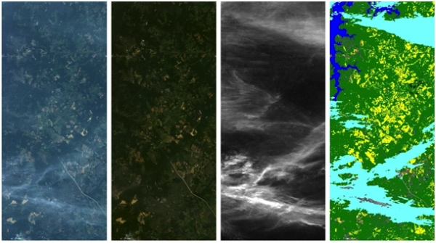
Processing & Analysis
Credit: ESA, 2016; AVIRIS Data Supplied by NASA/JPL
Preprocessing:
Atmospheric Correction
Band Composites
Band Ratios
Classification
Unsupervised
Supervised
Notes:
Expand by one or two additional slides… add in one about the samples and lab results
Start combining the classes – alluvium
One zoomed in shot.

Slide 20
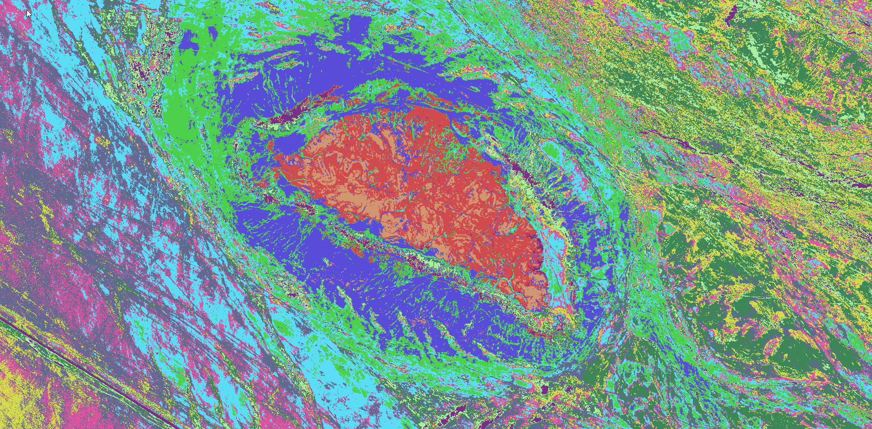
Processing & Analysis Continued
Notes:
Expand by one or two additional slides… add in one about the samples and lab results
Start combining the classes – alluvium
One zoomed in shot.

Slide 21
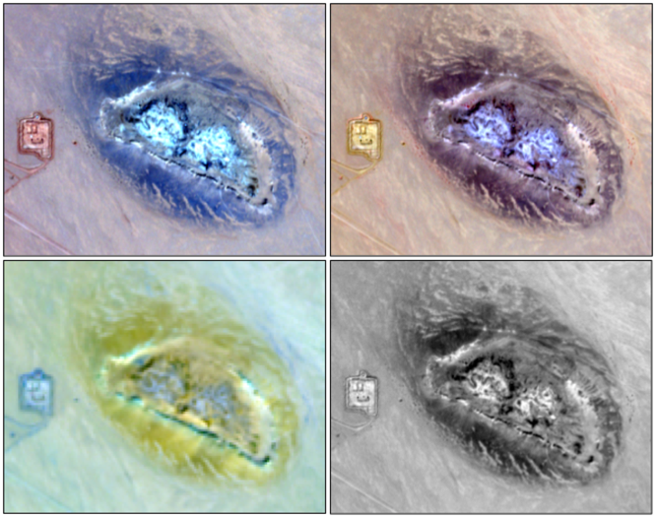
Testing
Credit: SNAP Software & Sentinel-2 Imagery
Imaging Software
SNAP
SAGA GIS
Opticks
GRASS GIS
ORFEO
OSSIM
InterImage
gvSIG
QGIS
OpenCV
SPECR &
Tetraorder
….
Notes:
SNAP
Developed by EGA
SAGA GIS
Opticks
plugins for raster math, radar processing and hyper/multispectral
GRASS
image classification, PCA, edge detection, radiometric corrections, 3D, geostatistics analysis and filtering options
ORFEO
High spatial resolution
radiometry, PCA, change detection, pan sharpening, image segmentation, classification and filtering.
OBIA (Object Based Image Analysis)
OSSIM
High spatial resolution
InterImage
Automatic image interpretation – OBIA
gvSIG
supervised classification, defining ROIs, band algebra and decision trees
QGIS
OpenCV
SPECR (SPECtrum Processing Routines) & Tetraorder

Slide 22
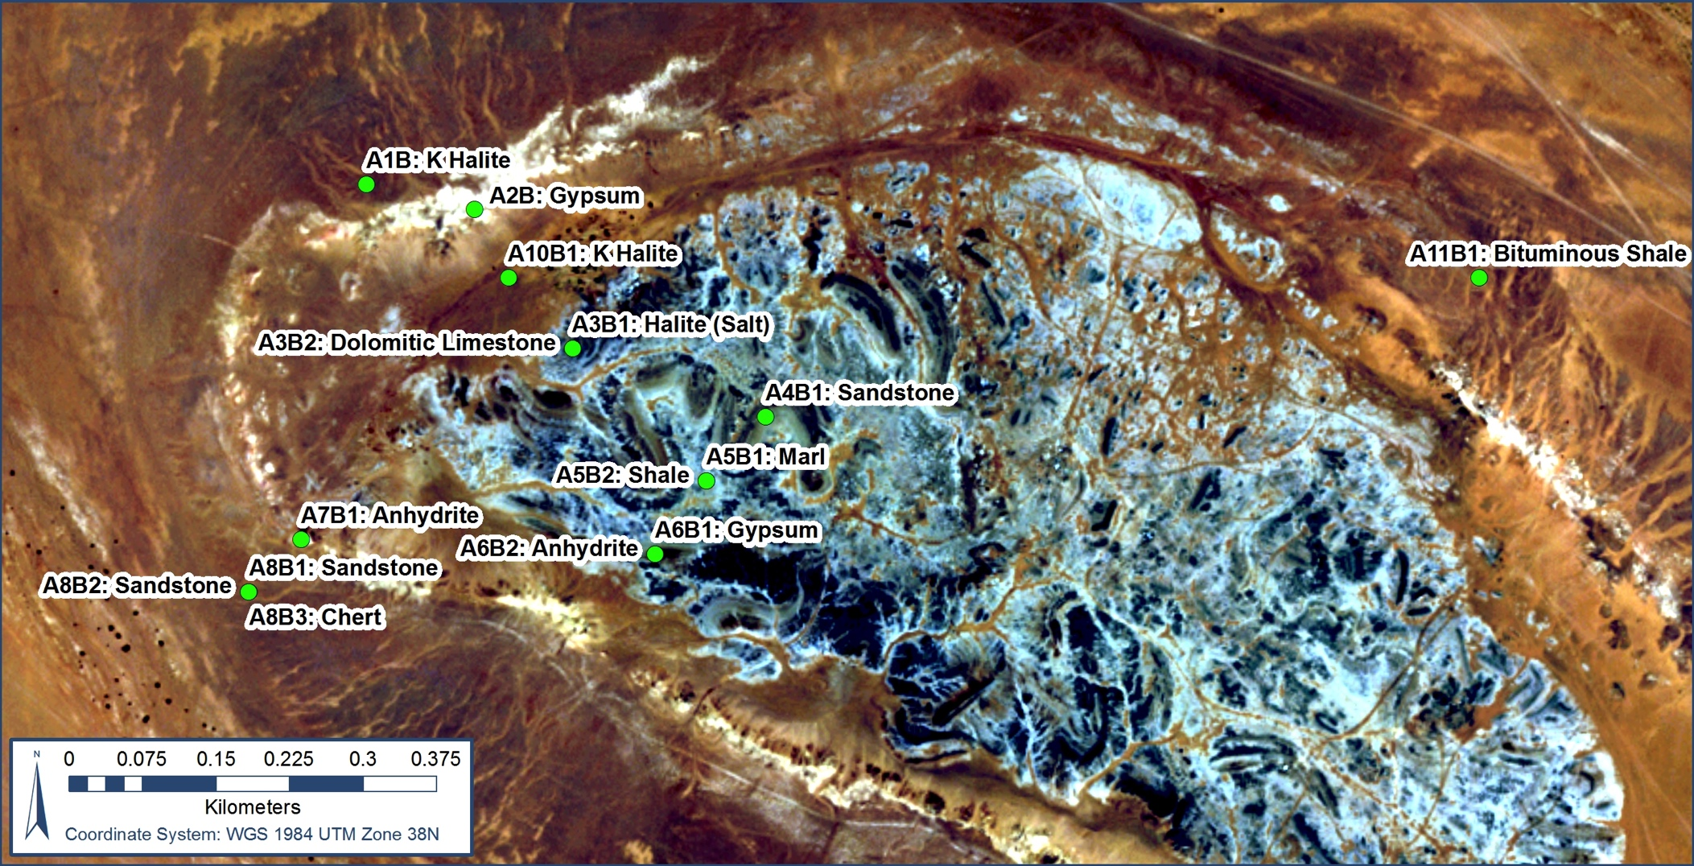
Ground-Truthing & Quality Checks
Original Samples
Second Round
Geological Maps
Regional Experts

Slide 23
Wrap-Up
Credit: DigitalGlobe

Slide 24
Estimated Timeline
Dec-16 | Jan-17 | Feb-17 | Mar-17 |  | Apr-17 |  | May-17
Deliver Proposal | Update Proposal |  |  | IGD
Request WV-3 SWIR
Receive Initial Lab Results
Research OS Software Options |  | Software testing
 |  | Workflow development
 |  |  |  |  |  | Target Area Analysis
 |  |  |  |  |  | Request Additional Samples
 |  |  |  |  |  |  | Quality Checks
Jun-17 | Jul-17 | Aug-17 | Sep-17 |  | Oct-17 |  | Nov-17
Quality Checks |  |  | IGD
Regional Analysis
 | Final Quality Checks
 |  | Finalize Workflows |  |  | Finalize Workflows
 |  |  |  |  | Prepare Presentation
 |  | Prepare Presentation
 |  |  |  |  |  |  | ESRI European Petroleum User Group Conference
Notes:
Proposal Fall/Winter 2016
Project: Spring/Summer 2017
Request WV-3 SWIR Dec 16/ Jan 17
Lithology Results from Lab January
Research OS software options January
Begin testing software & developing workflows February-March
(Gone for IGD – March-April)
Perform target area analysis, Request additional samples April-May
Quality Checks May-June
Repeat process at regional scale June-August
Run final quality checks July-August
Presentation Fall/Winter 2017
Finalize workflow & prepare presentation August-October
(Gone for IGD – September)
GEOG 597B: Fall I or II
Present at ESRI European Petroleum User Group Conference November

Slide 25
Deliverables
Lithological Map of the Milh Kharwah Salt Diapir
Mapping
Salt
Stringers
Perimeter Outcrops
Alluvium
Regional Map of Salt Features (Central-Eastern Sab’atayn Basin)
Establish internal workflows for image analysis
Credit: People’s Democratic Republic of Yemen (L), DigitalGlobe (R)

Slide 26
Acknowledgements
Notes:
Proposal Fall/Winter 2016
Project: Spring/Summer 2017
Request WV-3 SWIR Dec 16/ Jan 17
Lithology Results from Lab January
Research OS software options January
Begin testing software & developing workflows February-March
(Gone for IGD – March-April)
Perform target area analysis, Request additional samples April-May
Quality Checks May-June
Repeat process at regional scale June-August
Run final quality checks July-August
Presentation Fall/Winter 2017
Finalize workflow & prepare presentation August-October
(Gone for IGD – September)
GEOG 597B: Fall I or II
Present at ESRI European Petroleum User Group Conference November

Slide 27
Sources & Image Credits
Software:
Unless otherwise specified, maps and images appearing throughout this presentation were created using ArcGIS® software by Esri. ArcGIS® and ArcMap™ are the intellectual property of Esri and are used herein under license. Copyright © Esri. All rights reserved. For more information about Esri® software, please visit www.esri.com.
SNAP 5.0, Sentinel Application Platform, Desktop Implementation Version, jointly developed by the Brockmann Consult, Array Systems Computing and C-S for ESA SEOM. Licensed under the GNU GPL v3
Satellite Imagery:
WorldView2. (13 Sep. 2006) World View 2 Image ID: P2AS-055094839010, DG-AComp Product. Longmont, CO: DigitalGlobe, Inc. Provided by Deborah Humphreville.
Sentinel-2 (4 Dec. 2016) Sentinel 2 Image URI: S2A_OPER_MSI_L1C_TL_SGS__20161204T110552_A007582_T38PPC_N02.04, Level-1C. ESA Earth Online. Accessed at: https://eo-sso-idp.eo.esa.int
Visuals:
Baldridge, A. M., Hook S, J., C.I., G., & Rivera, G. (2009). The ASTER Spectral Library Version 2.0. . (Jet Propulsion Laboratory, California Institute of Technology) Retrieved December 5, 2016, from Remote Sensing of Environment: http://speclib.jpl.nasa.gov/search-1/rock
Callot, Jean-Paul, et.al. (November 2006). Stringers and evolution of salt diapirs, insight from analogue models. Presented at AAPG Perth. Accessed in October 2016 at https://www.researchgate.net/publication/273099175_Stringers_and_evolution_of_salt_diapirs_insights_from_analogue_models

Slide 28
Source & Image Credits
Visuals Continued
Encyclopedia Britannica (2016). Formation of a Salt Dome. Accessed in October 2016 at http://media.web.britannica.com/eb-media/51/62851-004-C3B6A459.gif
Geology.com (2016) Salt Glaciers. Accessed in October 2016 at http://geology.com/stories/13/salt-glacier/
Hartmann, Jens; Moosdorf, Nils (2012): The new global lithological map database GLiM: A representation of rock properties at the Earth surface. Geochemistry, Geophysics, Geosystems, 13, Q12004, doi:10.1029/2012GC004370 .
Institute of Geophysics of the CAS (2016) Rheology of Salt Rocks and Salt Tectonics. Accessed in October 2016 at https://www.ig.cas.cz/en/structure/departments/tectonics-and-geodynamics/projects/rheology-salt-rocks-and-salt-tectonics
Reuning, Lars, et.al. (July 2007). The salt domes of the Ghaba Salt Basin: An analogue for the hydrocarbon plays of the South Oman Salt Basin? Presented at 13th Bathurst Meeting of Carbonate Sedimentologists. Accessed in October 2016 at http://citeseerx.ist.psu.edu/viewdoc/download?doi=10.1.1.716.8179&rep=rep1&type=pdf
Streichsbier, Christian (2016). Leslie Jessen. Vienna.
Tari, Gabor, et.al. (November 2016). Styles of salt tectonics in the Sab’atayn Basin, onshore Yemen. Society of Petroleum Engineers. To be presented at the Abu Dhabi International Petroleum Exhibition and Conference. Abu Dhabi. ID: SPE-183119-MS
van der Meer, F. ,. (2014). Potential of ESA's Sentinel-2 for geological applications. Remote Sensing of Environment (148), 124-133.

Slide 29
Thank You!
Credit: DigitalGlobe

