Slide 1
Using GIS to link watershed planning with land use regulation
By Erik D. Johansen
Capstone Project
Pennsylvania State University
September 28, 2010
Advisor: Tim Murtha, Associate Professor of
Landscape Architecture

Slide 2
Background
Water in Washington State
Watershed planning
Water use regulation
Washington Department of Ecology
Water rights
When do you need one?
Closed Basin
Exempt water well withdrawals
RCW 90.44.050 allows up to 5000 gal. per day for domestic use
From Washington State Department of Community, Trade and economic development

Slide 3
Background Continued
Land use Planning in Washington State
Land use regulations in Washington State
The Growth Management Act (GMA)
Shoreline Master Program
Land use regulation in Stevens County
GMA planning county since 1993
No zoning until 2007
Outdated regulations
The growth management Act (14 goals including protecting the environment)
From Washington State Department of Community, Trade and economic development

Slide 4
Watershed Planning
Washington Administrative Code (WAC 173-559) closed the WRIA 59 basin to new surface water rights.
New ground water rights still open until 1994 when a court case (John Postema vs. Pollution Control Hearings Board, et al).
Interpretation of the case lead to the closure of new ground water withdrawals in closed basins.
In 1998 the Watershed Planning Act was adopted.
In 1999, WRIA 59 Watershed Planning team was formed.
From Golder Associates Inc. 2006, executive summary 1-2

Slide 5
Study Area
Figure 1: Map of the major watersheds that are partially or fully located in Stevens County. As you can see, the Colville (WRIA 59) watershed is nearly completely contained within Stevens County. Inset map of Washington State for reference. Data gathered from Stevens County Information Services Department as public information.

Slide 6
The Colville Water Resource Inventory Area (WRIA 59)
Colville River watershed is known by WRIA 59 in WAC 173-000
Includes approximately 1,300 square miles
All but one (1) percent of WRIA 59 is in Stevens County
WRIA team working since 2000 (over 23,000 personnel hours)
WRIA 59 Mission Statement
“Develop a long range sustainable Watershed Plan that locally directs
management and implementation of this Plan to address current and future
water needs, while working to help protect and improve the water resources
within the Colville River Watershed.”
From Golder Associates Inc. 2006, executive summary 1-2

Slide 7
Objectives
Develop a dynamic land quantity analysis (LQA) model with variable land use regulation data
Process:
Use GIS to create a LQA model at the WRIA 59 Sub-basin level (See figure 2 on slide 8)
Make some of the LQA criteria variable
Combine the LQA model with population growth trend data
Outcomes:
Use the model outcome data during the WRIA 59 rule amendment negotiations
Output GIS maps and charts that show how changes in land use affect the potential water uses
Demonstrate how much future domestic water use will occur in each sub-basin and how land use will help minimize potential impacts.

Slide 8
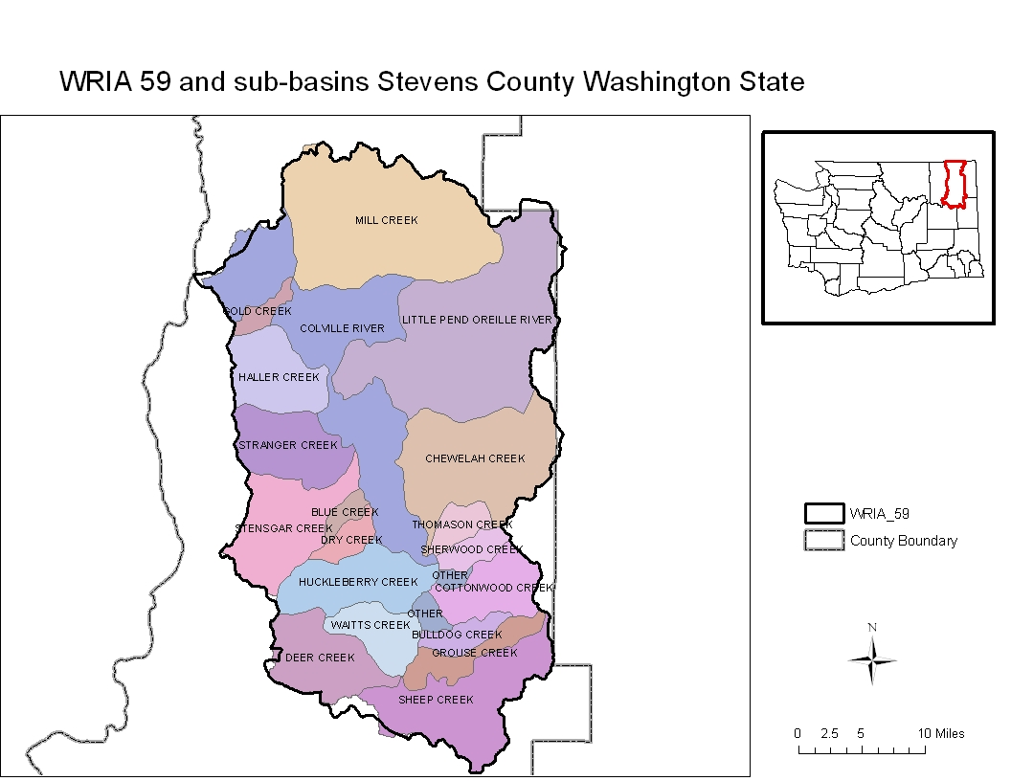
WRIA 59 Sub-Basins (23 total)
Figure 2: Map of the sub-basins located in the WRIA 59 watershed. Data gathered from Stevens County Information Services Department as public information. Not to scale.

Slide 9
Project Assumptions These assumptions are being made during the development of the LQA model. They help define the project’s scope of detail and answer questions about how the LQA has been set-up.
The WRIA 59 sub-basins will remain the same.
There are currently 3 different sub-area maps (WRIA 59-group’s, Department of Ecology, USGS)
The sum of the sub-basins is equal to the WRIA 59 watershed.
Lands with existing exempt wells and or existing electric meters are already developed.
Model parameters will be adopted by the WRIA group
Publically owned lands will not develop into residential properties.
Large timber ownerships will be removed by other model criteria.

Slide 10
DATA
Data | Type | Source | Use
State of Washington map | Shape file | Washington Department of Ecology | Background
Counties in Washington | Shape file | Washington Department of Ecology | Background
WRIA 59 watershed boundary | Shape file | Stevens County Land Services | Background
WRIA 59 sub-basins | Shape file | Stevens County Land Services | Background
Stevens County Parcels | Shape file | Stevens County Land Services | Background
PUD service boundaries | Shape File | Stevens PUD | Fixed parameter
Critical areas | GDB | Stevens county | Variable parameter
Exempt well locations | Excel | Washington DOE | Fixed parameter
Existing electrical meter locations | Excel | Avista corporation | Fixed parameter
Roads, railways | MDB | Stevens county | Fixed parameter
Population growth trends | Excel | Office of financial management | Variable parameter
Historic building data | Access | Stevens County Building | Fixed parameter
Zoning data | GDB | Stevens County | Variable parameter
Elevation data (10ft contours) | GDB | Stevens County | Variable parameter
Agricultural lands | GDB | Stevens County | Variable parameter
Table 1: Table of data for the project including data type, source, and how the data will be used.

Slide 11
Methods
Data preparation
Add data to the GIS
Define the data parameters (coordinate system, datum, projection, etc…)
Add in each layers making sure they are in the correct coordinate system and projection.
Clip data to the relevant study area (WRIA 59 watershed)
All of the data will be clipped to the WRIA 59 watershed boundary.
Data Analysis
Convert data from existing form to raster data
Most of the data are polygon shape files or polygon data in a gdb
Raster grid cell size
While converting data, I will use a grid cell size of 100 sq ft.
I will reclassify each new raster grid and set the buildable area portion zero
Complete the raster overlay analysis
I will use the raster calculator to add all of the raster layers together . The buildable lands will have a raster value of zero.
The buildable areas will be shown on a map for each sub-basin
Convert available lands to acres for each sub-basin

Slide 12
Methods Continued
Data Integration
Add raster analysis overlay results with predicted growth trends data
Show how long it will take to achieve build out in each sub-basin
Automate the process using GIS scripts
The data analysis portion will be automated.
I will create a user interface that will allow people to change the model parameters.
Analyze the results of model and growth trends
I will run a series of LQAs using the low medium and high growth trend predictions for each sub-basin.
Create a matrix table describing how land availability is affected by the variants in the model.
Create tables and time laps maps illustrating the proliferation of new exempt water wells within each sub-basin based on the low, medium, and high number of new exempt wells computed during the analysis.

Slide 13
Variables within the analysis
Variable | Description of user choices
Slope | Users will be able to chose slopes over 30 percent or slopes over 20 percent
Zoning | Users will be able to set the maximum zoning density from 5 to 40 acres per parcel
Agriculture | Users will have a yes/no choice to include ag. lands as re-developable or not
Critical areas | Users will be able to turn on/off the critical areas maximum buffers
Population growth | Users will be able to choose to get the results based on low, medium, or high population Growth estimates
Table 2: Table showing which of the model parameters will be variable and what the choices will be.

Slide 14
Predicted Outcomes
Some sub-basins within WRIA 59 are nearly built out and there is little room for further residential development. Thus, the potential impact to the sub-basin from new residential development will be deminimus.
The WRIA development group will run different scenarios through the dynamic LQA and find land use solutions to potential water availability issues.
Using land use planning regulations to curb potential for new residential development will lower the impacts to the watershed.
In some sub-basins, the rate of residential development within most of the sub-basins is so low that potential impacts to the watershed over the next twenty years are negligible regardless of which LQA parameters are used.
The need for over-arching blanket water-use regulations is not necessary in most sub-basins within WRIA 59.

Slide 15
Predicted Outcome example
Figure 3: Map of Mill Creek sub-basin showing slopes greater than 30 percent. Data provided by Stevens County.
A simple raster analysis was performed on this sub-basin to demonstrate that nearly 70 percent of the sub-basin has slopes over 30 percent. It is unlikely that slopes over 30 percent will develop into residential lots.

Slide 16
Limitations
Real-world issues:
It is difficult to account for the large timber company ownership. Currently the parcel ownership data are not stored to be able to sort be owner. If this becomes available, I will remove large timber company land from lands that are likely to develop with residential housing.
If the WRIA sub-basin maps change, the analysis will have to be retuned to fit the new sub-basins.
Funding may Affect the WRIA group’s ability to thoroughly review these data and decisions may be made without this information.
Data issues:
The population projection information available from the Washington State Office of Financial Management is not available at the sub-basin level. Data are only available at the WRIA level. Numbers will have to be averaged for each sub-basin.
There is intense political debate between the WRIA planning group and state regulatory agency that may threaten the usefulness of the study results.

Slide 17
Conclusions
A dynamic land quantity analysis model will aid in the development of a new watershed rule in WRIA 59.
Linking Land use and watershed planning is one of the next steps in the evolution of resource protection.
If successful, this model could be translated outside of WRIA 59 to include different watersheds throughout Washington State.
Using GIS to develop a land availability model with variable inputs is more functional than preparing a static land quantity analysis because it allows all of the interest groups to negotiate the model parameters and explore various outcomes based on those decisions.

Slide 18
Questions

Slide 19
Resources
Golder Associates. 2007. “Colville river watershed detailed
implementation plan.” Accessed September 18, 2010.
http://www.co.stevens.wa.us/Wria59/pdfs/Detailed%20Implemt/FINAL%20WRIA%2059%20DIP%20032206.pdf
Washington State Department of Community, trade and
economic development. “Growth Management.
Accessed September 12, 2010.
http://www.commerce.wa.gov/_cted/documents/id_892_publications.pdf

