Slide 1
Selection of models to identify areas vulnerable to groundwater contamination in Oregon
PSU: GEOG 596A Spring 2020
Capstone project presentation
Kayla jones
Advisor: Dr. Mike Nassry
Notes:
Hi. My name is Kayla Jones and my capstone project is the Selection of models to identify areas vulnerable to groundwater contamination in Oregon.

Slide 2


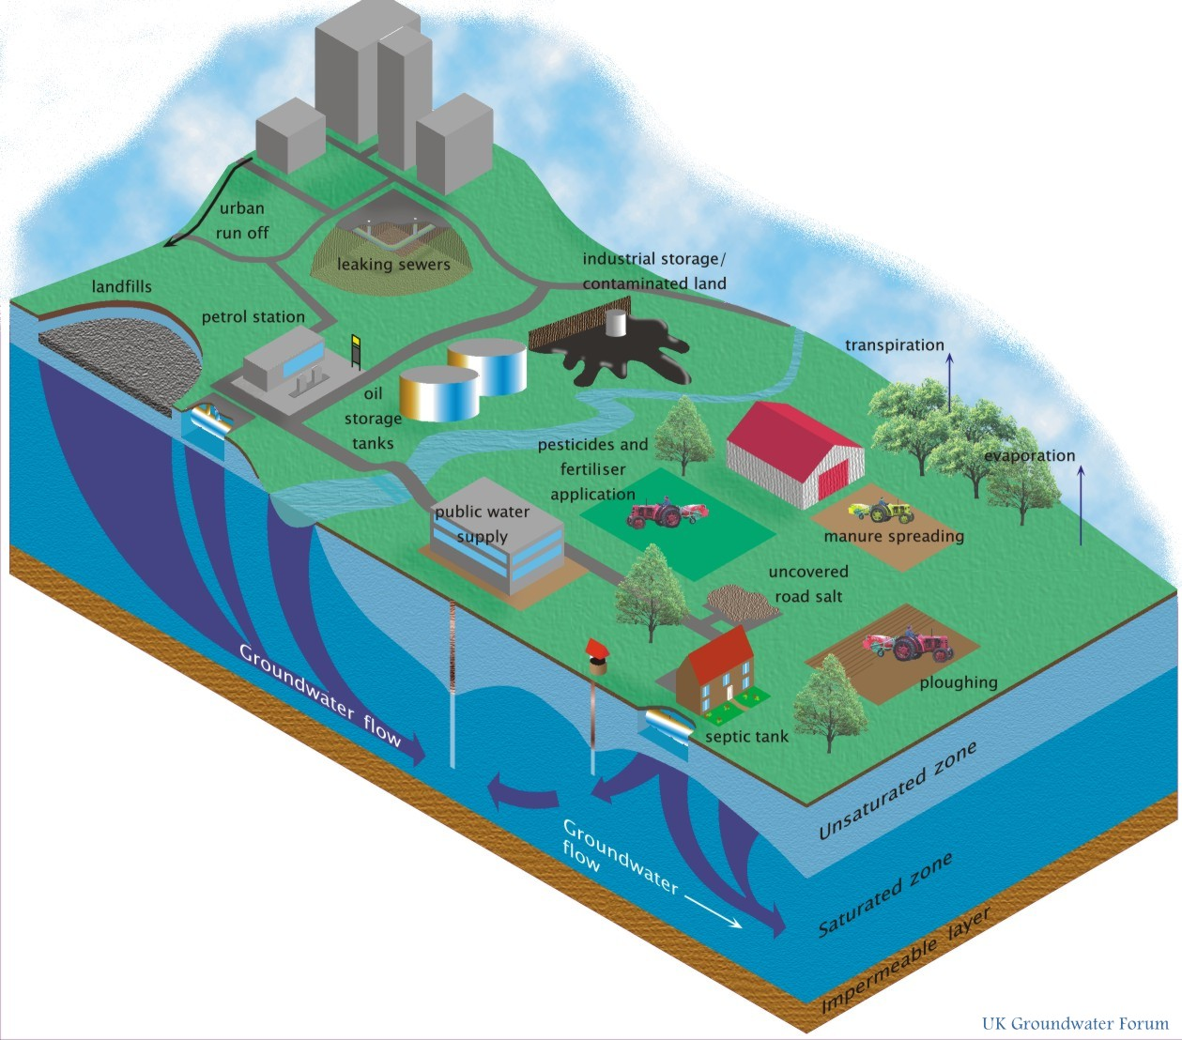
Overview
INTRODUCTION
Background
Objectives
Assessment methods
Data
Analysis and methodology
limitations
Anticipated results
Groundwater quality hazards.
http://www.groundwateruk.org/Image-Gallery.aspx
Notes:
Quick overview. We will do a little introduction and then go into the background and objectives of this project. I will go over the different assessment methods that I came across in the literature review and then go into the data and methodology that I intend to use to complete this project. Finally go over any limitations that I cam across and my anticipated results.

Slide 3
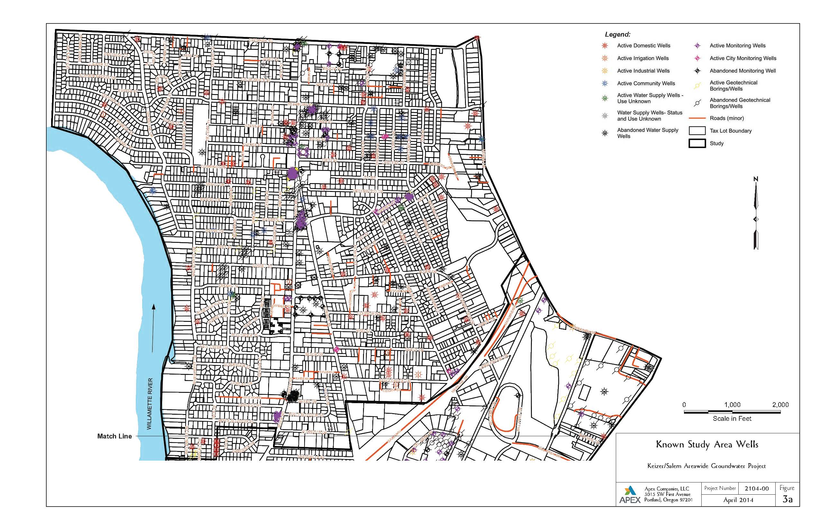
INTRODUCTION
Apex Companies, LLC –environmental consulting firm
Oregon Department of Environmental Quality (ODEQ)
Groundwater Use Survey and response Plan (2014)
Notes:
First a little introduction. I work in the Pittsburgh, PA office of an environmental consulting firm called Apex Companies, LLC. Our Portland Oregon office does a lot of work for the Oregon Department of Environmental Quality and I have provided GIS support to the ODEQ through our Portland office since around 2014 when I aided in the development of a Groundwater Use Survey and Response Plan which included a GIS Database focusing on chlorinated solvent contamination in groundwater for the cities of Salem and Keizer Oregon. The figure to the right is an example output of the GIS database for the study area of Keizer and Salem, Oregon. Over the years I have continued to provide GIS support to the ODEQ in various small projects. In January of this year, the ODEQ contacted us wanting to pursue a larger GIS based project focusing on overall groundwater contamination throughout the state.

Slide 4


background
United States Environmental Protection Agency (USEPA)
Increase in contaminated groundwater sites without an identifiable contamination source
Develop Regional Groundwater Risk Prioritization Model for Region 10 (Pacific Northwest)
Oregon Department of Environmental Quality (ODEQ)
Explore new methods of identifying areas vulnerable to groundwater contamination
Existing Site Assessment Prioritization System (SAPS)
Notes:
So a little more background on the groundwater contamination project.
Over the past decade, the USEPA has noticed an increase in contaminated groundwater sites without identifiable sources of contamination. These sites are considered a priority for assessment and remediation due to the human health risk potential associated with ingesting contaminated groundwater. The alarming number of sites lacking an identifiable contamination source prompted the USEPA to develop a methodology to identify at-risk, high priority municipal and domestic drinking water systems. These at-risk sites may qualify for assessment under an existing USEPA program. Therefore, USEPA is in the process of developing the Regional Groundwater Risk Prioritization Model. This model is being developed as a geospatial platform that will display relative groundwater vulnerability throughout USEPA Region 10 of the Pacific Northwest.
EPAs development of this model prompted the Oregon Department of Environmental Quality to explore new methods to efficiently identify sites with an increased vulnerability to groundwater contamination. Their existing process, which they call the Site Assessment Prioritization System or SAPS has not been satisfactory in identifying sites that may be in need of significant actions.

Slide 5
Odeq site assessment prioritization system (SAPS)
  Identifies and ranks a site's need for further investigation or cleanup actions
  SCORES A SITE BASED ON 15 CHARACTERISTICS
    hazardous waste containment, groundwater, surface water, soil, land use, and sensitive environments
Notes:
The SAP System identifies and ranks sites based on the potential threat to human health and environment using 15 site characteristics including hazardous waste containment, groundwater, surface water, soil information, land use, and sensitive environments such as state parks and vulnerable wildlife habitats. The prioritization score ranks the sites need for further investigation or cleanup actions.

Slide 6
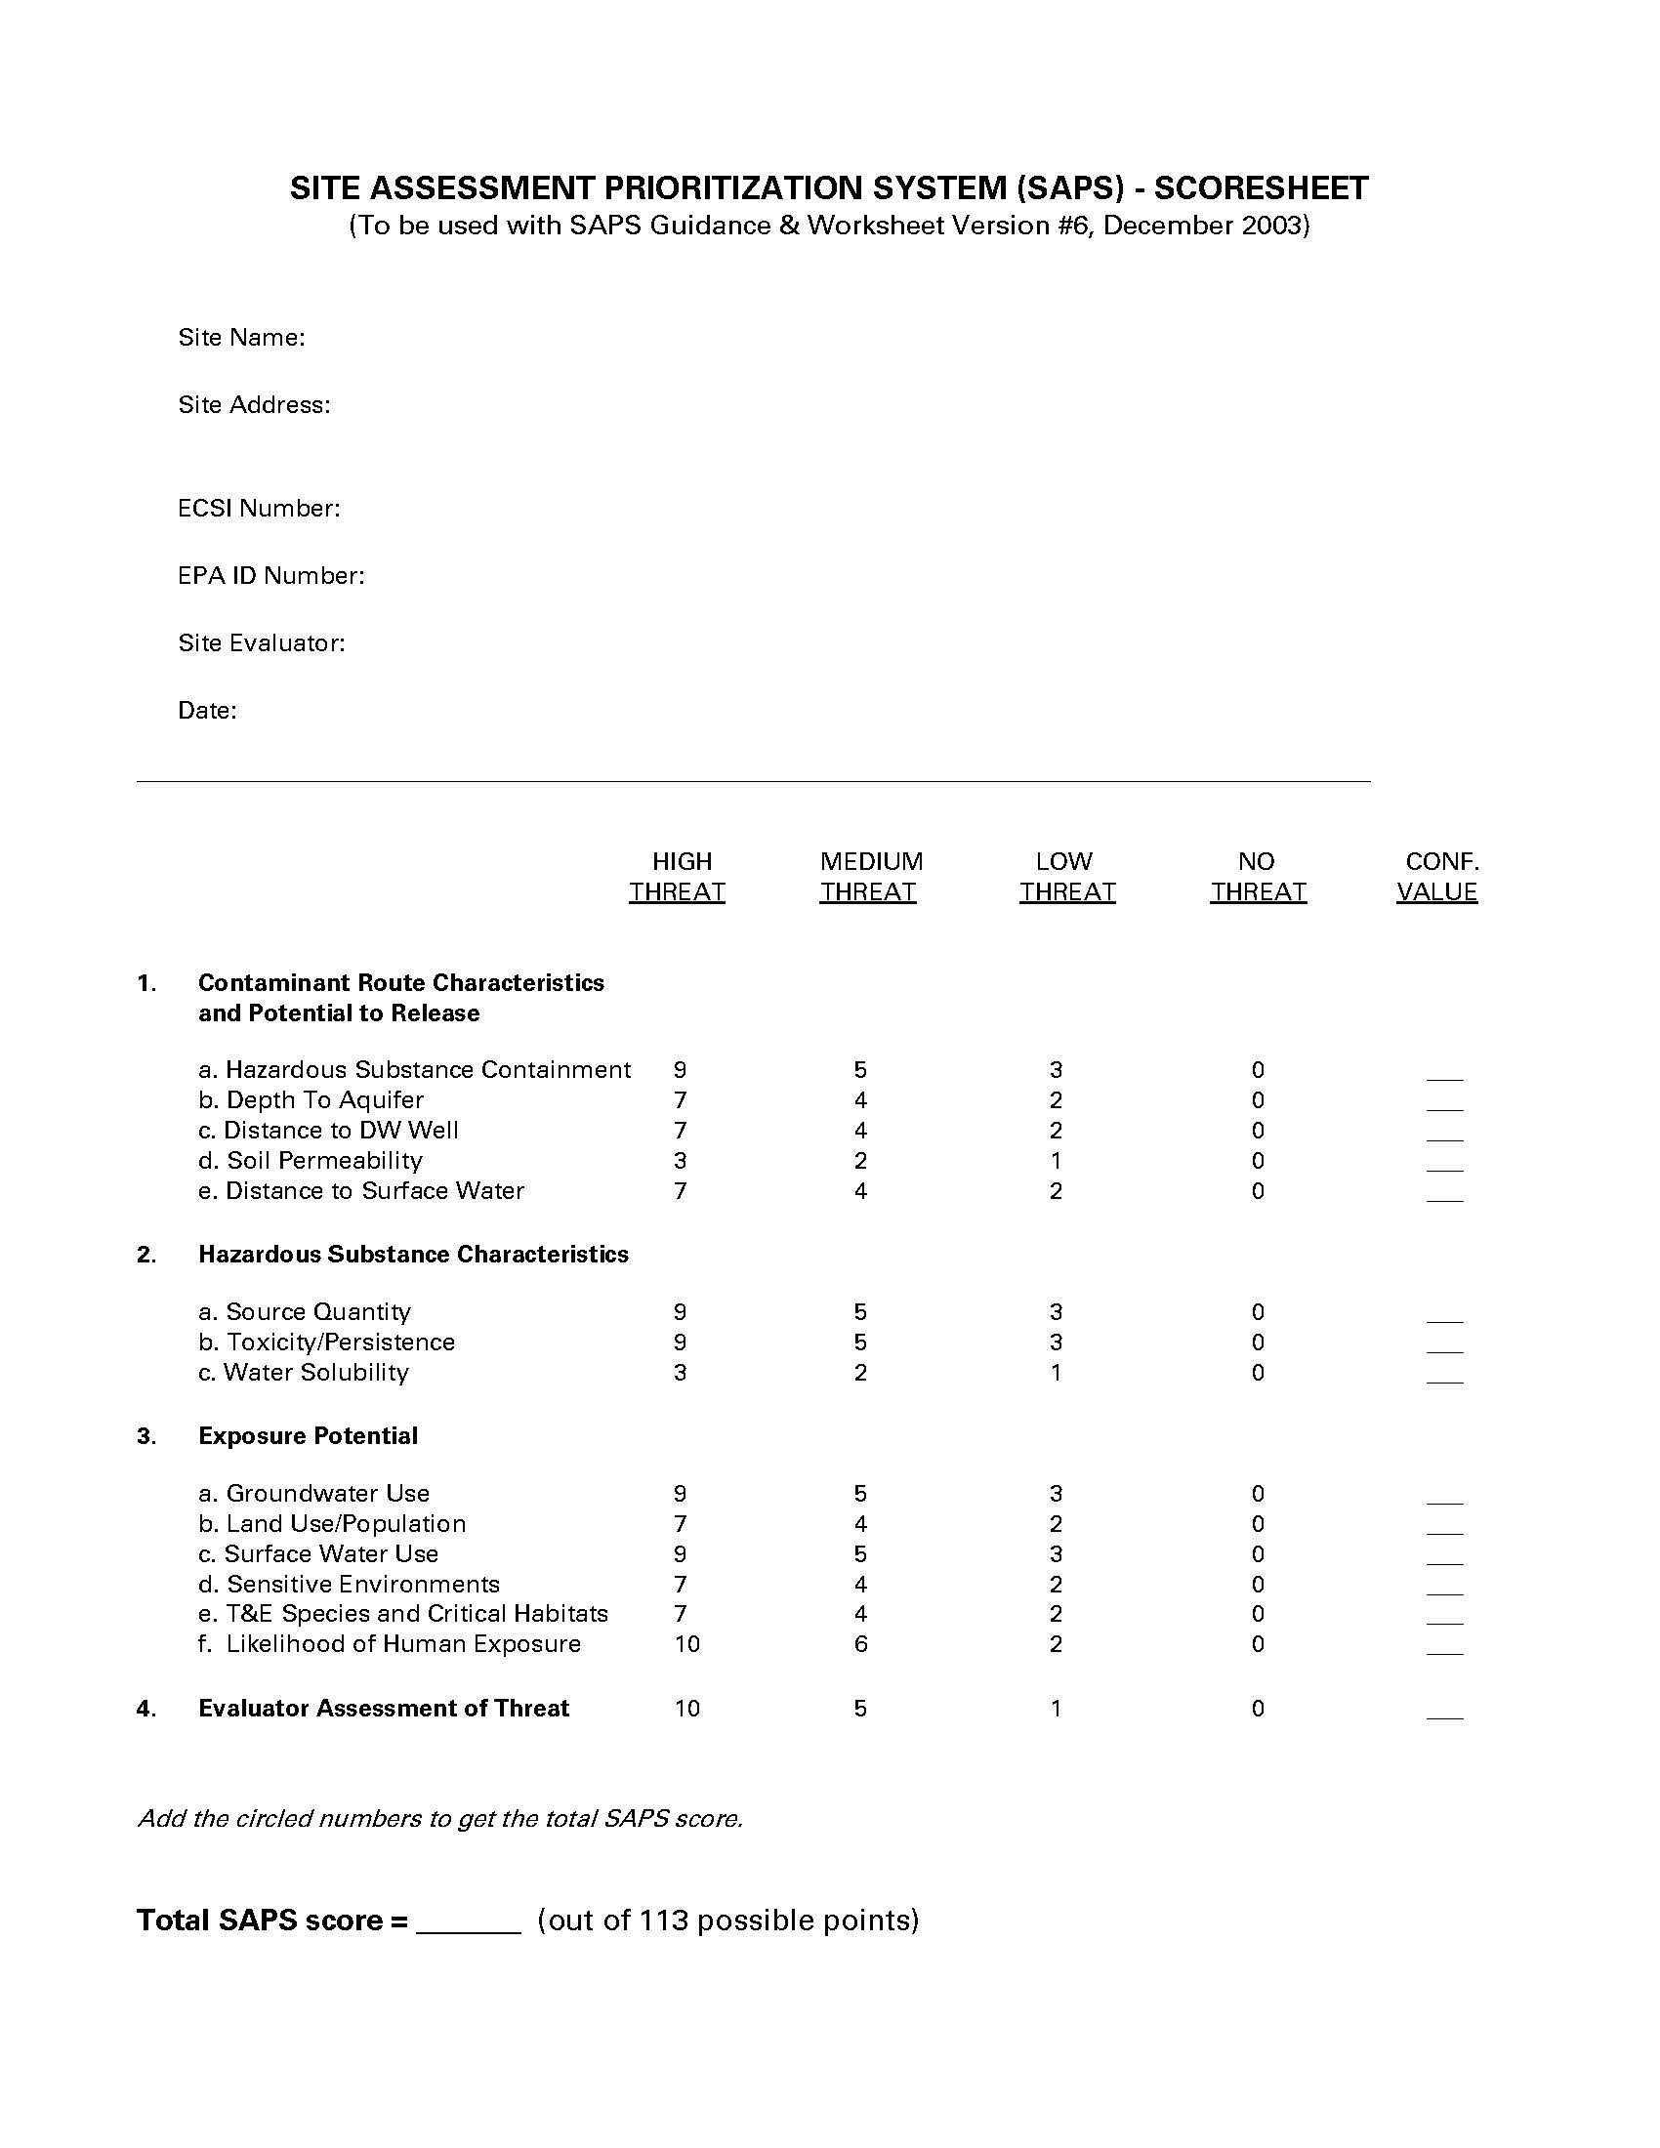
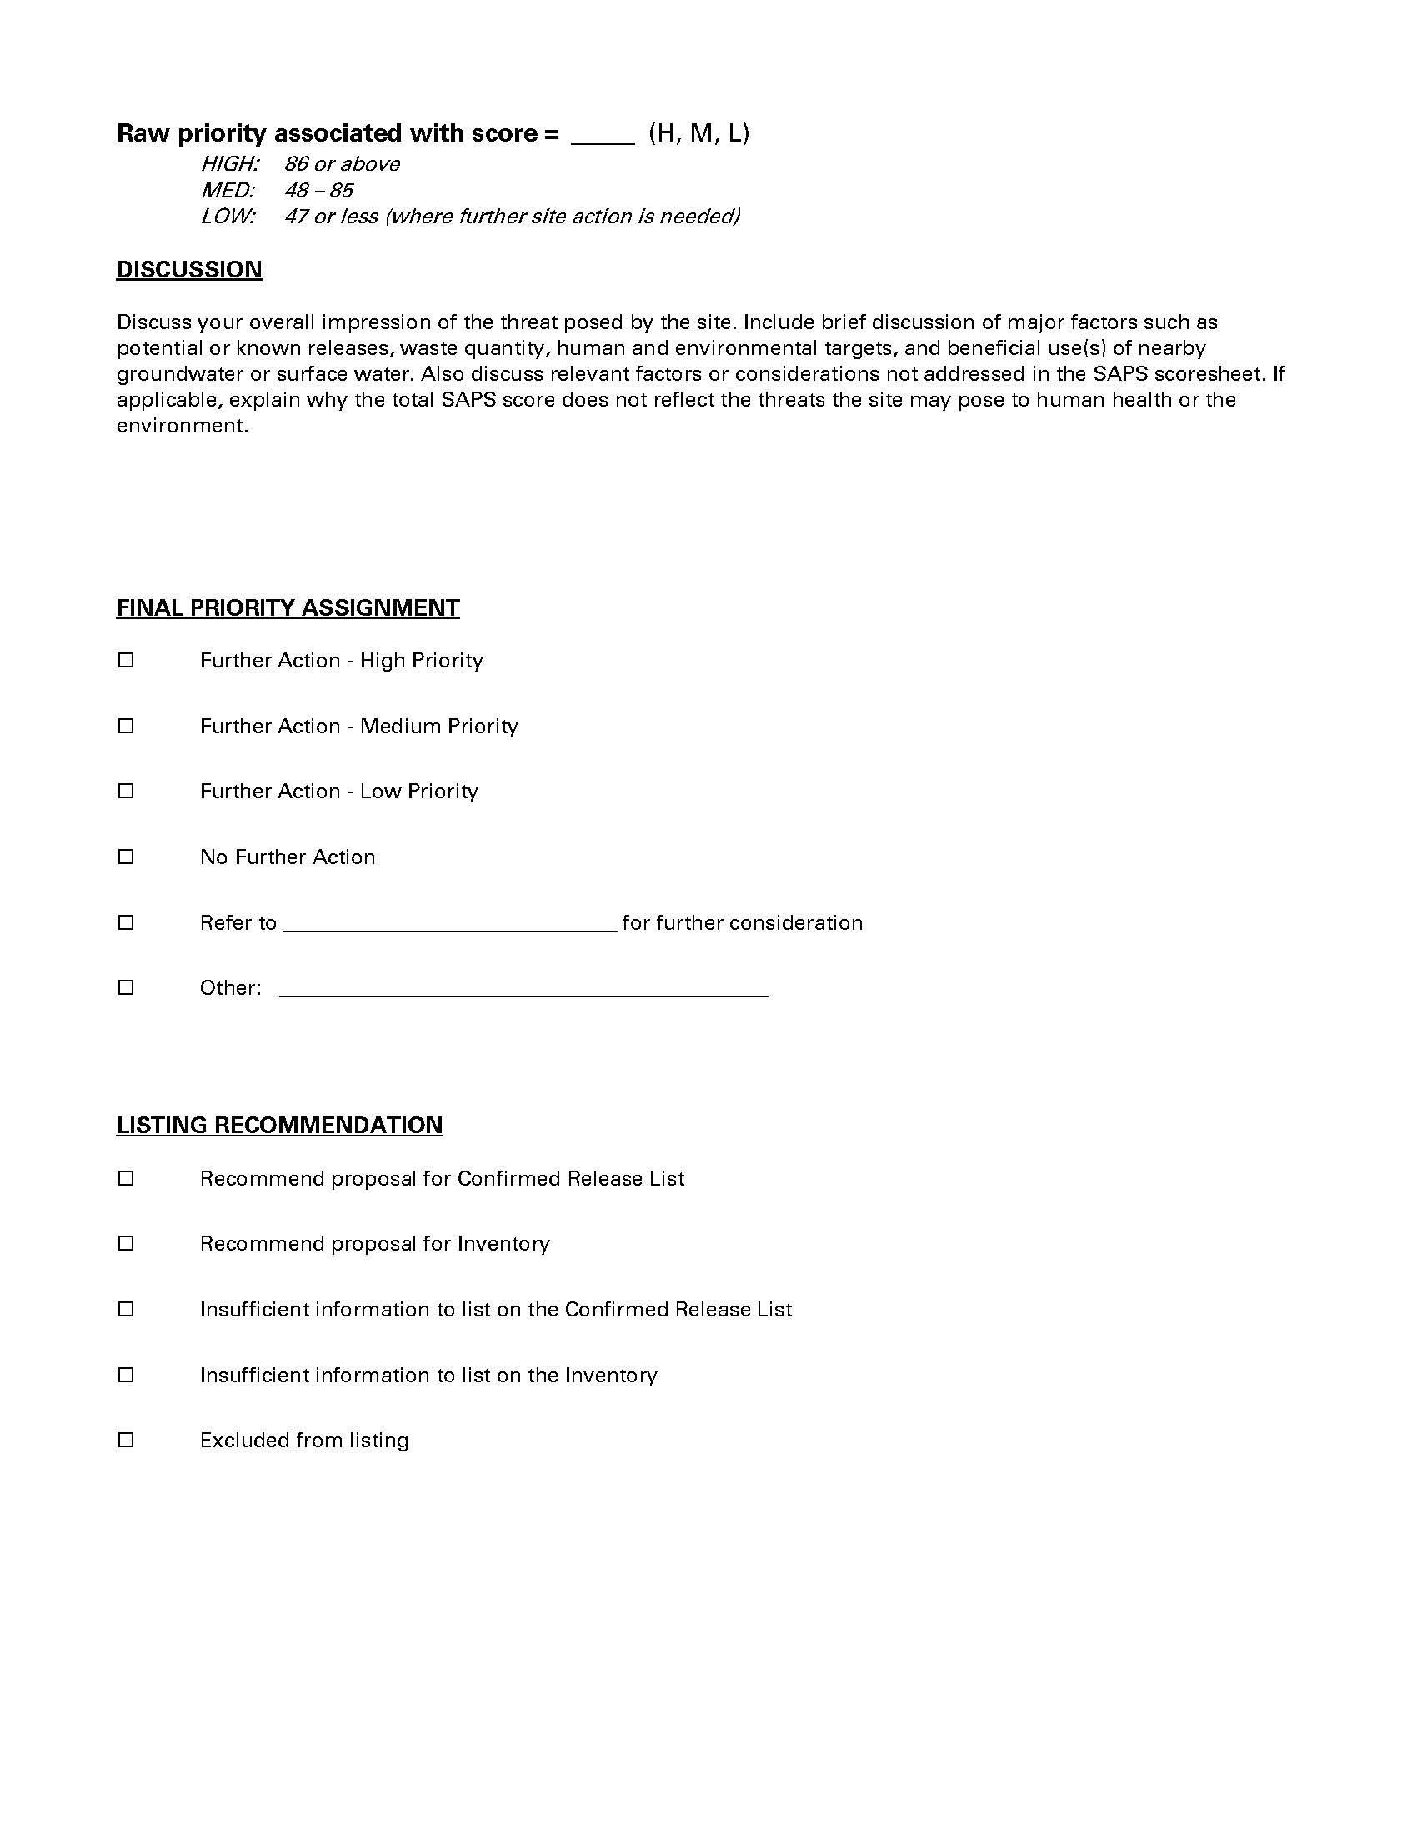
Odeq site assessment prioritization system (SAPS)
  Why it doesn’t work
    Generic scoring process
    Overlook or overstate site-specific factors
    Lack of data
    Lengthy process
SAPS Scoresheet showing 15 scoring characteristics. https://www.oregon.gov/deq/Pages/index.aspx
Notes:
Why this kind of system doesn’t work. The ODEQ provides an 11 page guidance document outlining example data sources and scoring criteria for each of the 15 assessment characteristics. Several data source examples are listed for each of the characteristics. Gathering, compiling, and scoring all of the necessary data can become a cumbersome and lengthy process. The ODEQ provides the two pages displayed here as a condensed scoresheet version of SAPS in an effort to make the process easier. This kind of generic scoring process can overlook or overstate site-specific factors and an area may have minimal to no data available for certain assessment characteristics. This can result in skewing the score towards one data source leaving the scoring to the assessors best professional judgement for other characeteristics. Overall, the SAPS assessment process could be overwhelming to the assessor and result in multiple data gaps.

Slide 7
objectives
Develop Two Detailed Statewide Groundwater Vulnerability Maps
Compare two models
Compare to actual groundwater quality data
What areas of Oregon have an elevated vulnerability to groundwater contamination and what model most accurately identifies these areas?
Notes:
So the objective of this project is to develop two statewide groundwater vulnerability maps utilizing two different models. These two models will be compared to actual groundwater quality data and then compared to each other to determine which model most accurately identifies areas of elevated groundwater vulnerability. The first model will be developed using the existing SAPS criteria explained on the last couple slides and the other will be developed using the DRASTIC model, which was developed by the EPA and is described on the following slide.

Slide 8
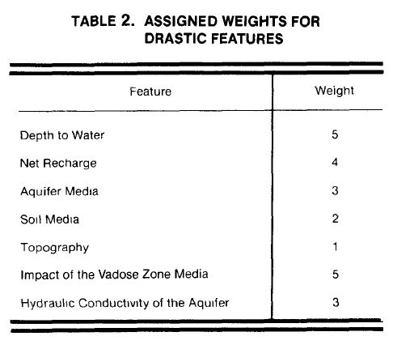
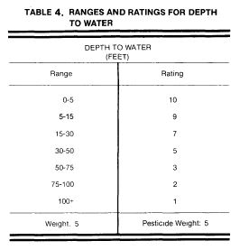
Assessment methods
OVERLAY AND INDEX
DRASTIC
  depth to water, net recharge, aquifer media, soil media, topography, impact to the vadose zone, and hydraulic conductivity
D_{R}D_{W} + R_{R}R_{W} + A_{R}A_{W} + S_{R}S_{W} + T_{R}T_{W} + I_{R}I_{W} + C_{R}C_{W} = POLLUTION POTENTIAL
  WHERE: R = RATING
    W = WEIGHT
Table 2 and 4 showing the assigned weights, ranges and ratings for DRASTIC Features. (EPA, 1987).
Notes:
To identify an applicable groundwater quality method to develop a statewide groundwater vulnerability map, a review of existing groundwater quality and vulnerability models was conducted. These existing models have been developed by state, regional and national entities including the United States Geological Survey, USEPA, and other state water districts. Each of the models reviewed utilized one or more assessment method.
The Overlay and Index method combines maps of parameters and assigns an index value to those parameters, resulting in a spatially oriented vulnerability index. This method is best for regional-scale assessments and relies on publicly available data. The DRASTIC method was developed by the EPA in 1987 and is the most popular overlay and index method used for developing groundwater vulnerability models. DRASTIC allows for the pollution potential of any site to be evaluated based on the study areas hydrogeologic settings and a relative rating system which is comprised of seven factors including depth to water, net recharge, aquifer media, soil media, topography, impact to the vadose zone and hydraulic conductivity. These factors are incorporated into a relative ranking system using the equation shown here and a combination of weights and ratings to produce a numerical value, or DRASTIC index. The table in the top right corner represents the weights to be used in the equation for each of the features and the table in the bottom right corner represents the ranges and ratings to be used for the depth to groundwater feature. A table like this is provided for each of the features assessed.

Slide 9
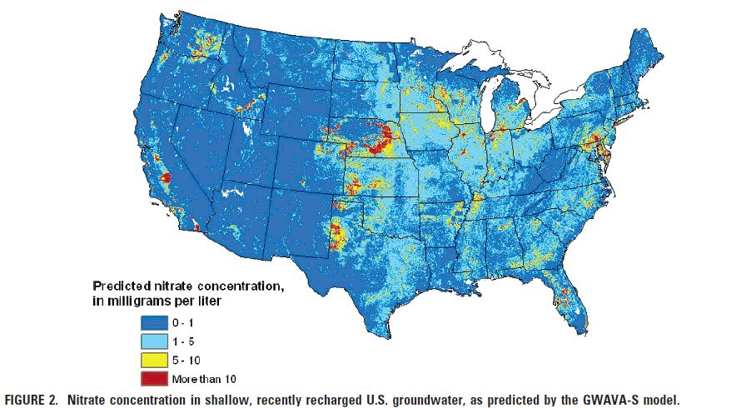
Assessment methods (Cont.)
STATISTICAL
  LOGISTIC REGRESSION
  NON-LINEAR REGRESSION
  CLASSIFICATION TREES
PROCESS BASED
  FATE AND TRANSPORT
Results of a non-linear regression model performed by Nolan and Hitt (2006).
Notes:
Additional assessment methods reviewed were the statistical and process based assessment methods.
The Statistical assessment method correlates analytical data to spatial variables and requires a large amount of high quality site-specific data. These models usually predict the probability that a well will contain a certain contaminant, but the results do not attempt to identify a cause-effect relationship. Some examples of statistical models are logistic regression, non-linear regression, and classification trees. Logistic regression is a popular method because it can be used to treat large numbers of censored values such as contaminant concentrations below laboratory detection levels also known as non-detect values which is useful when conducting assessments using laboratory results. Non-linear regression models predict contaminant concentration rather than the probability of the contaminant being present in a well. The figure to the right shows the nitrate concentrations in shallow groundwater as predicted by a non-linear model known as GWAVA-S which was developed by Nolan and Hit in 2006. Classification or decision trees are used to break up a complex decision into a union of several simpler decisions.
Processed based assessment methods utilize numerical first order equations to model contaminant fate and transport. These kinds of models are useful at the local level but not at regional level. This method can be used to address multiple interacting physical processes and identify the most important factor in groundwater sensitivity. These methods can be rather sophisticated and do not necessarily provide more reliable results than the other assessment methods.
A review of these three assessment methods determined the Overlay and Index method is best suited for identifying areas with elevated groundwater vulnerability on a statewide basis.

Slide 10
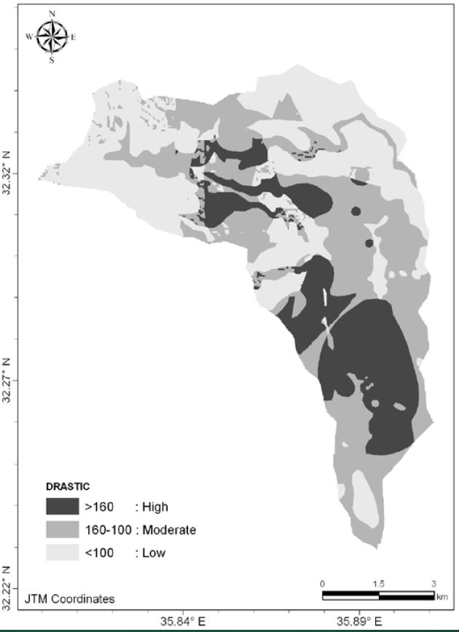
Analysis and methodology
Two statewide groundwater vulnerability maps
ESRI ArcGIS
Overlay and index assessment method
  Saps
  Drastic
Create Gis raster layer for each criteria and assign an index value
Combine layers using the Raster calculator tool of spatial analyst extension
  Higher score – more vulnerable
Example of DRASTIC results map.
http://courses.washington.edu/cejordan/SbCcMa_Presentation.pdf
Notes:
Analysis and Methodology. two statewide groundwater vulnerability maps will be developed using the Overlay and Index assessment method. The maps will be developed using the Esri ArcGIS platform equipped with the spatial analysis extension. The first map will be developed using the existing ODEQ SAP system and the other with be developed using the DRASTIC model. A separate GIS raster layer will be created for each of the assessment characteristic for each of the models. The layers will then be assigned an index value based on its corresponding scoring and/or ranking criteria. The raster layers will then be combined using the raster calculator tool included in the spatial analysis toolbox to provide a layer with an overall rank and/or score. The most vulnerable areas will have a higher rank or score and the least vulnerable areas having a lower score. An example of the final groundwater vulnerability maps is shown to the right with highly vulnerable areas shown in a darker color and less vulnerable areas shown in a lighter color.

Slide 11
Analysis and methodology
compare the groundwater vulnerability maps with monitoring well analytical data
  Contaminated/uncontaminated
  Determine if vulnerable areas are classified correctly based on well locations and analytical data
Compare SAPS and DRASTIC models to determine which model is more accurate
Notes:
Once the two models have been developed and maps created, monitoring well locations with groundwater quality information will be plotted on the maps and designated as contaminated or not contaminated. The amount of contaminated and uncontaminated wells will be calculated for each identified vulnerable area to determine if the areas were classified correctly. The SAPS and DRASTIC models will then be compared to each other to determine which model is more accurate in identifying the most areas correlating with the contaminated and uncontaminated monitoring well locations.

Slide 12
DATA
IDENTIFIED BASED ON SAPS
136 SOURCEs
72 SOURCES Provided BY odeq
  Drinking water protection program
Shapefiles, interactive web maps and tabular databases
Notes:
A review of datasets potentially applicable to the ODEQ SAP system was conducted and identified 136 data sources. The ODEQ website was the starting point of the data review because it was anticipated that most of the data needed could be provided through the ODEQ. The search then moved on to other state, federal, and open source entities. Once data was identified it was reviewed and evaluated to determine its applicability to the SAPS categories, listed in this table.
As you can see the Hazardous waste containment category includes active permitted facilities, storage tanks, and environmental site cleanup information.
The Groundwater category includes well log databases, water quality information, and groundwater drinking water source areas.
The Surface water category includes the most recent ODEQ surface water assessment information, watershed data, and water quality information.
The drinking water category includes drinking water source areas, drinking water services, public water system information and water rights information.
The Soil category includes soil data provided by the National Cooperative Soil Survey as well as well log information.
The land use and population category includes land cover and use as well as zoning and ownership data.
The Sensitive Environment category includes data such as National marine sanctuaries, historic places, designated natural areas and state parks.
Threatened and Endangered Species data is also included along with a general use category which contains administrative data such as county boundaries and topographic maps.
ODEQ provided 72 of the 136 data sources, primarily through their drinking water protection program. Some data sets were provided in downloadable spatial format (Shapefiles) but others were provided in interactive web applications or tabular databases.

Slide 13
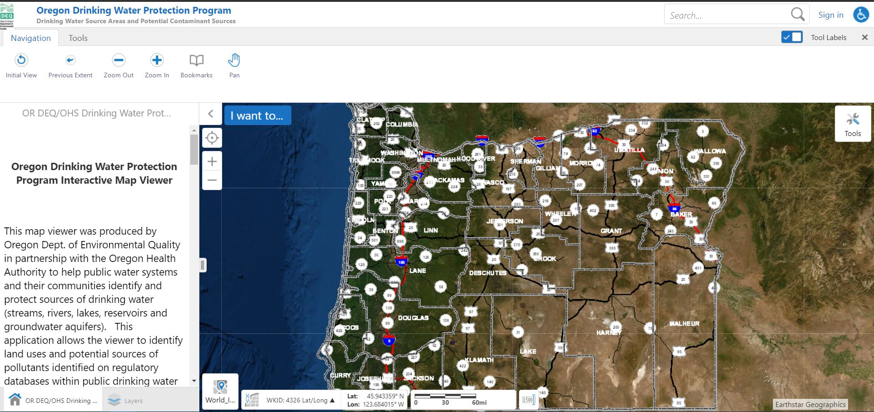
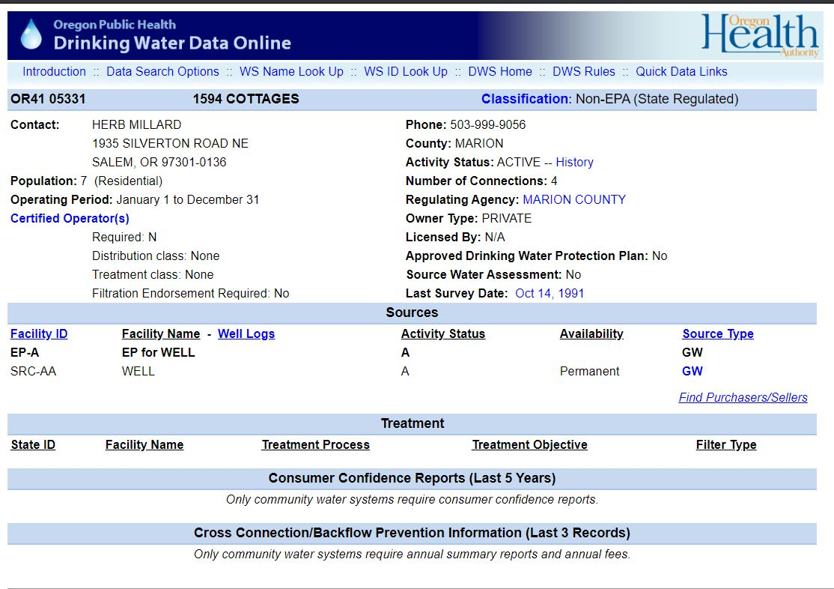
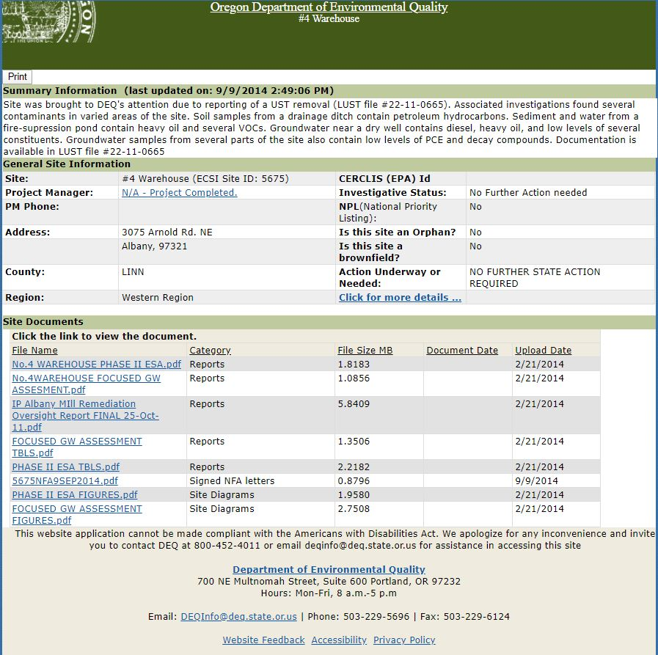
limitations
Generally apply to datasets
  Interactive maps not currently equipped with downloading capability
  Tabular format vs. spatial format
  Location data inconsistent
  Reference systems varied
Examples of data sources available from the ODEQ. https://yourwater.oregon.gov/inventory.php?pwsno=05331
https://www.deq.state.or.us/Webdocs/Forms/Output/FPController.ashx?SourceId=5675&SourceIdType=11
https://hdcgcx2.deq.state.or.us/HVR291/index.html?viewer=drinkingwater
Notes:
The limitations I came across generally apply to the reviewed datasets. Several datasets were found to be included in interactive web applications and are currently unable to be downloaded directly from the application in a spatial format. Obtaining data from these sources may require corresponding with the database owner. Furthermore, data for several databases could only be downloaded in a tabular format and location data was not consistently provided and was not and reference systems varied between sources.

Slide 14
Anticipated results
Saps and drastic model results will differ
Saps
  Known sites containing hazardous substances
  Shallow groundwater
  Highly permeable soil
  May provide more accurate results because it considers more variables
Drastic
  Does not consider hazardous substance sites
  Variables pertain mostly to groundwater
Notes:
It is anticipated that the SAPs and DRASTIC model results will differ based on the different inputs required for each model. The SAPS model will indicate that areas near known sites containing hazardous substances with shallow groundwater tables and highly permeable soil will represent areas most vulnerable to groundwater contamination. Since the DRASTIC model does not take into account known sites containing hazardous substances the results will be skewed toward areas having shallow groundwater tables and highly permeable soil. The SAPS model may provide more accurate results based on the amount of characteristics assessed.

Slide 15


Proposed timeline
May–June 2020
obtain and process data sets
June–Aug. 2020
develop layers and assign index values
Aug.–Sep. 2020
compare models to groundwater quality data and each other
Sep.–Dec. 2020
conference presentation (Esri Water Conference or EnerGIS?) and final project write-up
Notes:
The proposed timeline for completing this project is shown on this slide. I anticipate obtaining and processing the required data sets by the end of June 2020. Layers will be developed and assigned index values by August 2020. I will compare the models to each other and the groundwater quality data by September 2020. And I anticipate presenting the results at a conference between September and December 2020. One potential presentation venue is the Esri Water Conference in Chicago, Illinois and the other is the EnerGIS conference in Canonsburg, Pennsylvania. The EnerGIS conference was supposed to occur in April of this year but has been delayed due to the Coronavirus. All of the presentation spots are currently full but that may change due to the rescheduling.

Slide 16
Questions?

Slide 17
references
Aller, L., Bennet, T.,Lehr, J.H., and Hacket, G. (May 1987). DRASTIC: A Standardized System for Evaluating Ground Water Pollution Using Hydrogeologic Settings. United States Environmental Protection Agency. https://nepis.epa.gov/Exe/ZyPURL.cgi?Dockey=200093PP.txt
Barbash, J.E., and Voss, F.D. (2014). Design and Testing of a Process-Based Groundwater Vulnerability Assessment (P-GWAVA) System for Predicting Concentrations of Agrichemicals in Groundwater Across the United States. Science Investigations Report, United States Geological Survey. https://pubs.usgs.gov/sir/2014/5189/sir20145189.pdf
Osborn N.I., Hardy, R.H. (January 1999). Statewide Groundwater Vulnerability Map of Oklahoma. Oklahoma Water Resources Board. https://www.owrb.ok.gov/studies/reports/gwvulnerability/entire-report.pdf
Nolan, B.T. and Hitt, K.J. (2006). Vulnerability of Shallow Groundwater and Drinking-Water Wells to Nitrate int the United States. Environmental Science & Technology, 40, 7834-7840. https://water.usgs.gov/nawqa/nutrients/pubs/est_v40_no24/est_v40_no24.pdf
Ransom, K.M., Nolan, B.T., Traum, J.A., Faunt, C.C., Bell, A.M., Gronberg, J.M., Wheeler, D.C., Rosecrans, C.Z., Jurgens, B., Schwarz, G.E., Belitz, K., Eberts, S.M., Kourakos, G., and Harter, T. (December 1, 2017). A hybrid machine learning model to predict and visualize nitrate concentration throughout the Central Valley Aquifer, California, USA. Science of the Total Environment, 601-602, 1160-1172. https://www.sciencedirect.com/science/article/pii/S0048969717313013?via%3Dihub
Rupert, M.G. (March 1999). Improvements to the DRASTIC Ground-Water Vulnerability Mapping Method. United States Geological Survey. https://pubs.usgs.gov/fs/1999/0066/report.pdf
Ryker, S.J., and Williamson, A.K. (1996). Pesticides in public supply wells of the Central Columbia Plateau. U.S. Geological Surveyd Fact Sheet 122-96. https://pdfs.semanticscholar.org/fdab/993576049746de4b37f6b9fc93c08e612660.pdf?_ga=2.24550524.712024799.1584726542-320896695.1583953894
Saghebian, S.M., Sattari, M.T., Mirabbasi, R., and Pal, M. (July 2013). Ground water quality classification by decisions tree method in Ardebil region, Iran. Arabian Journal of Geosciences 7(11). https://www.researchgate.net/publication/255969865_Ground_water_quality_classification_by_decision_tree_method_in_Ardebil_region_Iran
Tesoriero, A.J., Inkpen, E.L., and Voss, F.D. (1998). Assessing Ground-Water Vulnerability Using Logistic Regression. Water Resources Division, United States Geological Survey. http://citeseerx.ist.psu.edu/viewdoc/download?doi=10.1.1.540.2733&rep=rep1&type=pdf
Todd Engineers and Kennedy/Jenks Consultants (October 2010). Revised Final Groundwater Vulnerability Study Santa Clara County, California. Santa Clara Valley Water District. https://www.valleywater.org/sites/default/files/201802/Groundwater%20Vulnerability%20Study.pdf
Twarakavi, N.K.C. and Kaluarachchi, J.J. (March - April 2005). Aquifer Vulnerability Assessmetn to Heavy Metals Using Ordinal Logistic Regression. Ground Water, 43, 200-214. https://go-gale-com.proxy.osl.state.or.us/ps/retrieve.do?tabID=T002&resultListType=RESULT_LIST&searchReultsType=SingleTab&searchType=AdvancedSearchForm&currentPosition=1&docId=GALE%7CA132292595&docType=Article&sort=RELEVANCE&contentSegment=ZGPP-MOD1&prodId=ITOF&contentSet=GALE%7CA132292595&searchId=R1&userGroupName=sale38182&inPS=true
Vu, T., Ni, C., Li, W., and Truong, M. (November 26, 2019). Modified Index-Overlay Method to Assess Spatial-Temporal Variations of Groundwater Vulnerability and Groundwater Contamination Risk in Areas with Variable Activities of Agriculture Developments. Water, 11, 2492. https://www.mdpi.com/2073-4441/11/12/2492

