Slide 1
Enhanced Parcel Queries in Kansas
Kristen Jordan

Slide 2
Project Goal
Provide expanded tools and services for statewide parcel queries in Kansas

Slide 3
Background
Kansas Data Access and Support Center (DASC)
Existing project: compiling statewide parcels & appraisal databases
Wanted to publish REST service w/ API for state departments to query
State departments need easier tools to work with

Slide 4
REST Web Service
Web service
Query parameters included in URL
URL is a request that returns query results
Original concept, already have a web interface
Query by: county, type, owner
Get results as json or xlsx

Slide 5
Project Specific Goals
Access service through desktop & web applications
Attribute and spatial queries
Return brief parcel data in variety of formats
Have complete documentation

Slide 6
Existing State Resources
Public, statewide, GIS driven sites- Utah, Wyoming, Massachusetts
Data for download- Hawaii, Utah, Massachusetts
Data queryable by county- Tennessee, California, Montana
Links to county sites- Texas, Minnesota
Massachusetts includes some appraisal attributes

Slide 7
Personal Impressions
GIS is moving in this direction
Lots of opportunities for growth
Wyoming & Massachusetts sites query multiple parcels

Slide 8
Existing Kansas Resources
Statewide appraisal system for 105 counties
Each parcel has unique 19 digit code
Parcel appraisal data for 92 counties- updated every 2 weeks, rotating
Counties maintain GIS data
GIS parcel data for about 40 counties

Slide 9
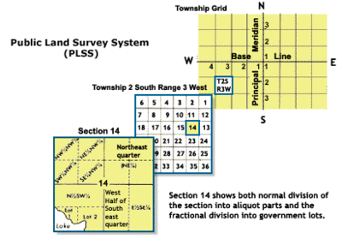
Section Township Range
Part of the BLM’s Public Land Survey System
Kansas is uniformly gridded by Section, Township, Range (STR)
Township- northing, Range- easting, Section- 1 square mile
Parcel’s STR stored in the appraisal database

Slide 10
Considerations & Users
Privacy
For this project, keep private to State departments
Needs frequently cross county boundaries
Roads, rivers, tornadoes: don’t stop at county boundaries
Need state & county cooperation to make public

Slide 11
User Research
Researched attributes with some State departments
Department of Revenue wanted everything- 150 tables with 1000+ attributes for each county
Heard back from Kansas Department of Health & Environment (KDHE)- multiple bureaus
Basics: PID, owner name, owner address, acres, legal description

Slide 12
KDHE: Specific Uses
Bureau of Environmental Reclamation
Contaminated sites
Finding owners frequently involves expensive travel
Bureau of Air
Permits for air emission locations
Bureau of Water
Ownership information
Currently: repeated county requests

Slide 13
Platform for Querying
Some interested in web based, some in desktop
REST service can accomplish both
KDHE users already use ArcGIS Desktop
KDHE also already uses a web-based selection tool they are willing to share

Slide 14
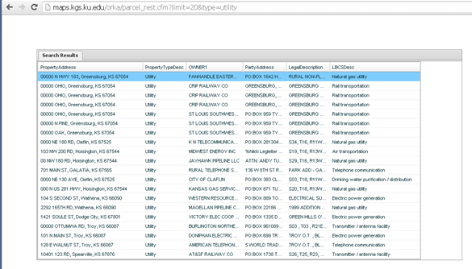
REST- Attribute Query
http://maps.kgs.ku.edu/orka/parcel_rest.cfm?limit=20&type=utility

Slide 15
Spatial Query- First Draft
Proof of concept
Hits database directly for most queries
Uses one existing web service
Queries STR by feature class envelope

Slide 16
Spatial Query Setup
Desktop tool, Python script
Input of feature class
Runs an intersect on the parcel merge first
If parcels don’t exist, tool queries STR data
Returns list of possibilities- limited number
Results presented in xlsx, show difference between parcels & STR possibilities

Slide 17
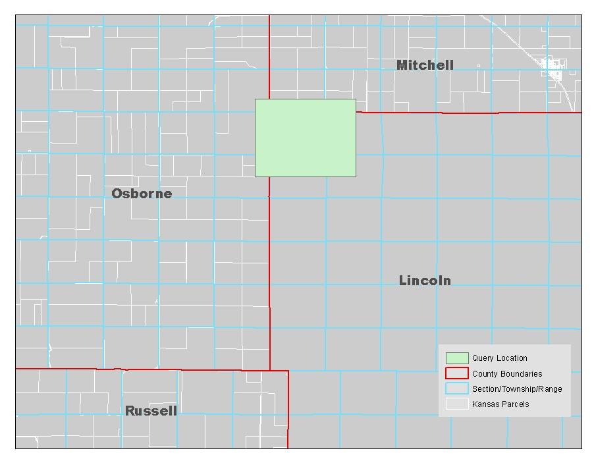
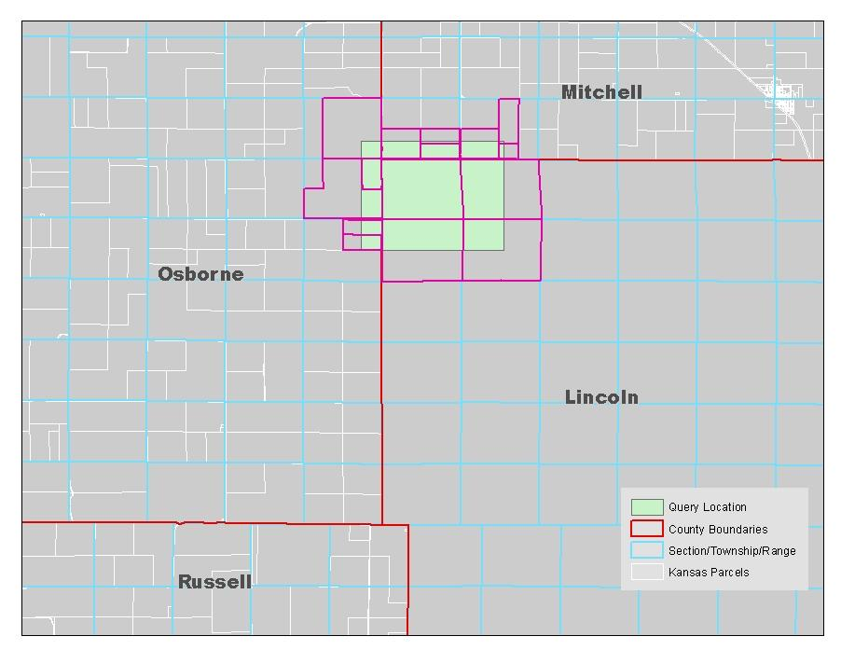
Spatial Query- Concept

Slide 18
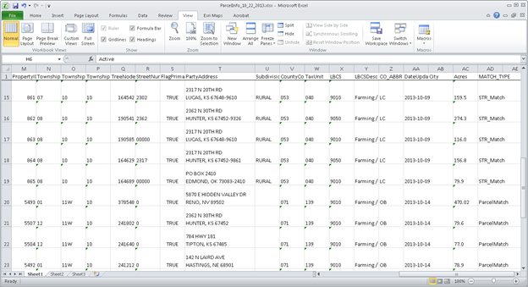
Spatial Query Output

Slide 19
Challenges & Issues
STR coding in appraisal database
Major lack of standard, consistent data
47 townships, 76 different entries
70 ranges, 197 different entries
36 possible sections, 62 different entries
Data updated every two weeks, so I can’t fix it once
Ended up creating a “data fix” view to handle inconsistencies

Slide 20
Future Plans
Generate web services to handle all queries
Rewrite desktop tool to use web service
Generate web tool that also uses web service
Expand input formats for desktop & web
Take user-drawn graphic as input
Presentation- MidAmerican GIS Consortium- April 2014

