Slide 1
Cloud-Based GIS Solutions for Lead & Copper Program Management
Justin Mitchell
MGIS Capstone 596A 2022

Slide 2
Overview
Introduction
History of the Lead & Copper Rule
Historic Municipality Solutions & Challenges
Compliance Requirements
A Need for Program Management
Existing Solutions
Goals & Objectives
Proposed Approach
Improvements Over Existing Solutions
Project Timeline

Slide 3
Introduction
Dangers of lead
Sources of lead exposure
Initial published regulations
Revisions to existing regulations

Slide 4
History of the EPA Lead & Copper Rule
1991: Published
2007: Enhancements
2021: First Major Revisions
2024: Planned Improvements

Slide 5
Historic Municipality Solutions & Challenges
Lack of spatial data for service connections
Historically compliance was reactive
Revisions require proactive service line replacements

Slide 6
Compliance Requirements
Service line replacements
Increased sampling
Prioritizing historically underserved communities
Increased public outreach requirements
Required support for affected customers

Slide 7
A Need for Program Management
Municipalities require a solution for managing the new requirements
Tracking progress of many program aspects
Relating all program activities to service connections
Single platform for consistency and easy implementation

Slide 8
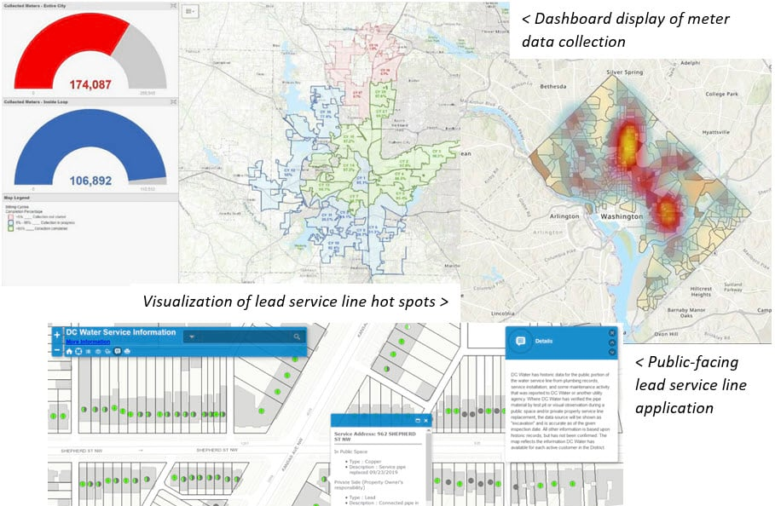
Existing Solutions - Pros
Excellent reporting concepts
Creative symbology
Well-developed schema for service line inventory

Slide 9
Existing Solutions - Cons
Esri’s Lead Service Line Solution
No related tables
Only manages the discovery of lead service lines
No method for recording customer interactions
Not leveraging latest technology
Other Consultants Solutions
Repackaging Esri’s solution
Similar gaps in compliance assistance

Slide 10
Goals & Objectives
Provide a cloud-based GIS solution
Improve municipality’s service line inventory management

Slide 11
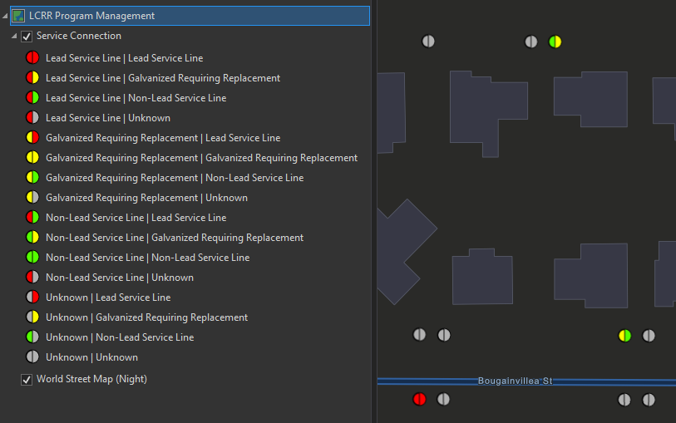
Proposed Approach
Generate service connections from financial systems & parcel data
Prioritize sites based on likelihood of lead presence and social justice factors
Utilize Esri’s cloud-based applications for all required workflow elements
Automated reporting solutions with custom python scripts

Slide 12
Workflow Categories
Preprocessing
Administrative
Field
Public
Management

Slide 13
General Workflow
Data Processing
Request Access
Field Investigation
Reporting
Public outreach & support

Slide 15
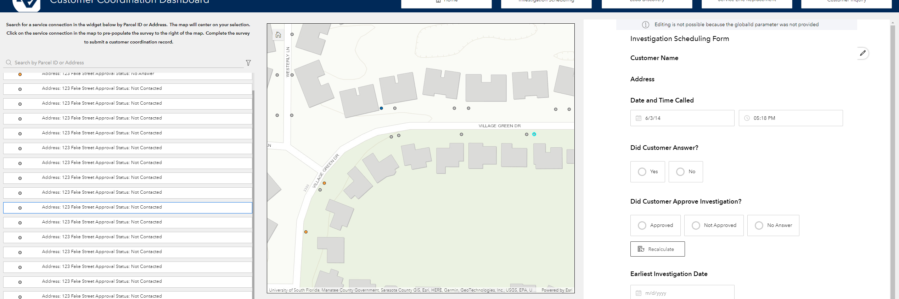
Improvements Over Existing Solutions

Slide 16
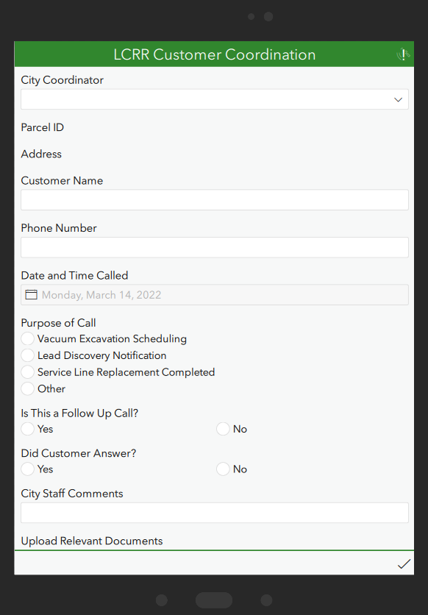
Addresses all compliance requirements
Provides referential integrity between activity records
Improves service line inventory management
Leverages latest technologies
Real time data
Improves workflow efficiency
Allows for user/role permissions
Notes:
Public outreach improvements

Slide 17
Project Timeline
March 2022: Create Prototype
April 2022: User Testing
May 2022: Refinements
June 2022: Presentation

Slide 18
References
Campbell, C., 2022. The Lead and Copper Rule: ArcGIS Helps to Meet Updated Requirements. [online] ArcGIS Blog. Available at: <https://www.esri.com/arcgis-blog/products/arcgis/water/the-lead-and-copper-rule-arcgis-helps-to-meet-updated-requirements/> [Accessed 14 March 2022].
Epa.gov. 2022. The New Lead and Copper Rule. [online] Available at: <https://www.epa.gov/sites/default/files/2020-12/documents/lcr_overview_fact_sheet_12-21-2020_final.pdf> [Accessed 14 March 2022].
Esri.com. 2022. Fort Worth Removes Lead Pipes through AMI Program. [online] Available at: <https://www.esri.com/en-us/industries/water-utilities/community/fort-worth-case-study?rsource=https%3A%2F%2Fwww.esri.com%2Fen-us%2Findustries%2Fwater%2Fsegments%2Fwater-utilities%2Ffort-worth-case-study> [Accessed 14 March 2022].
Esri.com. 2022. Lead Service Lines: Data Transparency for a Community in Action. [online] Available at: <https://www.esri.com/en-us/lg/industry/water/stories/lead-service-lines-data-transparency-for-a-community-in-action> [Accessed 14 March 2022].
Nolte, J., 2022. Denver Water Protects Customers with Data-Driven Lead Reduction Program. [online] Esri.com. Available at: <https://www.esri.com/en-us/landing-page/industry/water/2020/denver-water-protects-customers-with-data-driven-lead-reduction-program> [Accessed 14 March 2022].
US EPA. 2022. Basic Information about Lead in Drinking Water | US EPA. [online] Available at: <https://www.epa.gov/ground-water-and-drinking-water/basic-information-about-lead-drinking-water> [Accessed 14 March 2022].

Slide 19
References (Continued)
US EPA. 2022. Lead and Copper Rule | US EPA. [online] Available at: <https://www.epa.gov/dwreginfo/lead-and-copper-rule> [Accessed 14 March 2022].
US EPA. 2022. Lead: Science and Technology | US EPA. [online] Available at: <https://www.epa.gov/lead/lead-science-and-technology> [Accessed 14 March 2022].
US EPA. 2022. Revised Lead and Copper Rule | US EPA. [online] Available at: <https://www.epa.gov/ground-water-and-drinking-water/revised-lead-and-copper-rule> [Accessed 14 March 2022].
US EPA. 2022. Strategies to Achieve Full Lead Service Line Replacement | US EPA. [online] Available at: <https://www.epa.gov/ground-water-and-drinking-water/strategies-achieve-full-lead-service-line-replacement> [Accessed 14 March 2022].
US EPA. 2022. Supporting Materials: Final Revisions to the Lead and Copper Rule | US EPA. [online] Available at: <https://www.epa.gov/ground-water-and-drinking-water/supporting-materials-final-revisions-lead-and-copper-rule> [Accessed 14 March 2022].

