Slide 1
What Motivates OpenStreetMap Users? A Study of User Contributions Through a Comparison of Small-Scale Crisis Events
Erika Kamptner
Advisor: Dr. Fritz Kessler

Slide 2
Overview
Research Objective
Background
Related Research
Methodology
Anticipated Results
Limitations
Project Timeline

Slide 3
Objective
Do small-scale crisis events act as motivators for OSM user contribution?
Comparison study of four recent building fire incidents
Compare Western/Non-Western and developed/less developed areas
Measure any increases of OSM contributions following an incident
Classify users that contribute: Who are they and where are they located?
Objective
Background
Related Research
Methodology
Anticipated Results
Timeline
Limitations

Slide 4
Why is this research important?
Majority of research is on larger humanitarian events
Supports ongoing research on contribution patterns and motivation factors for OSM users
Where are mappers from?
What features do mappers add or update?
Are these casual or serious users?
Objective
Background
Related Research
Methodology
Anticipated Results
Timeline
Limitations

Slide 5
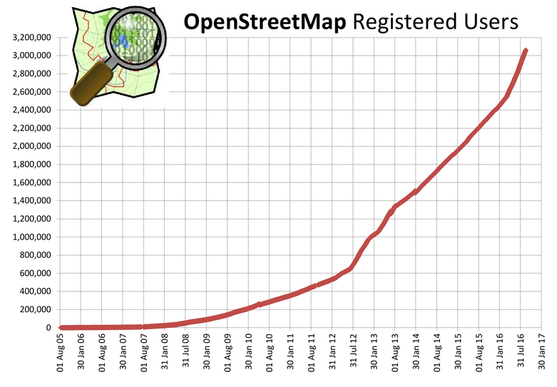
OSM Background
Founded in 2004
Open Data
4 million registered users (July 2017)
5 billion uploaded GPS points
Users contribute:
Nodes
Ways
Relations
Attribute tags
OSM Registered Users
Source: OSM Statistics
Objective
Background
Related Research
Methodology
Anticipated Results
Timeline
Limitations

Slide 6
Crisis Response Mapping
“Crisis informatics” and digital volunteers
2010 Haiti Earthquake and emergence of the Humanitarian OpenStreetMap
OSM Mapping Party
Source: LearnOSM, Tasking Manager
Objective
Background
Related Research
Methodology
Anticipated Results
Timeline
Limitations

Slide 7
User Classification
OSM Users are classified in the following ways:
Serious vs. casual mappers
Local vs. remote mappers
Country of origin
Editing patterns
Objective
Background
Related Research
Methodology
Anticipated Results
Timeline
Limitations

Slide 8
Methodology
Part 1: Do user contributions increase near the location of the incident?
Part 2: Classify Users
How often do they make edits to the project?
Where are users located?
What kinds of features or attributes are being updated?
Objective
Background
Related Research
Methodology
Anticipated Results
Timeline
Limitations

Slide 9
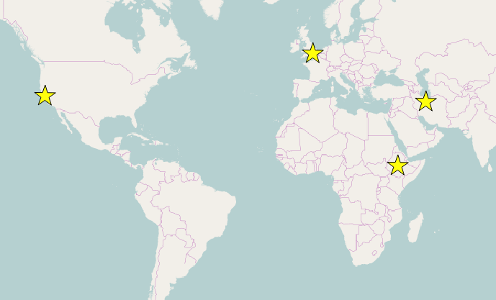
Study Areas
June 14 2017
Grenfell Tower
London, UK
Dec 2 2016
Ghost Ship Warehouse
Oakland, USA
Jan 19 2017
Plasco Building
Tehran, Iran
Similar events resulting in structural change
Widespread international media coverage
Within 1-year timespan
Sept 3 2016
Kilinto Prison
Addis Ababa, Ethiopia
Objective
Background
Related Research
Methodology
Anticipated Results
Timeline
Limitations

Slide 10
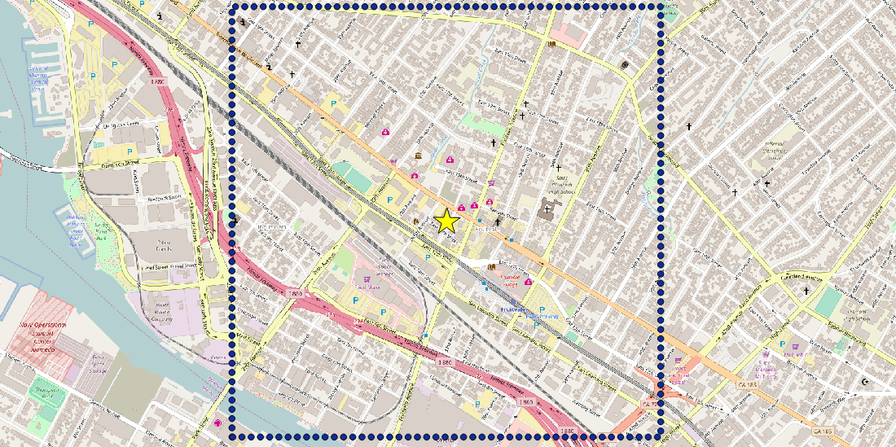
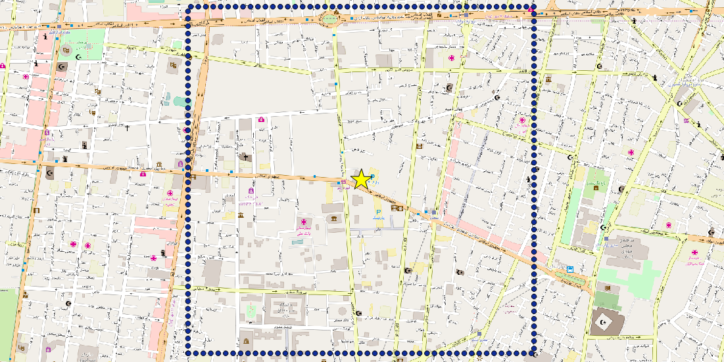
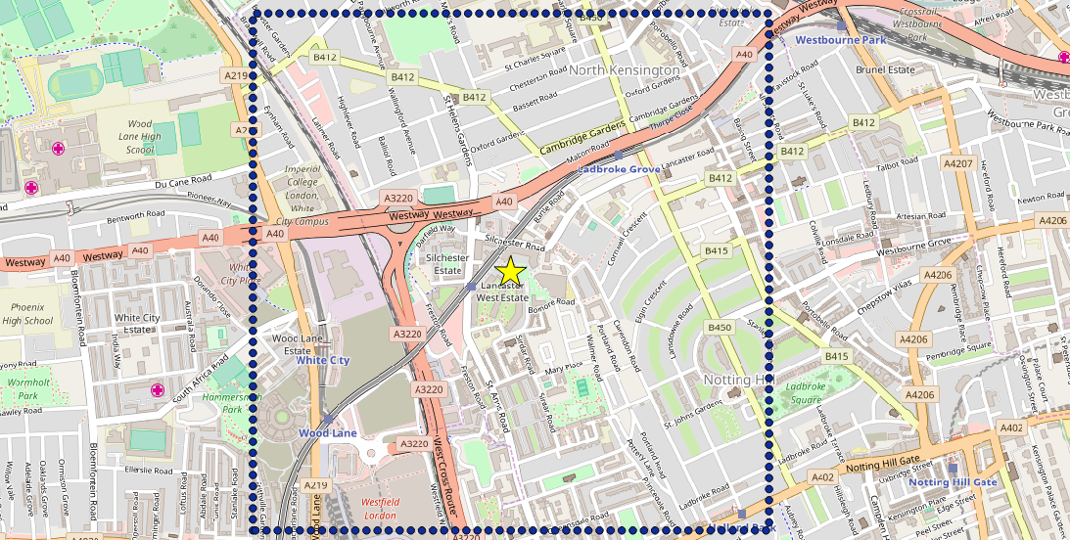
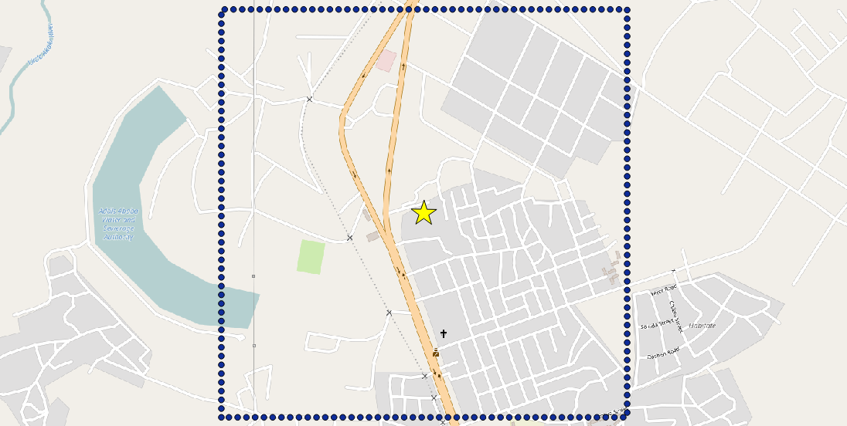
 | Western | Non-Western
Developed
Less Developed
Ghost Ship Warehouse
Oakland, CA
Plasco Building
Tehran, Iran
Grenfell Tower
London, England
Kilinto Prison
Addis Ababa, Ethiopia
Objective
Background
Related Research
Methodology
Anticipated Results
Timeline
Limitations

Slide 11
Data used for Analysis
Part 1: History (file)
Contains every node, way, relation ever logged in the OSM database
Includes references to user and changeset file
Objective
Background
Related Research
Methodology
Anticipated Results
Timeline
Limitations

Slide 12
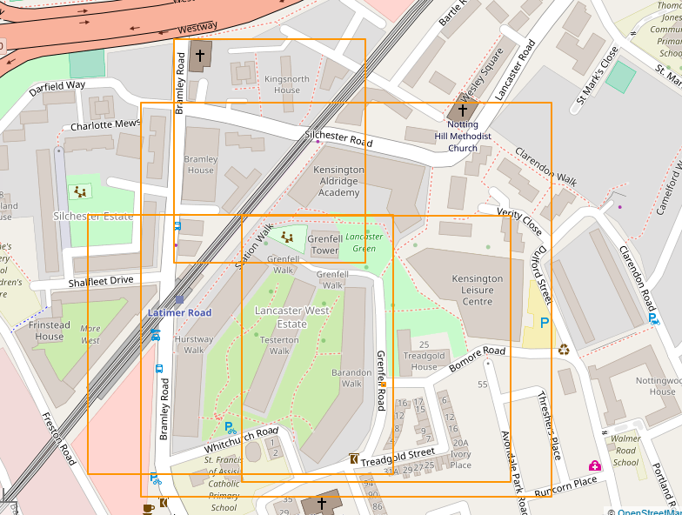
Data used for Analysis
Part 2: Changeset (file)
Bounding box of a users edits per session
Includes nodes, ways, and relations for each editing session
All changesets in OSM database
Objective
Background
Related Research
Methodology
Anticipated Results
Timeline
Limitations

Slide 13
Part 1: Is there an increase in OSM activity?
History File
OSMConvert
OSM to PostGreSQL
PostGreSQL: Edits/Updates per day
Incident bounding box
Is there an increase in incidents?
no
No further analysis for incident
yes
Cell Grid
Contribution Index Analysis
Incident Location
PostGreSQL: Users providing edits/updates
Part 2
Objective
Background
Related Research
Methodology
Anticipated Results
Timeline
Limitations

Slide 14
Part 1: Is there an increase in OSM activity?
Determine number of contributions per day
Create contribution index model to show contributions before and after incident.
Number of nodes
Average OSM version
Mean number of attributes
Number of users
Determine which users contributed after the incident
Objective
Background
Related Research
Methodology
Anticipated Results
Timeline
Limitations

Slide 15
Part 1: Contribution Index
Location of all nodes and nodes of ways and relations
Spatial join of OSM data to contribution grid
Symbolize based on node count, version, number of attributes and number of OSM users
Objective
Background
Related Research
Methodology
Anticipated Results
Timeline
Limitations

Slide 16
Part 2: Classify Users
Part 1
PostgreSQL: Users providing edits/updates
Changeset File
ChangesetMD to PostgreSQL
PostgreSQL: Changeset of users providing edits
Contribution Frequency
User Location
Editing Patterns
Triangular Mesh
Primary edits
Centroid of edits
Objective
Background
Related Research
Methodology
Anticipated Results
Timeline
Limitations

Slide 17
Part 2: Classify Users
Contribution Frequency
< 10 = Nonrecurring
< 1,000 = Casual Mapper
> 1,000 = Serious Mapper
User Location – 3 approaches
Primary Edits
Triangular Mesh
Centroid of Edits
Editing Patterns
Objective
Background
Related Research
Methodology
Anticipated Results
Timeline
Limitations

Slide 18
Part 2: Triangular Mesh
Delaunay triangulation of nodes
Removal of segments greater than 1km
The resulting polygon represents the area of most user activity.
Objective
Background
Related Research
Methodology
Anticipated Results
Timeline
Limitations

Slide 19
Anticipated Results
Activity is expected at and/or near the incident
Serious mappers
Local mappers
Western/Developed origin
Objective
Background
Related Research
Methodology
Anticipated Results
Timeline
Limitations

Slide 20
Limitations
Several outside factors influence contributions
Building type – Residential vs Non-residential
Extent of media coverage
Number of casualties or displaced individuals
Current status of building (demolished vs changed use “ruins”)
Location analysis is only an estimate
Objective
Background
Related Research
Methodology
Anticipated Results
Timeline
Limitations

Slide 21
Project Timeline
July
Data Preparation
August
Part 1 Analysis
September
Part 2 Analysis
October
State of the Map
November
Revision based on conference feedback
June
Site Selection
December
Submit Capstone
Objective
Anticipated Results
Timeline
Objective
Background
Related Research
Methodology
Anticipated Results
Timeline
Limitations
Background
Related Research
Methodology

Slide 22
References
Arsanjani, Jamal Jokar, Peter Mooney, Marco Helbich, and Alexander Zipf. (2015) "An Exploration of Future Patterns of the Contributions to OpenStreetMap and Development of a Contribution Index." Transactions in GIS 19.6 896-914
Budhathoki, Nama R., and Caroline Haythornthwaite. (2013) "Motivation for Open Collaboration: Crowd and Community Models and the Case of OpenStreetMap." American Behavioral Scientist 57.5 548-75.
Fast Victoria, Rinner Claus. (2014) “A Systems Perspective on Volunteered Geographic Information.” ISPRS International Journal of Geo-Information. 3: 1278-1292
Miller Harvey, Goodchild Michael. Data-driven geography. GeoJournal (2015) 80:449–461 DOI 10.1007/s10708-014-9602-6
Mulder Femke, Ferguson Julie, Groenewegen, Boersma Kees, Wolbers Jeroen. (2016) Questioning Big Data: Crowdsourcing crisis data towards an inclusive humanitarian response. Big Data and Society. SAGE.
Neis, Pascal, and Alexander Zipf. (2012) "Analyzing the Contributor Activity of a Volunteered Geographic Information Project -- The Case of OpenStreetMap." ISPRS International Journal of Geo-Information 1.3: 146-65.
Neis, Pascal, Dennis Zielstra, and Alexander Zipf. (2013) "Comparison of Volunteered Geographic Information Data Contributions and Community Development for Selected World Regions." Future Internet 5.2 282-300.
Norris, Wendy. "Digital Humanitarians." Journalism Practice 11.2-3 (2016): 213-28.
Palen, L., Soden, R., Anderson, T. J., & Barrenechea, M. (2015). Success & Scale in a Data-Producing Organization. Proceedings of the 33rd Annual ACM Conference on Human Factors in Computing Systems - CHI 15. doi:10.1145/2702123.270229
OpenStreetMap Stat Report (2017). Accessed 07/10/2017 from http://www.openstreetmap.org/stats/data_stats.html
Quattrone, Giovanni, Licia Capra, and Pasquale De Meo. (2015) "There's No Such Thing as the Perfect Map: Quantifying Bias in Spatial Crowd-sourcing Datasets."Proceedings of the 18th ACM Conference on Computer Supported Cooperative Work & Social Computing. Acm, 1021-032.
Quattrone, Giovanni, Afra Mashhadi, and Licia Capra. (2014) "Mind the Map: The Impact of Culture and Economic Affluence on Crowd-mapping Behaviours." Proceedings of the 17th ACM Conference on Computer Supported Cooperative Work & Social Computing. Acm, 934-44.
Quinn, Sterling. (2016) A geovisual analysis of social influence in OpenStreetMap construction. Carographica 51:2 p 67 – 83. Doi:10:3138/car.51.2.3301
Yang, A., Fan, H., Jing, N., Sun, Y., & Zipf, A. (2016). Temporal Analysis on Contribution Inequality in OpenStreetMap: A Comparative Study for Four Countries. ISPRS International Journal of Geo-Information,5(1), 5. doi:10.3390/ijgi5010005
Zielstra, D., Hochmair, H., Neis, P., & Tonini, F. (2014). Areal Delineation of Home Regions from Contribution and Editing Patterns in OpenStreetMap. ISPRS International Journal of Geo-Information, 3(4), 1211-1233. doi:10.3390/ijgi3041211

Slide 23
Questions? efk116@psu.edu ekamptner@gmail.com

