Slide 1
Statistical Analysis for Automated Seep Extraction in GIS
Presented by Pamela Kanu, GISP
Pennsylvania state university
Geog 596A Spring II 2017
MaY 11, 2017
Notes:
Conduct literature review (narrative identifying significant literature, including identification of major issues discussed, approach used, lessons learned, history of issues, and future of the issues, include formal reference citations)

Slide 2
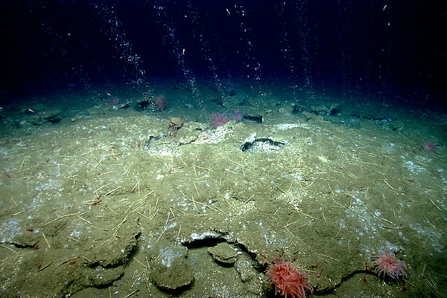
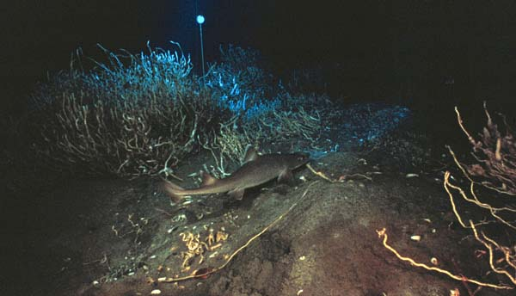
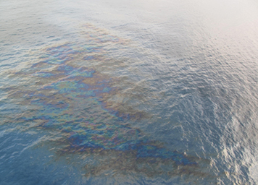
Seeps
Seeps are natural gas and crude oil that enter the ocean through cracks and sediments along the seafloor. Seeps emit continuously into the ocean (similar to an oil spill and drift with currents)
Due to the warm environment caused by geologic activity, the escaping methane gas produce bacteria that benthos consume ^{[1]}
Oil slick on the sea surface
Estimated 160,000 tons of natural petroleum enter North American waters each year ^{[4]}
Tubeworm bush^{[4]}
Notes:
http://oceanexplorer.noaa.gov/explorations/02arctic/background/benthos/benthos.html
Animals that live on the seafloor are called benthos. Benthic communities are invertebrates, including sea anemones, sponges, corals, sea stars, sea urchins, worms, bivalves, crabs, etc.

Slide 3
STUDY AREA
Vessel: Fugro Discovery
Instrument: Kongsberg EM302
Seabed mapping with high resolution to depth of 7,000+ m ^{[8]}
Missing Malaysian Flight MH370 Survey offshore Australia from October 23, 2014 to August 11, 2016
Southern Indian Ocean, Offshore Australia
Broken Ridge
Water Column
Search Area
Image courtesy of Fugro

Slide 4
Data acquisition
Data are acquired by sonar beams in a straight line swath width that captures meters of the surveyed area using GPS horizontal positioning and local water-level datums for vertical positioning
Accurate and precise horizontal and vertical positioning of the vessel are required to obtain an accurate sample of the water depth, water column, and seafloor
4 dimensions (XYZ and Time) are used to calculate and correct sounding locations ^{[5]}
Image courtesy of Fugro
Notes:
“The amount of time it takes for the sound waves to bounce off the seabed and return to a receiver is used to determine water depth”

Slide 5
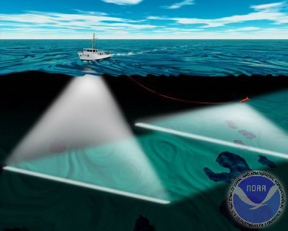
Multibeam echosounder sonar data
Multi-Beam Echo Sounder
Sonar that emit sound waves in a fan shape beneath the ship’s hull.
Multibeam uses spatial filtering (beamforming), a signal processing technique for directional signal transmission where sound waves ping the seabed and reflect off to calculate the water depth
XYZ that is converted into a continuous raster
Multibeam (left) and Sidescan sonar (right) data acquisition.
Image courtesy of NOAA.
Notes:
“The amount of time it takes for the sound waves to bounce off the seabed and return to a receiver is used to determine water depth”

Slide 6
Water column data
Captured with acoustic beams from multibeam sonars
Used to map marine life, oceanic processes, and seeps^{[3]}
XYZ points in the water column

Slide 7
Existing seep extraction techniques
Manual Extractions
2D and 3D for ArcGIS
Visualizing in Fledermaus
Fledermaus FMMidWater
Rapidly view and extract water column features from a range of sonar file by converting data into a Generic Water Column format (GWC) to use for further processing and visualization by threshold filtering^{[2]}
Research algorithms University of New Hampshire Center for Coastal and Ocean Mapping Joint Hydrographic Center (UNH CCOM-JHC)
Despeckle filter
Feature detection tool
Qimera Midwater
Add-on packages for water column processing
Extended FMMidWater Tool used to reduce sonar noise and converting the water column data sample into bathymetric format ^{[6]}
Notes:
Despeckle filter – removes small defects and reduces noise
Four steps for manipulating water column data:
Import sonar file(s)
Convert to GWC format
Identify features of interest using threshold filtering
Export to Fledermaus for visualization or ASCII for custom processing [11].

Slide 8
Lessons Learned
Digitizing in 2D, lack of 3D visualizations in ArcGIS
Need for an extension to ArcGIS environment
Need for improving water column data processes due to large amounts of data and noise
No web component
Notes:
This large volume of data must be recorded and protected from loss in some logical management scheme. The scheme must provide high performance access to facilitate efficient processing and visualization of such large amounts of data.

Slide 9
Capstone objective
My Capstone Project is to map the gas bubbles (plumes) that seep from the seafloor for potential exploration site investigation
Define level of accuracy in seep extraction

Slide 10
Methodology overview
DEM
Data Processing
TXT
Density
Convert XYZ to Points
Calculate Density, Determine Threshold and Conversions
Extract Z Values
Calculate Water Column Height
Add Fields for Weights
Apply Statistical Algorithms
Remove Noise
Weight Criteria
Spatial Statistics
Extract Seeps

Slide 11
What ARE THE CHARACTERISTICS OF a seep?
Closer to the Seafloor (but not always the case)
Linear
Condensed
Related to Benthic Communities
Disparate Amplitude Intensity
Weight Criteria
Spatial Statistics
Extract Seeps

Slide 12
Closer to the Seafloor (but not always the case)
Closer to the Seafloor (but not always the case)
Closer to the seafloor (but not always the case)
Calculate water column heights
Use a threshold of less than ~4 meters in the water column
Linear
Condensed
Related to Benthic Communities
Disparate Amplitude Intensity

Slide 13
Linear
Closer to the Seafloor (but not always the case)
Seeps will appear in a linear fashion
Bubbles locations are selected using Near_3D tool
Follow Tobler’s Law, items that are closer are more related than items that are distant
Linear
Condensed
Related to Benthic Communities
Disparate Amplitude Intensity

Slide 14
condensed
Closer to the Seafloor (but not always the case)
Seeps are in dense
XYZ points are used to calculate density
Seeps will be dense in the z value
May be dense relative to the seafloor
Linear
Condensed
Related to Benthic Communities
Disparate Amplitude Intensity

Slide 15
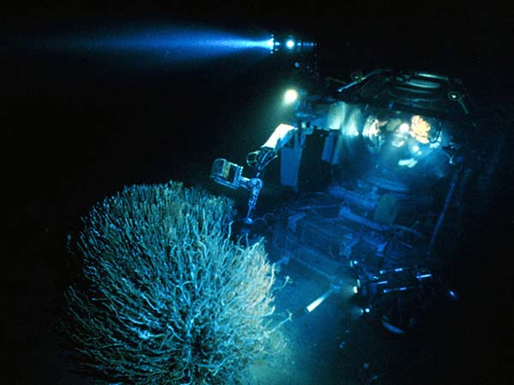
Related to benthic communities
Closer to the Seafloor (but not always the case)
Warm areas produce bacteria benthos consume
Geology activity
Analysis does not account for benthic communities
Linear
Condensed
Related to Benthic Communities
Disparate Amplitude Intensity
Tubeworm bush^{[4]}
Notes:
Identifying seeps could help identify or predict communities. Conversely, mapping communities can help identify seeps.

Slide 16
Disparate Amplitude Intensity
Closer to the Seafloor (but not always the case)
Amplitude values will vary, but depending on the item will reflect similar intensities
Items in the water column will reflect varying intensities
Amplitude values are relative
Linear
Condensed
Related to Benthic Communities
Disparate Amplitude Intensity
Notes:
These are the fields from the TXT files that are used to apply the criteria to the analysis.

Slide 17
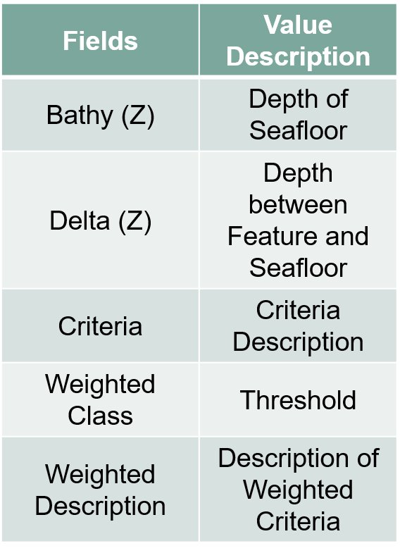
criteria
Fields | Value Description
Bathy (Z) | Depth of Seafloor
Delta (Z) | Depth between Feature and Seafloor
Criteria | Criteria Description
Weighted Class | Threshold
Weighted Description | Description of Weighted Criteria
Bathy (Z)
Delta (Z)
Criteria
Weighted Description
Weighted Class
Weight Criteria
Spatial Statistics
Extract Seeps

Slide 18
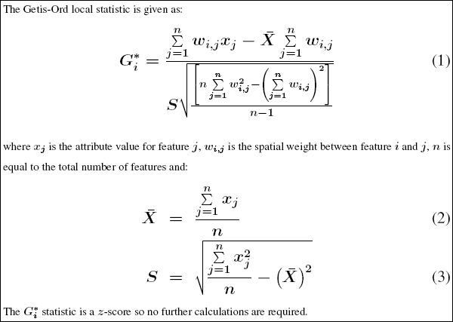
Spatial statistics
Hot Spot Analysis tool to detect concentrations of high or low values ^{[7]}
Positive z-scores identify seeps
The more intense the clustering of high values
Significantly negative z-scores identify fish
The more intense clustering of low values
P-value
Helps to determine the significance of the results ^{[9]}

Slide 19
Accuracy Assessment
Select random points using Create Accuracy Assessment Points tool
Experts in seep industry will interpret random points
Compute Confusion Matrix table
Errors of Omission – Analysis may result in items being classified as seeps or bubbles within a seep, may be classified as not a seep.
Errors of Commission – User’s error as interpreted data is subjective ^{[10]}
Notes:
Producer’s accuracy (Errors of Omission)

Slide 20
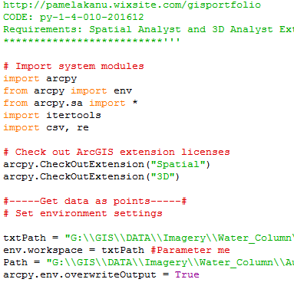
Automated techniques
Python
Calculate Density, Determine Threshold and Conversions
Extract Z Values
Calculate Water Column Height
Add Fields for Weights
Apply Statistical Algorithms
Remove Noise
JavaScript
Customized Web Application for Viewing Extracted Seeps in 2D and 3D
Convert XYZ to Points

Slide 21
Anticipated results AND DELIVERABLES
Seep Extraction
Feature class of extracted seeps
Attributed tables from FMMidwater
Custom web application in ArcGIS for JavaScript
Automated seep detection process
Accuracy Assessment
Perform an accuracy assessment using ArcGIS accuracy assessment tools
Account for errors of omission
Account for errors of commission

Slide 22
Timeline per week
Moving forward timeline:
Data Processing
Refine Analysis
Write Analysis Script
Data Migration
Web Application
Test Application
Deploy

Slide 23
references
[1] Carrie C. Wall, J. Michael Jech, Susan J. McLean; Increasing the accessibility of acoustic data through global access and imagery. ICES J Mar Sci 2016; 73 (8): 2093-2103. doi: 10.1093/icesjms/fsw014
[2] QPS B.V. (2016, October 18). Fledermaus 7.7.x Manual. SAAB.
[3] http://www.whoi.edu/oil/natural-oil-seeps
[4] http://response.restoration.noaa.gov/oil-and-chemical-spills/oil-spills/resources/what-are-natural-oil-seeps.html
[5] https://www.nauticalcharts.noaa.gov/csdl/publications/TM_NOS-CS03_FY2003-Brown_SonarDataSystem.pdf
[6] http://www.qps.nl/display/qimera/Qimera_Midwater
[7] O’Sullivan, D., & Unwin, D. (2010). Geographic Information Analysis. Hoboken, New Jersey: 2nd John Wiley and Sons
[8] https://www.km.kongsberg.com/ks/web/nokbg0397.nsf/
AllWeb/A915A71E90B6CFAEC12571B1003FE84D/$file/306106_em_302_product_specification.pdf?OpenElement
[9] http://resources.esri.com/help/9.3/arcgisengine/java/gp_toolref/spatial_statistics_tools/how_hot_spot
_analysis_colon_getis_ord_gi_star_spatial_statistics_works.htm
[10] http://desktop.arcgis.com/en/arcmap/latest/manage-data/raster-and-images/accuracy-assessment-for-image-classification.htm

