Slide 1
An Analysis of Symbol Design for an Indoor Navigation System
Kymberlie Kelly
Instructor/Advisor
Civil Engineering Technology, Surveying and Geomatics, GIS Technology
Delaware Technical Community College
Pennsylvania State University
Masters of Geographic Information Systems
Academic Advisor: Dr. Fritz Kessler
Notes:
Have you ever been lost finding your way around a building? Like in a hospital, or an airport, mall or a large school?
This is an ongoing challenge at the Stanton Campus of Delaware Tech and the focus of this project
In which I developed a proof of concept map application
with indoor navigation for the school.
This project was conducted as a capstone for the Masters of Geographic Information Systems at Penn State.

Slide 2
Presentation Outline
Project Objectives
Scope of Problem
Research
Design Methodology
Testing and Evaluation
Results
Conclusion
Notes:
In this presentation I will provide an overview of:
the project objectives,
the scope of the problem,
a brief summary of the research guiding my design methodology,
then we will move onto my findings and conclusion.

Slide 3
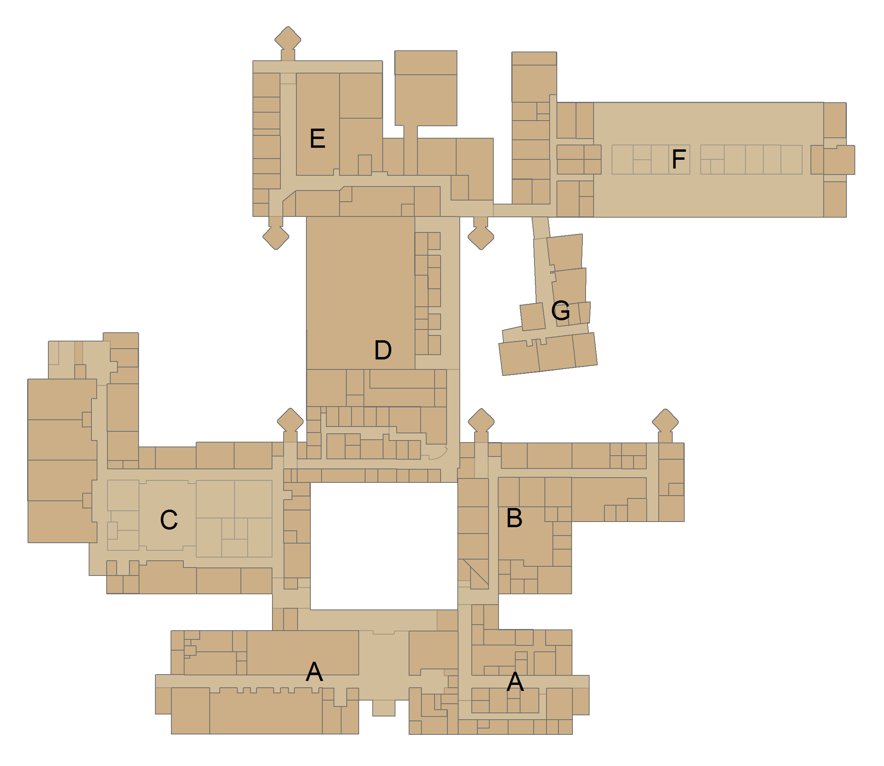
Scope of Problem
Delaware Technical Community College,
Stanton Campus:
No interior maps available
Complex, multi-story split level building
Students and visitors get lost
Faculty/staff volunteers to escort
Primary Goal:
Demonstrate need for navigational assistance
Provide suggested solution
Main Entrance
Notes:
The Stanton campus is a complicated building to navigate.
There aren’t any maps available of the interior of the building.
And students and visitors tend to get lost.
To counter-act that, faculty and staff volunteer to help direct students to their classes during the first week of each semester.
The research completed in this project demonstrates the need for navigational assistance on the Stanton Campus as well as provides a suggested solution.

Slide 4
Design of an Indoor Navigation System
Cartographic Presentation
Positioning
Point Symbol
Building Map
Route
Spatial Data Model
Notes:
Research shows that the design of an indoor navigation system has 3 basic stages:
Design of the cartographic presentation
specifically point symbols,
building map
and routing;
identification and development of the spatial data model
and selection and integration of a positioning system.
The following slides will highlight key points in the research on these steps that helped form this project.

Slide 5
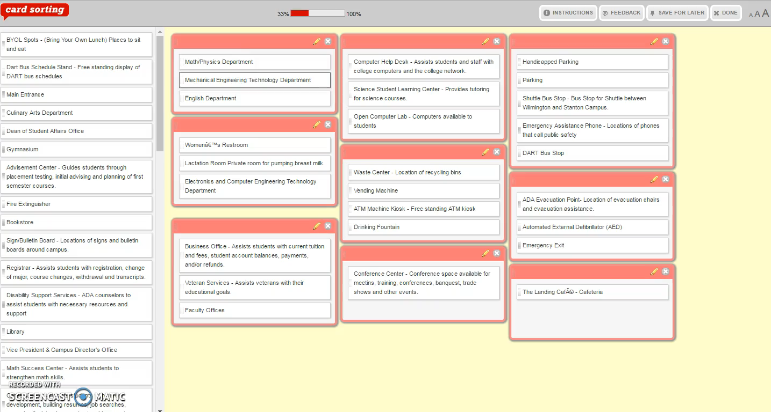
Point Symbol Design
Needs Assessment
Identify Existing Symbols
Group Symbols by Theme
Initial Symbol Design
Evaluate and Revise
Studies Cited:
Robinson, A. C., Roth, R. E., Blanford, J., Pezanowski, S., & MacEachren, A. M. (2012). Developing map symbol standards through an iterative collaboration process. Environment and Planning B: Planning and Design, 39(6), 1034-1048.
Notes:
A study by Robinson and associates suggests that the point symbol design process includes:
a needs assessment,
identifying and evaluating existing symbols,
grouping symbols by theme,
initial symbol design,
symbol evaluation
and symbol design revisions.
The study demonstrated a successful method to collaboratively develop symbol standards with the ultimate users of the symbols.
They used card sorting activities – which you see here
And surveys.
I used the steps outlined in this study as a framework
for the point symbol design stage of this project
and included students in the development of the symbols.

Slide 6
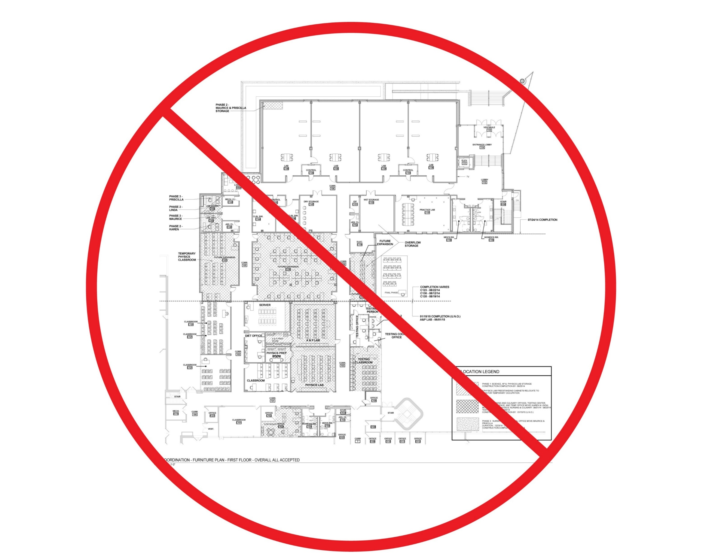
Building Map Design
Simplified Architectural Plan
Schematic Map
Proper Topology>Map Precision
Multi-story?
Studies Cited:
Radoczky, V. (2007). How to design a pedestrian navigation system for indoor and outdoor environments. In G. C. Gartner, Location Based Services and TeleCartography - Lecture Notes in Geoinformation and Cartography (pp. 301-316). Springer Berlin Heidelberg.
Agrawala, M., & Stolte, C. (2000). A Design and Implementation for Effective Computer-Generated Route Maps. Technical Report SS-00-01 (pp. 61-65). Menlo Park: AAAI Press.
Klippel, A., Tappe, H., Kulik, L., & Lee, P. U. (2005). Wayfinding choremes—a language for modeling conceptual route knowledge. Journal of Visual Languages & Computing, 16(4), 311-329.
Notes:
The studies cited state that a simplified architectural plan or a schematic map are preferred over a detailed architectural floor plan for navigation.
And that maintaining proper topology is more important than map precision, as long as distortion is minimized.
The research contains general cartographic recommendations for visualizing simple, one-story buildings.
Lacking in the overall body of research are solid methods for visualizing complex or multi-story buildings.

Slide 7

Route Design
Decision Landmarks
Maintenance Landmarks
More Indoors
Landmarks needed at floor changes
Studies Cited:
Xu, J., Evensmoen, H. R., Lehn, H., Pintzka, C. W., & Håberg, A. K. (2010). Persistent posterior and transient anterior medial temporal lobe activity during navigation. NeuroImage, 52, 1654-1666.
Radoczky, V. (2007). How to design a pedestrian navigation system for indoor and outdoor environments. In G. C. Gartner, Location Based Services and TeleCartography - Lecture Notes in Geoinformation and Cartography (pp. 301-316). Springer Berlin Heidelberg.
Hölscher, C., Meilinger, T., Vrachliotis, G., Brösamle, M., & Knauff, M. (2006). Up the down staircase: Wayfinding strategies in multi-level buildings. Journal of Environmental Psychology, 26, 284-299.
Notes:
Often when we give directions we might say something like
“Pass the big Red House on your right then make a left at the 7-11”.
The Big Red House and 7-11 are landmarks that we store in our own mental map of an area.
The purpose of a map and navigation system is to guide someone to a specific location, but it is also to aid users in developing their own mental map of the area
A study by Xu and associates shows that landmarks are essential to this process.
Decision landmarks are located at critical junctures and turning points, like my 7-11 example.
Where maintenance landmarks are located along routes to assure a user they are still on the correct path, like the Big Red House.
Studies by Radoczky and Holscher show that there is a need
for a higher density of landmarks for indoor navigation
than outdoor navigation,
particularly when changing floors.

Slide 8
Spatial Data Model
Building Interior Spatial Data Model
(BISDM)
Facilities Information Spatial Data Model (FISDM)
Local Government Base Map Model
Campus Routing Data Model Draft
CityGML
(Geography Markup Language)
Notes:
No standard data model currently exists for indoor/outdoor navigation maps.
These are several models that could be used as a foundation.
All of these models provide framework for the interior of buildings, some with more detail than others.
Only the Local government Base Map and CityGML models provide any structure for exterior elements such as parking and walkways.
The ideal spatial model for this project will provide enough detail both interior and exterior to allow routing on other Delaware Tech campuses in which there are multiple buildings.

Slide 9

Positioning
Cellular phone network
WiFi hotspots
Bluetooth beacons
RFID tags
Magnetic fields
Acoustic signals
Accelerometer
Gyroscope
YOU ARE HERE
Commercial Indoor Positioning Systems (IPS):
Meridian
Infsoft
Cartogram
Eyedog
IndoorAtlas
Geometri
Notes:
Indoor positioning systems have the ability to support a
“You Are Here” feature within a building when using
native Android and iOS mobile apps.
IPS systems use a combination of signals as shown on the slide
to identify positions within a building.
There are a variety of commercial IPS systems available that allow upload of floorplan images in their own navigation apps.
Several also offer developer tools to embed their positioning system in custom navigation apps.
All of the IPS systems shown here provide a version of this functionality.

Slide 10
Project Development
Needs Assessment
Point Symbol Design
Building Map Design
Route Design
Spatial Data Model
Positioning
App Development
Testing and Evaluation
Notes:
So now that you are familiar with the research, the following slides will discuss my findings from each of the stages of project development.

Slide 11
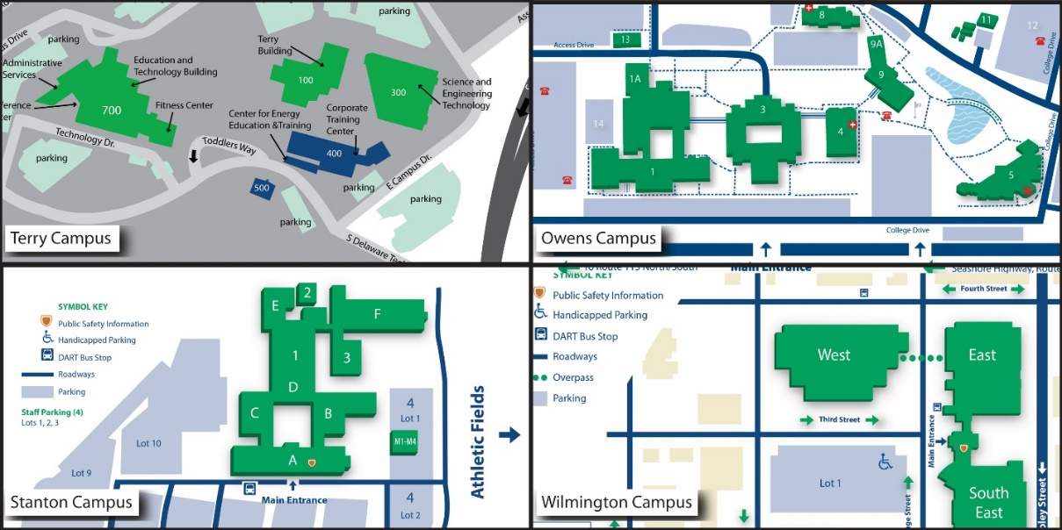
Needs Assessment
Evaluate current college/campus maps
Identify the target audience
Simulate common scenarios
Survey students, faculty and administrators
Comparison of Delaware Tech’s Four Campus Maps (Delaware Technical Community College, 2014c; Delaware Technical Community College, 2014a; Delaware Technical Community College, 2014b; Delaware Technical Community College, 2014d)
Notes:
The needs assessment stage included:
evaluation of current maps collegewide,
identifying students and visitors as the target audience,
simulating common scenarios,
and conducting a survey to identify the needs and desires of the future users.

Slide 12
Needs Assessment
Features ranked in order of importance:
Ability to search for locations of room numbers.
Ability to search for locations of services for students.
“You are here” feature.
Turn-by-turn directions with ADA accessible options.
Vocal turn-by-turn directions.
Ability to save a route.
Ability to print a map.
Distance/Mileage tracking.
Links to department or service webpages.
Identification of evacuation routes by wing, by floor and for ADA Access.
Notes:
There were 196 responses to the survey, 82% of which were students.
They were asked to rank possible app features and tools.
On the left side of this slide are the results.
The top desired feature is the ability to search for locations of room numbers, services for students and a “you are here” feature.
In this same survey, they were also asked to rank school services to be located.
The graphic on the right shows the percent of responses that were ranked highest importance.
The top services are the Open Computer Lab, Emergency Exits and Admissions.

Slide 13
Needs Assessment
196 responses
60% likely or very likely to use the app
70% would not pay for the app
52% iPhone
44% Android phone
VALUABLE
WORTHLESS
HELPFUL
UNHELPFUL
PROBLEM SOLVING
NOT PROBLEM SOLVING
NECESSARY
UNNECESSARY
Notes:
The survey results show that the map app concept is definitely considered
valuable,
helpful,
problem solving
and necessary by a majority of the respondents.
60% of them are likely or very likely to use the app,
but 70% said they would not pay for the app.
Since it is not likely that the app would produce any revenue to offset development costs, I’ve been considering the most economic options during proof-of-concept development.

Slide 14
Symbol Groups
Student and Faculty Services
Registrar
Admissions
Advisement Center
Financial Aid
Business Office
Veteran Services
Career Center
Disability Support Services
Workforce Development
Human Resources
DEMEP
Student Government
Dean’s Offices
Faculty Offices
Access ways
Stairs
Elevator
Main Entrance
Walkways
Personal Needs
Women’s Restroom
Men’s Restroom
Lactation Room
Academic Help Centers
Open Computer Lab
Computer Help Desk
Testing Center
Science Student Learning Center
Math Success Center
Math/Physics Tutoring Center
Writing Center
Campus Features
Library
Bookstore
Gymnasium
Wellness Center
Cafeteria
Conference Center
Classrooms
General Amenities
Vending Machine
Drinking Fountain
Pay Phone
ATM Machine Kiosk
Self Service Kiosk
Waste Center
Sign/Bulletin Board
Digital Signage
Student Community
Study Spots with plugs
Transportation
Shuttle Bus Stop
Study Spots
BYOL Spots
DART Bus Stop
Dart Bus Schedule Stand
Staff Parking
Parking
ADA Parking
Campus Safety
Emergency Exit
ADA Evacuation Point
First Aid Station
Emergency Assistance Phone
Fire Extinguisher
Automated External Defibrillator (AED)
Public Safety Reception
Public Safety Office
Notes:
From the results of the needs assessment, an online card sorting exercise was conducted.
The study participants were Delaware Tech Engineering Technology students who major in Architectural, Civil, or Environmental Engineering Technology or GIS.
This group of students was selected because of their knowledge of mapping.
This first study had 26 student participants who created and named the symbol groups you see scrolling on the slide.
The card sort was conducted with feature name and description only. The outcome of this exercise guided the initial symbol designs

Slide 15
Symbol Design
Designed and Collected from:
  Existing Delaware Tech Maps
  National Parks Service
  Homeland Security
  ANSI
  AIGA Symbol Signs
Organization for International Standardization's ISO 3864:
67% comprehension rate
Notes:
This project focused on creating pictorial symbols for the building features and landmarks necessary for navigation.
In this next stage students ran through a series of online surveys
to determine which symbols were best recognized.
Following ISO standard 3864, the required benchmark is a 67% comprehension rate.
Symbols were either designed or collected
from the existing Delaware Tech maps
and other well known symbol sets,
then modified by color and shape
to fit into their symbol categories.

Slide 16

Symbol Design
Test 1: 62 features tested
  42 symbols > 67% comprehension
Test 2: 20 re-evaluated
  15 symbols > 67% comprehension
5 symbols need to be redesigned
Which symbol best represents Library?
Notes:
In Test 1 there were 62 features tested.
The students were provided 3 different symbol choices for each feature and asked to select the symbol that best represented the feature. 42 symbols were selected.
There were 20 feature symbols that needed to be re-designed and re-evaluated. They were put forth in a second open-ended online test in which students were provided a symbol and asked to “explain what the symbol communicates”. Test 2 produced 15 symbols that were recognized by 78% or more of the students.
There were 5 symbols that clearly need to be re-designed in a future study.

Slide 17

Aliens Attack Students!
Notes:
My favorite of which is this symbol I designed for the science and technology labs, which one student said it communicates: “Aliens Attack Students!”

Slide 18
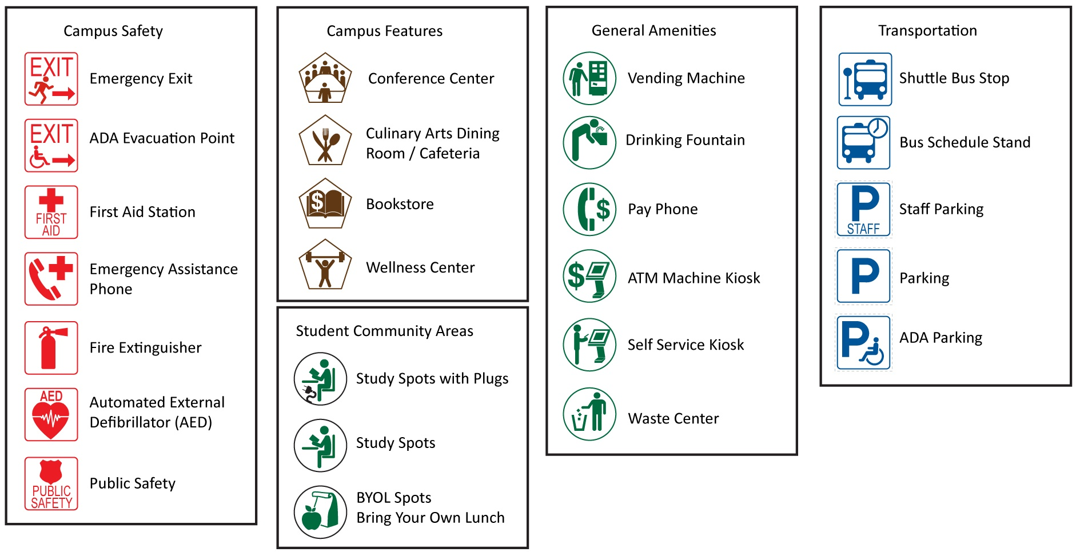
Final Symbol Set
Notes:
The final symbol set was the outcome of a second card sorting exercise in which 30 Engineering Technology students participated.
Only the Career Center and Library symbols were categorized differently.
They were omitted from the final map to be reevaluated and redesigned in the future.
The symbols shown here are a sampling of the final symbols in their groups.

Slide 19
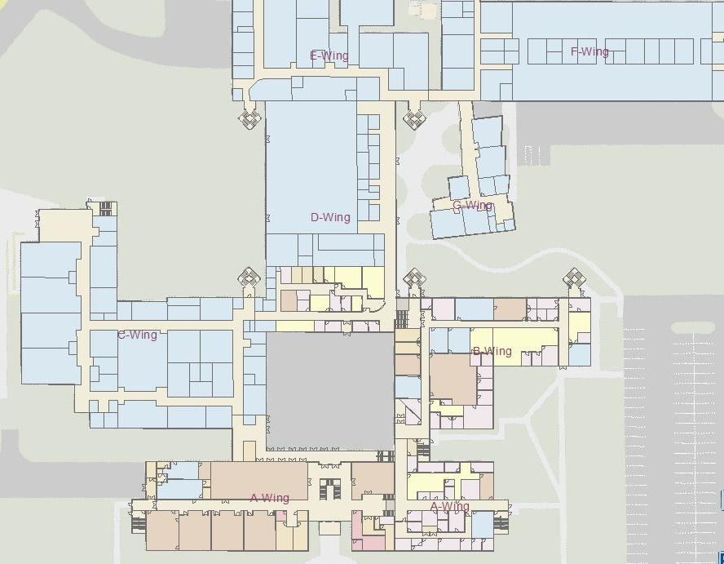
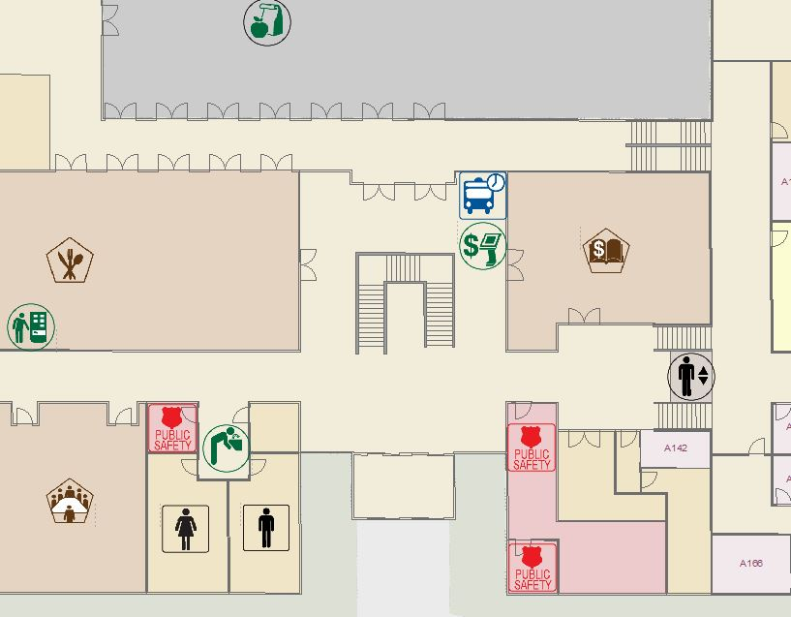
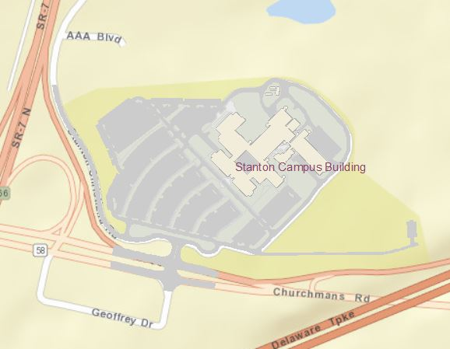
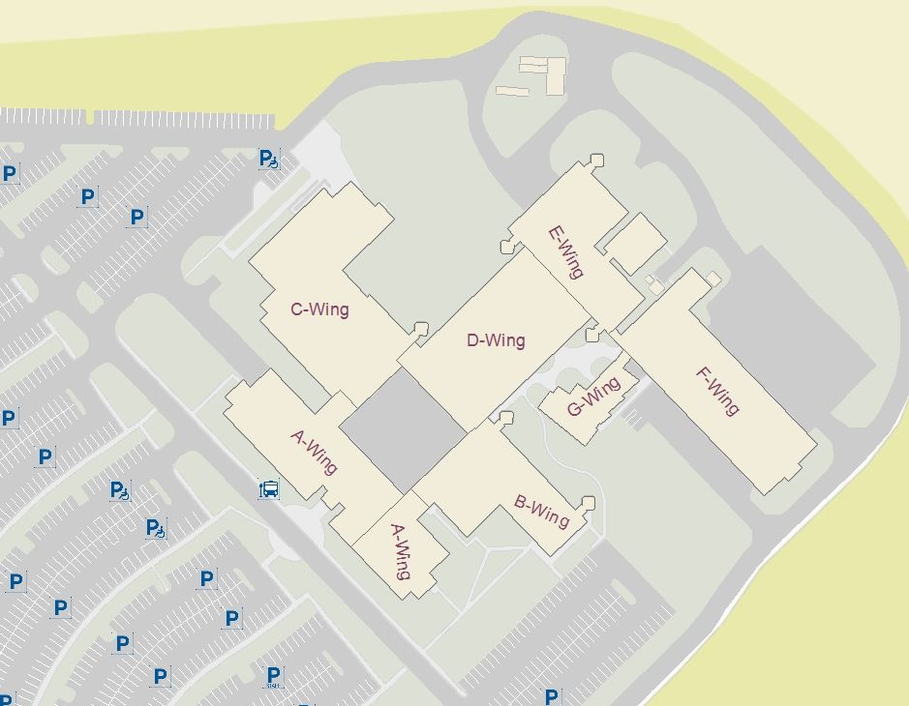
Building Map Design
Notes:
To develop the building maps, I was provided CAD and PDF files of the site and building.
I compiled everything in CAD first and ground truthed the data.
Then I used the Data Interoperability extension in ArcGIS Desktop to import the CAD data.
Based upon the recommendations in the literature review, there were three different maps developed.
This first map is a simplified architectural floor plan displayed in two-dimension.
Rooms were color coded by use category that correlates with the point symbol categories previously created.

Slide 20
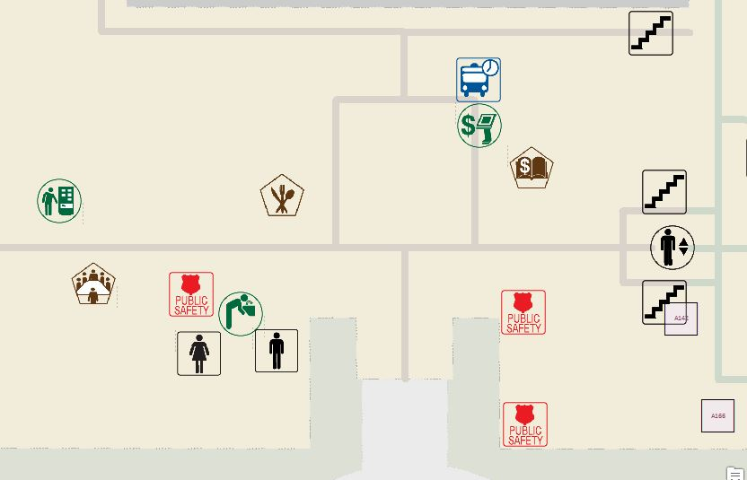
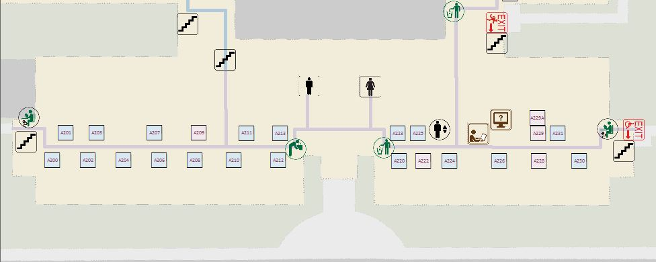
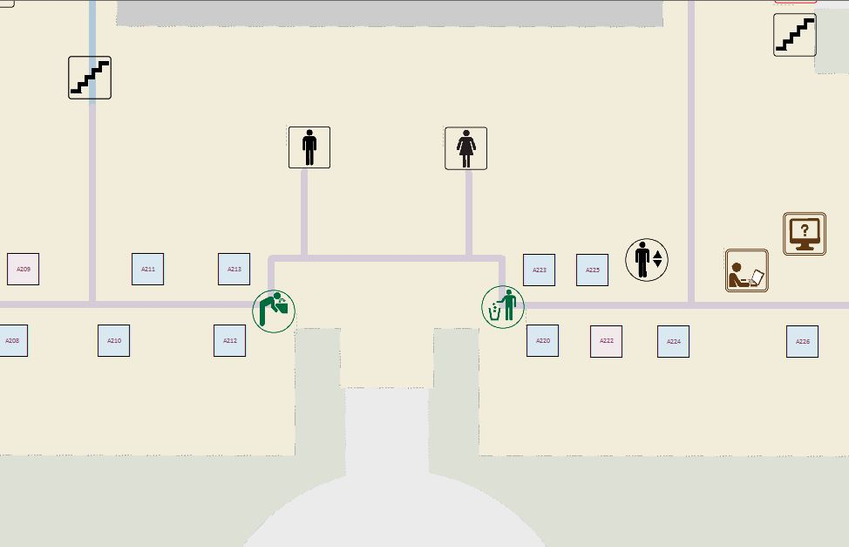
Building Map Design
Notes:
The second map is a more symbolic and abstract map
meant to focus more on the corridors as routes
and less on the classroom structure,
while still maintaining proper topology with minimal distortion.
For this map each of the room symbols were located at their doorway access location along the hallways.
This map is also displayed in two-dimension and follows the same color scheme as Map 1.

Slide 21
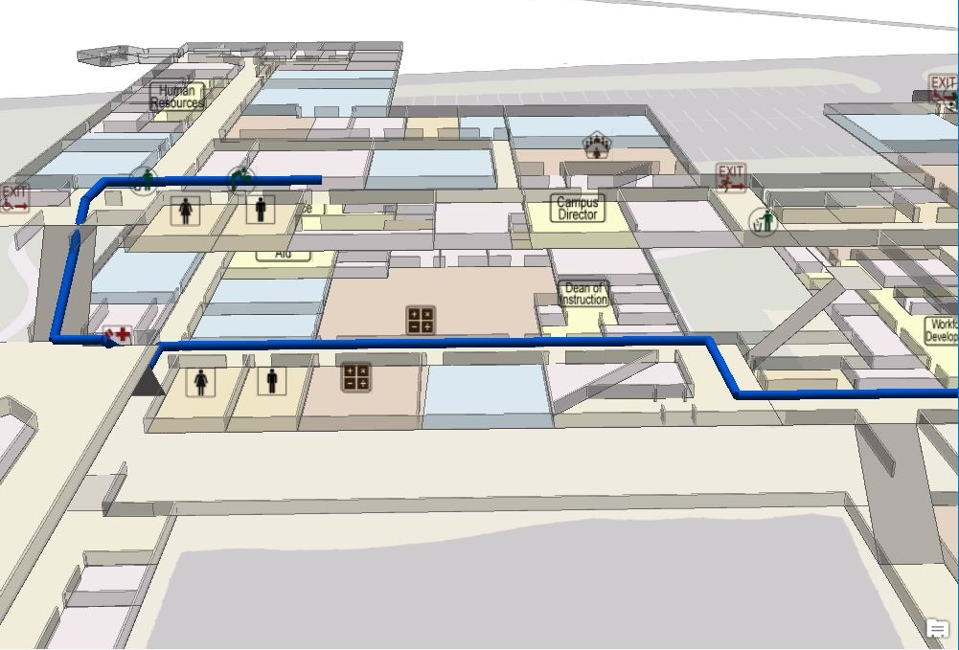
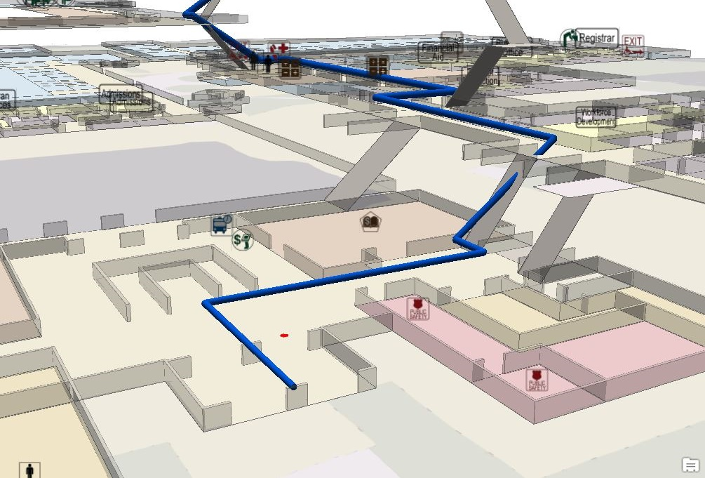
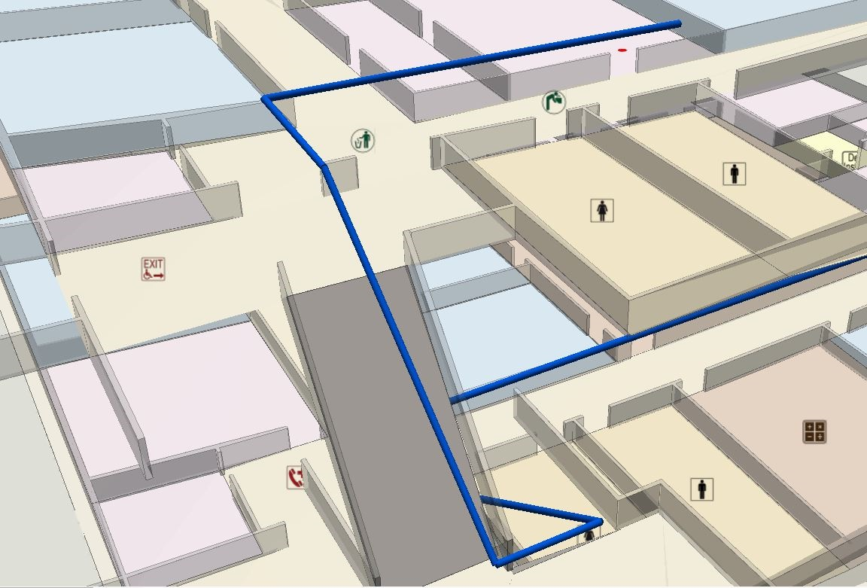
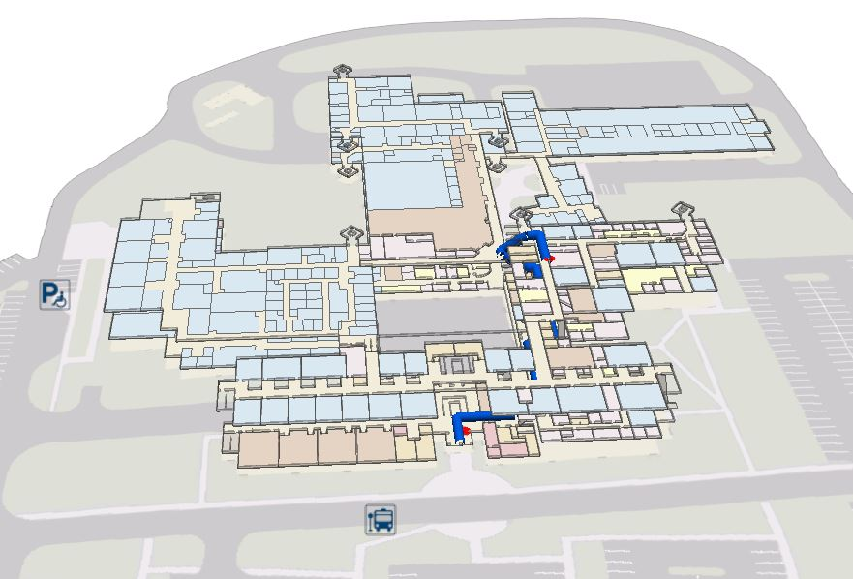
Building Map Design
Notes:
The third map was developed from the same simple architectural plans as Map 1,
but developed into a three-dimensional map.
This map was created using ArcGIS Pro.
The floor elevations are exaggerated by 3 times for clarity when changing levels.
The polygons for the walls are shown using an extrusion.
For simplicity, I elected to leave out door symbols and instead just show a gap in the walls where the room entrance would be.
In these images you can see the blue line showing the 3D routing.

Slide 22

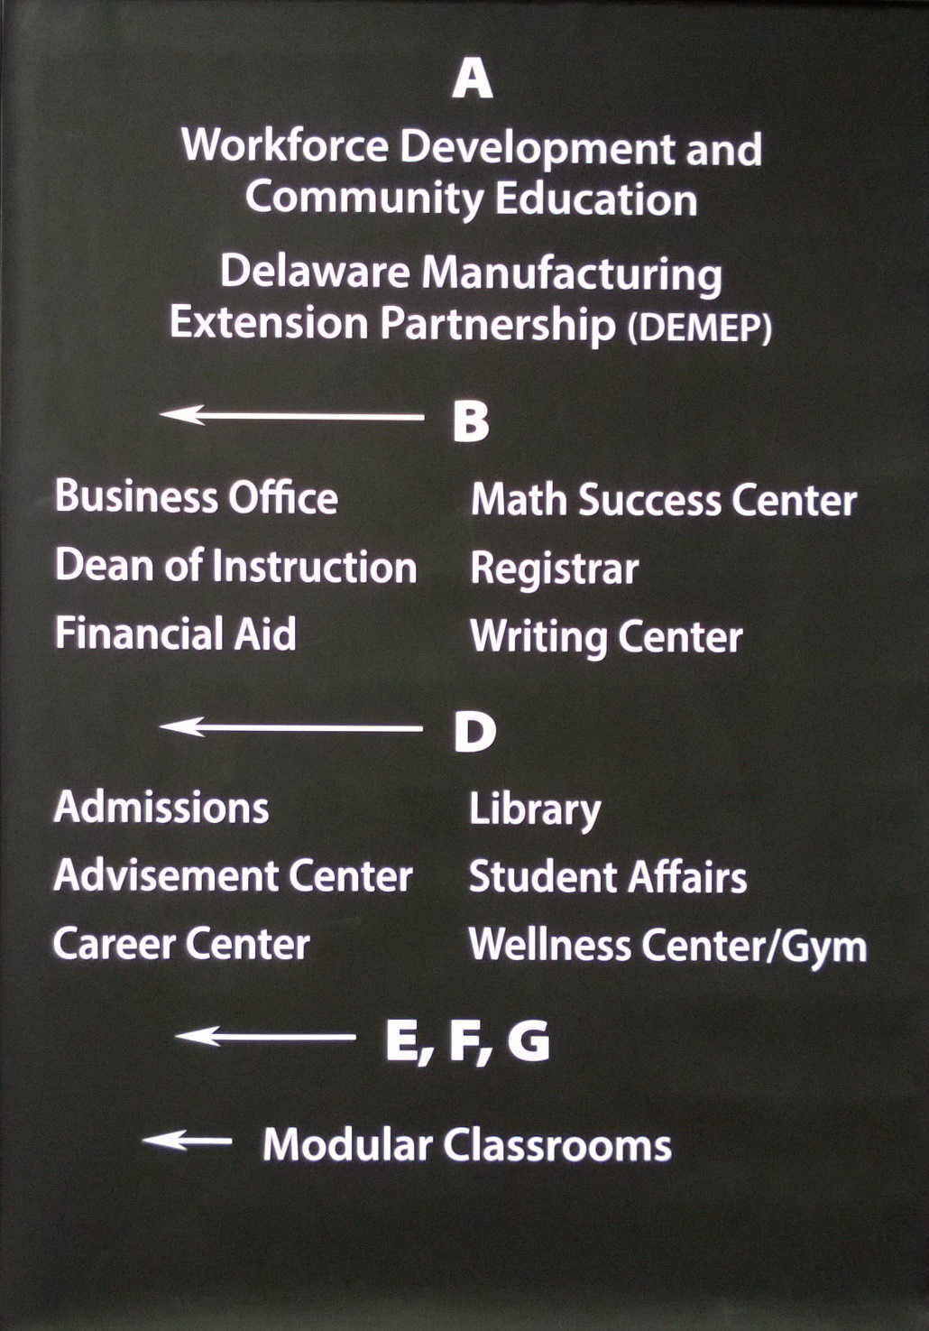
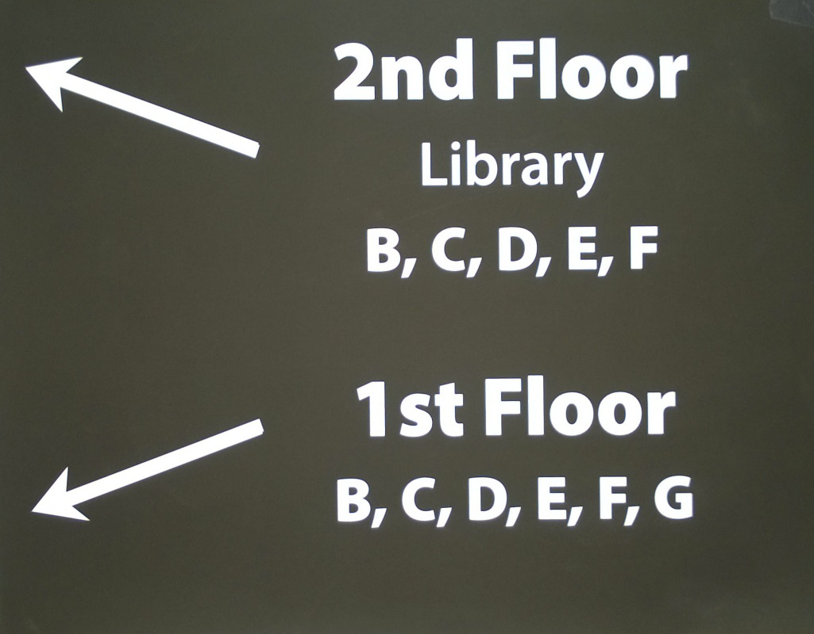
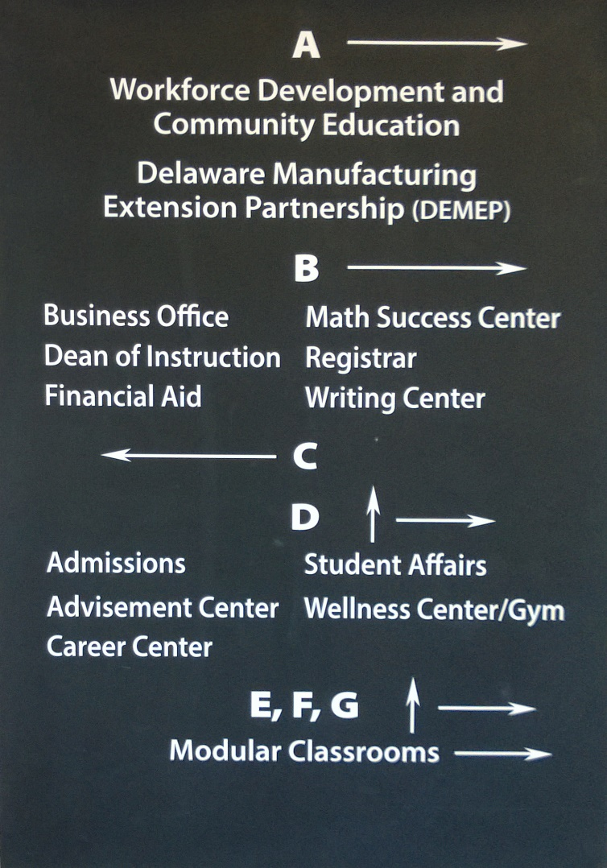

Route Design
Notes:
For the purpose of this proof of concept, a single route was designed.
The route began at the entrance of the school and traveled through the split-level portion of the building to the second floor.
Landmarks were identified at all decision points and at select points along the path for maintenance.
This route also has directional signage at most of the decision points that support the route.

Slide 23
Spatial Data Model
Notes:
In order to map the interior and exterior features with enough detail and flexibility to suit the needs of all our campuses
I used the “Buildings” feature dataset
from the Building Interior Spatial Data Model for interior features
and the “Facilities/Streets” dataset from the
Local Government Base Map Model
for exterior features.
I also added a Landmarks feature class to aid in navigation.
And a topology to ensure data accuracy.
Routing was developed in a separate geodatabase modeled after the Draft Campus Routing Data Model.

Slide 24
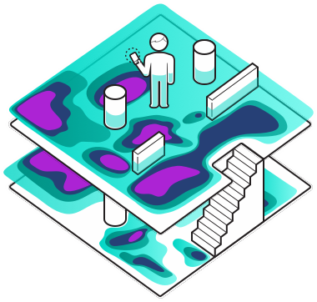
Positioning
IndoorAtlas
Wi-Fi and Magnetic Field mapping
Needs consistent internet connection
IndoorAtlas, Geomagnetic Fields, Retrieved from https://www.indooratlas.com/
Notes:
For proof of concept development,
Indoor Atlas provided the best value
and required the least amount of infrastructure.
Their technology uses a combination of wi-fi and magnetic field variations for positioning.
Due to inconsistent internet access in areas of the college,
The system identified my location incorrectly a number of times.
The school will need to invest in more Wi-Fi hotspots to allow for positioning to work.
Because of this, I opted to develop an app that did not include positioning.
I decided it was better to have users test the app by just following a route with turn-by-turn instructions rather than have the user be informed that they are in the wrong location.

Slide 25
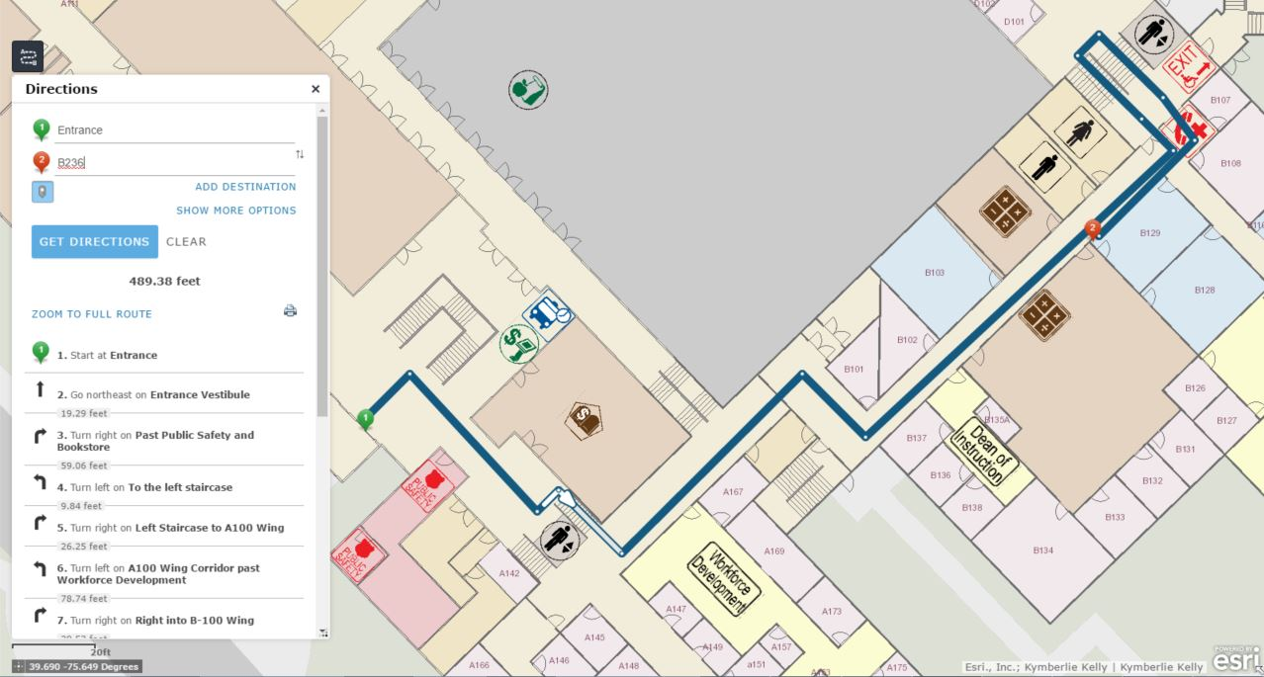
App Development
Map 1
Notes:
Since it was determined that positioning was not going to work and I was struggling with Android App development, I opted to work with Web AppBuilder for ArcGIS v 1.3 and create web apps that will load on any device with internet access. Map 1 and Map 2 were easily created and customized with a geocoding service to locate the classrooms within the building and a routing service to provide turn-by-turn instructions.

Slide 26
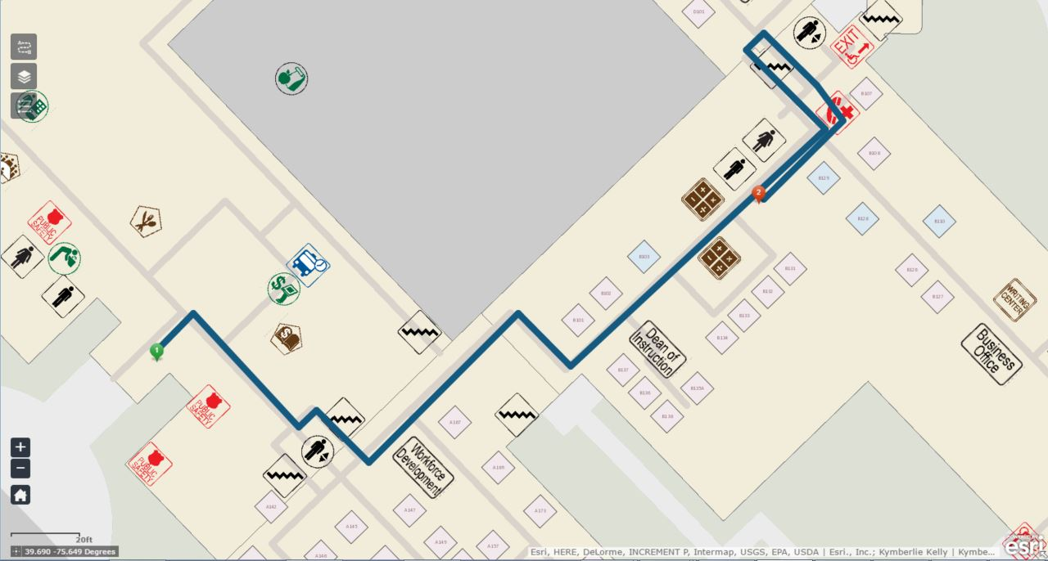
App Development
Map 2
Notes:
All services are hosted with ArcGIS for Server 10.3.1 on Amazon Web Services.

Slide 27
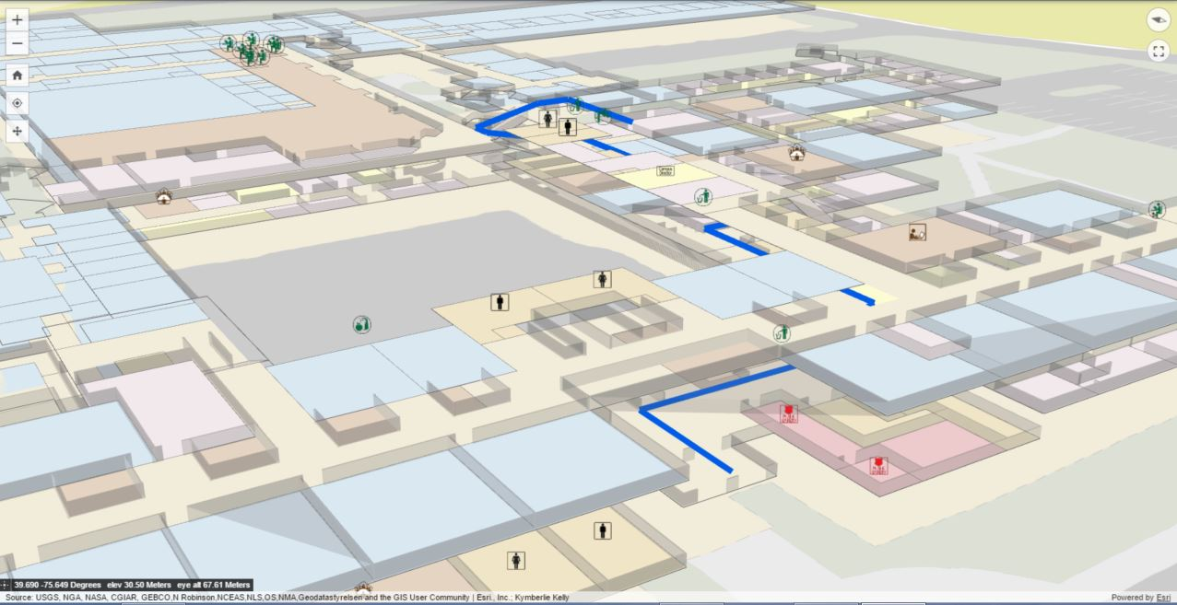
App Development
Map 3
Notes:
Map 3 proved to be much more challenging.
I used the BETA version of Web AppBuilder (Developer Edition) V2.0,
which actually just came out of BETA on March 31^{st.}.
The 3D visualization was exported from ArcGIS Pro as a web scene to ArcGIS Online and integrated in a 3D web app without routing capability.
The app loads with some minor visual issues on most web browsers,
but when loaded on a mobile device the image appears but navigating the map is close to impossible.
Tested on an iOS device as well as an Android device with no luck.

Slide 28
Testing and Evaluation
 | MAP 1 | MAP 2
Average Route Time | 4:29 | 3:59
Ave. Time to Begin Walking | 15 seconds | 13 seconds
Total Veer off Course | 3 | 5
Veer at Beginning | 0 | 1
Veer at Top of Stairs (A) | 3 | 2
Veer at Top of Stairs (B) | 0 | 2
Notes:
Using map apps 1 and 2 the route was tested by a total of 14 study participants. Participants consisted of 6 students who have been at the school for more than a year and presumably know their way around the school. The second group of participants were students and visitors who are new to the school, most of the participants have never been in the building before and therefore have little knowledge of how to navigate the complex split-level school building. The participants wore a head mounted camera to record their activity. The videos were then observed as they followed the route on the app for moments of uncertainty and for veering off the route. Times were recorded from start of navigation to finish, and the participants were interviewed after for their thoughts.
With only 14 participants, the quantitative data collected is not really statistically valid, but I do find it interesting that the average time to complete the route only differs by 30 seconds. Although participants using Map 1 took longer, they veered off course less, a total of 3 times with Map1 and 5 times with Map2. These differenced are fairly insignificant with the small sample set, what I find more telling is that a majority of participants veered off course at the top of the first flight of stairs using either map. This spot seems to be the most confusing along the route but has the best signage at that decision point.
From their interviews, a majority of the participants found the map easy to use. 9 of the participants mentioned confusion at the stairs and requested better visualization of the stairs. When asked to suggest improvements, 8 of the participants requested a you are here feature so the map would show where you are walking along the route.

Slide 29
Conclusion
Limited number of participants for final map testing.
More testing when 3D mobile functionality improves.
7 symbols need re-design and re-evaluation.
Additional testing of IndoorAtlas newest version.
Additional studies on changing floors.
Notes:
Testing of the app at the end was limited by the ability to get participants into the building when it wasn’t heavily populated.
Hearing the feedback from the participants about the confusion at each of the stairs, I still believe a 3D map app will reduce that confusion significantly. With the ability to develop 3D web maps just recently becoming available, it is likely this function will soon be available on a mobile device. At that point, the comparison of the different visualizations should be studied further.
If the college elects to implement this GIS system there are 7 symbols that will need to be re-designed and re-evaluated. Additionally, with the release of a newer version of Indoor Atlas’s positioning system, additional tests should be completed to determine if this is a viable option for positioning on campus.
Overall, both visualizations of map 1 and map 2 demonstrate the ability of a visitor with no knowledge of the school to be able to find their way by following the route in the application. Additional studies on best way to communicate floor changes and how to limit disorientation after changing floors would be helpful to strengthen the growing number of indoor navigation applications being developed.

Slide 30
Thank You!
Questions?
Kym Kelly
kkelly10@dtcc.edu

