Slide 1
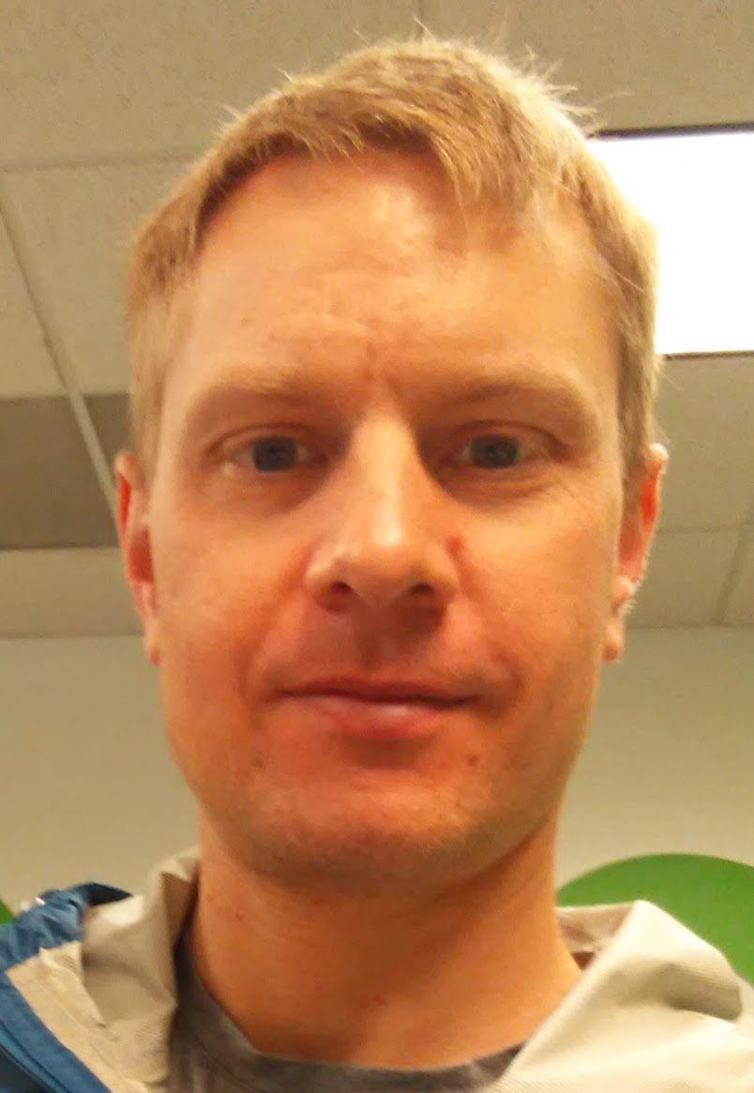
A Spatial Analysis of Supermarket Accessibility In Fairfax County, Virginia Using General Transit Feed Specification (GTFS) Data
Ryan Kemna
July 16, 2021
Advisor: Dr. Karl Zimmerer

Slide 2
Food access and food deserts
Transport accessibility and GTFS
Overview of Fairfax County, VA
Project Details

Slide 4
USDA food deserts
The US Department of Agriculture considers a census tract to be a food desert if it is low income (poverty rate greater than or equal to 20% or median family income at 80% or lower of the area median family income) and at least one-third of tract residents live more than 1 mile away (or 10 miles away in the case of rural areas) from a supermarket or large grocery store.
USDA identifies 6,529 tracts that meet the definition of “food desert”
There were about 74,000 tracts in the US in the 2010 Census
sources: https://www.ers.usda.gov/webdocs/publications/45014/30940_err140.pdf, http://apps.ams.usda.gov/fooddeserts/foodDeserts.aspx

Slide 5
Source: USDA, https://www.ers.usda.gov/data-products/food-access-research-atlas/go-to-the-atlas.aspx

Slide 6
1) Data on improved health outcomes when supermarkets are opened in food deserts is inconclusive.
“One study examined the effect of a new supermarket in a Philadelphia food desert. After opening, just over half of the residents of the neighborhood with the new supermarket used the supermarket for shopping; about a quarter of the residents used it as their primary source for food shopping. When compared to residents of a control neighborhood that was also a food desert, the new supermarket was associated with a perception of improved food access among residents in that neighborhood, but it was not associated with any improvements in fruit/vegetable intake or changes in BMI.”
2) People may not shop within their own neighborhoods even when a supermarket is present.
“In one study in France, only 30% of participants shopped for food at the supermarket closest to their home.”
Source: “Moving Beyond ‘Food Deserts’: Reorienting United States Policies to Reduce Disparities in Diet Quality”, (Block and Subramanian, 2015)
----------------------------------------------------------------------------------------------------------------
“While academic and policy research often defines access to food stores using simple Euclidean distance or road network metrics, dense urban areas with large public transit systems call for more sophisticated methods of determining access” (Farber et al., 2014)

Slide 7
Food access and food deserts
Transport accessibility and GTFS
Overview of Fairfax County, VA
Project Details

Slide 8
Literature Review
Accessibility is “the opportunity which an individual or type of person at a given location possesses to take part in a particular activity or set of activities” (Hansen,1959)
Activities:
Places of employment, health care facilities, supermarkets
Areas of analysis:
Network analysis by aggregation unit and overlay demographic data
Time-of-day analysis (Farber et al., 2014)
Transit fare comparison (El-Geneidy et al., 2016)

Slide 9
General Transit feed specification
GTFS started as Google Transit Feed Specification in 2005
Changed to General Transit Feed Specification in 2010
It’s a data specification that is used by 400+ cities worldwide
Can be used with Ersi Network Analyst to model transit trips
Used by companies and organizations for trip planning, ridesharing, measuring accessibility
It’s a series of text files

Slide 10
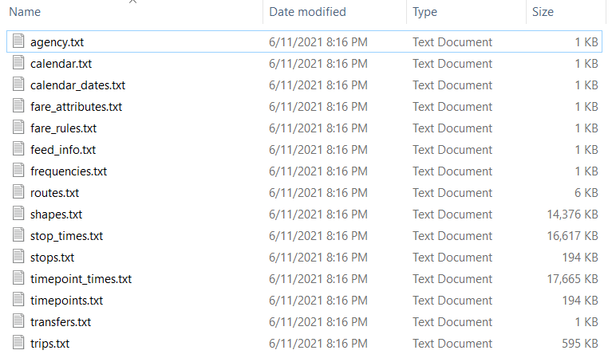

Slide 11
Food access and food deserts
Transport accessibility and GTFS
Overview of Fairfax County, VA
Project Details

Slide 13
Fairfax County: Who Rides the Bus?
County population: 1,147,532
Daily bus riders (weekday) –
Fairfax Connector: 27,782
Metrobus (in Northern Virginia): 54,914 (includes all NoVa, not just FFX County)
82,696/1,147,532 = 7.2% of the population rides the bus on a typical day
Sources: American Community Survey 1-year estimates, novatransit.org, 2019 data

Slide 14
Fairfax County: Who Rides the Bus?
2.2% of households in Fairfax County didn’t own a car in 2018
21.7% owned 3 cars
By comparison, in Washington DC:
37.2% of households didn’t own a car in 2016
DC trails only NYC metro area in no-vehicle households (NYC, Newark, Jersey City)
The geographic distribution of car ownership isn’t equal.
Though county-wide only 2.2% of households don’t own a vehicle, by census tract the percentage varies from 0% to 10%
Sources: ACS 1-year estimates, ACS table DP04, Selected Housing Characteristics, https://www.governing.com/archive/car-ownership-numbers-of-vehicles-by-city-map.html

Slide 15
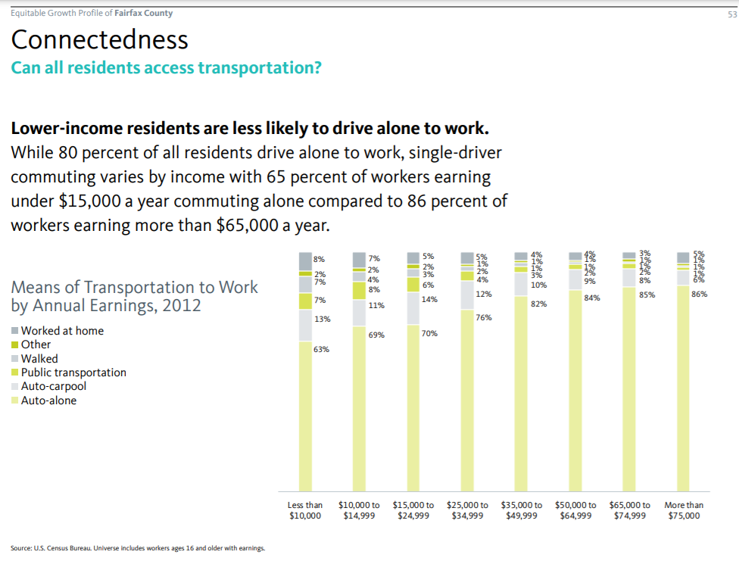
Source: National Equity Atlas,
https://nationalequityatlas.org/sites/default/files/Fairfax-Profile-6June2015-final.pdf

Slide 16
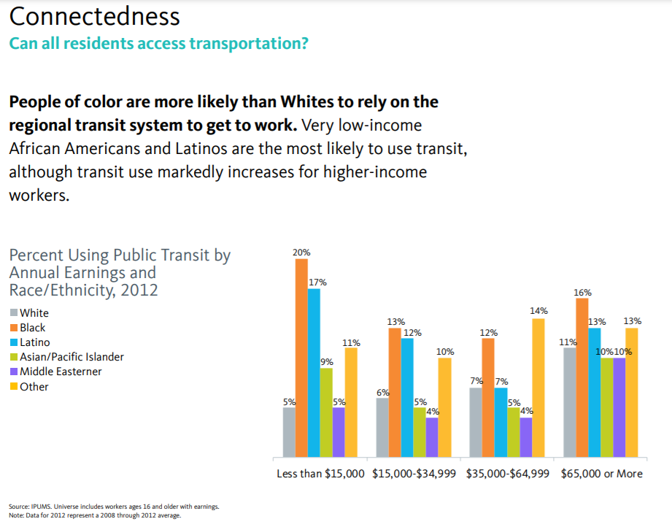
Source: National Equity Atlas,
https://nationalequityatlas.org/sites/default/files/Fairfax-Profile-6June2015-final.pdf

Slide 17
To be eligible for TOPS, you must be a resident of Fairfax County or the City of Fairfax, plus meet one of the following criteria:
Fifty years of age or older, with an annual income of $50,000 or less per household.
Registered user of MetroAccess.
Recipient of Supplemental Security Income (SSI) or Social Security Disability Insurance (SSDI).
Annual income that meets the 225% federal poverty levels by household size.
Program participants are eligible for two subsidies per year (one every six months). Each subsidy will provide $100 in benefits at a cost to the participant of $20. These subsidies may be used for an expanded menu of transportation options that includes taxicabs, rideshare services (Uber and Lyft), public transportation via SmarTrip card (bus and rail), and Capital BikeShare rentals.

Slide 18
Food access and food deserts
Transport accessibility and GTFS
Overview of Fairfax County, VA
Project Details

Slide 19
Goals and objectives
Are there areas of Fairfax County where it’s more difficult to access a grocery store using public transit?
Quantify access by Census block group using demographic variables
Examine differences in access to individual supermarkets or “classes” of supermarkets
Compare network analysis between datasets – Fairfax County GIS and OpenStreetMap

Slide 20
Methods
Create a Network dataset from street data and GTFS data
Use census block group as start point and geocoded supermarket as end point to measure transit trip (O-D cost matrix analysis or closest facility for trip length, Service Area analysis to determine area reachable within a defined time)
Python script to run analysis for each census block group in Fairfax County (~700 block groups)

Slide 22
ProjecT data
Geocoded supermarket locations
Google maps or
Orbis business directory
Census data
Block group boundaries (create centroids)
Demographic data from American Community Survey (ACS) – i.e. household income, car ownership
Street centerlines
Fairfax County GIS
OpenStreetMap (OSM)
GTFS data
WMATA
Fairfax Connector

Slide 23
Expected results
Lower-income census block groups will have better access to grocery stores than higher income block groups.
Access will decrease as the size of the store increases.
There will be better access for OpenStreetMap routes since the OSM database contains more paths in the vicinity of supermarkets.

Slide 24
Timeline/presentation venue
Timeline:
August: Incorporate peer feedback, access data
Late August/September: Build network datasets, create Python script and run models
October: Analyze results using demographic data, resolve issues
November: Finish final paper, attend conference
Presentation Venue:
Central Pennsylvania GIS Day Conference, which will be held on November 17, 2021 at Harrisburg University in Harrisburg, PA

Slide 25
references
Antrim, Aaron, and Sean J. Barbeau. “THE MANY USES OF GTFS DATA – OPENING THE DOOR TO TRANSIT AND MULTIMODAL APPLICATIONS,” 2013. http://www.locationaware.usf.edu/wp-content/uploads/2010/02/The-Many-Uses-of-GTFS-Data-%E2%80%93-ITS-America-submission-abbreviated.pdf.
Boarnet, Marlon G., Genevieve Giuliano, Yuting Hou, and Eun Jin Shin. “First/Last Mile Transit Access as an Equity Planning Issue.” Transportation Research Part A: Policy and Practice 103 (September 2017): 296–310. https://doi.org/10.1016/j.tra.2017.06.011.
El-Geneidy, Ahmed, David Levinson, Ehab Diab, Genevieve Boisjoly, David Verbich, and Charis Loong. “The Cost of Equity: Assessing Transit Accessibility and Social Disparity Using Total Travel Cost.” Transportation Research Part A: Policy and Practice 91 (September 2016): 302–16. https://doi.org/10.1016/j.tra.2016.07.003.
“Fairfax Connector.” Accessed June 11, 2021. https://www.fairfaxcounty.gov/connector/.
Farber, Steven, Melinda Z. Morang, and Michael J. Widener. “Temporal Variability in Transit-Based Accessibility to Supermarkets.” Applied Geography 53 (September 2014): 149–59. https://doi.org/10.1016/j.apgeog.2014.06.012.
Fransen, Koos, Tijs Neutens, Steven Farber, Philippe De Maeyer, Greet Deruyter, and Frank Witlox. “Identifying Public Transport Gaps Using Time-Dependent Accessibility Levels.” Journal of Transport Geography 48 (October 2015): 176–87. https://doi.org/10.1016/j.jtrangeo.2015.09.008.
“Metro Snapshop Fact Sheet 2019.” Accessed June 11, 2021. https://www.wmata.com/about/upload/2019-Metro-Snapshot-Fact-Sheet.pdf.
Swayne, Madison R.E., and Bryce C. Lowery. “Integrating Transit Data and Travel Time into Food Security Analysis: A Case Study of San Diego, California.” Applied Geography 131 (June 2021): 102461. https://doi.org/10.1016/j.apgeog.2021.102461.
Widener, Michael J. “Comparing Measures of Accessibility to Urban Supermarkets for Transit and Auto Users.” The Professional Geographer 69, no. 3 (July 3, 2017): 362–71. https://doi.org/10.1080/00330124.2016.1237293.
Widener, Michael J., Leia Minaker, Steven Farber, Jeff Allen, Brigitte Vitali, Paul C. Coleman, and Brian Cook. “How Do Changes in the Daily Food and Transportation Environments Affect Grocery Store Accessibility?” Applied Geography 83 (June 2017): 46–62. https://doi.org/10.1016/j.apgeog.2017.03.018.

Slide 26
Contact
Ryan Kemna
rfk5296@psu.edu

