Slide 1
Using GIS to Inventory and Characterize Horizontal Curvature

Slide 2

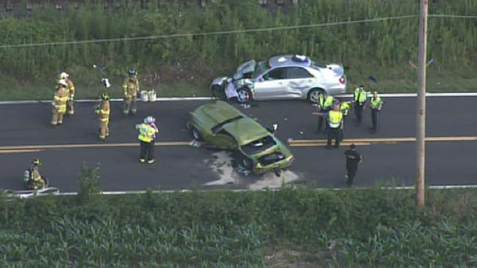
Overview
Improving highway safety is a priority for all state transportation departments.
Key roadway characteristics can be used to identify sections which would most benefit from safety improvements.
Roadway curvature is an important roadway characteristic for predicting highway safety.

Slide 3
Objective
To develop a tool which can automate the identification and characterization of horizontal curves in a roadway network from its centerline data.

Slide 4
Background
Roadway Curvature
PA Highway Safety
The Highway Safety Manual

Slide 5
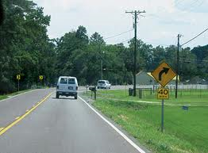
Roadway Curvature
Curves are roadway features that serve as transitions between straight sections of roadway.
There are two distinct types of roadway curves:
  Vertical Curves
  Horizontal Curves

Slide 6
Vertical Curves

Slide 7
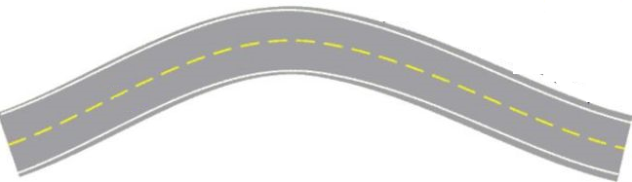
Horizontal Curves

Slide 8
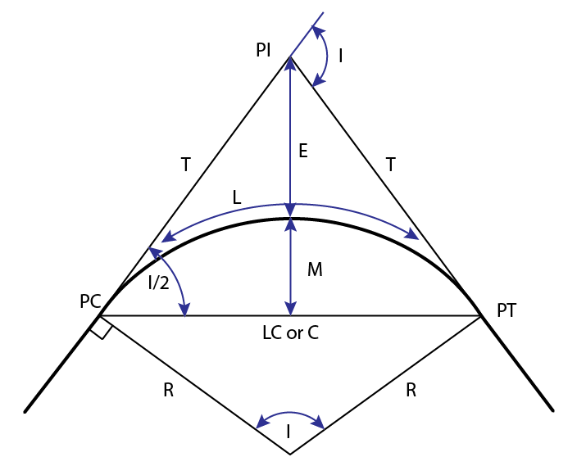
Characterizing Horizontal Curves

Slide 9
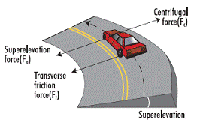
Super Elevation

Slide 10
PA Highway Statistics (2013)
120,000 miles of total roadway
40,000 miles of roadway owned by the state
124,149 reportable traffic crashes
1208 fatalities
83,089 injuries
99.5 billion vehicle miles traveled
1.21 deaths per hundred million vehicle miles
Source: PennDOT (2013)

Slide 11
State Owned Roadway Miles
Only Texas, North Carolina and Virginia have substantially more miles of state owned roadway than Pennsylvania.
Source: USDOT Federal Highway Administration (2012)

Slide 12
Making Our Roads Safer
DOTs have a limited budget for safety improvements.
The better the most dangerous sections of roadway can be identified, the more effectively available funding can be used to improve highway safety.
Two general approaches
  Look at crash data
  Look at roadway characteristics

Slide 13

Using Roadway Characteristics in Highway Safety
Highway Safety Manual (HSM) – Published by AASHTO (American Association of State Highway & Transportation Officials)
Presents methods of estimating expected crash rates from roadway characteristics, crash data and traffic volume.
These methods can be used to:
  Screen the roadway network
  Estimate the impacts of roadway improvements
  Evaluate alternatives during roadway design.

Slide 14
Some Key Highway Safety Terms
SPF – Safety Performance Function
(crash prediction models)
CMF – Crash Modification Factor
Also known as an Accident Modification Factor (AMF)
N_{predicted} = N_{spf} x (CMF_{1x} x CMF_{2x} x … x CMF_{yz}) x C_{x}
Counter Measure – A safety improvement designed to reduce crash rates

Slide 15
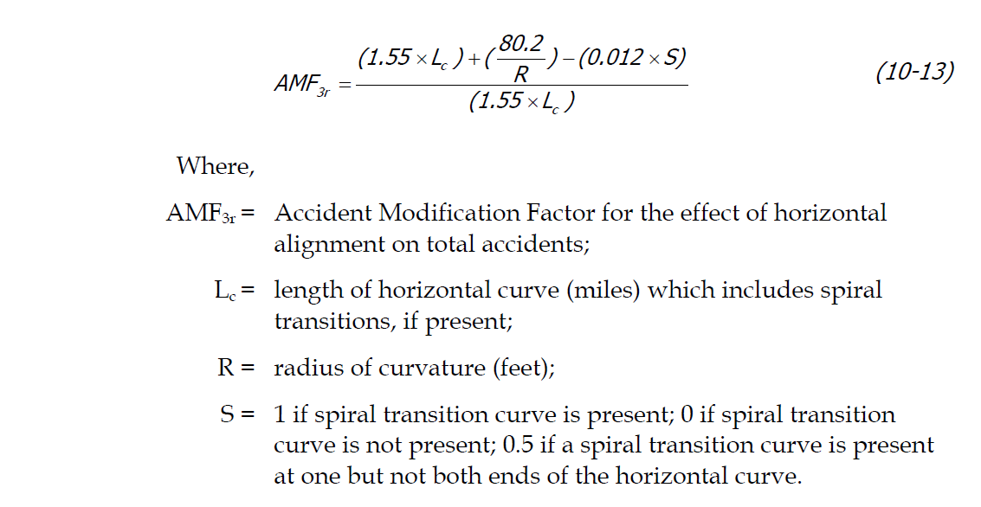
AMF for Horizontal Curve
Source: Highway Safety Manual (2010)

Slide 16
Existing Horizontal Curve Data
The HSM provides a model for using horizontal curvature to better screen a roadway network.
However, DOTs generally lack an inventory of characterized horizontal curves on there roadway networks.
  Information on horizontal curvature and other roadway characteristics often does not exist and when it does exist is generally buried in highway design documents and is not readily available for use by safety engineers.

Slide 17
Methodology
A tool will be developed in ArcGIS using Python.
The tool will step through the vertices of roadway features and:
  Create a spatial inventory of horizontal curves
  Determine the radius and length of each curve
LRS Key Start | LRS Key End | Length (miles) | Radius (feet)
01001504701500 | 01001504800250 | 0.4216 | 102
01001504900073 | 01001504901248 | 0.2233 | 89
(X₃, Y₃)
(X₁, Y₁)
(X₂, Y₂)
LRS Key - CCRRRRSSSSOOOO

Slide 18
Data Sources
Roadway Centerline Data – PennDOT Bureau of Planning and Research
Crash Data – PennDOT Bureau of Maintenance and Operations
Manually determined horizontal curves on rural two lane roads – PSU Professor Eric Donnelly
Roadway Design Documents – PennDOT Engineering District Offices

Slide 19
Other Efforts
ESRI – Curve Calculator
FDOT – Curve Extension
NHDOT - Curve Finder
Dr. Jeffery Dickey – LSU
  Developed an Excel based tool that characterizes horizontal curvature
Dr. Eric Donnell – PSU
  Examined 10,000 miles of rural roadway in PA and manually characterized horizontal curvature

Slide 20
Validation of Approach
Manually determined horizontal curve data will be used to examine the validity of the approach.
The algorithms in the tool will incorporate parameters which can be adjusted to bring the results of the model into agreement with the manually determined curve data.
Process Data
Validate Results
Refine Approach

Slide 21
Timeline (2015)
Assemble
Data
Validate and Refine Tool
Submit Paper
&
Present at Conference
Jan
Feb
Mar
Apr
May
Jun
Jul
Aug
Sep
Oct
Nov
Dec
Develop
Tool
Author Paper
&
Prep for Conference

Slide 22



Publications & Conferences
Potential Journals
  SAE International Journal of Transportation Safety
  Journal of Transportation Safety and Security
  Journal of Transportation Planning and Technology
  URISA Journal
Potential Conferences
  Transportation Engineering and Safety Conference (December 2015 in State College PA)

Slide 23
Automating Grade Determination Along a Road Network
Grade is also an important roadway characteristic.
LiDAR (light detection and ranging) data will be used with PA highway centerline data to associate elevation data with the roadway network at regular intervals.
The elevation data will be used to calculate grade.

Slide 24
Acknowledgements
Beth King (PSU)
Eric Donnell (PSU)
Gary Modi (PennDOT)

Slide 25
References
Federal Highway Administration (2014). “Highway Performance Monitoring System Field Manual”
American Association of State Highway and Transportation Officials (AASHTO) (2009). “Highway Safety Manual”
Donnell, E. (2013). “Safety Performance Functions for Two-Lane Rural Highways and Intersections in Pennsylvania”, Presentation at the December 2013 Transportation Engineering and Conference, State College PA
Federal Highway Administration, (2012). “Highway Statistics”
Pennsylvania Department of Transportation (2013). “Crash Facts and Statistics”
Khattak, A. and Shamayleh, H. (2005). ”Highway Safety Assessment through Geographic Information System-Based Data Visualization.” J. Comput. Civ. Eng., 19(4), 407–411
Rasdorf, W., Findley, D., Zegeer, C., Sundstrom, C., Hummer, J. (2012). “Evaluation of GIS Applications for Horizontal Curve Data Collection”, J. Comput. Civ. Eng. 2012.26:191-203.

Slide 26
Questions
or
Comments?

