Slide 1
Building Spatial Search Capabilities for the Omaha District Geospatial Data Catalog
Mary LaMagna Reiter
GIS Analyst, Contractor GEOG 596A

Slide 2
Brief Overview of the Data Catalog
The Omaha District Geospatial Data Catalog will provide an interactive, web-based GIS data catalog used to search the vast amounts of data housed by the US Army Corps of Engineers (USACE) Omaha District’s GIS Service Center (GSC).
It will also serve as a communication tool between project managers, supervisors, GIS users, and the GSC.

Slide 3
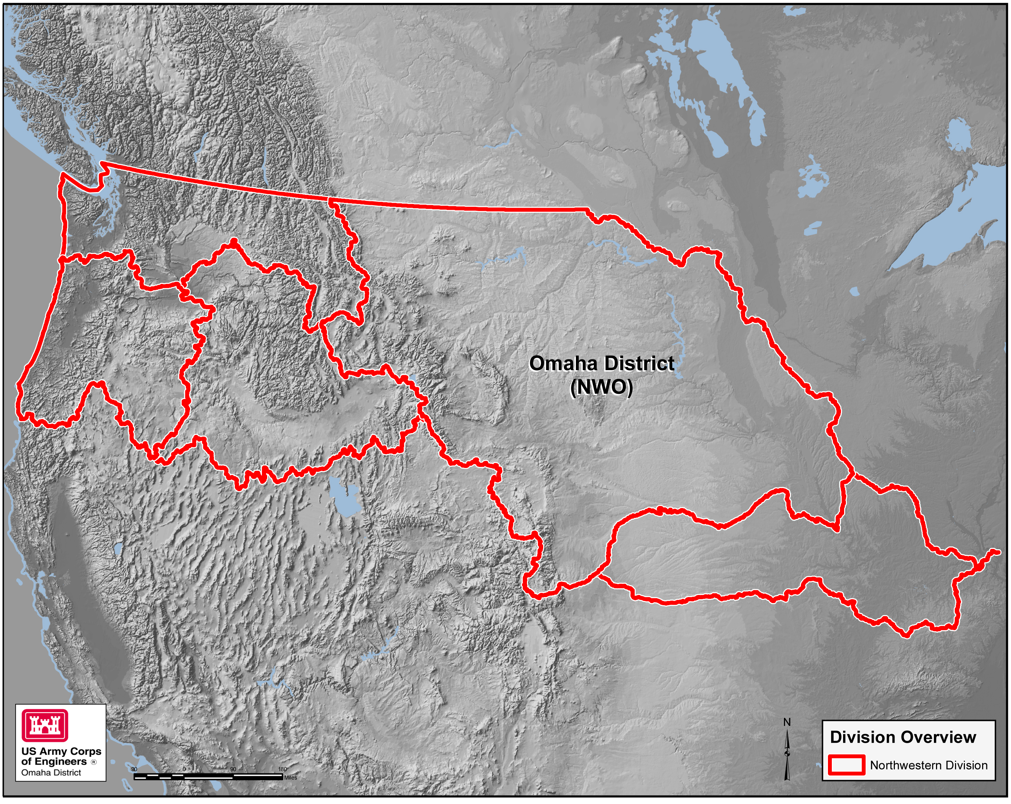
Overview of the Omaha District
The Omaha District is one of five districts within the USACE’s Northwestern Division.
Commonly referred to as NWO (Northwestern Division – Omaha), the Omaha District serves Civil, Military, and Regulatory missions covering an area of 700,000 square miles (US Army Corps of Engineers [USACE], 2011).

Slide 4
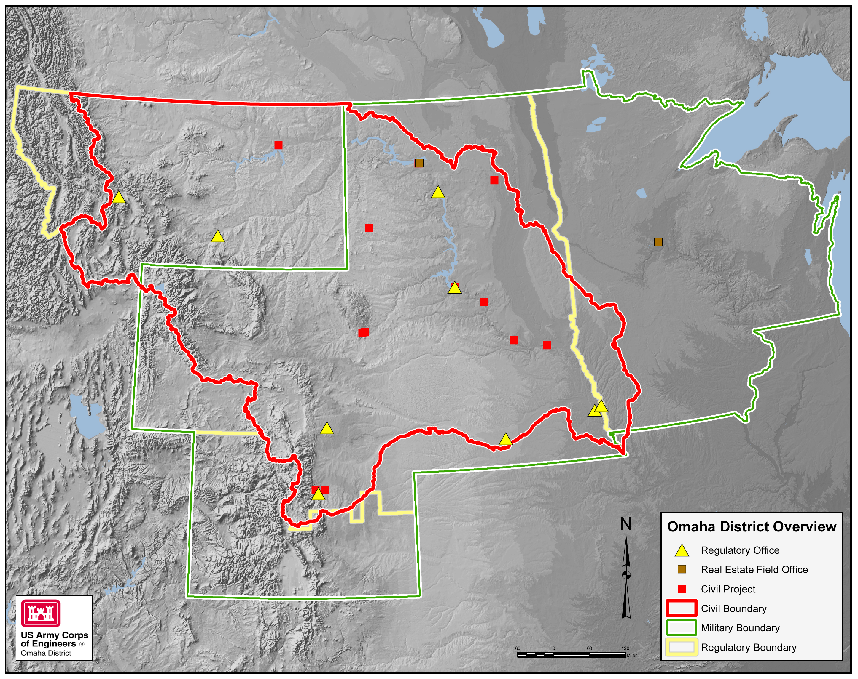
Overview of the Omaha District (cont.)
The Omaha District includes (USACE, 2011):
25 offices, including District Headquarters at Omaha.
27 Dams (including 6 hydropower dams along the Missouri River)
53 Federally-recognized Tribal Nations
99 miles along the Missouri National Recreation River
247 miles of River Navigation
284 Recreation Areas
6,627 miles of Shoreline

Slide 5
Overview of the GIS Service Center (GSC)
The GIS Service Center (GSC) provides geographic enterprise resources and solutions within the Omaha District to assist with the U.S. Army Corps of Engineers’ missions and objectives. The GSC is committed to working with the GIS community to deliver current and cutting edge technology, tools and data that improve the coordination, communication and execution of program requirements. (Morrison, 2010)

Slide 6
Overview of the GSC (cont.)
The GSC provides software, technical support, and data development activities to approximately 300 active desktop GIS users throughout the entire Omaha District.
GIS missions vary greatly across all district personnel. The GSC supports users in Engineering, Hydrology, Cultural Resources, Natural Resources, Planning, and Economics.

Slide 7
Why create the Omaha District Geospatial Data Catalog (NWO-GDC)?
Supervisors and project managers do not want to learn ArcGIS just to search for available data.
Current process can be cumbersome for both GIS users and GSC staff.
Keyword database search does not necessarily guarantee project area coverage for returned datasets.

Slide 8
Goals and Objectives for the NWO-GDC
Contain fully functional web-based spatial search capabilities for data maintained and stored by the GSC.
Promote awareness of and access to available GIS datasets to project managers and GIS users.
Facilitate communication of GIS data needs and requirements between the wider Omaha District community and the GSC.

Slide 9
Literature Review
Reviewed 10 state and federal GIS catalogs and data clearinghouses.
Predominant methods of spatial search in all map-based catalogs were a rectangular bounding box or user defined point.
Most robust functionality was found in the USGS’s EarthExplorer tool (U.S. Geological Survey [USGS], 2014).
The NWO-GDC will incorporate all types of searches found during the literature review, tailored to the Omaha District’s needs.

Slide 10
Technical Specifications
The NWO-GDC will utilize existing GSC infrastructure:
Oracle Application Express (APEX) front end
GSC’s NWO Web Map Interface
ArcGIS API for JavaScript
ArcGIS for Server 10.1
ESRI’s Spatial Data Engine technology
Oracle 11g Database
The spatial search will leverage available tools within the API for JavaScript to intersect tiled catalog indexes served through ArcGIS for Server.

Slide 11
Features of the NWO-GDC spatial search
The spatial search tools will search for available data by:
User drawn inputs on the map interface:
Point
Line (USGS, 2014)
Polygon
Uploading an existing shapefile or KML/KMZ (USGS, 2014)
User defined attributes:
City
County
Federal Levee System
Public Land Survey System (PLSS)
Missouri River Bend Name
River Mile
USGS 24k Quad Name

Slide 12
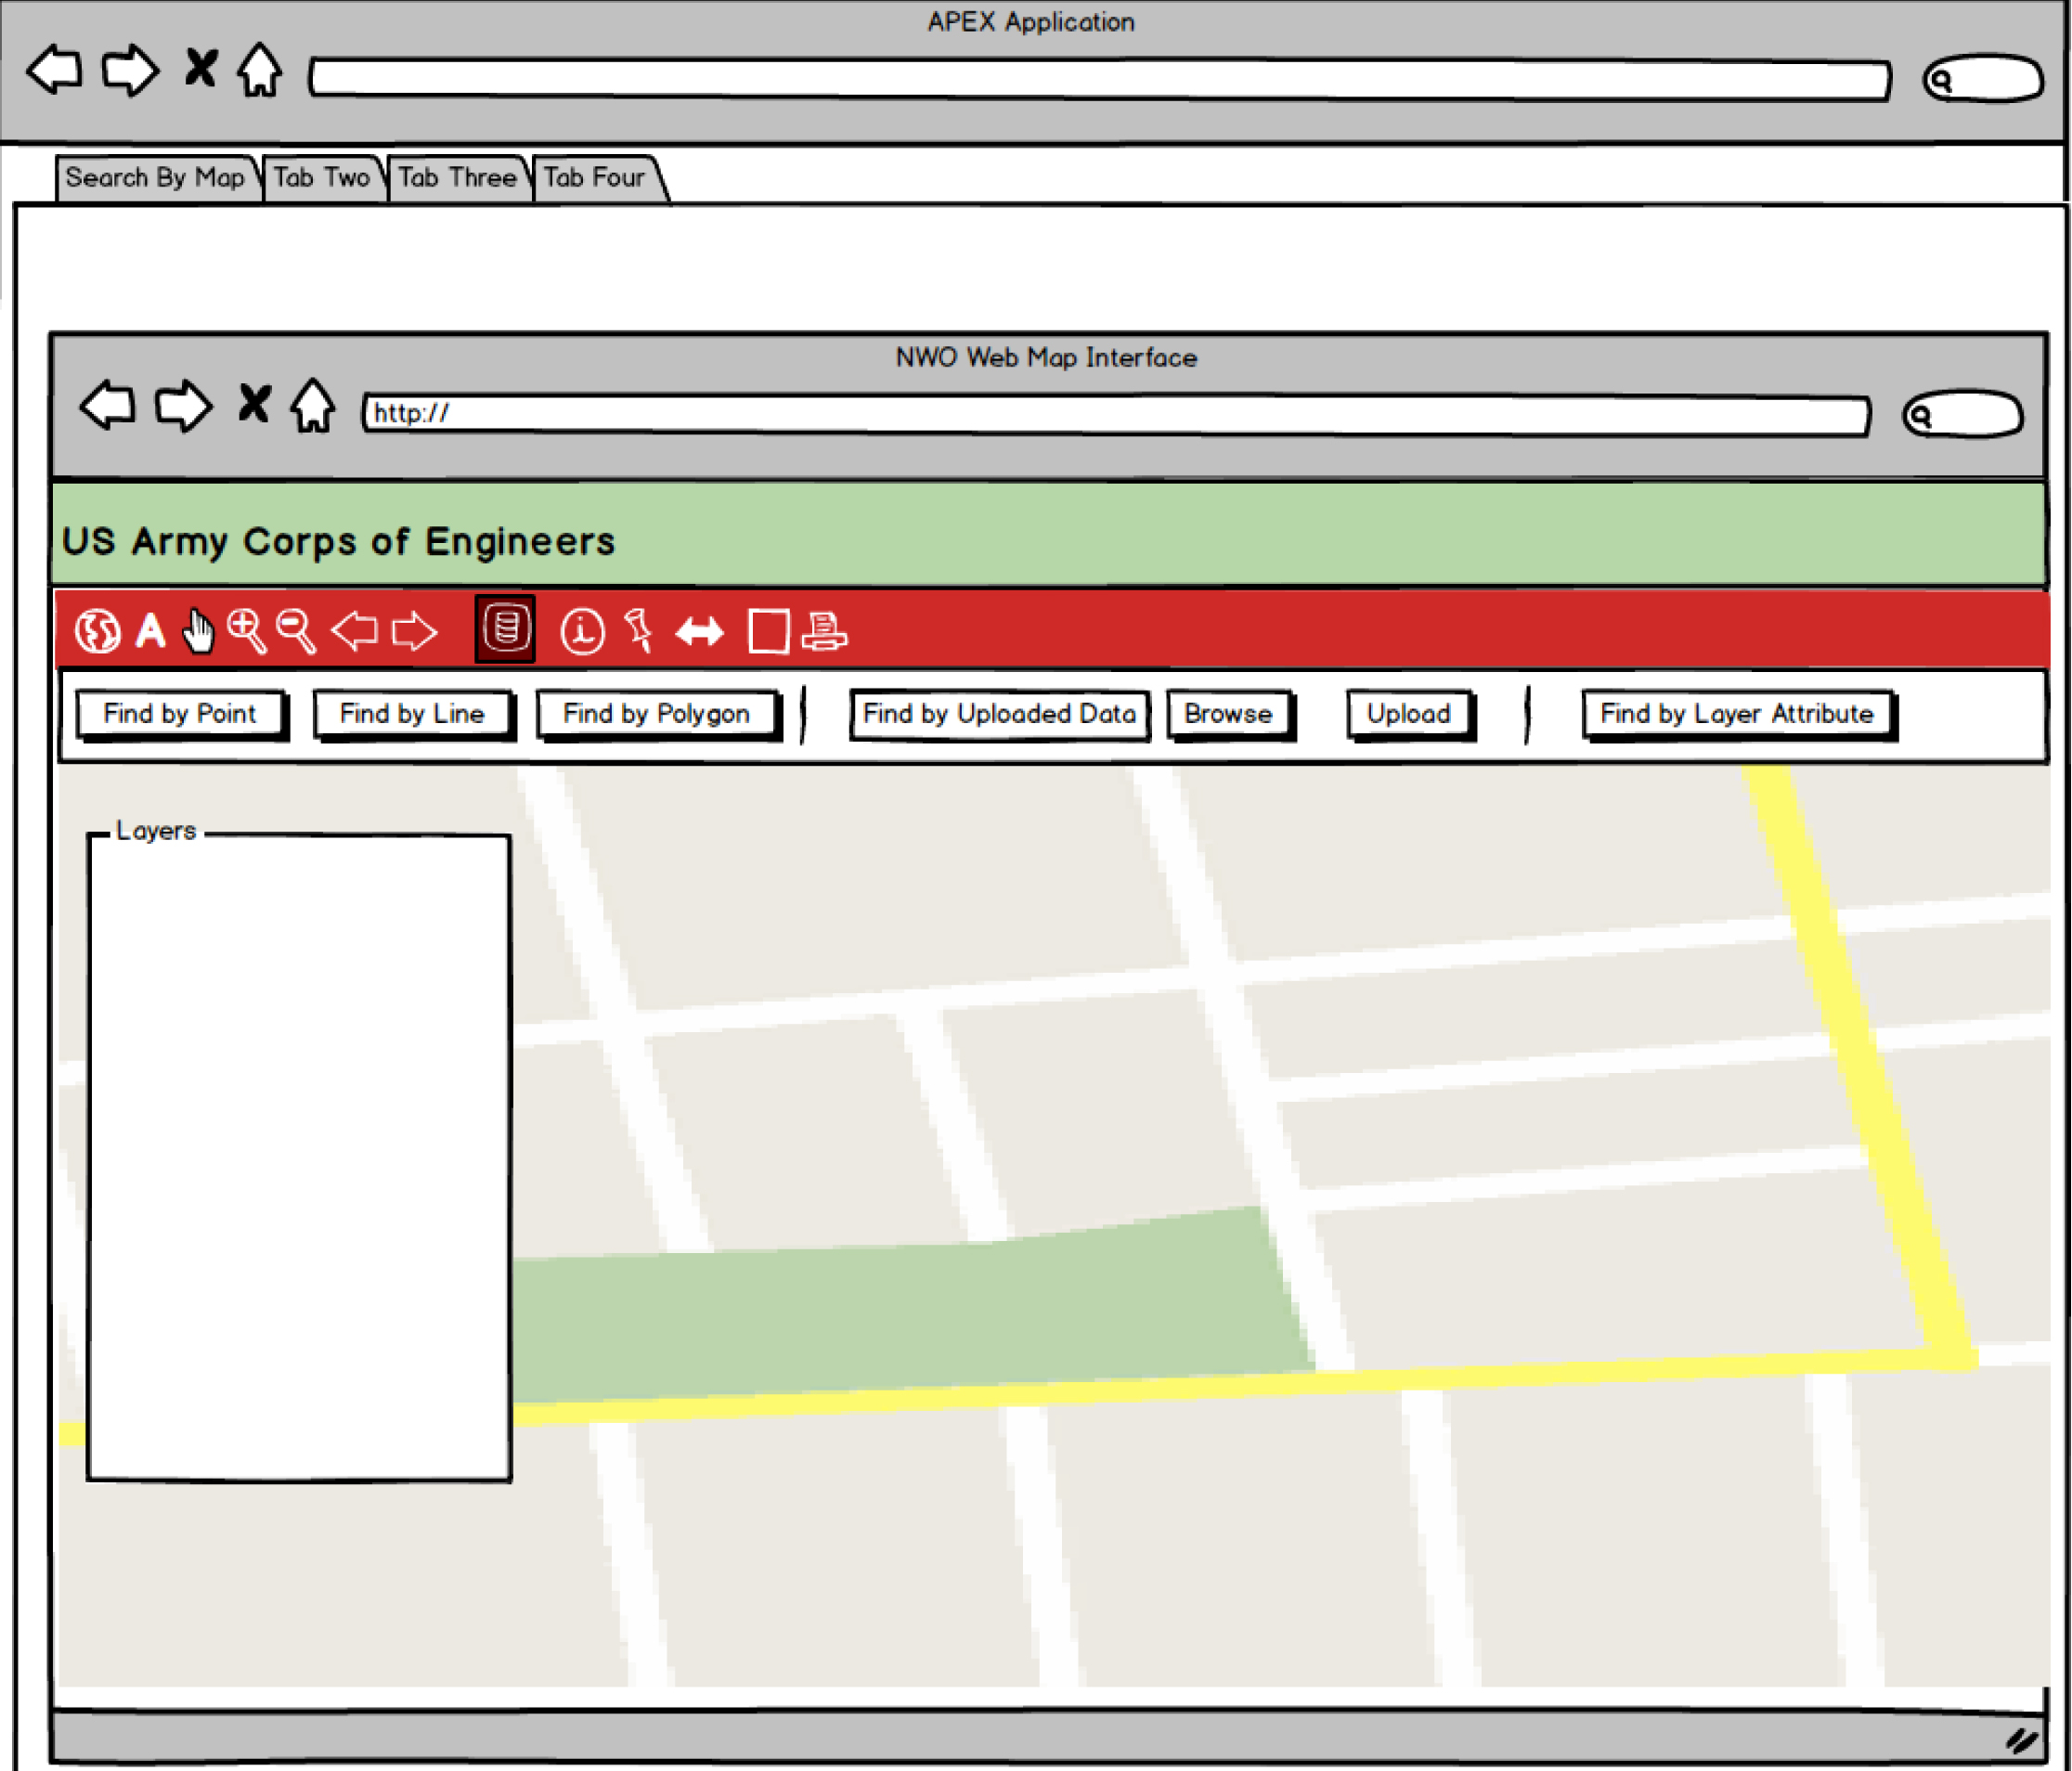
Features of the NWO-GDC spatial search
Created with Balsamiq Mockups (http://webdemo.balsamiq.com/)

Slide 13
Result(s) Handling
Search results will be classified by their data location status:
Online – Data that is stored on the GSC’s GIS servers
Offline – Data that is stored on external hard drives or other media and is not directly accessible over the network.
Regardless of classification, the functionality on the proceeding slide will be available for all search results.

Slide 14
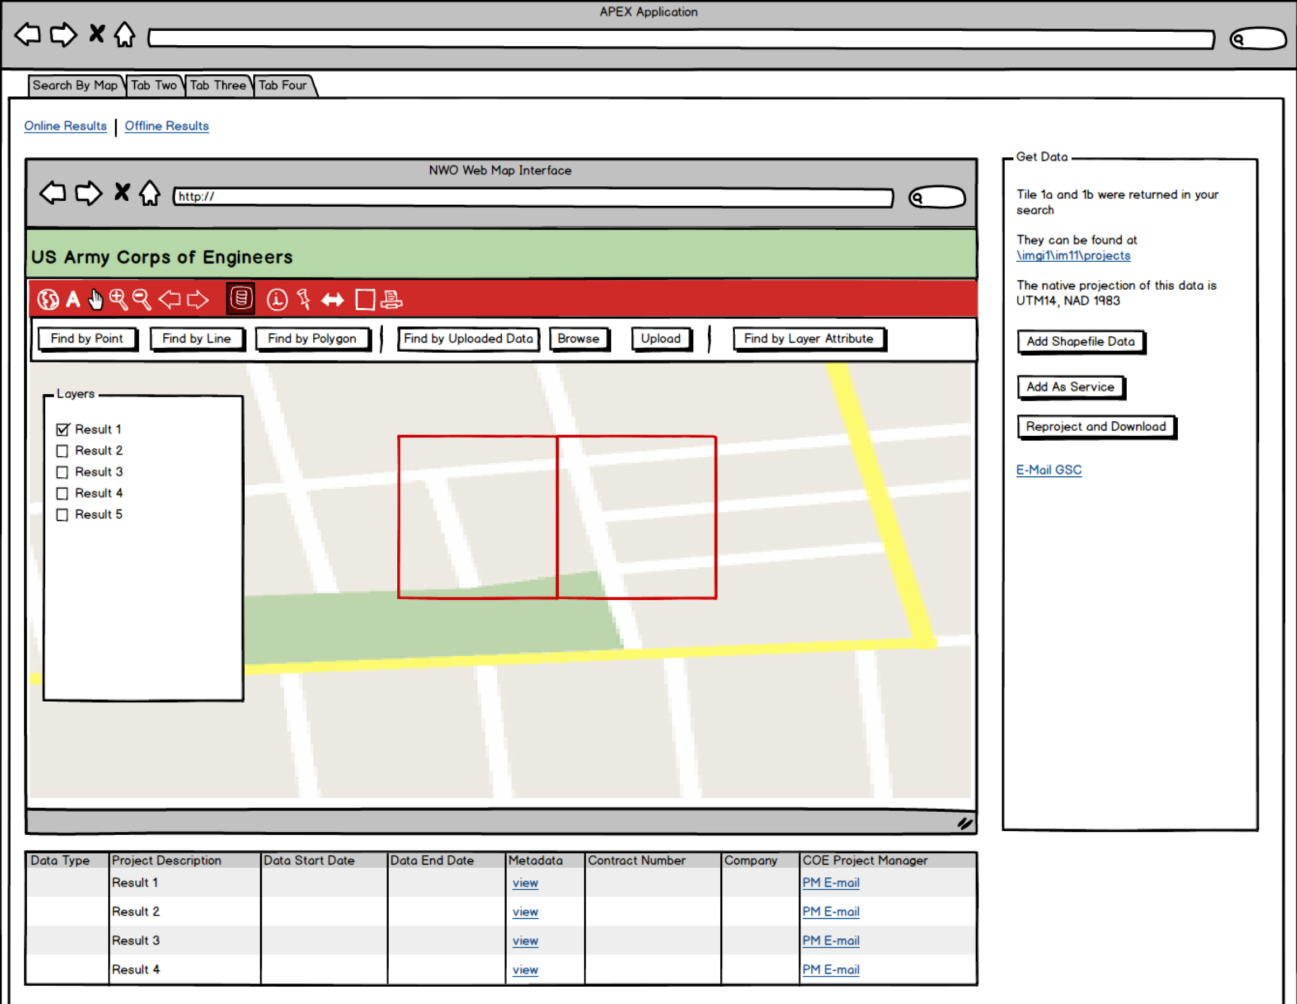
Result(s) Handling (cont.)
Returned tiled indexes will be shown on the embedded map document and can be toggled on or off.
Basic details for each result will be displayed including:
Data type
Project description
Data collection start date
Data collection end date
Contract information
Project manager contact information.
Other metadata will be viewable through the link under the “Metadata” column.
Created with Balsamiq Mockups (http://webdemo.balsamiq.com/)

Slide 15
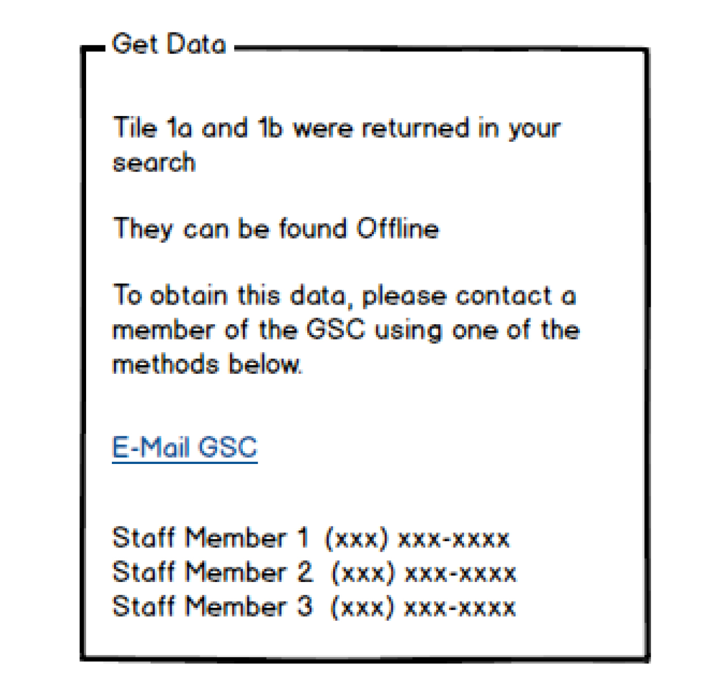
“Offline” Data Results
The key difference between “Offline” and “Online” results will be in the options presented in the “Get Data” window.
Since “Offline” data can only be obtained with GSC assistance, these options will be presented to contact a GSC staff member:
“E-mail the GSC” link:
Auto-populates an e-mail with the basic details of the desired result.
Provides GSC staff members with the necessary information for locating the data on media.
List of GSC staff member phone numbers.
Created with Balsamiq Mockups (http://webdemo.balsamiq.com/)

Slide 16
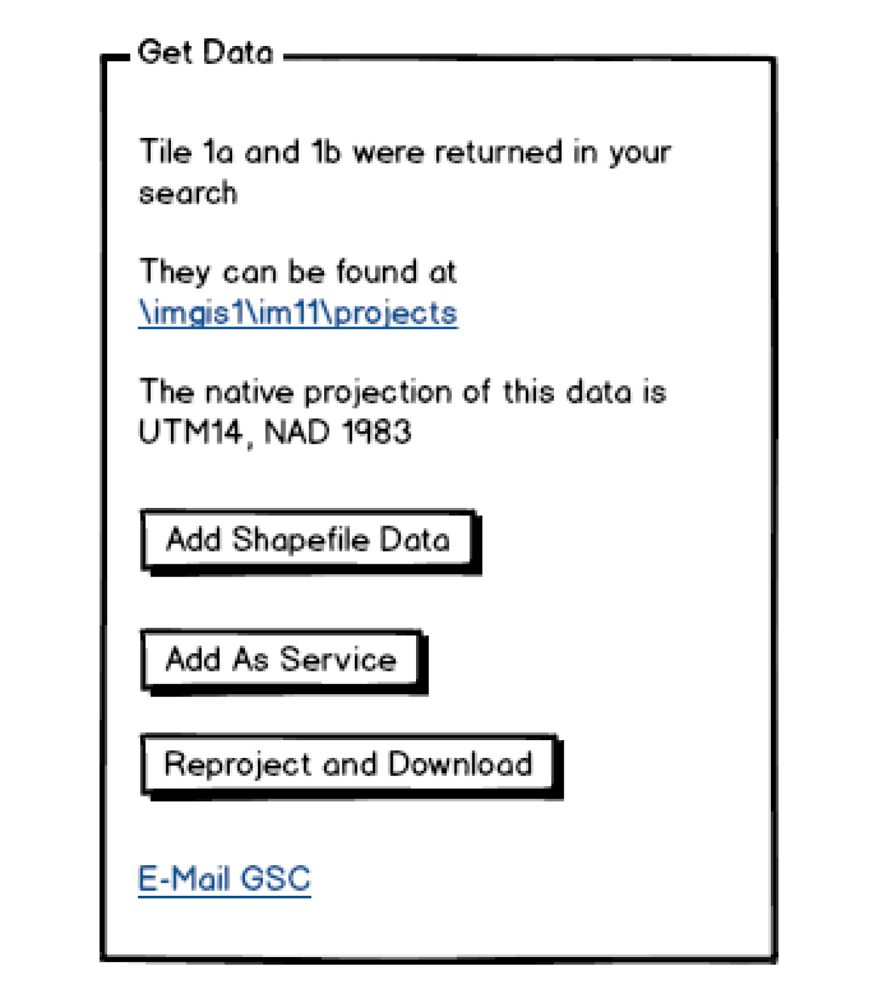
“Online” Data Results
“Online” data can be accessed through the following options:
Clicking the direct path to flat files at the online project location.
Adding the data to the NWO Web Map Interface if it meets the following conditions:
If the desired data is in shapefile format.
If the data is already available as a service (Penn State Institutes of Energy and the Environment, 2013).
Clicking the “E-mail the GSC” link
Auto-populates an e-mail with the basic details of the desired result.
Created with Balsamiq Mockups (http://webdemo.balsamiq.com/)

Slide 17
“Online” Data Results (cont.)
The native projection of the desired data will also be displayed.
The “Get Data” window will provide the ability to reproject and download a dataset if it is in the following formats:
Shapefile
Geodatabase Feature Class
ESRI Raster Format
A user notification method and data size limit will be determined in early rounds of user testing.
Created with Balsamiq Mockups (http://webdemo.balsamiq.com/)

Slide 18
Anticipated Results
The final product should be so much more than a simple data search!
The NWO-GDC should provide:
Greater visibility of the GSC’s data and services
Increase in usage of available GIS datasets
Reduction in duplicate data collection efforts
Better communication between project managers, supervisors, GIS users, and the GSC.

Slide 19
Timeline
Late Summer/Early Fall 2014
JavaScript tutorials and additional training
GEOG 863 Mashups
Late Fall/Winter 2014-2015
Complete project
User testing
Spring 2015
Present at industry conference
ESRI Federal Users Conference 2015
Nebraska GIS/LIS Conference 2015

Slide 20
References
Balsamiq Studios, LLC. (2014). Balsamiq Mockups Web Demo (Version 2.2.25) [Software]. Available from http://webdemo.balsamiq.com/.
Morrison, E. (2010). GIS Service Center Geospatial Solutions, 1 (1), 1.
Penn State Institutes of Energy and the Environment. (2013). Pennsylvania Spatial Data Access. Retrieved from http://www.pasda.psu.edu/. Accessed 2014, June 16.
US Army Corps of Engineers. (2011, January 13). New Employee Orientation [PowerPoint slides].
US Army Corps of Engineers. (n.d.). Garrison Dam & Lake Sakakawea. Retrieved from http://www.nwo.usace.army.mil/Missions/DamandLakeProjects/MissouriRiverDams/Garrison.aspx. Accessed 2014, June 29.
U.S. Geological Survey. (2014, May 14). EarthExplorer. Retrieved from http://earthexplorer.usgs.gov. Accessed 2014, June 16.

Slide 21
Questions?
Thanks for attending!

