Slide 1
Marijuana Dispensaries and Crime in Denver
Effects of Dispensary Locations on the Spatial AutoCorrelation of Crime Rates in Denver, Co
By Ashley Lanier
Penn State University – GEOG 596A

Slide 2
Overview
Legalizing Marijuana Debate
History of Marijuana Legalization in Colorado
Research Questions
Why I Chose Denver, CO
Previous Research
Goals and Objectives
Crime Theories Sourced
Methodology
Challenges/Limitations
Expected Results
Timeline
https://www.nativerootsdispensary.com/south-denver-marijuana-dispensasry

Slide 3
The debate – Legalizing Marijuana
Good
or
Bad
“This will reduce crime!”
“This will promote crime!”

Slide 4
History of Legal Marijuana in Colorado
1979 – Medical marijuana officially legalized in Colorado
No legal regulatory system in place until 2000
2000-2008 – Amendment 20 is passed
Legal regulatory system that limited number of patients per caregiver aka no dispensaries
2009 – Patient-to-caregiver limitation overturned
Explosion in the medical marijuana market
2010 – Medical marijuana dispensaries legalized
By the end of 2012, 532 licensed medical marijuana dispensaries in Colorado
2012 – Colorado becomes first state to legalize recreational marijuana
2014 – First retail marijuana businesses in Colorado are licensed

Slide 5
Research Questions
Do dispensary locations affect spatial auto-correlation of crime types?
What types of crimes are showing statistically significant effects?
Is there a statistically significant difference in crime rates over time?

Slide 6
Why Denver, Colorado?
First state to legalize recreational marijuana
Legal regulatory system in place for recreational marijuana dispensaries
Over 5 years of data
Open data catalog
https://mjnewsnetwork.com/business/colorados-legal-cannabis-industry-by-the-numbers/

Slide 7
Previous Research
Ample research on crime rates and dispensary locations across multiple states
Less research on spatial autocorrelation of crime rates and dispensary locations
Typically 1-2 years time period for study
Nothing published past 2016
Varying results between studies conducted at smaller and larger scales
Modifiable Areal Unit Problem (MAUP) not addressed in these studies
Used similar variables sourced from crime theory to weight data

Slide 8
Crime Theory used for Crime Mapping
Social Disorganization Theory
Routine Activity Theory
Crime is not evenly dispersed over space and time
Socioeconomical variables cause social deficiency and can be used to predict crime
High poverty
Low education
Racial heterogeneity
Population
Residential mobility
Etc.
Three conditions must exist and converge in time and space for crime to occur
Likely offender
Suitable target
Absence of capable guardian

Slide 9
Crime Theory used for Crime Mapping
Social Disorganization Theory
Routine Activity Theory
Crime is not evenly dispersed over space and time
Socioeconomical variables cause social deficiency and can be used to predict crime
High poverty
Low education
Racial heterogeneity
Population
Residential mobility
Etc.
Three conditions must exist and converge in time and space for crime to occur
Likely offender
Suitable target
Absence of capable guardian

Slide 10
Goals and Objectives / my contribution
Investigate the spatial relationship of crime rates and marijuana dispensaries in Denver, CO
Spatial autocorrelation
Account for MAUP
Investigate the statistical significance of change over time
Analysis of Variance (ANOVA)
2013-2018
Utilize two frequently-used crime theories to inform my research
Social disorganization theory
Routine activity theory

Slide 11
Methodology - DAta
City of Denver Open Data Catalog
American Community Survey 5-year
Neighborhood boundaries
Crime 2013-2018
Dispensary active business licenses
Address table with XY coords
Population
Total
Ages between 15-29
Race
Unemployment
Household income
Single family homes
Percentage of rental units
FBI Uniform Crime Reporting Program
Crime categorization
Persons
Property
Society

Slide 12
Methodology – Choropleth map
Examples of the choropleth maps I previously created for Geog 586 when researching the same datasets for 2013-2016 (Lanier, 2018). Used for educational purposes only.] Created using ArcGIS® software by Esri. ArcGIS® and ArcMap™ are the intellectual property of Esri and are used herein under license. Copyright © Esri. All rights reserved

Slide 13
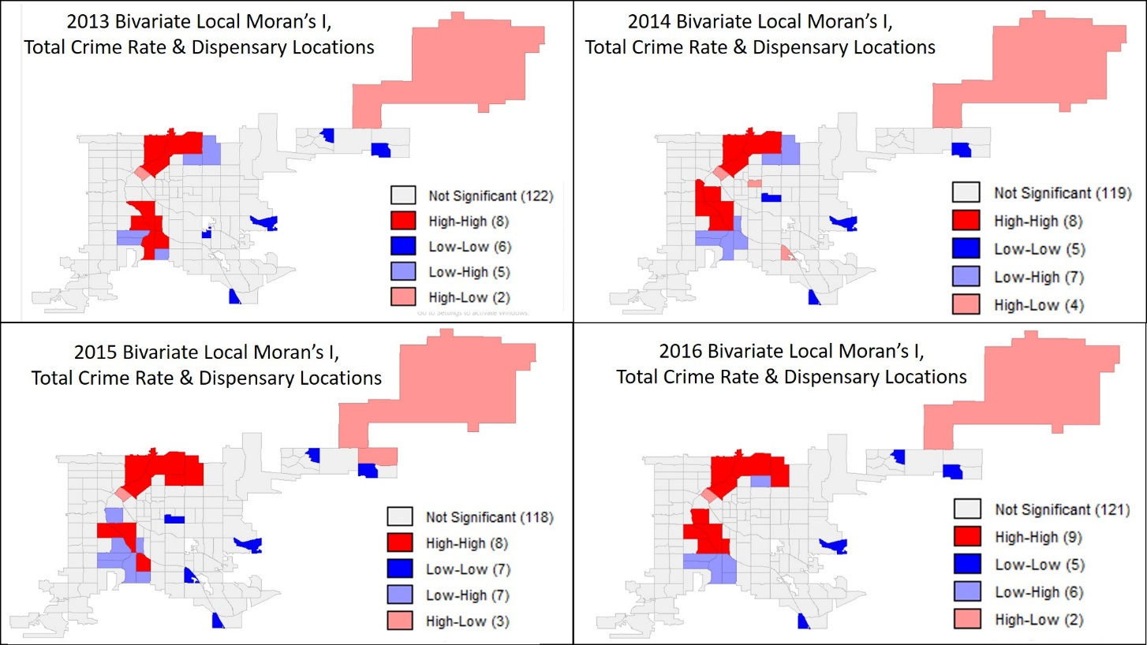
Methodology – bivariate local moran’s i
Examples of the bivariate local Moran’s I spatial autocorrelation cluster maps for 2013-2016 I previously created for Geog 586 (Lanier, 2018). Used for educational purposes only.]

Slide 14
Methodology – analysis of variance
https://www.technologynetworks.com/informatics/articles/one-way-vs-two-way-anova-definition-differences-assumptions-and-hypotheses-306553

Slide 15
Methodology - Software
https://www.pobonline.com/ext/resources/article_images/esri.gif
https://github.com/GeoDaCenter/geoda
https://www.rstudio.com/about/logos/

Slide 16
Challenges & Limitations
Census data are 5 year estimates and not 10 year official counts
Some tracts have zero population and will need to be removed
Only active business licenses are tracked in the dispensary data
Address the impact of MAUP
https://www.tutorialspoint.com/5g/5g_challenges.htm

Slide 17
Expected results

Slide 18
Project Timeline for “gis in the rockies”
May - June
Condition Data
July
Analyze Results
August
September
Finalize Methodology
Submit Abstract
Finalize presentation
Present at GIS in the Rockies

Slide 19
references
0-4-287 Colorado Constitution article XVIII. https://www.colorado.gov/pacific/sites/default/files/CHEIS_MMJ_Colorado-Constitution-Article-XVIII.pdf
0-4-287 Colorado Constitution article XVIII amend. 64. § 16. https://www.fcgov.com/mmj/pdf/amendment64.pdf
City and County of Denver (2019). Marijuana Active Business Licenses dataset. Open Data Catalog. Retrieved from https://www.denvergov.org/opendata/dataset/city-and-county-of-denver-marijuana-active-business-licenses
City and County of Denver (2018a). Statistical Neighborhoods dataset. Open Data Catalog. Retrieved from https://www.denvergov.org/opendata/dataset/city-and-county-of-denver-statistical-neighborhoods
City and County of Denver (2018b). Crime. Open Data Catalog. Retrieved from https://www.denvergov.org/opendata/dataset/city-and-county-of-denver-crime
City and County of Denver (2018c). Addresses. Open Data Catalog. Retrieved from
https://www.denvergov.org/opendata/dataset/city-and-county-of-denver-addresses
Cohen, L. E., & Felson, M. (1979). Social change and crime rate trends: A routine activities approach. American Sociological Review, 44(4), 588
Federal Bureau of Investigation. (2012). Uniform crime reporting handbook: UCR Crimes Against Persons, Property, and Society. Retrieved from https://ucr.fbi.gov/nibrs/2012/resources/crimes-against-persons-property-and-society
House Bill 10-1284, 2010 General Assembly, 2010 Reg Sess. (CO. 2010). https://cdpsdocs.state.co.us/ccjj/Resources/Leg/2010/HB10-1284.pdf
Openshaw, S. and Taylor, P.J. 1979: A million or so correlation coefficients: three experiments on the modifiable areal unit problem. In Wrigley, N. , editor, Statistical applications in spatial sciences, London: Pion, 127—44.
Rengifo, A. F. (2009). Social disorganization Oxford University Press. doi:10.1093/obo/9780195396607-0008
Rocky Mountain High Intensity Drug Trafficking Area (2014). The Legalization of Marijuana in Colorado: The Impact vol.2. Retrieved from https://rmhidta.org/files/D2DF/7Legalization%20of%20Marijuana%20in%20Colorado%20the%20Impact%20Vol%202.pdf
United States Census Bureau (2013-2018). American Community Survey with 5-year estimates. TIGER/Line with Selected Demographic and Economic Data. Retrieved from https://www.census.gov/geo/maps-data/data/tiger-data.html
Wikström, P. H. (2009). Routine activity theories Oxford University Press. doi:10.1093/obo/9780195396607-0010

