Slide 1
Visualizing Temporary Traffic Control in Virtual Reality Geographic Information Systems
Student: Roberto Lasaga
Advisor: Dr. Patrick Dudas
GEOG 596A

Slide 2
Background
Manual on Uniform Traffic Control Devices – National Standard For Traffic Control
States and entities within – must use MUTCD as minimum standard
*FDOT Standard Plans for Road Construction
Traffic Control Devices, design and implementation improve roadway safety, studies are reoccurring, revisions factor dependent
FDOT Standard Plans yearly, MUTCD periodically
Temporary Traffic Control (TTC) – critical to public and worker safety during construction
Notes:
DOT, FHWA. Safety effects of traffic control devices (tcd) / low cost safety improvements.
FDOT (2022b). FY 2022-23 STANDARD PLANS FOR ROAD CONSTRUCTION. State of Florida Department of Transportation, fy 2022-2023
Example,
The addition of curve warning signs with advisory speed plaques can reduce crashes by 22%

Slide 3
IMPACT oF project
2D spaces used extensively for design TTC, but has limitations
Improvement of design
Make designers aware of conditions in the field
Remote workers can visualize design in close-to-reality

Slide 4
Critical Literature Relate
VRGIS used in urban development and transportation infrastructure visualization [Halabi et al., 2019]
VR utilization in workers behavior within work zone [Kim and Ahn, 2020]
Questionnaire, professional opinion [Manuel et al., 2020]
Notes:
Halabi, A. S. E., Sayad, Z. T. E., and Ayad, H. M. (2019). Vrgis as assistance tool for urban decision making: Rafah – Gaza – Palestine. Alexandria Engineering Journal, 58:367–375. ---
Researchers used City Engine in ArcGIS 360 VR to create VR scene to inform decision-makers. Well-received.
Kim, N. and Ahn, C. R. (2020). Using a virtual reality-based experiment environment to examine risk habituation in construction safety. Waterloo: IAARC Publications, 37:1176–1182. ---
Create a VR environment that involved road maintenance, milling process, participants cleared away debris with a broom. Recorded unsafe behavior, which is the leading cause of death in workplace fatalities. Not maintaining line of sight, or proximity to moving equipment
Manuel, J., Delgado, D., Asce, A. M., Oyedele, L., Beach, T., and Demian, P. (2020). Augmented and virtual reality in construction: Drivers and limitations for industry adoption. Journal of Construction Engineering and Management, 146

Slide 5
Methodology
Four phases:
Development – create VR environment, set up questionnaire, get approval from supervisor.
Collect data – have participant's research
Analysis – conduct statistical analysis on data collected
Dissemination – deliver results (TBD)
Notes:
The processing of the data will occur in statistical software yet to be determined.
Likely a t-test will be used to determine the results given the number
of projected participants. Gaussian Distribution will likely be used for analysis
in determining the accuracy and precision of the TCD points in relation to the
benchmarks. Binary classification statistics will be used to analyze if the correct
sign were placed. These methods are subject to change. Consultation with the
Penn State University Statistical Consulting Center on appropriate methods for
statistical analysis and software will be done.

Slide 6
Methodology (Cont.)
Process – how participants will be participating!
Currently set to use 10 participants, professionals involved in either TTC design or its implementation
Estimated two weeks to complete survey
Notes:
Participants will be required to design a TTC plan based on the 102-612 FDOT Index Standard Plans [FDOT, 2022b] in 2D GIS and VRGIS. The scene will involve a work zone on the shoulder outside of the travel way [FDOT, 2022a], the area of the ROW designed for motorized transportation. The role of the participant will be to place TCDs in their appropriate locations about a pre- determined work zone.

Slide 7
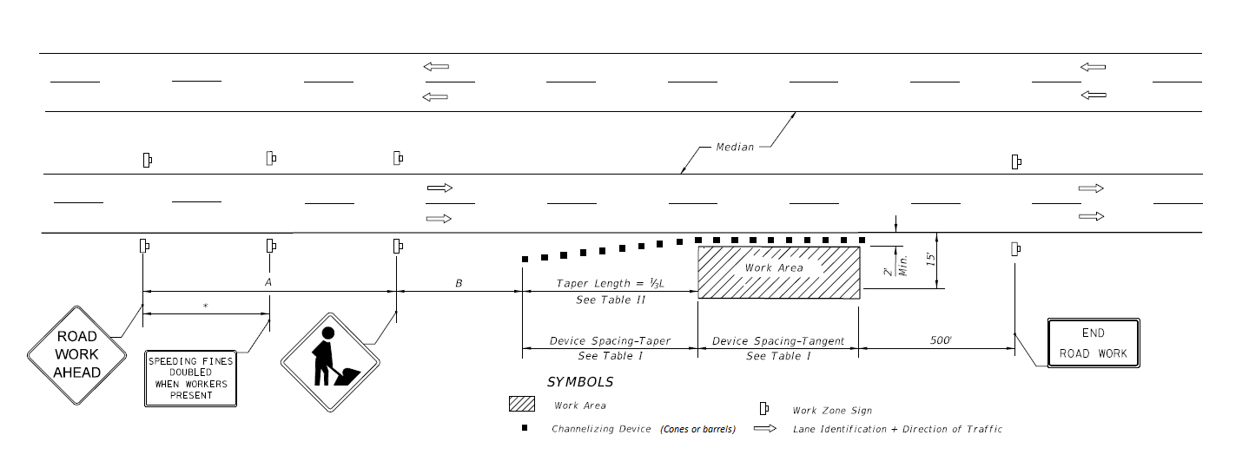
Standard plan design
Notes:
Explain what's here, that you start at the road work ahead sign. There are four zones that are involved in TTC; the advance warning area, which contains the signage alerting and instructing motorists, the transition area where traffic merges out of the travel way and tapers are added to direct the process, the activity areas where the work zone occurs and activity for the main project is taking place, and finally the termination zone where traffic resumes normal pattern

Slide 8
Datasets
Marion County, Florida
LiDAR to build the terrain, 2003 data if 3DEP is not available
Road centerline (possibly building footprints, and water bodies)
Local County/Municipal datasets, consider age and quality

Slide 9
Expected results
Understand accuracy between TTC device placement of designs in a GIS 2D environment & 3D immersive VR experience
Insight into usability and participants view of implementing VR in TTC
Notes:
Hypothesis is that 3D environment is more accurate when used for designing TTC under clear normal conditions. Enhanced visualization and field of view that cannot be account for in 2D in the same way.
Likert scale for evaluating view of VRGIS

Slide 10
References
DOT, FHWA. Safety effects of traffic control devices (tcd) / low-cost safety improvements.
FDOT (2022b). FY 2022-23 STANDARD PLANS FOR ROAD CONSTRUCTION. State of Florida Department of Transportation, fy 2022-2023
FHWA (2013). Manual on Uniform Traffic Control Devices for Streets Highways. Federal Highway Administrator, 2009 edition.
Halabi, A. S. E., Sayad, Z. T. E., and Ayad, H. M. (2019). Vrgis as assistance tool for urban decision making: Rafah – Gaza – Palestine. Alexandria Engineering Journal, 58:367–375.
Kim, N. and Ahn, C. R. (2020). Using a virtual reality-based experiment environment to examine risk habituation in construction safety. Waterloo: IAARC Publications, 37:1176–1182.
Manuel, J., Delgado, D., Asce, A. M., Oyedele, L., Beach, T., and Demian, P. (2020). Augmented and virtual reality in construction: Drivers and limitations for industry adoption. Journal of Construction Engineering and Management, 146

Slide 11
Questions?
Looking for feedback in specific areas;
Usage of ArcGIS Maps SDK for Unity plugin
Prior experience with VRGIS that could facilitate this project, recommendations?
Number of participants?

