Slide 1
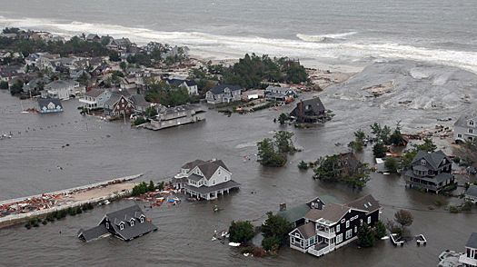
Conveying Coastal Inundation Potential Associated with Extratropical (ET) Cyclones
Adrienne Leptich
National Weather Service / Penn State University
Esri International User Conference
July 11, 2017

Slide 2
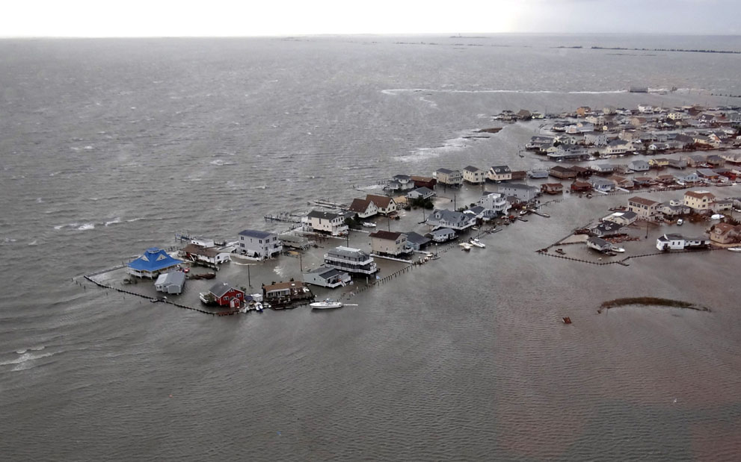
Overview
Background
Methodology
Results
Future Work
Tuckerton, N.J., inundated on Oct. 30 by the storm surge from Superstorm Sandy. Photo: U.S. Coast Guard

Slide 3
Background

Slide 4
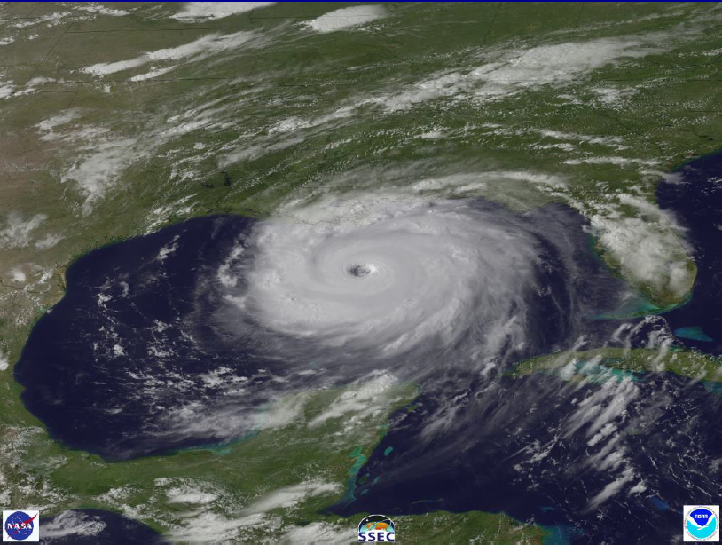
Cyclones: Extratropical vs Tropical
“Superstorm”: March 1993
Hurricane Katrina: August 2005
L
Extratropical Cyclones
Energy from horizontal temperature gradient
Frontal features
“Cold Core”
Tropical Cyclones
Energy from latent heat release
No frontal features
“Warm Core”
Both can cause life threatening storm surge

Slide 5
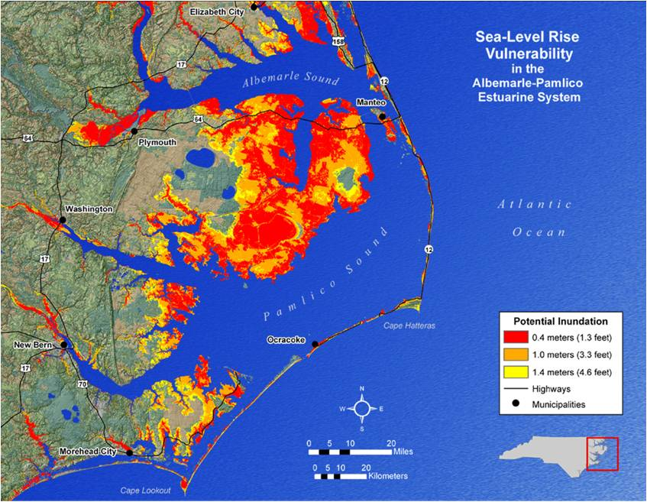
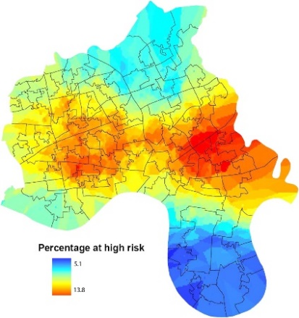
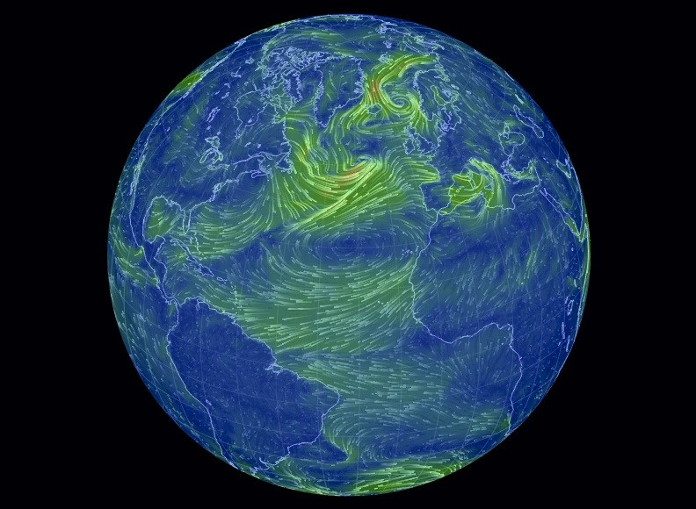
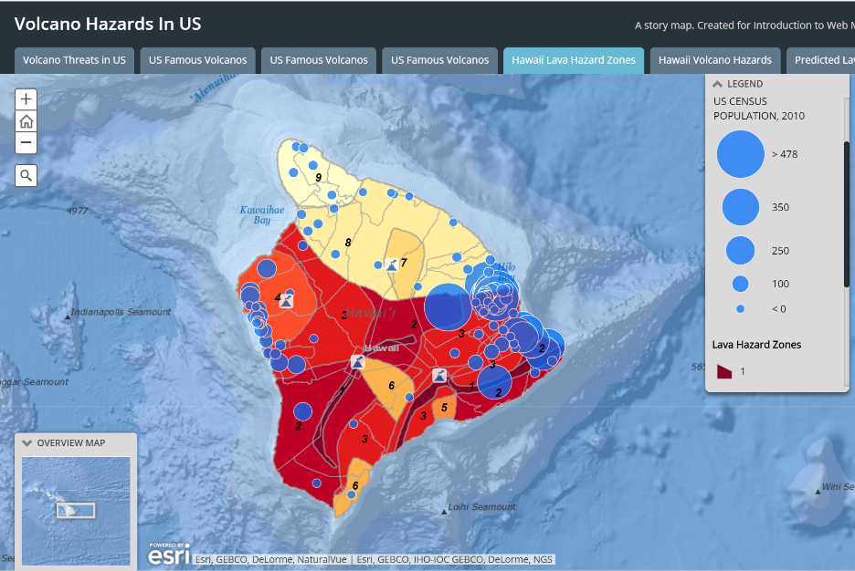
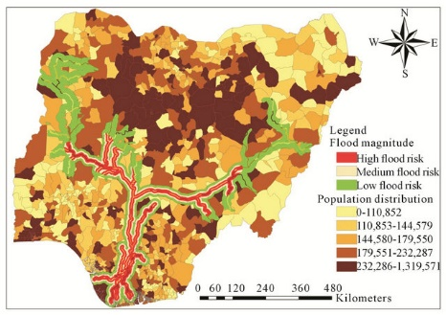
Employing Geographic Visualization to Convey Risk
“The human visual system is the most powerful processing system known” (Buckley et al., 2000)
Geovisualization – the creation and use of visual representations to facilitate thinking, understanding, and knowledge constructions about geospatial data (Nöllenburg, 2007)

Slide 6
The Need for Visualization
Irene and Sandy Service Assessments
Conveying storm surge information was extremely difficult
“there is considerable confusion on what the datums mean in terms of real world impacts.”
“The storm surge forecast was excellent but we are missing the ability to communicate it more visually”
“Mayor Bloomberg asked me every time, ‘If I walk out of my door, how far will the water be up on my legs’ ...He doesn’t want to know 12 feet, 8 feet, etc.... The more you can give me about the impact of surge by area—that would be helpful. Graphical inundation forecasts would be helpful.”
“There were forecasts, but there were no details about what the predicted surges would cause…There was no wording in the warning like, ‘Most of lower Manhattan will be under water at a certain point’ or ‘Staten Island will flood up to Beach Street.’”

Slide 7
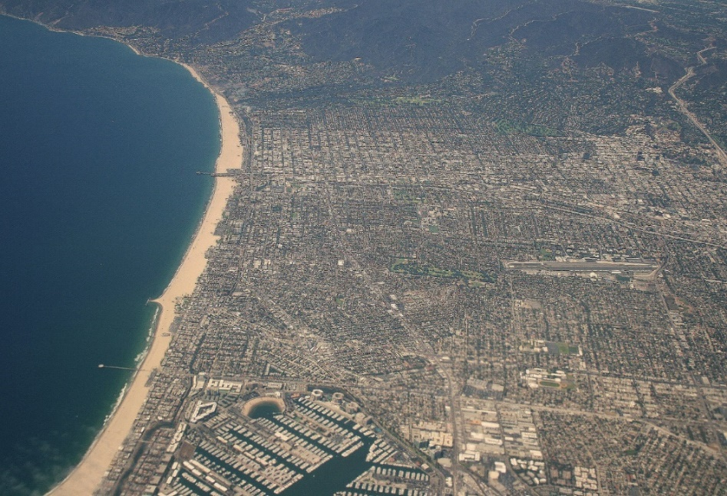
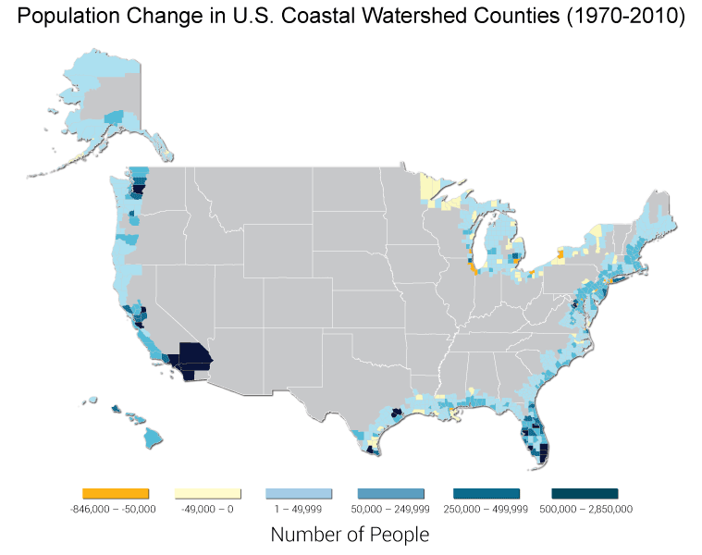
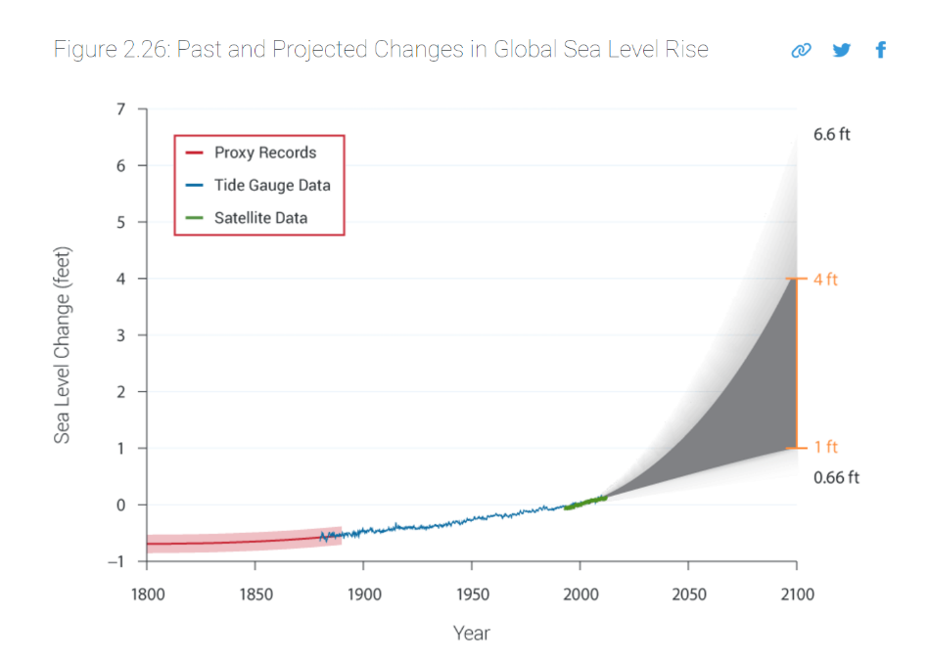
Coastal Population Density
Santa Monica, CA
Increasing population density along the U.S. Coast
Sea Level Rise
Source: The Third National Climate Assessment, 2014
Source: The Third National Climate Assessment, 2014

Slide 8
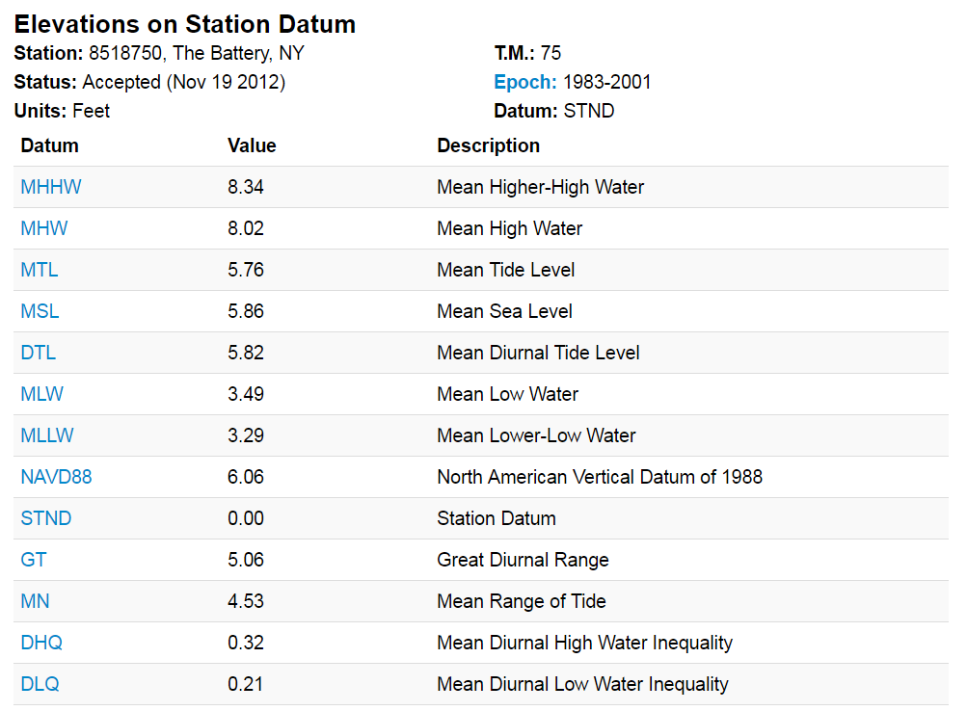
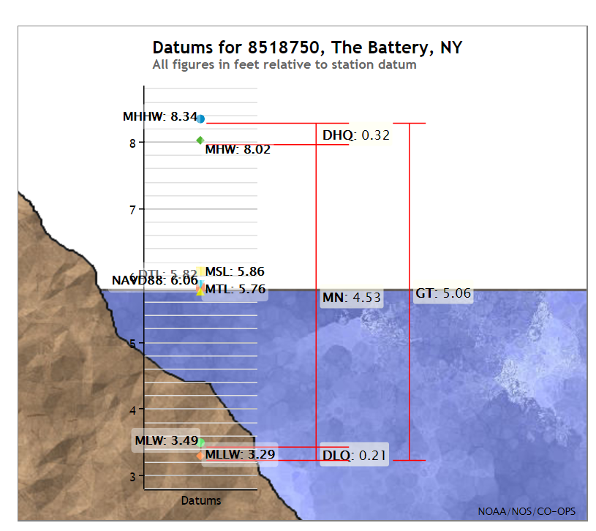
Vertical Datums
Orthometric, Ellipsoidal and Tidal
Tidal = Related to particular stages of ocean tide

Slide 9
The Battery, NYC

Slide 10
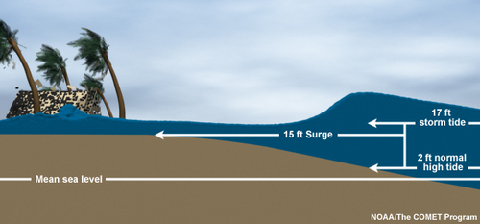
Storm Surge vs Storm Tide
Storm surge = an abnormal rise of water generated by a storm, over and above the predicted astronomical tide level
Storm Tide = Astronomical Tide + Storm Surge

Slide 11
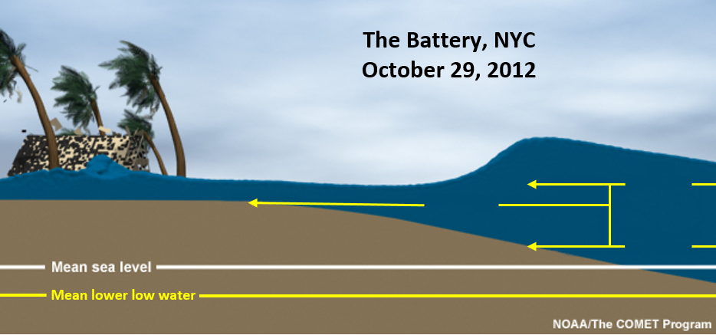
Storm Surge/Tide - Sandy
Storm surge is often the greatest threat to life and property from a tropical or extra-tropical storm
Complex hazard, difficult to convey without visualization tools
13.9 ft
Storm Tide
9.2 ft Surge
4.7 ft Normal High Tide
Storm Tide = Astronomical Tide + Storm Surge

Slide 12
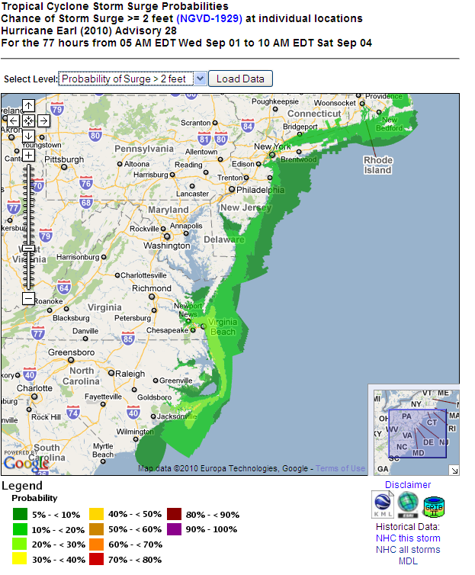
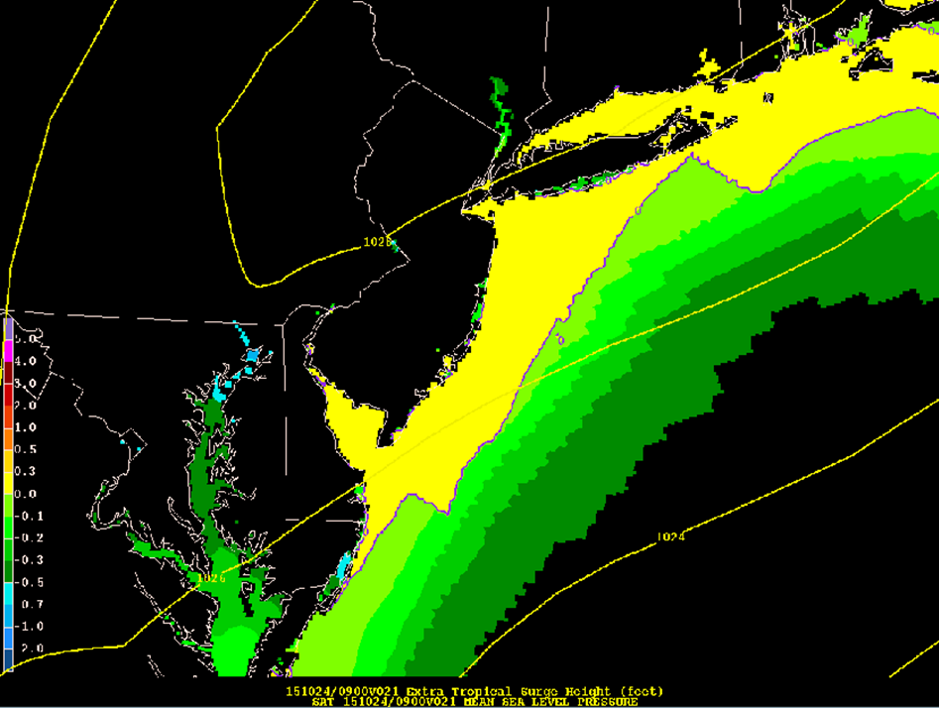
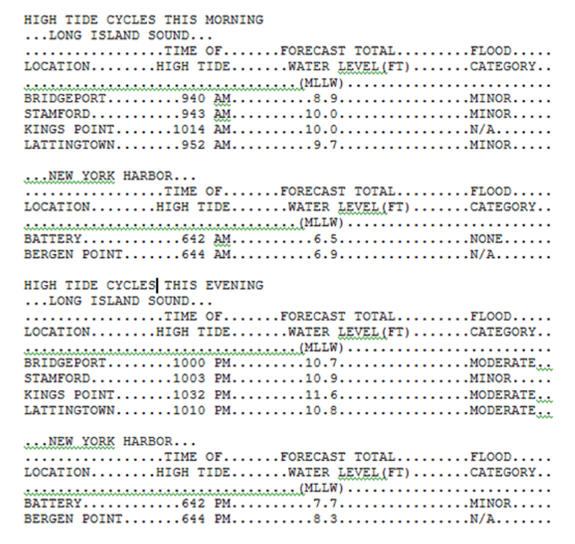
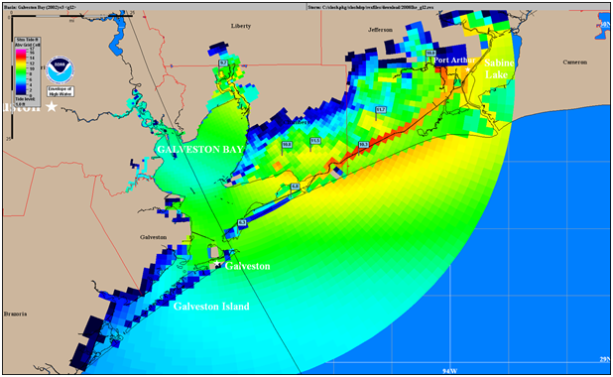
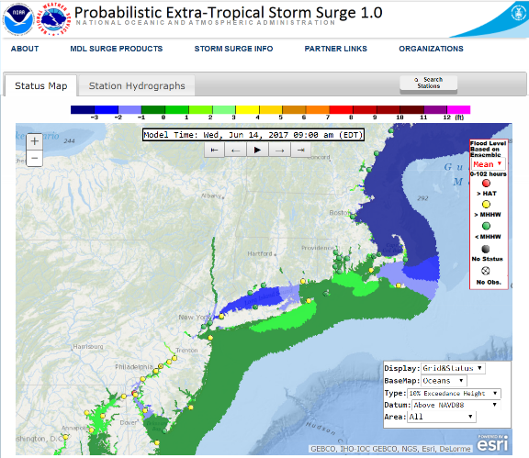
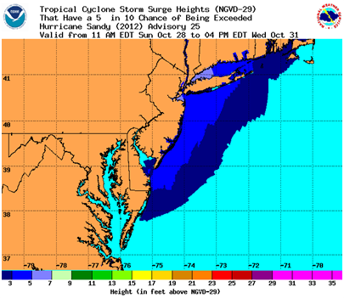
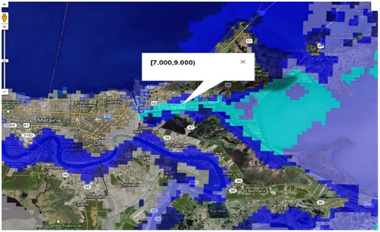
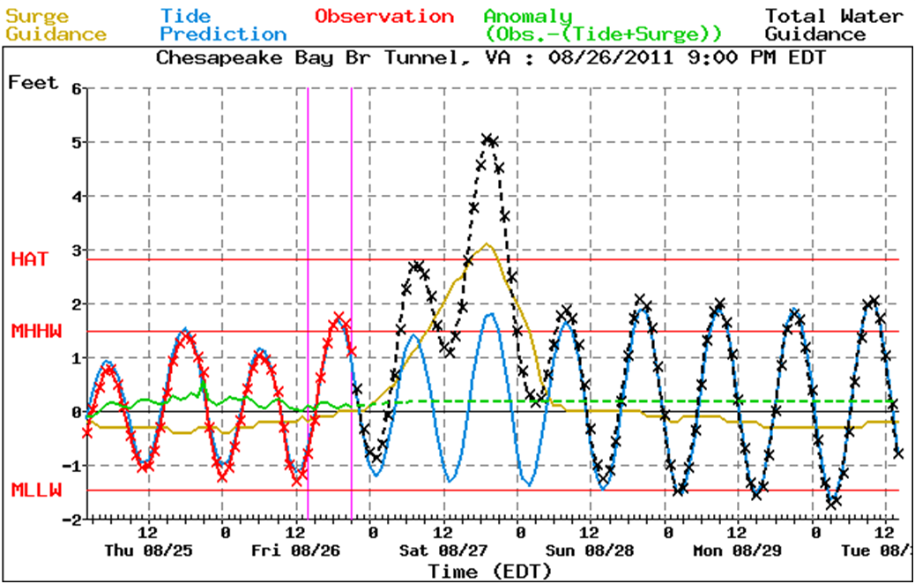
NWS Products
Tropical
Extratropical

Slide 13
METHODOLOGY

Slide 14
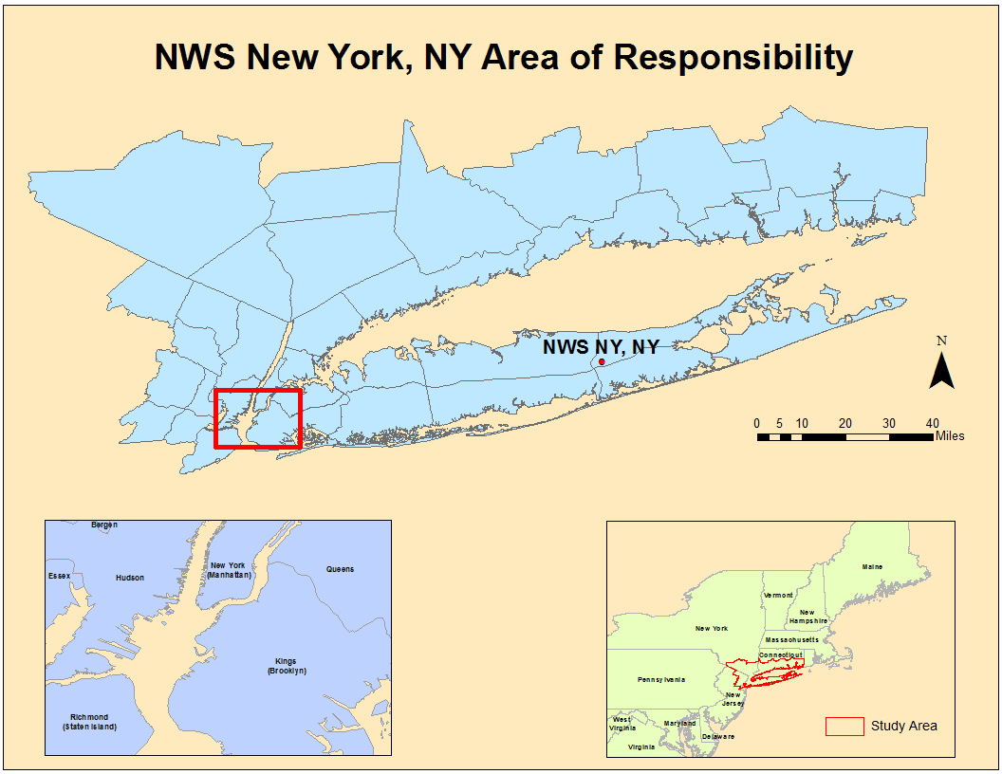
Study Area

Slide 15
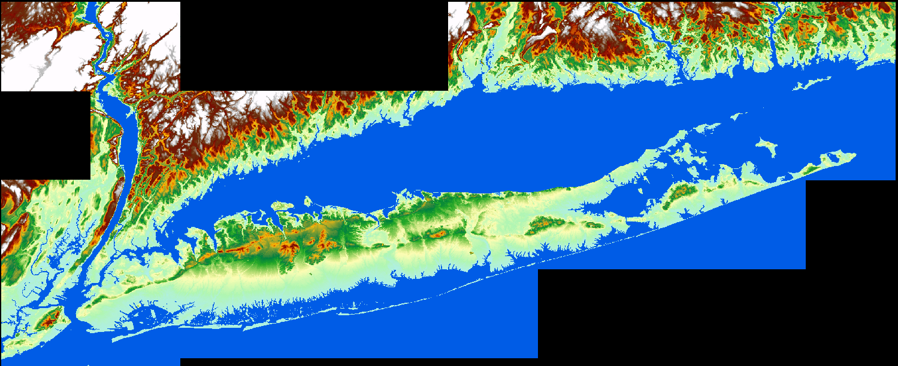
Digital Elevation Model
Post-Sandy DEM
Horizontal Coordinate System: NAD83, 1/9 Arc Second
Vertical Coordinate System: NAVD88, meters

Slide 16
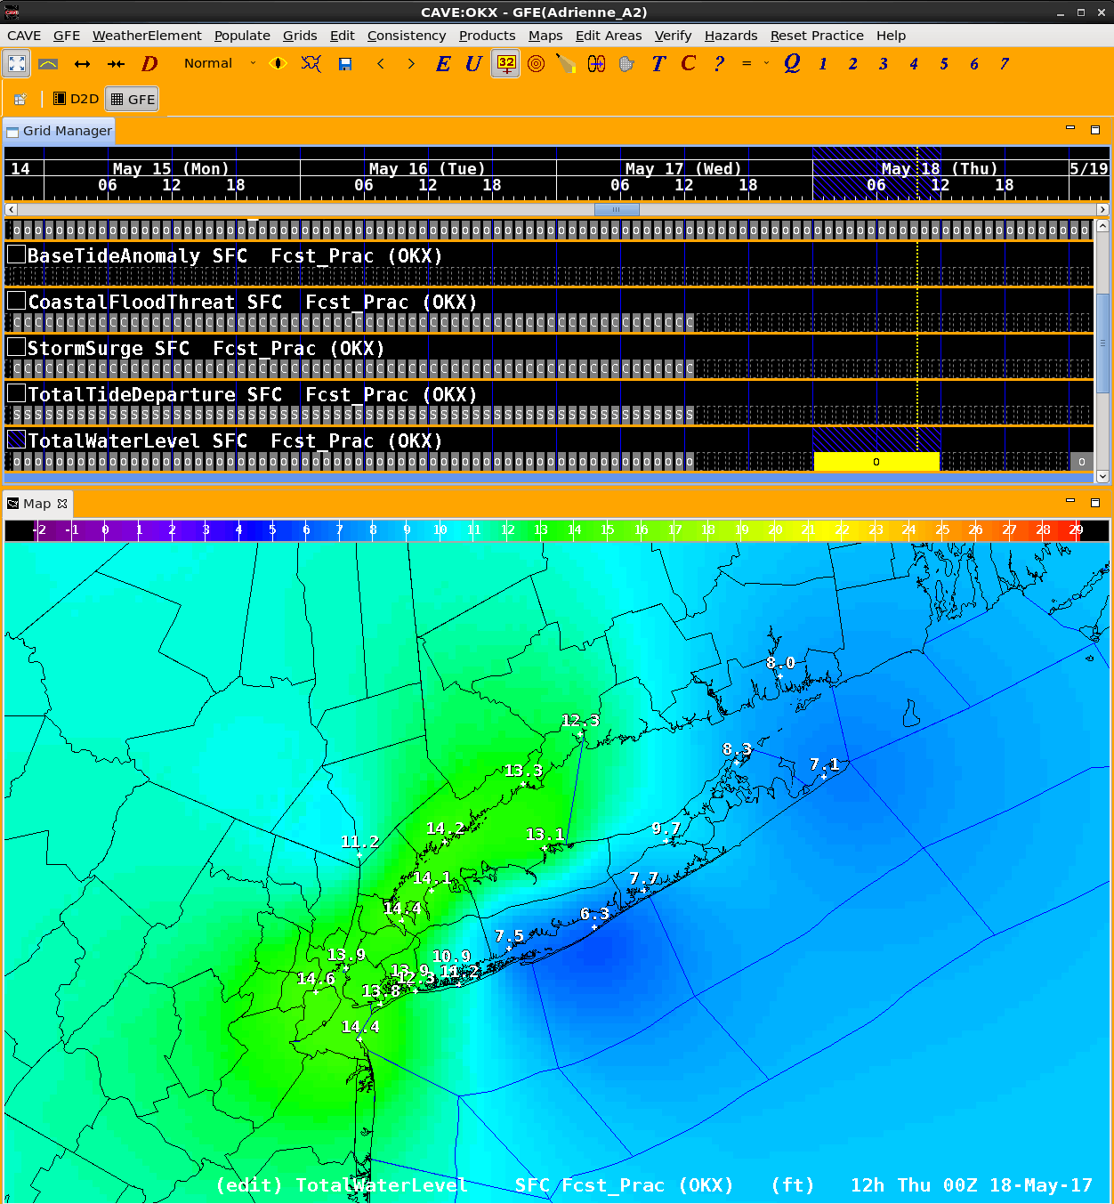
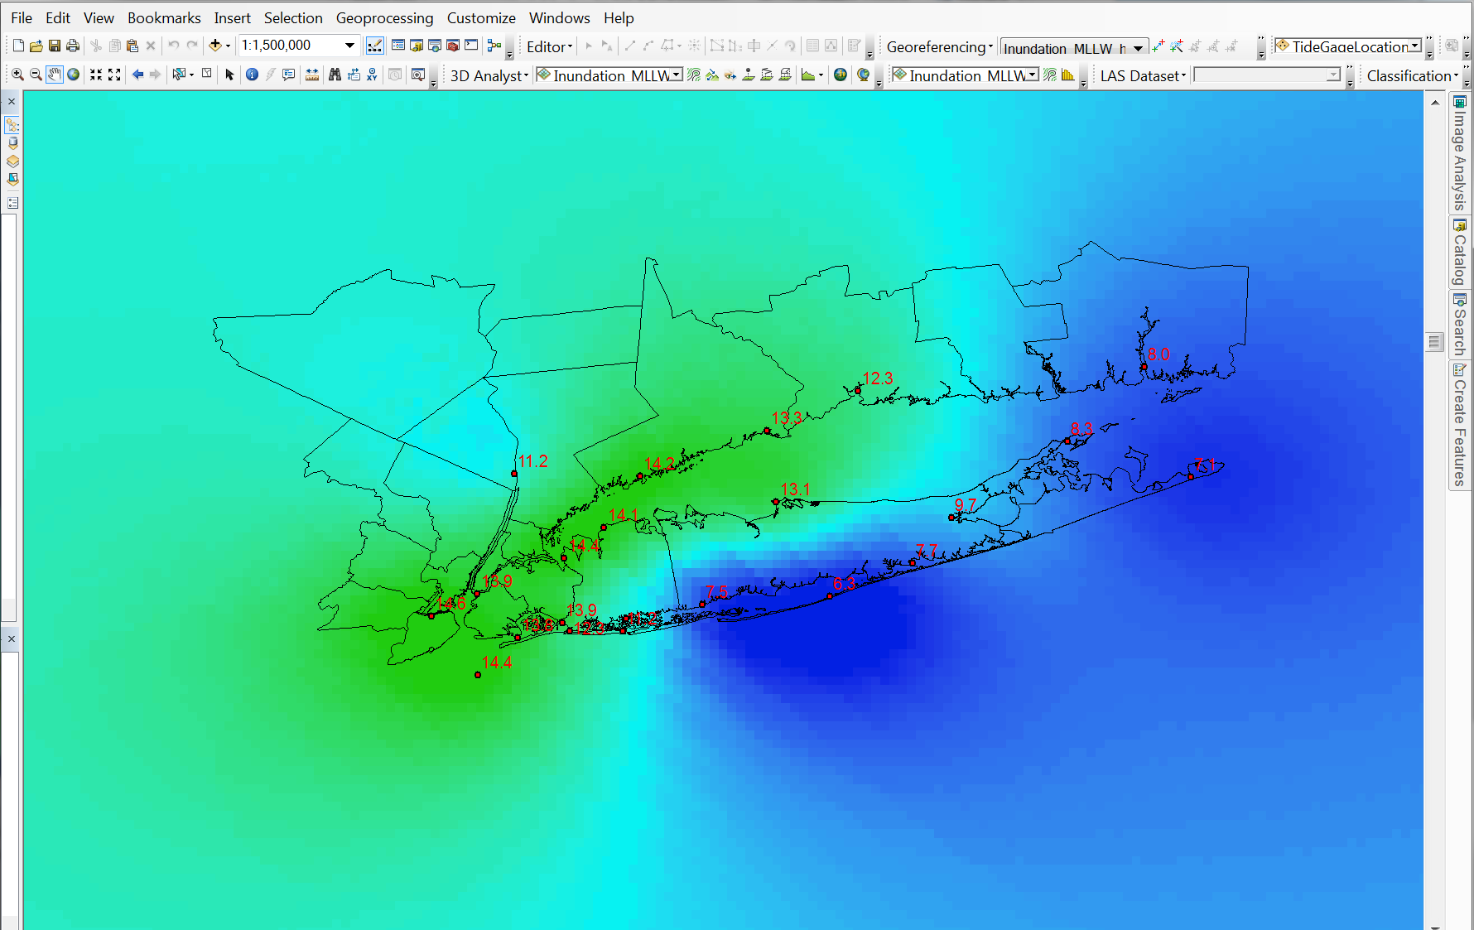
Storm Tide Data
Extract Total Water Level (TWL) grid from NWS’ Graphical Forecast Editor (MLLW, Feet)
Geospatial Data Abstraction Library (GDAL)
Graphical Forecast Editor

Slide 17
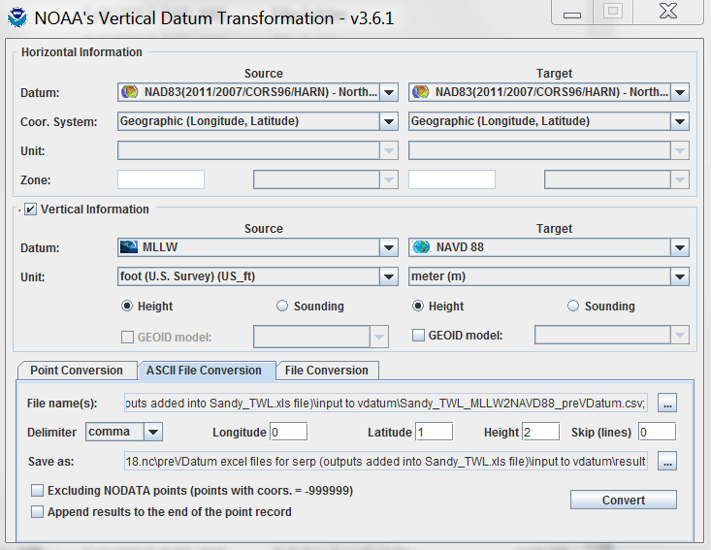
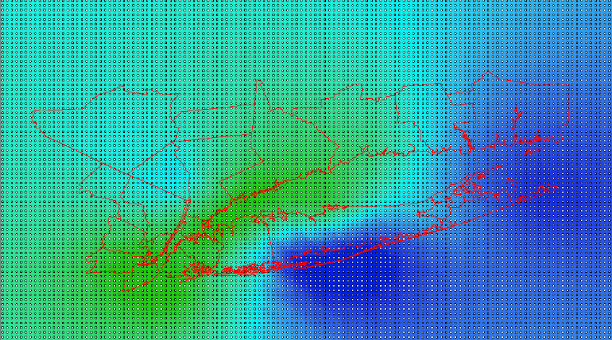
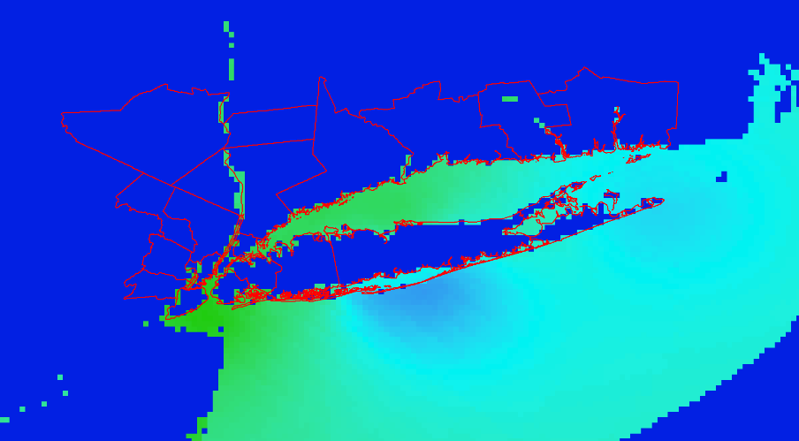
VDatum
TWL grid (MLLW/feet) DEM (NAVD88/meters)

Slide 18
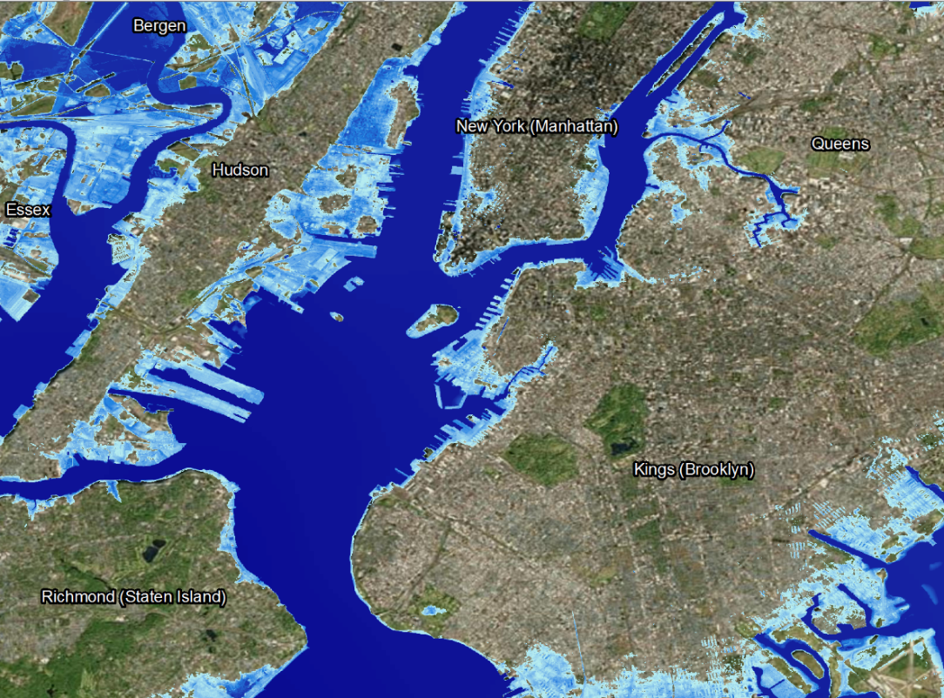
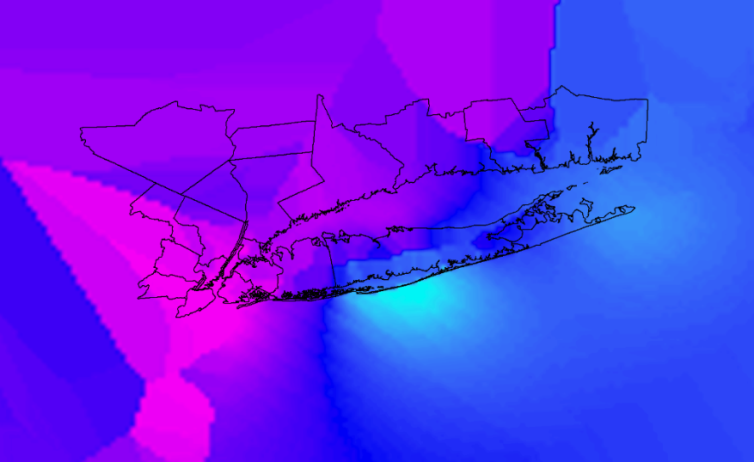
Geoprocessing
Euclidean Allocation Extract overland
Resample
Raster Calculator Inundation (“bathtub approach”)
Spatial Analyst Convert units (meters to feet)
Post VDatum raster
Resampled EA raster

Slide 19
RESULTS

Slide 20
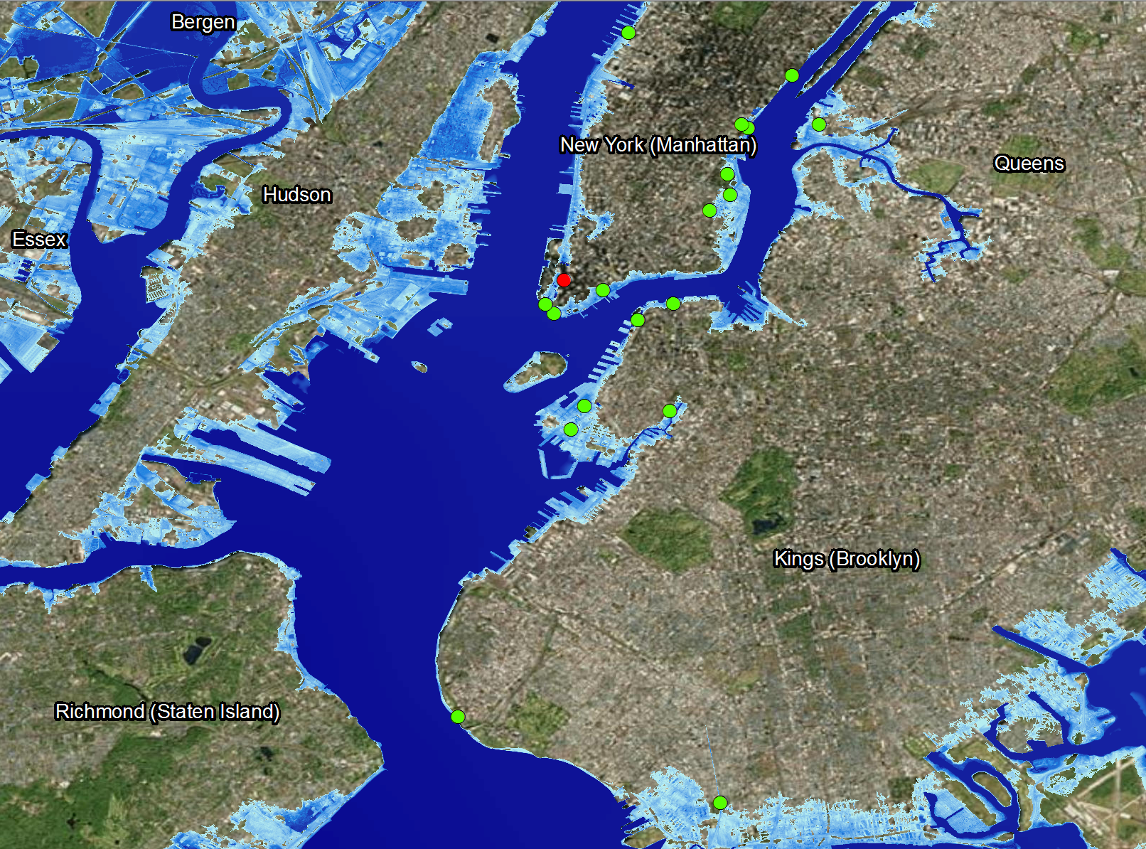
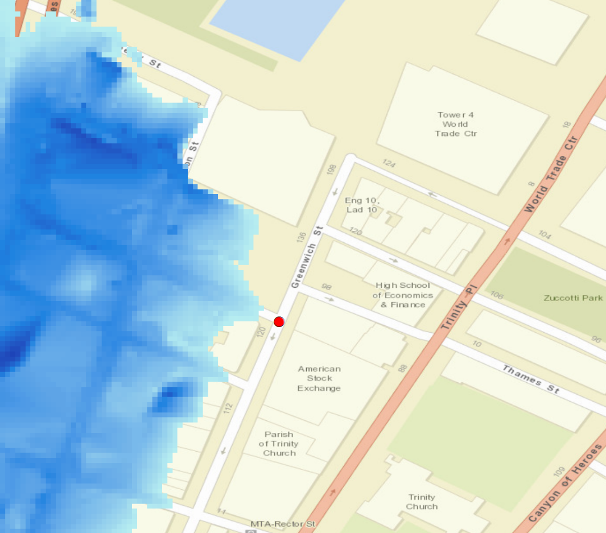
Results

Slide 21
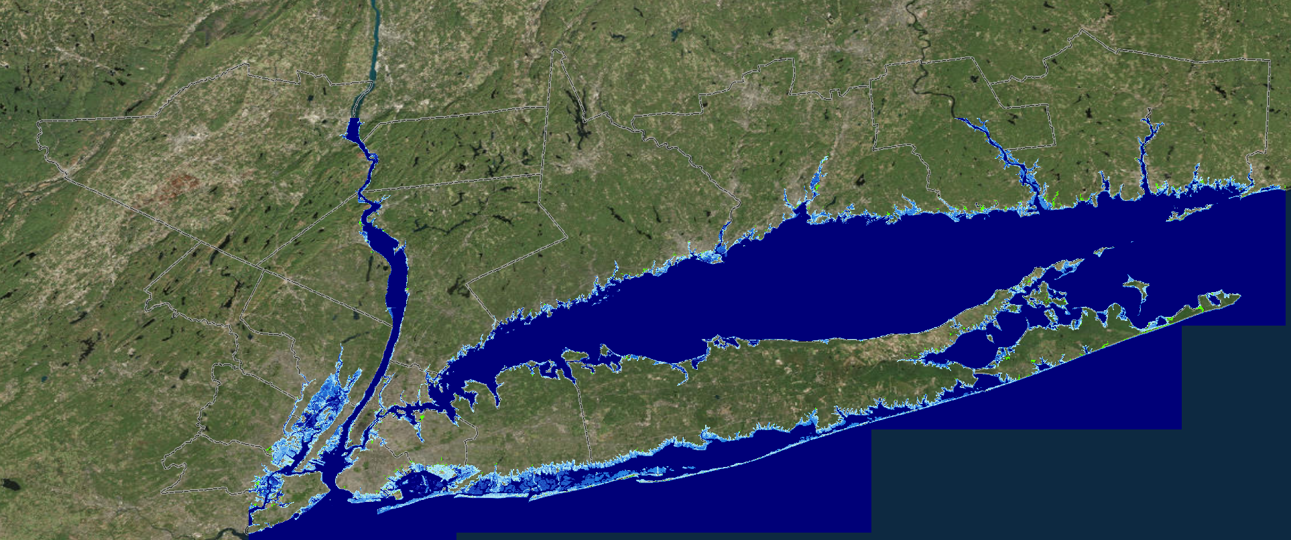
Results

Slide 22
FUTURE WORK

Slide 23
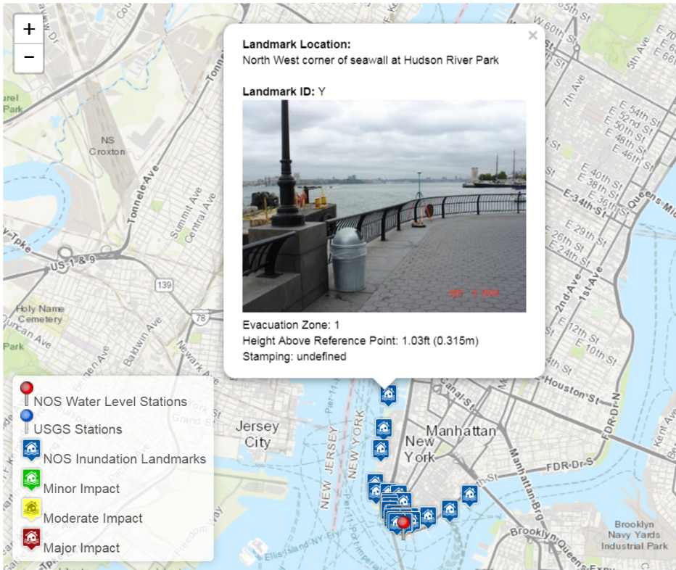
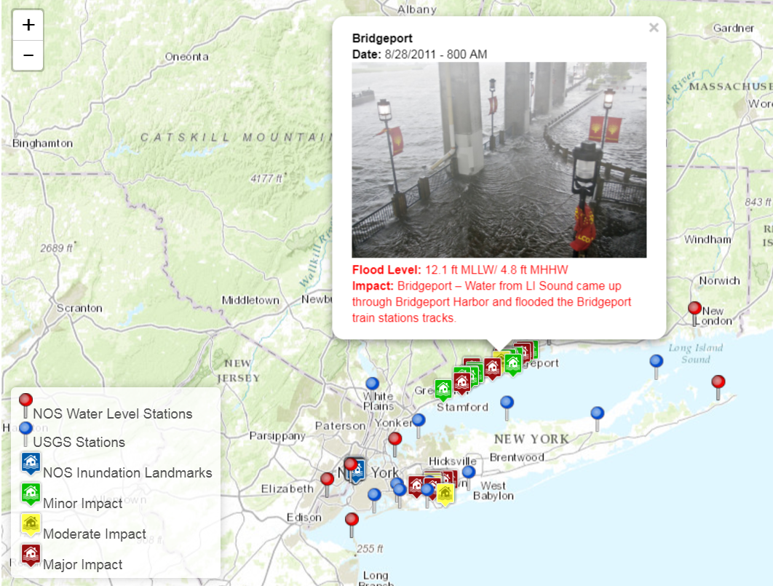
Future Work
Compare other impacts to inundation results
Automate processing
Minor to moderate coastal flooding event
Web interface

Slide 24
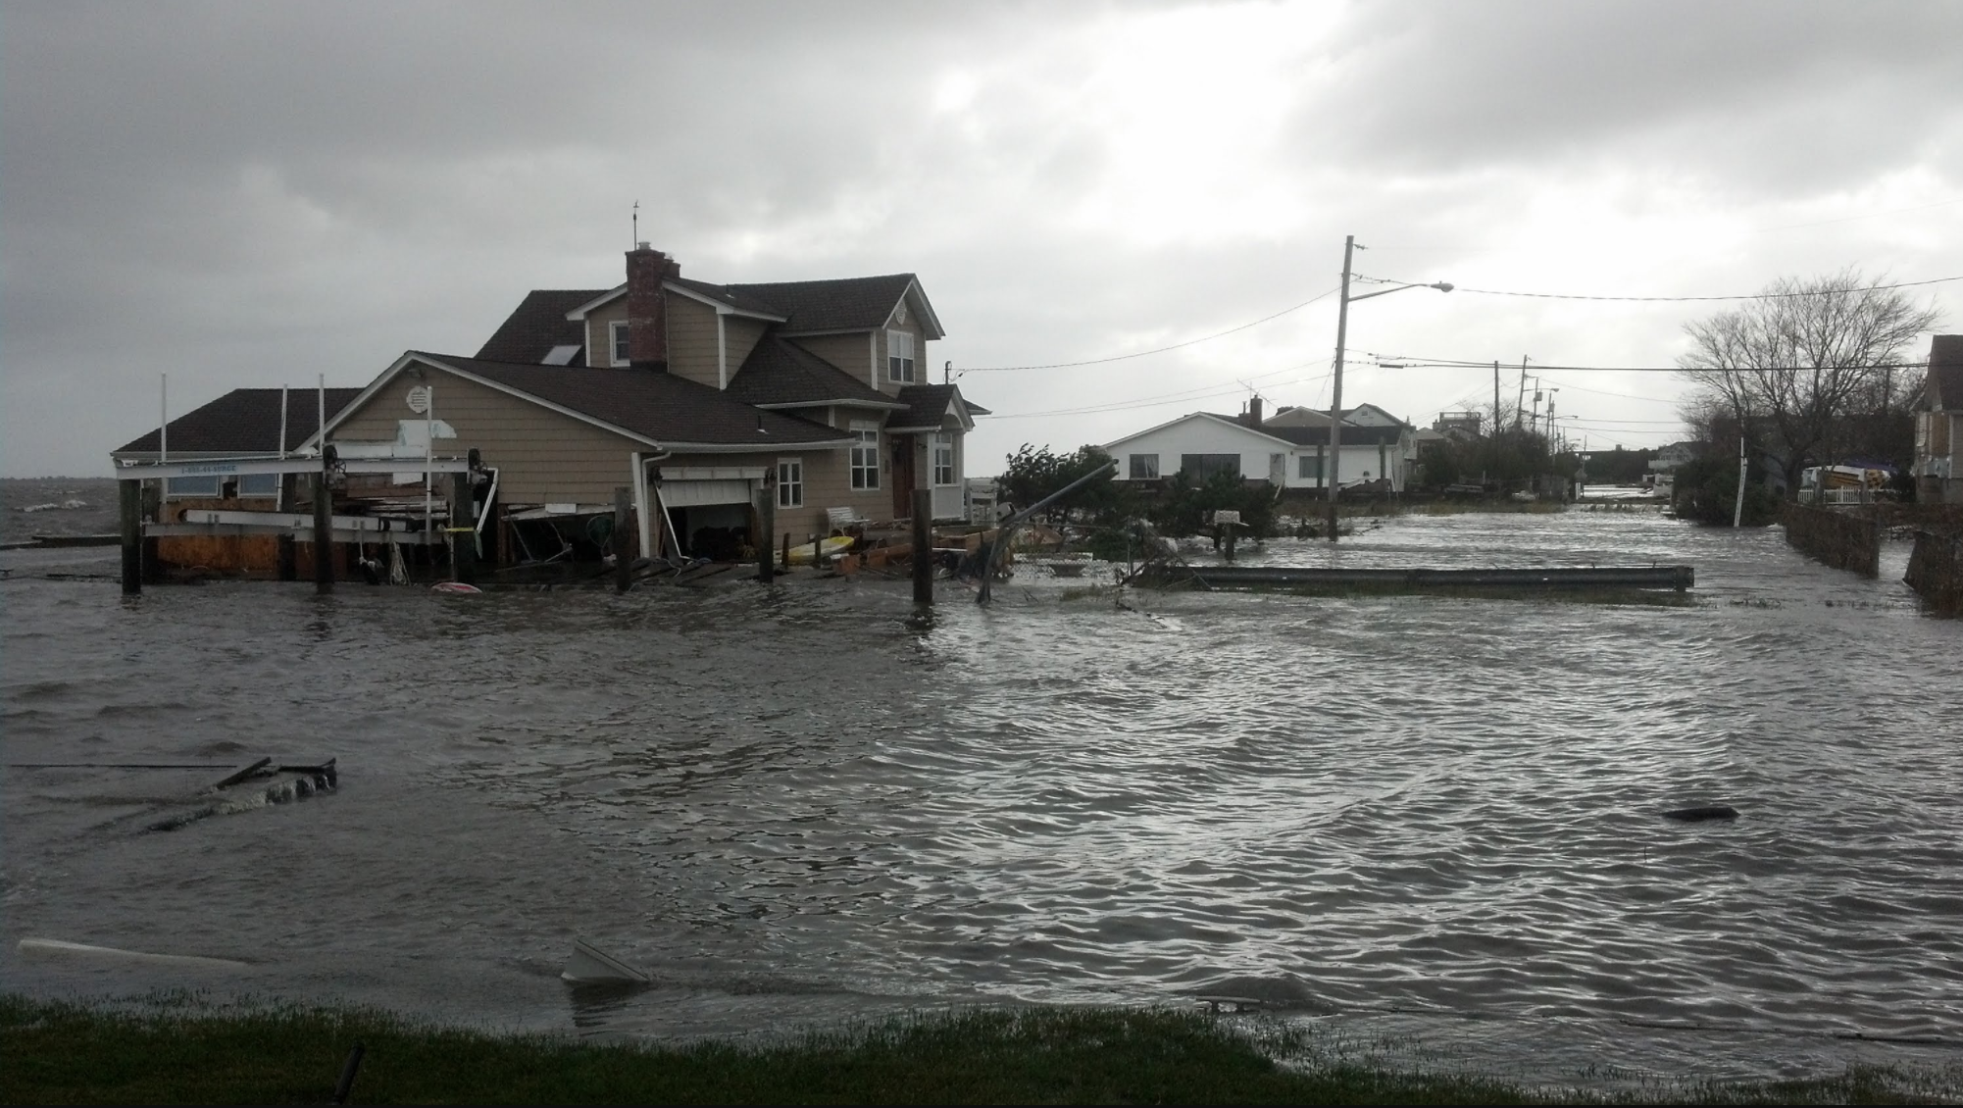
THANK YOU!
adrienne.leptich@noaa.gov

Slide 25
References
Buckley, Aileen R, Mark Gahegan, and Keith Clarke. 2000. "Geographic visualization." Emerging Themes in GIScience Research.
Nöllenburg, Martin. 2007. "Geographic Visualization." In Human-Centered Visualization Environments, edited by Andreas Kerren, Achim Ebert and Jörg Meyer, 257-294. Springer Berlin Heidelberg.

