Slide 1
Fast-Casual Restaurants, Race, and Poverty: A Geographic “Weighted” Regression Approach
Raul Llamas
Geog 596 A
12/8/2020
Adviser: Stephen A Matthews

Slide 2
Problem
Are fast casual restaurants excluding low income and minority populations?

Slide 3
Background
Fast-food restaurants correlated with unhealthy outcomes.
Location of fast-food restaurants and health of the communities within them.
Income levels and race
Lack of grocery stores and “food deserts”
Figure 1. Map of Fast-Food Restaurants in New Orleans (Block, 2004)

Slide 4
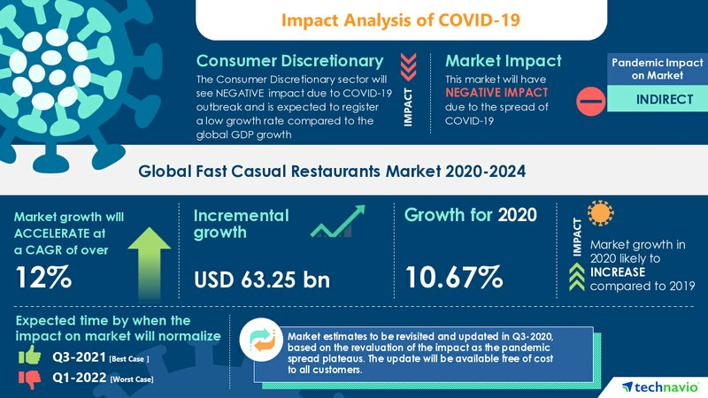
Fast-Casual Restaurants
Fast Casual Definition
Around $10
Counter Order
Fresher Ingredients
Gained popularity in the past 20 years, with vast growth in the past 10 years
Have survived during COVID
Low cost, built for take out
Chipotle
Over 2500 locations in the United States
National
Top of sales
Modern
Figure 2. Infographic of Current Fast-Casual Economic Outlook (Technavio, 2020)

Slide 5
Background
Fast casual restaurants have not been included in many analysis regarding race or poverty, have mostly focused on grocery stores in terms of food deserts and fast-food restaurants.
Fast Casual restaurants offer a healthier option of instant food with not much of a rise in cost
Inequality of healthier options possible in these areas.

Slide 6
Objective
Using geographic regression analysis, I will study the most popular fast casual restaurant, Chipotle, and the demographics of the areas that they are in. This study will focus on the Houston metropolitan area at the ZIP Code scale.

Slide 7
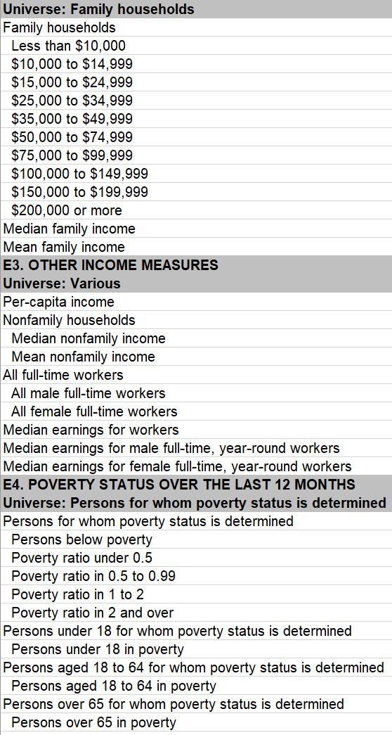
Data
Chipotle Restaurant locations
American Community Survey 2014 -2018
Variety of demographic information across multiple years.
Economic and Demographic variables
Multi collinearity
Index
Figure 3. Screenshot of American Community Survey Economic Data

Slide 8
Methods
Moran’s I and Local Moran’s I
Multiscale Geographic Weighted Regression
Varies across space
Allows for a more nuanced look
Relatively New
Figure 4. Map of Health Variables in Greater Phoenix Area (Oshan, 2020)

Slide 9
Challenges
Nighttime population vs. Daytime population
Margin of Error
Temporal data issues

Slide 10
Results
Correlation between higher income areas and a presence of a Chipotle
Correlation between white population and the presence of a Chipotle
Correlation between minority populations and the absence of the restaurant.
Correlation between the “busy” areas and the presence of the restaurant

Slide 11
Timeline
Dec - March 2021
Gather and assemble data into proper format
Explore indexing literature to be able to properly create poverty index and “busy” variable.
March - April 2021
Run analysis
Write report
Analyze results
May 2021
Develop presentation from report
Submit Report
May 2021-?
Present Capstone Project

Slide 12
References
Block, J. P., Scribner, R. A., & DeSalvo, K. B. (2004). Fast food, race/ethnicity, and income: a geographic analysis. American journal of preventive medicine, 27(3), 211-217.
Carman, T. (2019, December 31). Why fast-casual restaurants became the decade's most important food trend. Retrieved December 07, 2020, from https://www.washingtonpost.com/news/voraciously/wp/2019/12/31/why-fast-casual-restaurants-became-the-decades-most-important-food-trend/
Fotheringham, A. S., Yang, W., & Kang, W. (2017). Multiscale geographically weighted regression (MGWR). Annals of the American Association of Geographers, 107(6), 1247-1265.
Oshan, T. M., Li, Z., Kang, W., Wolf, L. J., & Fotheringham, A. S. (2019). mgwr: A Python implementation of multiscale geographically weighted regression for investigating process spatial heterogeneity and scale. ISPRS International Journal of Geo-Information, 8(6), 269.
Oshan, T. M., Smith, J. P., & Fotheringham, A. S. (2020). Targeting the spatial context of obesity determinants via multiscale geographically weighted regression. International Journal of Health Geographics, 19, 1-17.
Powell, L. M., Chaloupka, F. J., & Bao, Y. (2007). The availability of fast-food and full-service restaurants in the United States: associations with neighborhood characteristics. American journal of preventive medicine, 33(4), S240-S245.
TechNavio. Fast Casual Restaurants Market by Cuisine Type and Geography - Forecast and Analysis 2020-2024. (n.d.). Retrieved from https://www.technavio.com/report/fast-casual-restaurants-market-industry-analysis#:~:text=The fast casual restaurants market,year-over-year growth.
Walker, R. E., Keane, C. R., & Burke, J. G. (2010). Disparities and access to healthy food in the United States: A review of food deserts literature. Health & place, 16(5), 876-884.
Walker, R., & Merkley, G. (2017). Chipotle Mexican grill: Food with integrity?. Kellogg School of Management.
Zenk, S. N., Lachance, L. L., Schulz, A. J., Mentz, G., Kannan, S., & Ridella, W. (2009). Neighborhood retail food environment and fruit and vegetable intake in a multiethnic urban population. American Journal of Health Promotion, 23(4), 255-264.

