Slide 1
GIS APPLICATION IN FIREWALL LOG VISUALIZATION
Penn State MGIS 596A Peer Review
Presenter: Juliana Lo
Advisor: Dr. Michael Thomas Date: December 17, 2014
Notes:
Juliana Lo This presentation fulfills the peer re-view requirement of my capstone project towards a master degree in Geographic Information Systems.
Presentation title is GIS Application in Firewall Log Visualization.
My advisor is Doctor Michael Thomas who has been very helpful providing guidance on this project.
My educational background is in information technology with a degree in computer science. I have worked in the industry for over 25 years, fairly familiar with networking technology and firewall operation. My interest in GIS are related to use of spatial technology in emergency management to support hazard mitigation, response, and recovery activities

Slide 2
Presentation Outline
Introduction to firewall
Problem definition
Project goal and objectives
Design methodology and process
Potential challenges
Project status
Notes:
Go over the presentation outline.
In this presentation I will give you a quick firewall definition, problem definition, project goal and objectives, go into design methodology and process, potential problems, and project status.

Slide 3
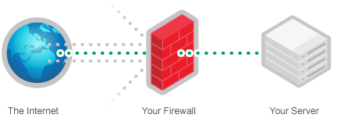
Firewall Definition
A firewall is a hardware or software designed to permit or deny network traffic based on a set of rules
Protect network from unauthorized access.
Notes:
Firewall is a security device that sits on organization’s perimeter. Its purpose is to project network from unauthorized access.

Slide 4
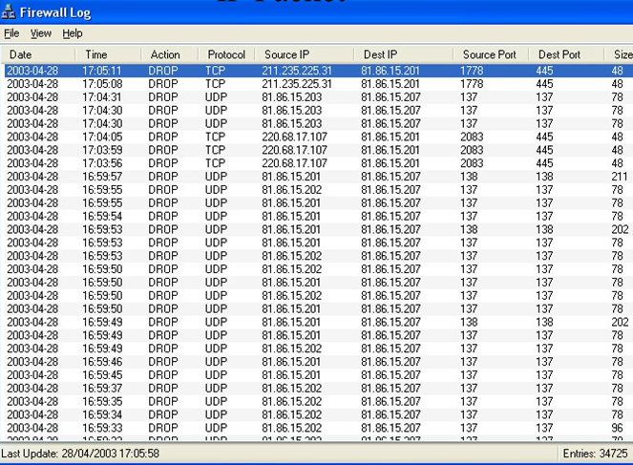
Firewall Security Log
Traffic logging is essential for these reasons:
System monitoring
Compliance
Forensics
IP Packet
Challenges:
Too much data to sort through
Live dynamic data
Notes:
Firewall system has traffic logging function, capturing incoming traffic for the purpose of system monitoring, compliances, and security forensics. The data that firewall captures are called IP packets, data that travelled between source computer system and destination computer system.
This is a screen capture of a typical firewall log showing IP packets. Let’s examine the components in this window:
Date/time of the event.
Each packet has two IP addresses. Each machine connects to the Internet is assigned a unique IP address, a number expressed in dotted decimals. For example, a typical IP address likes this 211.235.225.31 in the Source IP column. This machine on the Intranet was trying to communicate with a computer in the Destination IP column.
Source Port and Destination port columns – identify the application port number sent and received the packet.
As we can see here firewall captures important details. It gives the network administrator insight on what type of traffic has been passed through the network. The challenge is monitoring the information because there are thousands of records generated each day. Examining the data is important and yet often overlooked because the volume of data, there are too much information to go through. The firewall data is live, dynamic data that are constantly added each day.

Slide 5
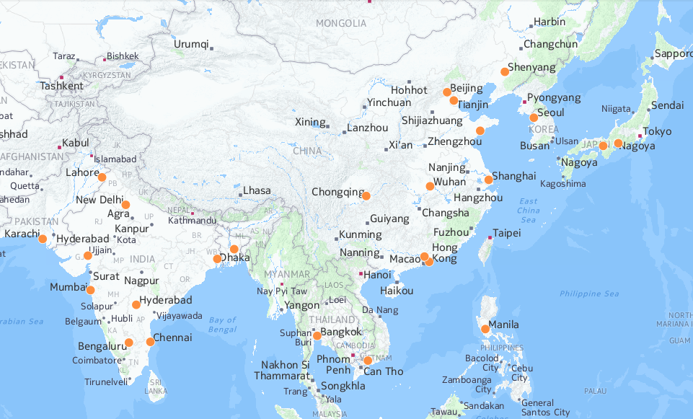
Firewall Security Log Solution
Transform Table
Map
Attributes: event time, severity,
# of occurrences
Source IP: 211.235.225.31
Charts
Database
Latitude 37.3925, Longitude 126.9269
Notes:
My proposed solution to this problem is to visualize the firewall traffic on a map using machine IP address. For example, this IP number can be translated using a location database into latitude and longitude coordinate and plotted on a map. Other attributes like the event time stamps, severity, # of occurrences can be incorporated into the map. The application will not only show the locations. It can also perform analysis, and aggregates the records together to product charts.

Slide 6
Project Goal and Objectives
Project Goal Develop a GIS-enabled web application to visualize firewall traffic in near-real time.
Project Goal Develop a GIS-enabled web application to visualize firewall traffic in near-real time.
Objectives
Geolocation of firewall IP packets into geographic coordinates. Visualize the information on a map.
Develop a feasible workflow for data extraction, transformation, and loading process.
Automated data processing to support near-real time data.
Use the cloud infrastructure to share GIS data and applications.
Notes:
The goal is simple and straight forward, it define what the final outcome to be, which is to develop a GIS-enabled web application to visualize firewall traffic in near-real time.
The keywords are “GIS”, “web”, “firewall traffic”, and “near-real time“. The goal is to build an application to capture network packets coming through the firewall, process the data in GIS, present the information visually on the web, and the last key element is that data must be dynamic, close to real-time.
There are four objectives.
First objective is firewall IP packet geolocation, the process of translating a machine IP address into latitude and longitude.
Second objective is developing a workflow for data extraction, transformation, and loading process. In our project we have identified WHAT need be done; this objective is to determine HOW to go about accomplishing the goal. We need to develop the specific processing steps that make up the components in the workflow, from data extraction stage getting data from firewall, transformation stage parsing data into records with attributes, geocode data to coordinates, to last stage loading data into the a relational database.
Third objective is automated processing. Its main purpose is to create a system for use in real-time provide operational support to network administrators. Data are constantly streaming across the firewall and filtered, the updates need to be reflected in our application.
Fourth objective is use the cloud infrastructure to share GIS data and applications. There are different service models with varying degree of management responsibility, pick and choose which service model is best suited for our application.

Slide 7
Design Methodology
Discovery
System
Requirements
Design
Development
Technical
Design
Coding
Testing
Test
Develop system specification
Identify subsystems, hardware and software
Data flow diagrams
System test plan
Operational testing and evaluation
System assessment
Acceptance
Conceptual design
Needs identification
System requirements
Assemble system components
Software programming
Unit and integration tests
Client Ok
Launch
Notes:
The system design methodology follows “waterfall model” sequential design process used in software engineering, in which progress is seen as flowing steadily download through the process of Discovery, Design, Development, and Test.
In the discovery stage we create a conceptual design of what the system will look like. Talk to the stakeholders and ask questions about their needs, identify high-level system capabilities. Use website mockup & wireframe tool to help stakeholders build a shared understanding of site functionality. From a list of functional requirements we will develop system requirements to meet the needs. The requirements will define what the system will do but not how the system will do it.
In the design phase will create a high-level design showing overall framework and components making up the system. Identify subsystems, hardware and software. Each component is described, inputs and outputs are specified. Document hardware required, system configuration changes, software to be developed, and any other resource required to complete the system. Create a test plan on how to validate the system.
In the development phase we will begin to create the hardware and software components identified in the system design. Part of the solution will require software development, either use commercial off-the-shelf solution modified to meet the design specifications or write new programs from scratch. Each software module is tested individually; modules are then are then tested together from end-to-end for integration test.
In the last stage the system is fully deployed to the cloud. We do operational testing and evaluation, asses system functionality and performance outputs. Customer acceptance.

Slide 8
System Architecture Diagram
Definition: a collection of components organized to accomplish a specific task of function or set of functions
Inside Network
Computers reaching firewall
firewall
Application server
Internet
database
web app
Clients access web app
Cloud GIS
Notes:
This is the high-level view of the system architecture diagram. By definition a system is a collection of components working together to accomplish a specific task or a set of functions. This diagram shows that in our system there are two zones "inside network" and "cloud GIS", computer on the Internet are external entities, and the Internet itself.
I will describe the relationships between the components. The computers in the top right corner attempt to break through the firewall security in the "inside network" zone, the sessions are captured and sent to the application server. The server processes the data, geocodes the computer location. The data is then uploaded to the "Cloud GIS" zone; new records are appended to database. The new data will show up as the most recent records in the application. This application is accessible anywhere from the Internet from client’s web browser.

Slide 9
Data Flow Diagram
Definition: Movement of data between entities and the processes and data stores within a system
Computer
Capture
Load
SQL updates
Changes since last update
New records
Network traffic
Filtered
data
Unprocessed records
File with lat,lon
RDBMS
Firewall
Add geographic
coordinates
Data feed
Parser
IP Address Geolocation
Web App
Symbols
Source/Entity
Extract attributes
Query
records
Returns
map
Data Flow
Process
Formatted file
Geolocation file
Client
Data Store
Notes:
This data flow diagram provides a high-level view of the system that identifies the major processes and data flows.
There are four basic components in the diagram: source/entity, process, data flow, and data store.
Entities either provide data to the system or receive data from it. In this diagram Computer and Firewall are the source and destination of information (the entities), respectively. The network traffic from a computer is received by the firewall. The arrow or Data Flow is the movement of data between components. The process is the work that performs work or direct data based on business rules. A data store is where a process stores data between processes. In this diagram the Capture process writes the changes since last update to a 1st data store “unprocessed records”, which is the input to the Parser process that extracts the attributes and writes to 2nd data store “formatted flat file”. This data file and 3rd data store “Geolocation file” are inputs to IP Address Geolocation process; outcomes are stored in 4th data store “Flat file with latitudes and longitudes”. The geocoded file is input to Load process which will perform SQL updates appending new GIS data to a relational database.
Entity Application server receive the data feed from database. Client on the internet access the web site, query records, results are returned and rendered visually.

Slide 10
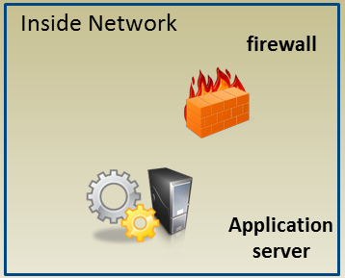
System Components (HW, SW)
Hardware
Firewall (existing)
Application Server (new)
Raw Data
11/27/2014 1:20 PM,Alert,208.65.121.2,NetScreen device_id=0185112010000717 [Root]system-alert-00442: TCP sweep! From 117.206.184.139 to zone Untrust, proto TCP (int ethernet0/2). Occurred 37 times.
11/27/2014 1:30 PM,Alert,208.65.121.2,NetScreen device_id=0185112010000717 [Root]system-alert-00442: TCP sweep! From 120.10.202.181 to zone Untrust, proto TCP (int ethernet0/2). Occurred 10 times. (2014-11-27 12:01:32)
Programs that need to be written
Capture
Parser
IP Geolocation
Data loading
Formatted Data
Geocoded
SQL Statement INSERT INTO my_table (date, severity, point_geom …) VALUES (…)
Notes:
In the hardware category, the firewall is already part of the network setup there is nothing to do here. We will be adding a new application server to host services and programs that need to written. Programs that need be written are the Processes we discussed in the Data Flow Diagram, program capturing changes to Raw Data, parser program to parse data into Formatted Data with attributes, IP geolocation to add location information, and construct SQL statements to append records to database.

Slide 11
GIS in the Cloud
Key Advantages
Data Access & Availability
Anywhere and any time
IT Infrastructure
Reduced setup cost
Reduced maintenance cost
Candidate Providers:
ArcGIS Online, CartoDB, Mapbox
Evaluation Factors
COST
Data
API
Notes:
One of the objectives is to use cloud GIS infrastructure. There are several key advantages using cloud-based services and providers. Advantage for customers - the data access is from any connection, anywhere, and any time.
Advantage for the IT management and reduced overhead, the need to have dedicated hardware environment and GIS administrators are reduced as we can outsource that to the cloud GIS provider. The overall maintenance costs will be reduced. For our project I picked several candidate providers: ArcGIS Online, CartoDB, and MapBox. They are evaluated based on cost, data support, and Application Programming Interface.

Slide 12
GIS in the Cloud Evaluation
 | Data Support | Cost | API
ArcGIS Online | Layer packages, shapefiles, CSV files, map services | Free individual account, org expensive | Robust Javascript library and design tool
MapBox | Tiles, shapefiles, KML, geotiff | Subscription is easy to understand | Robust Javascript library and design tool
CartoDB | Excel, CSV, XML, SHP, GeoJSON, and PostSQL/PostGIS backend | Subscription is easy to understand | Robust Javascript library and design tool
CartoDB Advantage
Cloud based geospatial database
Use SQL API to post data to PostGIS backend
Live, Dynamic Data!
Notes:
In terms of data support, they all capable of importing a number of data types and files formats - Shapefiles, CSV, KML, and geotiffs. They all can use WMS layer as base map data. In ArcGIS you can add vector layers from map services.
CartoDB and MapBOX can you can sync up data with documents in Google Drive and Dropbox.
In terms of Cost, ArcGIS Online is free for individual accounts, organization account can be expensive. The other two their subscription model are easy to understand.
In terms of application interface support, they all have robust javascript library and design tool.
What makes CartoDB stands out comparing the other two is the company offers a cloud based geospatial database based on Postgres SQL. What this means I can use API to write a program to post data to CartoDB’s database online. This methodology works well with live, dynamic data since. I don't need to spin up my own geodatabase or having to stand up separate map services.

Slide 13
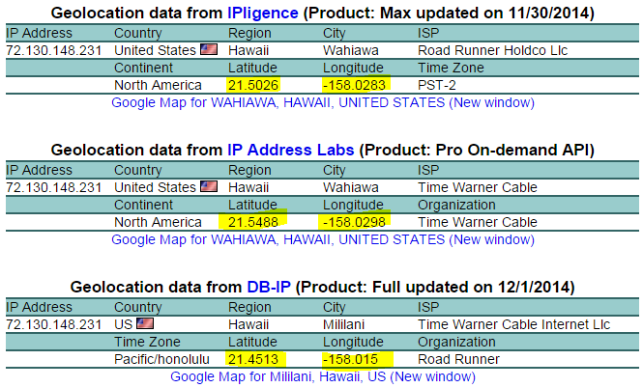
IP-Based Geolocation Issues
Inaccuracies
Rely on vendor provided database
Accuracy is good about location at county, state, and city level
ISP level accuracy is less reliable
Notes:
Let’s look a look at data accuracy issue. How reliable is IP location? Using geolocation technology, we can map machine IP address to a geographic coordinate latitude/longitude and include attributes country, region, and name of city. All these information are collected and stored in different database by vendors. We are relying on vendor updating their database. The general rule of thumb is accuracy is good about location at county, state, and city level. ISP level accuracy is less reliable.
The screen capture shows the results from 3 separate databases looking up a single IP address. The attribute values for country, region, city, and ISP are correct. The latitude and longitude are different from each other. Comparing with actual location degree of accuracy varies by several miles.

Slide 14
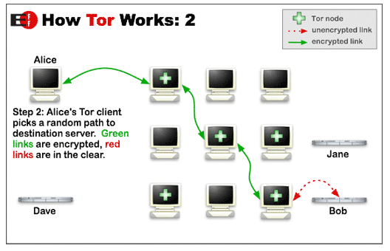
IP-Based Geolocation Issues
Variation in result accuracy
Use proxy servers at known locations (GeoSurf, FoxyProxy, and many others)
Virtual Private Network (VPN)
TOR Project, like a proxy but server changes
https://www.torproject.org/about/overview.html.en
Notes:
There are several reasons for this variation in results because:
Use of proxies by the user hides the exact location. Geolocation services use the location of the server on which that IP is accessing the internet, not the location of the user’s machine. There are a number of commercial proxy servers, such as GeoSurf, FoxyProxy, and many others.
Virtual Private Network (VPN). This is a network set up to communicate privately over a public network, encrypted communication tunnel between computer and internet gateway. If you have access to company’s VPN network you are behind a proxy.
TOR Project is an anonymous network. Set up like a proxy but server changes.

Slide 15
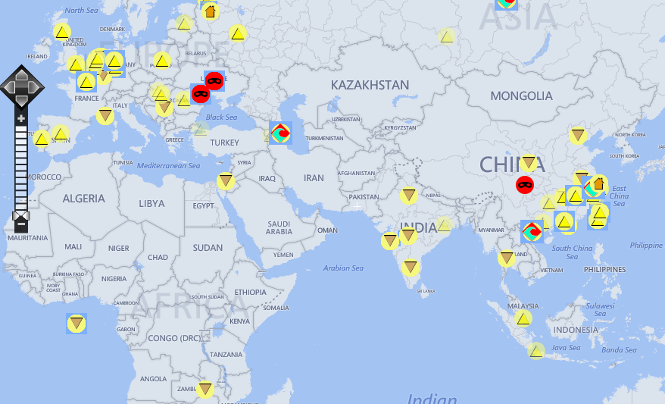
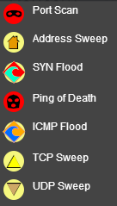
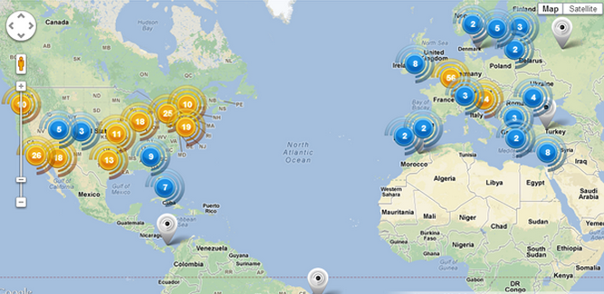
Anticipated Results
Map with symbols, cluster map
Pie Chart and Line Graph
Notes:
The anticipated result for the web application should look something like the maps shown on the screen, maps with symbols, and cluster map. Pie chart and line graph to display statistics.

Slide 16
Project Status
In Progress (to be completed by 2nd week Jan, 2015)
Concept Design
System Specification
System Design
Implementation & Testing (Jan 2015 – Apr 2015)
Data extraction, transformation, load scripts
Web site development
Visualization scripts
Notes:
This slide outlines the project status. I have done a lot of research on designing the system figuring out the hardware, software, and cloud GIS components; looked into web programming API, Javascript libraries, and scripts that are needed for data integration. I expect to have the design finalized by 2nd week in January. Implementation, integration, and testing will follow from January to April.

Slide 17
Presentation
ESRI User Conference
San Diego, CA
July 20 – 24, 2015
Abstract submitted
Notes:
I am hoping to attend ESRI user conference next year July in San Diego. Abstract submitted in November and is waiting for decision.

Slide 18
References
A. Chuvakin, K. Schmidt, C. Phillips, "The Authoritative Guide to Understanding the Concepts Surrounding Logging and Log Management", Chapter 2, Publisher Syngress, December 13, 2012.
S. Northcutt, J. Shenk, D. Shakleford, "The Log Management Industry: An Untapped Market", Sans Institute InfoSec Reading Room, June 2006, http://www.sans.org/reading-room/whitepapers/logging/log-management-industry-untapped-market-34630
"Log Formats Supported by Sawmill", Sawmill, http://www.sawmill.net/log_formats.html (accessed Oct 25, 2014).
T. Bond, "Visualizing Firewall Log Data to Detect Security Incidents", Sans Institute Global Information Assurance Certification Paper, Sans Institute, 2009, http://www.giac.org/paper/gcia/1651/visualizing-firewall-log-data-detect-security/109883
I. Poese, S. Uhlig, M Ali Kaafar, B. Donnet, B. Gueye, "IP Geolocation Databases: Unreliable?", ACM SIGCOMM Computer communication Review (CCR), April 2011.
J. A. Muir, P.C. van Oorschot, “Internet Geolocation and Evation”, ACM Computing Surveys, vol. 42, no. 1, 2009.
VN Padmanabhan, L Subramanian, “An investigation of geographic mapping techniques for Internet hosts”, ACM SIGCOMM Computer Communication Review 31 (4), 173-185, 2001.
Y Tian, R Dey, Y Liu, KW Ross, “China’s Internet: Topology Mapping and Geolocating”, INFOCOM, 2012 Proceedings IEEE, 2012.

