Slide 1

Geospatial Standards and ROI
International Organization for Standardization
(International Standards)
OGC® (Software Interface Standards)
FGDC (Geospatial Data Standards)
Capstone Peer Review
Jessica M. Longshore, MGIS Candidate
David DiBiase, GISP, Graduate Advisor
July 5, 2011

Slide 2
Acknowledgements
David DiBiase, GISP
  Graduate Advisor
  The Pennsylvania State University
  Director, URISA
David Lanter, PhD & GISP
  Co-Instructor of workshop
  URISA Curriculum Development Chair
Carl Reed, PhD
  CTO and Executive Director Specification Program
  Open Geospatial Consortium

Slide 3
Project Overview
Background
Development
Benefits
Conclusion

Slide 4
Project Background
Industry resistance
Industry support and involvement
Lack of industry support
Lack of process knowledge
Problem
  The Geospatial industry and stakeholders have misconceptions towards adopting and implementing standards within the workplace.
  Peers and Professionals are not involved in the Geospatial standards development process.
Proposed Solution
  Research case studies that demonstrate the qualitative and quantitative benefits to implementing geospatial standards into the workplace
  Educate the Geospatial community about the ISO, OGC® and the FGDC organizations and their standards development processes. Encourage involvement by eliminating lack of understanding the process.

Slide 5
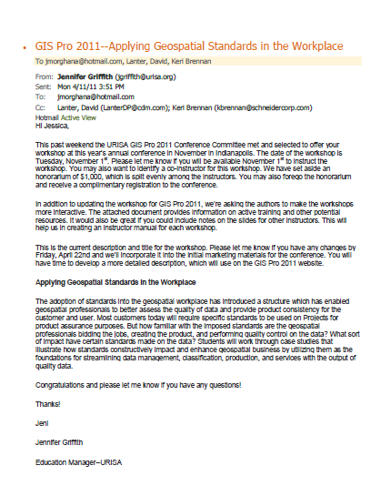
Project development
Phase 1:
Identify the best forum for educational outreach
Timeline
February 1, 2011- A tentative outline for the workshop was sent to URISA for review.
February 7, 2011- Workshop proposal due.
March 11, 2011- URISA support to develop the workshop.
April 11, 2011- Workshop was selected to be offered at the GISPRO 2011 Conference in Indianapolis, IN on November 1st.

Slide 6
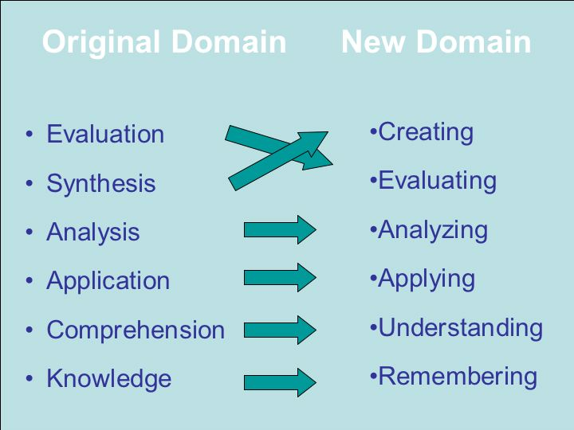
Project Development
Phase 2:
Establish purpose and objectives of the workshop
URISA provided a workshop development document outlining topics such as:
  Learning Objectives
  Instructional Methods
  Visual Aids
  Instructional Plans
  Learning resources
Bloom’s Revised Taxonomy
Image Source: Don Clark @ nwlink.net

Slide 7
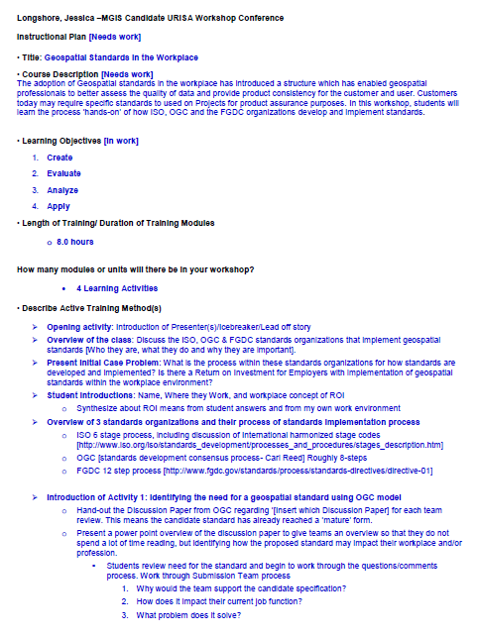
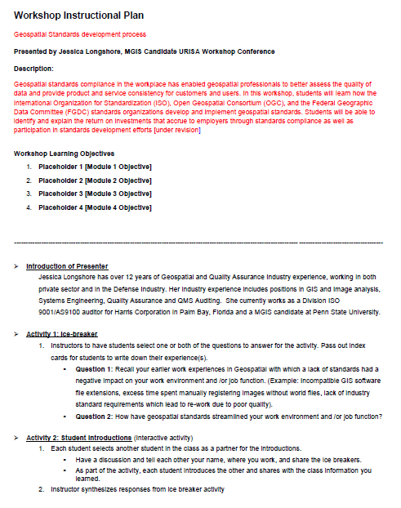
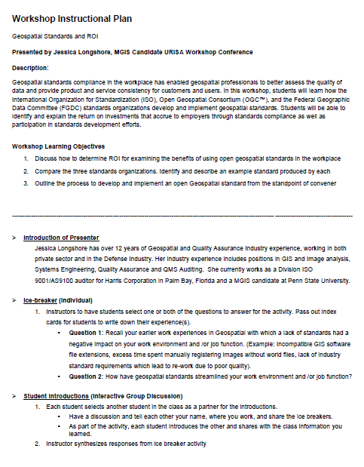
Project Development
Phase 3:
Develop Instructional Plan
and Workbook
April
May
June

Slide 8
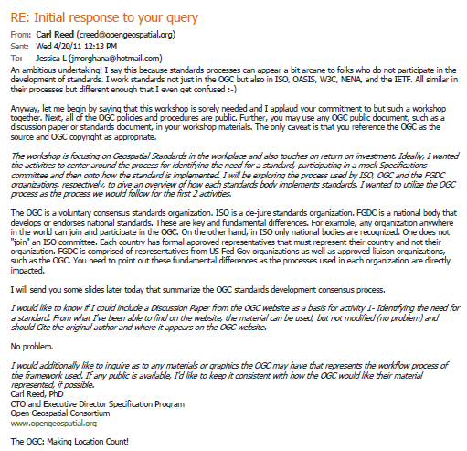
Project Development
Research and Resources
OGC® has an ‘open’ standards process and has affordable and publicly available membership levels.
Best candidate for standards implementation process

Slide 9
Project Development
Workshop Learning Objectives
Discuss how to determine ROI for examining the benefits of using open geospatial standards in the workplace
Compare the three standards organizations. Identify and describe an example standard produced by each
Outline the process to develop and implement an open Geospatial standard from the standpoint of convener

Slide 10
Project Development
Workshop Module Development process
Defining a ‘standard’ and the types of standards
De Facto
OGC
Software Interfaces: Instantiate Domain and Dejure into Infrastructure
ISO/ FGDC
Domains: Object / Abstract Models, Content, Vocabulary
De Jure
Domain
Infrastructure
Copyright © 2009 Open Geospatial Consortium, Inc.

Slide 11
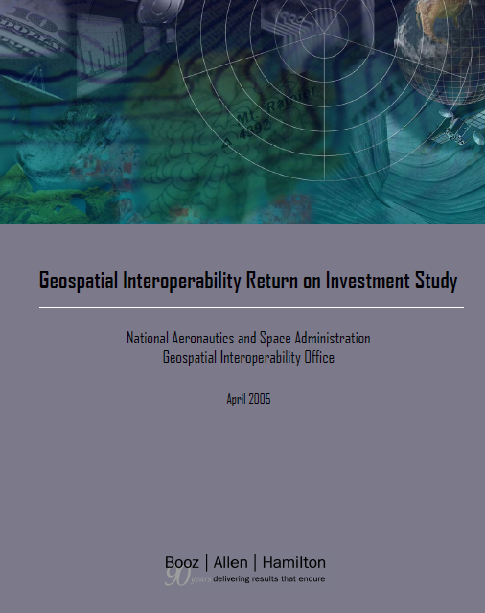
Project Development
Workshop Module Development process
Module 1: Case Study learning resource
Geospatial Interoperability Standards and Return on Investment (ROI)
http://www.egy.org/files/ROI_Study.pdf

Slide 12
Project Development
Workshop Module Development process
Module 2: Discuss history and background of Geospatial Standards Organizations and their standards outputs
ISO (International Standards)
OGC (Software Interface Standards)
FGDC (Geospatial Data Standards)

Slide 13
Project Development
Workshop Module Development process
Module 3: Overview of ISO, OGC™ & FGDC’s Standards Development Process
Proposal Stage (Idea/Need)
Project Stage (Work Group)
Draft Stage (Submission)
Review Stage (Peer and Committee Input)
Approval Stage

Slide 14
Project Development
Workshop Module Development process
Module 4: Generation of an RFC Package (Request for Comment) using the OGC™ Candidate Standard process
Submission team formed. 3 or more Members
OGC
Architecture Board Review
30 day public comment period
Final edit, schema validation, processing of URIs
Proper Documentation Submitted
OK for
Public
Comment?
Comments received and processed
Publication!!
Yes
Workshop
focus
NO
RFC or
Fast Track
Work Happens
Group decides whether candidate ready for adoption vote
Public announcement
SWG Charter Developed and Reviewed
60 day adoption vote
Implementation Experience
SWG Announced and call for participation
Implementation Community creates change requests
NO
Approved?
Yes
Work Happens
Image Copyright © 2011 Open Geospatial Consortium.
And the process repeats for a revision to a standard

Slide 15
Project Development
Workshop Learning Resources
Module Learning Objectives (2-3)
Challenge questions
Interactive learning activities
Post-tests

Slide 16
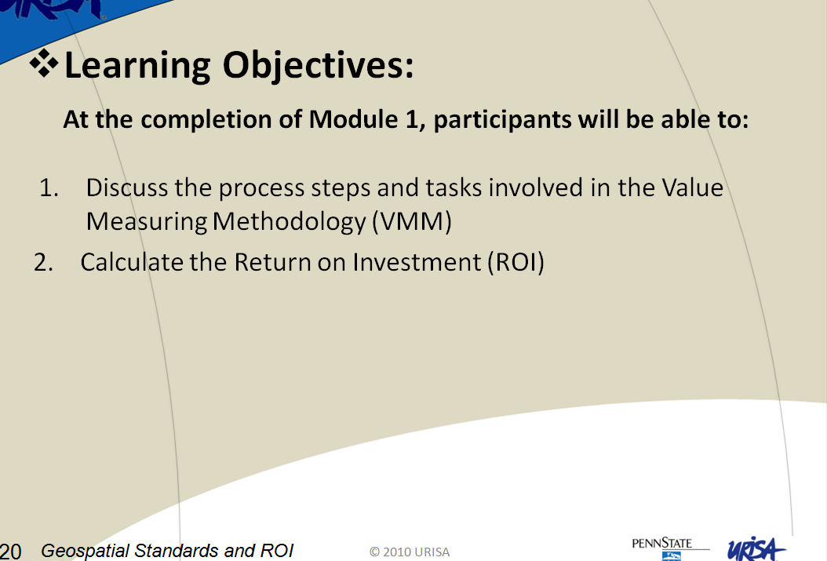
Project Development
Module Learning Objectives
What does the participant need to take-away from the module?

Slide 17
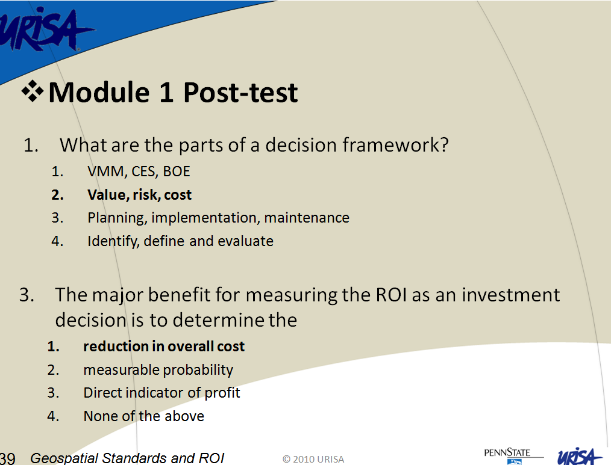
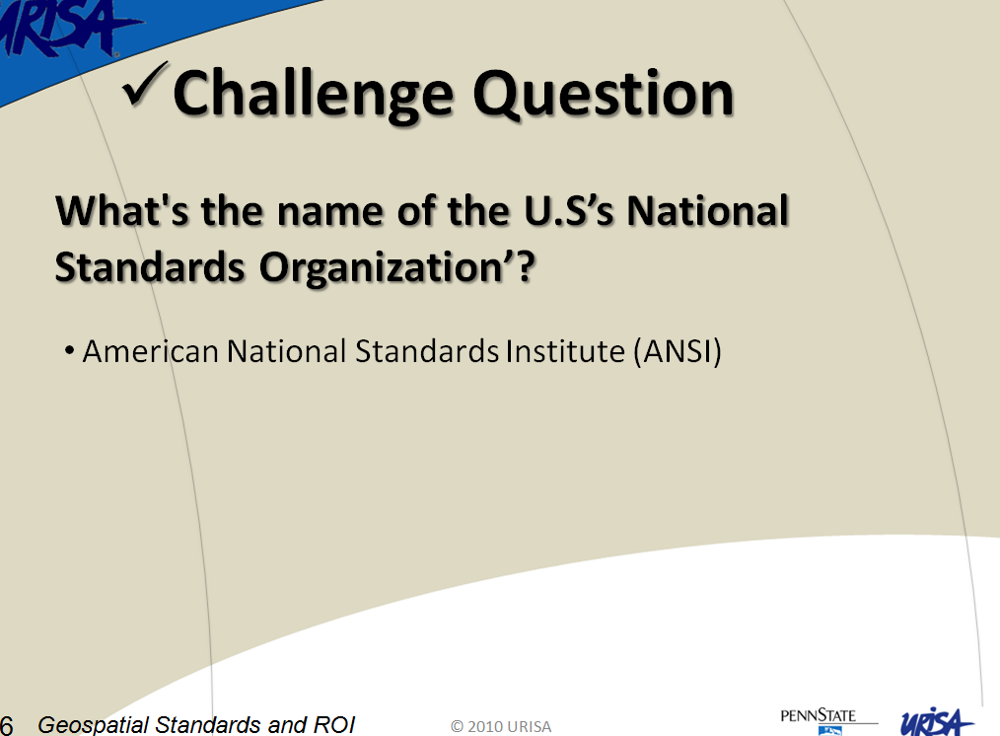
Project Development
Use of Pre and Post-Tests for
measuring training effectiveness
How effective was the lecture, challenge quizzes and activity?
Are the participants retaining the information ?

Slide 18
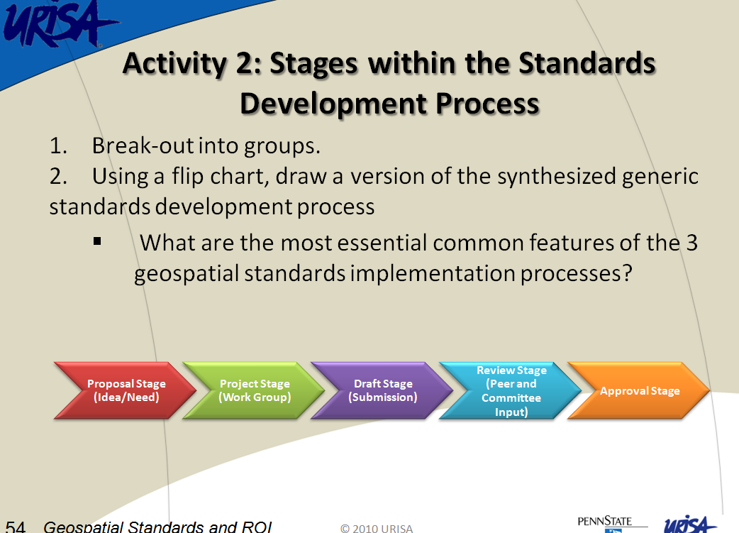

Project Development
Activities
URISA encouraged interactive learning methods
Activities are tied to the learning objectives and post-test questions

Slide 19
Project Benefits
Promote the benefits of involvement in the standards development process
Provide real-life case study that demonstrates cost savings on investing in implementing geospatial standards in the workplace
Industry standards ‘best practices’ become commonplace

Slide 20

Conclusion
The ‘Geospatial Standards and ROI’ workshop to be presented at the GIS-PRO 2011 Conference on November 1st in Indianapolis, IN.
For more information, visit http://www.urisa.org/gispro2011
Image Copyright URISA.Org

Slide 21
QUESTIONS

Slide 22
REFERENCES
Booz Allen Hamilton. (2005). Geospatial Interoperability Return on Investment Study. Retrieved April 2011, from http://www.egy.org/files/ROI_Study.pdf
Clark, D. R. (2010), Bloom’s Revised Taxonomy [Image]. Retrieved June 15, 2011 from http://nwlink.com/~donclark/hrd/bloom.html
Reed, Carl (OGC Executive Director Specification Program). OGC Process Introduction [PowerPoint presentation]. April 2011
URISA. (2009) GIS-PRO 2011 Conference logo. Retrieved June 20, 2011 from http://www.urisa.org/gispro2011
Griffith, Jennifer (2011). URISA Workshop Development. Retrieved April 2011 from http://www.urisa.org/

