Slide 1
Intelligence Led Police Patrols: A Geospatial Approach to Providing Evidence Based Policing Tactics with Patrol Routes
Wesley MacCuish Penn State – World Campus GEOG 596a

Slide 2
Background: Project idea generation
Personal Interest
Undergrad capstone was international money laundering scenarios
Close work with Department of State Diplomatic Security as an Embassy Guard
Professional Interest
Imagery Analyst by trade
Recently completed Deployment to EUCOM building web applications

Slide 3
Background: Problem Development
Aid law enforcement in the following:
Community Transparency
Provide intelligence centered from historic data
Alleviate bias through evidence-based decision making
Solution:
Develop a tool that leverages historical analysis to provide a patrol solution that is accessible by the public and allows that information to be used in conjunction with a patrol officer’s expertise.
A web-based application that performs route development based on hotspot analysis to “link” high density crimes areas
Notes:
Having a decent chunk of exposure to the law enforcement community through school and work, I wanted to see how I could provide a geospatial solution to some of the issues present in that field. This is how I developed the “problems”.​
​
TRANSPARENCY - Policing in the modern world has begun to shift from a reactive force to a proactive and preventative practice. Developing this process includes constant evaluation of procedures to increase efficiency and transparency to the public. ​
​
ENVIROMENT - How an individual thinks and behaves is largely driven by the cultural values, behaviors, and attitudes from the society that they live in, and locational occurrences are often influenced by the type of person(s) who occupy the area. The population associated with an environment both cultivate an area and a society.​
​
After assessing those, I think I had found a solution that meshed with each the identified “problems” while providing something unique. And that is with patrol routes. SO how do police patrol?​
​
Types of patrols​
Preventative: Standard patrol practice​
Team: using a team for an area​
High and low Vis: how detectable do you want to be patrolling​
High vis for community awareness ​
This will blend both together ​
Decoy: undercover​
Split force: Preventative with response officers ​
​
​
After assessing those, I think I had found a solution that meshed with each the identified “problems” while providing something unique​

Slide 4
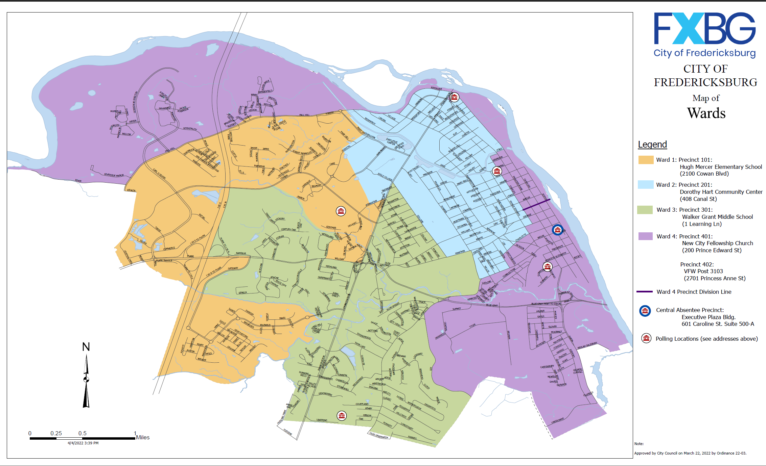
Project Area: 22401 – Fredericksburg, VA
Fredericksburg is located 48 miles south of Washington, D.C. and 53 miles north of Richmond.
Total area is approximal 10.5 square miles.
As of the 2021 census, the population was 28,367.
There are four zones that the police department uses as patrolling areas – not depicted (pending FOIA request)
Notes:
Fredericksburg is a small area with over 28 thousand people in the middle between Washington DC and Richmond. However, the township is “divided” between different counties. For this project I am going to deal with what is referred to “Fredericksburg Proper/Downtown Fredericksburg”.
However, while a small area, rising populations likely mean that crime is also going to increase.

Slide 5
Goals and objectives
Transparency of the Local Police Force
Community access to the tool and the underlying crime data
Further hotspot analysis conducted for crime in an area
Typical analysis develops the hotspots and zonal analysis but does little to combine the results of analysis into something actionable
Develop the tool for the Fredericksburg Police Department, but be replicable across most police departments
Documenting the process will allow for clear processes given to the FPD, but also providing the framework for other police departments to adopt this process.
Notes:
The problems then became the goals ​
​
-Community access vs closed system accessible by only the user​
​
-Hotspot analysis is good for supvisors and policy makers, but is not immediately actionable ​
​
-Develop the tool to be replicable

Slide 6
Proposed methodology: Functionality
Step 1: Import crime data, patrol zones, city jurisdicition and estimate average officers patrolling per day
According to Officer Greg Baugher of the FPD, one officer is usually assigned to each of the four zones
Step 2: Create a tessellation in each zone
This is to aggregate the crime into equal sized areas
Step 3: Perform a density on the crime
Types and total crime
Step 4: Create a route with “stops” at each hotspot generated within the tessellation, unique to each zones data.
Notes:
The methodology of this project has two main components : the map and the application

Slide 7
Proposed methodology: Applicability
Step 1: Develop/condition the data in the ArcGIS Pro environment
Step 2: Explore Routing tools native the ArcGIS Pro
This will likely involve using ModelBuilder to make a single process
Possibly creating/expanding a current routing tool to make a unique toolbox for this project
Step 3: Ensure functionality in strictly the ArcGIS Pro environment
Step 4: Migrate the map and toolbox to ArcGIS Online
Step 5: Convert the web map and geoprocessing into a web application

Slide 8
Project Timeline
August: Data acquisition and map formatting
September: Development of routing tool in ArcGIS Pro
October: Migrating the tool into AGOL and Start of GEOG 596b
November: Refinement of the AGOL application
December: Presentation and Conclusion of GEOG 596b
Notes:
AUGUST - A large window for the aggregation is being considered as some of this data is not easily digestible into a GIS as it is an unstructured dataset in the form of PDF files with recent arrests and reported crimes. The Fredericksburg Police Department IT department does maintain a database of crimes in the area, but that data has not been evaluated to determine the degree of “cleaning” required to be imported into a GIS.​
​
SEPTEMBER - September will be used for fine tuning the routing tool within the ArcGIS Pro environment. It is also planned to combine the tools used in ArcGIS Pro into a single script and toolbox that can be imported into the workspace and allow various drop-down parameters to be set​
​
OCTOBER - the migration into ArcGIS Online will begin. This will also include the transfer of the geoprocessing component of the routing methodology to be packaged together and imported into the web map. During this time, it is likely that a “beta test” of the tool will be presented to Officer Greg Baugher in the Fredericksburg Police Department as a means to verify the utility and overall application to the police department​
​
NOVEMBER – refine the application & buffer window for unforeseen complications

Slide 9
Presentation Venue: Fredericksburg Police Department
Deliver to the widest APPLICABLE audience
Custom tailored tool for the Fredericksburg Police Department should be delivered TO the department
Ideally, during rollcall to show the most officers in one place at one instance
Presentation structure:
Quick summary background and purpose
Tool demonstration through zones with audience input on parameters
Q & A / provide input for future refinement of the tool

Slide 10
Anticipated Results
Minimum desired result:
An ArcGIS Pro workspace that can export a custom, crime-based route to be disseminated to the patrol officers
Desired result:
A web-based application that can be accessed by a police officer on their work computers to generate their own unique routes based on user input, predefined parameters.
***Mobile use will be considered while developing the application
This would allow the officer to create a route at any point during the patrol and customize it based on their uniquely desired but limited parameters.
Notes:
The selected venue for this presentation will be at the Fredericksburg Police Department. The reason was to present the final tool as to the users directly. This will allow the targeted demographic to provide insights and questions that may not have been easily facilitated at other venues. Additionally, with the tool being custom-tailored to the crime, jurisdiction, and patrol zones of the Fredericksburg Police Department, it would allow for both easy visualization and understanding while also presenting a unique opportunity to have the officers who are patrolling the zones to confirm or deny the accuracy of the overarching idea of the tool. Ideally, this presentation would take place during the shift change roll call to have the maximum attendance. ​

Slide 11
Questions?

