Slide 1
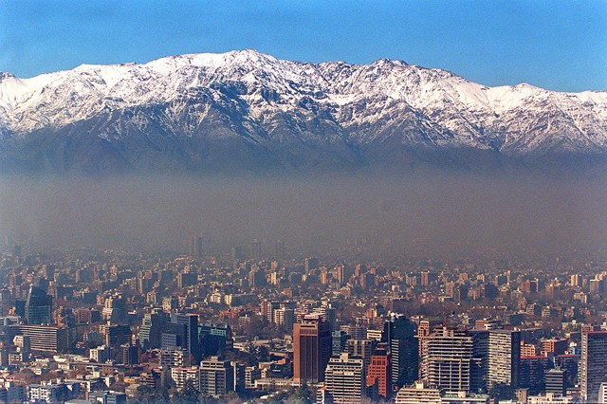
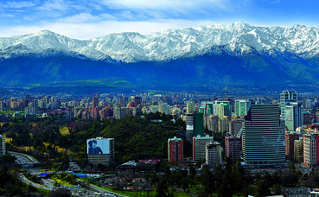
Spatial and temporal patterns of PM_{2.5} in Santiago, Chile Carolina Magri, Penn State MGIS
Notes:
Santiago is one of the most polluted cities in Latin America (similar to Ciudad de Mexico) due to human factors as well as its geographic situation. Scientific research is focusing on PM 2.5 (particulate matter under 2.5 microns in diameter) as one of the most dangerous air pollutants, linking it to lung and heart disease and more recently to neurological disorders.

Slide 2
What is PM_{2.5}?
Particulate matter or PM is a common air pollutant that consists of a mix of solid and liquid particles that varies by location.
It is described by its mass concentration (micrograms per cubic meter, μg/m³) and classified according its particle diameter .
PM2.5 are particles with diameters less than 2.5 μm.
Notes:
PM10 particles with diameters less than 10 microns (μm), and PM2.5 to particles with diameters less than 2.5 μm which include ultrafine particles that have diameters smaller than 0.1 μm. European studies suggest that PM2.5 constitutes 50 to 70% of PM10. Particles with diameters between 0.1 and 1 μm can remain in the atmosphere for days or weeks and can be carried long distances by wind.

Slide 3
Health Impacts
Short term and long term exposure of PM2.5 leads to cardiovascular and respiratory diseases as well as lung cancer.
It also increases morbidity in patients with preexisting lung or heart diseases, the elderly and children.
In 2015, papers publish in the British Medical Journal showed the effects of PM 2.5 in the brain.
The black carbon portion of PM2.5 is considered a known carcinogen and a major contributor to global climate change.
Notes:
In children long term exposure affects lung development and lung function.
One study (6.2 million cases of stroke in 28 countries) found a significant correlation between air pollution levels during the seven days before hospitalizations or deaths due to stroke, with the level of exposure of on the day of the stroke being particularly significant. A second study (71,271 women between 57 to 85 years of age) found that symptoms of high anxiety were significantly more common among women exposed to high concentrations of PM2.5.
Other studies have shown that cognitive function is poorest among adults who live in areas with higher PM2.5 concentrations and that the effect is equivalent to almost 2 years of brain aging.

Slide 4
PM_{2.5} guidelines
World Health Organization defines the guidelines for PM2.5 as,
Annual average not larger than 10 μg/m³.
The 24-hour mean smaller than 25 μg/m³ not to be exceeded for more than 3 days/year.

Slide 5
Sources of PM_{2.5}
Primary sources of PM are both man-made and natural.
Man-made sources are combustion engines, solid fuel combustion for energy production (households and industry), and other activities such as construction, mining, agriculture, residential wood or coal burning for heating or cooking, pavement erosion due to traffic and the wear-down of brakes and tires.
Natural sources of PM are soil, dust resuspension, forest and grassland fires, to name a few.

Slide 6
Patterns in PM_{2.5} concentration
PM2.5 concentration has a distinct bimodal pattern during the day, showing a peak between 7 and 8 AM and another peak between 7 to 11 PM, with a minimum concentration around noon.
Meteorological variables such as wind speed and air temperature have negative correlations that are stronger than the one for relative humidity (when these variables are compared on a daily basis).
Wind speed has the most effect and shows an inverse correlation, especially when the topography of the area is considered as well.

Slide 7
Study Area
Notes:
Santiago is the capital of Chile and has a population of 7.3 million people. The city is surrounded by two mountains ranges: the Andes to the east and the Coastal range to the west, both with peaks higher than 2,000 meters above sea level, which makes air circulation difficult, especially in winter (a low altitude thermal inversion layer forms and keeps pollutants close to the surface). The city also has 4.7 million vehicles and 70% of the country´s total mineral and agricultural industries are concentrated in the surrounding area.

Slide 8
Conditions in Santiago
Since 1997 Chile has implemented decontamination plans that have reduced the levels of air pollution in Santiago.
Santiago persistently exceeds the daily and annual averages for PM2.5 concentrations of 50 and 20 µg/m3, respectively, defined by Chilean law (D.S. N°12/2011).
In 2005, the Chilean Ministry of the Environment and the World Health Organization estimated that, at a national level, 4,000 premature deaths are the consequence of atmospheric pollution, costing the country 670 million dollars in medical expenses and loss of productivity.

Slide 9
Sources in Santiago
The major sources of PM 2.5 in Santiago are
Industry and agriculture (33%)
Residential burning of wood (22%, but reaching 30% in winter time)
Other vehicles (36%, including 3% attributable to private vehicles)
Public transportation (8%)
Between 10% and 20% of PM2.5 in Santiago is Black Carbon.

Slide 10
Objectives
Examine the spatial and temporal patterns of hourly PM2.5 concentration.
Explore its relationship to environmental factors such as wind speed and direction, relative humidity (RH), air temperature and elevation.
Identify areas of concentration and levels of exposure that exceed recommended levels.
Explore seasonal variations of the concentration throughout the city.

Slide 11
Data sources
11 measurement stations.
Hourly measurements of PM2.5 and weather conditions taken between January 1 and December 31, 2016.
Notes:
96,360 records

Slide 12
Effect of environmental factors on PM_{2.5} concentration
Regression analysis of hourly PM2.5 (dependent variable) and weather conditions (independent variables) will be performed for each measurement station.
Results will be compared in search of similarities.
Notes:
There are going to be 11 regression models, one for each station. It is possible that not all the stations behave the same way.

Slide 13
Interpolation of PM2.5 through space and time
Three dimensional Kriging will be performed using GSLib (open source geostatistical software developed at Stanford University).
Ordinary kriging using the time stamp for the hourly measurements as the Z coordinate will be used.
Co-kriging will be used to interpolate values of PM2.5, incorporating elevation as secondary variable to make better predictions (if there is a strong correlation between PM2.5 and elevation).
Notes:
Kriging is widely used in geostatistics to estimate values at unsampled locations using a dataset-specific variogram model of spatial correlation that accounts for the spatial structure of the variable being estimated, including anisotropy. The estimated value minimizes the expected squared error between the unknown true value and the estimate.
Ordinary kriging has advantage over Simple kriging in that it can replicate spatial trends by relying on local means rather than on a global (fixed) mean in the interpolation process (Deutsch, 2016), which is especially important in spatially sparse datasets.

Slide 14
An example
Notes:
The time column (Z-PT) was modified to resemble the UTM coordinates because data are binned based on distance. Semivariogram models in three directions (X, Y and Z) will be adjusted. Once the semivariograms were modeled, Ordinary 3D Kriging was run to create a grid of interpolated values in space and timeCoverage can be adjusted by modifying the kriging search parameters.

Slide 15
Emerging Hot Spot Analysis
Notes:
The Emerging Hot Spot Analysis tool in the ArcGIS Space Time Pattern Mining toolbox will be used to analyze the 3D kriged data to detect areas than can be classified as hot or cold spots. This tool identifies trends in the data. It uses a space-time NetCDF cube created using the Create Space Time Cube tool as input and performs a space-time implementation of the Getis-Ord Gi* statistic develop by ESRI. Areas are categorized as new, consecutive, intensifying, persistent, diminishing, sporadic, oscillating, and historical hot and cold spots depending on how the variable (in this case PM2.5 concentration) behaves through space and time

Slide 16
Expected Results
Corroborate the day/night cycles of PM2.5 concentration.
Find differences between week days and weekends due to changes in traffic patterns.
Find important seasonal variation, particularly between winter and spring or summer, as climatic conditions are different.
Wind speed and temperature are expected to be negatively correlated with PM2.5 concentrations.
High levels of relative humidity should help dissipate particles larger than PM2.5, so its effect on PM2.5 concentration is expected to be weak.
Notes:
Wind direction and speed should have the most effect in winter time improving the ventilation and dissipating the thermal inversion layer, allowing PM2.5 particles to dissipate.

Slide 17
Time Line
January and February 2017: get data ready for GSLib.
March to May: process the data in GSLib and ArcGIS
June: write the presentation.
July 2017: present at the ESRI User´s Conference

Slide 18
Thank you!
Questions, comments

