Slide 1
Decision Support Tool for Infrastructure Improvement
Elsit Mandal
MGIS –Capstone Project Peer Review
Advisor: Dr. Jan Wallgrun
Disclaimer: KDOT data or information on these slides are displayed only for academic purposes.

Slide 2
Presentation Outline
Introduction
Background
Motivation
Goal
Approach
Timeline
References

Slide 3
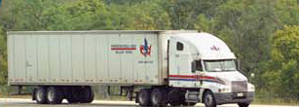
Introduction
Factors affecting Transportation Cost
fuel cost, vehicle operating cost, travel time
travel time impacted by speed limit, length of route, traffic congestion
Funding is Scarce
Infrastructure improvement is cost intensive

Slide 4
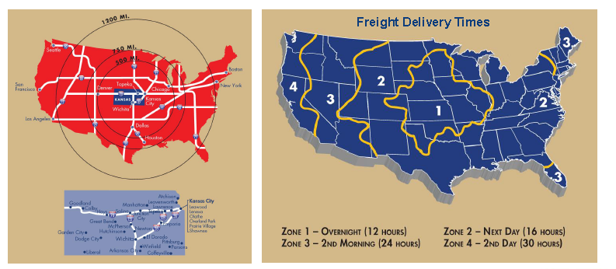
Background
The Location Advantage!
Credit: KDOT/Kansas Freight Advisory Committee

Slide 5
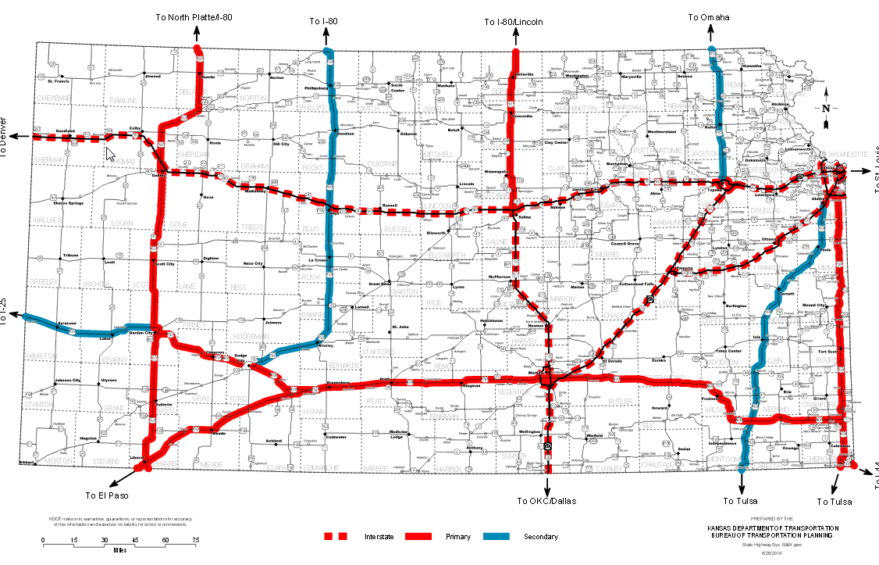
Freight Corridors of Significance
Credit: KDOT/Kansas Freight Advisory Committee (2014)

Slide 6
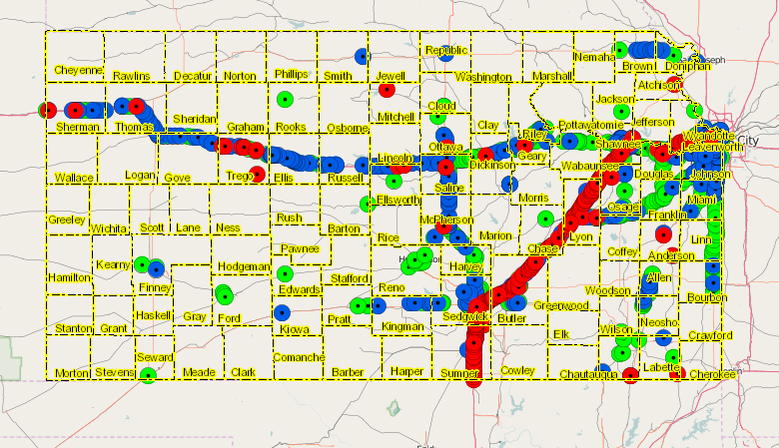
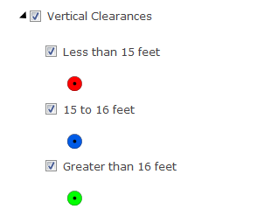
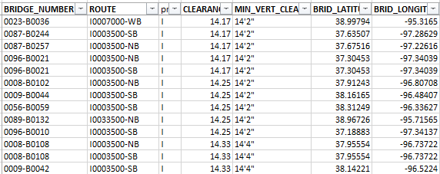
About 950 bridges passing over State Highway System [corrected number of bridges]
Approx. 70 Bridges passing over Interstate has <15 feet vertical clearance [corrected number of bridges]
Bridge Vertical Clearance Map-State Highway System
Credit: KDOT Bureau of Structures & Geotechnical Services

Slide 7
Age of Bridges in Kansas Credit: KDOT Bureau of Structures & Geotechnical Services

Slide 8
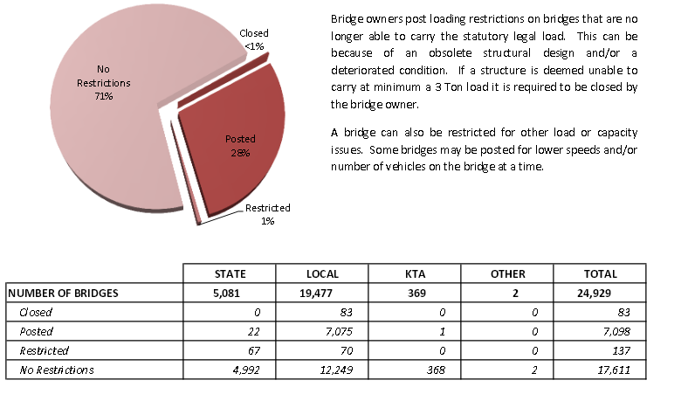
Load Restricted Bridges Credit: KDOT Bureau of Structures & Geotechnical Services

Slide 9
Structurally Deficient Bridges Credit: KDOT Bureau of Structures & Geotechnical Services

Slide 10
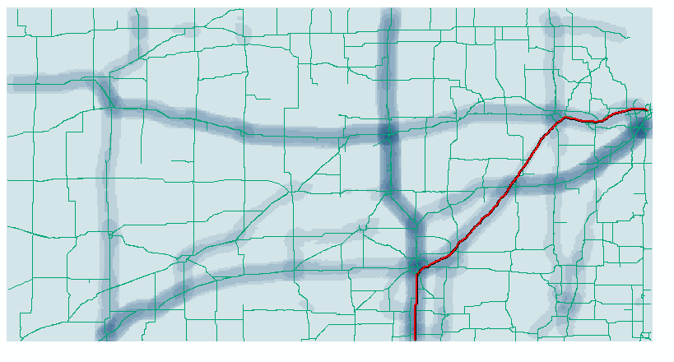
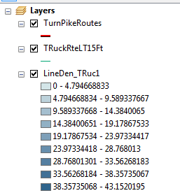
Exploring KTRIPS Data-Oversize/Overweight Truck Travel Patterns (Sample One month Data from KTRIPS-Truck Route Permit System-Truck Ht < 15 Ft)

Slide 11
Motivation Prioritizing Projects-Limited Funding
Traditionally, Investment decisions are made based up on physical condition
More beneficial to consider multiple criteria for allocating investments (Arif, Bayraktar & Chowdhury, 2015)
Decision Support System (DSS) would be helpful
Growth in GIS technologies enabled Spatial Decision Support Systems (SDSS)
Address the limitations of already existing DSS, by utilizing location data

Slide 12
Motivation-Contd. Available software
TransCAD (by Caliper Corp.)
Special GIS software for transportation planning
Transportation travel demand modeling and forecasting
Single user licenses costing $15,000
Customization will be needed to automate analysis
TREDIS: Transportation Economic Development Impact System
(no travel demand model, can take input from TRANSCAD)
Bridge Management System
AASHTOWare BrM (specific to Bridge –not much GIS functionality)
ArcGIS products and extensions-general GIS software
Widely deployed with ELA, several concurrent licenses, many out of the box tools
Large User community, easy to customize with python
Broad access to GIS platform, Increased business intelligence

Slide 13
Goal
Develop an ArcGIS tool to support selection of candidate bridges for improvement or rehabilitation
Network Analyst extension & ESRI Streetmap required
Inputs
Origin-Destination Pairs.
Truck traffic spatial geometry captured by Kansas Truck Routing Intelligent Permitting System (KTRIPS) as traffic demand Attributes include Truck height, weight and length
Barriers.
Input restricted bridges as barriers. Attributes should include posted weight restrictions, vertical clearances and cost to improve or replace each one of the bridges
Available funding
Anticipated Output
Tool should maximize benefit/cost and output a list of candidate bridges.

Slide 14
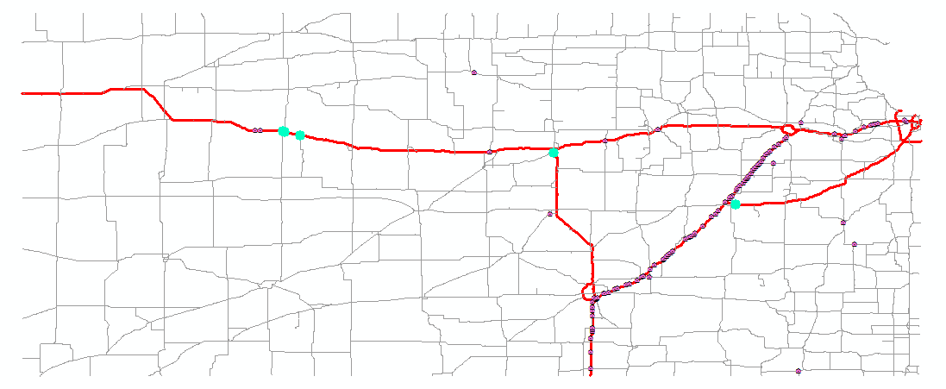
Anticipated Output
Prioritized list of bridges

Slide 15
Approach
Identify Origin-Destination (O-D)Pairs by analyzing KTRIPs data
Have 2 years worth of KTRIPS data
Create an O-D Cost matrix before improvement of bridges
Bridges with Height/weight restrictions act as barriers. Travel time is the cost
Remove barriers or ‘barrier groups’ one by one from the route network (barrier groups will be explained later)
Investment constraint limits the number of barriers that can be removed.
Recalculate travel cost matrix for various barrier removal scenarios to identify minimum cost (min. travel time) scenario

Slide 16
Approach- Cont.
Calculate total saved time for each scenario of barrier removal
Calculate a priority index for each bridge or bridge group obtained as travel time saving/cost of improvement.
Select as many bridges with highest priority index, as possible, from this ordered list as the amount of investment allows

Slide 17
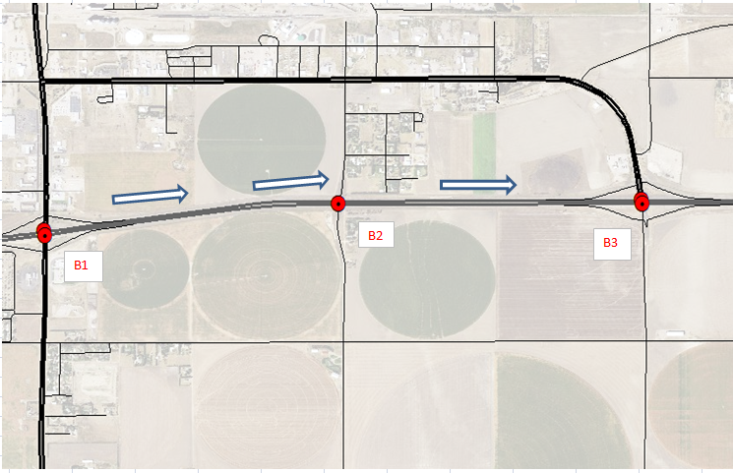
Approach Cont. Barrier Groups
Bridges between interchanges

Slide 18
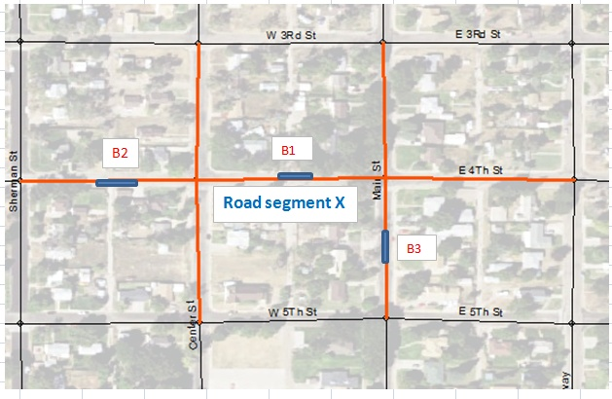
Potential Grouping-To Investigate
Investigate how to include all potential grouping effects
Grouping effect is present when the saving in time when the group of barriers are removed > the sum of savings when the barrier removal is done one at a time
Group bridges on First level of interconnected segments
Group bridges on freight corridor segments
Freight corridor segments can be accommodated in the route hierarchy

Slide 19
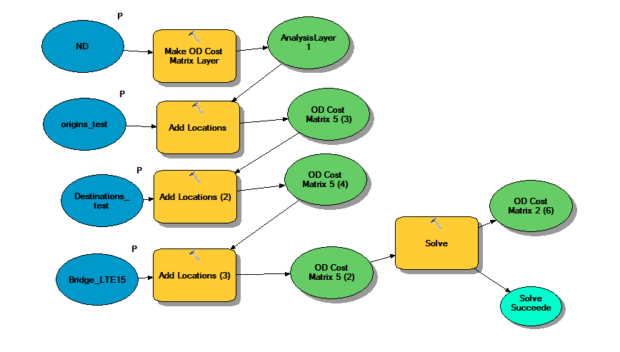
Model Builder Work Flow-Network Analyst Origin-Destination (O-D) Cost Matrix

Slide 20
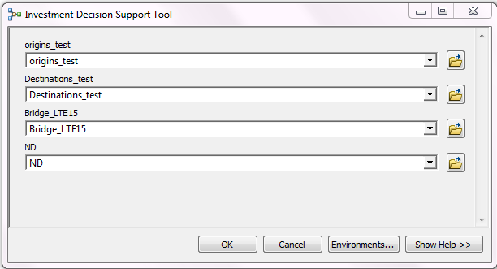
Sample User Interface-Data Input

Slide 21
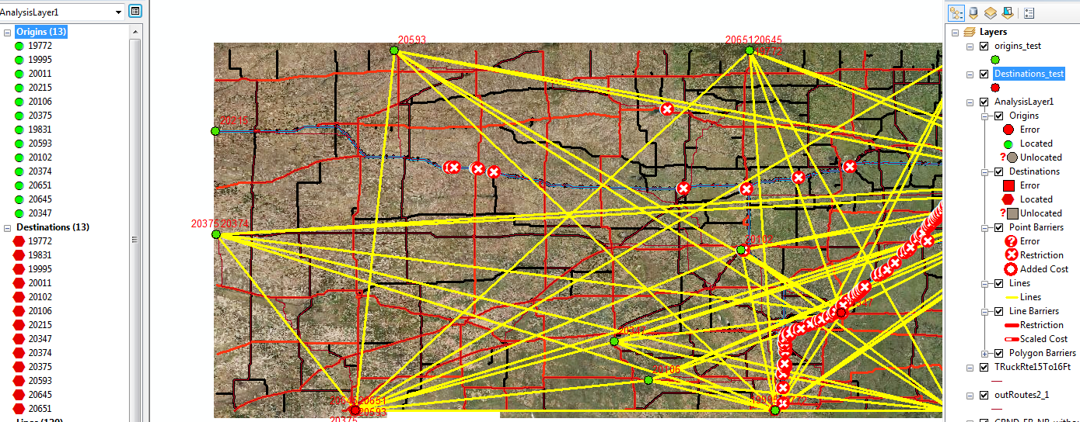
Sample O-D cost matrix output

Slide 22
Prototyping of the Tool
Invite feedback from interested users
Statewide Planning
Users of TransCAD for traffic modeling & transportation planning studies and TREDIS for economic impact
Bridge Management
Users of Bridge Management software (AASHTOWare BrM)

Slide 23
Project Timelines
January-April 2016
Build Prototype, Demo/user testing, prepare survey questions, collect user feedback
May-July 2016
Data Analysis & Exploration
August-December 2016
Tool Development, Testing and Documentation
Spring 2-2017
596B, Presentation at ESRI User Conference April 2017

Slide 24
References
1. Arif, Farrukh., Bayaraktar ,Mehmet E., Chowdhury, Arindham G., Decision Support Framework for Infrastructure Maintenance Investment Decision Making, Journal of Management In Engineering, ASCE, 2015
2. TRANSCAD, Transportation Planning Software, Caliper Corp., http://www.caliper.com/PDFs/TransCADBrochure.pdf, Retrieved November 12, 2015
3. An Analysis of the Operational Cost of Trucking, A 2014 Update, American Transportation Research Institute, September 2014. http://atri-online.org/wp-content/uploads/2014/09/ATRI-Operational-Costs-of-Trucking-2014-FINAL.pdf , retrieved December 1, 2015
4. Kansas DOT, KDOT vertical clearance maps, http://www.ksdot.org/burtransplan/maps/VerticalClear.asp, retrieved October 27, 2015
5. FHWA, http://www.fhwa.dot.gov/bridge/081597.cfm, retrieved October 27, 2015
6. Kansas DOT, http://ksdot1.ksdot.org/bureaus/burRail/rail/pdf/KFACKickoffMeetingPresentation.pdf, retrieved October 27, 2015

Slide 25
References-Cont.
7. FHWA, http://www.ops.fhwa.dot.gov/freight/freight_analysis/data_sources/index.htm. retrieved October 30, 2015
8. FHWA, Vertical Clearance, http://safety.fhwa.dot.gov/geometric/pubs/mitigationstrategies/chapter3/3_verticalclearance.cfm, retrieved October 24, 2015
9. Kansas Department of Revenue, http://www.truckingks.org/KTRIPS/KTRIPSUserGuide.pdf, retrieved November 15, 2015
10. Resources for Measuring Transportation Costs and Benefits, Transportation Costs & Benefits, Victoria Transportation Policy Institute, http://www.vtpi.org/tdm/tdm66.htm, retrieved November 15, 2015
11. OD Cost Matrix, http://resources.arcgis.com/en/help/main/10.2/index.html#//004700000032000000, retrieved November 10, 2015
12. ASCE, http://www.infrastructurereportcard.org/bridges/, retrieved December 8, 2015
13: Sugumaran, R.,Degroote, J., Spatial Decision Support systems: Principles and Practices, CRC Press, Ringgold Inc, Portland, USA, 2011

Slide 26
Acknowledgements KDOT David Cronister David Schwartz Kyle Gonterwitz Calvin Reed Tina Cramer Penn State Dr. Jan Wallgrun

Slide 27
Questions?
………
THANK YOU!

