Slide 1
ArcGIS Decision Support Tool for Infrastructure Improvement
ELSIT MANDAL (Penn State MGIS Candidate)
Road Systems Engineer, GIS Unit, Bureau of Transportation Planning
Kansas Dept. of Transportation

Slide 2
ArcGIS Decision Support Tool for Infrastructure Improvement
Presentation Outline
Background & Data Analysis
Goals
Methodology & Approach
The Decision Support Tool Set
Conclusions & Outlook

Slide 3
Freight Corridors of Significance
Credit: KDOT/Kansas Freight Advisory Committee (2014)

Slide 4
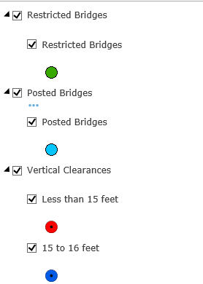
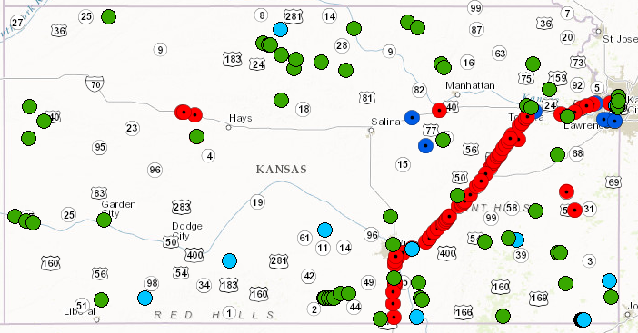
Bridges: Posted, Restricted or Vertical Clearance Limited
This material is protected from discovery and admission into evidence in litigation pursuant to 23 USC 409. KDOT makes no warranties, guarantees, or representations for accuracy of this information and assumes no liability for errors or omissions.
Credit: KDOT

Slide 5
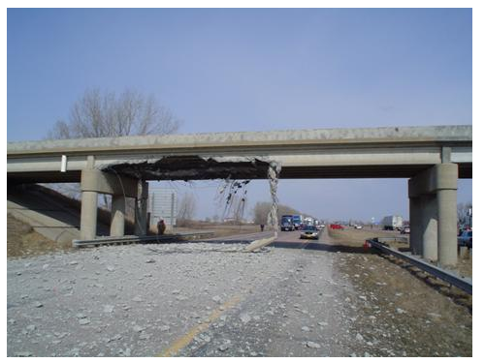
Safety-Oversize Overweight (OSOW) Trucks
KTRIPS OSOW Terminology
Truck /Load Dimensions
Height > 14’ OR
Weight > 40T OR
Length > 120’ OR
Width > 8 ‘ 6 ”
KTRIPS*: Kansas Intelligent Truck Routing System
Credit: FHWA; https://safety.fhwa.dot.gov/geometric/pubs/mitigationstrategies/chapter3/3_verticalclearance.cfm

Slide 6
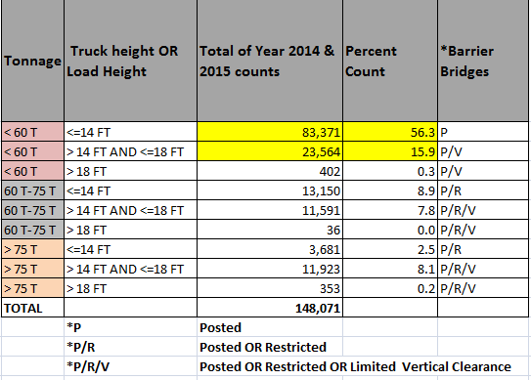
Analysis/Classification of OSOW Data
Oversize Overweight (OSOW) Routes Geometry Available from KTRIPS Summary Classification of Data for 2 Years

Slide 7
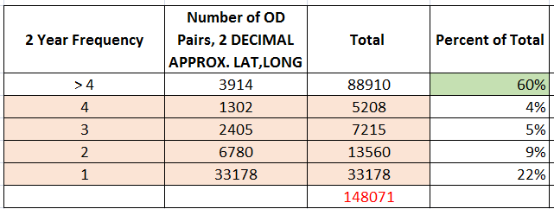
Analysis/Classification of OSOW Data
Oversize Overweight (OSOW) Routes Geometry Available from KTRIPS Grouped Classification of Data for 2 Years

Slide 8
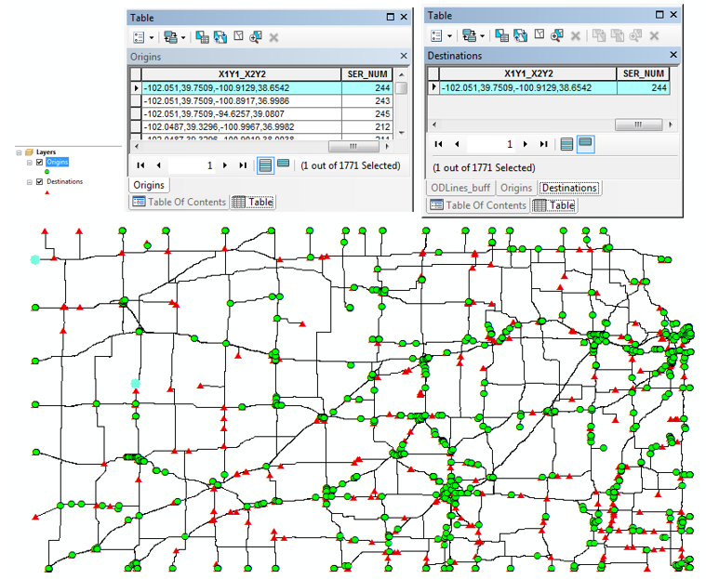
Analysis of OSOW Data: Origin and Destination (OD) Pairs

Slide 9
Goals
Project Prioritization

Slide 10
Goals
Develop Tools To:
Analyze OSOW Truck Routes
Help Visualize the Data
Support Objective Decision Making
Provide Easy to Use & Easily Modifiable Tools
Provide Prioritized List of Bridges for Improvement Projects

Slide 11
Methodology & Approach
Network Analyst

Slide 12
Methodology & Problem Solving Using Network Analyst
Required:
ArcGIS Network Analyst Extension
Routable Network Dataset (Used ESRI Data & Maps: StreetMap North America Dataset)
Origin & Destination (OD) Pairs: Point Features
Barrier Bridges- Point Features Snapped to Network Dataset
Optional:
OSOW Truck Route Geometry

Slide 13
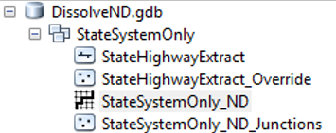
Network Data Set Properties

Slide 14
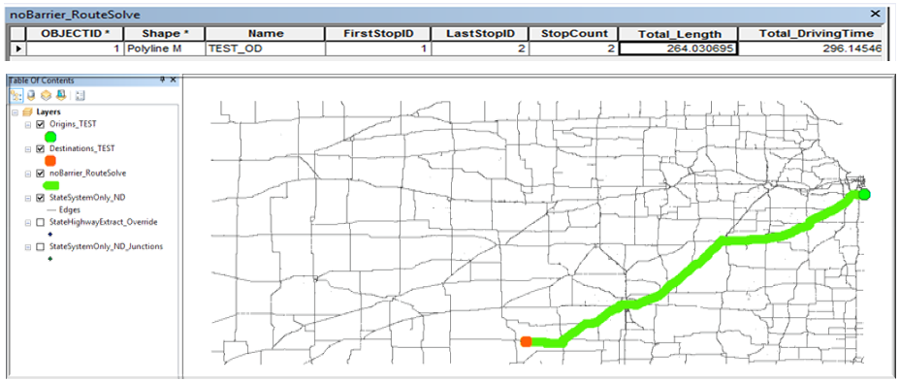
Approach--Network Analyst Route Solver--3 Step Process
Step1: No Barrier Route Solve
Find Shortest Path Geometry & Travel Length
*Test Data Used for Illustration of Methodology

Slide 15
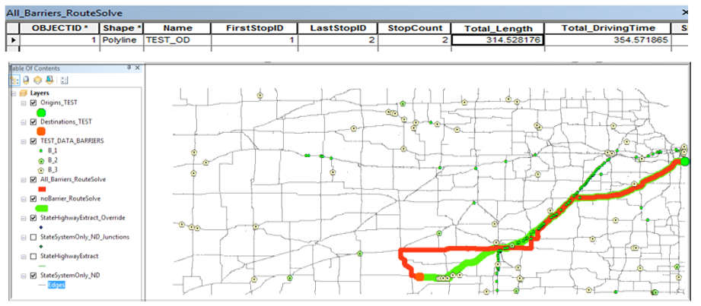
Methodology-Route Solver Process Step2-Route Solve with Barriers
Determine Barriers Specific to the OD pair
Solve Route if Barriers Present on Shortest Path; Get New Route Length
Select Barrier Bridges intersecting Shortest Path
Assign Additional Miles Travelled to Intersecting Barriers as ‘ExtraMiles’ (314-264=50)
Analyze all OD Pairs, Prioritize Barriers Based on Highest Accumulated ExtraMiles
*Test Data Used for Illustration of Methodology

Slide 16
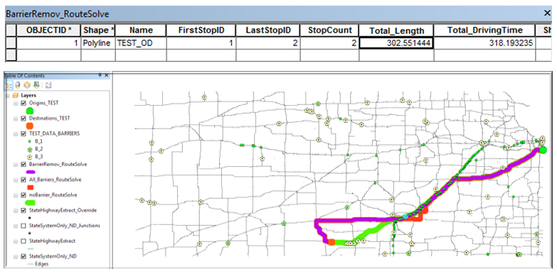
Methodology-Route Solver Process Step3
Step3: Barrier Solve After Removing Priority Barriers
Re-calculate Travel Length Cost for the OD Pairs to Validate-Saved Miles (314-302)
*Test Data Used for Illustration of Methodology

Slide 17
Computation Time Issues: Approach
Reduce Number of OD Pairs to be Analyzed: Total 148,000
Grouping by Spatial Locations & by OSOW Load Characteristics: 47,579
OD Lines Frequency >4: 3914
Reduce Size of Network Data Set
Extract State Highway Segments Only 6 Sec. to 3 Sec. per OD Pair
Apply ‘Dissolve’ on the Extracted Subset (No Barrier Solution)
Use OSOW Route Geometry for ‘With Barrier Route Solution’: This can Bypass Step2 Process

Slide 18
The Decision Support Tools
Python Scripts

Slide 19
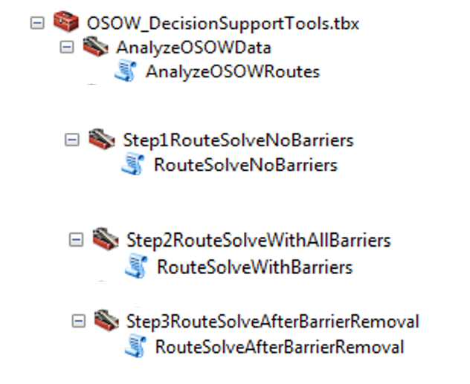
Python Script Tools

Slide 20
Analyze OSOW Data
Derive OD pairs, Classify Interstate, Inbound, Outbound & Intrastate
INPUTS: KTRIPS Routes, State Boundary Polygon
OUTPUTS: Origins, Destinations, OD Lines Frequency Polygon with Traffic Class

Slide 21
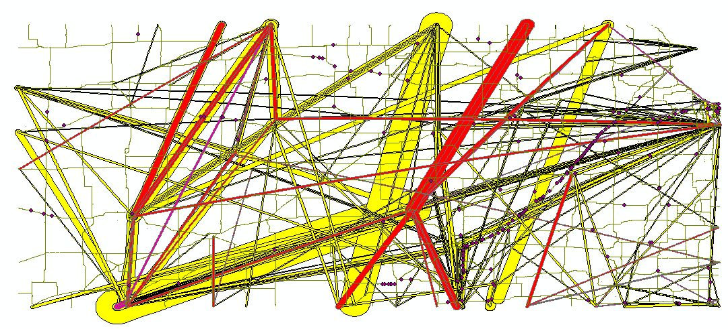
Analyze OSOW Data
Derive OD pairs, OD Lines, Classify Interstate, Inbound, Outbound and Intrastate Traffic

Slide 22
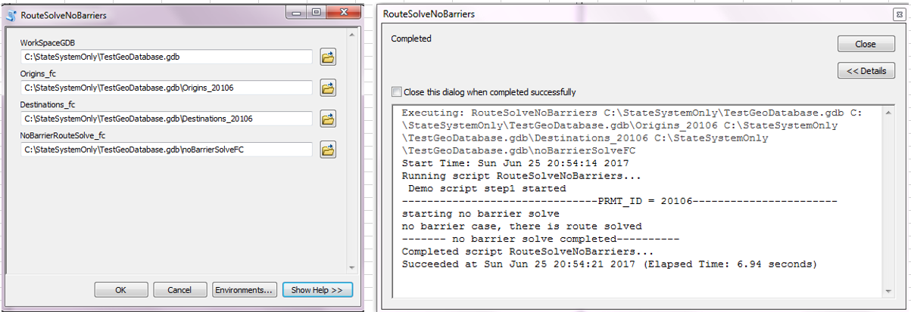
Step1:Route Solve -No Barriers Case
INPUTS: Origins, Destinations
OUTPUT: Shortest Path Route Feature Class

Slide 23
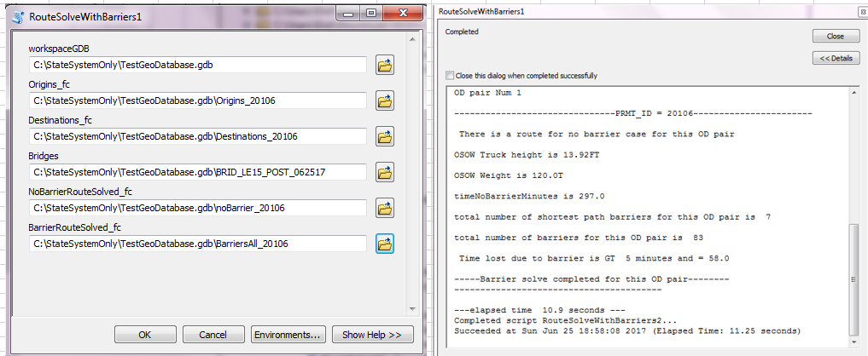
Step2-Route Solve With All Barriers
INPUTS: Origins, Destinations, Barriers, Shortest Path Route
OUTPUTS: Alternative (Longer due to Presence of Barriers) Route Path
Prioritized Barriers

Slide 24
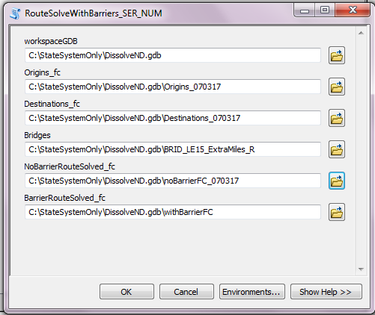
Step3-Route Solve With Priority Barriers Removed
INPUTS:
Origins
Destinations
Barriers
Shortest Path Route
OUTPUTS:
Route Path with Lesser Number of Barriers, Prioritized Barriers

Slide 25
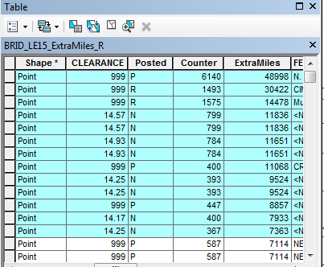
List of Priority Bridges

Slide 26
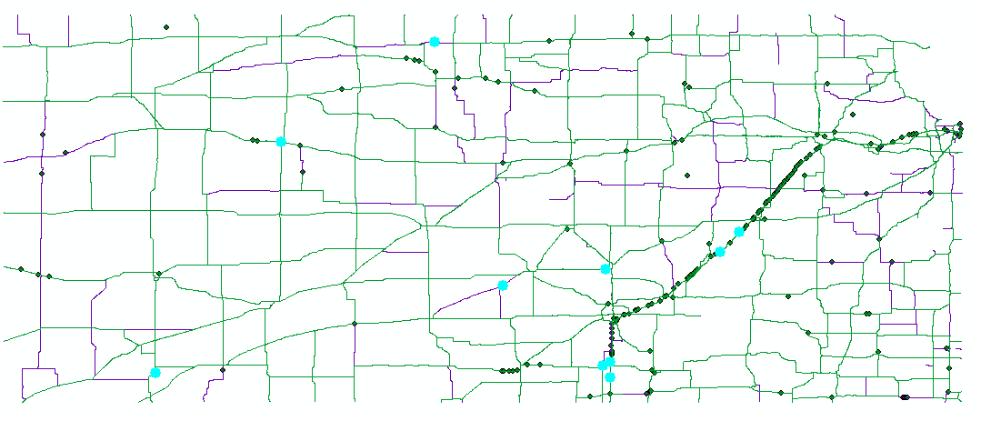
Bridge Improvement Projects Prioritization

Slide 27
Conclusions & Outlook
The Tool Provides Insight for Planning Purposes
Provides Spatial Data Analysis /Visualization
Creates Prioritized Initial List of Bridges
Makes it Possible to Validate/Evaluate the Priority List
Further Work
Run the Tool for Different Datasets for Further Evaluation
Categorize OD Pairs To Explore Monthly/Seasonal Patterns
Further Explore Ways to Reduce Computation Time
Investigate Effect of Grouping of Bridges in Barrier Removal
Different Methods of Applying Cost of Barrier
Divide the Extramiles by Total number of Barriers
Use Ton-Miles Instead of Miles
**The Tool Scripts will be Provided for Download on GitHub**

Slide 28
Acknowledgements
Penn State MGIS program: Dr. Jan Wallgrun, Capstone Project Advisor
KDOT: Kyle Gonterwitz, P.E, GISP GIS Manager
David Schwartz, P.E, Asst. Director, Planning & Development
David Cronister, Planner, Models/ Forecasting
Tina Cramer, GIS Application Developer
John Culbertson, P.E, Bridge Evaluation Engineer
John Maddox, Freight/Rail Manager
Melinda Desch, P.E, Asst. Bureau Chief, Bureau of Program & Project Management

Slide 29
Questions?

