Slide 1
Refining the spatial allocation of livestock farms with the US Department of Agriculture 2007 ‘Census of Agriculture’
Notes:
This project comes out of a need for locating feed lots. At my work at the USDA, this comes up a lot. Since there have been outbreaks and spills recently, locating them.

Slide 2
Outline
Introduction
Justification
Why do we need to know where feedlots are located?
Background
The Chesapeake Bay environment, and efforts to curb pollution from feedlots
Past Studies
Past efforts to model the allocation of manure and the distribution of feedlots at the county level
Objective
Determine if zip code level data can provide significant and meaningful change to the allocation of manure
Methodology
Steps to collect, test and model the allocation of manure
Logistics
Data sources and time line for activities

Slide 3
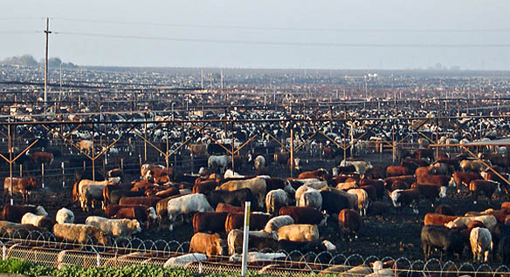
Justification
2,500 : 411,000
Notes:
Photo downloaded from the site: http://www.oklahomafarmreport.com/wire/news/2010/07/00358_COFJULY2010_143112.php
It is vital to a regions health to take into account feedlot operations, since they have such a huge potential impact. The EPA estimates that a farm of 2,500 cattle creates similar amounts of waste as a city of 411,000 people. (Source: EPA, 2004) Feedlot operations pollute almost as many miles of river as industrial sources combined. (Source:
While the number of hogs has remained almost unchanged in the past 30 years, there are accommodated on 1/10 the number of farms. Knowing where these concentrations are should be a major concern of policymakers and community leaders, as well as farmers.

Slide 4
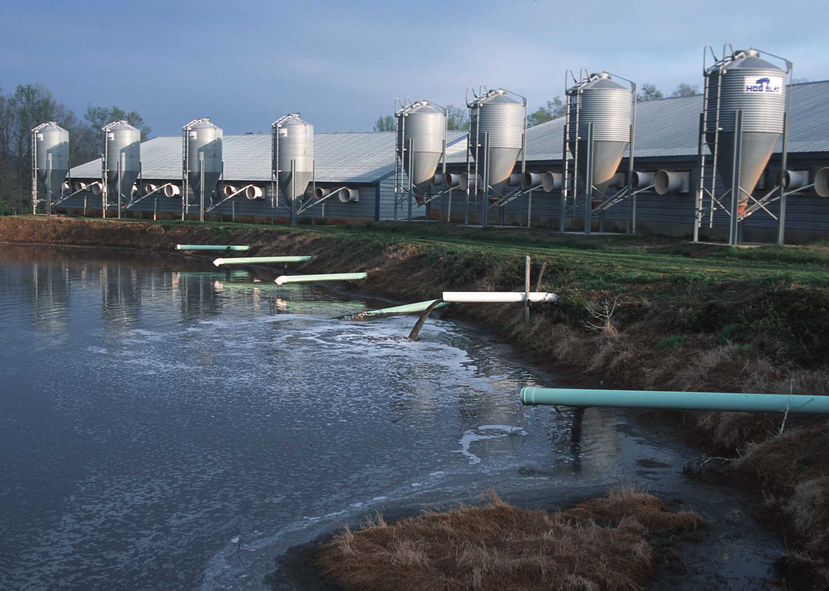
Justification
Large feedlots produce as much waste as a city, yet we don’t know where they are located
Notes:
Photo downloaded from the site: http://www.whirlwind.us.com/Biogas/Biogas_Landfill.htm on Sept 10, 2012. Photographs contained within this site are proprietary in nature and are the sole property of Whirlwind, LLC - All Rights Reserved -.
Feedlot operations pollute almost as many miles of river as industrial sources combined. While the number of hogs has remained almost unchanged in the past 30 years, there are accomodated on 1/10 the number of farms. Knowing where these concentrations are should be a major concern of policymakers and community leaders, as well as farmers.
“Huge open-air waste lagoons, often as big as several football fields, are prone to leaks and spills. In 1995 an eight-acre hog-waste lagoon in North Carolina burst, spilling 25 million gallons of manure into the New River. The spill killed about 10 million fish and closed 364,000 acres of coastal wetlands to shellfishing. “
NRDC site http://www.nrdc.org/water/pollution/ffarms.asp

Slide 5
Background
Animals
Population density by county, based on inventory at the time of the 2007 census
0 10 100 1,000 10,000 animals per square mile
Cows
Pigs
No cartographically meaningful agriculture in Alaska. Only inhabited islands shown
Sheep & Goats
Chickens
Turkeys
All maps shown in the same scale using equal area projections
Data from the 2007 US Census of Agriculture.
Map by Bill Rankin 2009, titles by DRM
No cartographically meaningful agriculture in Alaska. Only inhabited islands shown

Slide 6
Background
Ratio of animal to crop value, per acre
Aggregate market value of agricultural products sold in 2007, by county
$3,000 per acre
$300
$30
$0
All maps shown in the same scale using equal area projections
Data from the 2007 US Census of Agriculture.
Map by Bill Rankin 2009, titles by DRM
100% of value from animals
100% from crops
No cartographically meaningful agriculture in Alaska. Only inhabited islands shown

Slide 7
Background
Ratio of animal to crop value, per acre
Aggregate market value of agricultural products sold in 2007, by county
$3,000 per acre
$300
$30
$0
All maps shown in the same scale using equal area projections
Data from the 2007 US Census of Agriculture.
Map by Bill Rankin 2009, titles by DRM
100% of value from animals
100% from crops
No cartographically meaningful agriculture in Alaska. Only inhabited islands shown

Slide 8
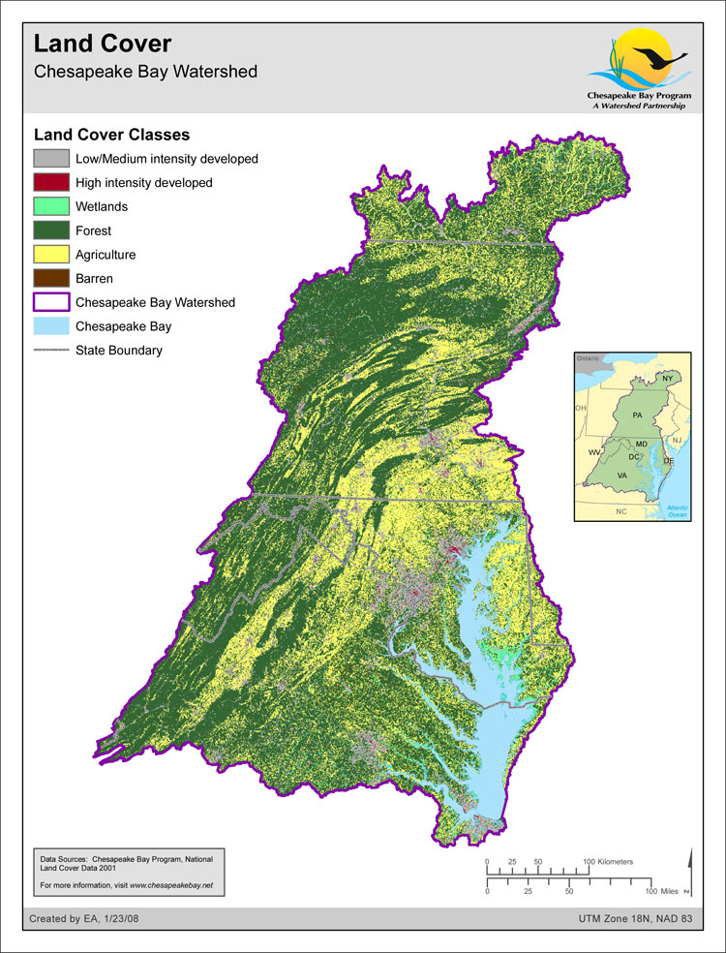
Background
Land cover alternates between agriculture and forest for much of the watershed. Agriculture dominates a large swath of the region, starting in Central Virginia and continuing North to Harrisonburg and Central Pennsylvania, before heading towards the ‘Eastern Shore’ of Maryland and Virginia.

Slide 9
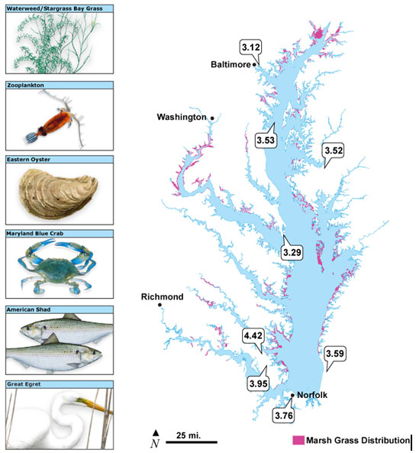
Background
Aquatic life in the Chesapeake Bay
2,700 species of plants and animals
500 million pounds of seafood produced per year.
Young and molting blue crabs rely on bay grass beds for protection from predators. From Chesapeake Bay Program, 2009, Addressing Chesapeake Bay Regional Climate Change Impacts.
Notes:
Chesapeake Bay Program. 2009. Addressing Chesapeake Bay Regional Climate Change Impacts. Retrieved September 24, 2012 from http://executiveorder.chesapeakebay.net/post/Addressing-Chesapeake-Bay-Regional-Climate-Change-Impacts.aspx

Slide 10
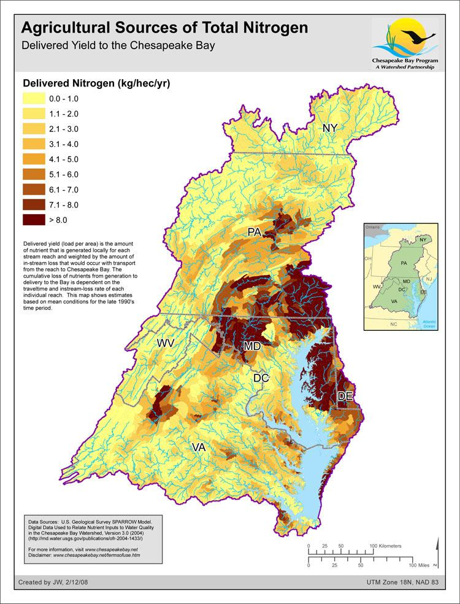
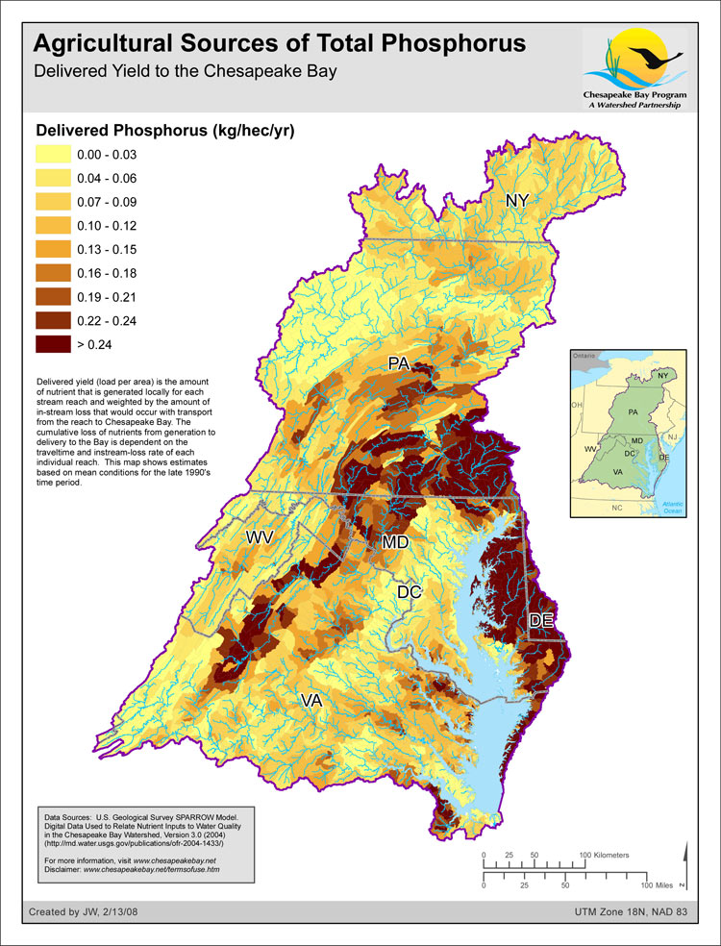
Nitrogen and phosphorus in the Chesapeake Bay
*
*
U.S. Geological Survey SPARROW Model. From Digital Data Used to Relate Nutrient Inputs to Water Quality in the Chesapeake Bay Watershed, Version 3.0. from http://md.water.usgs.gov/publications/ofr-2004-1433/
U.S. Geological Survey SPARROW Model. From Digital Data Used to Relate Nutrient Inputs to Water Quality in the Chesapeake Bay Watershed, Version 3.0. from http://md.water.usgs.gov/publications/ofr-2004-1433/
*
“Delivered yield (load per area) is the amount of nutrient that is generated locally for each stream reach and weighted by the amount of in stream loss that would occur with transport from the reach to Chesapeake Bay. The cumulative loss of nutrients from generation to delivery to the Bay is dependent on the travel time and in stream-loss rate of each individual reach. The map shows estimates based on mean conditions for the late 1990’s time period.”
Notes:
Nitrogen and Phosphorus work

Slide 11
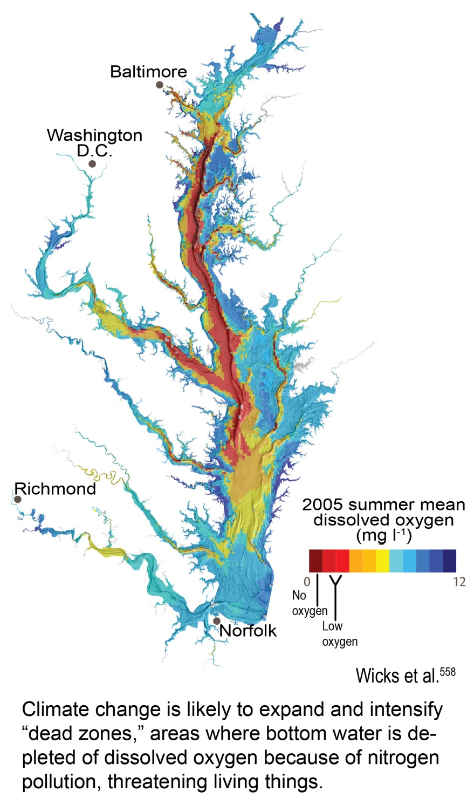
Effects of nitrogen and phosphorus
Background
With increases in nitrogen and phosphorus in the Bay, algal blooms begin
Marsh grass stops growing
Crabs and fish loose food and protection
When algae decomposes, oxygen deprived ‘dead zones’ form
Notes:
Wicks, C., D. Jasinski, and B. Longstaff, 2007: Breath of Life: Dissolved Oxygen in Chesapeake Bay. EcoCheck, Oxford, MD, 4 pp. <http://www.eco-check.org/pdfs/do_letter.pdf> Retrieved September 24, 2012 at http://www.globalchange.gov/publications/reports/scientific-assessments/us-impacts/full-report/regional-climate-change-impacts/coasts.

Slide 12
Background
Policy response
The Environmental Protection Agency (EPA), along with the states within the watershed, set up a limits to how much nitrogen and phosphorus could enter the Bay. This is called the Chesapeake Bay Total Maximum Daily Load (TMDL). Although thousands of TMDLs have been created, Chesapeake Bay is the biggest. It sets how much pollution the Bay can take and still meet the requirements for the Clean Water Act (“fishable” and “swimmable” area). They divide the region by Hydrologic Unit Code (HUC) and administrative unit. Each state in the watershed is responsible to meet these standards.
The TMDL has been in design since 2000, with a final version ratified at the end of 2010. The plan goals are to be met by 2025, with 60% reduction expected by 2017.
Agriculture is one of many sources of pollution, but they are also the major offender. According to Chesapeake Bay Program (CBP), it makes up almost 40% of nitrogen pollution and 50% of phosphorus pollution in the Bay (CBP, 2011).
Notes:
Centers for Disease Control (CDC). Spontaneous Abortions Possibly Related to Ingestion of Nitrate-Contaminated Well Water -- LaGrange County, Indiana, 1991-1994 . CDC, 1996. Article downloaded from site http://www.cdc.gov/mmwr/preview/mmwrhtml/00042839.htm on Sept 11, 2012. Two line
EPA. Nitrates and Nitrites. EPA: TEACH Chemical Summary, 2006. Article downloaded from site http://www.epa.gov/teach/chem_summ/Nitrates_summary.pdf on Sept 11, 2012.

Slide 13
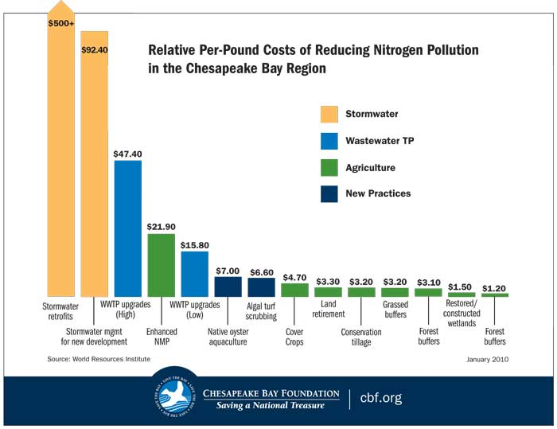
Background
Policy costs
There are various options for reducing the nitrogen and phosphorus (nutrient) pollution.
One of them, a Nutrient Management Program (NMP), is very costly, but gets to the heart of the nitrogen/ phosphorus problem: how to mitigate the manure from animal feedlots
Notes:
M.D.Smolen. BAE 1521: Phosphorus and Water Quality. Oklahoma State Cooperative Extension Service, 2005.

Slide 14
Nutrient Management
Background
Feedlots have various options to meet the obligations of the TMDL, from reducing the amount of nutrients in an animals manure through diet change, to spreading on nearby farmland, to converting manure into more standard fertilizers, for use outside of agriculture.
One of the potential options is spreading manure. It is a costly option.
Nitrogen and phosphorus (and potassium, among others) are needed for plant growth and survival
Farmers spend money on obtaining synthetic fertilizer to deliver the same ingredients. If feedlots could take their excess fertilizer, for animal manure, both could potentially save money.
Yet all of this comes with costs, for both the delivering feedlot and the farmer. For the feedlot person, transporting manure is costly.
Notes:
Marc Ribaudo, Noel Gollehon, Marcel Aillery, Jonathan Kaplan, Robert Johansson, Jean Agapoff, Lee Christensen, Vince Breneman, and Mark Peters. 2003 Manure Management for Water Quality: Costs to Animal Feeding Operations of Applying Manure Nutrients to Land. Agricultural Economic Report No. (AER-824) 97 pp. June 2003. Economic Research Service, USDA.

Slide 15
Previous study on manure distribution
Past Studies
Economic Research Service (ERS), part of the United States Department of Agriculture (USDA), did a study of the costs of manure transport and land application in the Chesapeake Bay. If all the nitrogen was spread out at the limits of what cropland can utilize, over 40% of agricultural land would be covered. There’s enough phosphorus to cover almost 75% of land (Ribaudo, et al, 2003).
In order to better simulate the travel cost, they incorporated the competition between feedlots for available land : the more concentrated the feedlots, the higher the competition.

Slide 16
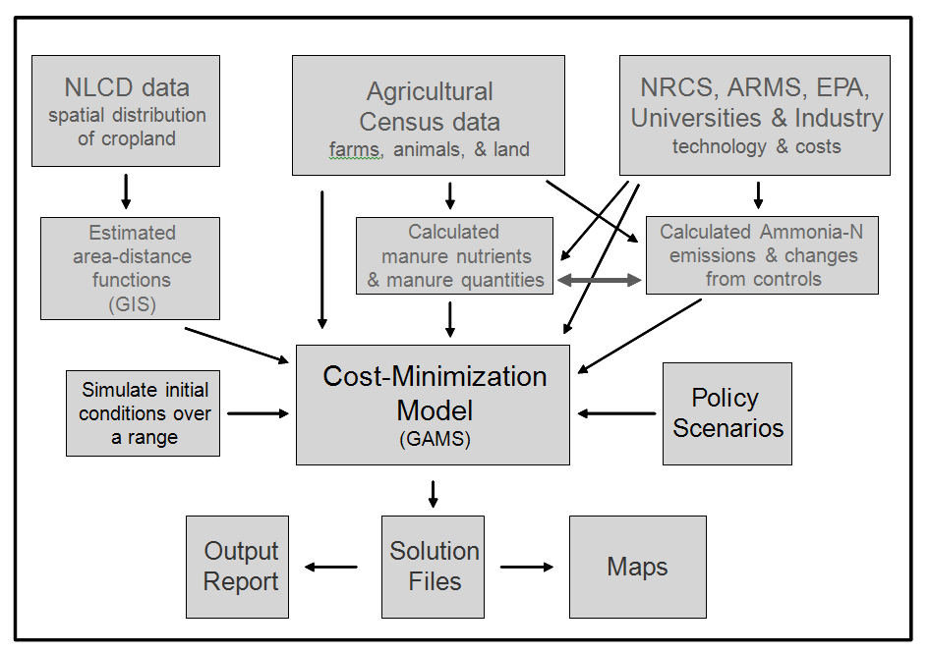

Slide 17
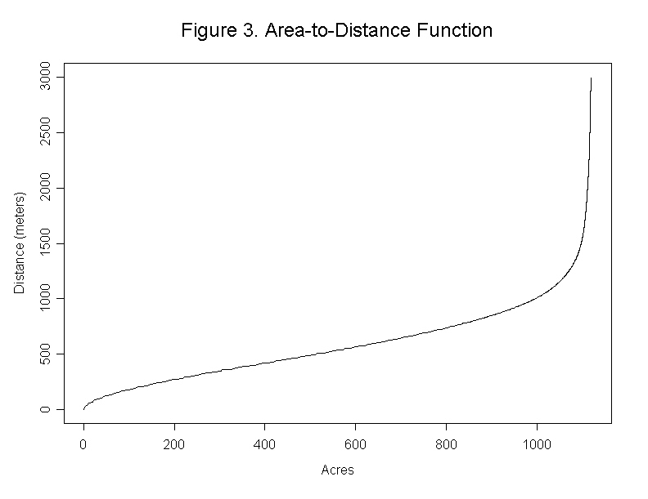
Area to Distance Function
Past Studies
This competition is recorded in a area to distance plot. It shows the distance (Y) necessary to spread manure on (X) number of acres
The higher the curve along the y axis, the longer travel distance required to offload manure. The previous study assumed that real locations of feedlots were more concentrated, and more likely to have to travel farther to offload manure.

Slide 18
Distance to available land
This competition will effect the spatial pattern of both the distribution of the feedlots and the available land. If feedlots were more clustered any random point in a given area would probably be farther from the nearest feedlot.
C
C

Slide 19
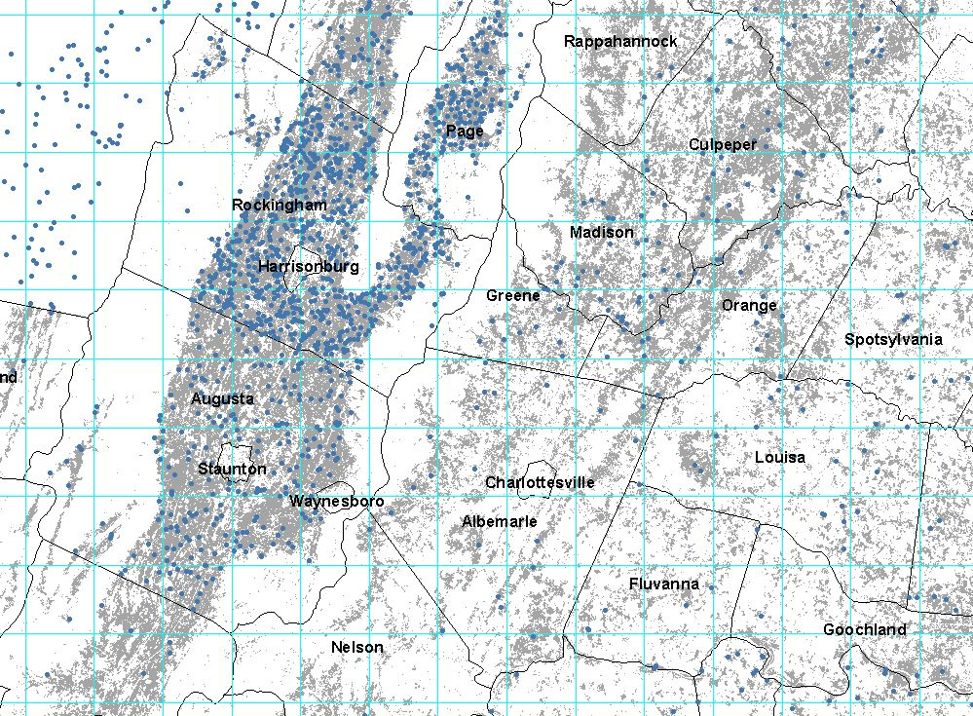
Feedlots in northwestern Virginia
feedlots
cropland
Albers Equal Area USGS

Slide 20
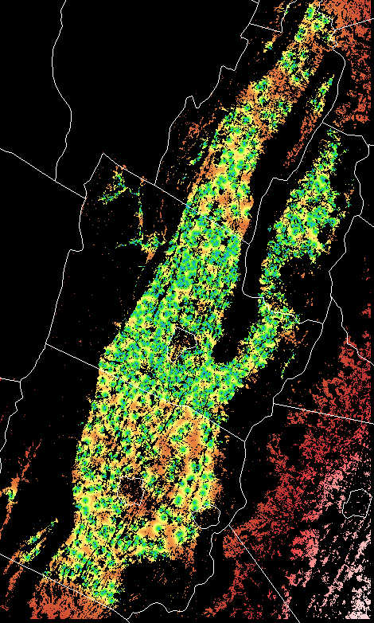
How area to distance was calculated
Dist (m) Count Acres Cum Acres
30 14 3.1 3.1
60 30 6.7 9.8
90 50 11.1 20.9
120 80 17.8 38.7
150 135 30.0 68.7
- - - -
1000 400 89.0 6709
2000 567 126.1 17900
3000 430 95.6 24609
4000 354 78.7 31572

Slide 21
Problem: Lack of exact location
Past Studies
Because of disclosure issues, the actual location of these feedlots is unknown, even by the USDA. The study was forced to assign feedlots to a random location in the county.
They have increased precision by limiting results to cropland, and by HUC region.
A potential exists to further increase precision, by adding Zip Code locations on the site.

Slide 22
Objective
Objective
1. Determine if including zip code in model results in a measurably different distribution of points.
2. Model manure allocation to see if new distribution would result in a meaningful difference in minimum distance ne.

Slide 23
Methodology
Methodology
In order to improve comparisons, only dairies will be analyzed
For each county, simulate the location of dairy feedlots within polygons using three classification methods:
County only
County, HUC (hydrologic unit code) and cropland
County, HUC, cropland and zip code
Test for clustering, using Ripley’s K
Model minimum distance traveled to allocate excess manure on cropland

Slide 24
Methodology
Assumption: As more elements of spatial location are defined (county, river valley, zip code), underlying clustering will emerge
Basic method
Current method
Proposed method

Slide 25
Ripley’s K
Methodology
Improves on nearest neighbor (which only checks for one relationship)
Looks at the concentration of points at different intervals (Ex: Do feedlots tend to cluster around 5 miles?)
# feedlots between 2 distances/ # feedlots in total area
Notes:
Ripley B.D. 1976. The second –order analysis of stationary point processes. Journal of Applied Probability 13: 255-266. From Ronald Briggs. 2010. Point Pattern Analysis. Henan University. Downloaded on September 24, 2012 from http://www.utdallas.edu/~briggs/

Slide 26
Allocation model
Methodology
Assumptions
Treat dairy feedlots as points
Even distribution of excess manure within each zone
Total manure in zipcode - HUC section/ Total feedlots
All cropland equally accepts manure
Manure quality is the same weight and composition (wet/dry)
Euclidian distance (no regard for roads)

Slide 27
Area to Distance Function
From the point of view of cropland, increased clustering would mean more distance is required to cover the same area with manure.
4000
3000
Minimum distance required(meters)
2000
1000
5000
Acres needed for manure spreading

Slide 28
Weaknesses
Ripley’s K
Problems with edge effects
Distance bands are random (need to try different intervals)
Like rest of study, results only consider count, and not magnitude of the objects (how big is a feedlot)
Allocation model (for initial study)
Does not include all types of feedlots (chickens, hogs, etc). The competition for space would be much greater, in actuality
Is at the intra county only. It does not account for edge effects, nor spillovers into other areas
It does not take into a

Slide 29
Results
Outcomes
3 Ripley’s K curve function and test for distribution (clustered/ random/regular distribution), and at what distance band most pronounced
3 Simulated distribution of farms map (for each county in the Chesapeake Bay)
3 Area-Distance function (intra county only)
Comparison of results, and how much the zip code classification improves results
Expected Outcomes
Clustering will increase when zip code is added to the allocation criteria of feedlots, resulting in a significant increase across the counties in the Chesapeake Bay
If there is clustering, this will result in overlapping coverage. Farmers will have to travel farther to unload manure, increasing costs.

Slide 30
Logistics
Logistics
Obtain feedlot data from US Census of Agriculture 2007, using SAS
Summarize the feedlot count, and Animal Units, by 3 different allocation scenarios
Join with Census ZCTAs and county boundaries
Run Ripley’s K(d) Point Analysis
Allocate manure based on summarized Animal Units
Run manure distribution models
Obtain significance results
Consult with researcher at USDA, to see if distance results are meaningful
Present at AAG conference April 9 – 13th.
Notes:
Manure

Slide 31
Summary
Summary
Justification
Background
Past Studies
Objective
Methodology
Logistics

Slide 32
Resources
Logistics
Ator, S.W., Brakebill, J.W., and Blomquist, J.D., 2011, Sources, fate, and transport of nitrogen and phosphorus in the Chesapeake Bay watershed—An empirical model: U.S. Geological Survey Scientific Investigations Report 2011–5167, 27 p. Retrieved September 26, 2012 at http://pubs.usgs.gov/sir/2011/5167/.
Blankenship, K. 2005. Solutions sought for excess manure piling up on farms. Bay Journal June 2005. Retrieved on September 24, 2012 from http://www.bayjournal.com/article/solutions_sought_for_excess_manure_piling_up_on_farms
Centers for Disease Control (CDC). Spontaneous Abortions Possibly Related to Ingestion of Nitrate-Contaminated Well Water -- LaGrange County, Indiana, 1991-1994 . CDC, 1996. Article downloaded from site http://www.cdc.gov/mmwr/preview/mmwrhtml/00042839.htm on Sept 11, 2012. Two line
Chesapeake Bay Program. 2009. Addressing Chesapeake Bay Regional Climate Change Impacts. Retrieved September 24, 2012 from http://executiveorder.chesapeakebay.net/post/Addressing-Chesapeake-Bay-Regional-Climate-Change-Impacts.aspx
Chesapeake Bay Program. 2011. Water Quality Issues: Nitrogen and Phosphorus Pollution. Retrieved on September 26th 2012 from http://http://www.cbf.org/n2
Environmental Protection Agency. Nitrates and Nitrites. EPA: TEACH Chemical Summary, 2006. Article downloaded from site http://www.epa.gov/teach/chem_summ/Nitrates_summary.pdf on Sept 11, 2012.
Fry, J., Xian, G., Jin, S., Dewitz, J., Homer, C., Yang, L., Barnes, C., Herold, N., and Wickham, J., 2011. Completion of the 2006 National Land Cover Database for the Conterminous United States, PE&RS, Vol. 77(9):858-864.
Kellogg, R.L..2011. Estimates of Recoverable and Non-Recoverable Manure Nutrients Based on the Census of Agriculture. Draft in progress. USDA-NRCS.
Ribaudo, M. Gollehon, N., Aillery, M., Kaplan, J., Johansson, R., Agapoff J., Christensen, L., Breneman, V., and Peters, M. 2003 Manure Management for Water Quality: Costs to Animal Feeding Operations of Applying Manure Nutrients to Land. Agricultural Economic Report No. (AER-824) 97 pp. June 2003. Economic Research Service, USDA.
Ripley, B.D. 1976. The second –order analysis of stationary point processes. Journal of Applied Probability 13: 255-266. From Ronald Briggs. 2010. Point Pattern Analysis. Henan University. Downloaded on September 24, 2012 from http://www.utdallas.edu/~briggs/
Smolen, M.D.. 2005. BAE 1521: Phosphorus and Water Quality. Oklahoma State Cooperative Extension Service, 2005.
National Agricultural Statistics Service. 2007. US Census of Agriculture, 2007. U.S. Department of Agriculture (USDA)
Wicks, C., D. Jasinski, and B. Longstaff, 2007: Breath of Life: Dissolved Oxygen in Chesapeake Bay. EcoCheck, Oxford, MD, 4 pp. <http://www.eco-check.org/pdfs/do_letter.pdf> Retrieved September 24, 2012 at http://www.globalchange.gov/publications/reports/scientific-assessments/us-impacts/full-report/regional-climate-change-impacts/coasts

