Slide 1
Livestock Market’s Effect on Methane Production in Kansas
Identifying Key Areas for Strategic Mitigation

Slide 2
About Me
Education
Embry Riddle Aeronautical University
B.S. Computational Mathematics
Workplace
Textron Aviation
Quality Data Analyst
Bliss Climbing & Fitness
Rock Climbing Instructor/Coach
Fun Fact
I hope to thru-hike the PCT

Slide 3
Agenda
Background
Goals and Objectives
Proposed Methodology
Project Timeline
Possible presentation venue
Anticipated Results

Slide 4
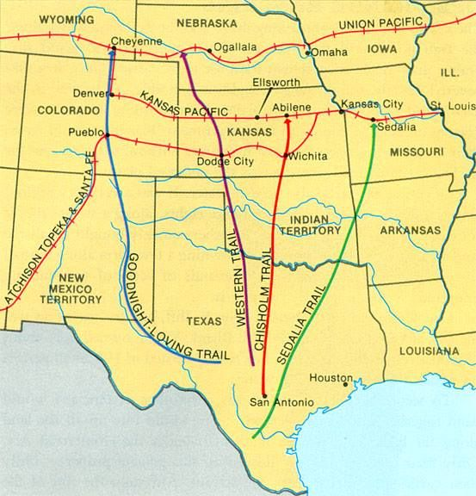
Background
Cattle boom post-Civil War
Number 1 beef producer in the United States
Generates 1.4 billion dollars

Slide 5
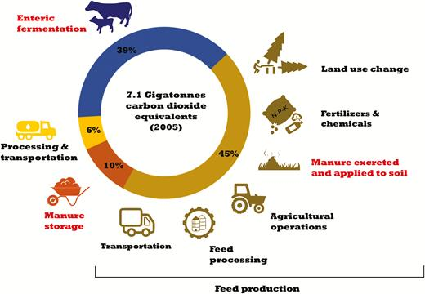
Background- Livestock Methane
Enteric Fermentation
Manure Management

Slide 6
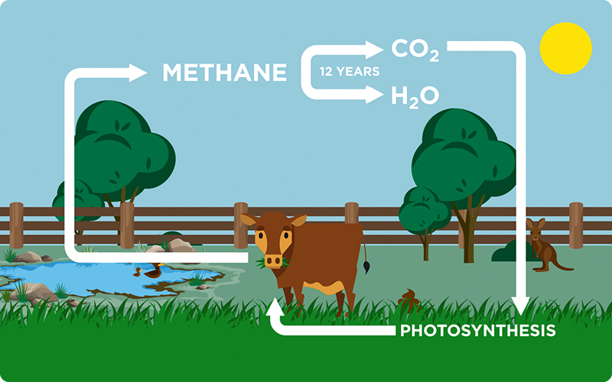
Background- Methane Breakdown
80 times more potent than carbon dioxide
Lifespan around 20 years
Often breaks down into CO2 which has a lifespan of 300-200 years

Slide 7
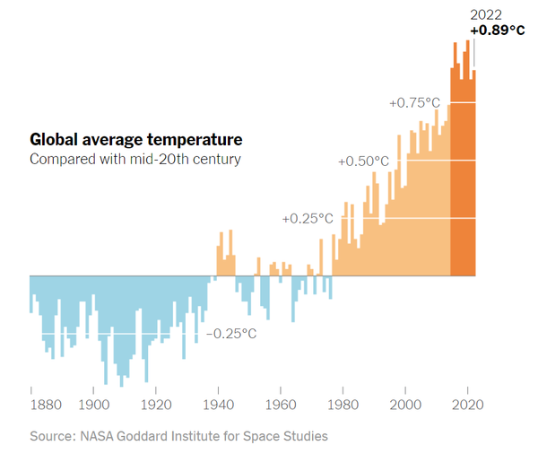
Background- Global Warming

Slide 8
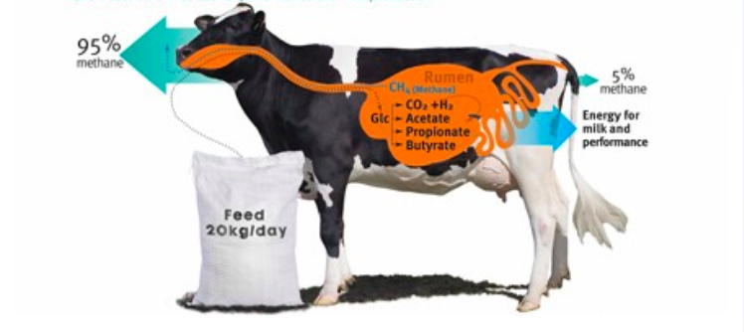
Cow Methane Production
1 cow = 154 to 264 pounds
Beef cows produce 98% of the methane through enteric fermentation

Slide 9
Background- Mitigation Studies
Red seaweed has been proven to reduce enteric methane
We are only at the beginning of practical methods for mitigation

Slide 10
Goals & Objectives
Analytic goals
Why is this Important?
Identify historic trends in methane production and cattle population
Determine groupings of counties that experience similar conditions to assist in the identification for mitigation plans
Assists in the understanding of the cattle situation in Kansas
Identifies areas that are higher risk
Provides an overview of current cattle methane status
Gives a baseline to track improvement

Slide 11
Data
Cattle Population Data
National Agriculture Statistics Service
Cattle Weight Data
Environmental Protection Agency
Fat Correct Milk
National Agriculture Statistics Service
Temperature Data
National Oceanic Atmospheric Administration

Slide 12
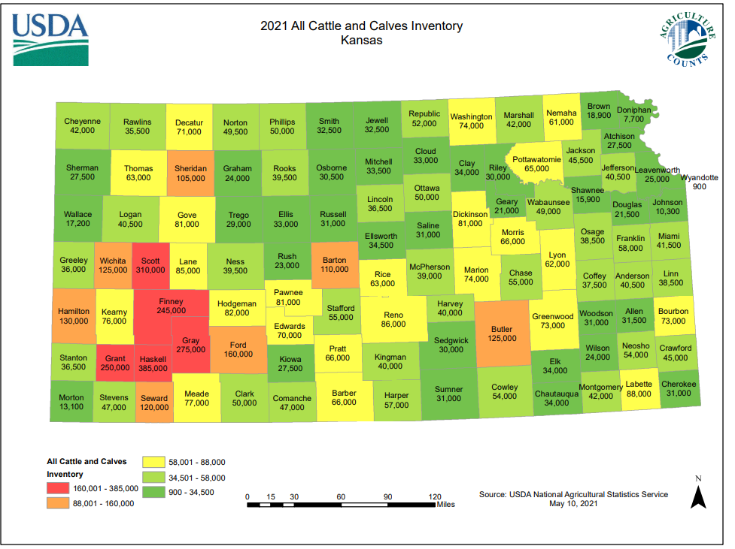
Kansas Cattle Data

Slide 13
Dry Matter Intake Calculations
$$Beef Cattle DMI={BW}^{0.75}× (0.0194 + 0.0545 × NEm)$$
$Dairy Cattle DMI=0.372 \text{×} FCM \text{×} \text{0.0968} \text{× }{BW}^{0.75}$
$$Calves DMI = [{BW}^{0.75}× (0.2453 × NEm – 0.0466 × {NEm}^{2} – 0.1128)] ÷ NEm$$
$$Cattle on Feed DMI = [{BW}^{0.75}× (0.2453 × NEm – 0.0466 ×{ NEm }^{2}– 0.0869)] ÷ NEm$$

Slide 14
Methane Calculation
$$methane emission from enteric fermentation \left(\frac{Gg}{yr}\right)=cattle category specific feed dry matter intake \left(\frac{DMI;\frac{kg}{head}}{d}\right)×cattle category specific methane emission factor \left(\frac{g}{kg}DMI\right)×365 \left(\frac{d}{yr}\right)× county cattle population by category \left(head\right)$$

Slide 15
Uncertainty Calculations
$$G\left(x , , µ σ\right) ={ \frac{1σ}{√2π}e}^{−\left(x−µ\right)2/2σ2}$$

Slide 16
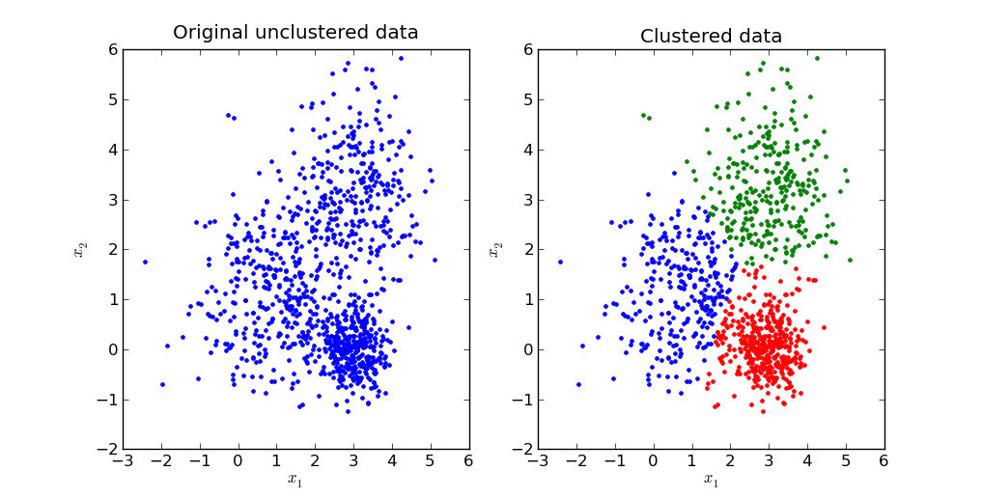
GIS Analysis- Multivariate Clustering

Slide 17
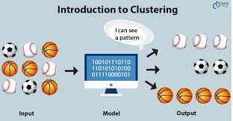
Analyzing Clusters

Slide 18
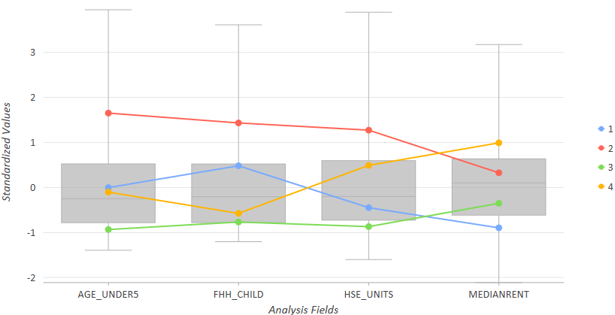
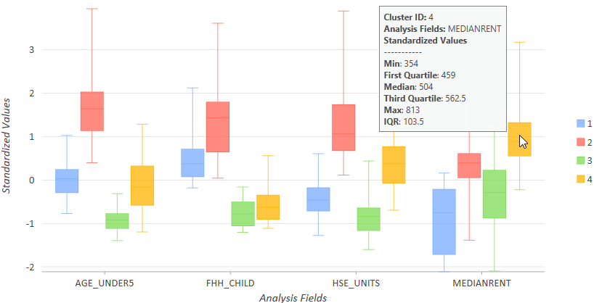
Clustering Analysis

Slide 19
Project Timeline

Slide 20
Presentation Venues
Presentation Venue 1: American Association For The Advancement Of Science (AAAS) Annual Meeting
Location: Denver, Colorado
Dates: February 15-17, 2024
Abstract Submission: Wednesday, October 11, 2023
Presentation Venue 2: American Association of Geographers
Location: Denver, Colorado
Dates: TBA Approx. Late March
Abstract Submission: TBA Approx. October
Presentation Venue 3: PA GIS Conference
Location: State College, Pennsylvania
Dates: April 10-12, 2024
Abstract Submission: TBA

Slide 21
Anticipated Results
High methane production around cattle trail counties
An exponential growth of methane in larger counties
3-5 similar groups to evaluate conditions for
Increase in temperatures in high methane counties

Slide 22
Questions?

Slide 23
Body Wieght
Body Weight (kg)
Year | Calves | Dairy Cows | Beef Cows | Cattle on Feed
1990 | 121 | 680 | 553 | 441
2000 | 122 | 680 | 577 | 441
2010 | 122 | 680 | 611 | 441
2020 | 123 | 680 | 611 | 441
[HAN1]Are you sure these did not change?

Slide 24
Net Energy
. For cattle, according to the IPCC, this coefficient is 0.322 for beef cattle, feed cattle, and calves, and 0.386 for dairy cattle
$$\text{Net} \text{Energy} \text{for} \text{Maintenance}\text{(}{ NE}_{m}\text{(}\text{Mcal}\text{/}\text{kg}\text{))}={Cf }_{i}×{BW}^{0.75}$$

Slide 25
Emission Factors
This makes $MY$ for Dairy, Beef/calves, and cattle on feed 20, 21, and 10 $( \frac{kg CH4 kg}{DMI})$, respectively
$$Emission Factor \left(EF\left( \frac{kg CH4}{head yr}\right)\right)=DMI ×\frac{MY}{1000}×365$$

