Slide 1
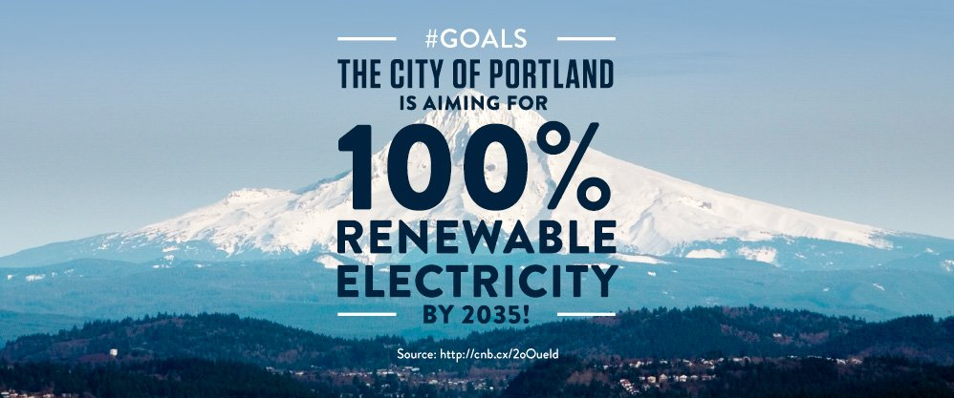
Modeling Solar Photovoltaic Rooftop Potential: Portland, Oregon
Curran McBride
Penn State MGIS Program
Advisor: Jim Detwiler
Geog 596A, Fall 2018

Slide 2
Overview
Introduction
Background
Purpose
Objectives & Scope
Demo web application
Research
Solar Around the World
Industry Best Practices
Methodology
Technology & Data
Rooftop Modeling Workflow
Analysis
Compare & Contrast PV Potential Against Historical Loads
Expected Results
Determine Rooftop Potential
Determine Net-Zero Buildings
Timeline
Milestones
References

Slide 3
Background
As the environmental costs of more than a century of fossil fuel use escalate beyond our control to contain them, the coupling of science and technology has provided the tools to move away from a dirty energy market into a greener renewable energy-driven market.
With this awareness, in June 2017, the city of Portland, and the county of Multnomah, formally committed to generating 100% of their electricity needs by renewable sources by 2035.

Slide 4
Purpose
The purpose of my graduate thesis project is to provide actionable intelligence for all Portland and Multnomah stakeholders by modeling and analyzing the net difference of the rooftop solar potential against the electricity consumption for residential and commercial buildings across Portland.

Slide 5
Objectives & Scope
Research Questions
How much energy can solar PV produce across all rooftops in Portland?
Objective 1: Model solar PV potential for each day of the year on each rooftop.
Objective 2: Compare/contrast historical energy requirements vs. rooftop potential to determine how many buildings are net-zero.

Slide 6
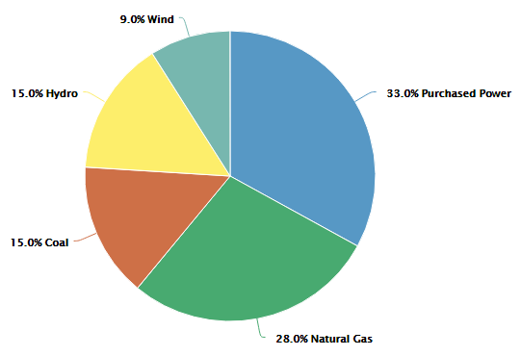
PGE Electricity Portfolio
Solar currently provides only 6 Megawatts of energy for PGE.

Slide 7
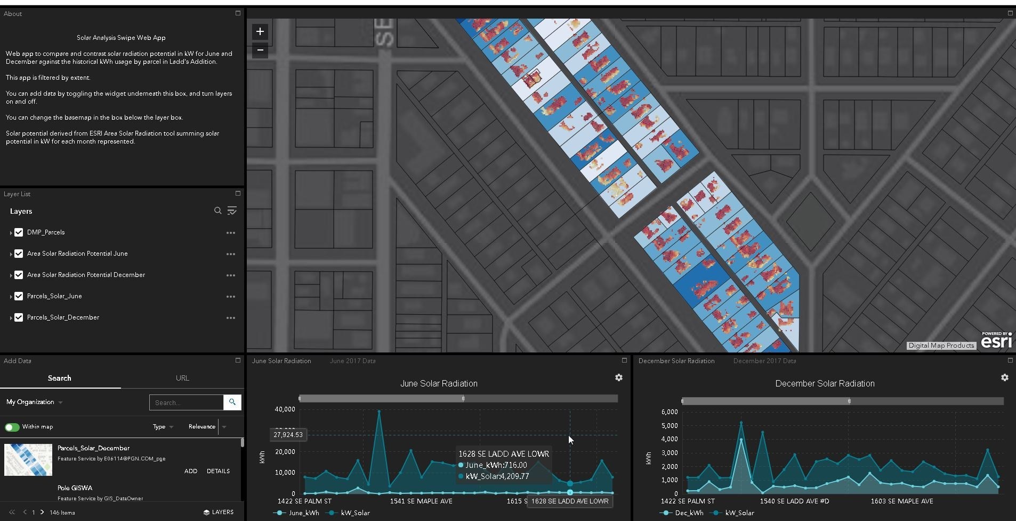
Solar PV Potential Web App
Visualizing the historical electrical consumption side-by-side with the rooftop PV potential.

Slide 8
How Solar Energy is Derived

Slide 9
First Solar Array: NYC 1884

Slide 10
Solar Industry
The first solar array deployed in 1884, NYC.
Panels then were only around 1% efficient.
Today’s panels are often measured between 18%-27% efficiency.

Slide 11
Solar Industry
By 2015, the solar panel industry in the U.S. was employing more people than the oil, gas, and coal industries combined.
By 2017, the U.S. was ranked 2nd in the world for installed solar capacity at 50 Gigawatts.
1 Gigawatt of power can supply roughly 700,000 homes with electricity.

Slide 12
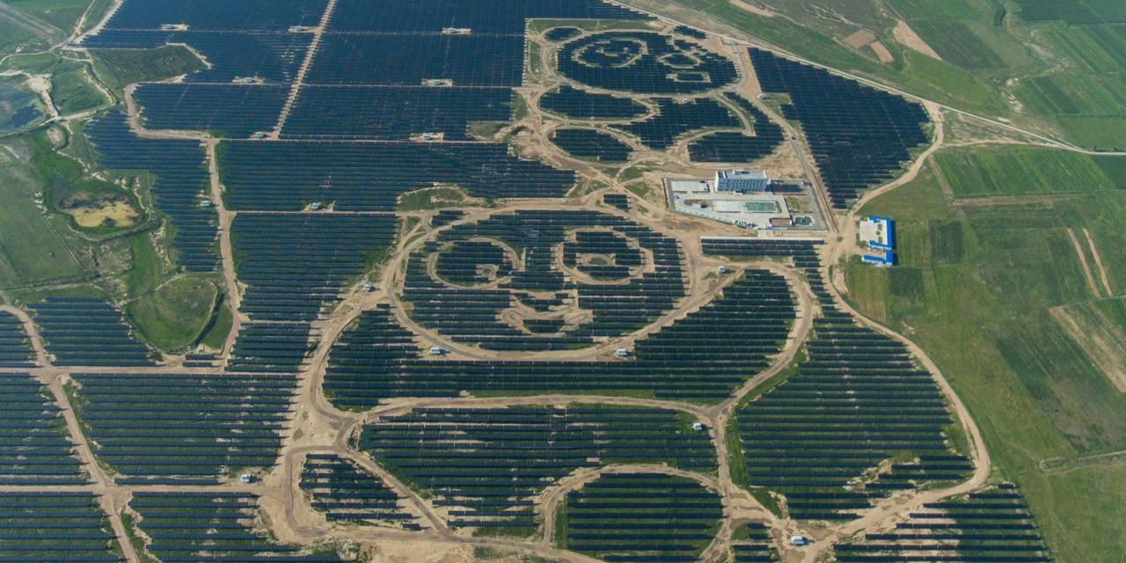
Solar Around The World
In 2017, China had the global lead with over 100 Gigawatts of solar capacity installed.

Slide 13
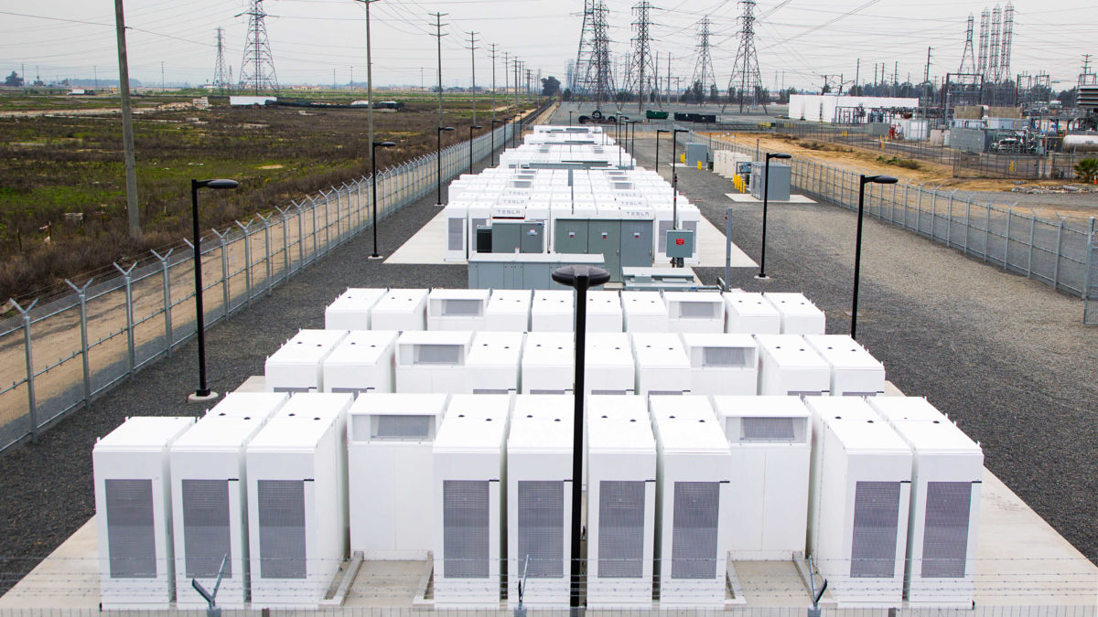
Solar in California
In 2018, California became the first state in the country to require solar panels on all new homes built from 2020 onwards.

Slide 14
Measuring Rooftop Suitability

Slide 15
Technology
ArcGIS Desktop
Esri Analysis tools
Esri Conversion tools
Esri Data Management tools
Esri Spatial Analyst tools

Slide 16
Data
LiDAR (2014) from Oregon Department Of Geology & Mineral Industries/NOAA
Building footprints from City of Portland
Historical energy use from electrical utility
Parcel data from electrical utility

Slide 17
Methodology
Convert LiDAR to DSM
Clip Rasters To Building Footprints
Area Solar Radiation Tool
Add Slope & Aspect w/Raster Calculator
Points Solar Radiation Tool
Reclassify Slope & Aspect Rasters
Create Slope Raster
Extract by Mask Solar Radiation vs. Viable Cells
Create Aspect Raster
Export Raster to Polygon
Reclassify Slope Raster discarding > 50 degrees
Clip Points Solar Radiation To Viable Cells Polygon
Reclassify Aspect Raster discarding NW, N, NE Aspects
Spatial Join & Sum All Points Within Building Footprint

Slide 18
Subset Study Area

Slide 19
Ladd’s Addition

Slide 20
LiDAR Data
LiDAR acquired 2014

Slide 21
Digital Surface Model
1 meter surface

Slide 22
Modeling Shade

Slide 23
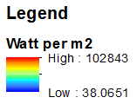
June Solar Radiation

Slide 24
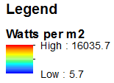
December Solar Radiation

Slide 25
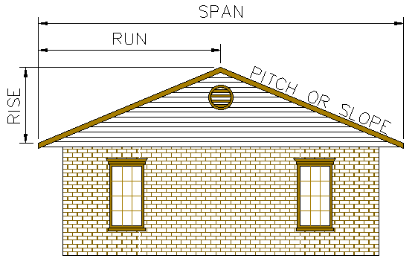
Measuring Slope
Rooftop cells with slopes over 50 degrees will be rejected.

Slide 26
Slope Raster

Slide 27
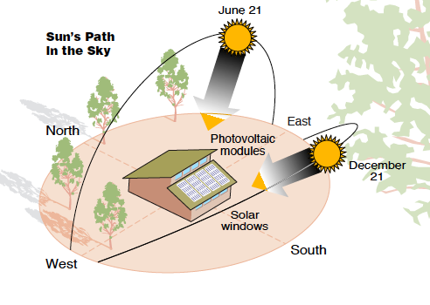
Measuring Aspect
Rooftop cells with aspects facing northwest, north, and northeast will be rejected.

Slide 28
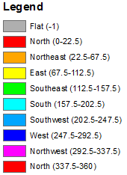
Aspect Raster

Slide 29
Reclassified Slope & Aspect

Slide 30
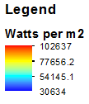
June Viable Rooftop Cells

Slide 31
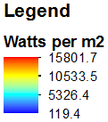
December Viable Rooftop Cells

Slide 32
Orthoimagery Example
Canopy
Roof

Slide 33
DSM Example
Canopy
Roof

Slide 34
Solar Radiation Example
Canopy
Roof

Slide 35
Points Solar Radiation Example
Canopy
Roof

Slide 36
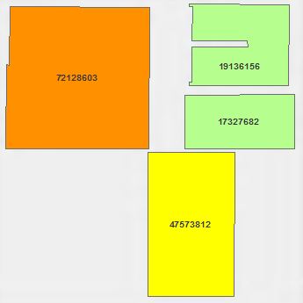
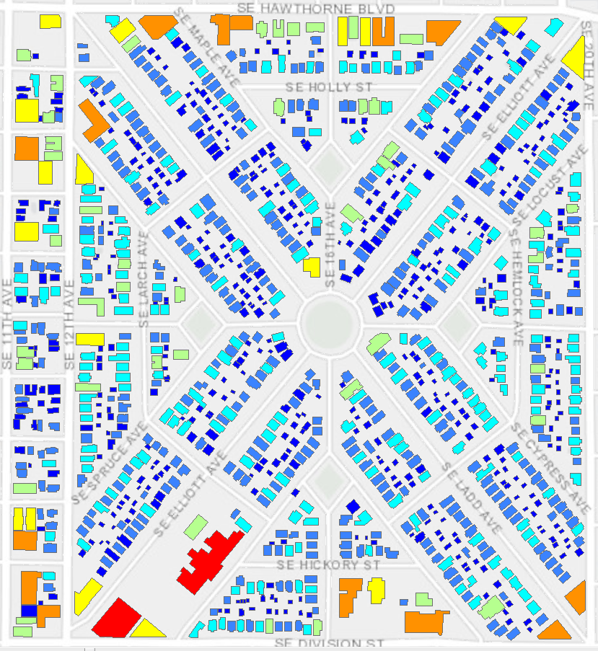
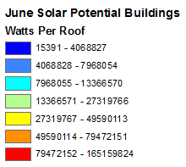
Expected Results
Viable PV potential results for all building footprints in the greater Portland area.

Slide 37
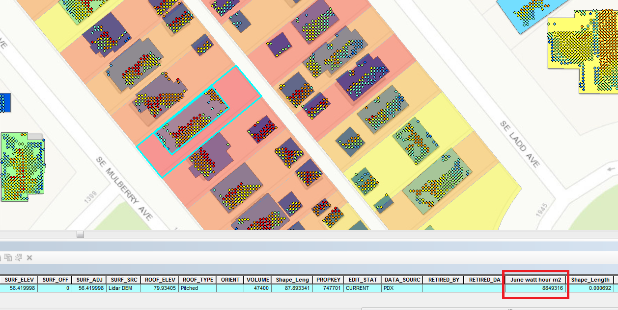
Expected Results
Determine net-zero buildings
A PV install on this rooftop would produce 8,849,316 watts of energy for June.

Slide 38
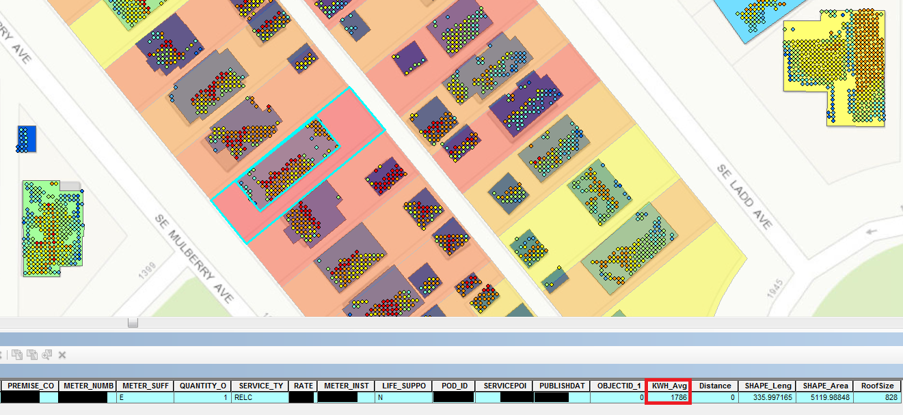
Expected Results
Dividing the PV potential of 8,849,316 watts by 1,000 = 8,849 kilowatts.
Divide 8,849 kw by 20% for efficiency of a modern solar panel = 1,769 kw.
This building’s energy use for the month of June was 1,786 kwh.
1,786 kw vs. 1,769 kw makes it essentially a net-zero building in this scenario.

Slide 39
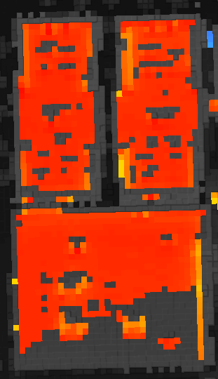
Limitations
LiDAR data is outdated (2014)
Accuracy potentially off due to microclimate
Not all viable cells are chosen; unknown reasons
Modeling 3 flat roofs, but not all viable cells were chosen with Slope and Aspect parameter inputs.

Slide 40
Timeline
Summer 2018-Proof of Concept deployed
Fall 2018-596A Peer Review & Final Methodology
November 2018 – Start Analysis by grids
February 2019-Upload all analysis to web app
July 2019-Present at Esri UC

Slide 41
References
A. Frangoul, "Portland commits to 100 percent renewable energy by 2050", https://www.cnbc.com/2017/04/12/portland-commits-to-100-percent--renewable-energy-by-2050.html. Accessed September, 2018.
A. Hirtenstein, "Clean-Energy Jobs Surpass Oil Drilling for First Time in U.S.", https://www.bloomberg.com/news/articles/2016-05-25/clean-energy-jobs-surpass-oil-drilling-for-first-time-in-u-s. Accessed September, 2018.
Bloomberg News, "China Is Adding Solar Power at a Record Pace", https://www.bloomberg.com/news/articles/2017-07-19/china-adds-about-24gw-of solar-capacity-in-first-half-official. Accessed September 2018.
Solar Energy Industry Association, "What's in a Megawatt?", https://www.seia.org/initiatives/whats-megawatt. Accessed September, 2018.
Z. Hagadone, "Megawhat?", https://www.boiseweekly.com/boise/megawhat/Content?oid=3433953. Accessed September, 2018.
B. Burger, "Recent facts about photovoltaic's in Germany", https://www.energy-charts.de/energy_pie.htm. Accessed September 2018.
M. Kaufman, "California says new homes must have solar panels, in push to go all-renewable", https://mashable.com/2018/05/09/california-becomes-first-state-to-mandate-solar-panels-on-new-homes/#IVV.BE4NvmqQ. Accessed September, 2018.
D. Baker, "California bill requiring 100 percent renewable power clears Assembly", https://www.sfchronicle.com/bayarea/article/California-bill-requiring-100-percent-renewable-13189841.php. Accessed September, 2018.
C. Sweet, "How California Utilities Are Managing Excess Solar Power", https://www.wsj.com/articles/how-california-utilities-are-managing-excess-solar-power-1488628803. Accessed September, 2018.
R. Elmore, P. Gagnon, R. Margolis, J. Melius, and C. Phillips, "Rooftop Solar Photovoltaic Technical Potential in the United States: A Detailed Assessment", https://www.nrel.gov/docs/fy16osti/65298.pdf. Accessed September, 2018.
T. Weyrer, "GIS Based Analysis of the Potential of Solar Energy of Roof Surfaces in Baton Rouge, Louisiana", https://static1.squarespace.com/static/559921a3e4b02c1d7480f8f4/t/5859a456c534a5b321544c43/1482269784755/Weyrer.pdf. Accessed September, 2018.

Slide 42
References
A. Chow, A. Fung, and S. Li, "GIS Modeling of Solar Neighborhood Potential at a Fine Spatiotemporal Resolution", https://pdfs.semanticscholar.org/7777/0e7ca2adbfa615c992ce416f0c321e527600.pdf. Accessed September, 2018.
National Renewable Energy Laboratory, "System Advisor Model (SAM)", https://sam.nrel.gov. Accessed September, 2018.
Energy Sage, "What's the best angle for my solar panels?", https://www.energysage.com/solar/101/impact-of-roof-angl. Accessed September, 2018..
C. Landau, "Optimum Tilt of Solar Panels", https://www.solarpaneltilt.com. Accessed September, 2018.
C. Haroldson, "Wall-mounted solar: A rising trend or barely hanging on?", https://www.solarpowerworldonline.com/2017/07/wall-mounted-solar-trend. Accessed September, 2018.
Esri, "Modeling solar radiation", http://desktop.arcgis.com/en/arcmap/10.3/tools/spatial-analyst-toolbox/modeling-solar-radiation.htm. Accessed September, 2018.
P. Fu, and P. M. Rich, "The Solar Analyst 1.0 Manual", Helios Environmental Modeling Institute (HEMI), USA. http://desktop.arcgis.com/en/arcmap/10.3/tools/spatial-analyst-toolbox/how-solar-radiation-is-calculated.htm. Accessed September, 2018.
C. Carl, "Calculating Solar Photovoltaic Potential On Residential Rooftops In Kailua-Kona, Hawaii", https://spatial.usc.edu/wp-content/uploads/2014/03/CarlCarolineThesis.pdf. Accessed September, 2018.
R. Elmore, P. Gagnon, R. Margolis, J. Melius, C. Phillips, "Using GIS-based methods and LiDAR data to estimate rooftop solar technical potential in U.S. cities", http://iopscience.iop.org/article/10.1088/1748-9326/aa7225/meta. Accessed September, 2018.
Greenmatch, "How Efficient Are Solar Panels?", https://www.greenmatch.co.uk/blog/2014/11/how-efficient-are-solar-panels. Accessed September, 2018.
National Renewable Energy Laboratory, "PV Watts Calculator", https://pvwatts.nrel.gov/. Accessed September, 2018.

Slide 43
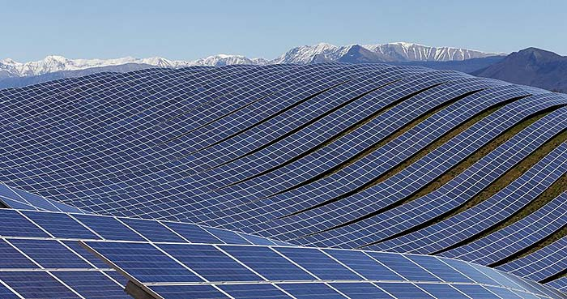
Questions?
cxm842@psu.edu

