Slide 1
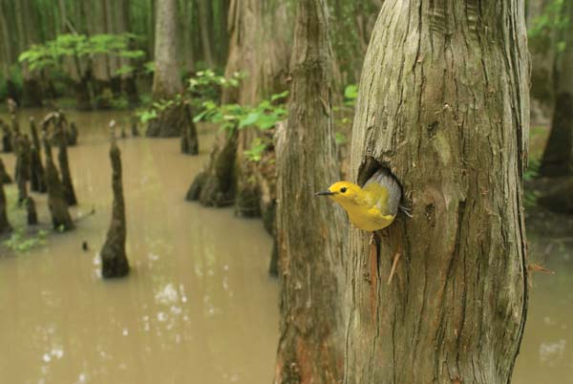
Effective Refuge Design in the Face of Uncertainty
Sarah McCabe
GEOG 895A
April 2014
Penn State
Advisor:
Joe Bishop
Notes:
Splash Page

Slide 2
Outline:
Topic : Migrating Songbirds
Place: Texas Gulf Coast
Project Question: Finding the best areas for a Refuge
Identify the Criteria
Identify Data
Part 1: Model the Criteria
Part 2: Model the edges
Part 3: Model Habitat Corridors
Notes:
Here is a brief outline of what I am going to talk about. My topic is identifying habitat for migratory songbirds on the Texas Gulf Coast. My project question is: Which areas are the best to include in a wildlife refuge. I will talk about the criteria for areas to be included, the data I can get, and also modeling the landscape, the edges of the existing refuge parcels, and habitat corridors between the parcels.

Slide 3
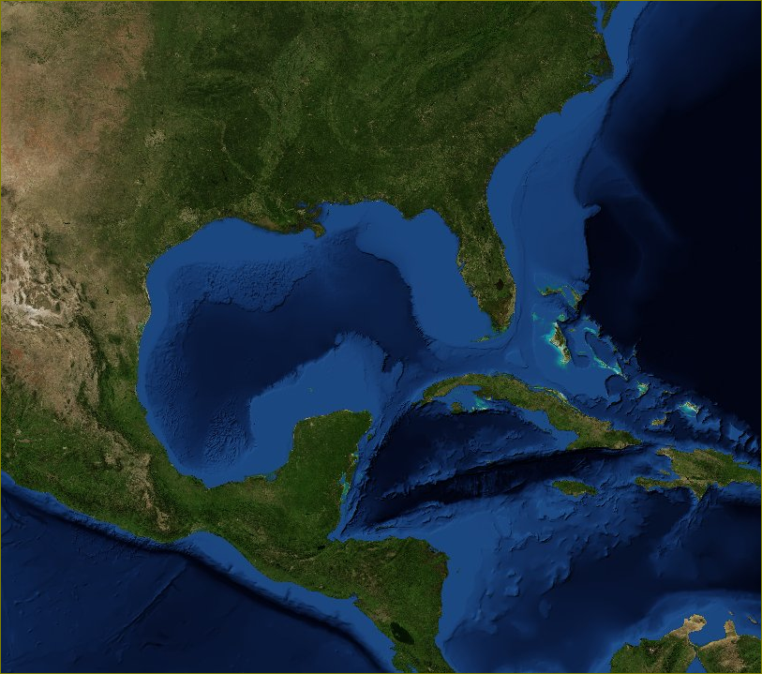
North American
Migration
Notes:
Every spring large numbers of birds cross the Gulf of Mexico to breed in the forests of North America.
Every Fall they cross again to go to Central and South America, or they may stop in the southern states as many ducks and geese do. Some birds such as hawks and cliff swallows go around Gulf of Mexico. The birds that go around by land travel during the day, feeding as they go. But the birds that go directly across, like many Warblers, fly at night across the water.

Slide 4
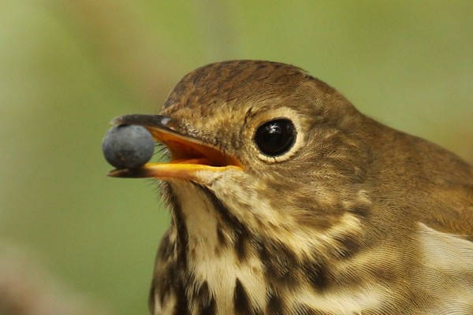
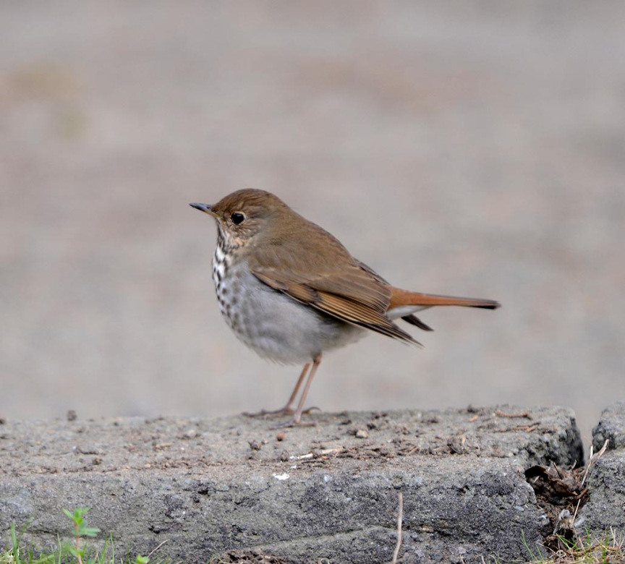
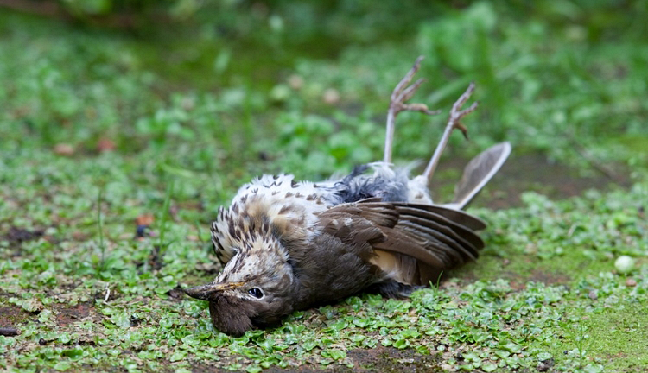
Migration – Hazards and Foraging habitat
Hermit thrush
Notes:
This migration demands a lot of physical energy. Birds eat heavily to store fat before they migrate. Forest birds take off after dusk and fly at night, probably to avoid enemies, but also so they can forage during the day. If migrating birds do not find shelter, food and water on their journey, they may die from exhaustion or predation. (Moore et al.)

Slide 5
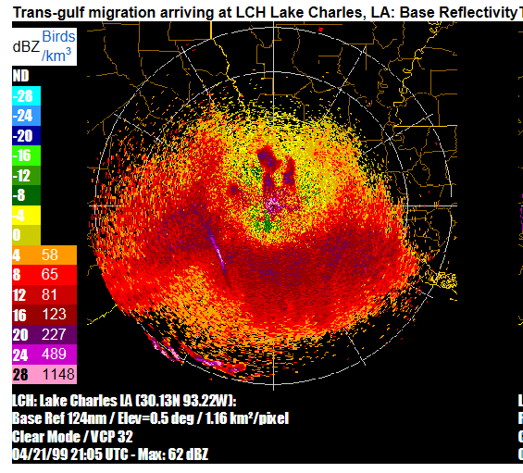
Radar Studies:
Annually, 29 million individual birds, of 240 species, use the Gulf Coast.
“Forested wetlands are used almost exclusively as important stopover areas and extensive pine flatlands are rarely used” (Gauthreaux, 2005).
1944
Image:http://virtual.clemson.edu/groups/birdrad/COM4D.HTM
Notes:
The migration of birds can be observed with radar, similarly to weather observations. Waves of migrating birds can be detected taking off at dusk, as low-altitude radar reflection. The radar studies show that migrating song-birds strongly prefer wetland forest as stop-over areas.

Slide 6
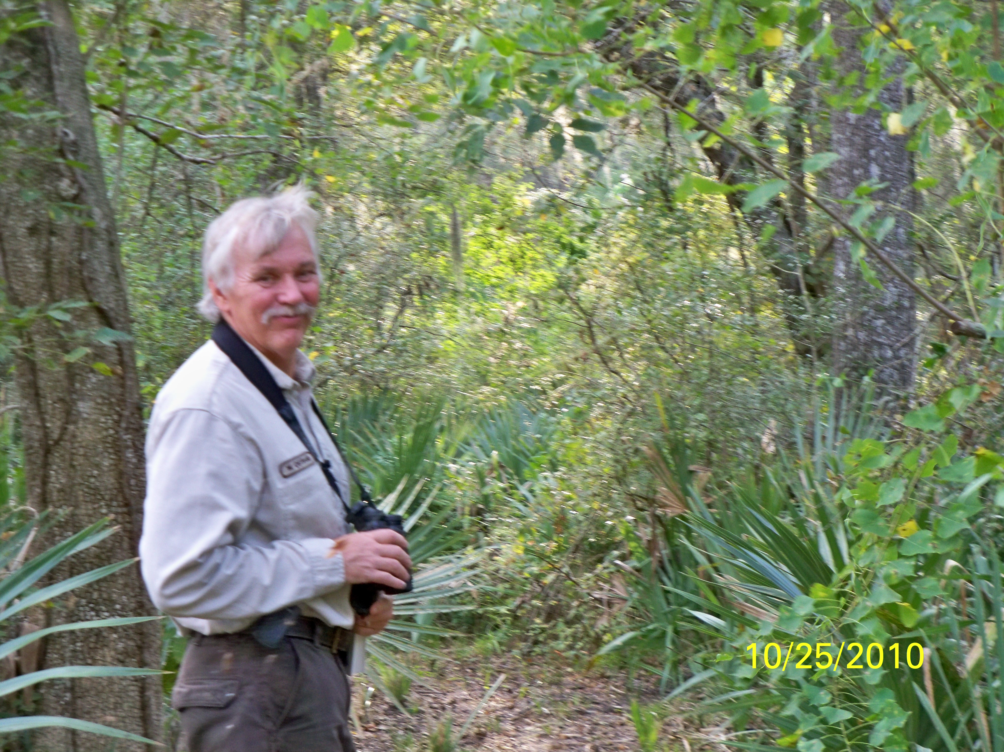
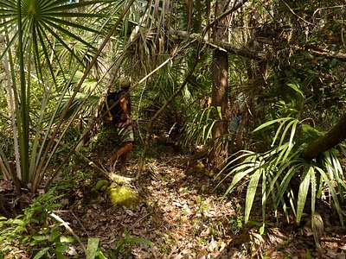
Why are Wetland Forests
Valuable for Migrating Birds?
Structure
Large and small trees,
Shrubs
Vines
High insect biomass
Notes:
Why are Wetland Forests valuable for Migrating Birds? Poorly drained Bottomland forests often contain large trees as well as understory and mid-story plants. The complex tangle of twigs and leaves provides safe resting areas for birds. The wet soil provides adequate moisture to produce leaves, and the large mass of edible vegetation provides food for a large number and variety of insects.

Slide 7
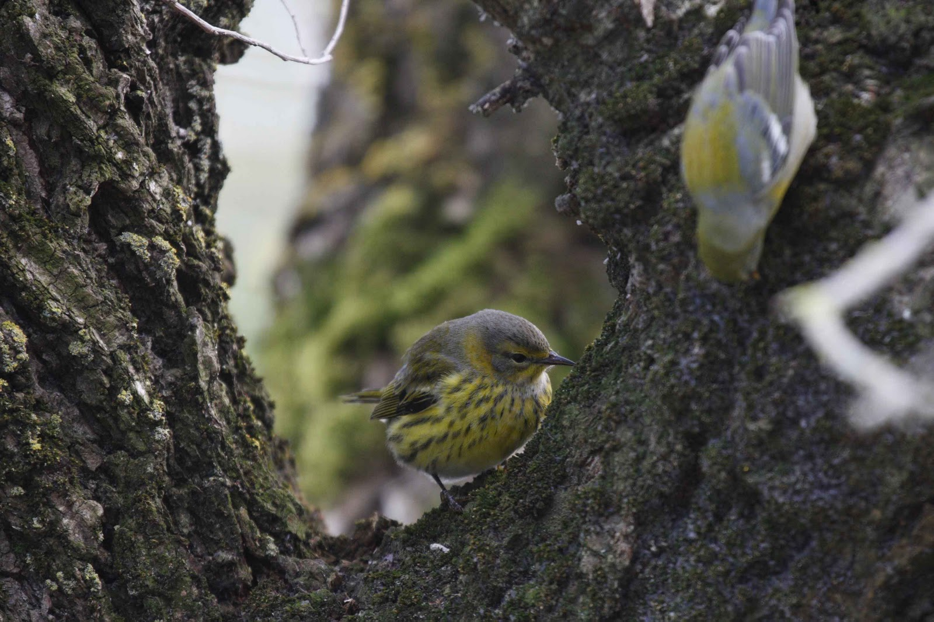
Why are Wetland Forests
Valuable for Migrating Birds?
Cape May Warbler and Northern Parula foraging for insects.
Notes:
So wetland forests are exceptionally good places for a migrating bird to rest and feed.

Slide 8
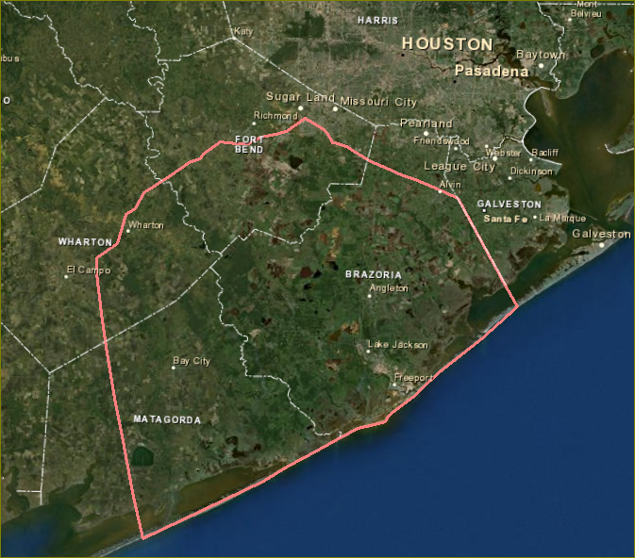
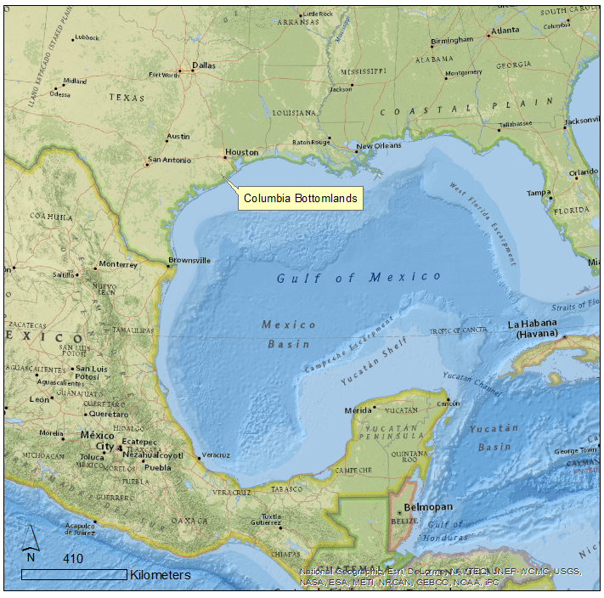
Columbia Bottomland Forest
Forest
Crops
Notes:
The Columbia Bottomlands south of Houston is the area for my project. This is the forested area around the Brazos, San Bernard and Colorado Rivers. The area includes parts of four counties. The metropolitan area of Houston is expanding rapidly into Fort Bend and Brazoria counties. Agriculture and oil and gas are important industries here

Slide 9
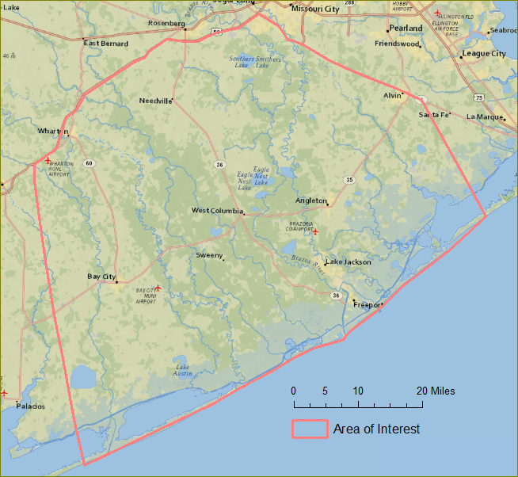
The Columbia Bottomlands
Original extent: 700,000 acres
(US Fish and Wildlife Service, 2013)
Notes:
The original extent of this forest area is estimated to have been 700,000 acres. Common bottomland tree species here are live oak, cedar elm and hackberry trees with an understory of yaupon holly. In frequently flooded areas there are stands of green ash and palmetto. These species are not particularly useful for lumber, so the timber industry is not active here as it was in east Texas. The bottomlands were formerly surrounded by upland coastal prairie, which has largely been converted to agriculture. In the 1990s a study was done with aerial photography that measured the forest cover. comparing the 1970s and 1990s, that showed a reduction of 16 per cent in 20 years.

Slide 10
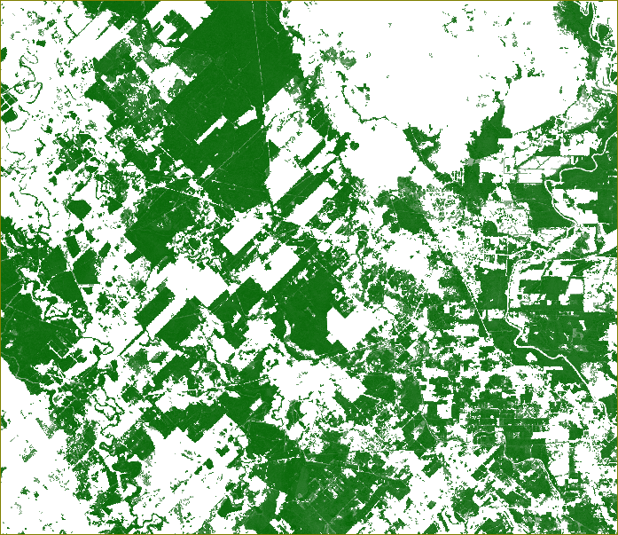
The Columbia Bottomlands
1976: 305,914 acres
1996: 254,269 acres
Reduction of 16%
(Webb, 1996)
Percent Canopy, 2001
National Land Cover Dataset
Notes:
This is a section of the canopy theme of the National Land Cover data set, centered around the town of West Columbia. Forested areas are shown as shades of green, and open areas are white. The large white areas at the top and bottom left were formerly prairie. The forest area has gradually been cleared for agriculture, and more area is being used for housing with the growth of the oil industry.

Slide 11
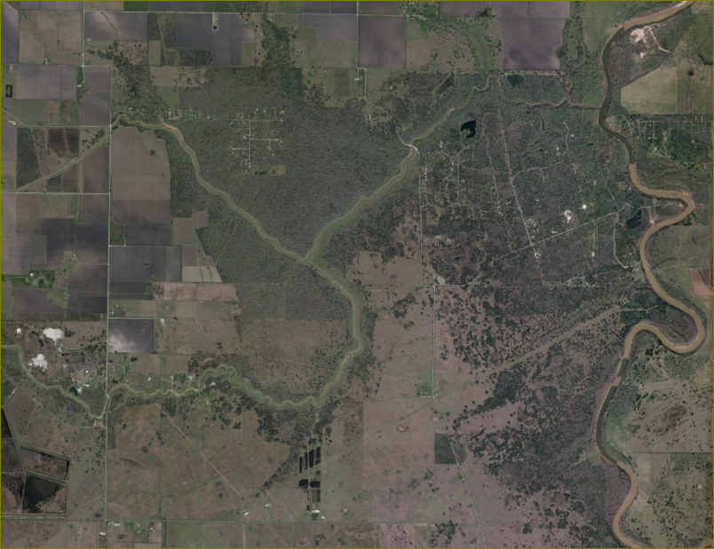
Causes of
Clearing
Crops
Pasture
Ponds and reservoirs
Roads
Pipelines
Exurban development
Drainage canals
Notes:
In this photograph you can see a remnant of the pattern of forest bottomland and prairie upland. The Brazos River is on the left. In this region, forest clearing is done to expand cropland, and to provide pasture for horses and cattle. Small ponds and reservoirs as in the bottom left corner are frequently constructed. Fragmentation can be for roads, utility rights of way and petroleum pipelines, exurban development of homes on large lots, and my personal favorite, clearing of vegetation near creeks by the local drainage district to provide faster draining of water.

Slide 12
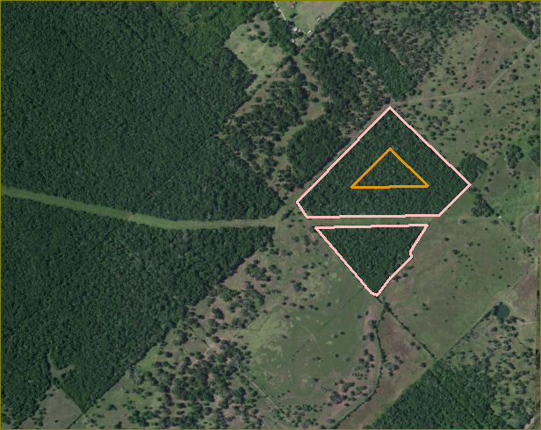
Edge distance: 100 meters from the forest boundary.
Core forest and edge forest
Core
Edge
Notes:
Here I should explain the concepts of core and edge forest. The interior of a heavily forested area is shaded and more humid than the edge of a forested area, where individual plants receive more sunlight. Some animals prefer edge habitat, like deer, and some animals prefer core or interior habitat. In this image, the power line easement has cut through the small woodlot, so much of the area is less than 100 meters from the forest edge.

Slide 13
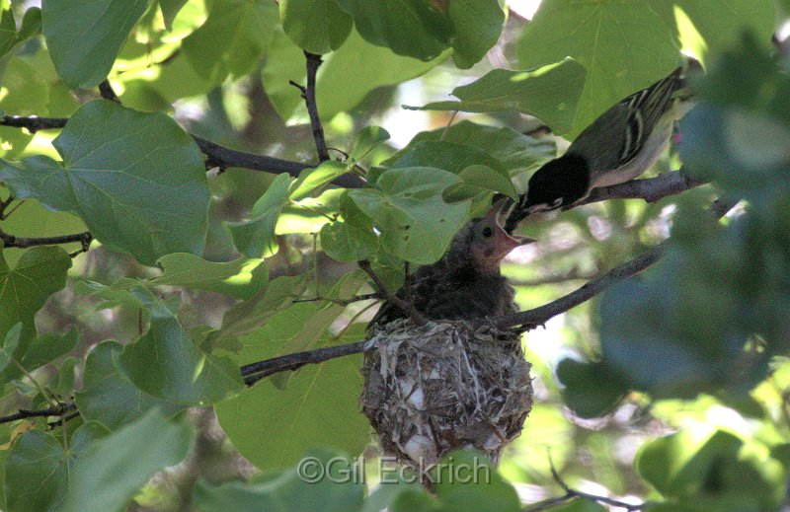
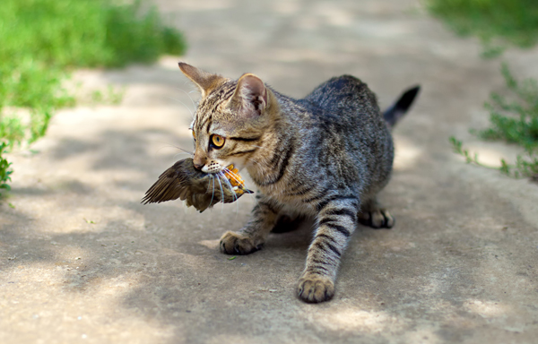
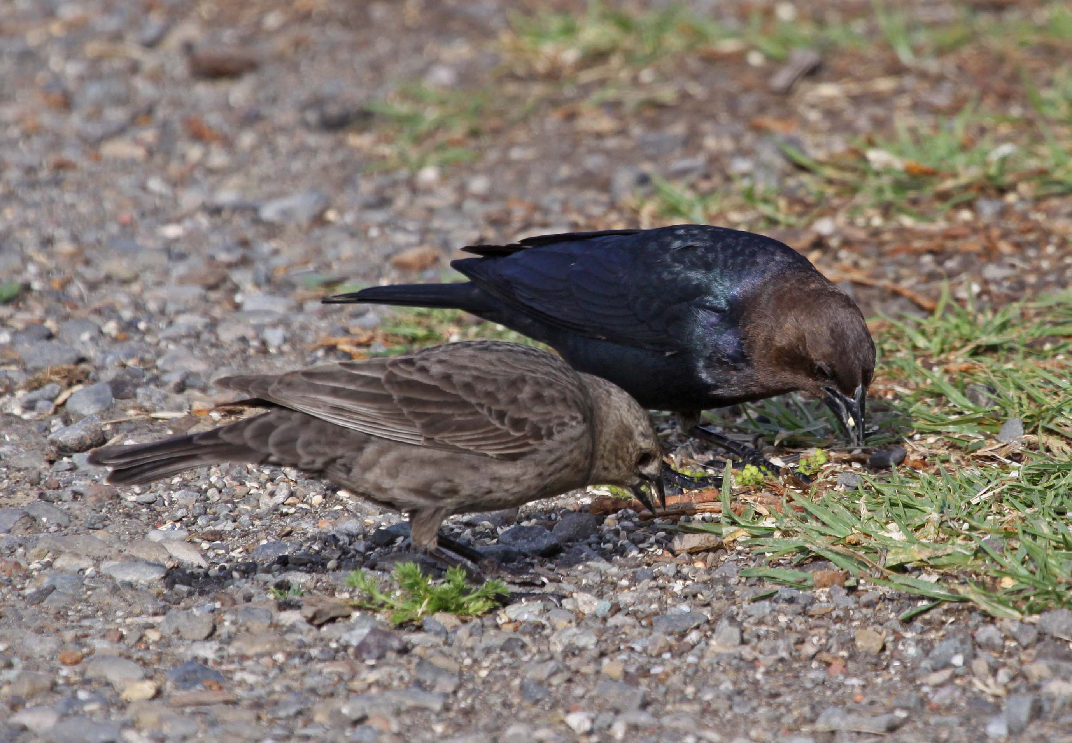
Decreased movement for some animals. Small, isolated habitat patches support fewer species. Conversion of core forest (deep shade) to edge forest (sunlight) favors different plant species. Decreased humidity reduces invertebrate numbers. Change in animal species. Large trees more vulnerable to wind. Increased access for predators and parasites.
Forest Fragmentation – Why is it a problem?
Notes:
Animals may have difficulty moving between habitat patches to find food and breeding habitat, and to find mates. Small, isolated habitat patches support fewer species. (Harris 1984) Fragmentation converts core forest which has shade and high humidity, to edge forest which receives more sunlight, allowing a different group of plants to thrive, like invasive Chinese tallow. Animals that prefer edge habitat increase in number, animals that prefer core habitat decrease in number. Large trees are more vulnerable to blow-down on forest edges. Predators like cats and snakes, and nest parasites like cowbirds from outside the forest have access to nesting birds in the edge forest.

Slide 14
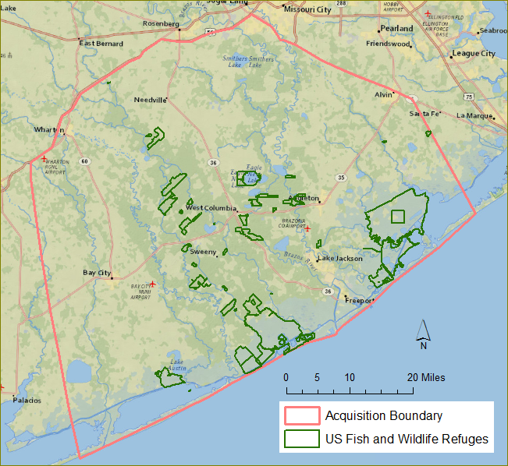
Texas Parks and Wildlife US Fish and Wildlife Service Natural Resources Conservation Service Ducks Unlimited Gulf Coast Bird Observatory Cradle of Texas Conservancy
Austin’s Woods Conservation Plan
Goal: Conserve 10% of original forest area, or
70,000 acres.
Methods:
Donation of fee title
Conservation Easements
Purchase of Fee title from willing sellers
Initial Approval for 28,000 acres
Notes:
During the 1990s a coalition of government agencies and non-profit entities formed to conserve some of the Columbia Bottomlands. They set a goal of 10 percent (70,000 acres) of the original forest habitat. The Texas Midcoast Refuge Complex had originally been established as three large refuges for waterfowl on the coast. The refuge complex received initial approval from the Fish and Wildlife Service to acquire 28,000 acres. In Texas, the majority of land is privately owned, so to create a wildlife refuge the Federal government can not segregate it from other federal land as they might do in most of the western United States. Also, this program cannot condemn land as a municipal or state government might do. To add to the Refuge complex, the Fish and Wildlife Service must deal with willing sellers.

Slide 15
Austin’s Woods
Part II
Further Approval for 42,000 acres to achieve goal of 70,000 acres.
Notes:
This map shows the current configuration of the refuge parcels. The Refuge complex has received permission to increase the acquisition program complete the quota of 70,000 acres. Which areas would be the best to conserve? This question is complicated by the fragmented nature of much of the landscape, and also the fact that the US Fish and Wildlife must deal with private landowners. They have limited control on what the final configuration of the refuge complex will look like.

Slide 16
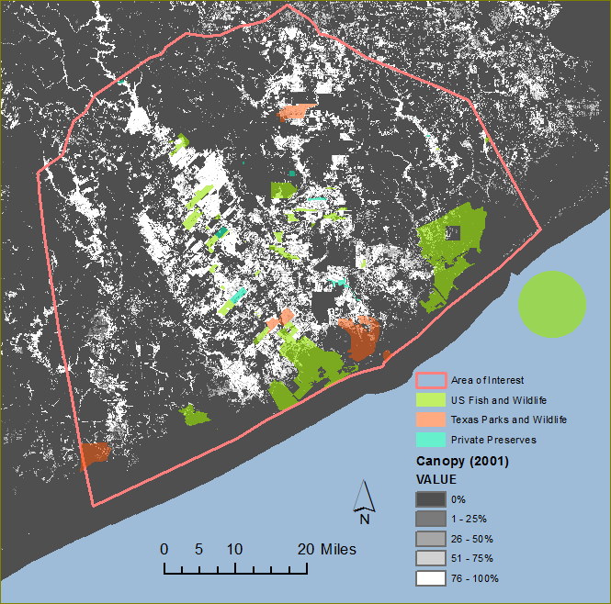
Austin’s Woods
Part II
Further approval for 42,000 acres to achieve goal of 70,000 acres.
What would be the ideal configuration of refuges, to select the most ecologically valuable areas, and to enhance the wildlife habitat conserved already?
42,000
acres
Notes:
Here is another view of the pattern of refuge parcels, along with the Texas Parks and Wildlife Units, and some other county or private preserves. The background is the Tree Canopy dataset, showing areas of trees as white. As you can observe, in some instances the Fish and Wildlife reserve is next to a state or private reserve. Two of those reserves are mitigation banks. The green dot is the approximate size of 42000 acres. The question is, how should that acreage be distributed, to provide quality habitat for migrating birds.

Slide 17
Austin’s Woods Project
Land Protection Plan Priorities List
Does the unit provide high quality old growth undisturbed habitat?
Does the unit include exceptional/unique plant communities (e.g., canebrakes, willow swamps, bald cypress swamps, cherry laurel stands)?
Is the size of tract greater than 1,200 acres, or does it have the potential to have adjacent lands conserved that would meet this criteria?
Does the tract complement, is adjacent to or near other protected areas, particularly where natural links exist such as the same hydrologic system or seed dispersal corridors?
Would acquisition maximize maintenance of natural ecological functions and processes (e.g., natural hydrological patterns)?
Does the unit have a high degree of structural (plant community and topographic) complexity?
Does the unit have great restoration potential with basic ecological processes; natural hydrological components, species presence intact and minimal invasive species?
Does the unit influence hydrologic or watershed patterns?
Notes:
In determining the most important areas to protect, the Fish and Wildlife Service has written a Land Protection Plan, which identifies principles to follow in acquiring parcels. There are eight Primary Priorities and eight Secondary priorities. Here is a paraphrased list of the Primary Priorities: The main priorities are undisturbed Old Growth forest habitat, Exceptional plant communities, Tract size greater than 1200 acres, proximity to existing refuge areas, particularly if linked by water, and topographic complexity.
You will have noticed this charming Prothonotary warbler that has made a nest in the cypress knee. Prothonotary warblers prefer very specific habitat for nesting, namely tree cavities above standing water. Migrating birds when they are moving through the landscape do not look for their specific nesting habitat – they are looking in general for tree or shrub stands that may have food. (Moore 1995) The Land Protection plan lists several species of concern that need undisturbed habitat for breeding – Prothonotary warbler, Swainson’s warbler and Acadian Flycatcher, to represent species with similar needs in the Columbia Bottomlands.
The goal of my project is to model the priorities of the Land Protection Plan, similarly to modelling habitat for a specific animal. The main difference is that I will include the size of land parcels, to try to increase the efficiency of the program, and decrease the problem of habitat fragmentation.

Slide 18
Habitat Modelling:
Approach 1:
Literature Review and Expert Opinion-based Habitat Suitability Models
Similar to site location.
US Fish and Wildlife, Habitat Evaluation Procedures Handbook, 1981
Approach 2:
Empirical and Statistical Techniques
Good data for species abundance or absence
Method: GIS habitat data is associated with species occurrence data.
More accurate, more costly.
Notes:
The practice of habitat modelling has two major approaches. The first approach, Literature Review and Expert opinion-based habitat Suitability models is similar to site location. The Fish and Wildlife service has a detailed handbook on how to do it.
The second approach is empirical, and requires good data on whether an animal is present or absent. The approach that I will take for determining the best areas to include in the system is the first approach – choosing data sets to model the different priorities including tax parcel size, weighing their values, and comparing the results to the highest value to determine a suitability index.

Slide 19
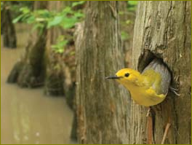
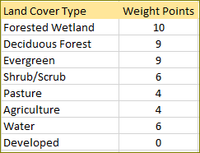
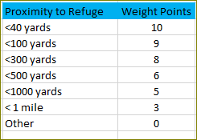
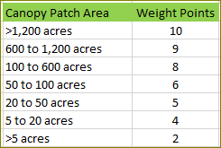
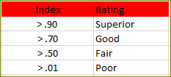
Project Goal 1:
Assess the Landscape for priority values, and identify the areas most highly rated.
Objective 1 – Model each of the priorities using geographic data.
Objective 2 – Weigh each of the factors and combine values to make a “Habitat Suitability Map” of Priority values.
Objective 3 – Identify parcels with high Priority Values.
Example:
+
+
/Max =
Notes:
My project has three related goals. The first goal is to model the landscape within the acquisition area to identify areas that meet the Priority Criteria. I will do this by selecting data sets to model each of the priorities, and weighing the possible values. The sum for each area will be divided by the maximum summed value (which could be 30 in this example). The areas will have a possible rating of 0 to 1.0. The final index will include canopy size, vegetation, elevation, wetland and hydrology data sets.

Slide 20
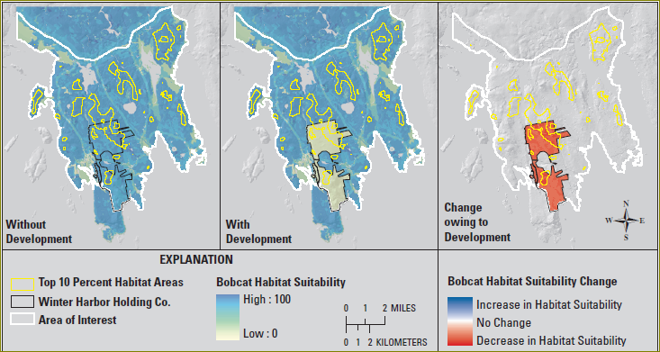
Project Goal 1:
Assess the Landscape for priority values, and identify the areas most highly rated.
Example: Bobcat habitat suitability in Acadia National Park.
Rohweder, 2012
Notes:
The end result will look something like this model of Bobcat habitat suitability in Acadia National Park in Maine. Areas that are good bobcat habitat are shown as deep blue on the left, and the top 10 percent of bobcat habitat are outlined in yellow.

Slide 21
Data Sets
County Tax Parcel Data Sets
Brazoria - Available online from Houston-Galveston Area Council
Fort Bend - Available on disk from County Offices
Also available online from Houston-Galveston Area Council
Matagorda - Data downloadable from their website
Wharton. - Available on disk in .dng format from County Offices
Infrastructure Data Sets
County Roads
Texas Railroads
Source: Houston-Galveston Area Council
Land Cover
National Land Cover Database 2011.
National Land Cover Database Tree Canopy 2011
2008 Land Cover Source: Houston-Galveston Area Council
Wetlands
National Wetlands Inventory
Water features
National Hydrography Data Set
Water Features. Source: Houston-Galveston Area Council
Vegetation
National Vegetation Classification – General Vegetation Classes
This data set has poor spatial resolution in this area
National Land Cover Data 2011 – Identifies Forested Wetland
Unique and Exceptional Plant Communities - Poll of local experts: Thomas Adams, Warren Pruess, Chris Kueper, David Rosen, Michael Lange. Survey form and on-line map.
Vegetation Complexity
US Basal Area-Weighted Canopy Heights 2000 (Woods Hole Research Center)
Topographic Complexity
National Elevation Data (NED)
Wharton County (30 meter grid)
Brazoria County (10 meter grid)
Matagorda County (10 meter grid)
Fort Bend County Lidar (in 50 foot grid)
Preserve Areas
Refuge Boundaries
Other protected areas: State Wildlife Management Areas, Mitigation Banks, Private Reserves – Source: Michael Lange, US FWS Biologist
Notes:
Most of the data sets I will use are available from National Map.gov. I was really please to find a measure of tree canopy heights from Woods Hole, though it is 10 years old and may not have good resolution. I have not found any really detailed vegetation data. I will get the county roads and railroads from the Houston-Galveston Area Council, and County parcels from individual counties. If it is available I will get the owner ID numbers to try to find areas that have common ownership of small parcels.

Slide 22
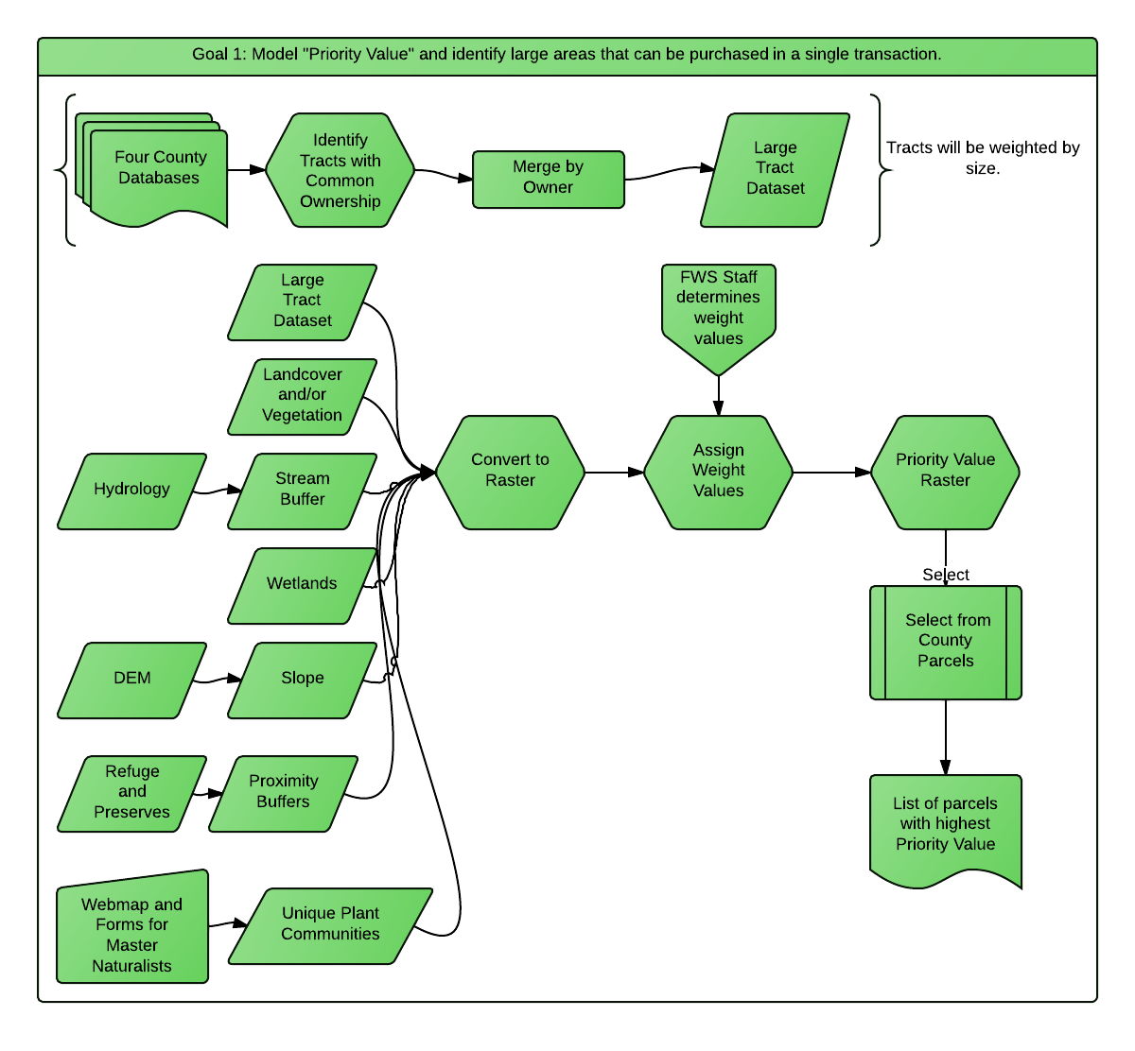
Goal 1
Data Flow Chart
Notes:
First I would use the databases of the four counties to identify areas that have common ownership. Then I would create proximity buffers for the existing refuges, and then use the landcover, hydrology, elevation models, parcel size and proximity information to create an index. The staff at the Fish and Wildlife service will give their opinion on the relative importance of each data element. Areas of high index value will be used to select the best tax parcels to add to the refuge system.

Slide 23
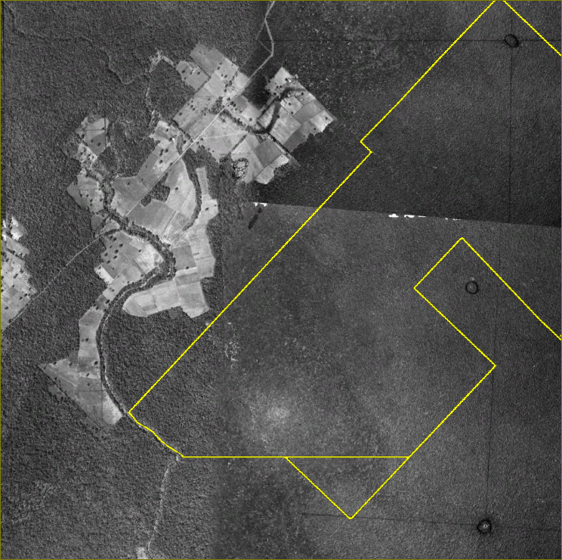
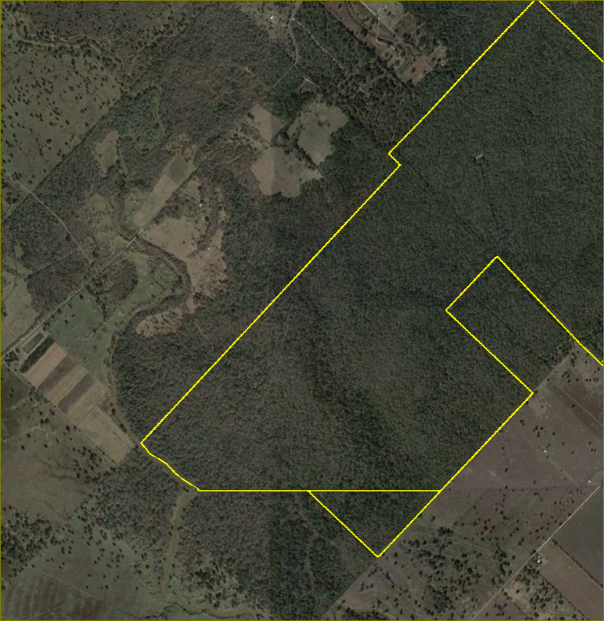
Assess vulnerability for conversion to edge forest.
Project Goal 2:
Linville Bayou
Unit
Objective 1 – Calculate Current core and edge forest on refuge parcels.
Objective 2 – Model “brush removal” on refuge parcel exterior. Recalculate areas of core and edge forest.
Objective 3 – Identify neighboring parcels with greatest impact
Results – List of Parcels that would have a large impact on core forest if they were cleared.
1944
2011
Google Earth
Notes:
Goal 2 is to assess how much core forest acreage would decrease if all of the forest buffer surrounding the refuge units were to be removed. The top photographs shows the forest in 1944. The Linville Bayou unit (which did not actually exist at that time) was almost entirely core forest. The current state of the unit has edge forest on the south-east margin. This unit also has a notch of land which could change a large area within the refuge parcel to edge forest if it were cleared.

Slide 24
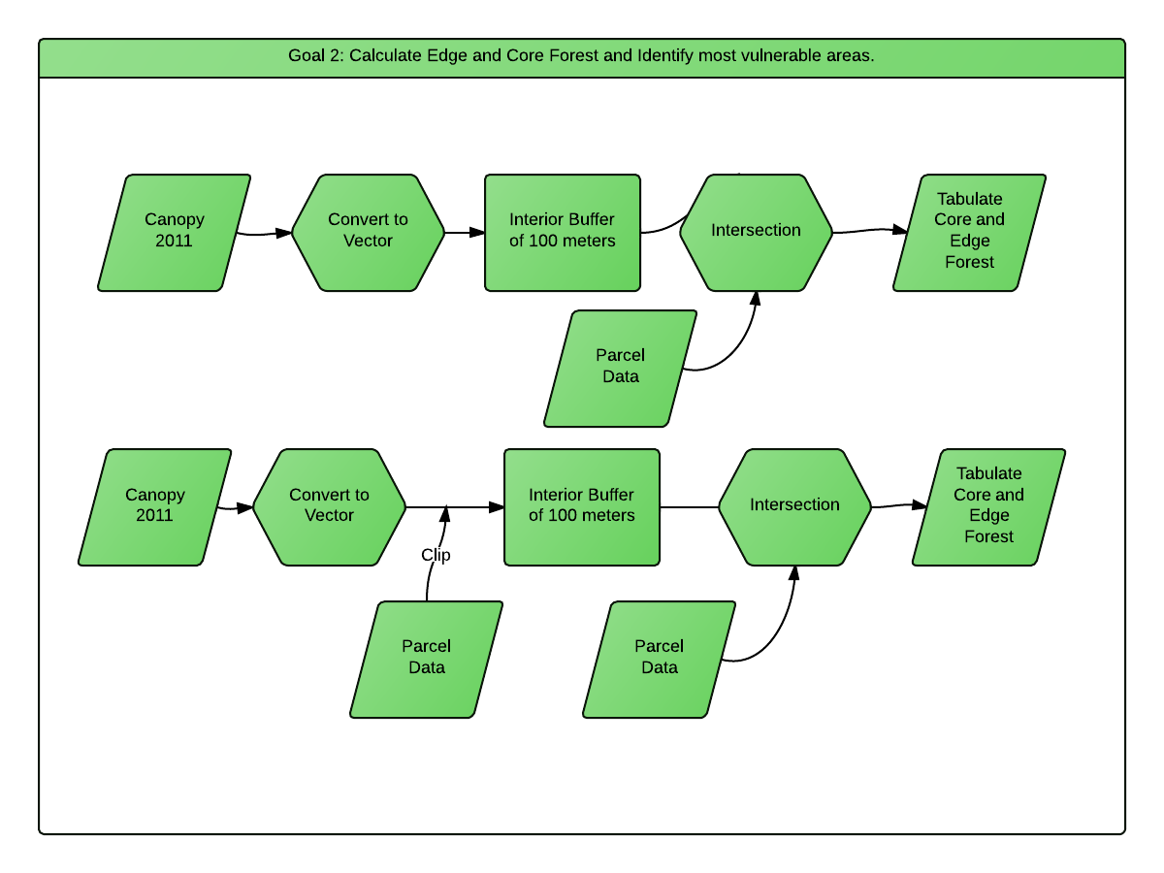
Goal 2 Data Flow Chart
Notes:
This model uses only two data sets: The existing refuge parcels, and the Tree Canopy coverage data, converted to vector.

Slide 25
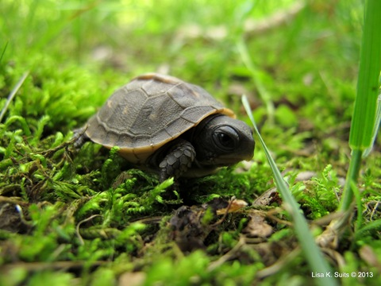
Model travel corridors for Gulf Coast Box Turtle.
Project Goal 3:
Objective 1 – Identify habitat needs of juvenile Box Turtles (more likely to travel than adults).
Objective 2 – Identify data sets to represent barriers, corridors, and quality habitat.
Objective 3 – Model corridors with a Least Cost calculation.
Result – A raster data set modelling the dispersal of juvenile Box Turtles.
Small objects can be
barriers for young box turtles.
Notes:
Project Goal 3 is to model the entire landscape for an actual animal. Though the purpose of the refuge is to provide habitat for migrating birds, I think it would be useful to model how a terrestrial animal would move through the landscape. Box turtles actually establish home territories, and they do not move very much as adults. Juvenile box turtles need wetter environments than adults do, because their diet consists mostly of invertebrates where the adults have a more vegetarian diet. Box turtles are frequently killed on roads, so roads will be modelled as a barrier for them, and roads with more traffic will be higher barriers.
Models for corridor design are based on habitat models. There is an assumption that animals will want to travel in an environment where they can find shelter or food. However, sometimes animals will use areas that are poor habitat to get between patches of good habitat. Box turtles have been observed to travel relatively quickly in pastures, even though they prefer forests as habitat. Even though the forest is better habitat, the forest floor has more obstacles than the pasture.

Slide 26
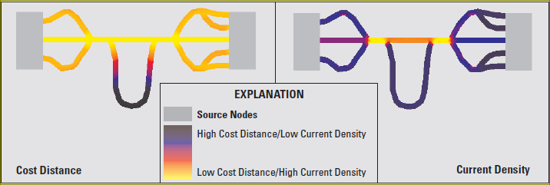
Goal 3 – Corridor Design using cost distance
Rohweder, 2012
Notes:
Areas that are good habitat for young box turtle, like upland forest, small streams and ponds will be assigned a low value, while areas that are barriers like roads and railroads will be assigned a high value.

Slide 27
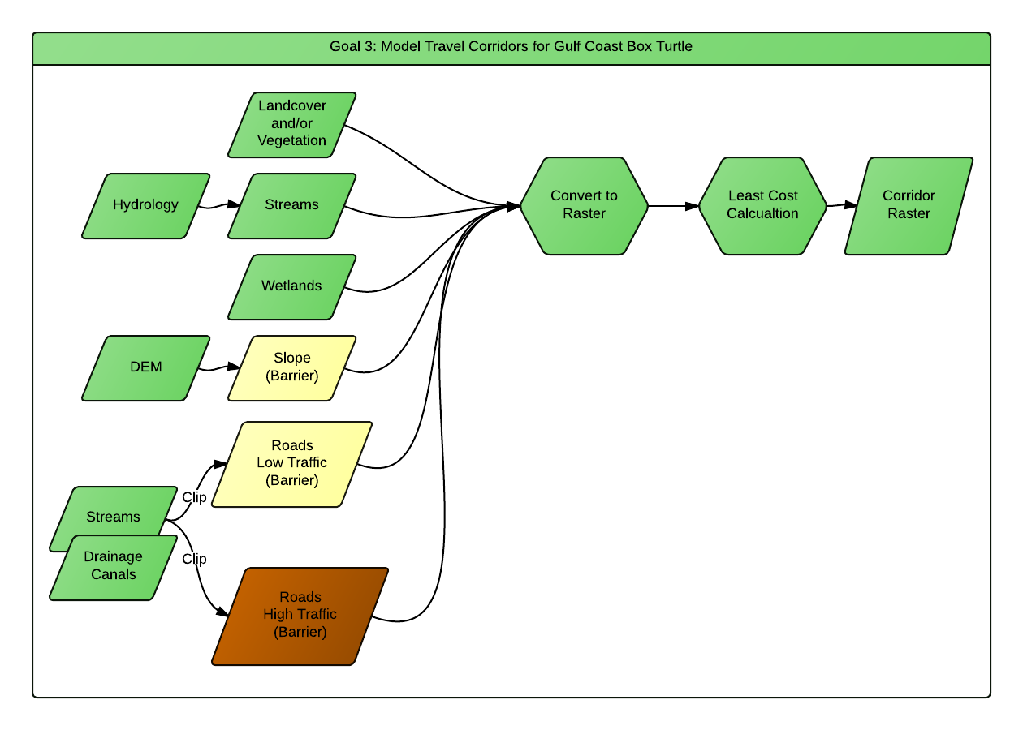
Goal 3 Data Flow Chart
Notes:
This model will use many of the same datasets as the first model, but This model assumes that streams and canals are directed under roads, so they will counteract the effects of the roads as they go underneath in the culvert.

Slide 28
Goal 1: Assess the Landscape for priority values:
What I have done so far:
Identified most of the National , State and County sources of data.
Identified Two Habitat Modelling examples to imitate
Surprises/Concerns:
Counties vary widely in the availability and format for tax parcel data. The options are: Download Link, email for ftp permission, bring a big check for a CD.
I need to keep a “Data Directory” spreadsheet so I know where the data is.
Major To-Do’s:
Study and understand the modeling examples.
Acquire and review data
Keep another spreadsheet with processing steps.
Notes:
One surprise for me is that the two rural counties in my area do have GIS data, but it is not in shapefile or geodatabase format, and also I will have to drive to the county seats to get it. I also may need to convert the data format for one county.
With so many data sets, and so many processes, I will need to keep a data directory.

Slide 29
Goal 2: Assess vulnerability for conversion to edge forest
What I have Done so Far:
Data will be adapted from the Goal 1 project.
Surprises/Concerns:
I want to identify the neighboring parcels that contribute the most to protecting the core forest. That list may need a lot of explanation
Major To-Do’s:
Data Processing should be simple.
Notes:
I expect the core/edge forest analysis will be the most straight-forward part of this project, but I many need to explain the results for each parcel, because they are all different.

Slide 30
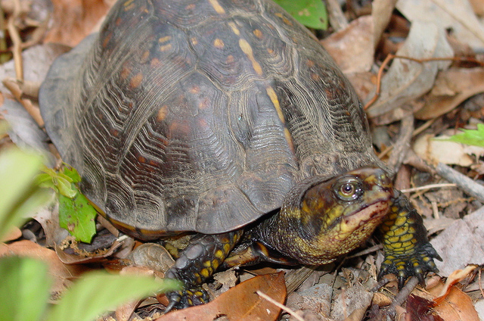
Goal 3: Model travel corridors for Gulf Coast Box Turtle
What I have done so far:
A literature search on Box Turtle habitat and movement.
Surprises/Concerns:
Texas Parks and Wildlife has a Box Turtle reporting system (They consider Box Turtles as threatened.)
The data sets I am using may not have fine enough scale to be meaningful.
I may make incorrect assumptions about how turtles behave.
Major To-Do’s:
Choose data sets to model the habitat for young box turtles.
Review the habitat and corridor modelling examples.
Notes:
I was pleased that Texas Parks and Wildlife has two data sets on turtles, but because they are not systematic and report where turtles are NOT found, I can not use them for a habitat model, so I will use the First approach, which is literature review. I am not a turtle expert, and I may make incorrect assumptions about them.
The most difficult part of this step is to choose the data sets and use them to model the habitat. I have some concern that the elements that affect turtles occur on a finer scale than I will be able to find data for.

Slide 31
Results:
Identify:
Areas of highest value for stop-over habitat for migratory birds
A specific list of county tax parcels that include those areas
Parcels that are valuable for the protection of core habitat on refuge parcels
A corridor model for animals moving between existing refuge parcels.
Discussion:
“Reconciliation ecology” – Improving a human-altered landscape for wildlife.
Tax benefits and conservation easements - steps a private landowner would need to do to take advantage of any of these programs.
Identifying parcels around the refuges to apply these programs to.
Notes:
My goal at the end of this project is to have a set models that can be used to make the optimum choices about which real estate parcels to pursue. In the discussion, I also want to write about the matrix of private land that the refuge parcels will be imbedded in. In a fragmented landscape, the landcover and activities on land that is adjacent to the refuge becomes very important. There are a number of conservation programs and tax incentives for wildlife conservation by private landowners in Texas. I want to investigate those and discuss them briefly I think it is important to encourage the best land cover that is compatible with the refuge on the surrounding parcels.

Slide 32
Week 1 – May 28
A. Collect any data I do not have already
Week 2 – June 4
A. Model: Priority 1 Old-growth Habitat B. Priority 2: Contact Plant Experts, gather their input
C. Priority 3: Identify large contiguous tracts from county parcels and Tax ID.
D. Priority 4: Model Adjacency to large Tracts
E. Priority 4: Identify Adjacent parcels that share water or wetland features.
G. Priority 5a: Areas with Multi-story Plant Communities
H. Priority 6. Topographic complexity
I. Write about Priority modelling. Use illustrations and charts.
Week 3 – June 11
A. Identify a rating system on the priorities. B. Calculate priorities as a heat map C. Discuss rating with Mike Lange, Refuge Biologist, adjust weight values.
D. Identify water features that control water level.
Week 4 – June 25
A. Make List of large, priority parcels B. Work on Core and Edge Forest calculations C. Identify top acreage: Top 10K, 20K, Top 40K, Top 60K acres
D. Write about Priority modelling. Use illustrations and charts a lot.
Weeks 5 and 6– July 9 B. Model habitat corridors for box turtles. C. Write about habitat modelling.
Week 7-8 – July 23
A. Write Results section B. Write about “reconciliation ecology” and partnerships with private owners. C. Work on presentation.
Week 9-10 July 30
A. Rewrite everything B. Presentation.
Schedule:
Notes:
I am going to try to finish this during the summer semester. The first four weeks will be for the general habitat model, the next two will be for the box turtle corridor, and the final four weeks will be for writing about the process, and about other conservation programs. It will be really hot in Texas this summer, so I will have few distractions.

Slide 33
Conference:
Northwest GIS Users Conference Oct 13-17, 2014 Lynnwood, WA
Other Conferences:
Society for Conservation GIS July 11-13, 2014 Monterey, CA
Society for Conservation Biology (N America) July 13-17, 2014 Missoula, MT
Southern Forestry and Natural Resource Management GIS Conference
December 2014
Texas Wildlife Society Feb 19-22, 2015 Corpus Christi, TX
Texas Land Conservation Conference: Mar 4-6, 2015
International Association of Landscape Ecology July 5-10, 2015 Portland Oregon.
Notes:
The ideal time to give a conference presentation would be August to November this year. I found many Texas or conservation-oriented conferences, but they are either too early or too late. The Northwest GIS Users Conference is in October, so I will aim for that one. I may see you there, Lindsey. I can go to these other conferences later.

Slide 34
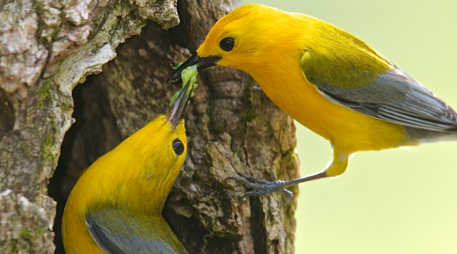
References
Clemson University, 2013. Web page. “Migrating Birds: Transgulf Migration”http://virtual.clemson.edu/groups/birdrad/COM4D.HTM
Habitat Modelling, Corridordesign.org website, http://corridordesign.org/designing_corridors/habitat_modeling/
Accessed 4/28/2014
Gautreau, S.A. Jr. and Belser, C.A. (2005). Radar ornithology and the conservation of migratory birds. In: C. John Ralph and Terrell D. Rich, editors. 2005. Bird Conservation Implementation and Integration in the Americas: Proceedings of the Third International Partners in Flight Conference. 2002 March 20-24; Pp.871-875. http://virtual.clemson.edu/groups/birdrad/pubs/Gauthreaux_networks_9-2005.pdf
Harris, L.D. 1984. The Fragmented Forest: Island Biogeography Theory and the Preservation of Biotic Diversity. University of Chicago Press, Illinois.
Moore, F. R., Gauthreaux Jr, S. A., Kerlinger, P. A. U. L., & Simons, T. R. (1995). Habitat requirements during migration: important link in conservation.Ecology and management of neotropical migratory birds, a synthesis and review of critical issues (TE Martin and DM Finch, eds). Oxford University Press, New York, 121-144.
Webb, J., 1996 (Unpublished). “Forest Habitats of Austin’s Woods of Texas” Gulf Coast Bird Observatory, Texas A&M University at Galveston.
US Fish and Wildlife Service, 2013. Texas Mid‐Coast Refuge Complex Comprehensive Conservation Plan and Environmental Assessment. Appendix I, Land Protection Plan, pages 281 to 314. http://www.fws.gov/southwest/refuges/plan/docs/Texas/TMC_CCP_portfolio.pdf Accessed 03/08/2014.
US Fish and Wildlife Service, 1981, Habitat Evaluation Procedures Handbook. http://www.fws.gov/policy/esmindex.html Accessed 4/28/2014

Slide 35
Questions

