Slide 1
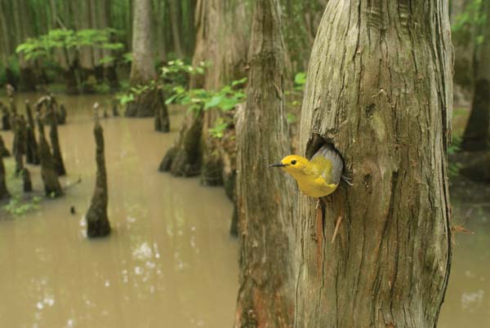
Optimizing a Refuge Plan: A Practical Example on the Texas Gulf Coast
Sarah McCabe
October 2014
Penn State
Advisor:
Joe Bishop
Notes:
Hello Folks, it is great to be here today My presentation is on the Capstone project I am doing as part of the Masters in GIS program at Penn State. I worked on the maps for the Comprehensive Conservation Plan for the Fish and Wildlife Service in this region a few years ago, and I wanted the expansion of the refuge system to be the topic for my capstone project.

Slide 2
Outline:
Topic : Conserving habitat for Migrating Songbirds
Place: Texas Midcoast National Wildlife Refuge Complex
Project Question: Making choices for a Refuge plan
Identify the Criteria
Identify Data
Model the Criteria
Identify Parcels with Forest Habitat
Notes:
Here is a brief outline of what I am going to talk about. My topic is identifying areas to preserve habitat for migratory songbirds on the Texas Gulf Coast. My project question is: Which areas are the best to include in a wildlife refuge. I will talk about the criteria for areas to be included, the data I could get, and also modeling the landscape, and buffering the existing refuges.

Slide 3
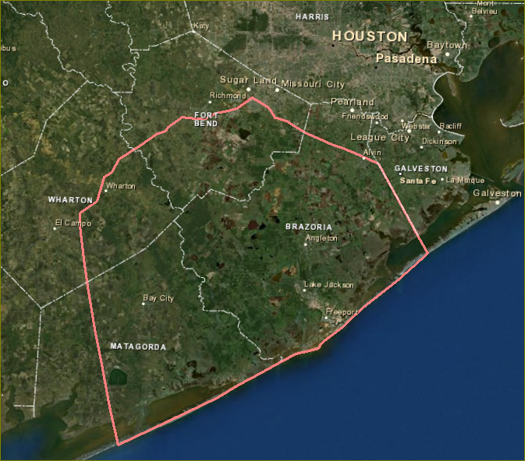
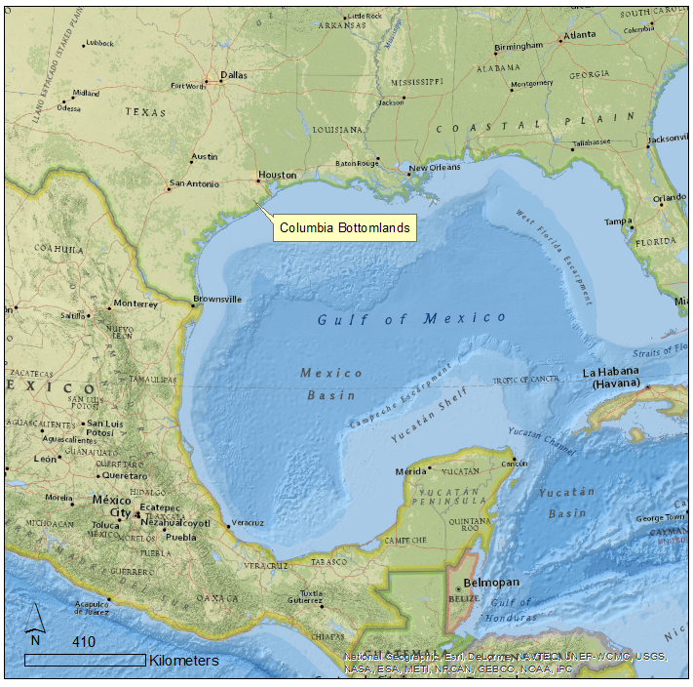
Columbia Bottomland Forest
Forest
Crops
Notes:
The Columbia Bottomlands south of Houston is the area for my project. This is the forested area around the Brazos, San Bernard and Colorado Rivers, in four counties The metropolitan area of Houston is expanding south rapidly into this area. Agriculture and oil and gas are important industries here. This area is, of course, in the Gulf Coast region that was one of the session topics yesterday afternoon.

Slide 4
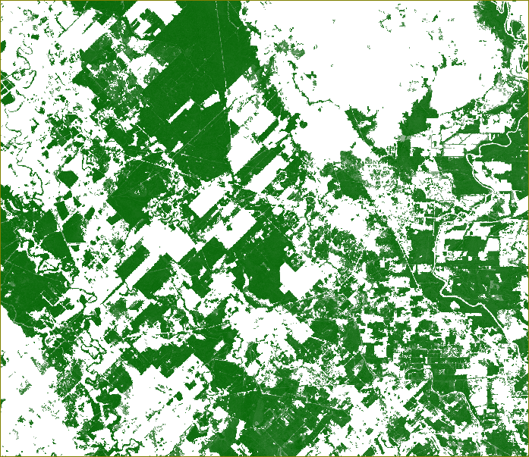
The Columbia Bottomlands
Original extent: 700,000 acres
(US Fish and Wildlife Service, 2013)
1976: 305,914 acres
1996: 254,269 acres
Reduction of 16%
(Webb, 1996)
Percent Canopy, 2001
National Land Cover Dataset
Notes:
This is a representation of the forest canopy, centered around the town of West Columbia. Forested areas are shown as shades of green, and cleared areas are white. The large white areas at the top and bottom left were formerly prairie, now converted to agriculture. The original extent of this forest area is estimated to have been 700,000 acres. Common bottomland tree species here are live oak, cedar elm and hackberry trees. These species are not particularly useful for lumber, so the timber industry is not active here as it is in east Texas. In the 1990s a study was done with aerial photography that measured the forest cover. comparing the 1970s and 1990s, that showed a reduction of 16 per cent in 20 years.

Slide 5
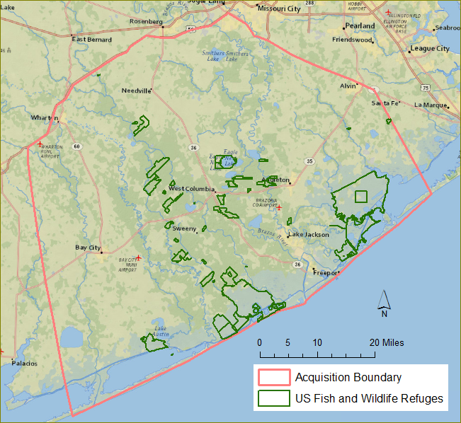
Texas Parks and Wildlife US Fish and Wildlife Service Natural Resources Conservation Service Ducks Unlimited Gulf Coast Bird Observatory Cradle of Texas Conservancy
Austin’s Woods Conservation Plan
Goal: Conserve 10% of original forest area, or
70,000 acres.
Methods:
Donation of fee title
Conservation Easements
Purchase of Fee title from willing sellers
28,000 acres conserved.
Notes:
During the 1990s a coalition of government agencies and non-profit entities formed to conserve some of the Columbia Bottomlands. They set a goal of conserving 10 percent (70,000 acres) of the original forest habitat. The Texas Midcoast Refuge Complex had originally been established as three large refuges for waterfowl on the coast. The refuge complex received initial approval from the Fish and Wildlife Service to acquire 28,000 acres. In Texas, the majority of land is privately owned. To add to the Refuge complex, the Fish and Wildlife Service must deal with willing sellers. This work is being done by Michael Lange, a biologist at the Texas Mid-coast Refuge complex, along with other FWS employees and volunteers.

Slide 6
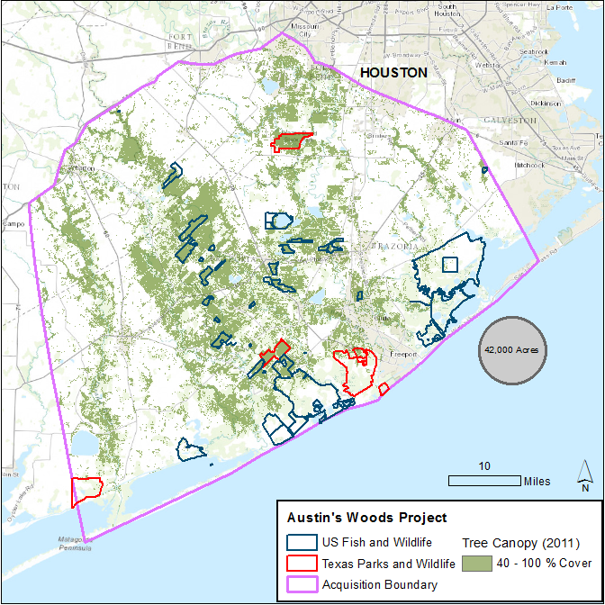
Austin’s Woods
Part II
42,000 acres for a bioreserve network
What would be the ideal configuration of refuges, to select the most ecologically valuable areas, and to enhance the wildlife habitat conserved already?
Notes:
Here is another view of the pattern of refuge parcels, along with the Texas Parks and Wildlife Units, and some other county or private preserves. The background is the Tree Canopy dataset, showing areas of trees as green. The grey dot is the approximate size of 42000 acres. The question of my project is, how should that new acreage be distributed, to protect quality habitat for migrating birds.

Slide 7
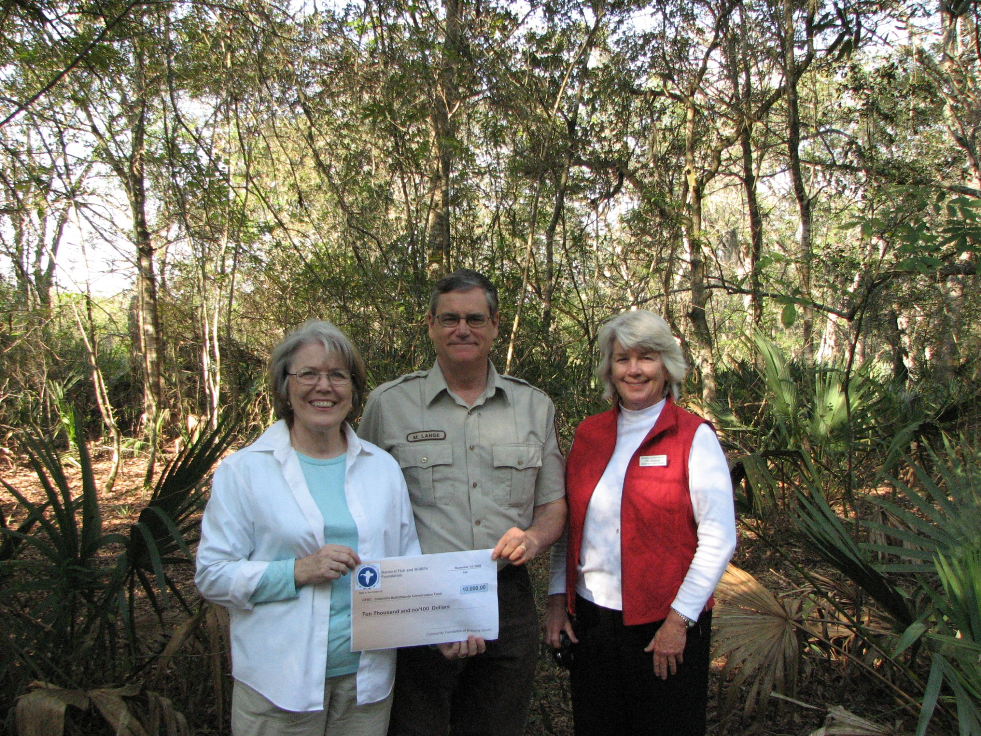
“You can’t buy it if it’s not for sale - Until it’s for sale, you can’t buy it.”
Michael Lange, Biologist
US Fish and Wildlife Service
With members of the Gulf Coast Bird Observatory
Notes:
Before I get started, this quote from Mike Lange: You can’t buy it if it’s not for sale – Until it’s for sale, you can’t buy it. No matter how good a parcel of habitat might be, sometimes it is just not available. Conditions may change over time, and sometimes Mike succeeds on proposals he put forth many years ago.

Slide 8
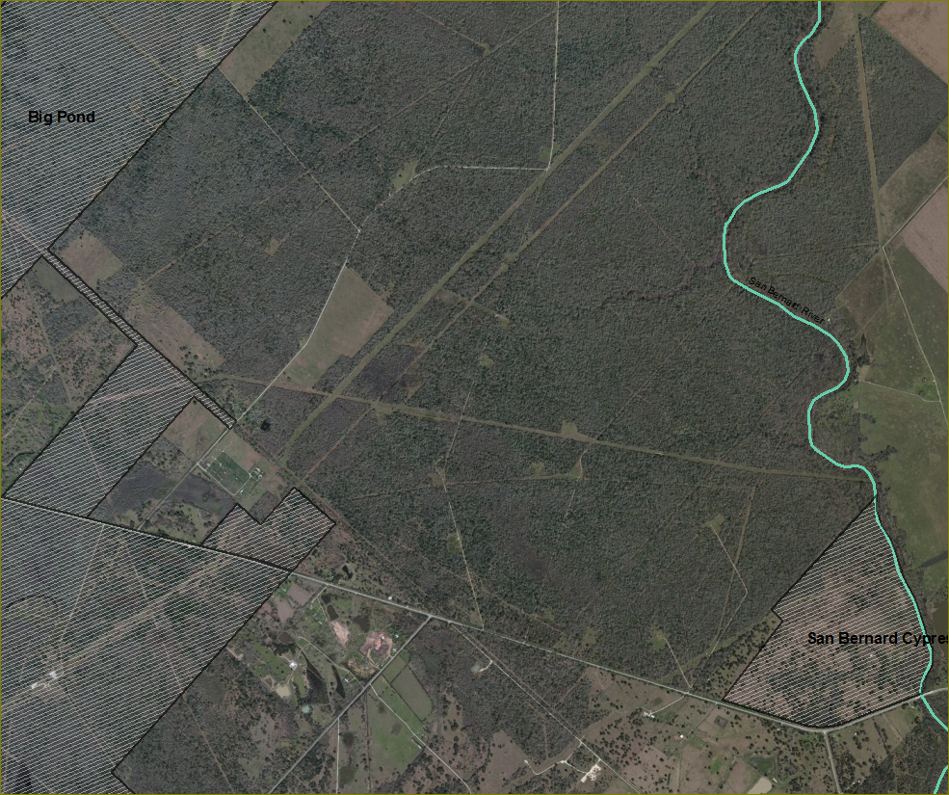
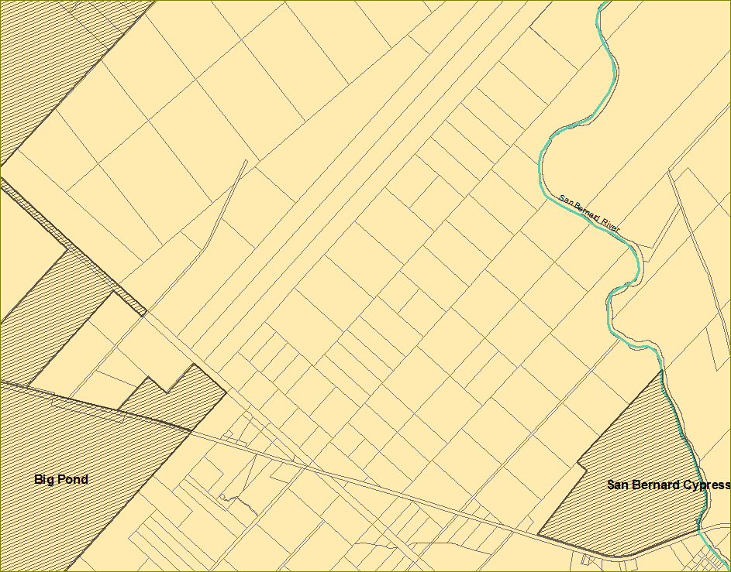
Assigning “Suitability” values to tax parcels.
Visualizing Land ownership
Notes:
This project aims to describe how a refuge system can be made in a practical manner – One of the obstacles in this area is the pattern of land ownership. For example, the parcel in the image on the left would be a good candidate because has a lot of forest, and is next to the San Bernard River, and between the Big Pond and San Bernard Cypress Units. It has some oil exploration survey lines on it, so maybe it is owned by an oil company. The county parcel outlines show that it has been subdivided.
Is there a common owner? Mike Lange has been using Google Earth Pro to visualize the lot lines, using the online County data bases to look up tax parcel information. One thing I wanted to do in this project was to make the pattern of land ownership more obvious.

Slide 9
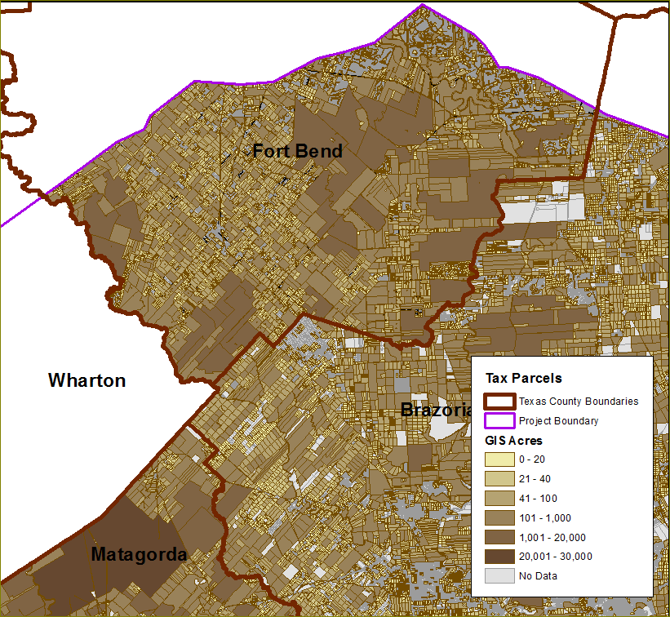
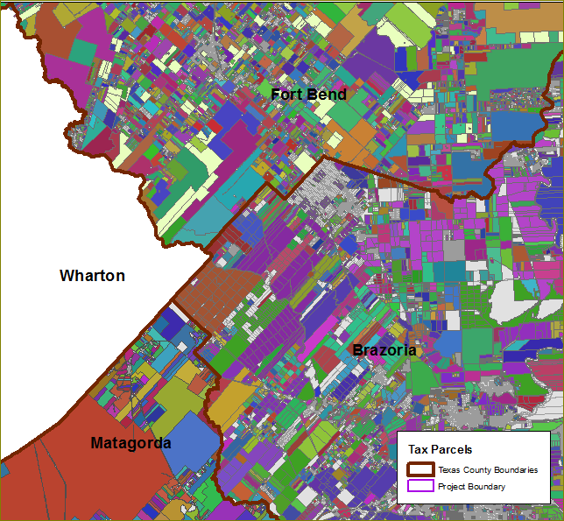
County Parcel and Owner data
Notes:
The Parcel data helped to visualize where large parcels are located. I dissolved the tax parcels larger than 5 acres by owner, so that the data set would show single parcels, or disconnected parcels, for each owner.. On the left they are colored by parcel size, and on the right they are colored by owner.

Slide 10
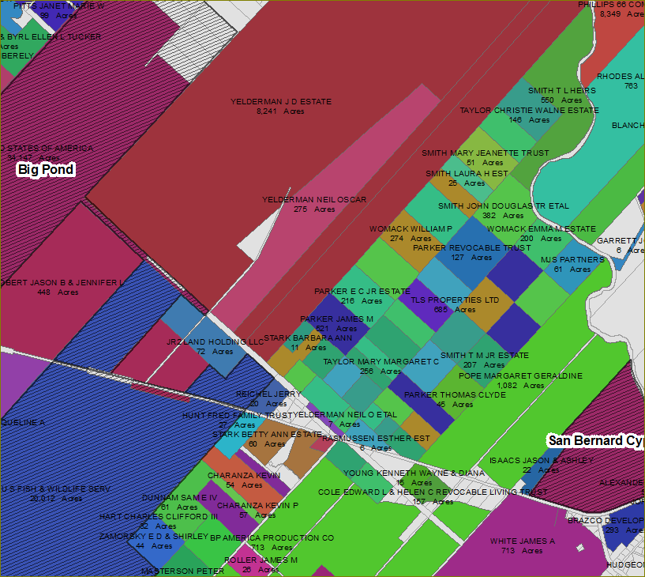
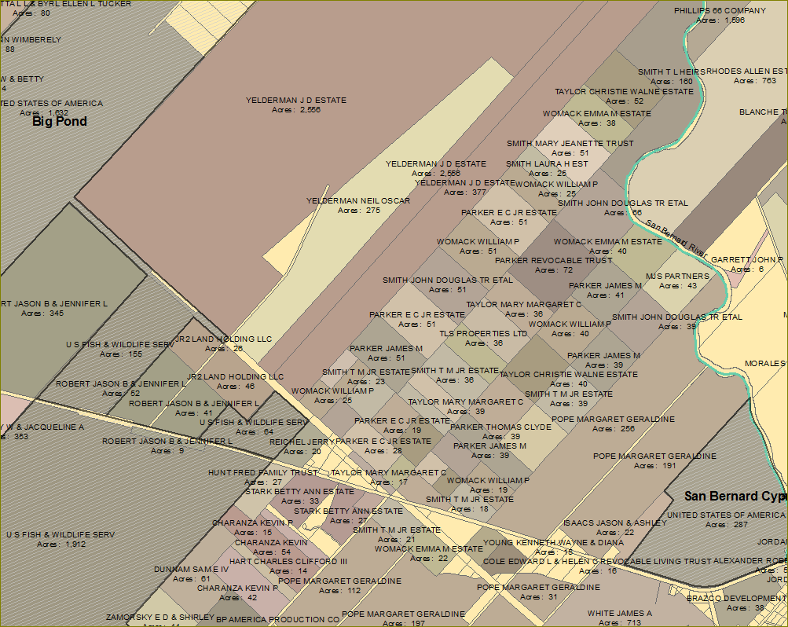
County Parcel and Owner data
Notes:
Getting back to the area we were looking at earlier. On the right, the county tax data shows that the parcels in the upper left have a common owner (they were dissolved into the red shape), but the parcels near the river (blues and greens) have ownership distributed among a group of people. It may take some time to get them all to agree to selling or conserving this land. If Mike were able to conserve only a few of the parcels, the habitat value could decrease over time if the neighboring owners cleared the forest. To acquire contiguous acreage for conservation, it would be worthwhile to talk to the owner of the large red parcel.

Slide 11
Austin’s Woods Project
Land Protection Plan Priorities List
High quality old growth undisturbed habitat?
Exceptional/unique plant communities
Size of tract greater than 1,200 acres, or expandable
Near other protected areas
Acquisition helps maintain natural hydrological patterns
Plant structure complexity, topographic complexity
Restoration potential
Does the unit influence hydrologic or watershed patterns?
Notes:
In determining the most important areas to protect, the Fish and Wildlife Service has written a Land Protection Plan for this project, which identifies principles to follow in acquiring parcels. This is a paraphrased list of the Primary Priorities: The main priorities are undisturbed Old Growth forest habitat, Exceptional plant communities, Tract size greater than 1200 acres, proximity to existing refuge areas, particularly if linked by water, and topographic complexity.
The goal of my project was to model the priorities of the Land Protection Plan, similarly to modelling habitat for a specific animal. The main difference is that I will include the size of land parcels, to try to increase the efficiency of the land acquisition program, and decrease the problem of habitat fragmentation within the refuge complex, given that the acquisition plan does not have complete control over which parcels will eventually be included.

Slide 12
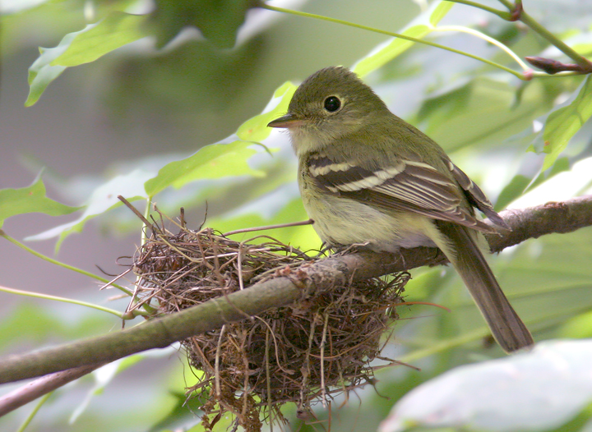
How to model the goals of the Land Protection Plan?
Notes:
How to model the goals of the Land Protection Plan? There area lot of things to think about, and sometimes it helps to use the perspective of a particular animal when thinking about forest ecology. The Land Protection Plan for the Austin’s Wood project was designed for the whole suite of migratory birds, who do not need specific habitat when they are travelling (they just prefer bottomland forest). However, the Land Protection Plan mentions several birds in particular because they need undisturbed habitat for nesting. A this point I would like to introduce my consultant, the Acadian Flycatcher, who gave her viewpoint on habitat values.

Slide 13
How to model the goals of the Land Protection Plan?
Size of the patch of Forest
Old-growth Character of Forest
Distance from managed lands
Core Forest
Neighboring Landscape
Streams
Wetlands
Notes:
I thought about the goals of the Land Protection Plan, and tried to image how to model them. These are the themes that I thought would best describe the desirable qualities of prospective parcels in terms of GIS data.

Slide 14
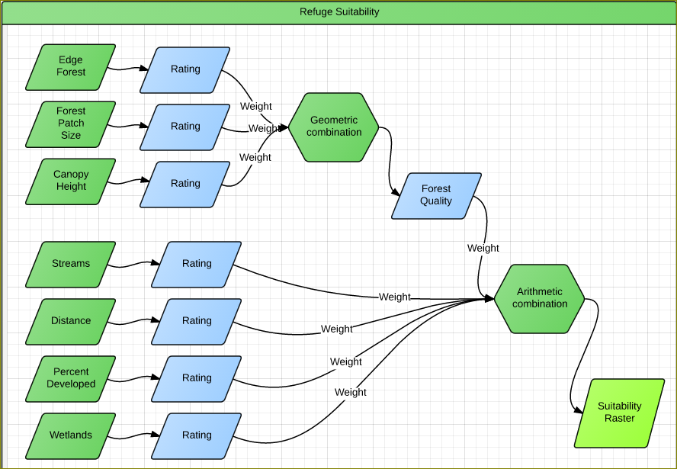
Model Proportions
Software:
Corridor Design Toolbox for
ArcGIS Desktop
Notes:
After a period of looking for data and tinkering with it, I decided on combining it this way. I combined the each of the forest related themes, weighted geometrically, into one Forest quality index. Using the geometric combination helped cancel out error in the forest patch size and Canopy height theme. After several combinations, I realized that I really wanted the Forest Quality theme to be most predominant.

Slide 15
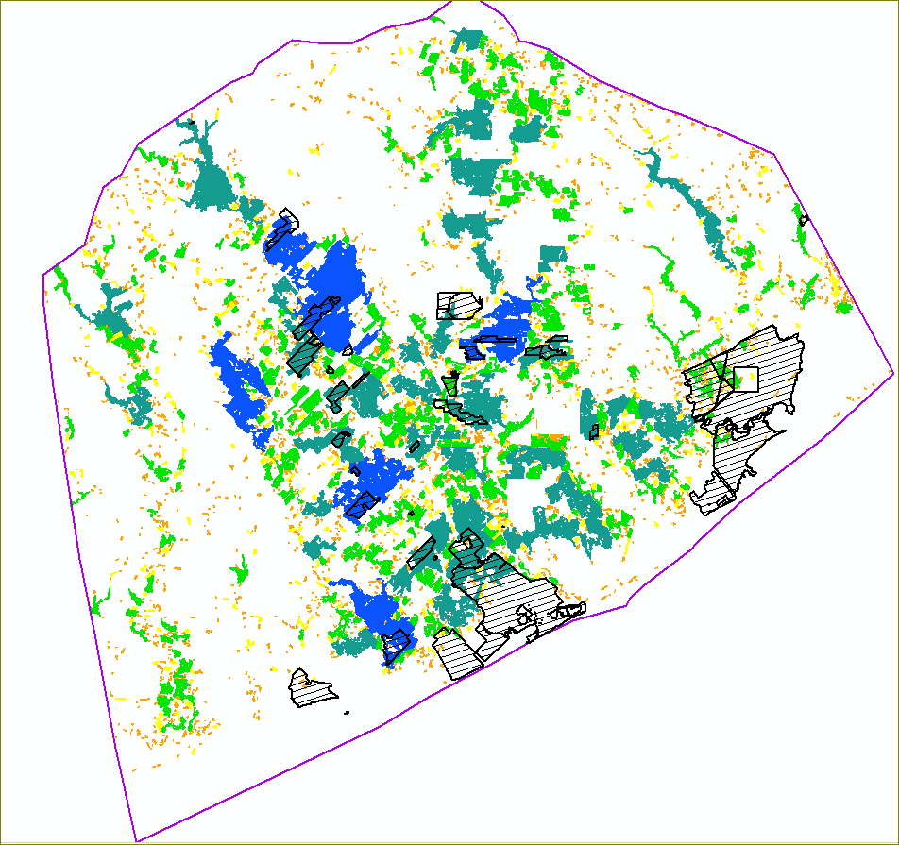
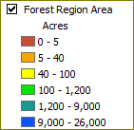
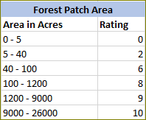
Size of Forest Patch
National Land Cover Database 2011
Deciduous , Evergreen and Mixed Forest
Woody Wetlands
Notes:
Acadian flycatchers and some other forest birds prefer large patches of forest habitat to nest in, preferably larger than 300 acres. The size of the patch of forest also determines the potential for expansion of the refuge in that area. I used the four forest classes of the National Land Cover database to represent the forest, and then calculated the patch size. Areas representing forest in large patches get the highest rating.

Slide 16
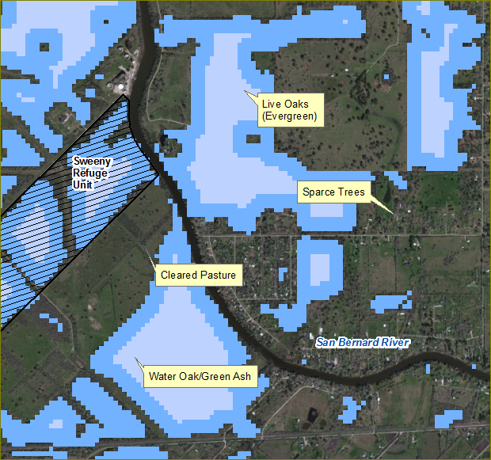
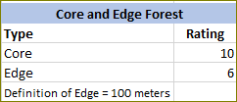
Core Forest
National Land Cover Database 2011
Percent Canopy Cover, >50 %
Notes:
Many animals thrive in edge habitat, but Acadian flycatchers prefer to forage in the clear area under tall tree canopies in the core of the forest.. Edges also allow cowbirds, which are nest parasites to flycatchers, into the forest. To model edges, I used values above 50 percent in the Canopy dataset from NLCD. This data set was sensitive to areas of sparse trees and breaks in the forest cover. Core grid squares were rated more highly than edge squares.

Slide 17
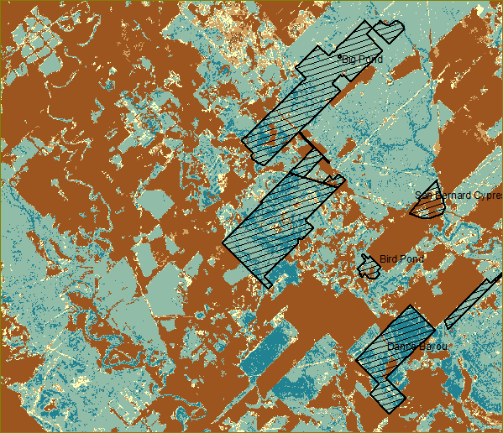
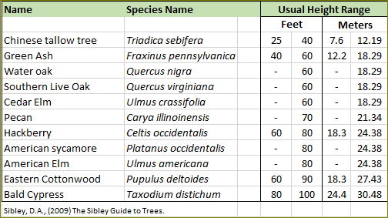
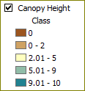
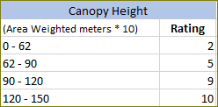
Canopy Height
Canopy Height
(NACP Aboveground Biomass and Carbon Baseline Data, 2000)
Notes:
Canopy Height represents Old Growth qualities and structural complexity in the forest. To avoid penalizing moderately sized tree species, the height class divisions were drawn to penalize only the shortest trees, which were often associated with second growth forest, and the invasive Chinese tallow Tree.

Slide 18
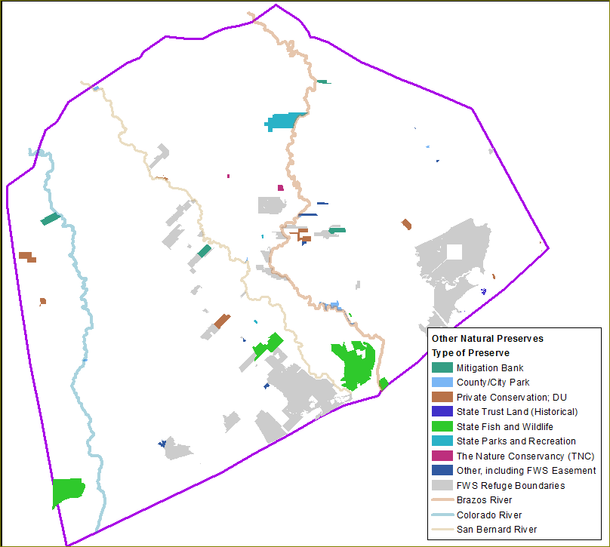
Proximity to
Existing
Refuges and Preserves
Notes:
Positioning a new refuge parcel adjacent to another preserve effectively increases the size of the refuge. This area has several Texas Wildlife Management Areas, some small Ducks Unlimited sites, Nature Conservancy sites, and other conservation easements. I included in this group county parks and Texas Historical sites.

Slide 19
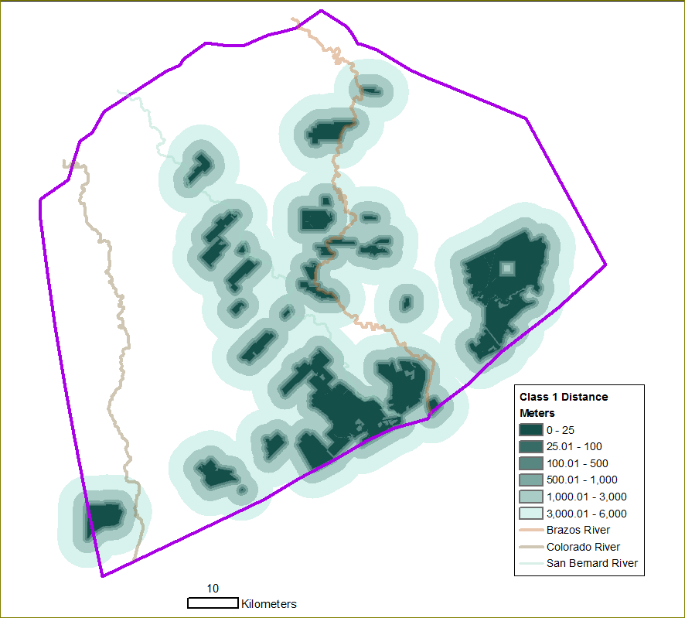
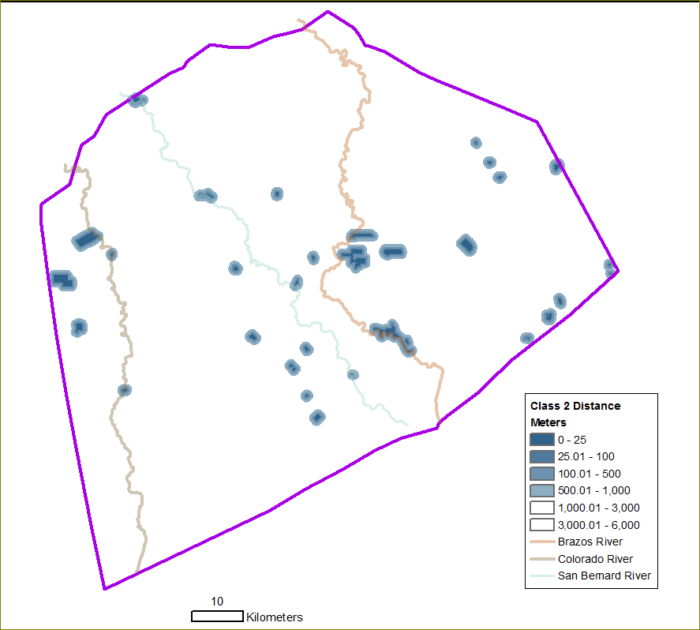
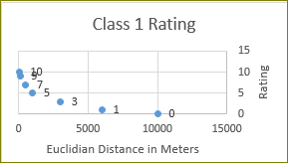
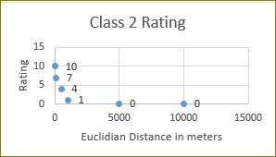
Proximity to Existing Refuges and Preserves
Large Preserves >250 acres:
Small Preserves <250 acres:
Notes:
One of the propositions in the theory of Island biogeography is that at a given distance, small islands will receiver fewer plants and animals from a continental source than large islands. To make sure that small preserves did not have an undue effect on the location of new Refuge units, I calculated the distance rasters around small preserve units less extensively than around large units. I decided, arbitrarily, that the limit of the influence of the preserve would be the same for all of the reserves in either the large or small class, and that it would be about the average long diameter of that class. Whether a distance is small enough for an animal to move between refuges depends on that particular species – but I wanted to include distance as a general principal.

Slide 20
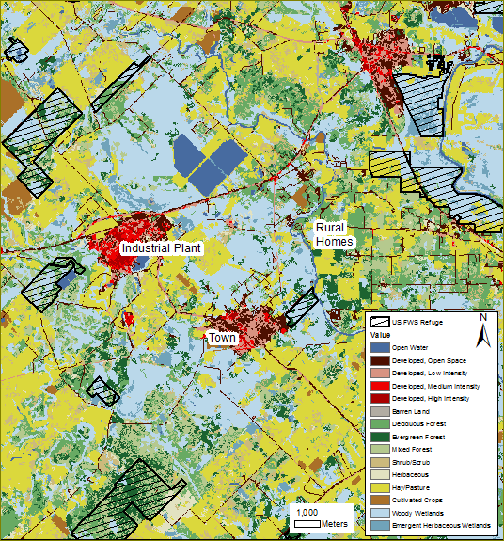
Neigboring Landscape: Percent Developed Class within 1 km
Why not Distance to Roads?
Roads are well represented by NLCD in this area.
The US Fish and Wildlife Service requires physical and legal access to new refuge units, so a road is actually a required feature.
For abundance of Acadian Flycatchers, no difference between number of buildings, road, pavement and lawn as percent cover. (Rodewald and Shustak, 2008)
National Land Cover Database 2011
Notes:
To model disruption from development, I used the four developed classes of the National Land Cover Data base. Why not distance to roads? First, the Fish and Wildlife Service requires physical and legal access to new refuge units, so a road is actually a required feature. In a study on Acadian Flycatchers in Ohio, flycatchers were found to avoid an “urban index” which was the percent of land cover as buildings, roads, pavement and lawn, but there was no difference between the effect of any of those land cover classes. So using just roads as a factor is not the best way of modeling the effect of human activity on Acadian flycatchers.

Slide 21
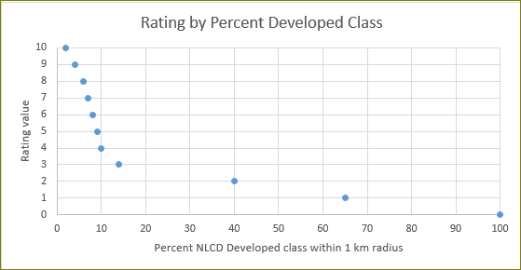
Percent Developed Class within 1 km
Notes:
Since several the studies I read showed the abundance of forest birds fell away rapidly with this factor, I had ratings decrease rapidly from 1 to 12 percent.

Slide 22
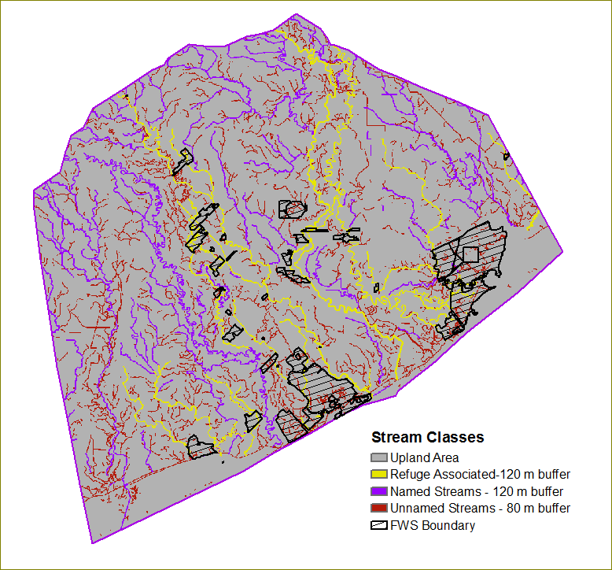
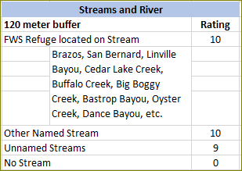
Streams and Rivers
National Hydrography Dataset
Buffered to allow linear features to affect tax parcel polygons
Three Classes
Refuge Associated
Named Streams
Unnamed Streams
Notes:
I grouped the streams into three classes. Refuge associated streams go through or border the Refuge units, so they have the potential to carry organisms into or out of the refuges. Whether streams are named or unnamed is a proxy for their size.

Slide 23
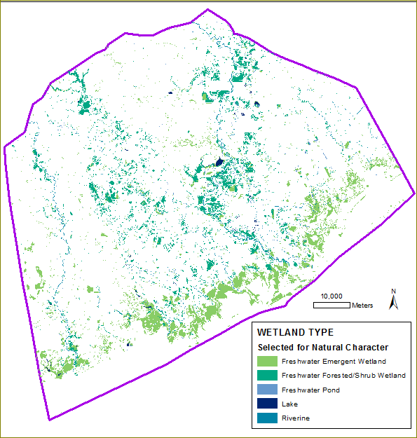
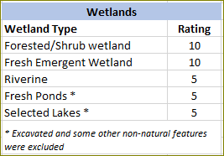
Wetlands
US Fish and Wildlife Service
National Wetland Inventory
Notes:
Wetlands were included both for their value as water features, and for a proxy for the vegetation communities they support.

Slide 24
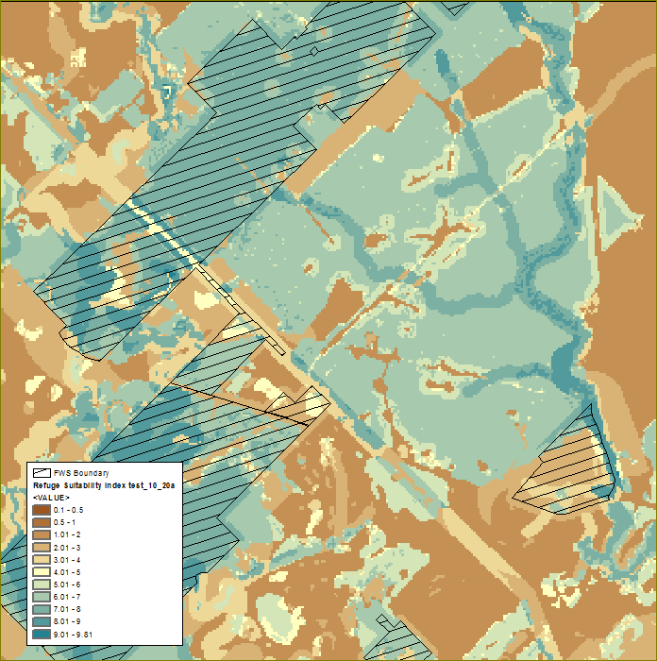
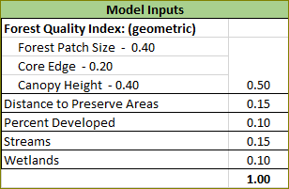
Image of Model Results
High Values:
Large forest areas
Near to Preserve Areas
Near to Streams.
Notes:
I was pleased with the end result, which assigned high values to areas in large forest patches, with tall trees, near streams, and near existing refuges and preserves,

Slide 25
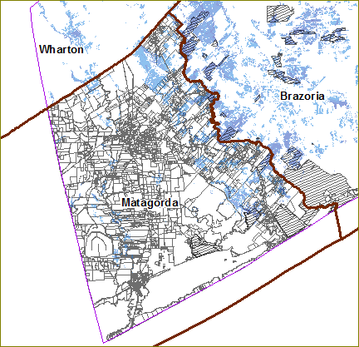
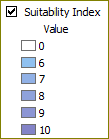
Assigning habitat values to parcels
Associate high suitability values with County tax parcels
Investigate the parcels with the highest sum.
Large parcels will have larger sums.
Notes:
Now let’s use the Suitability theme to find the parcels with owners to approach, focusing on Matagorda county because it is relatively small.

Slide 26
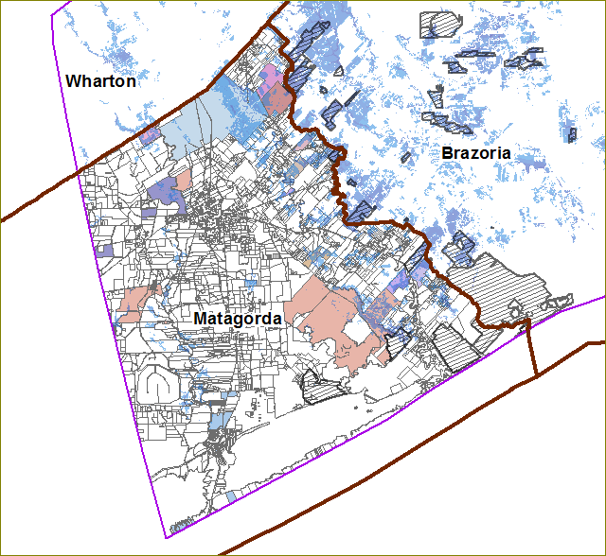
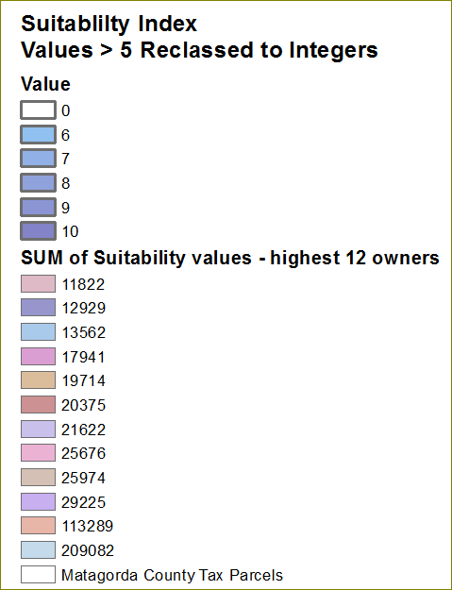
Assigning habitat value to tax parcels
Notes:
The parcels with the largest sum of Suitability values are now shown in color. The largest sum is more than 200,000, which is ten times larger than most of the rest of the sums. Definitely, the owners of the Blue parcel in the north of the county would be the party to approach.

Slide 27
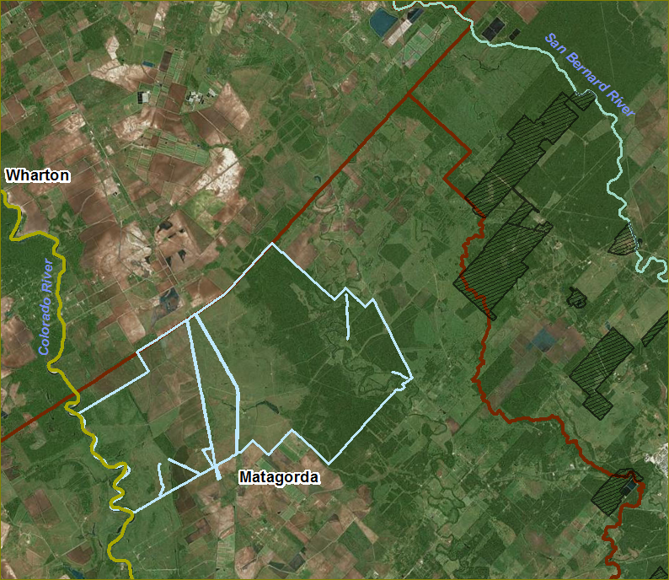
Lesson learned: Use a few simple criteria!
Notes:
Here is that one parcel shown with the area we were looking at earlier. The blue lines are roads. In the context of the whole project, the forest on the blue parcel does not really stand out. Other areas, in particular the one by the San Bernard River, stand out because of older, taller trees. The blue parcel is a cattle ranch, and the forested area should be considered a restoration project. This parcel is worth investigating because it has a minor stream, Caney Creek, and it is a single large area. Over time it could become valuable habitat.
(CLICK) This project aims to be practical. I think I could have got the same result just using forest Area as a criterion. However, going through the thought process of modeling, and gathering the data, was useful. In particular, the locations of other preserves and the percent developed data, was useful to develop.

Slide 28
Discussion:
Drawbacks of the “Refuge Suitability” analysis
Not a true habitat model – really a “Site Suitability” study. Each species needs its own model.
Results strongly influenced by the area of the tax parcel.
Most useful features of this process:
Finding large parcel groups
Forest Area calculations
Locations of parks and conservation easements
Locations of smaller streams
Development of library of habitat data for modelling animal habitat.
Notes:
At the end of this project I hope to have many of the data products in .kml format, which is the form that Mike prefers to use, since it is easy for him to share via Google earth or Google maps with other people in the Fish and Wildlife Service. In particular I think identifying the other preserves was useful to him. He had his own collection of conservation easements, but I found many more.
Definitely, being able to visualize land ownership patterns, and to associate forest area with parcels will be helpful. Getting the data and software together is useful to start answering questions like, How much habitat do we have for Acadian Flycatchers? I also want to identify small areas that are important for animals to use as rest stops as they move around this area.

Slide 29
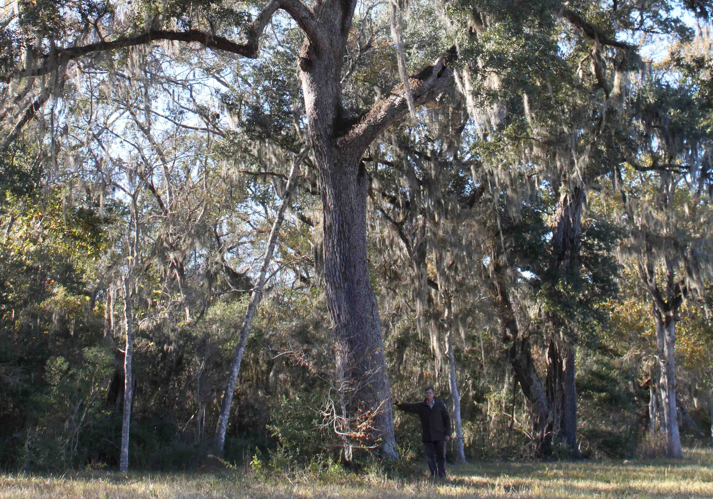
“You can’t buy it if it’s not for sale - Until it’s for sale, you can’t buy it.” Michael Lange, US FWS.
Notes:
This quote from Mike Lange is still true. However there is another famous quote that applies: “Opportunity comes to the prepared mind.” So get your data together now!

Slide 30
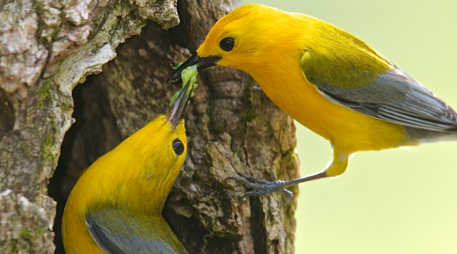
Thanks
Joe Bishop, Phd.
Pennsylvania State University
Michael Lange
US Fish and Wildlife Service
Texas Midcoast Refuge Complex
Notes:
At this point, I would like to acknowledge the help of my advisor, Joe Bishop, Mike Lange at the Texas Midcoast Refuge complex, and of course, my husband.

Slide 31
Questions
Sarah McCabe
Sarah.mccabe.tx@gmail.com
Notes:
Any questions?

Slide 32
References
Bakermans, M.H. (2003) Hierarchical habitat selection in the Acadian flycatcher: implications for conservation of riparian forests. MSc thesis, The Ohio State University, Columbus, OH.
Corridordesign.org, Habitat Modeling. http://corridordesign.org/designing_corridors/habitat_modeling/
Accessed 4/28/2014
Gauthreaux, S.A. Jr. and Belser, C.A. (2005). Radar ornithology and the conservation of migratory birds. In: C. John Ralph and Terrell D. Rich, editors. 2005. Bird Conservation Implementation and Integration in the Americas: Proceedings of the Third International Partners in Flight Conference. 2002 March 20-24; pp.871-875.
http://virtual.clemson.edu/groups/birdrad/pubs/Gauthreaux_networks_9-2005.pdf
Harris, L.D. 1984. The Fragmented Forest: Island Biogeography Theory and the Preservation of Biotic Diversity. University of Chicago Press, Illinois.
Lussier, S. M., Enser, R. W., Dasilva, S. N., & Charpentier, M. (2006). Effects of habitat disturbance from residential development on breeding bird communities in riparian corridors. Environmental Management, 38(3), 504-521. DOI: 10.1007/s00267-005-0088-3
MacArthur, R.H., and Wilson, E.O., (1967). The Theory of Island Biogeography. Princeton University Press. Princeton, N.J.
Moore, F. R., Gauthreaux Jr, S. A., Kerlinger, P. A. U. L., & Simons, T. R. (1995). Habitat requirements during migration: important link in conservation.Ecology and management of neotropical migratory birds, a synthesis and review of critical issues (TE Martin and DM Finch, eds). Oxford University Press, New York, 121-144.
Saunders D.A., Hobbs R.J., Margules C.R. (1991). Biological consequences of ecosystem fragmentation: a review. Conserv Biol 5: 18–32.
Webb, J., 1996 (Unpublished). “Forest Habitats of Austin’s Woods of Texas” Gulf Coast Bird Observatory, Texas A&M University at Galveston.
US Fish and Wildlife Service, 2013. Texas Mid‐Coast Refuge Complex Comprehensive Conservation Plan and Environmental Assessment. Appendix I, Land Protection Plan, pages 281 to 314. http://www.fws.gov/southwest/refuges/plan/docs/Texas/TMC_CCP_portfolio.pdf Accessed 03/08/2014.
US Fish and Wildlife Service, 1981, Habitat Evaluation Procedures Handbook. http://www.fws.gov/policy/esmindex.html Accessed 4/28/2014

Slide 33
Images
Prothonotary Warbler in Cypress Knee. Joel Sartore. http://archive.audubonmagazine.org/features0707/prothonotaryWarbler.html
Cape May Warbler and Northern Parula. Linda. http://www.phillybirdnerd.net/2011/10/all-righty-then.html
Young Box Turtle. Lisa K Suits. http://mycologista.blogspot.com/2013/06/the-backlog-logjam-continuesheres-baby.html
Adult Box Turtle. Flicker User pondhawk. http://www.boxturtles.com/gulf-coast-box-turtle/
Bobcat at Tule Lake National Wildlife Refuge. US Fish and Wildlife Service. http://digitalmedia.fws.gov/FullRes/natdiglib/5657706937_9b60048076_b.jpg
Prothonotary Warbler Pair. L. Pace. http://www.fws.gov/refuge/Dahomey/wildlife_and_habitat/warbler.html

Slide 34
Data Sets
County Tax Parcel Data Sets
Brazoria . Available online from Houston-Galveston Area Council (H-GAC)
Fort Bend. Available on disk from County Offices
Also available online from Houston-Galveston Area Council
Matagorda . Data downloadable from their website
Wharton. Available on disk in .dng format from County Offices
Infrastructure Data Sets
Roads (Texas Natural Resources Information System)
Texas Railroad Commission (from H-GAC)
Land Cover
National Land Cover Database 2011.
National Land Cover Database Tree Canopy 2011
4. Wetlands
National Wetlands Inventory, US Fish and Wildlife Service
5. Water features
National Hydrography Data Set
6. Vegetation
National Vegetation Classification – General Vegetation Classes
Texas Ecological Systems Database Project (Texas Parks and Wildlife)
7. Vegetation Complexity
US Basal Area-Weighted Canopy Heights 2000 (Woods Hole Research Center)
8. Topographic Complexity
National Elevation Data (NED)
Gulf Coast Counties ( 10 meter grid)
9. Preserve Areas
Refuge Boundaries – US Fish and Wildlife Service
Other protected areas:
Texas Wildlife Management Areas
National Conservation Easement Database
County Parks
Mitigation Banks – Army Corp of Engineers – RIBITS website
Notes:
I looked over a lot of data sets, and it was good to be able to make some choices. Most of this data was available online, from the federal government, the State of Texas website, and from the Houston-Galveston Area Council. I was really excited to find a measure of tree canopy heights from Woods Hole. One continuing source of frustration was the vegetation data set – I was looking for a way to map what the plan calls “exceptional plant communities.” Texas recently completed a satellite imagery based vegetation mapping study in this area, and though it had good descriptions of plant communities in each region, I was not happy with how it handled disturbed areas, so I did not use it.

Slide 35
Software:
ESRI 2011. ArcGIS Desktop: Release 10.2.1, License type: Advanced. Redlands, CA: Environmental Systems Research Institute.
Majka, D., J. Jenness, and P. Beier. 2007. CorridorDesigner: ArcGIS tools for designing and evaluating corridors. Available athttp://corridordesign.org.
Rempel, R.S., D. Kaukinen., and A.P. Carr. 2012. Patch Analyst and Patch Grid. Ontario Ministry of Natural Resources. Centre for Northern Forest Ecosystem Research, Thunder Bay, Ontario.
Patch Analyst Software: http://www.cnfer.on.ca/SEP/patchanalyst/Patch5_1_Install.htm

