Slide 1
NB Coastal Flood Web Viewer Capstone Project Narrative
Reid McLean
Oct 31, 2017
Advisor:
Karen Schuckman
Abstract
Creation of a Flood Risk Web application for New Brunswick’s coastal zone using LiDAR data and future sea level rise prediction.
Notes:
This template can be used as a starter file to give updates for project milestones.
Sections
Right-click on a slide to add sections. Sections can help to organize your slides or facilitate collaboration between multiple authors.
Notes
Use the Notes section for delivery notes or to provide additional details for the audience. View these notes in Presentation View during your presentation.
Keep in mind the font size (important for accessibility, visibility, videotaping, and online production)
Coordinated colors
Pay particular attention to the graphs, charts, and text boxes.
Consider that attendees will print in black and white or grayscale. Run a test print to make sure your colors work when printed in pure black and white and grayscale.
Graphics, tables, and graphs
Keep it simple: If possible, use consistent, non-distracting styles and colors.
Label all graphs and tables.

Slide 2
Overview
Project Overview
Sea Level Rise
HHWLT and Coastal Zones
Flood Estimates
Flood Modeling
LiDAR Specification
LIDAR QA Workflow
Flood Extent and Depth to Water Workflow
Building Extraction
Visualizing and Communication
Timeline
Challenges
Notes:
What is the project about?
Define the goal of this project
Is it similar to projects in the past or is it a new effort?
Define the scope of this project
Is it an independent project or is it related to other projects?
* Note that this slide is not necessary for weekly status meetings

Slide 3
Project Overview
This project looks to address aspects of New Brunswick’s Flood Risk Reduction Strategy. Strategies main objectives:
Accurate Flood Hazard Identification
Where does coastal flooding occur?
Planning for Communities and Infrastructure to Avoid Flood Risk
Who and what infrastructure is at risk?
Informed Mitigation of Existing Flood Risk
How best to communicate this information?
Notes:
What is the project about?
Define the goal of this project
Is it similar to projects in the past or is it a new effort?
Define the scope of this project
Is it an independent project or is it related to other projects?
* Note that this slide is not necessary for weekly status meetings

Slide 4
2009 and 2014, NB has seen a sharp increase in the number of residents applying for disaster financial assistance (DFA) as a result of property damage due to coastal and inland flooding
this trend is expected to continue with sea levels projected to rise during the 21st century at an accelerated due to increased ocean warming and a loss of ice cover in Greenland and Antarctica (IPCC, 2013)
To allow decision makers and the greater public to plan for and decide where development can and shall occur along New Brunswick’s coastal areas.
Notes:
What is the project about?
Define the goal of this project
Is it similar to projects in the past or is it a new effort?
Define the scope of this project
Is it an independent project or is it related to other projects?
* Note that this slide is not necessary for weekly status meetings

Slide 5
Research indicates that that actions taken to reduce flood risk yield long term benefits that far exceed their cost.
In terms of coastal flooding, what is needed is a set of predictive maps for coastal sections of New Brunswick that will delineate the horizontal extent and depth of flooding based on predicted future flood elevations that include consideration of future sea level rise. These maps can then be used as an important tool for communicating flood risk to decision makers and the public.
Sea Level Rise Report
Lidar DEM and flood model
Notes:
Duplicate this slide as necessary if there is more than one issue.
This and related slides can be moved to the appendix or hidden if necessary.

Slide 6
Sea Level Rise
Daigle, R. (2017). Sea-Level Rise and Flood Estimates for New Brunswick Coastal Sections. Moncton: ACASA.
Components of Sea-Level Rise:
IPPC AR5 Representative Concentration Pathway 8.5 (Business as Usual)
Glacial Meltwater Fingerprinting
Glacial Isostatic Adjustment
Regional Oceanographic Effects
Notes:
Duplicate this slide as necessary if there is more than one issue.
This and related slides can be moved to the appendix or hidden if necessary.

Slide 7
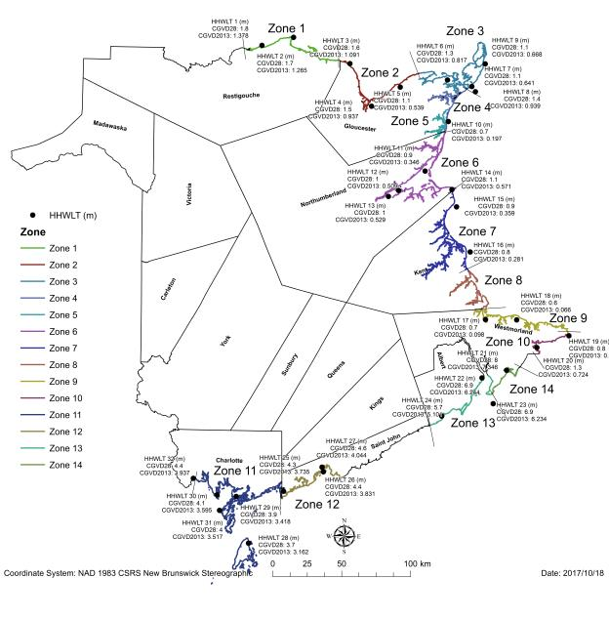
HHWLT and Coastal Zones
- each zone shares a quasi-homogenous HHWLT elevation and storm-surge flooding climatology

Slide 8
Flood Estimates
For each section of NB Coast, an Extreme Total Sea-Level table was created:
HHWLT
Regional Sea-Level Rise component
Storm Surge Return Level
Levels for 2010, 2030, 2050 and 2100
Return Periods 1, 2, 5, 10, 25, 50 and 100-Year.

Slide 9
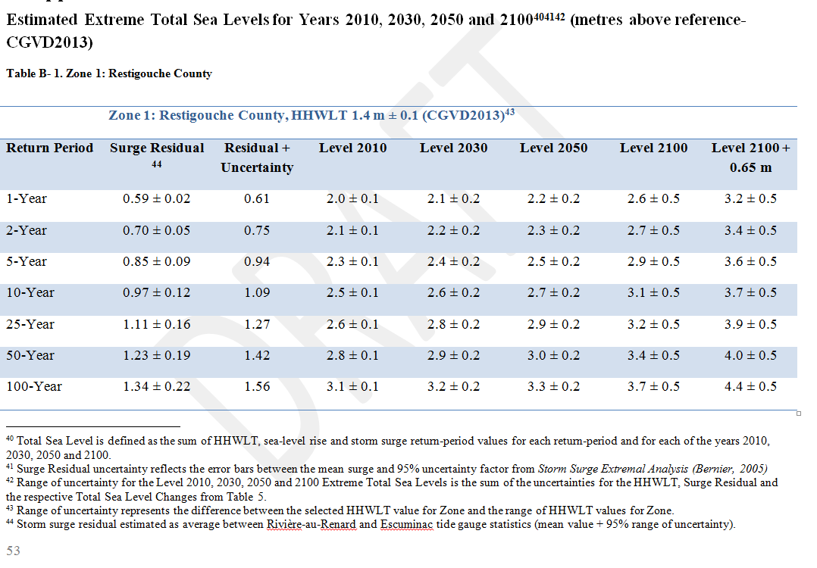

Slide 10
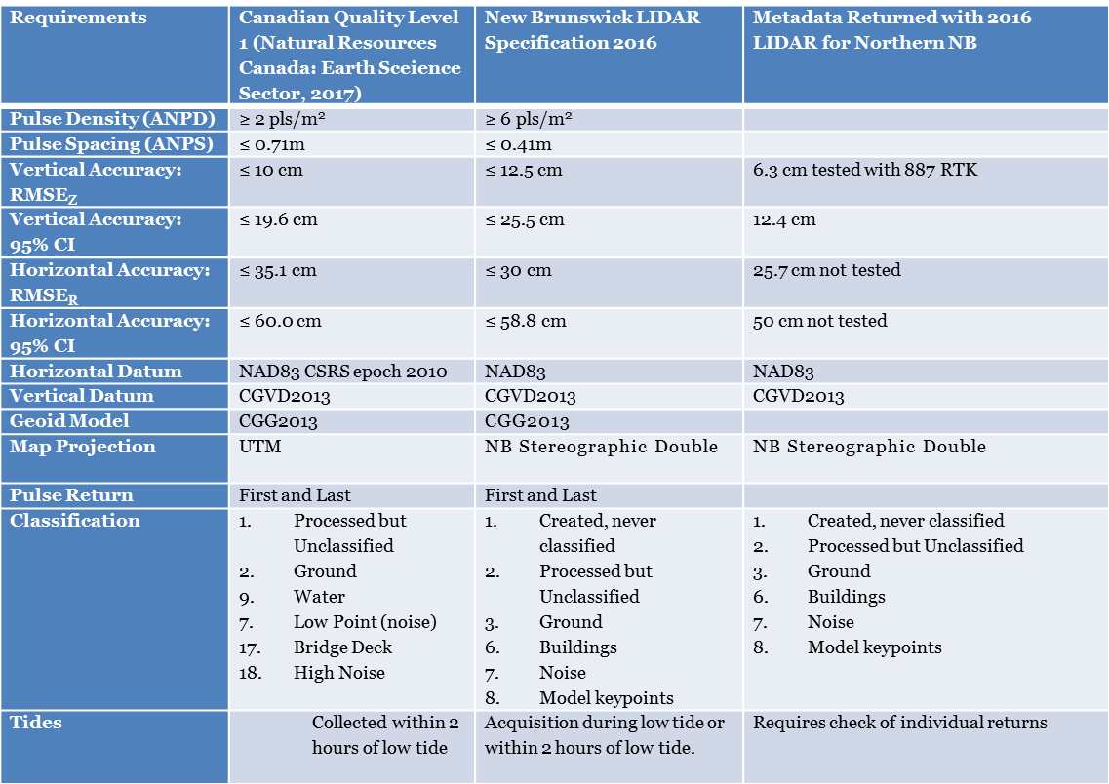
LiDAR Specification

Slide 11
LIDAR QA Workflow
Gross Radiometric Check (Subjective, look at intensity)
Fundamental Vertical Accuracy (Nov 1-3: survey team to collect RTK points to verify FVA)
Supplemental Vertical Accuracy (Nov 1-3: survey team to collect RTK points to verify SVA)
Local Accuracy (swath alignment)
Point Density (All hits and Ground)
Notes:
Requirements
Canadian Quality Level 1 (Natural Resources Canada: Earth Sceience Sector, 2017)
New Brunswick LIDAR Specification 2016
Metadata Returned with 2016 LIDAR for Northern NB
Pulse Density (ANPD)
≥ 2 pls/m²
≥ 6 pls/m²
Pulse Spacing (ANPS)
≤ 0.71m
≤ 0.41m
Vertical Accuracy: RMSE_{Z}
≤ 10 cm
≤ 12.5 cm
6.3 cm tested with 887 RTK
Vertical Accuracy: 95% CI
≤ 19.6 cm
≤ 25.5 cm
12.4 cm
Horizontal Accuracy: RMSE_{R}
≤ 35.1 cm
≤ 30 cm
25.7 cm not tested
Horizontal Accuracy: 95% CI
≤ 60.0 cm
≤ 58.8 cm
50 cm not tested
Horizontal Datum
NAD83 CSRS epoch 2010
NAD83
NAD83
Vertical Datum
CGVD2013
CGVD2013
CGVD2013
Geoid Model
CGG2013
CGG2013
Map Projection
UTM
NB Stereographic Double
NB Stereographic Double
Pulse Return
First and Last
First and Last
Classification
Processed but Unclassified
Ground
Water
Low Point (noise)
Bridge Deck
High Noise
Created, never classified
Processed but Unclassified
Ground
Buildings
Noise
Model keypoints
Created, never classified
Processed but Unclassified
Ground
Buildings
Noise
Model keypoints
Tides
Collected within 2 hours of low tide
Acquisition during low tide or within 2 hours of low tide.
Requires check of individual returns

Slide 12
Flood Extent and Depth to Water Workflow
Compile files into ArcGIS with LP360 extension to be used
Hydro Flatten and hydro condition (LP360)
Extract buildings (LP360)
Extract 1 m raster DEM and run through custom Python script
Create Rest service for Depth to Water and Flood Extents
Create Web App (time slider, swipe tool)

Slide 13
Building Extraction
Classification code 6 – buildings
LP360 point cloud task to extract building foot prints
ArcGIS Regularize Building footprints.
Join building footprint to SNB property assessment data (assessed value and use)
Join building footprint to Census block data to determine average pop per household.
Spatially analyze which building are affected by each flood elevation to determine population at risk and assessed property value at risk.
Potentially use Medicare data through New Brunswick Institute for Research, Data and Training (NB-IRDT )

Slide 14
Visualizing and Communication
Once the coastal flood hazards (water level and depth to water raster) are created, they can be combined with the flood risk data (buildings, infrastructure) for communicating the potential flood risk to GNB staff and the public allowing them to identify and prepare for potential flooding in the future.
Traditional GIS would be a technological barrier so ArcGIS online will be used.
Create REST service
Create feature layer for download to users application
ELG has an Enterprise ESRI License and technical training
SNB GeoNB Portal is being completely rewritten using ArcGIS online web app builder.

Slide 15
Timeline
QA Lidar Point Cloud
Hydro Conditioning/ Flattening
Python Script
Oct1 - Nov 20
Oct 2 - Oct 31
Building extraction/ Demographics
Nov 1 – Nov 10
Build Web App
Nov 15 – Nov 31
Nov 1 - Nov 15
Notes:
The following slides show several examples of timelines using SmartArt graphics.
Include a timeline for the project, clearly marking milestones, important dates, and highlight where the project is now.

Slide 16
Challenges
Visualizing raster datasets in ArcGIS online (Mosaic, Tile Cache, Raster catalogue, Image server)
Building attributes (Multiple buildings, SNB/Census block versus Medicare information)
Visualizing levels of uncertainty ( +/- and median, 95% CI, 1% return)
Processing 6 pt/m² LIDAR data (260 GB)

Slide 17
Questions?
Thank You
http://www.coastalzonecanada.org/czc-2018-conference/
The conference will focus on the broad theme of “Coastal Communities: Seeking Practical Solutions to Real Issues”. Under this broad theme, we will address sub-themes of Collaboration, Engagement, and Technologies.

Slide 18
Bibliography
Ashleigh B. Turner, J. D. (2013, 09 13). Flood Modeling Using a Synthesis of Multi-Platform LiDAR Data. Water, pp. 1533-1560.
Basic, F. (2009, 11). Geographic Visualization Tools for Communicating Flood Risk To The Public. Retrieved 09 11, 2017, from Research gate: https://www.researchgate.net/publication/228880054_Geographic_visualization_tools_for_communicating_the_risk_of_floods
Daigle, R. (2010). Sea-Level Rise and Flood Estimates for New Brunswick Coastal Sections. Moncton: ACASA.
Daigle, R. (2014). Updated Sea-Level Rise and Flooding Estimates for New Brunswick Coastal Sections. Moncton. Retrieved from http://www2.gnb.ca/content/dam/gnb/Departments/env/pdf/Flooding-Inondations/SeaLevelRiseAndFloodingEstimates.pdf
IPCC. (2013). Climate Change 2013 The Physical Science Basis - Summary for Policymakers. Switzerland: IPCC.
Koerth-Baker, M. (2017, 08 30). It's Time To Ditch The Concept Of The '100-Year Floods'. Retrieved 09 01, 2017, from fivethirtyeight.com: https://fivethirtyeight.com/features/its-time-to-ditch-the-concept-of-100-year-floods/
Meyer, R. (2017, 09 10). How Hurricane Irma Is Sucking Florida’s Beaches Dry. Retrieved 09 12, 2017, from The Atlantic: https://www.theatlantic.com/science/archive/2017/09/irma-sucks/539325/
National Academy of Science. (2009). Mapping the Zone: Improving Flood Map Accuracy. Washington, D.D.: The National Academies Press.
Natural Resources Canada, Public Safety Canada. (2016). Canadian Hydrologic and Hydraulic Procedures for Floodplain Delineation (DRAFT). Ottawa: Government of Canada.
Natural Resources Canada: Earth Science Sector. (2017). Federal Airborne LiDAR Data Acquisition Guideline (DRAFT). Ottawa: Government of Canada.
NB Institute for Research, Data and Training. (nod). Retrieved 09 13, 2017, from New Brunswick Research, Data and Training: http://www.unb.ca/fredericton/arts/nbirdt/index.html
Province of New Brunswick. (2014). New Brunswick's Flood Risk Reduction Strategy. Fredericton: Province of New Brunswick.
T.L. Webster, D. F. (2005). USING AIRBORNE LIDAR TO MAP EXPOSURE OF COASTAL AREAS IN MARITIME CANADA TO FLOODING FROM STORM-SURGE EVENTS: A REVIEW OF RECENT EXPERIENCE. Canadian Coastal Conference 2005. Dartmouth. Retrieved from http://agrg.cogs.nscc.ca/gallery2/main.php?g2_view=core.DownloadItem&g2_itemId=821
T.S. James, J. H. (2014). Relative Sea-Level projections in Canada and the Adjacent mainland United States. Ottawa: Geological Survey of Canada Open File 7737. Retrieved from http://publications.gc.ca/site/archivee-archived.html?url=http://publications.gc.ca/collections/collection_2016/rncan-nrcan/M183-2-7737-eng.pdf

