Slide 1
The Last 200 Feet
A Low-Cost Approach to Landing Aircraft in Zero-Zero Conditions
William J. McDevitt III
Advisor – Karen Schuckman, C.P., P.L.S., MGIS
The Pennsylvania State University
World Campus
State College, Pennsylvania
*** For best results, view in PowerPoint SlideShow Mode ***

Slide 2
Outline
Problem
Proposed Solution
Issues
System Requirements
Database Creation and Data Flow
Test Methodology and Test Points
Expected Outcome
Acknowledments
Questions

Slide 3
Problem
Current FAA Category I Instrument Landing System approach minima are:
  200’ AGL Decision Height
  2,400’ Runway Visual Range
Pilot may not begin an approach to landing if reported conditions are below minimums and may only continue the approach below decision height if the runway environment is in sight

Slide 4
But that is not really a problem…
These standards have been around for many years
  There are ILS approaches (Category IIIc) with no decision height and no RVR requirement (zero-zero)
  Not available at most small airfields or to general aviation pilots
The problem is when a pilot unexpectedly encounters weather below minimums at his destination with not enough fuel to reach a suitable alternate airfield…
  Then what…?

Slide 5
Proposed Solution
Synthetic Vision System (SVS)
  A virtual presentation of the world as the pilot would see it from the cockpit
  Displayed on a Windows™-based tablet computer
  Location driven by Wide Area Augmentation System (WAAS) augmented GPS
    Provides highly accurate own-ship location – typically 1 meter horizontal and 1.3 meters vertical
      Well within the footprint of even the smallest aircraft

Slide 6
Synthetic Vision System Issues
Government agencies, universities, and aerospace corporations already at work on systems of this type
  Will initially be designed for commercial, military, or business-class aircraft
  Very expensive – 10’s to 100’s of thousands of $$
  Unaffordable for general aviation pilots
    This system is designed to support their needs

Slide 7
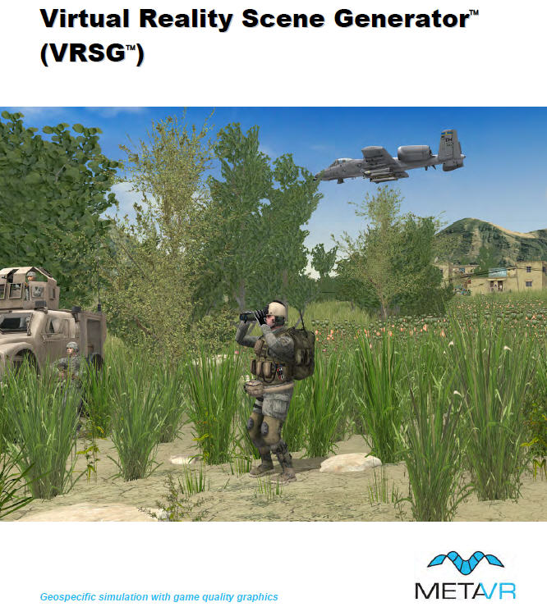

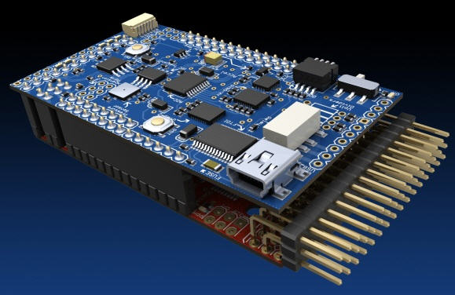
System Requirements
Synthetic Vision System
  Tablet computer
  Attitude Heading
  Reference System (AHRS)
  Terrain Database
  Rendering Engine

Slide 8
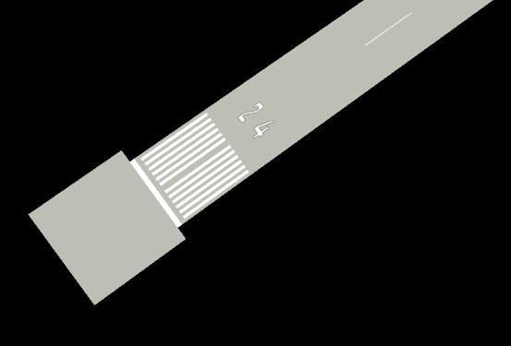
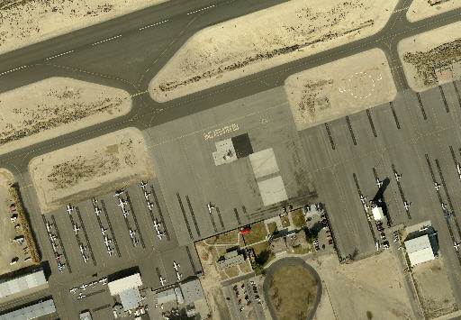
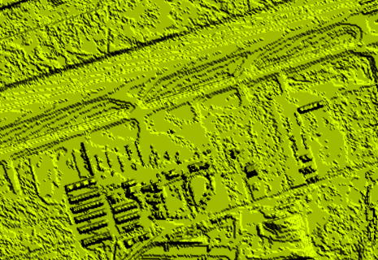

System Requirements
Terrain Database
  Imagery
  Elevation Data
  Vector Drawings
  Precise survey

Slide 9
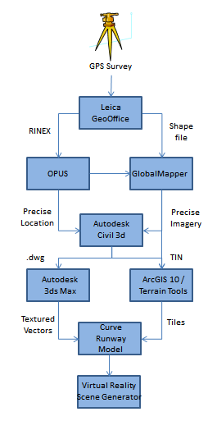
Terrain Database Creation
Multi-step process
  GPS Survey
    Process raw GPS data with GeoOffice
    OPUS post-process survey for precision
  Georeference imagery
  Vector drawings
    Texture drawings
  Create precise TIN
  Create tiles for VRSG
    ‘Curve’ drawings to elevation TIN
  Display with VRSG

Slide 10
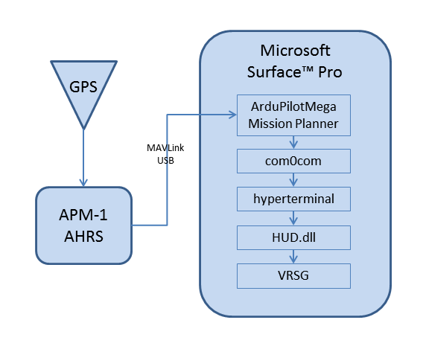
Real Time Data Flow
GPS
  Latitude, longitude, altitude
AHRS
  Roll, pitch, heading
Surface™
  Decodes data
  Transfers as ASCII to serial
  Picked up by HyperTerminal
  HUD.dll – drives eyepoint
  VRSG displays results

Slide 11
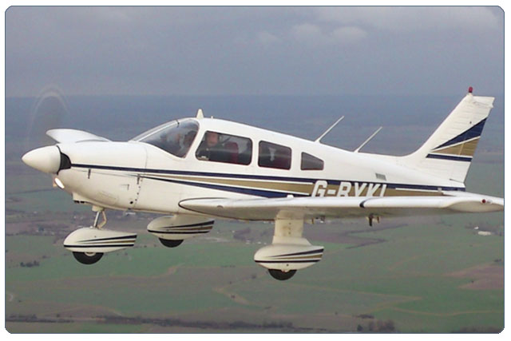
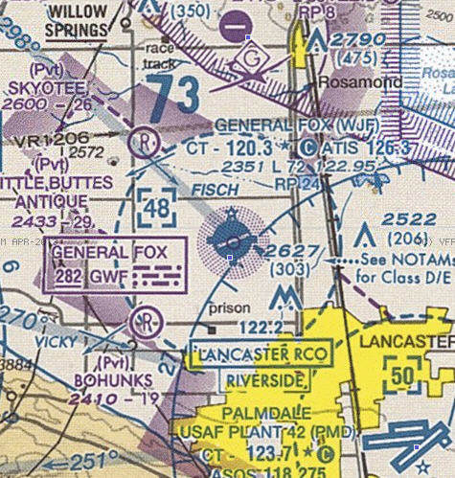
Test Methodology
Test aircraft – Piper PA-28 Archer
Test airfield – General William J. Fox Field, Lancaster, CA
All testing will occur in VFR conditions
Video recordings
  Cockpit and outside world
  SVS
Data logging

Slide 12
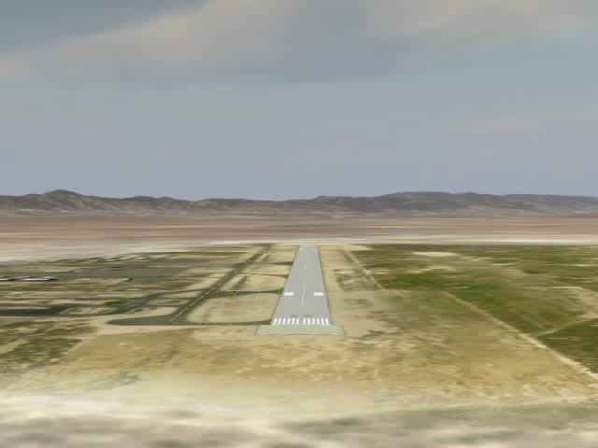
Sample SVS Video

Slide 13
Test Points
Flight 1 (Day)
  SVS recording only
    All visual flying
  1 GPS LPV approach
  5 touch and go landings
  Record SVS for latency determination
Assess feasibility of:
  SVS approach
  SVS takeoff and landings
Flight 2 (Day)
  1 GPS LPV approach using SVS to DH
  Continue visual landing to full stop
  Takeoff using SVS as primary reference
  1 GPS LPV approach using SVS to touchdown
  5 additional landings using SVS to touchdown

Slide 14
Test Points
Flight 3 (Night)
  SVS recorded only
  3 touch and go landings at night with data and video recording using normal flight displays and instruments
Assess feasibility of:
  Night SVS approach
  Night SVS landings
Flight 4 (Night)
  1 night GPS LPV approach and landing using SVS

Slide 15
Expected Outcome
SVS will allow a pilot to continue an approach from a 200’ AGL decision height on a standard 3° glideslope and be assured of touching down in the center of the runway.
  SVS will ensure the pilot can ‘see’ the runway and use it to make ‘visual’ corrections.
SVS will allow the pilot to make an emergency safe landing in weather conditions that would otherwise preclude it.

Slide 16
Timeline
May 2013 – Complete software connectivity, GPS Survey of Fox Field
May 20 – Acceptance letters from conference
June - July – Flight Testing
July - August – Data analysis, paper wrap-up
August 31 – Deadline for paper submission
October 6-10 – Present at 32nd Digital Avionics Systems Conference, Syracuse, NY

Slide 17
Bottom Line
This system, as presented, will allow an aircraft to land safely when no other options are available, providing a possibly lifesaving tool for general aviation pilots in a life or death situation.

Slide 18
Acknowledgements
Advisor – Karen Schuckman
GIS Data – Los Angeles County GIS Portal
HUD.dll code – MetaVR, Inc
Programmer – RuthAnn Abruzzi, Applied Research Associates, Albuquerque, NM
Pilot – John Howell, Lockheed-Martin Corporation, Palmdale, CA

Slide 19
Questions?

