Slide 1
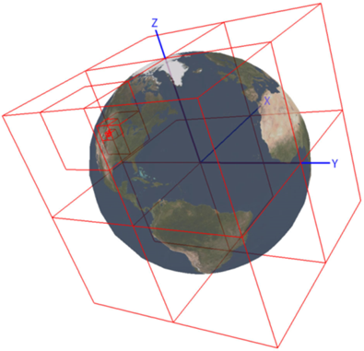
Point Cloud Data Access on a Global Scale
Aaron W. McVay
Capstone Project
Advisor: Frank Hardisty
GEOG 596A - Fall 2013
The Pennsylvania State University

Slide 2
Project Goal
The goal of this project is to design and implement a prototype 3D partitioning scheme that provides an efficient, contiguous, and global approach to handling massive point clouds containing trillions of points.
Notes:
Mention the vast size of the datasets. Consider moving back to slide 7ish, recreate a short full story for here.

Slide 3
Presentation Discussion
Point Cloud Definition
Current Limitations
Spatial Partitioning
Data Storage / Access
Approach
Team Structure

Slide 4
Point Clouds
Sampled 3D (X, Y, Z) Surface Coordinates of an Object
KC-135 Aircraft
The Stanford Bunny Model (Turk, 2000)
Room Interior (Open Perception, 2013)

Slide 5
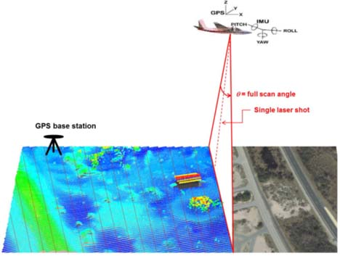
Light Detection and Ranging (LiDAR) Point Clouds
Linear Mode Airborne LiDAR
(NOAA, 2012)

Slide 6
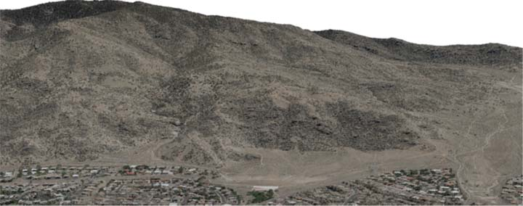
Data Volume Scalability Limitations
Example DARPA’s High Altitude LiDAR Operations Experiment (HALOE) Sensor
Geiger Mode System (1000s of points per pulse)
Generates over a terabyte of data per hour of flight
“Gazillions” of Points
Processing Exploitation and Dissemination (PED) cycle takes days to months
Notes:
PED cycle will be reduced by providing ability to work with raw data rather than derived products

Slide 7
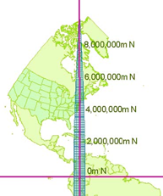
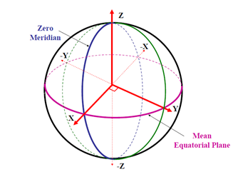
Coordinate System Scalability Limitations
GIS community still thinks in terms of imagery
UTM Zone 18
(NGA, 2013)
WGS84 Earth Centered Earth Fixed (ECEF)
Coordinate System
(NOAA, 2007)
Notes:
Registration problem, going to have error, distorition, a GIS can solve this, but not provide interactive frame rates for visuliation if convert on the fly

Slide 8
Earth Centered Earth Fixed (ECEF)
Pros
Contiguous Global Coverage
Cartesian (Euclidian) Coordinate System (X, Y, Z)
Cons
Requires 64-bit storage
Can use local coordinate systems with offsets (translation, not projection)
Z is not up
Store elevation values along with coordinates (increase storage requirement)
Notes:
Might move this one back to after UTM/ECEF slide

Slide 9
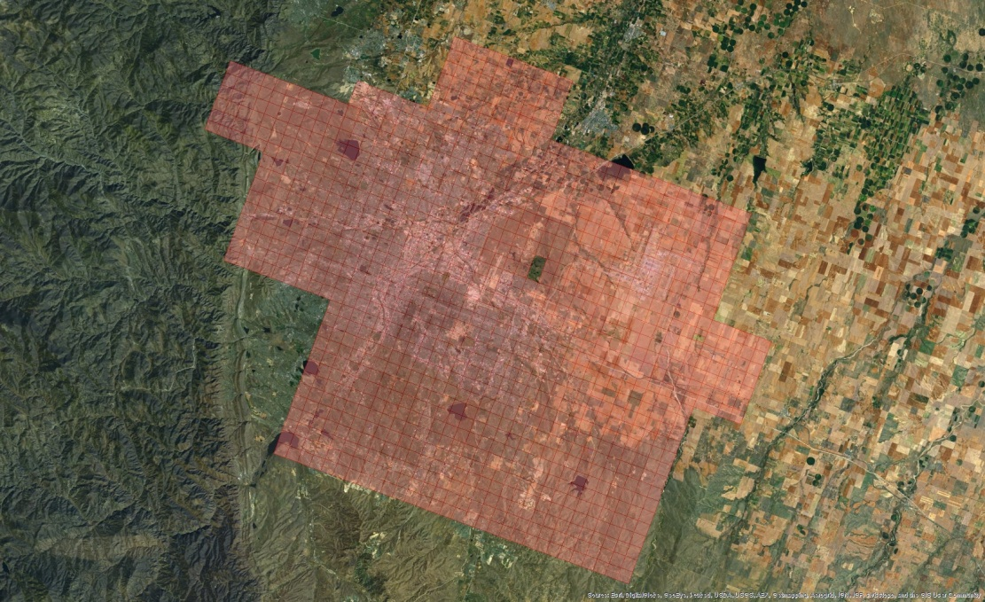
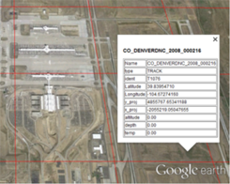
Workflow Limitations
USGS Earth Explorer
http://earthexplorer.usgs.gov
Denver 2008 - Democratic National Convention (DNC)
6.4 Trillion Points
167 G (LAS files)
1163 Tiles
Metadata
Shapefiles
KML
ESRI ArcMap

Slide 10
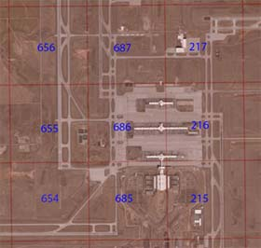
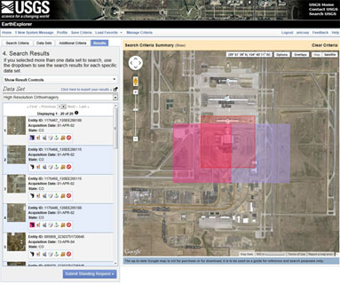
Workflow Limitations
Data Assembly

Slide 11
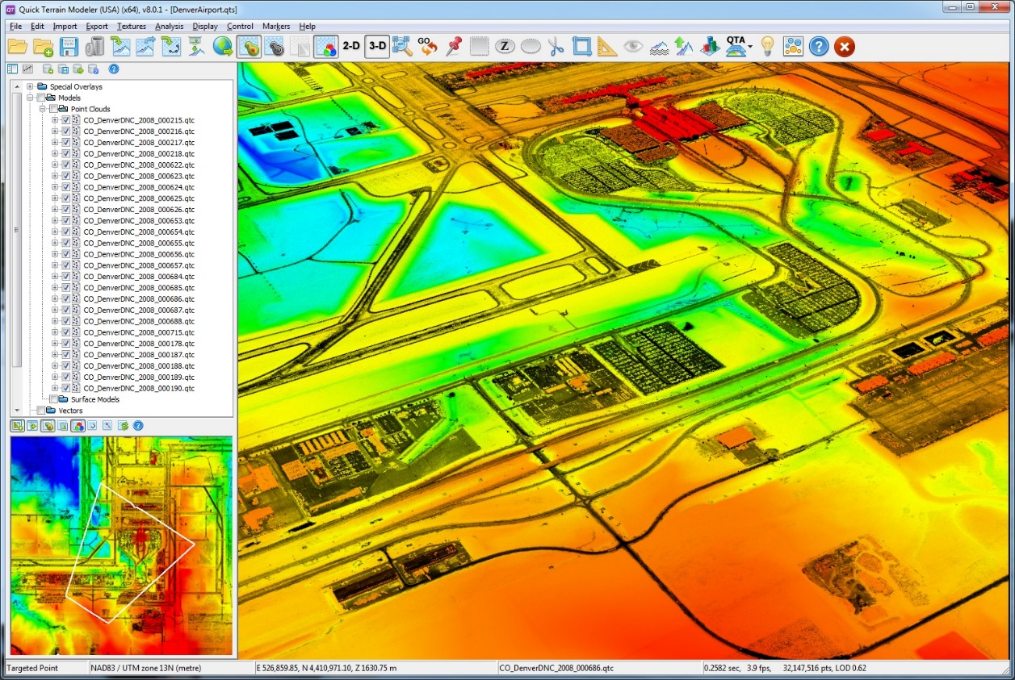
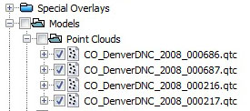
Software Limited by RAM and Local Storage
Local disk storage
Network disk storage
Most software loads entire
dataset into RAM
Manual Load/Unload Tiles
QT Modeler
(Applied Imagery, 2013)
Notes:
Commander asks “Show me what’s north of the airport”, and the airman response is “Let me figure out what tiles I need to load”

Slide 12
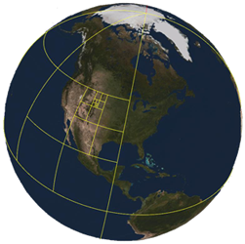
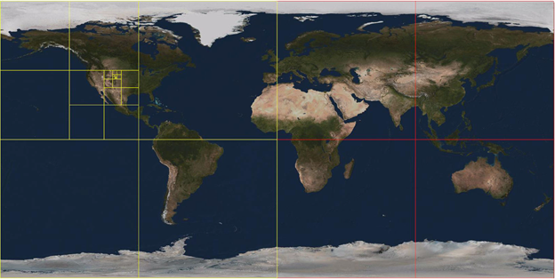
Spatial Partitioning (Acceleration) Techniques
Quadtree
Spatial Partitioning
of DenverDNC
dataset
Notes:
Spatial storage is a critical aspect of a GIS, performance it driven by the efficiency of the storage technique

Slide 13
Octree
Spatial Partitioning
of DenverDNC
dataset

Slide 14
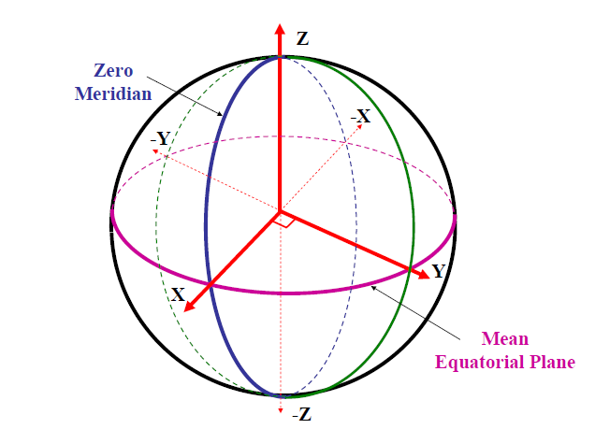
Octree Data Insertion
Not all cells contain data
Each cell represents a storage bucket of N points
Z
WGS84 ECEF Coordinate System (NOAA, 2007)
Mt. Everest
Cells divide when size exceeds N
Y
Marianas Trench
WGS84 Ellipsoid

Slide 15
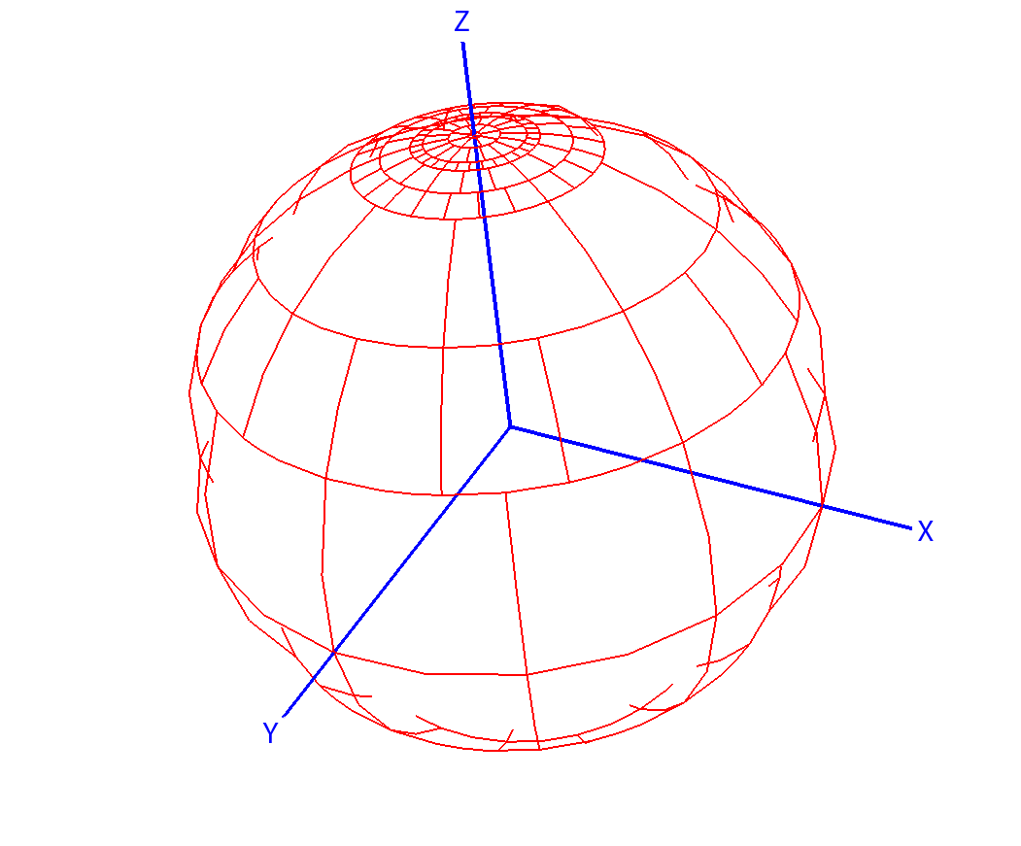
Hybrid Approach
Spatial Partitioning in Geographic Coordinates
Data in ECEF
JView World
(Moore & McVay 2008)
228 Individual Quadtrees

Slide 16
Data Access Techniques (Client / Server)
Sphere (r)
X, Y, Z Value
Longitude / Latitude / Elevation
2D Geospatial Bounds
Rectangle
Polygon
View Frustum for Visualization Clients
Level of Detail

Slide 17
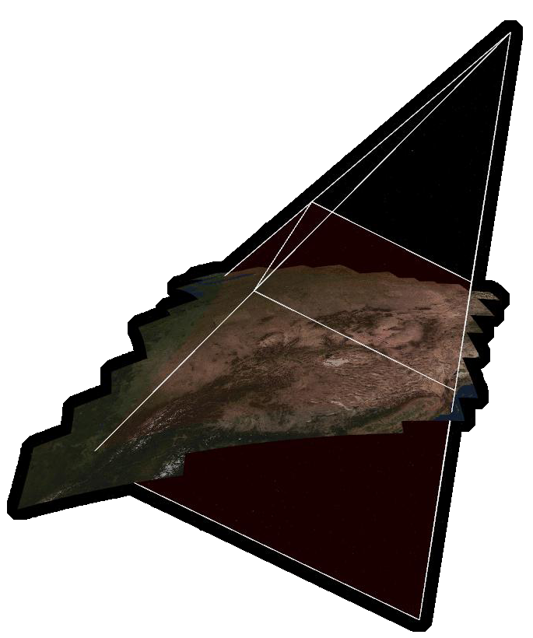
Visualization Clients
“A view frustum is a 3D volume that defines how models are projected from camera space to projection space” (Microsoft)
Near Plane

Slide 18
View Frustum
Z
WGS84 ECEF Coordinate System (NOAA, 2007)
Mt. Everest
Only access cells that overlap frustum
Y
Marianas Trench
WGS84 Ellipsoid
Some cells will contain points outside frustum

Slide 19
Approach
Assemble Data
Relevant to the Department of Defense (DOD)
Design Spatial Partitioning Scheme
ECEF Octree?
Develop Spatial Partitioning Prototype(s)
Linux Based
C++
API suitable for Multiple Client Categories
Measure Performance of Prototype
Determine Key Performance Parameters (KPPs)

Slide 20
Open Source Software
libLAS http://www.liblas.org/
PDAL – Point Data Abstraction Library http://www.pointcloud.org/
GDAL – Geospatial Data Abstraction Library http://www.gdal.org/
PCL – Point Cloud Library http://pointclouds.org/
Megatree http://wiki.ros.org/megatree

Slide 21
Team Structure
Air Force Research Laboratory (AFRL)
In-house research, this project will provide internal research teams with simplified access to their datasets.
Starting point for a Contractual Effort currently listed on Fed Biz Ops https://www.fbo.gov/index?s=opportunity&mode=form&tab=core&id=d55798394c9f7ec782d7b433deaab7b7&_cview=0
Collaboration
US ARMY Corps of Engineers (USACE) Cold Regions Research & Engineering Laboratory (CRREL)
Geospatial Repository and Data Management System (GRiD)
National Geospatial-Intelligence Agency (NGA)
National Reconnaissance Office (NRO)

Slide 22
References
Air Force Research Laboratory (AFRL). (2013). JView 1.7+ JAVA/OpenGL API. Retrieved No 7, 2013, from https://software.forge.mil
Applied Imagery. (2013). Quick Terrain Modeler. Retrieved Dec 2, 2013, from http://appliedimagery.com
Microsoft. (n.d.). What Is a View Frustum? Retrieved Nov 20, 2013, from http://msdn.microsoft.com/en-us/library/ff634570.aspx
Moore, J., & McVay, A. (2008, Jul). Out-of-Core Digital Terrain Elevation Data (DTED) Visualization. Retrieved Oct 30, 2013, from DTIC Online: http://www.dtic.mil/dtic/
Nayegandhi, A., & USGS. (2007, June 20). Lidar Technology Overview. Retrieved Nov 2013, 2013, from lidar.cr.usgs.gov
NOAA. (2007). Datums, Heights and Geodesy. Retrieved Aug 30, 2013, from http://www.ngs.noaa.gov/GEOID/PRESENTATIONS/2007_02_24_CCPS/Roman_A_PLSC2007notes.pdf
NOAA. (2012, Nov). Lidar 101. Retrieved Nov 19, 2013, from http://csc.noaa.gov/digitalcoast/_/pdf/lidar101.pdf
Open Perception. (2013, Aug 28). Point Cloud Library (PCL) Module Octree. Retrieved Nov 19, 2013, from http://docs.pointclouds.org/1.7.0/group__octree.html
Turk, G. (2000, Aug). The Stanford Bunny. Retrieved Nov 20, 2013, from http://www.gvu.gatech.edu/people/faculty/greg.turk/bunny/bunny.html

